Slide 1
Veritus AI
Check a rumor before you share it.
Private, evidence-based fact-checking for WhatsApp in Urdu, Roman Urdu and English
Team Bug Beaters · Ghunain · Sharjeel · Muheed · Emaan

Slide 2
People share first and check later
31%
Why WhatsApp is hard
Private chats and groups: nobody sees or corrects a false forward.
In the same survey, WhatsApp was the most common place people met misinformation (32%).
Fact-checks exist, but they are slow and hard to find in the moment.
of 365 surveyed Pakistani residents checked whether information was true before passing it on.
Source: COVID-19 infodemic survey of 365 Pakistani residents, July 2020 (Esculapio journal, esculapio.pk). Small online sample.
Veritus AI
2

Slide 3
Paste it, share it, understand it
1. Send
2. Research
3. Understand
Paste a message on the web, select text in the browser, or share it straight from WhatsApp to the app.
We pull out the claim, search for evidence and weigh how good each source is.
A likely answer with a confidence range and sources, never a bare TRUE or FALSE.
Opinions, satire, religion and predictions are not judged. Not enough evidence is a valid answer.
Veritus AI
3

Slide 4
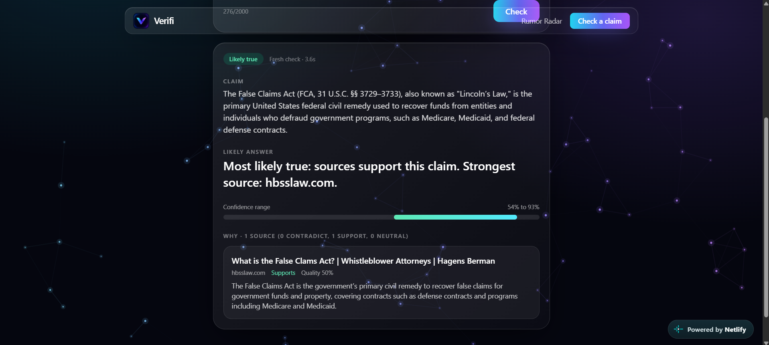
One engine, three ways to use it
Where it works
Android app: share from WhatsApp, scan a screenshot, Listen
Chrome extension: select text, right-click, Check
Web app: claim checker and Rumor Radar
One backend and one API contract for all of them
Veritus AI
4

Slide 5
Privacy by design
Your message stays yours
Private lookup
Text is processed in memory only and is never stored or logged. No accounts: just a random install token.
Apps check a local fingerprint first. The server only sees a 4-character prefix, never the exact message.
Radar without surveillance
Counts, not content
Only fingerprints and salted hashes are kept, in memory. A claim shows only after 10 installs on 3 networks.
No accounts, sender, group or message text is kept. Screenshots are read on the phone.
Veritus AI
5

Slide 6
Built to resist abuse
Built protections
Honest by design
Rate limit: 20 checks per install per hour
2000-character cap and strict input checks
Text normalization for look-alike letters and Roman Urdu spellings
Radar threshold: 10 installs on 3 networks
CORS allow-list of trusted origins
A confidence range plus sources, never a bare TRUE or FALSE
Opinion, satire and faith are refused, with a reason
Full list: docs/THREAT_MODEL.md
Veritus AI
6

Slide 7
What's next
Roadmap
Team
Persistent storage for cache and radar
Partner fact-checkers publish official responses
Urdu script reading and more voice coverage
Play Store and Chrome Web Store release
Ghunain: research agents, Android app, API contract
Sharjeel: API, security, privacy
Muheed: Chrome extension
Emaan: web app and docs
Veritus AI
7

