Slide 1

Software Defect Prediction
Abdelrahman Khaled Mohamed
Supervised by:
Dr. Abeer Hamdy

Slide 2
Content
Software defect prediction definition.
Types of defects.
Problem statement.
Motivation.
Methodology:
Overall architecture.
Preprocessing workflow.
Deep learning models architecture.
Results.

Slide 3
Software Defect Prediction
1
Generally speaking

Slide 4
Types Of Defects
Include but are not limited to
Syntax
02
Compilation
Types of defects
03
Grammatical mistakes
Compiler fail to compile piece of code
Logical
01
Unexpected behavior
Run time
04

Slide 5
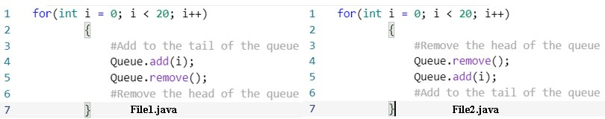
Logical Error
Types of defects

Slide 6
Problem Statement
40% of software developments’ budget spent on testing phase
Labor-intensive and impractical
Cost
Manual defect review

Slide 7
Motivation
Reduce resources
Increase reliability

Slide 8
Previous Approaches
Hand-crafted metrices
Regular machine learning techniques
Natural language processing
Those approaches however do not sufficiently capture the syntax and different levels of semantics of source code
Deep learning techniques

Slide 9
2
Methodology
Generally speaking

Slide 10
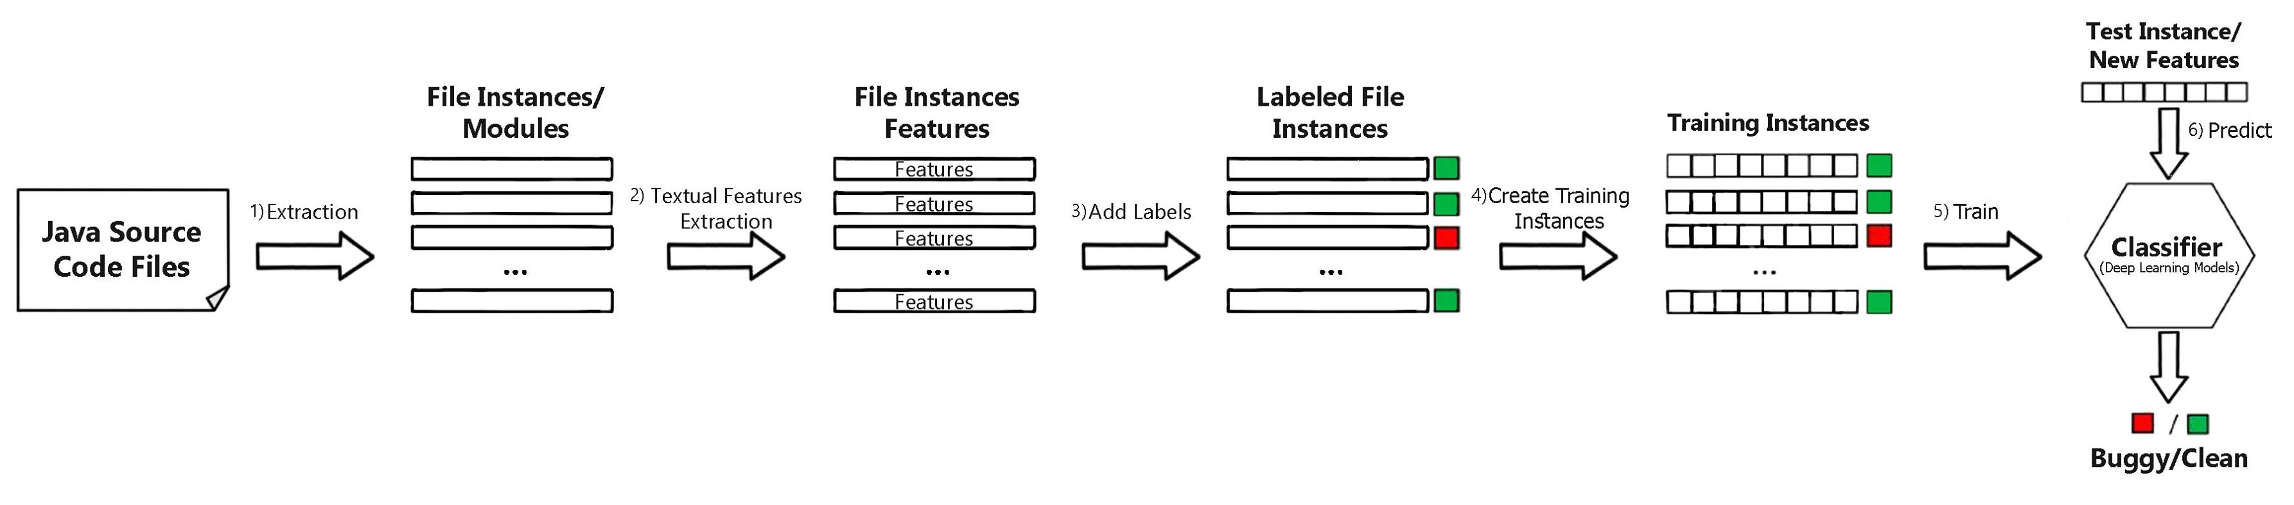
Methodology Diagram
Types of defects
Overall software defect prediction workflow

Slide 11
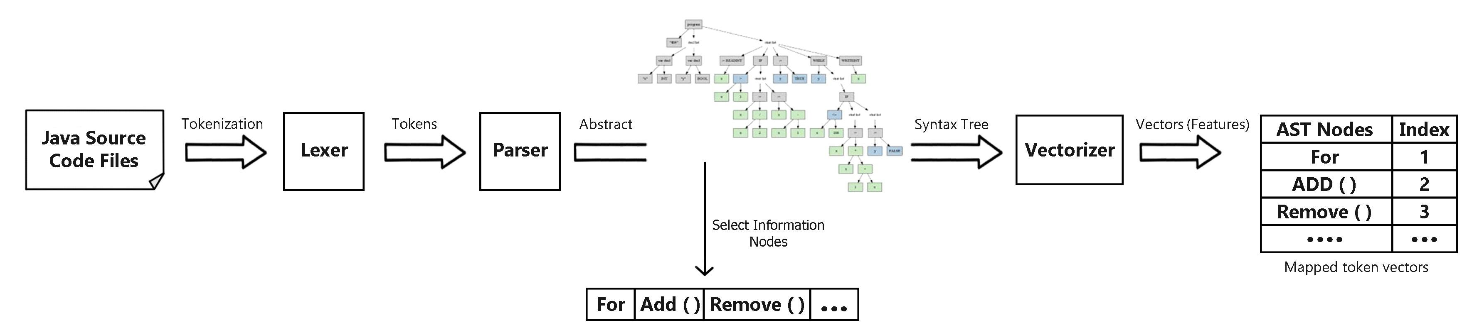
Preprocessing
Types of defects

Slide 12
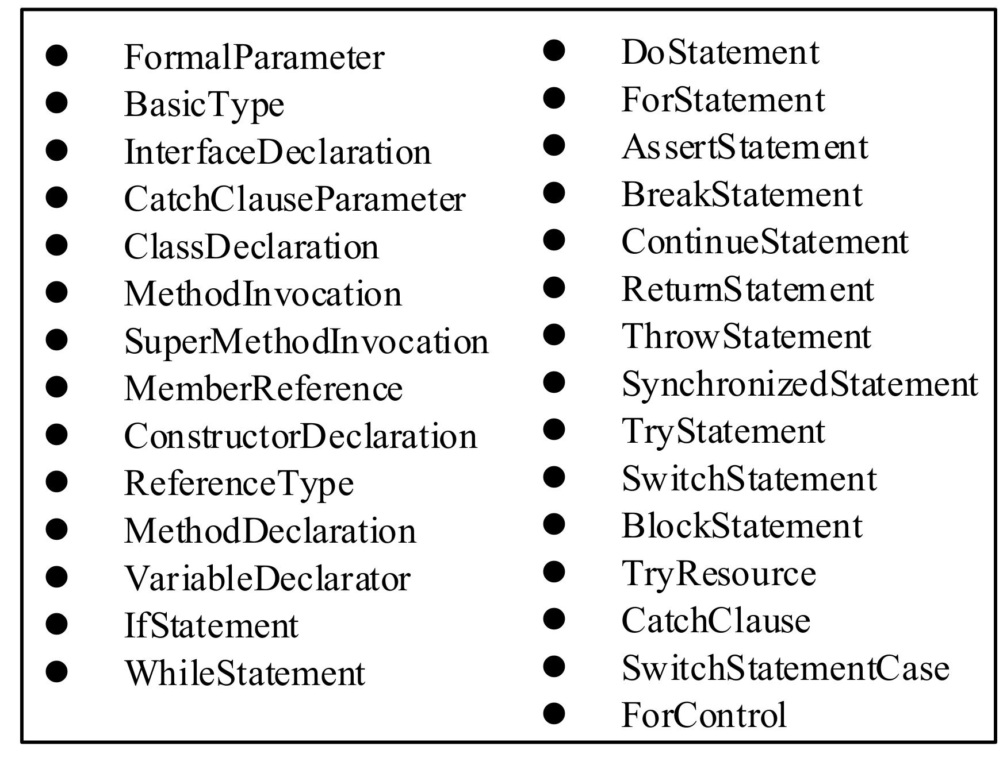
Abstract Syntax Tree
Types of defects
Abstract syntax tree selected nodes

Slide 13
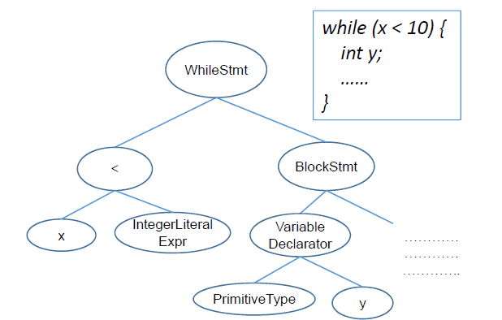
Abstract Syntax Tree
CONT’D
Types of defects

Slide 14
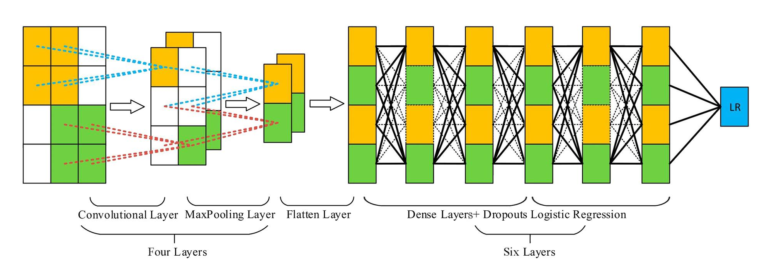
Proposed CNN Architecture
Types of defects

Slide 15
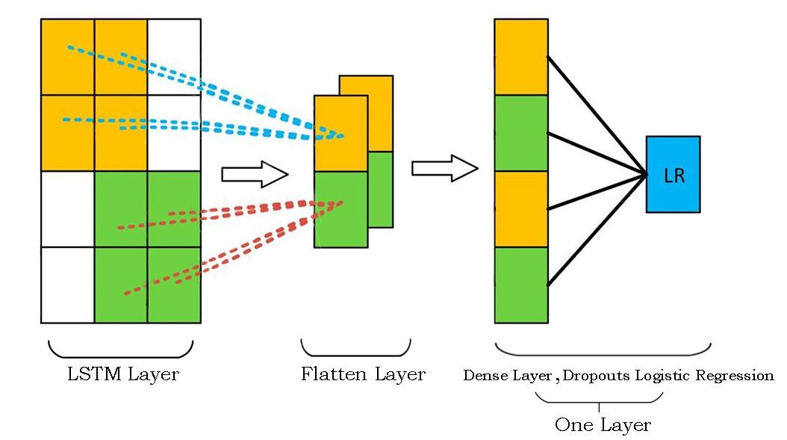
Proposed RNN Architecture
Types of defects

Slide 16
Diff. From Prev. Work
Types of defects
 | Li’s CNN | Cong’s CNN | Improved CNN
Convolutional layers | 1 | 3 | 4
Dense layers | 1 | 3 | 6
MaxPooling layers | 1 | 3 | 4
Activation functions | ReLU + sigmoid (Last layer) | ReLU + sigmoid (Last layer) | ReLU + sigmoid (Last layer)
Dropouts | None | Between dense layers | Between dense layers (probability of 0.6)
Regularization | None | L2 regularizations | None
Optimizer | Adam | Adam | Adam with learning rate 0.0001
Loss function | - | Binary cross-entropy | Binary cross-entropy

Slide 17
3
Results

Slide 18
Comparison And Results
Types of defects

Slide 19
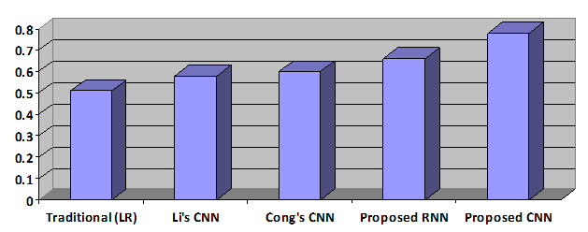
Comparison And Results
Types of defects

Slide 20

Thank You!
Do you have any questions?

