Slide 1

SAMSUNG PRISM
GuideRail
Theme 2:
Smart Guided Troubleshooting
Team Name – Power Rangers
College Name – Thapar Institute Of Engineering And Technology
Members –
1. Akshay Kumar Pandey (apandey1_be25@thapar.edu)
2. Vartika Kureel (vkureel_be25@thapar.edu)
3. Aryamann Sharma (asharma19@thapar.edu)
GitHub - github.com/GhxstOSINT/Samsung-Prism
Demo – added in the github repo.

Slide 2
Theme 02 - Smart Guided Troubleshooting
Customers describe several symptoms in everyday language. Support agents currently translate them into technical issues, assemble steps, and tell users where to navigate. The supplied brief estimates roughly 15 minutes per scenario across millions of interactions.
Four non-negotiable targets:
Required output
REST API with ordered JSON actions, steps, and exact in-app Settings deeplinks
1 Query enrichment for vague complaints
2 Two-stage structure and mapping pipeline
3 Reusable catalog design for 10k+ scenarios
4 Prevalidated cache at or below 300 ms P95

Slide 3
Existing approaches leave safety and scale gaps
Manual support workflow
Generic LLM answer
GuideRail boundary
Agents search unstructured articles, interpret symptoms, order steps, then explain Settings navigation. The guide reports about 15 minutes per scenario.
Fluent text can invent steps, leak web links, choose a parent Settings screen, or generate a URI that never existed in the catalog.
The model may propose. Retrieval and deterministic validators decide what can leave the API or enter the fast cache.
Design consequence: low confidence returns a named no_match or no_siis_context fallback instead of guessed remediation.

Slide 4
Architectural workflow
Raw complaint
+ optional SIIS text
Stage 1 model
issue structure +
8–10 paraphrases
Hybrid retrieval
reference text +
deeplink candidates
Stage 2 model
actions, steps,
allowed catalog URIs
Validation gate
verified plan or
named fallback
Fast path: only validated plans are admitted. Exact and semantic paraphrase matches return without another model call.
A configured model performs issue structuring and evidence-constrained plan generation. The deterministic gate stays authoritative.

Slide 5
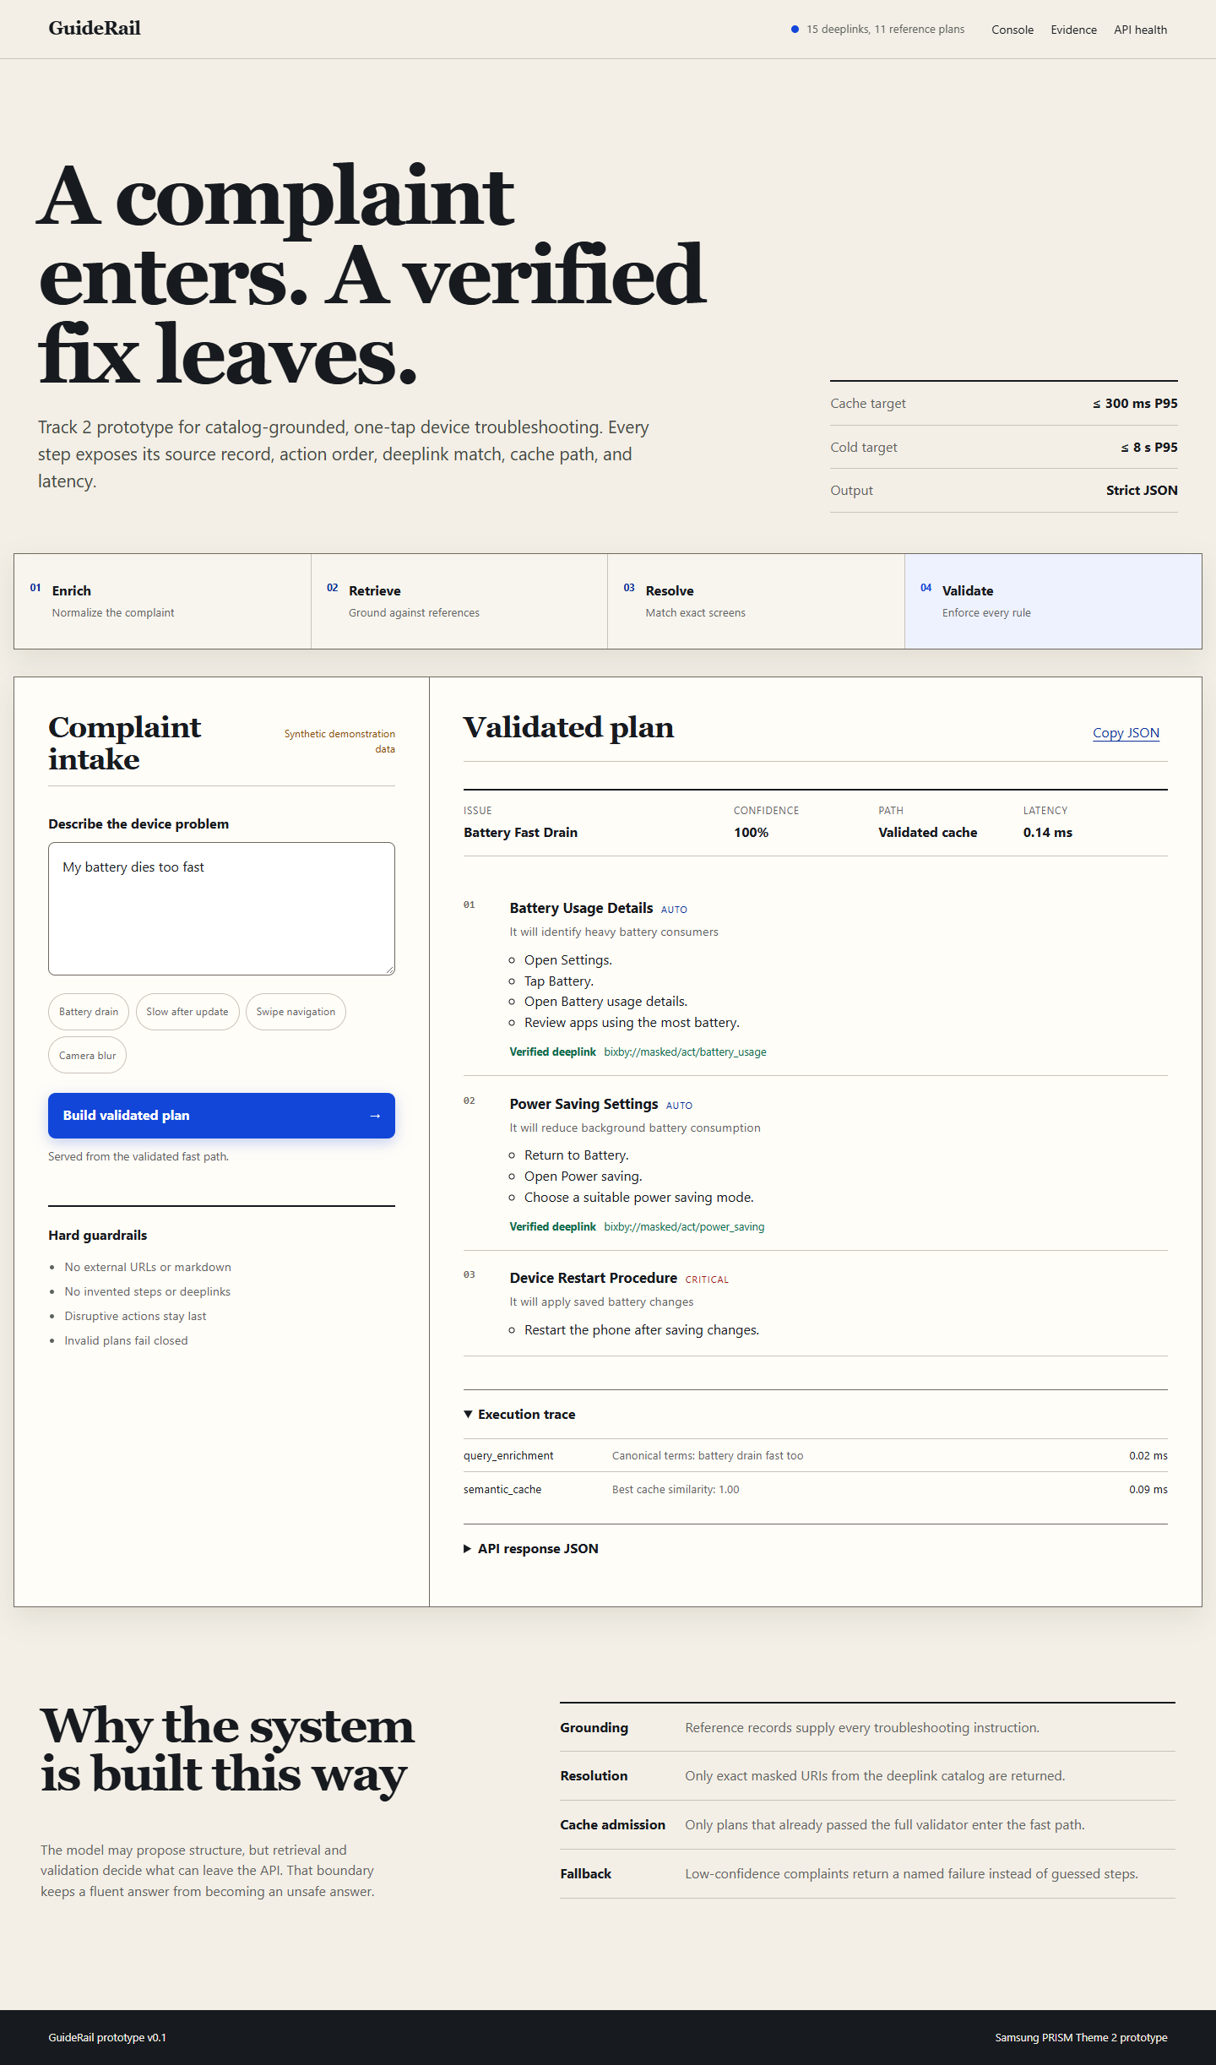
Working prototype walkthrough
Demo sequence
1 Enter one vague or multi-issue complaint
2 Inspect normalized terms and evidence trace
3 Open one-tap Settings deeplinks in JSON
4 Repeat a paraphrase for the validated fast path
5 Submit an unknown query and verify fail-closed behavior

Slide 6
Technology stack
API and schema
Python 3.10–3.12, stdlib threaded HTTP server, Pydantic v2
Retrieval
BM25-style lexical scoring, concept overlap, replaceable dense index adapter
Safety
Exact catalog lookup, evidence check, URL rejection, action hierarchy validation
Fast path
Thread-safe semantic cache prewarmed with validated paraphrases
Interface
Responsive HTML, CSS, and JavaScript using the same REST endpoint
Delivery
Docker, unittest suite, benchmark harness, AI disclosure, 12-slide deck

Slide 7
Benefits and measurable value
Customer benefit
Exact Settings routes reduce navigation effort. Multi-issue complaints receive separate ordered plans.
Support benefit
Grounded steps improve consistency. Evidence IDs and named fallbacks make every response auditable.
Platform benefit
Validated caching reduces repeat latency and model usage. The data-driven catalog supports new scenarios without new code paths.
Step accuracy 0–3
Deeplink relevance 0–2
Schema validity ≥99%
Cache hit P95 ≤300 ms
Cold path P95 ≤8 s
Cost per query tracked
What to prove on official data?

Slide 8
Innovation, current results, and limitations
Innovation
Synthetic benchmark
Limitations
Multi-issue complaints can return several grounded contexts. The cache accepts only plans that passed every deterministic check. The model provider remains swappable.
Official starter assets were not attached. Current numbers are illustrative and cannot predict hidden-test results. The two-stage path requires a permitted model endpoint for the live demo.
33 paraphrase scenarios
100% top-1 plan match
100% schema validity
100% catalog-valid deeplinks
<1 ms local cache P95
Verification: 13 automated tests pass, including two-stage transport, hallucinated URI rejection, official-data normalization, routing, and catalog integrity.

Slide 9
Feasibility and viability
Technical feasibility
Operational and business viability
API boundary fits support and self-service channels
Catalog records add scenarios without code branches
Provider adapter avoids model lock-in
Validated cache controls latency and repeat cost
Metrics expose accuracy, latency, and failures
Working REST API and responsive interface
13 automated tests pass
Docker-ready deployment
Official-data normalization utility
Safe fallback without model access
Current boundary: official assets and an approved model endpoint are still required for competition-scale evaluation.

