Slide 1

SAMSUNG PRISM
GuideRail
Smart Guided
Troubleshooting
Theme 02 2026 – 27
Team Name - [ADD]
College Name - [ADD]
Members - [ADD NAMES AND EMAILS]
GitHub - [ADD PUBLIC OR SHARED LINK]
Demo - [ADD VIDEO LINK]
Notes:
Replace bracketed team fields before submission. Official requirements source: Samsung PRISM Generative AI Hackathon 3rd Edition overview, pages 11–13.

Slide 2
Theme 02 Smart Guided Troubleshooting
Customers describe several symptoms in everyday language. Support agents currently translate them into technical issues, assemble steps, and tell users where to navigate. The supplied brief estimates roughly 15 minutes per scenario across millions of interactions.
Required output
REST API with ordered JSON actions, steps, and exact in-app Settings deeplinks
Four non-negotiable targets
1 Query enrichment for vague complaints
2 Two-stage structure and mapping pipeline
3 Reusable catalog design for 10k+ scenarios
4 Prevalidated cache at or below 300 ms P95
Notes:
Source: supplied Theme 2 guide, sections 1–6; supplied hackathon overview, page 5.

Slide 3
Existing approaches leave safety and scale gaps
Manual support workflow
Generic LLM answer
GuideRail boundary
Agents search unstructured articles, interpret symptoms, order steps, then explain Settings navigation. The guide reports about 15 minutes per scenario.
Fluent text can invent steps, leak web links, choose a parent Settings screen, or generate a URI that never existed in the catalog.
The model may propose. Retrieval and deterministic validators decide what can leave the API or enter the fast cache.
Design consequence: low confidence returns a named no_match or no_siis_context fallback instead of guessed remediation.
Notes:
Theme 2 guide: zero URL leaks, catalog integrity, no hallucinated steps, pure JSON delivery, and graceful fallbacks. RAG grounding: Lewis et al., NeurIPS 2020, https://papers.nips.cc/paper/2020/hash/6b493230205f780e1bc26945df7481e5-Abstract.html

Slide 4
GuideRail architecture
Raw complaint
+ optional SIIS text
Query enrichment
canonical issue +
8–10 paraphrases
Hybrid retrieval
reference text +
deeplink candidates
Structure + map
actions, steps,
exact catalog URIs
Validation gate
schema, evidence,
URL, order, catalog
Fast path: only validated plans are admitted. Exact and semantic paraphrase matches return without another model call.
A configured model performs issue structuring and evidence-constrained plan generation. The deterministic gate stays authoritative.
Notes:
Research basis: hybrid retrieval and RRF, Cormack et al., SIGIR 2009, https://doi.org/10.1145/1571941.1572114; constrained decoding, Scholak et al., EMNLP 2021, https://aclanthology.org/2021.emnlp-main.779/; zero-shot dense retrieval caveats, Ren et al., Findings of EMNLP 2023, https://aclanthology.org/2023.findings-emnlp.1057/

Slide 5
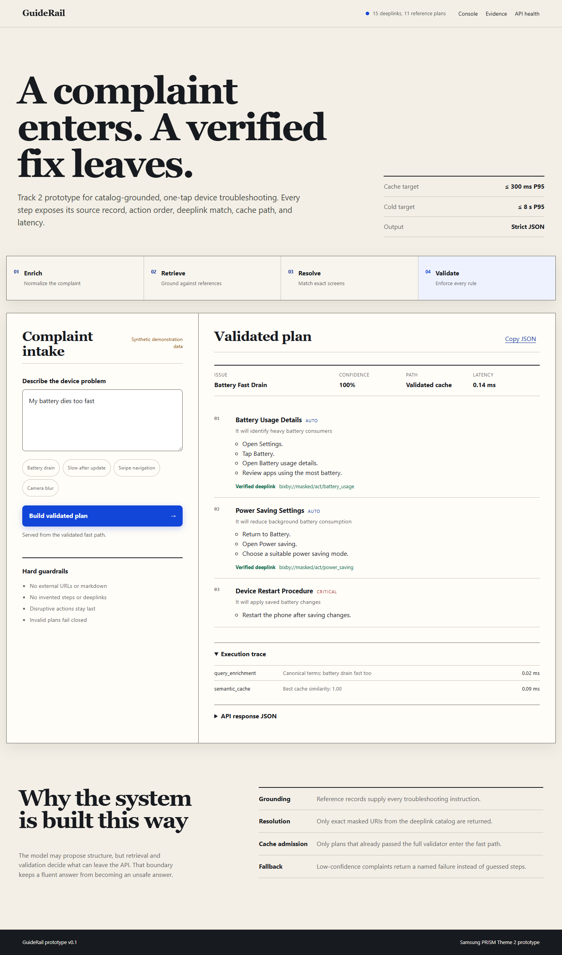
Working prototype walkthrough
Demo sequence
1 Enter one vague or multi-issue complaint
2 Inspect normalized terms and evidence trace
3 Open one-tap Settings deeplinks in JSON
4 Repeat a paraphrase for the validated fast path
5 Submit an unknown query and verify fail-closed behavior
Notes:
The screenshot is from the working local prototype. Suggested video examples: multi-issue screen flicker + battery drain, cached battery paraphrase, unknown complaint.

Slide 6
Tools and technical stack
API and schema
Python 3.10–3.12, stdlib threaded HTTP server, Pydantic v2
Retrieval
BM25-style lexical scoring, concept overlap, replaceable dense index adapter
Safety
Exact catalog lookup, evidence check, URL rejection, action hierarchy validation
Fast path
Thread-safe semantic cache prewarmed with validated paraphrases
Interface
Responsive HTML, CSS, and JavaScript using the same REST endpoint
Delivery
Docker, unittest suite, benchmark harness, AI disclosure, 12-slide deck
Notes:
All core demo behavior works without external model access. Environment variables can configure an OpenAI-compatible model endpoint for the proposal layer.

Slide 7
Production use cases and measurable impact
Customer support
Generate consistent plans for repeated complaints while exposing the evidence and failure mode.
Self service
Return screen-specific actions with exact deeplinks so users can act without hunting through Settings.
Quality operations
Measure step accuracy, deeplink precision, latency, cache efficacy, and cost per query separately.
What to prove on official data
Step accuracy 0–3 Deeplink relevance 0–2 Schema validity ≥99% Cache hit P95 ≤300 ms Cold path P95 ≤8 s Cost per query tracked
Notes:
Targets come from the supplied Theme 2 guide. The 15-minute baseline and millions-of-interactions scale come from the same source. No savings claim is made before official-volume testing.

Slide 8
Innovation, current results, and limitations
Innovation
Synthetic benchmark
Limitations
Multi-issue complaints can return several grounded contexts. The cache accepts only plans that passed every deterministic check. The model provider remains swappable.
33 paraphrase scenarios
100% top-1 plan match
100% schema validity
100% catalog-valid deeplinks
<1 ms local cache P95
Official starter assets were not attached. Current numbers are illustrative and cannot predict hidden-test results. The two-stage path requires a permitted model endpoint for the live demo.
Verification: 13 automated tests pass, including two-stage transport, hallucinated URI rejection, official-data normalization, routing, and catalog integrity.
Notes:
Synthetic results generated by scripts/benchmark.py on 33 paraphrases from the included demonstration fixtures. Do not compare these figures with hidden or official data. Semantic caching context: Liu et al., ICLR 2026 submission/paper, https://openreview.net/pdf/3b13fe693b16e8f2abb20689166e3d10217afe15.pdf

Slide 9
Build phases and next milestones
1
Completed
Schema, validators, ordering, fallbacks
2
Completed
Grounded retrieval and exact deeplink resolver
3
Completed
Validated semantic cache and latency benchmark
4
Completed
Two-stage model orchestration, API, interface, Docker, tests
5
Next
Load official assets and reproduce supplied samples
6
Next
Run official holdout, tune thresholds, record demo, tag release
Notes:
Final submission deadline and release-tag requirement come from the supplied hackathon overview, pages 12–13. Required tag: PRISM_GENAI_HACKATHON_Y2026.

Slide 10
Why GuideRail is different
Naive generated answer
GuideRail
One model pass
Free-form text
Generated Settings paths
Raw-string caching
Confident answer on weak evidence
Separated structure and mapping
Strict response schema
Exact catalog identifiers
Validated semantic cache
Named fallback below confidence threshold
Research anchors: RAG grounding, hybrid rank fusion, constrained generation, zero-shot retrieval caution, and verified semantic caching.
Notes:
Sources: Lewis et al., NeurIPS 2020; Cormack et al., SIGIR 2009; Scholak et al., EMNLP 2021; Ren et al., Findings of EMNLP 2023; Gao et al., ACL 2023, https://aclanthology.org/2023.acl-long.99/

Slide 11
Submission checklist
YES Working prototype code
YES Reproducible README
YES Dockerfile and requirements
YES Automated tests and benchmark harness
YES Presentation and AI disclosure draft
PENDING Public or shared GitHub link
PENDING Unedited demo video, maximum 5 minutes
PENDING Official starter assets and final held-out results
PENDING Release tag PRISM_GENAI_HACKATHON_Y2026
Notes:
Do not mark pending items complete until the links, official assets, final evaluation, and release tag exist. Source: supplied hackathon overview, pages 11–13.

Slide 12
Thank you
GuideRail
Theme 02 Smart Guided Troubleshooting
Questions and live prototype walkthrough
Organised by the Language AI Team and the PRISM Team, Samsung R&D Institute India
Notes:
Add the final GitHub and demo links to the cover and submission form before sending.

