Slide 1
DE Project TEAM – A
Ibrahim
Ghayda
Shrouq
Mawaddah

Slide 2
Data Sets and Goals
Data Sets:
Vaccination and Covid Cases
Goals :
Visualization for total cases on the world on map
Building a forecasting model LSTM to predict the wave
up-to-date data (daily prediction and visualization)

Slide 3





Open-Source Project Tools
Apache Airflow
ElasticSearch and Kibana
^{Two DAGs:} ^{- ETL} ^{- LSTM}
Postgres
Data Storage
- Data Visualisation
- Dashboard

Slide 4
Project pipeline
Update daily data
Ingest COVID 19 data
PROJECT
LSTM forecasting model
on Air-Flow
Transformation and Feature Engineering on Airflow
Loading cleaned data to Postgres
Generate Daily World map simulation

Slide 5
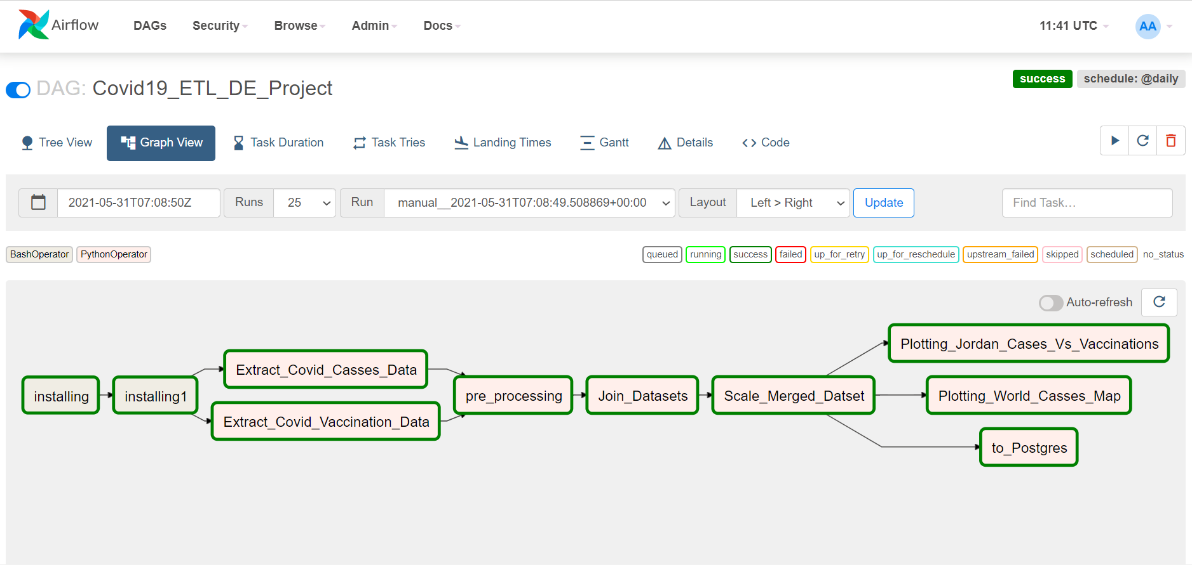

Slide 6
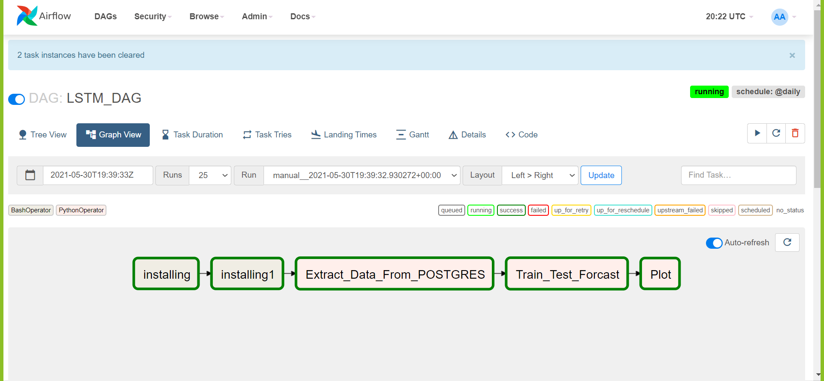

Slide 7
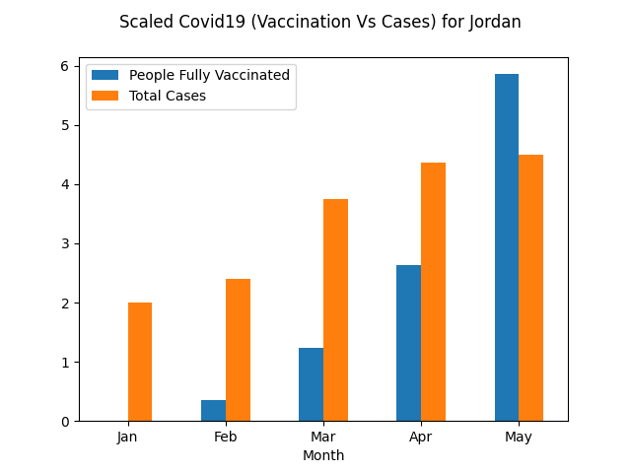

Slide 8


Slide 9
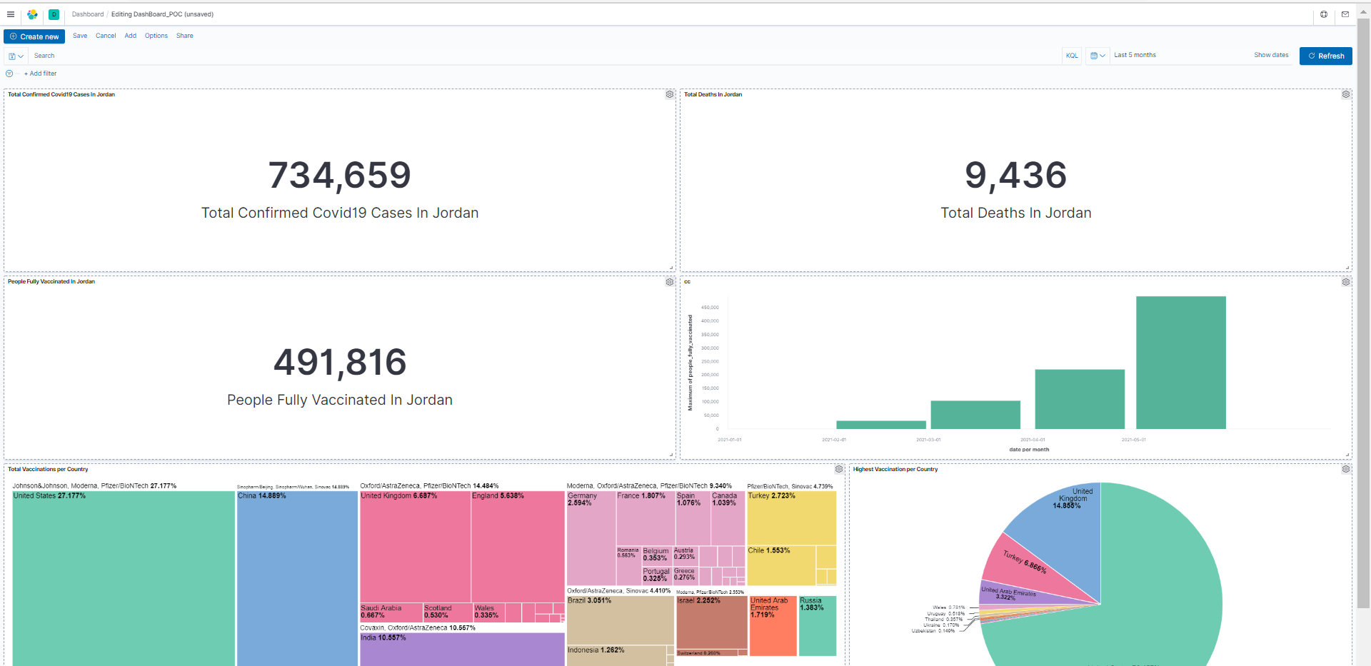
Kibana Analysis

Slide 10

LSTM

Slide 11
Future Work
1- Gain more knowledge on elasticsearch and logstash so we can automate the update of the Kibana dashboard daily within our DAG
2- We can make another world map for vaccination data and keep tracking it with the new cases.
3- We notice that vaccination data began in Jordan in Jan 2021, and case data is increasing since March 2020. We need to wait two months or more for a more comprehensive and realistic Plot to clarify the effect of vaccinations in Jordan and how they help to reduce cases.
4- Working on improving the model and adding more layers

Slide 12
Thank You

