Slide 1
Recap of SW2 – Friday
Giordano Altomare & Adrian Bucher

Slide 2
Topic
Project structure

Slide 3
Recap of last Week's Recap:
VCS
pull/push/stage/commit/branching
Ignoring files

Slide 4
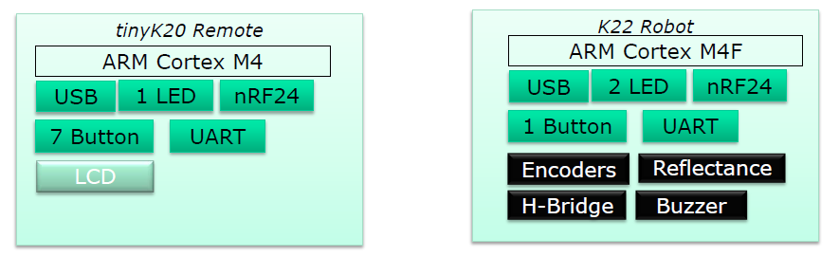
Project structure
The two Controllers have many system blocks in common
Appr. 10-15% is different

Slide 5
Project structure
Three ways to share common used files & folders
1. real library (static, cannot configure at run time)
2. folder outside project (eclipse limitation, only project view!)
3. folder inside one project (common folder with links)
Be sure you link the folder by using a relative link
Add the linked folder in the compiler settings include path

Slide 6
Project structure
Platform.h: activates driver for both (robo & remote) MCUs depending on..
…your personal, NOT common used Platform_local.h configuration
Don't mix up with sharing in the spirit of Version Control Systems like Git.
Notes:
Unsere Platform.h, konfigurations"liste", lokale paltform-liste für liste für spezi.

Slide 7
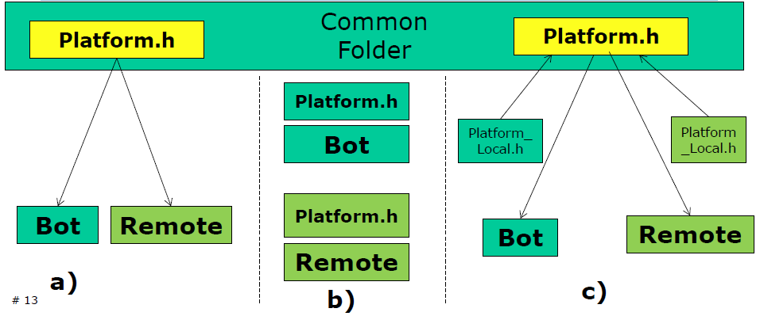
Project structure
Notes:
möglichkeiten die platform.h zu teilen:
direkt geteilt -> wenig möglichkeiten gerätespezifische einstellungen vorzunehmen.
lokale Kopie in beiden Projekten -> muss je nach anpassungen synchronisiert werden
kompromiss -> geteilt in beiden projekten mit lokaler anpassungen. "zwischenfile"

Slide 8
Kwäschtschen 1
What was one of the topics from last week's recap?
Inheritance
Processor Expert
nonviolent communications
Version Control System
Project Structure

Slide 9
Kwäschtschen 2
How is the project structure of Mr. Stygers default project organized?
Real library
Folder outside project
Folder inside project (with relative link)
Folder inside project (with absolute link)
Virtual folder

Slide 10
Kwäschtschen 3
What do you have to consider when adding a new relative or absolute linked folder with header files to your project?
Don't use capital letters
When sharing in Git add the folder in the .gitignore list
Check the platform.h for adjustments
Nothing to consider, because Eclipse will do it for you
Tell the compiler where to look for header files

Slide 11
Kwäschtschen 4
Why do we use a common folder?
For backup and saving your project
Common drivers don't need to be individually implemented (time-saving)
You can verify your teammate's working progress
To have at least something in common
To add the extra level of complexity to the course

Slide 12
Kwäschtschen 5
How should you not identify your board in your project (for driver mapping)?
In the project settings (Project Level)
With preprocessor macros (Compiler settings)
With macros in source (#define)
At runtime with the ID of the MCU
Choose the project name in Eclipse that it ends with _Robot or _Remote

