Slide 1
Recap of SW2 – Friday
Giordano Altomare & Adrian Bucher

Slide 2
Topic
Project structure

Slide 3
Recap of last Week's Recap:
VCS
centralised or distributed
pull/push/stage/commit
Ignoring files

Slide 4
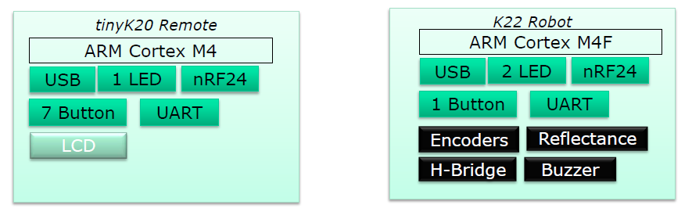
Project structure
The two Controllers have many system blocks in common
Appr. 10-15% is different

Slide 5
Project structure
Three ways to share common used files & folders
1. real library (static, cannot configure at run time)
2. folder outside project (eclipse limitation, only project view!)
3. folder inside one project (common folder with links)
Be sure you link the folder by using a relative link

Slide 6
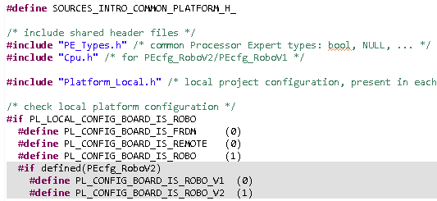
Project structure
Platform.h is file in which specific project settings can be made

Slide 7
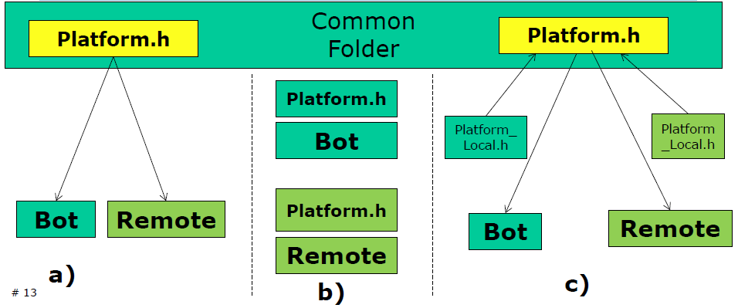
Project structure

Slide 8
Kwäschtschen 1
What was one of the topics from last week's recap?
Inheritance
Processor Expert
nonviolent communications
Version Control System
Project Structure

Slide 9
Kwäschtschen 2
How is the project structure of Mr. Stygers default project organized?
Real library
Folder outside project
Folder inside project (with relative link)
Folder inside project (with absolute link)
Virtual folder

