Slide 1
Replica apple 1 build the ben heck show
A Journey Back to an 8-bit Era

Slide 2
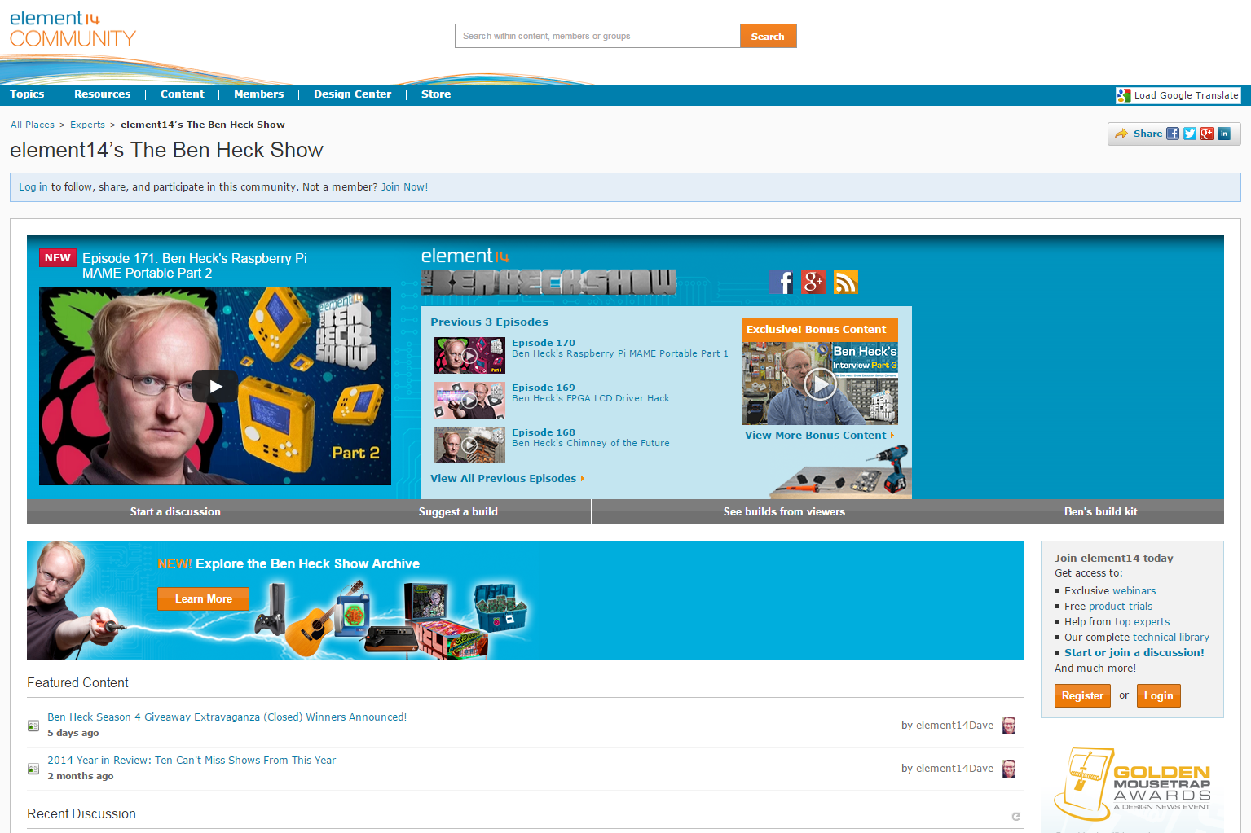
About the ben heck show
Weekly show on element14.com community and YouTube
Focus on technology, problem solving and real-world assembly
Projects designed to engage community
175 episodes since debut in 2010

Slide 3
Project origins
Personal fan of classic 8-bit computers
Recent success with classic Sinclair Spectrum
Fun opportunity to explore the roots of modern computing

Slide 4
Project overview
Find schematics for original Apple 1
Locate ROM images and map correctly to modern EPROM
Find as many modern, compatible components as possible
Hand-wire Apple 1 circuitry as a 6502 single-board module
Hand-wire microcontroller alternative to Apple 1 video circuit
Create custom keyboard and scan with the microcontroller
Design project enclosure based off the size of the LCD
CNC, laser cut and 3D print custom case, assembly and wire

Slide 5
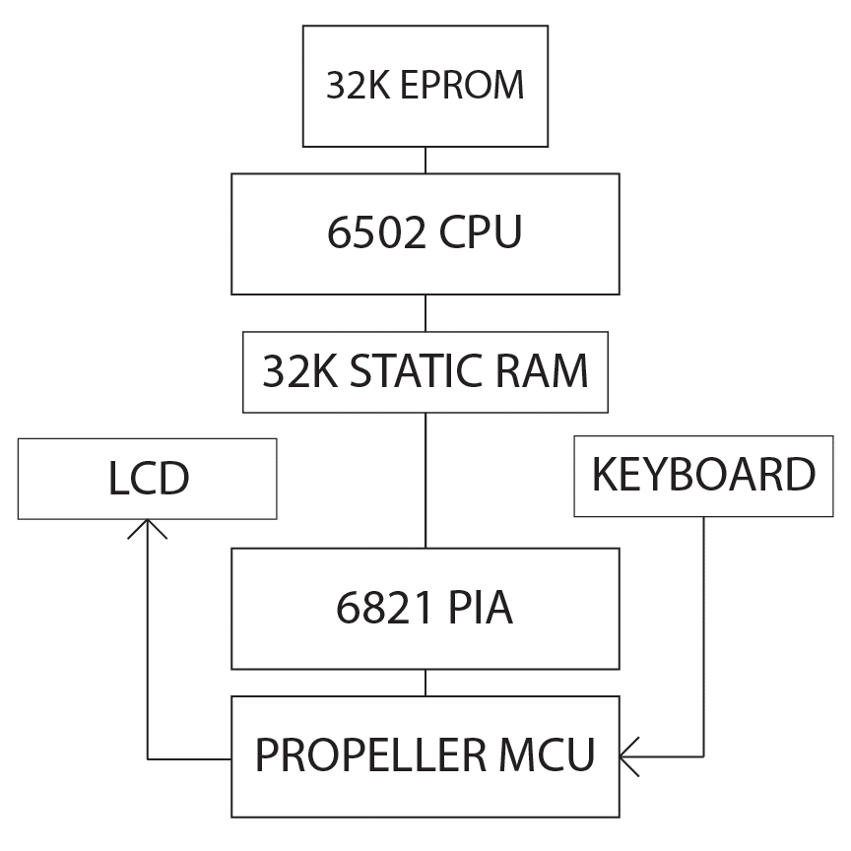
Apple 1 overview
Part 1: 6502 system
Part 2: PIA and Microcontroller for I/O
Original parts:
6502, PIA
Modern parts:
EPROM, RAM, MCU, glue logic

Slide 6
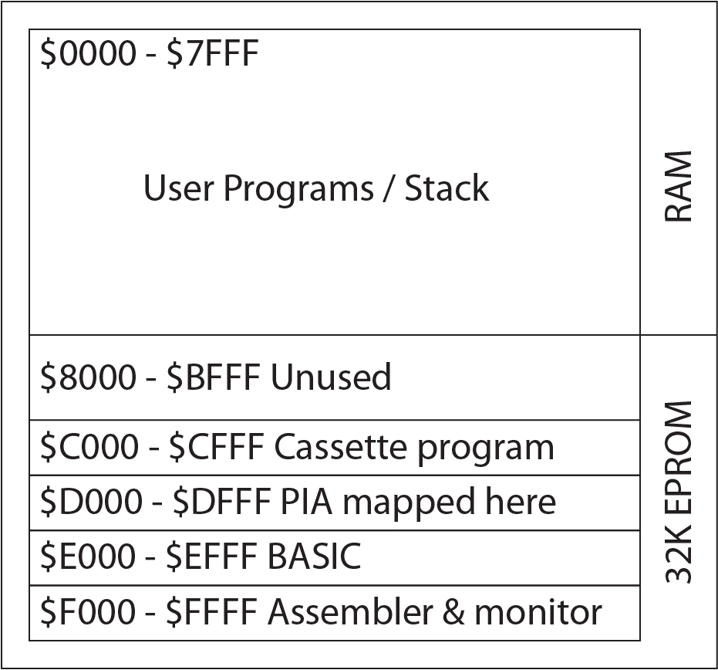
Memory map
Original Apple had RAM at bottom and top of memory (below WOZ monitor)
Replicas place RAM at bottom of memory, EPROM programs at top
Cassette, BASIC and monitor programs arranged via HEX editor and burned to EPROM
Mapping done with a few logic circuits

Slide 7
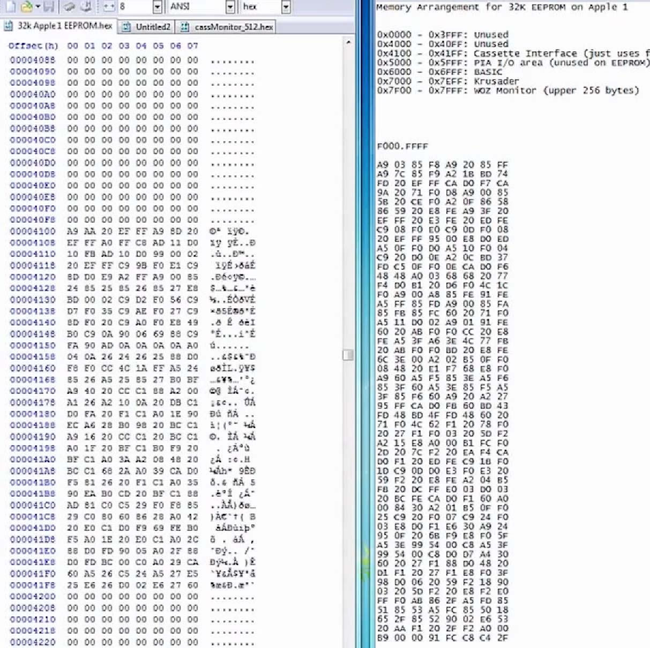
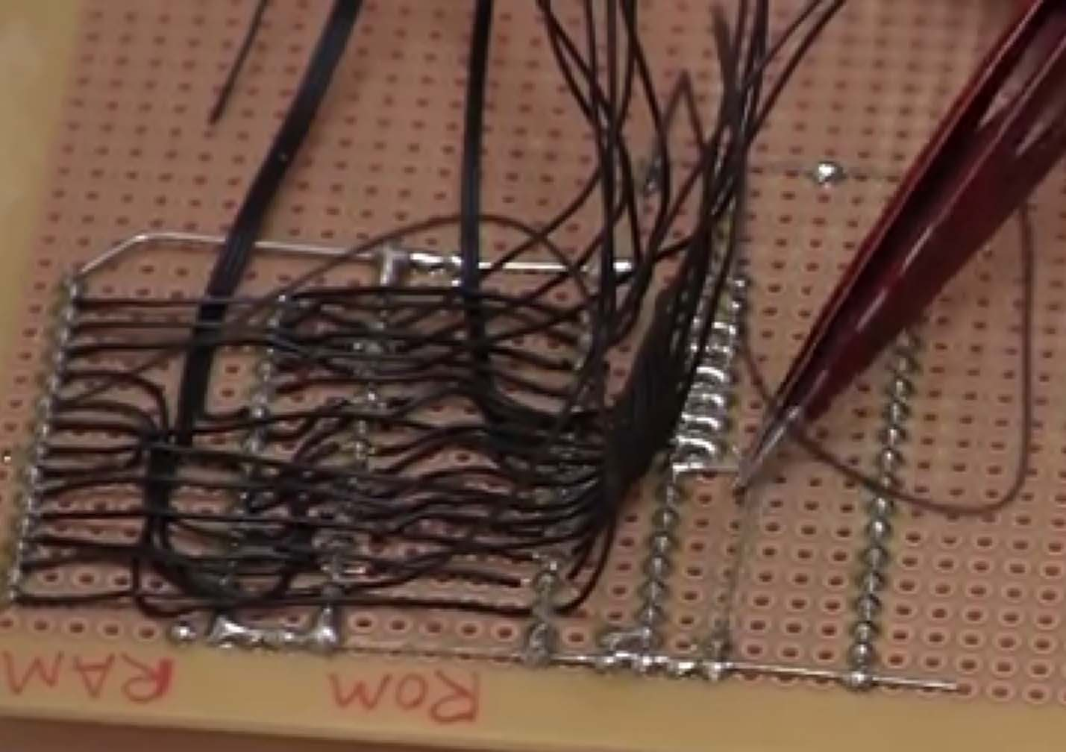

Slide 8
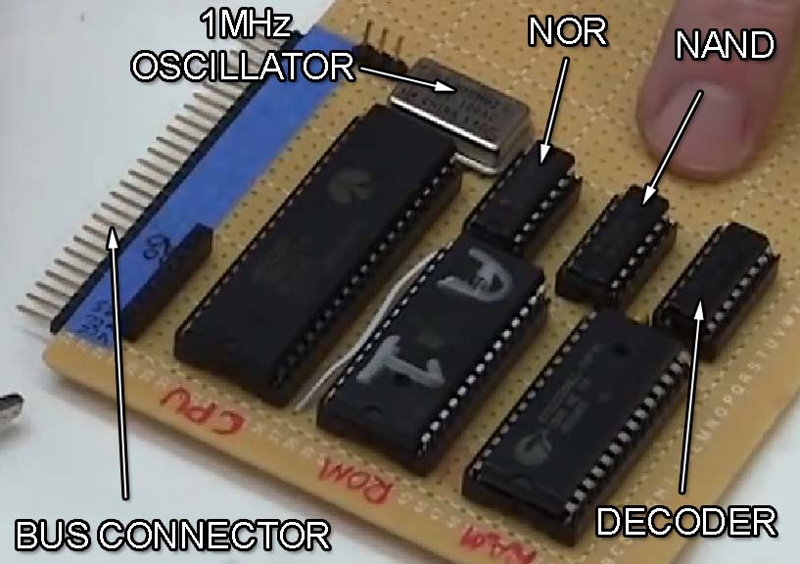

Slide 9
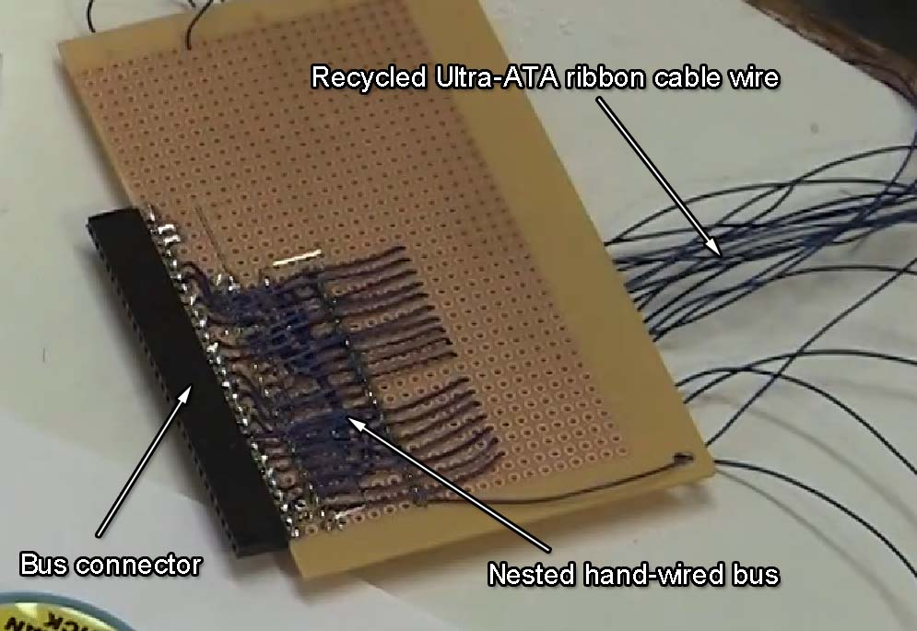

Slide 10
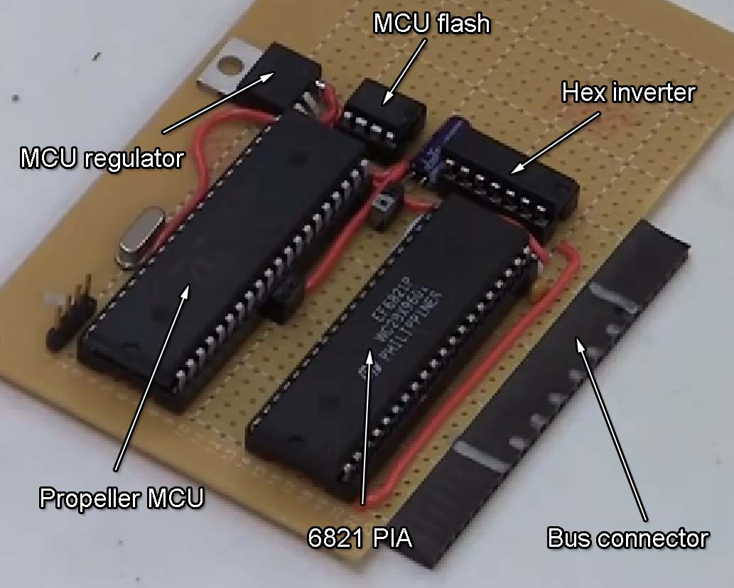

Slide 11
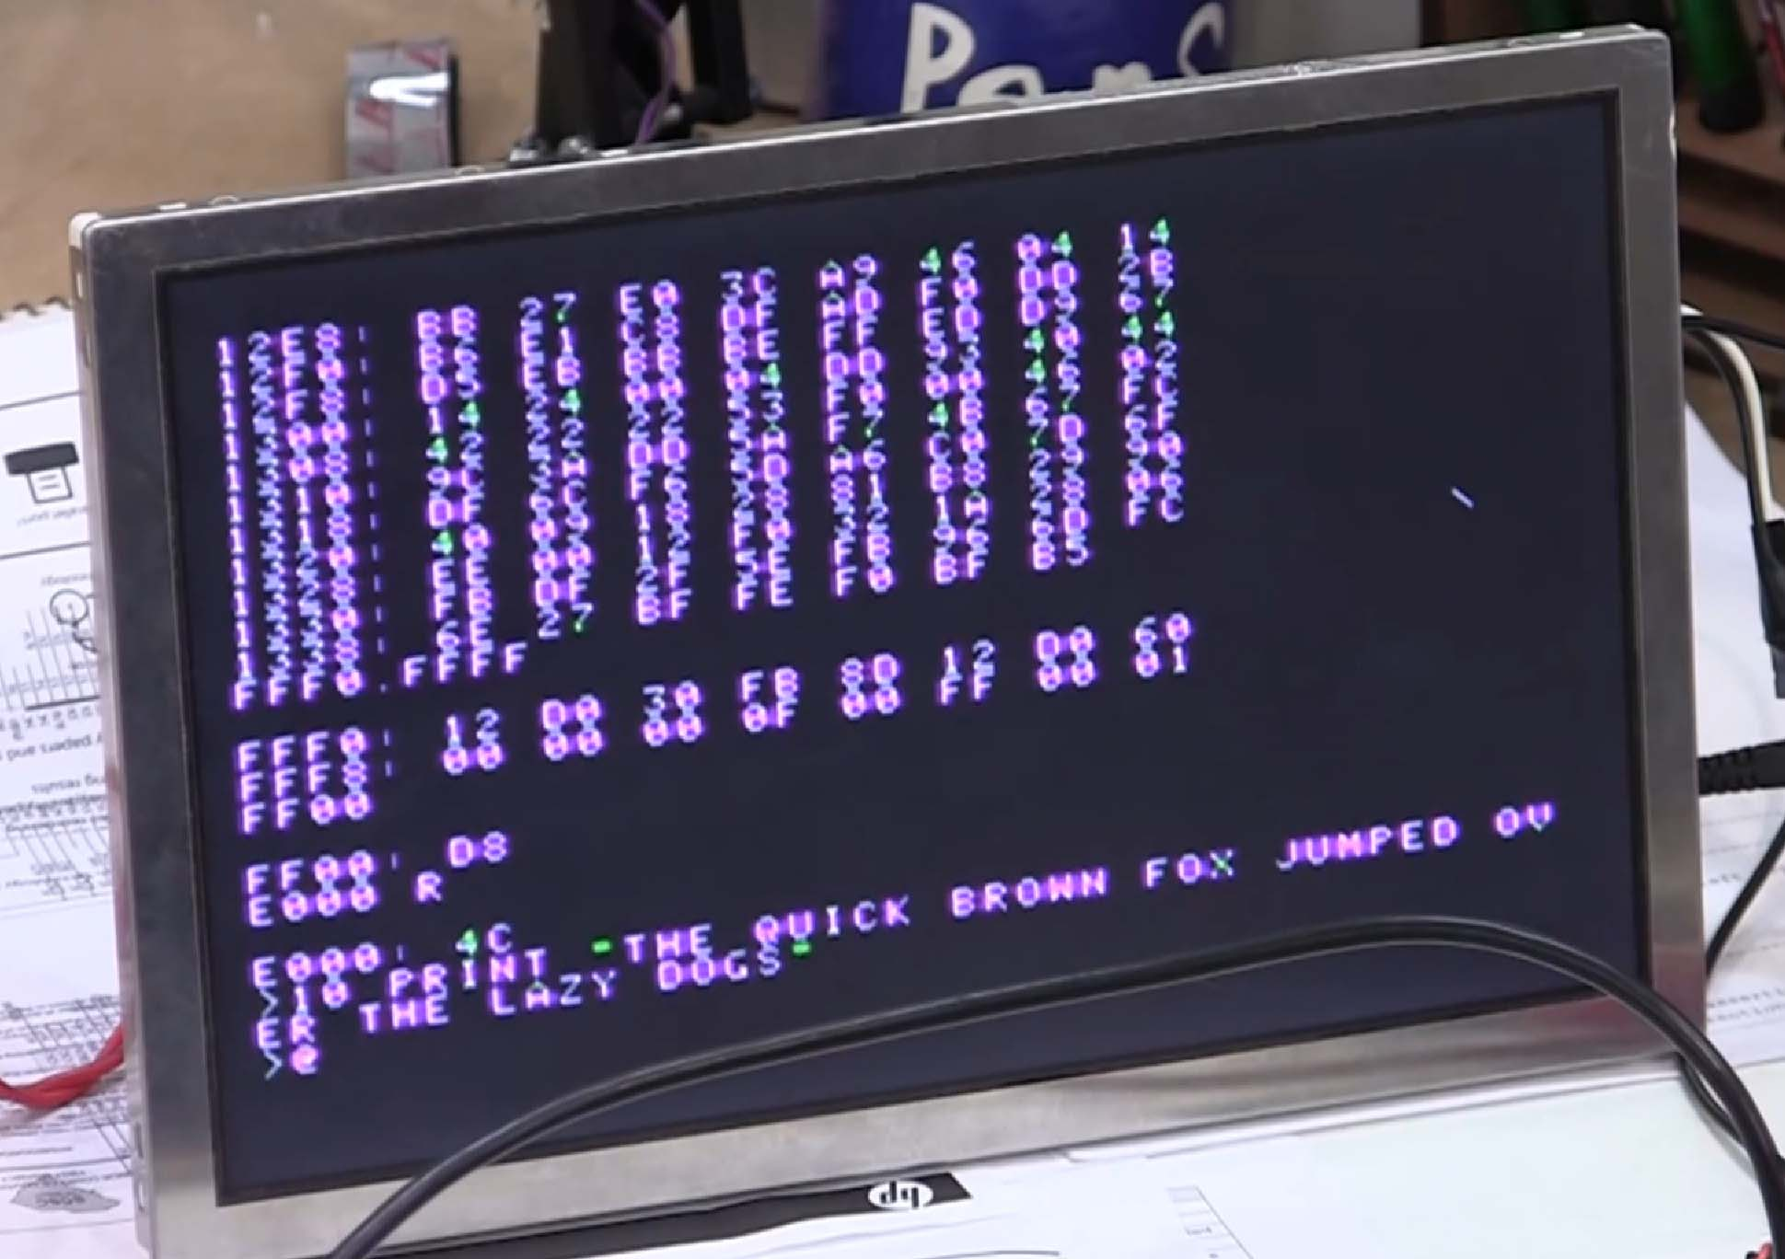

Slide 12
Enclosure design & construction
Bringing a Blast from the Past

Slide 13
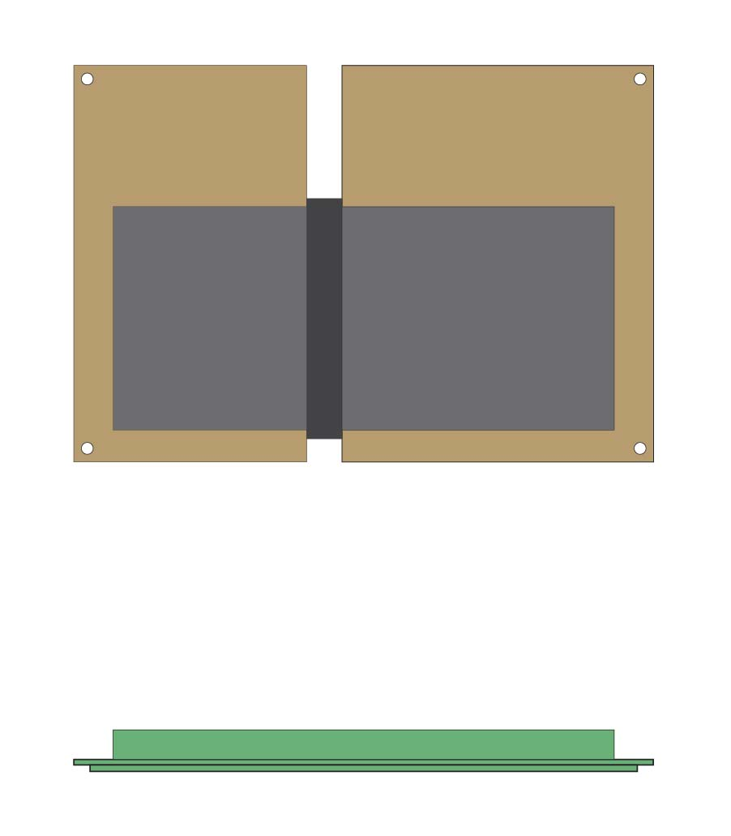
Base pcb layout
Basic dimensions of hand-wired PCB are drawn into computer
Only major shapes drawn for expediency

Slide 14
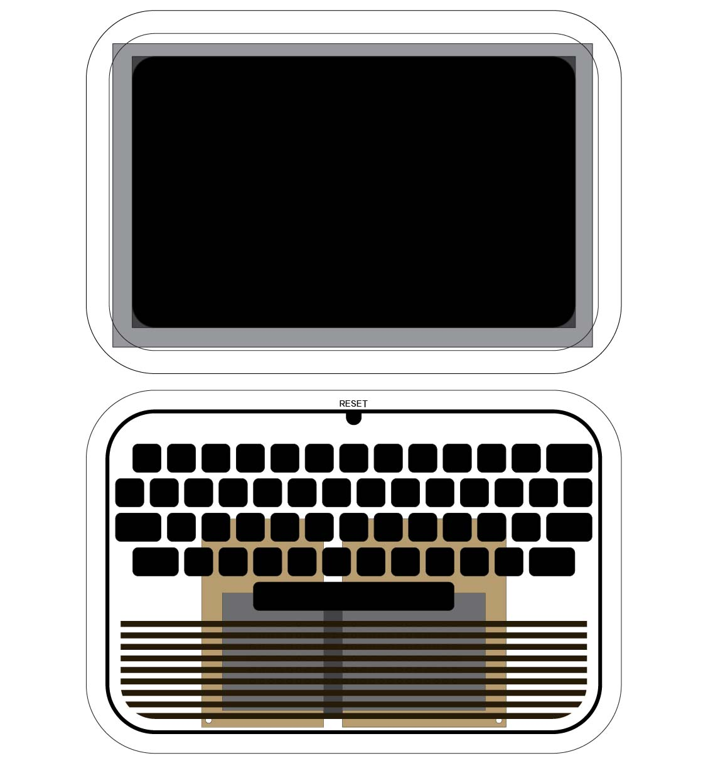
LCD drives majority of layout
Used old spare composite LCD taking up space in shop
Size of LCD drives size & design of custom keyboard
Extra layers and texturing added to increase detail

Slide 15
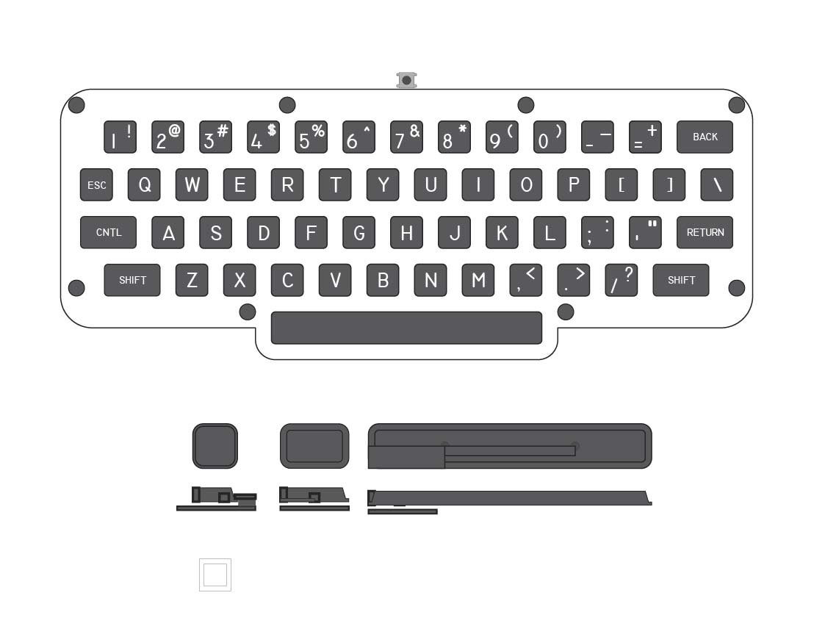
Minimalist custom keyboard
Spacing and size derived from case shape – custom allows us to make it perfectly fit our case
6mm tactile switches mount to laser-cut plastic template

Slide 16
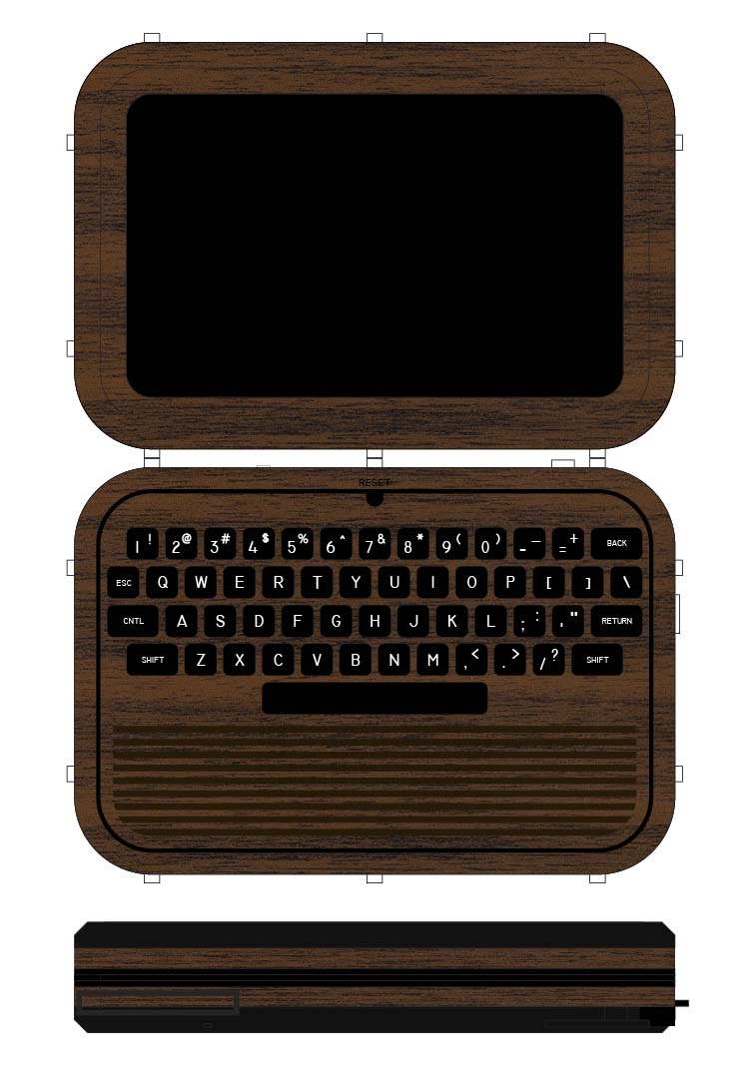
Final case design
3D printed keys with laser-etched white glyphs
Dark stained wood & gloss black color theme
Meant to look like a well-made, homemade computer from a wood-grain era

Slide 17
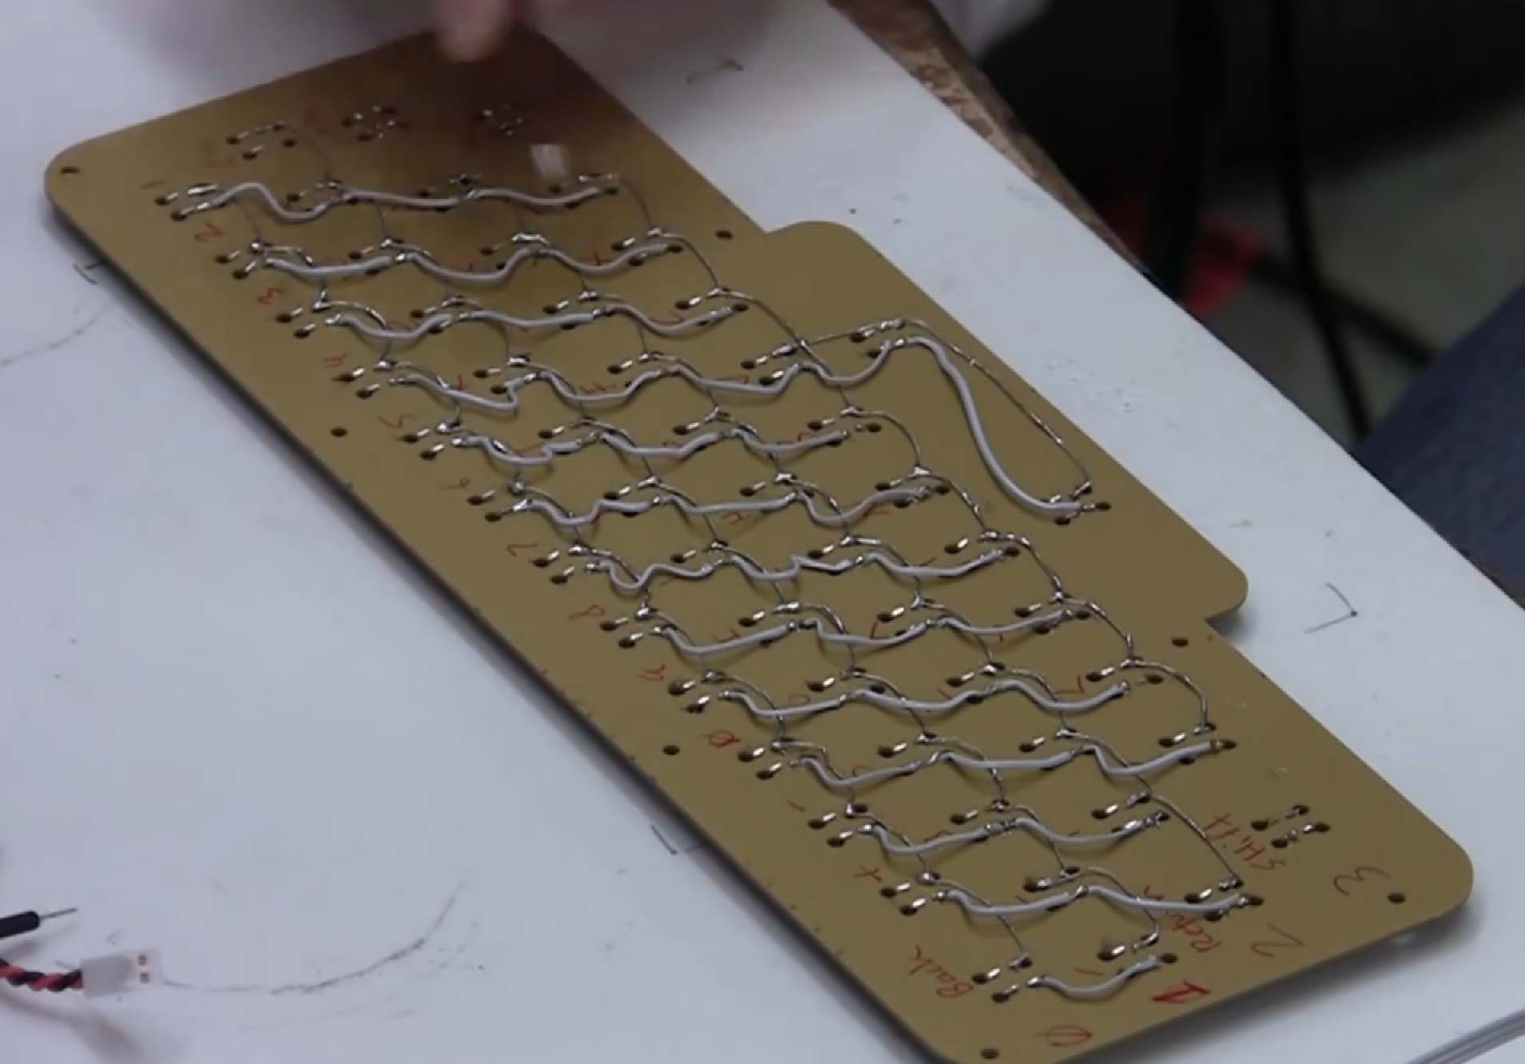

Slide 18
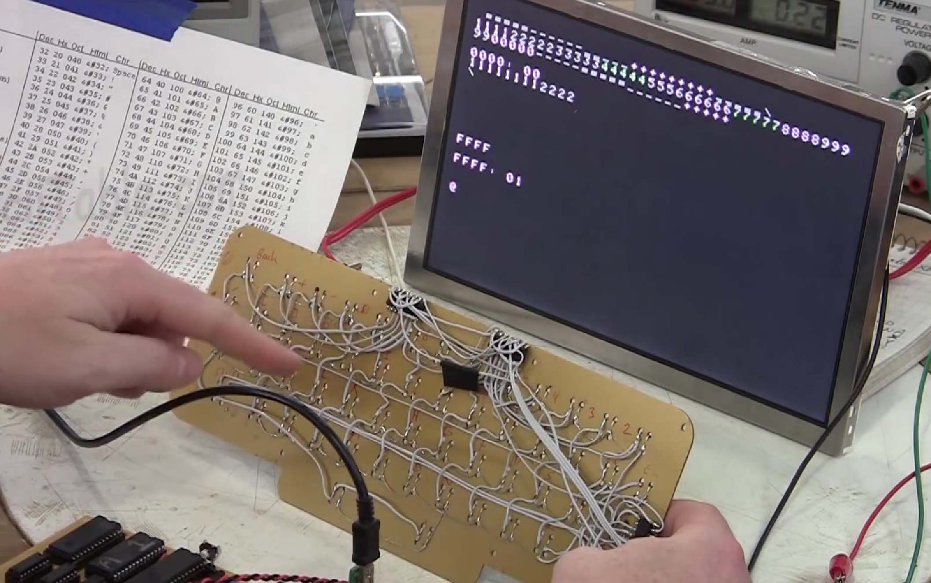

Slide 19
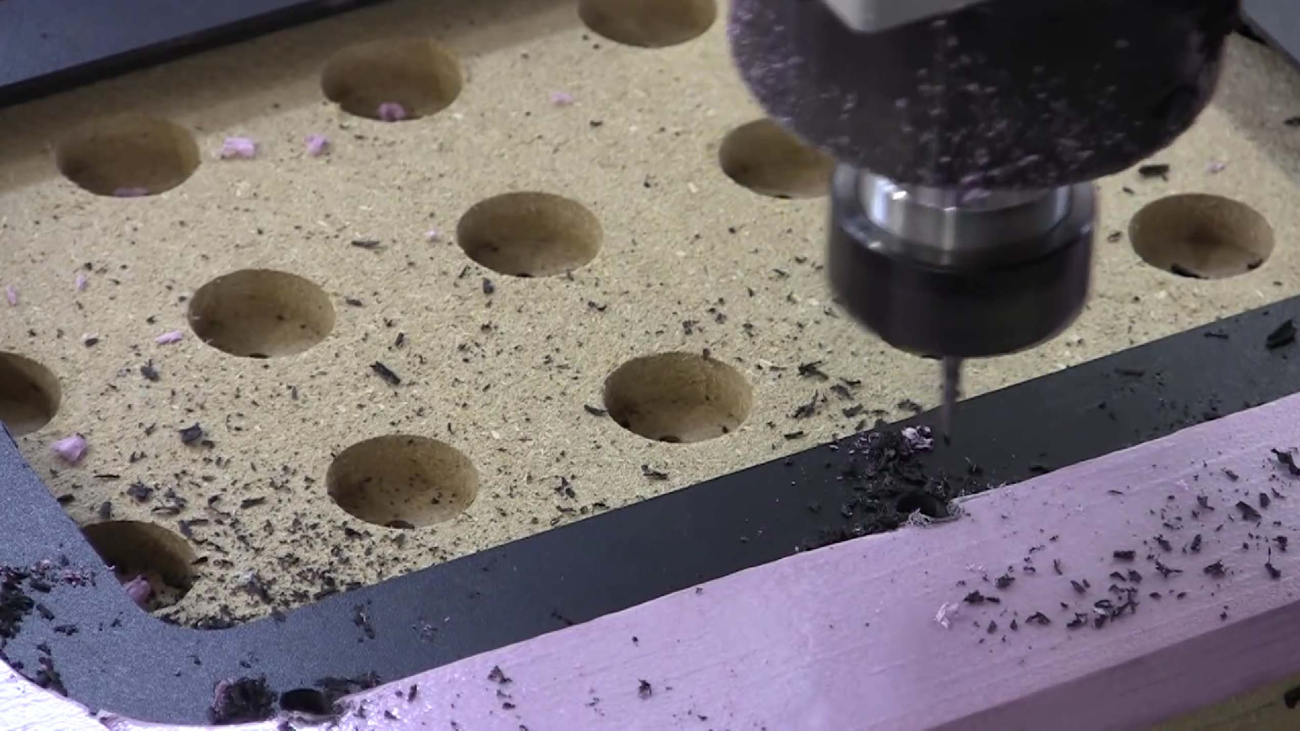

Slide 20
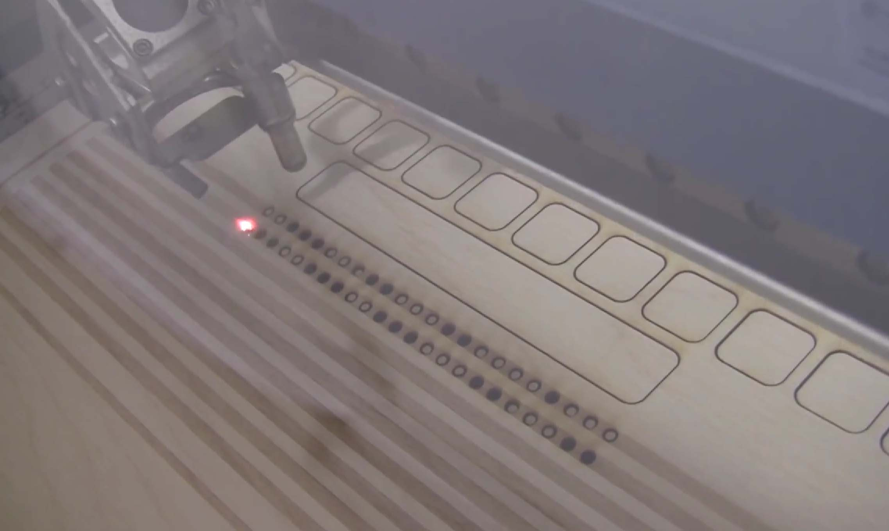

Slide 21
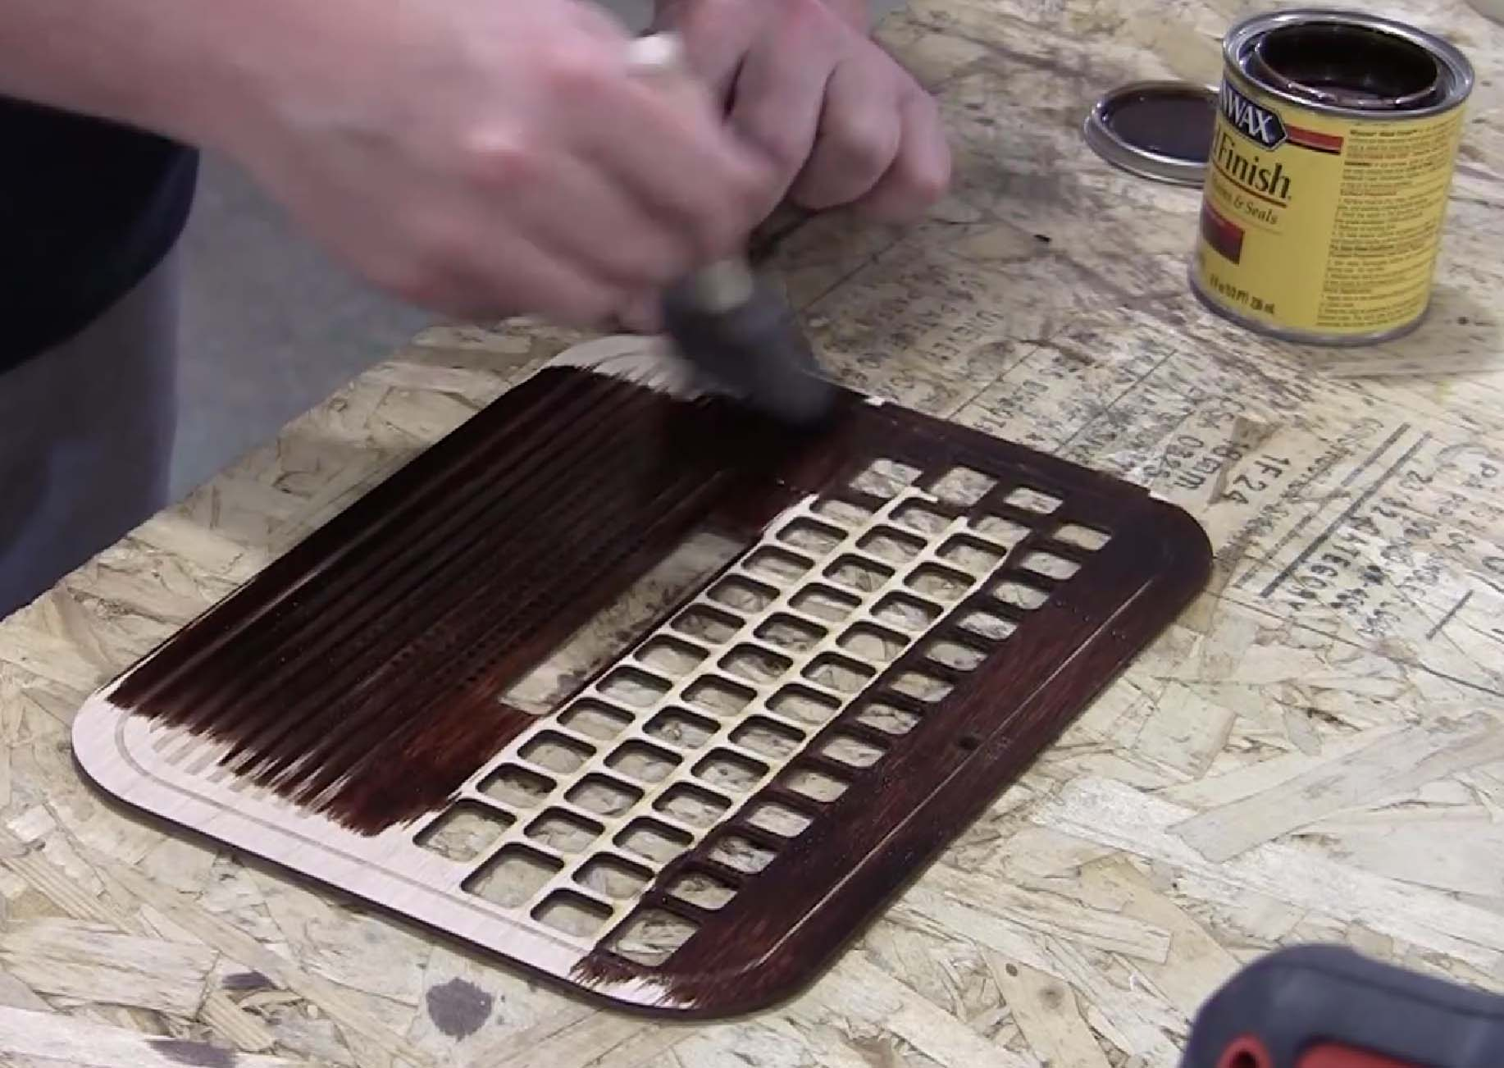

Slide 22
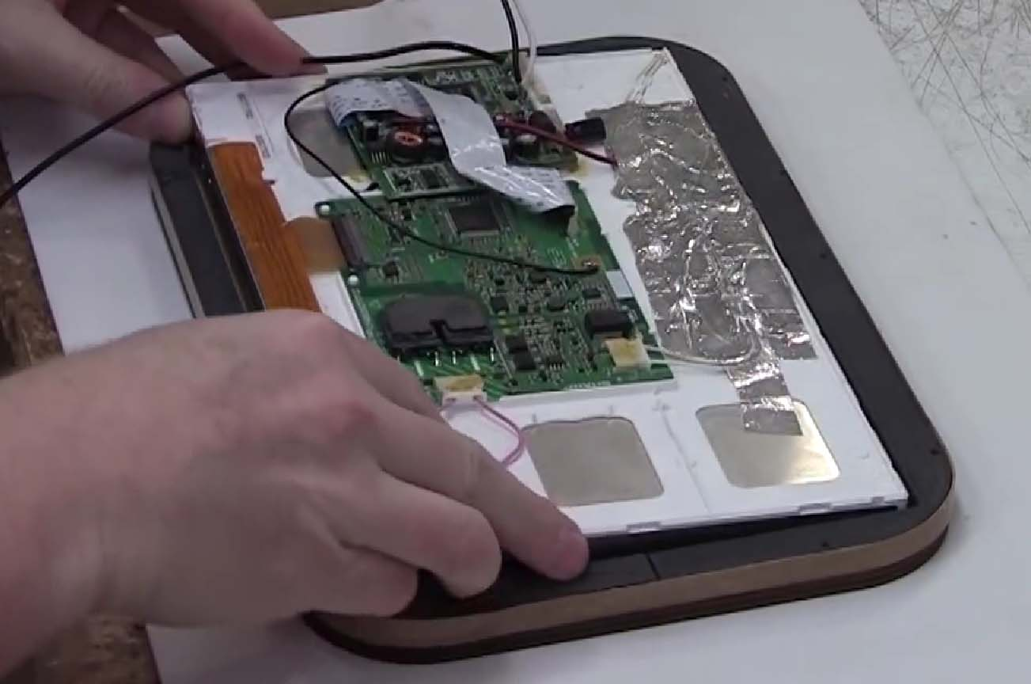

Slide 23
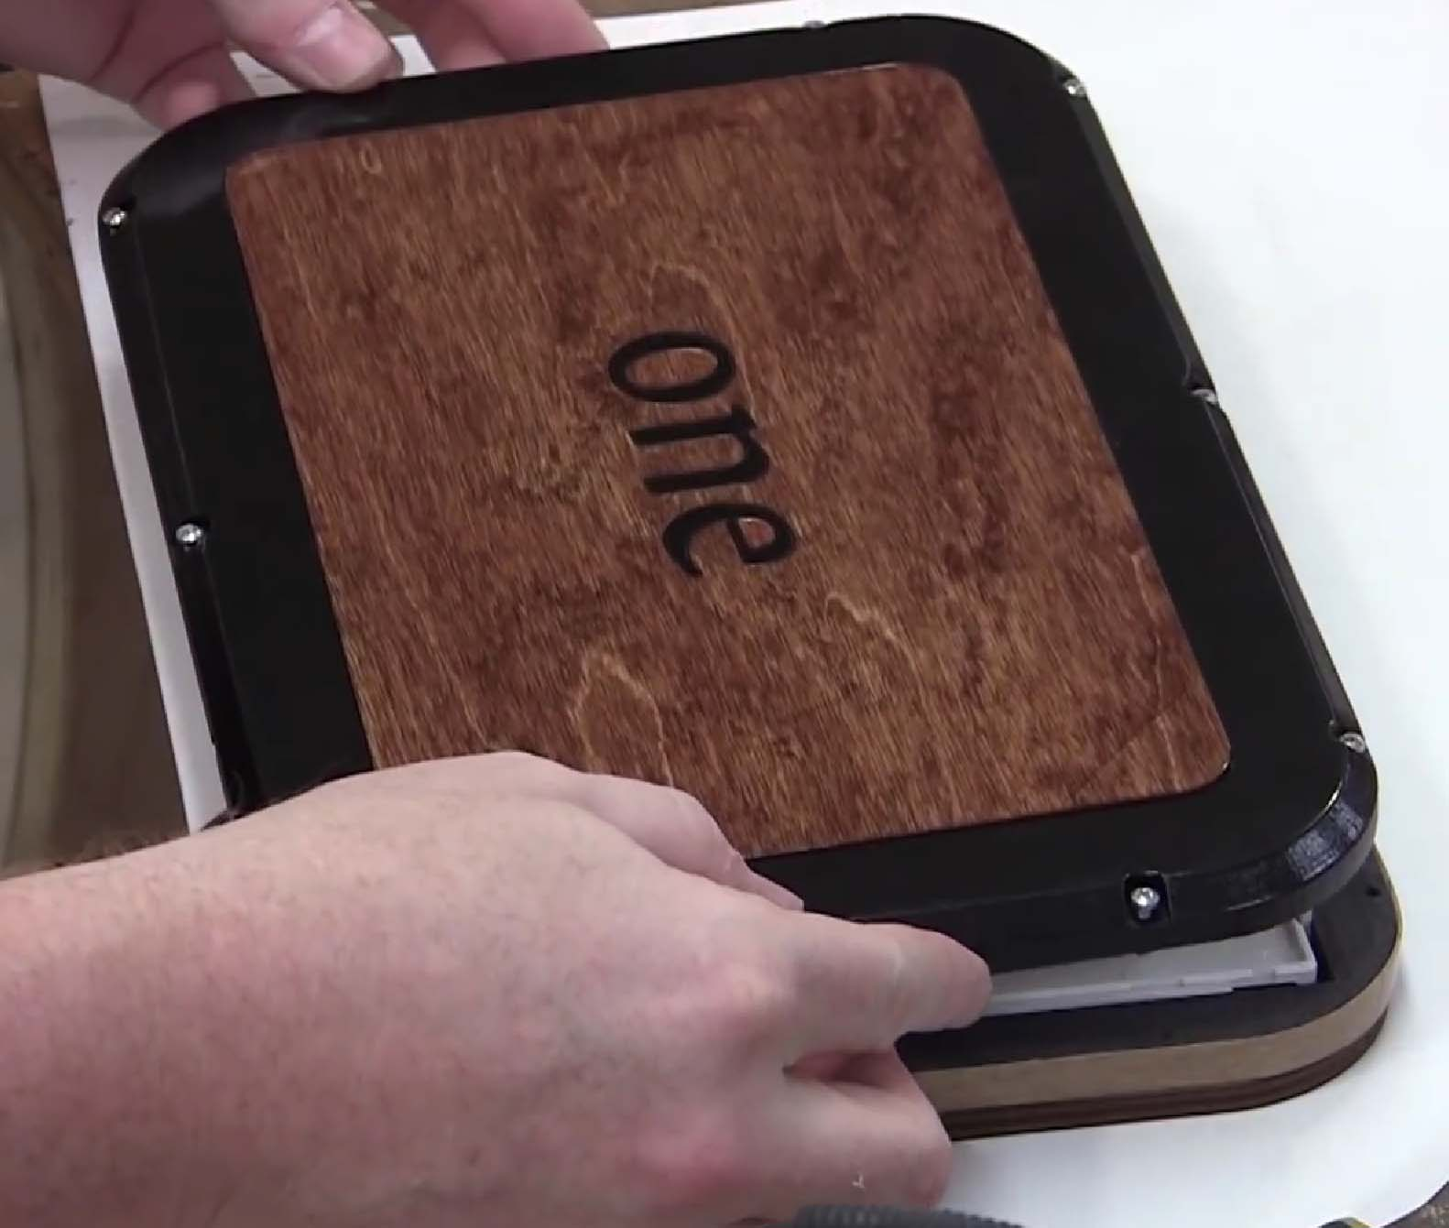

Slide 24
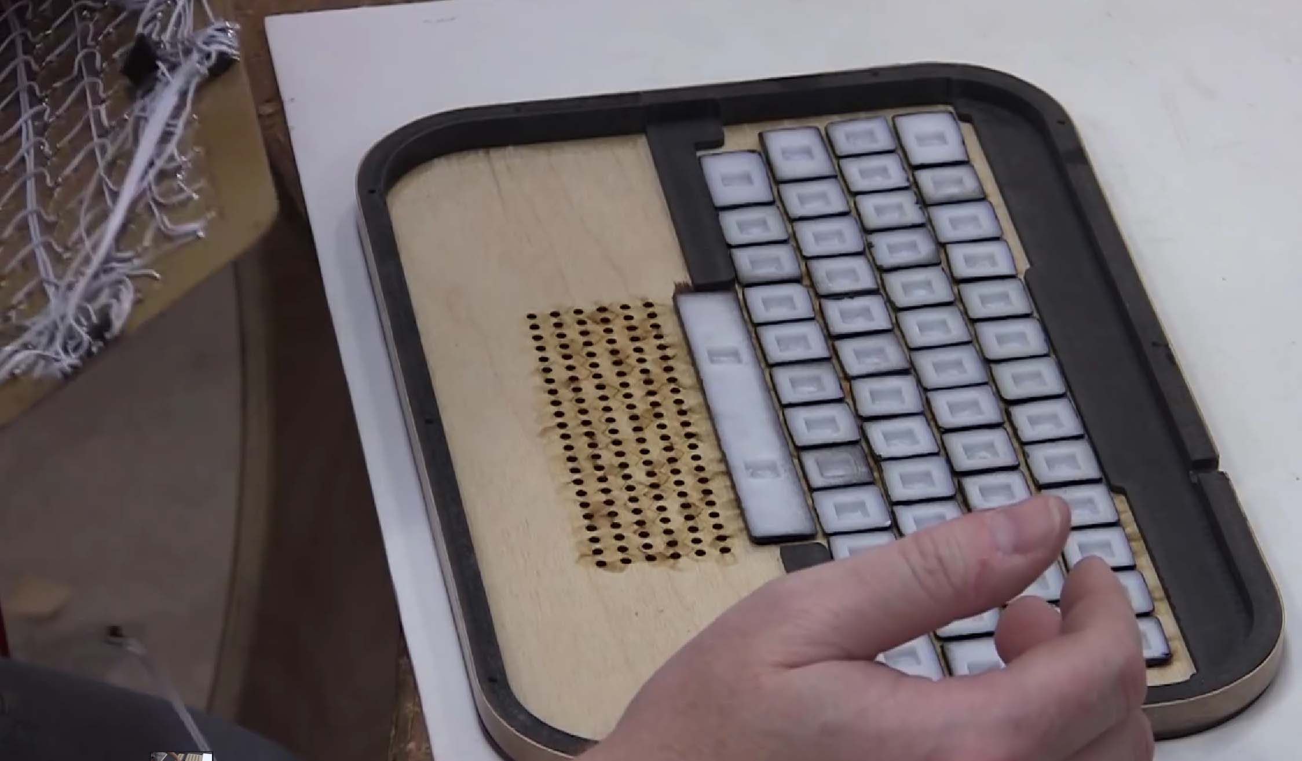

Slide 25
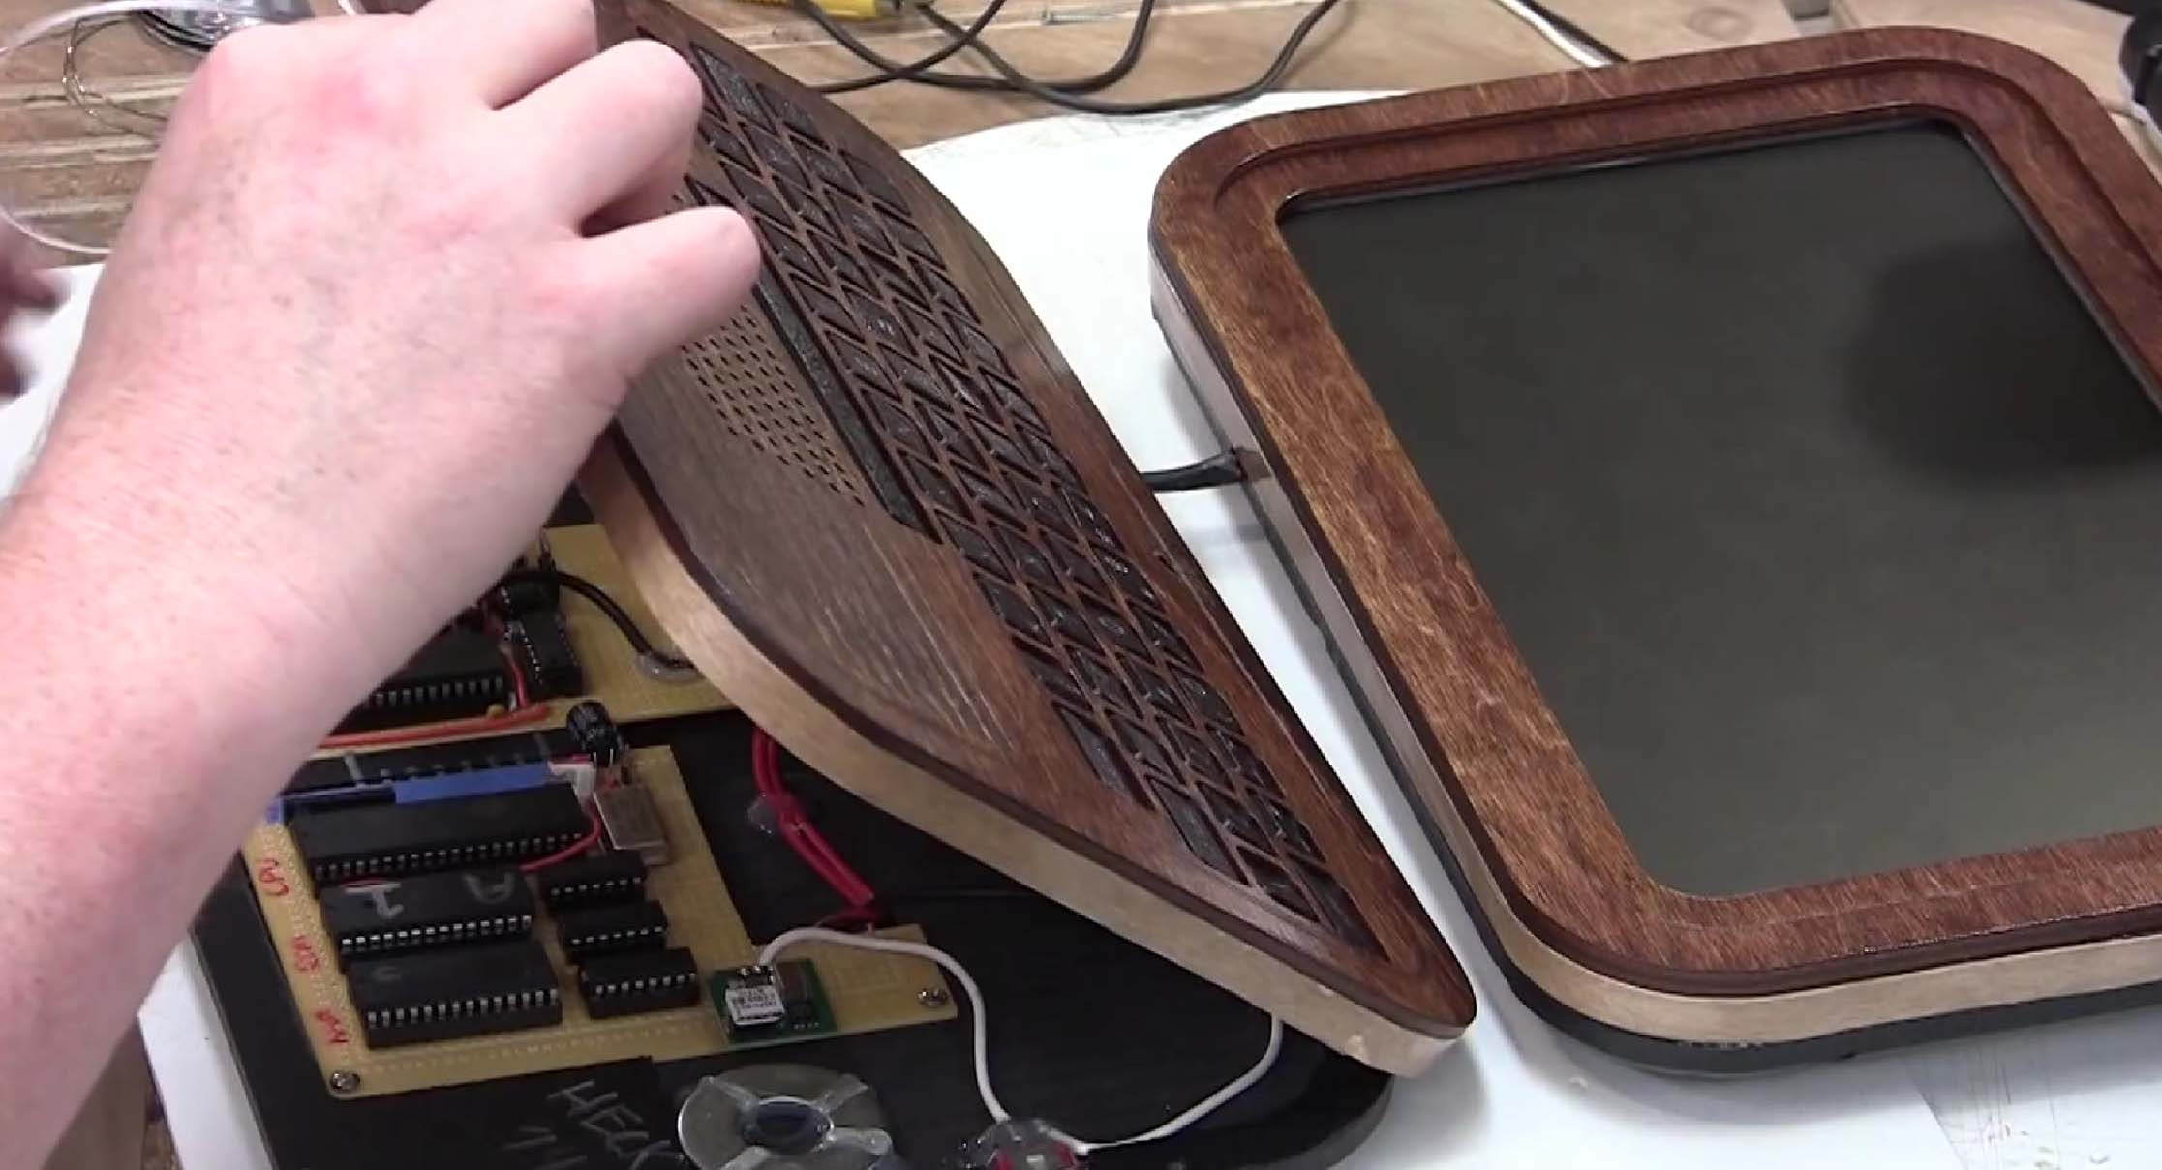

Slide 26
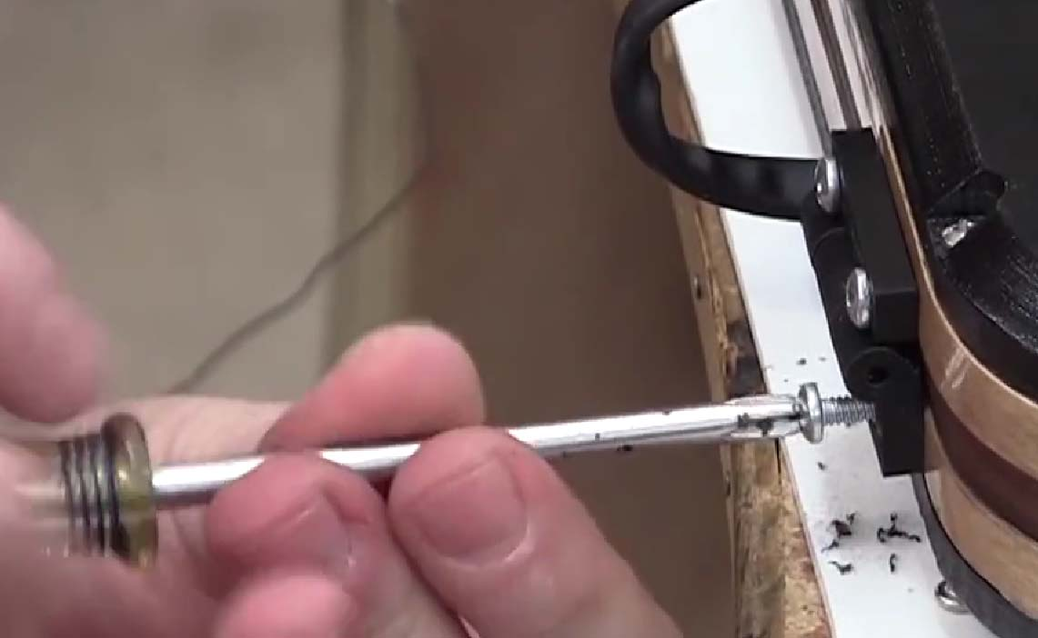

Slide 27
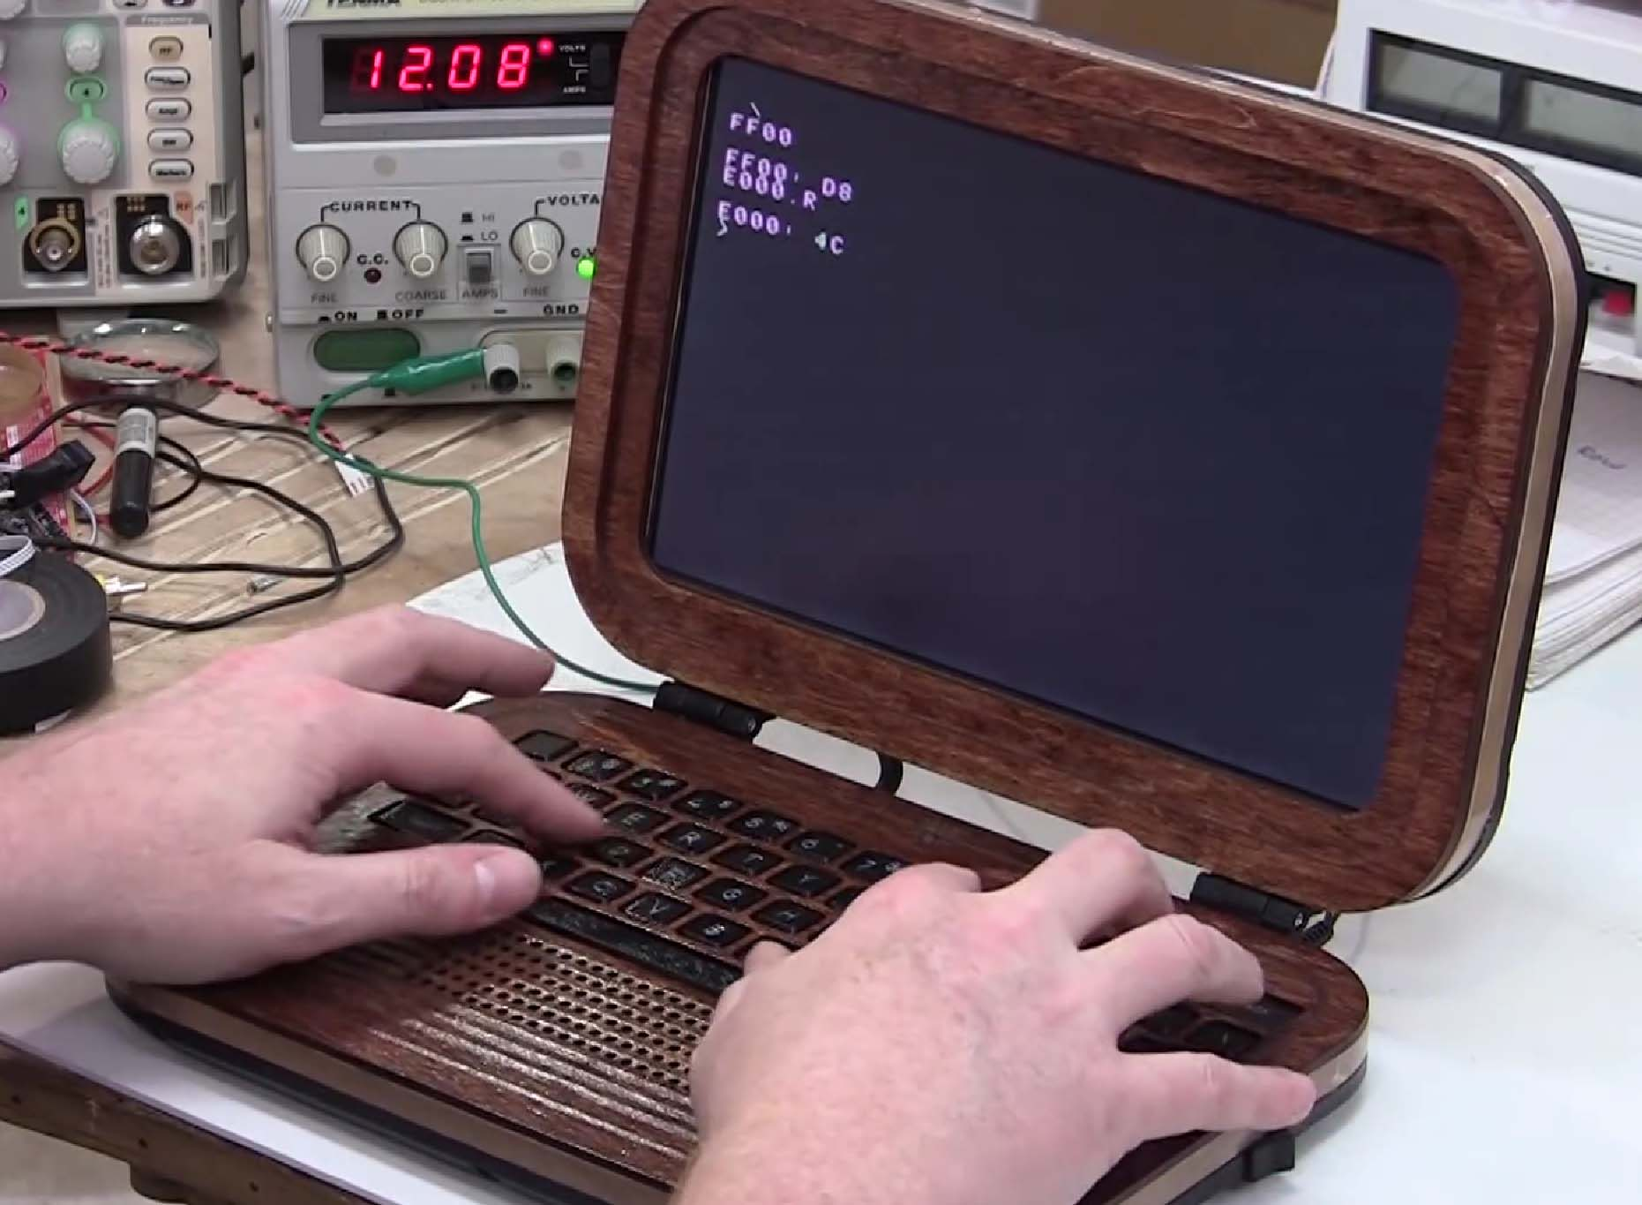

Slide 28
Things I liked about project:
Great wood aesthetic, fairly compact size
Used almost all original components, fairly simple and fun electronics
Learned a lot about where Apple came from and was very impressed by the use of technology, especially the 256 byte “Woz Monitor”
Used up a clunky old LCD that was taking up space in my shop
Made great use of a variety of CNC tools.
Always fun to do woodworking

Slide 29
Things I could have done better:
Custom keyboard ate up a lot of build time, was it worth it?
Old PS/2 keyboard would have worked better but at cost of design / size
“Junk” LCD has poor display (even by composite standards) and consumes a lot of power, making batteries not an option
Sometimes buying new is better than using up what you have
Audio in / cassette port would have been nice
6821 PIA could probably have been emulated in MCU assembly if I had the time to write code

Slide 30
Questions?
Questions about this build, other builds, our show, etc?

