Slide 1

NATIONAL AND KAPODISTRIAN UNIVERSITY OF ATHENS DEPARTMENT OF INFORMATICS AND TELECOMMUNICATIONS
MSc Thesis
Modular LLM Pipeline for
Task-Oriented Customer Service Dialogue
Georgios Xydias
Supervisor: Kosmas Kritsis, Research Associate, ILSP, ATHENA R.C.
Examiners: Aggelos Pikrakis, Associate Professor, University of Piraeus
Georgios Paraskevopoulos, Researcher C, ILSP, ATHENA R.C.
Athens, 2026

Slide 2
Motivation
Customer service in hotels and restaurants is:
High-volume
Repetitive
Rule-bound
This makes it a natural target for AI automation, since today the work is handled by human staff at significant cost in labor and errors, with no 24/7 availability.
Modern LLMs enable fluent multi-turn conversation, but cost, hallucination, and control remain open challenges.
Goal: investigate the architectural choices that lead to a TOD system for customer service that is reliable, controllable and affordable.

Slide 3
Research Questions
Question 1: Does architectural decomposition into specialized LLM modules (DST + ResponseGen) improve dialogue performance over a single-LLM baseline?
Question 2: Does role-specific LoRA fine-tuning of each module yield further improvement on top of decomposition?

Slide 4
Dataset: MultiWOZ 2.2
A schema-guided benchmark for task-oriented dialogue.
10,437 multi-turn dialogues across 7 service domains
Per-turn annotations: belief state (intent + slot values), dialog acts
Per-domain database with real entities for grounded recommendations
This thesis evaluates on hotel + restaurant only, the two most frequent and information-rich domains, matching the hospitality customer-service scope.
Filtered subset: 2,850 train, 171 dev and 186 test dialogues.

Slide 5
Positioning This Work
Two recurring strategies across eras: information enrichment + task decomposition. In LLMs: parameter-efficient fine-tuning.
Three trends shape modern LLM-based TOD research:
Information enrichment:
Schema-guided prompts (SGP-TOD 2023)
Examples from training set (Hudeček & Dušek, few-shot variant)
Task Decomposition: modular pipelines / multi-agent LLMs
(Hudeček & Dušek 2023, DARD 2024, DIMF 2025)
PEFT: LoRA fine-tuning (Spec-TOD 2025)
This work sits at the intersection with controlled comparisons isolating each variable: architectural decomposition and role-specific LoRA fine-tuning

Slide 6
Experimental Design
Exp 1. Single-LLM Baseline
One LLM handles DST, DB selection, and response generation
in a single prompt.
Exp 2. Zero-Shot Modular Pipeline
Two specialized LLMs: DST extracts the belief state, a
deterministic DB lookup runs, ResponseGen writes the reply.
Exp 3. Fine-Tuned Modular Pipeline
Same architecture as Exp 2, but each LLM module is replaced
by a LoRA fine-tuned adapter for its role.
Progression: monolithic → modular → modular + fine-tuned.

Slide 7
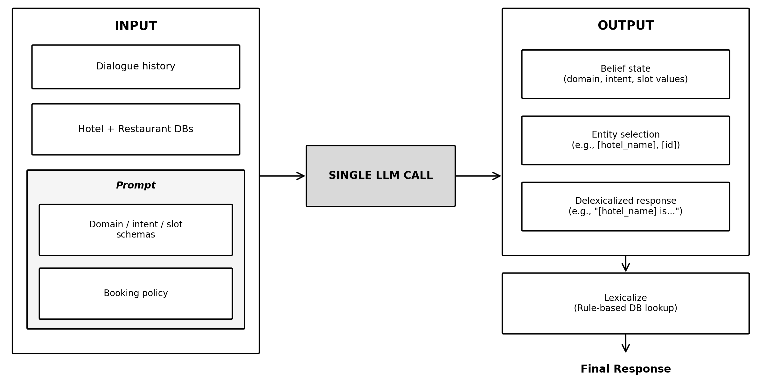
Exp 1: Single-LLM Baseline

Slide 8
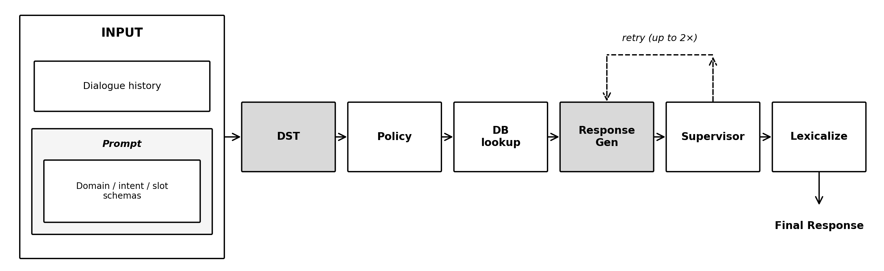
Exp 2: Zero-Shot Modular Pipeline

Slide 9
Exp 3: Fine-Tuned Modular Pipeline
Architecture (Exp 2 + LoRA fine-tuning):
Dialogue History → DST(LoRA) → Policy → DB → ResponseGen(LoRA) → supervisor → lexicalize → Response
Fine-tuning setup (QLoRA via Unsloth):
• Base model: open-source LLM, 4-bit quantized (NF4)
• LoRA adapter: applied to attention + MLP layers (rank 16)
• Trainable parameters: ~0.75% of total weights (e.g., 24M of 3.2B for LLaMA-3.2)
• Two adapters per config: one DST, one ResponseGen
• Train on MultiWOZ train split, validate with early stopping
Tests whether role-specific fine-tuning improves over Exp 2.

Slide 10
Models and Infrastructure
Commercial APIs (used in Exp 1, Exp 2):
• GPT-4o-mini (OpenAI)
• Claude 3 Haiku (Anthropic)
Open-source LLMs (used in Exp 1, Exp 2, Exp 3):
• LLaMA-3.2-3B, LLaMA-3.1-8B (Meta)
• Qwen3-4B / 8B / 14B (Alibaba)
• Phi-4-14B (Microsoft)
• Range: 3B to 14B parameters, 16K to 200K context windows
• Infrastructure: EuroHPC Leonardo (CINECA, Italy), NVIDIA A100 GPU

Slide 11
Evaluation Metrics
Standard MultiWOZ metrics:
• JGA, Slot F1: belief state accuracy
• Inform, Success: task completion
• BLEU: response quality
• Combined: (Inform + Success) / 2 + BLEU
Custom metrics (operational): Hallucination Rate, Policy Violation Rate, Domain / Intent Precision, Latency (s), API Cost ($).
Standard metrics use the same protocol as published TOD work
(hotel + restaurant only, not directly comparable to full-domain scores).
Custom metrics reflect control and deployment realism.

Slide 12
Exp 1: Results
Model | JGA | SlotF1 | Inform | Success | BLEU | Combined
Claude 3 Haiku | 44.8 | 88.3 | 90.9 | 83.3 | 3.67 | 90.8
Qwen3-14B | 33.3 | 83.0 | 82.3 | 72.0 | 3.69 | 80.8
Phi-4-14B | 25.8 | 74.3 | 66.1 | 59.7 | 4.46 | 67.4
GPT-4o-mini | 24.8 | 71.2 | 58.6 | 44.1 | 3.08 | 54.4
Qwen3-4B | 14.8 | 54.7 | 50.5 | 39.8 | 2.59 | 47.7
Qwen3-8B | 32.3 | 82.1 | 43.0 | 31.2 | 4.48 | 41.6
LLaMA-3.1-8B | 5.2 | 33.1 | 14.0 | 2.2 | 2.30 | 10.4
Key findings:
• Haiku leads, but at $21 in API fees, ~8× more than GPT-4o-mini ($2.75)
• Qwen3-14B is the best open-source, close to API quality
• LLaMA-3.1-8B fails entirely, Qwen3 scaling non-monotonic

Slide 13
Exp 2: Results
Config | JGA | SlotF1 | Inform | Success | BLEU | Combined
Claude 3 Haiku | 45.1 | 87.3 | 90.3 | 83.9 | 4.25 | 91.4
Haiku → GPT | 44.6 | 87.0 | 88.2 | 81.2 | 2.95 | 87.7
GPT → Haiku | 34.7 | 81.9 | 78.0 | 72.6 | 3.92 | 79.2
GPT-4o-mini | 35.7 | 81.7 | 79.0 | 72.0 | 3.14 | 78.6
Qwen3-14B | 33.4 | 80.4 | 73.7 | 68.3 | 5.00 | 76.0
Qwen3-14B → Phi-4-14B | 33.7 | 81.1 | 68.3 | 62.9 | 2.91 | 68.5
Qwen3-4B | 26.7 | 77.2 | 68.3 | 59.7 | 3.11 | 67.1
Phi-4-14B | 23.8 | 69.7 | 61.3 | 43.5 | 2.83 | 55.2
Qwen3-14B → Qwen3-8B | 33.7 | 81.6 | 52.7 | 45.2 | 5.20 | 54.2
Qwen3-8B | 34.2 | 81.3 | 51.6 | 42.5 | 5.10 | 52.2
LLaMA-3.1-8B | 18.1 | 63.4 | 55.4 | 35.5 | 1.53 | 47.0
LLaMA-3.2-3B | 5.3 | 42.5 | 28.5 | 14.5 | 1.26 | 22.8
Key findings:
• API cost drops 10×: Haiku $21 → $2.10, GPT $2.75 → $0.20
• Decomposition helps weak models dramatically: LLaMA-3.1-8B, GPT-4o-mini,
but hurts strong open-source: Qwen3-14B, Phi-4-14B
• DST is the bottleneck: Haiku → GPT vs GPT → Haiku

Slide 14
Exp 3: Results
Config | JGA | SlotF1 | Inform | Success | BLEU | Combined
Phi-4-14B | 47.0 | 88.9 | 66.7 | 57.5 | 8.74 | 70.8
Qwen3-14B | 47.7 | 89.5 | 61.3 | 55.4 | 12.26 | 70.6
Qwen3-14B → Phi-4-14B | 46.9 | 89.2 | 66.7 | 57.0 | 8.71 | 70.6
Qwen3-8B | 47.3 | 89.1 | 53.2 | 48.4 | 11.35 | 62.2
LLaMA-3.2-3B | 43.5 | 87.8 | 57.0 | 39.8 | 9.39 | 57.8
LLaMA-3.1-8B | 44.0 | 87.1 | 50.5 | 40.3 | 9.22 | 54.6
Qwen3-4B | 44.8 | 88.3 | 54.8 | 36.0 | 8.35 | 53.8
Key findings:
• Fine-tuning closes the DST gap with commercial APIs: Qwen3-14B FT reaches
JGA 47.7, matching Haiku Exp 2 (45.1)
• But Combined Score stays at ~71, 21 points behind Haiku (91.4)
• Phi-4-14B recovers from its Exp 2 drop

Slide 15
Cross-Experiment Synthesis
Config | Exp 1 | Exp 2 | Exp 3 | Best
Claude 3 Haiku | 90.8 | 91.4 | — | Exp 2
Qwen3-14B | 80.8 | 76.0 | 70.6 | Exp 1
Phi-4-14B | 67.4 | 55.2 | 70.8 | Exp 3
GPT-4o-mini | 54.4 | 78.6 | — | Exp 2
Qwen3-4B | 47.7 | 67.1 | 53.8 | Exp 2
Qwen3-8B | 41.6 | 52.2 | 62.2 | Exp 3
LLaMA-3.1-8B | 10.4 | 47.0 | 54.6 | Exp 3
LLaMA-3.2-3B | — | 22.8 | 57.8 | Exp 3
Findings:
• No single architecture wins for every model
• Three patterns:
– Monotonic up: LLaMA family, Qwen3-8B (every step helps)
– Monotonic down: Qwen3-14B (already grounded, hurt by each step)
– Non-monotonic: Phi-4-14B, Qwen3-4B

Slide 16
Key Findings
Question 1: Architectural decomposition.
Helps conditionally. Weak base models gain.
Already-strong open-source models lose ground.
DST is the dominant bottleneck.
Question 2: Role-specific LoRA fine-tuning.
Closes the DST gap with commercial APIs.
End-to-end Combined stays below APIs.
Observed pattern:
Disciplined models tend to peak in Exp 1.
Undisciplined ones tend to gain from Exp 2 or Exp 3.

Slide 17
Contributions
Controlled three-experiment design that isolates architectural decomposition (Exp 1 → Exp 2) and role-specific LoRA fine-tuning (Exp 2 → Exp 3) on the same data and metrics
Head-to-head comparison of commercial APIs and small open-source models (3B–14B) across all three architectures
Empirical evidence, across model families, that DST is the dominant bottleneck in modular pipelines

Slide 18
Limitations and Future Work
Limitations:
• Results sensitive to implementation choices (prompts, delex protocol, fine-tuning hyperparameters)
• Domain scope: hotel + restaurant only, not directly comparable to full-domain MultiWOZ leaderboard
Future Work:
• Extend to all MultiWOZ domains, or specialize to a single domain
• Explore prompting alternatives, e.g., retrieval-augmented few-shot
• DPO post-training: preference-based fine-tuning
• Workflow-graph orchestration with tool calling for booking flows

Slide 19
Thank you

