Slide 1
Microcontrollers and FPGAs
Embedded Systems

Slide 2
Verilog
Verilog is a Hardware Description Language (HDL).
It is a surprisingly big language, but most of its instructions are useful for simulation only. The number of structures that can actually be put in an FPGA is much smaller.
An HDL is not a programming language, it is a formalism for describing digital logic. As such, it’s vitally important that you understand how every piece of Verilog that you write will actually look when it has been synthesized in to hardware.
If your Verilog isn’t working, try sketching the logic gates and registers yourself. If you can’t make your Verilog look like good hardware, then the synthesizer probably can’t either!
Two primary classes of logic: Combinatorial and Sequential

Slide 3
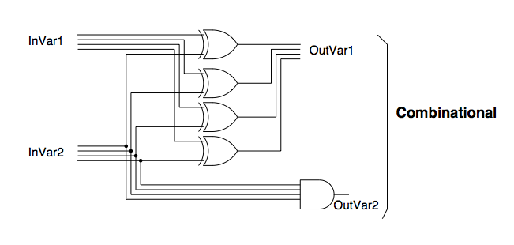
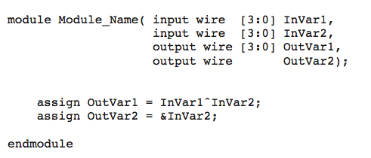
Verilog
Combinatorial logic with assign statements

Slide 4
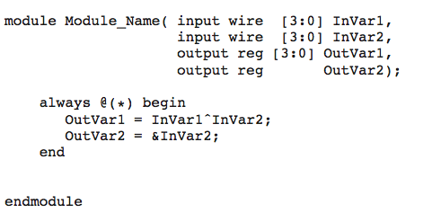
Verilog
Combinatorial logic with always statements

Slide 5

Verilog
Rules for combinatorial circuits:
No feedback allowed.
assign or always(*) statements may be used.
Assigns are more compact and often used for simple wiring tasks like assign reset_n = key[0];
Always statements are more flexible and lead in to sequential logic
The signals between the brackets in the always statement is called the sensitivity list. You don’t need to have a ‘*’ for combinatorial logic, you can list each input signal separately, however if you forget to enter a signal then the logic is no longer strictly combinatorial and may not synthesize as you expect.
Wrong!

Slide 6
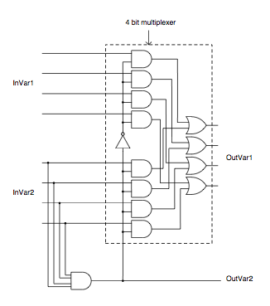
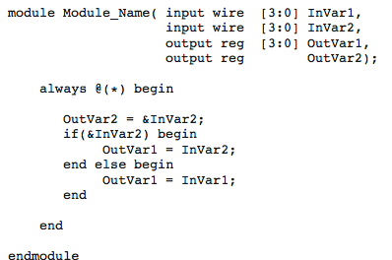
Verilog
If statements

Slide 7
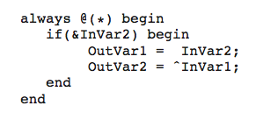
Verilog
If Statements:
Synthesize to two distinct pieces.
A wire representing the outcome of the test
A multiplexor that selects the correct input signal given the above wire
Cases should be complete! They don’t strictly have to be, the below code is valid, but the synthesizer will create latches for to cover the unused case. Latches are almost never what you actually want.

Slide 8
Verilog
If Statements:
Also note that two latches no not equal a correct multiplexor. The synthesizer will probably not be smart enough what you meant with the code below, even if it’s obvious to you
always @(*) begin
if (&InVar1) begin
OutVar1 = InVar1;
end
end
always @(*) begin
if (!(&InVar1)) begin
OutVar1 = ~InVar1;
end
end

Slide 9
Verilog
Case Statements:
If statements are special case statements.
Like if statements, case statements synthesize to two parts:
A wire (generally a bus of wires) representing all possible selections of the case statement
A multiplexor that selects the correct input given the above wire
Like if statements, they should be complete to avoid the generation of latches

Slide 10
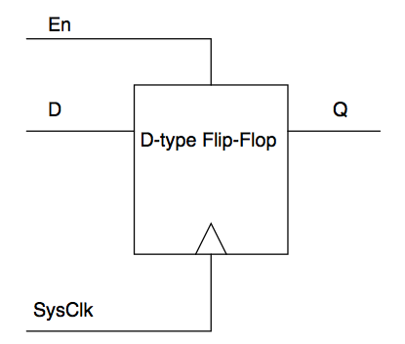
Verilog
Sequential logic
The ‘D’ flip-flop

Slide 11
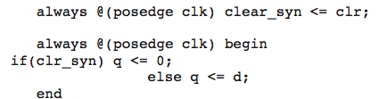
Verilog
Sequential logic:
Use non-blocking assignments, i.e <=
Always block sensitivity list should be edge-triggered
always @(posedge clk)
All signals inside the block must be registered to the clock edge. If your logic is working intermittently, try registering your wires before use
In sequential blocks, if and case statements need not be complete. Unmatched cases effectively synthesize to OutVar <= OutVar

Slide 12
Verilog
Important point: What is the ‘System Clock’?
When talking about sequential logic, we’ve been talking about a system clock. This is often simply a net routed from a pin in the top level file
If this clock rate is not right for you, what do you do?
reg [1:0] my_clock;
always @(posedge clk) begin
my_clock <= my_clock + 1;
end
always @(posedge my_clock[1]) begin
…
end
Wrong!

Slide 13
Verilog
Why? Internally my_clock[1] is a logic net, not a clock net (gclk in Altera-speak). This won’t matter for slow-speed designs, but as speed increases the time it takes for a logic signal to propagate through the chip begins to matter.
This is our first example of having to think about things in the time domain but it won’t be our last!
The correct way to do this is to have the external clock in the sensitivity list but use my_clock[1] in the always body to drive a state machine or otherwise determine what to actually do.

Slide 14
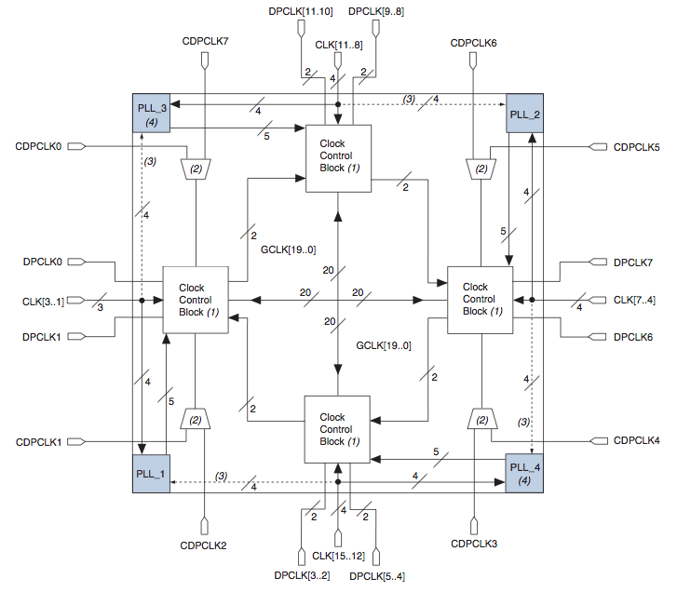
Clocks
The exception is when you can use dedicated hardware on the chip to modify the clock and route it back on to a gclk.
The clock infrastructure of the Cyclone IV part on our DE2 boards is pictured here.
If you need a clock that can’t be generated easily by the tricks on the previous slide, you can use a Phase Locked Loop (PLL)

Slide 15
Clocks
altpll altpll_component (
.inclk (sub_wire3),
.clk (sub_wire0),
.activeclock (),
.areset (1'b0),
.clkbad (),
.clkena ({6{1'b1}}),
.clkloss (),
.clkswitch (1'b0),
.configupdate (1'b0),
.enable0 (),
.enable1 (),
.extclk (),
.extclkena ({4{1'b1}}),
.fbin (1'b1),
.fbmimicbidir (),
.fbout (),
.fref (),
.icdrclk (),
.locked (),
.pfdena (1'b1),
.phasecounterselect ({4{1'b1}}),
.phasedone (),
.phasestep (1'b1),
.phaseupdown (1'b1),
.pllena (1'b1),
.scanaclr (1'b0),
.scanclk (1'b0),
.scanclkena (1'b1),
.scandata (1'b0),
.scandataout (),
.scandone (),
.scanread (1'b0),
.scanwrite (1'b0),
.sclkout0 (),
.sclkout1 (),
.vcooverrange (),
.vcounderrange ());
defparam
altpll_component.bandwidth_type = "AUTO",
altpll_component.clk0_divide_by = 1,
altpll_component.clk0_duty_cycle = 50,
altpll_component.clk0_multiply_by = 2,
altpll_component.clk0_phase_shift = "0",
altpll_component.compensate_clock = "CLK0",
altpll_component.inclk0_input_frequency = 37037,
altpll_component.intended_device_family = "Cyclone IV E",
altpll_component.lpm_type = "altpll",
altpll_component.operation_mode = "NORMAL",
altpll_component.pll_type = "AUTO",
altpll_component.port_activeclock = "PORT_UNUSED",
altpll_component.port_areset = "PORT_UNUSED",
altpll_component.port_clkbad0 = "PORT_UNUSED",
altpll_component.port_clkbad1 = "PORT_UNUSED",
altpll_component.port_clkloss = "PORT_UNUSED",
altpll_component.port_clkswitch = "PORT_UNUSED",
altpll_component.port_configupdate = "PORT_UNUSED",
altpll_component.port_fbin = "PORT_UNUSED",
altpll_component.port_inclk0 = "PORT_USED",
altpll_component.port_inclk1 = "PORT_UNUSED",
altpll_component.port_locked = "PORT_UNUSED",
altpll_component.port_pfdena = "PORT_UNUSED",
altpll_component.port_phasecounterselect = "PORT_UNUSED",
altpll_component.port_phasedone = "PORT_UNUSED",
altpll_component.port_phasestep = "PORT_UNUSED",
altpll_component.port_phaseupdown = "PORT_UNUSED",
altpll_component.port_pllena = "PORT_UNUSED",
altpll_component.port_scanaclr = "PORT_UNUSED",
altpll_component.port_scanclk = "PORT_UNUSED",
altpll_component.port_scanclkena = "PORT_UNUSED",
altpll_component.port_scandata = "PORT_UNUSED",
altpll_component.port_scandataout = "PORT_UNUSED",
altpll_component.port_scandone = "PORT_UNUSED",
altpll_component.port_scanread = "PORT_UNUSED",
altpll_component.port_scanwrite = "PORT_UNUSED",
altpll_component.port_clk0 = "PORT_USED",
altpll_component.port_clk1 = "PORT_UNUSED",
altpll_component.port_clk2 = "PORT_UNUSED",
altpll_component.port_clk3 = "PORT_UNUSED",
altpll_component.port_clk4 = "PORT_UNUSED",
altpll_component.port_clk5 = "PORT_UNUSED",
altpll_component.port_clkena0 = "PORT_UNUSED",
altpll_component.port_clkena1 = "PORT_UNUSED",
altpll_component.port_clkena2 = "PORT_UNUSED",
altpll_component.port_clkena3 = "PORT_UNUSED",
altpll_component.port_clkena4 = "PORT_UNUSED",
altpll_component.port_clkena5 = "PORT_UNUSED",
altpll_component.port_extclk0 = "PORT_UNUSED",
altpll_component.port_extclk1 = "PORT_UNUSED",
altpll_component.port_extclk2 = "PORT_UNUSED",
altpll_component.port_extclk3 = "PORT_UNUSED",
altpll_component.width_clock = 5;
A PLL is instantiated like any other Verilog sub-module but the synthesizer recognizes that it’s special and builds the logic out of a PLL hardware block instead of generic gates.
PLLs and a host of other pieces of logic can be created using the Altera MegaCore Plugin Wizard. The generated code to turn a 50MHz clock in to 100MHz is shown to the right, obviously not the sort of thing you want to write by hand.

Slide 16
Clocks
Aside: A fully-functional FM radio transmitter using a PLL in 7 lines:
pll clockgen(clk, clk2);
always @(negedge clk)
begin
ctr <= ctr + 1;
pwm <= wav_dat < ctr[7:0] ? 0 : 1;
end
assign out = pwm ? clk : clk2;
Cheated a bit, not shown is the bit that loads wav_dat with the current waveform point, nor all the definitions.
Get a 100MHz carrier using a Wizard-generated PLL
Generate a PWM signal with duty cycle proportional to the sound data
The output is just the carrier clock modulated by the PWM signal

Slide 17
Clocks
Aside: A fully-functional FM radio transmitter using a PLL in 7 lines:
pll clockgen(clk, clk2);
always @(negedge clk)
begin
ctr <= ctr + 1;
pwm <= wav_dat < ctr[7:0] ? 0 : 1;
end
assign out = pwm ? clk : clk2;
Cheated a bit, not shown is the bit that loads wav_dat with the current waveform point, nor all the definitions.
Get a 100MHz carrier using a Wizard-generated PLL
Generate a PWM signal with duty cycle proportional to the sound data
Project idea!
The output is just the carrier clock modulated by the PWM signal

Slide 18
Finite State Machines (FSM)

Slide 19
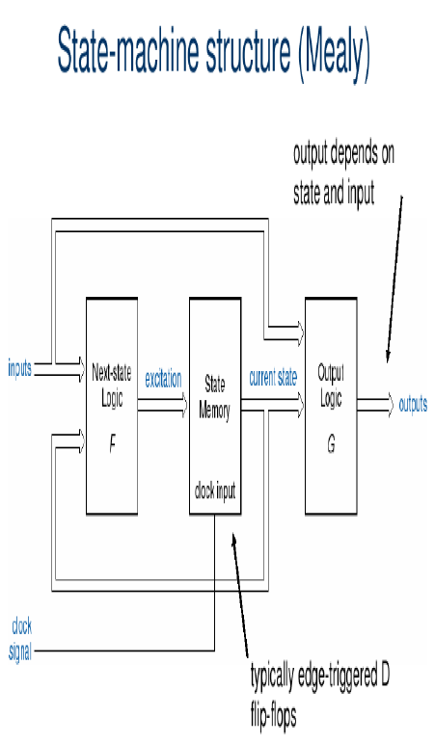
FSM

Slide 20
FSM
Let x(t) - input, s(t) - state, z(t) - output
Moore machine:
s(t+1) = F(s(t), x(t)) −state equation
z(t) = G(s(t)) −output equation
Mealy machine:
s(t+1) = F(s(t), x(t)) −state equation
z(t) = G(s(t), x(t)) −output equation
ENGN3213 only uses Synchronous State Machines;

Slide 21
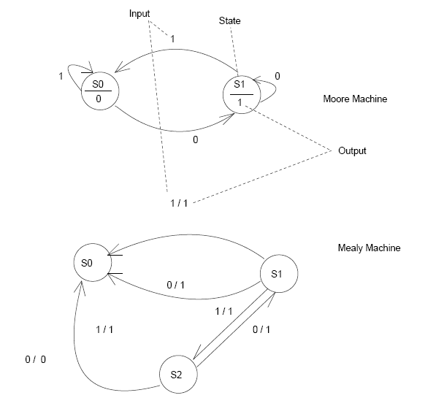
FSM

Slide 22
FSM in Verilog http://www.altera.com/support/examples/verilog/ver_statem.html

Slide 23
FSM – Design Steps
1. Determine the inputs / outputs. Determine the states and give them
mnemonic names
2. Draw up a state diagram and a next state table.
3. Render the inputs, outputs and states in binary format (VERILOG
parameter).
4. Draw an excitation table
5. Draw an Output table
6. Use K-maps to obtain produce minimal next state and output
combinational logic.
7. Use the standard VERILOG formulation to simulate your design and check
for correct operation. Revise as appropriate.
8. Check for potential practical problems (e.g. non-ideal effects).

Slide 24
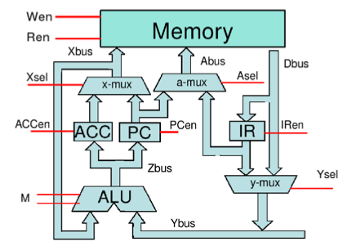
Microprocessors
MU0
A realistic but simple processor which is capable of executing one instruction every two clock cycles.
We won’t be looking at this in labs, but the data path and control flows will be used in illustrating many of the more advanced topics in microprocessors over the coming lectures

Slide 25
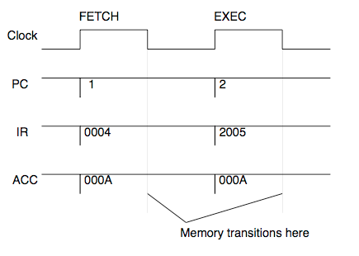
Microprocessors
Timing is important to understand. The processing of a single instruction is split in to two parts, one per clock cycle: Fetch and Execute.
Thus each instruction takes two clock cycles to complete.
Actually there are four states with two occurring on the falling edges. This is valid as MU0 is simple and runs slowly. When we get to more complex systems, we’ll note that these extra states are made explicit

Slide 26
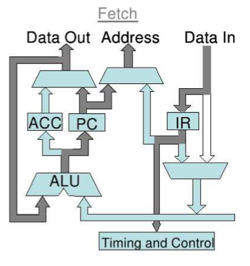
Microprocessors
During the Fetch cycle, the Program Counter is wired in to the memory address, and the instruction at that location is loaded in to the Instruction Register.

Slide 27
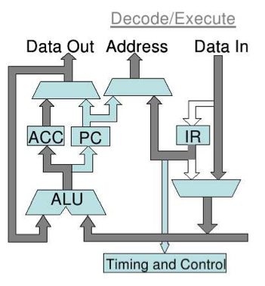
Microprocessors
The Execute phase is centred around the Arithmetic Logic Unit (ALU). It takes two operands, one of which is always a register (either the Accumulator or the Program Counter depending on the operation). The other is either a memory location whose address is coded in to the instruction, or some portion of the instruction itself.

Slide 28
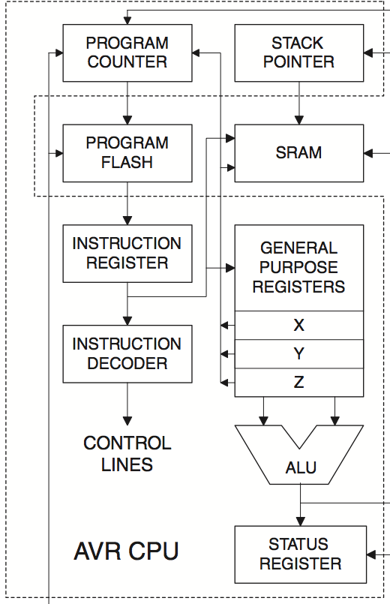
Microprocessors
This basic structure is very similar across all CPUs. Here we see the CPU portion of the Atmel ATMega8 microcontroller.
Program Counter, Instruction Register, ALU, Memory busses all pretty much the same.
Differences: MU0 has one working register, ACC, Mega8 has 32 (6 of which can be paired in to 3 special registers, XYZ, of twice the size). Different memory architecture, MU0 has a single memory to hold instructions and data, the AVR has two blocks labeled Program Flash and SRAM respectively.

Slide 29
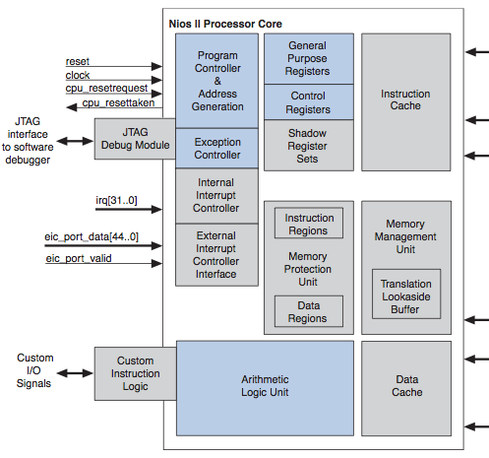
Microprocessors
The Nios2 core we will be using in labs is more complex again, but uses the same concepts still.
Note the register sets, the ALU and the Program Controller (that includes the Program Counter, Instruction Register etc.).
Most of the extra complexity here is to do with interrupts (not yet covered) or simply accessing many more types of memories.

Slide 30
Optional: Asynchronous Machines
Used some slides from Prof.Marek Perkowski (PSU, ECE573-2009)

Slide 31
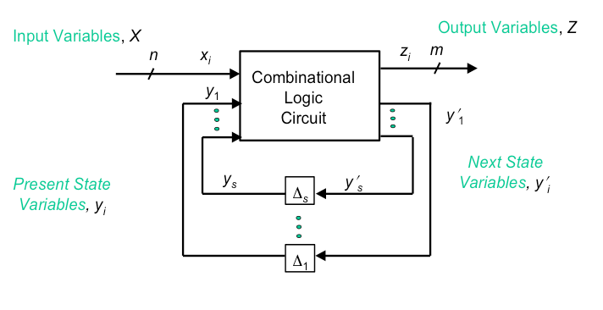
Feedback Model for Asynchronous Sequential Networks

Slide 32
Asynchronous FSM
Fundamental Mode Assumption
Only one input can change at a time
Analysis too complicated if multiple inputs are allowed to change simultaneously
Circuit must be allowed to settle to its final value before an input is allowed to change
Behavior is unpredictable (nondeterministic) if circuit not allowed to settle

Slide 33
Asynch. Design Difficulties
Delay in Feedback Path
Not reproducible from implementation to implementation
Variable
may be temperature or electrical parameter dependent within the same device
Analog
not known exactly

Slide 34
Stable State
PS = present state
NS = next state
PS = NS = Stability
Machine may pass through none or more intermediate states on the way to a stable state
Desired behavior since only time delay separates PS from NS
Oscillation
Machine never stabilizes in a single state

Slide 35
Races
A Race Occurs in a Transition From One State to the Next When More Than One Next State Variables Changes in Response to a Change in an Input
Slight Environment Differences Can Cause Different State Transitions to Occur
Supply voltage
Temperature, etc.

Slide 36
Races
PS
01
11
00
if Y1 changes first
if Y2 changes first
10
desired NS

Slide 37
Types of Races
Non-Critical
Machine stabilizes in desired state, but may transition through other states on the way
Critical
Machine does not stabilize in the desired state

Slide 38
Races
01
PS
if Y2 changes first
11
00
if Y1 changes first
10
00
desired NS
non- critical race
critical race

Slide 39
Types of Races
Asynchronous State machines have similarities to multi-threaded software as different elements are not coherently synchronized to a single time source.
We will revisit the concept of races and stability in the context of embedded software starting in Week 5

Slide 40
Asynchronous FSM Benefits
Fastest FSM
Economical
No need for clock generator
Output Changes When Signals Change, Not When Clock Occurs
Data Can Be Passed Between Two Circuits Which Are Not Synchronized
In some technologies, like quantum, clock is just not possible to exist, no clocks in live organisms.

Slide 41
Asynchronous FSM example
input
next
state
present
state
y1
y2

Slide 42
Next State Variable
You should analyze this machine at home

Slide 43
Asynchronous State Tables
States are either Stable or Unstable.
Stable states encircled with symbol.
Present state | Next state, output
 | x=0 | x=1
Q₀ | Q₀,0 | Q₁,0
Q₁ | Q₂,0 | Q₁,0
Q₂ | Q₂,0 | Q₃,1
Q₃ | Q₀, 0 | Q₃,1
Oscillations occur if all states are unstable for an input value.
Total State is a pair (x, Q_{i})

