Slide 1
Real Time Systems
Well, there's a dull ache, certainly.
And layered on top of that is a club sandwich of pain. Only instead of bacon, there's
ENGN{4,6}521
Embedded Systems

Slide 2
Outline
What is time?
What is real time (really)?
Interfacing with time
Safety and Liveness
References:
Burns and Wellings Real-Time Systems and Programming Languages (Third Edition), Addison Wesley Longmain 2001
Thanks to Dr Uwe Zimmer for inspiration and material from COMP4330

Slide 3
What is Time?
Do we exist in time, or is it part of our existence?
Is time an intrinsic property of nature? (Platonism)
Time is an underlying external phenomenon. Thus simultaneous events happen at the same exact time. There is an underlying assumption that time is progressing, even if no changes can be observed.
Is time a construct which is based on external events? (Reductionism)
Time is an observation of distinguishable events. If all possible observers detect one event before another, they are said to be in sequence. If this cannot be assumed for all observers, they are said to be simultaneous. Therefore the notion of time is actually one of causality.
.. but what happens to time between events?

Slide 4
What is Time?
Is time an intrinsic property of nature?
Quantum Physics. Time is a parameter of the quantum wavefunction from which all state is derived.
Is time a construct which is based on external events?
General Relativity. Time and Space are the same, distinguished from each other by the sign of the diagonal entries of the Metric Tensor. If two events can be connected by a “straight trajectory” in time and space where the velocity is less than light, the events are “time-like”, and are separated in time, but not necessarily in space (for all observers). If the velocity of the path between events is greater than the speed of light, the events are “space-like” in that they’re definitely separated in space, but might happen at the same time for some observer. This implies that time(space) and events in time(space) are not independent.

Slide 5
What is Time?
What is time Mathematically?
Transitivity: x < y ∧ y < z ➔ x < z
Linearity: x < y ∨ x > y ➔ x ≠ y
Irreflexivity: not(x < x)
Density: x < y ➔ z | x < z ∧ z < y
The density condition states that time is continuous. Any measurement of time however is necessarily discrete.
E

Slide 6
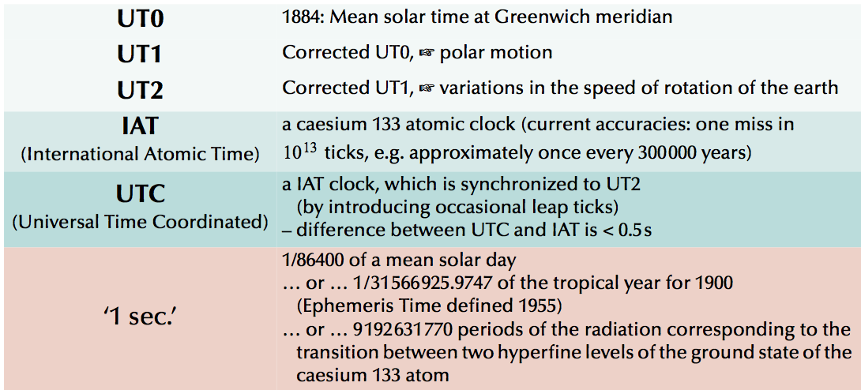
What is Time?

Slide 7
What is Time?
Fundamentally, time is tracked in an Embedded System by a series of logic level transitions with well defined periods (Clocks), typically derived from the vibration of precisely cut pieces of crystal (Crystal Oscillators, XTALs) or the repeated buildup and release of charge from a capacitor (RC Oscillator).
There may be a hierarchy of such sources, each one corrected by another. For example, a high frequency crystal phase- or frequency-locked to a high precision timing device.
You’ll often come across the concept of “Clock Skew” in FPGAs. Clock Skew errors come about because the FPGA’s concept of “Now” is linked to a clock edge, but the finite propagation speed of that edge means not every part of the chip has the same idea of “Now”!
Input clocks are the only fundamental concept of time that a processor can understand, but is it Real?

Slide 8
What is Real Time?
In practical Engineering, the precise definition and understanding of time isn’t often required.
With so many different definitions of time though, which one is Real?
Time in an Embedded System is given with reference to an external source. It doesn’t necessarily matter which source, so long as it’s consistent though the design.
The most practical time source is selected for the task and is used as the Real Time.

Slide 9
What is Embodiment?
Hypothesis
Embodied Phenomena are those that by their very nature, occur in real time and real space.
Refinement
Embodiment is the property of any engagement with the real world that (may) may that engagement meaningful. (Paul Dourish)
Claim
Embodied Phenomena are the essence of meaningful interaction. Embedded Systems are Technical Instantiations of Embodied Phenomena.

Slide 10
What is Embodiment?
Meaningful Embedded Systems are part of an ‘ecological niche’ (Rolf Pfeifer)
The Operational Environment is supportive of, and supported by the system
The Embedded System is constructed as part of the Operational Environment according to the task
The task is meaningful considering the morphology and cognitive ability of the system as well as the response of the Environment.
Situated, Embodied and Self-Sufficient.

Slide 11
What is Embodiment?
Embodied skills depend on a tight coupling between perception and action, up to the level where the distinction between each can be difficult.
Tight coupling between perception and action means to operate under real time constraints (and to construct meaningful morphologies).
An Embedded System operates under constraints on real time. To make its interaction with the world meaningful, such a system must depend not only on the logical correctness of a result, but the real time at which that result was delivered.

Slide 12
Real Time Systems
A Real Time system depends not only on the logical correctness of a result, but the time at which that result was delivered.
Not too early, not too late. A ‘Goldilocks’ result.
Often defined in terms of a deterministic response to an external stimulus
Car crash ➔ Airbag deployment: An airbag that deploys a second too late is worse than no airbag at all!

Slide 13
Real Time Systems
A Real Time system depends not only on the logical correctness of a result, but the time at which that result was delivered.
Note that we haven’t referred to the system speed. This is intentional, contrary to popular belief, real time systems are not necessarily fast, just predictable (predictably correct).
In general, a non-RT system cannot be made to obey a RT specification by making it faster.

Slide 14

Real Time
Motivation
Failing to process inputs from a limit switch in a bounded time
your robot rips itself apart
Failing to process sensor measurements in a bounded time
your jet engine blows a hole through the plane and its passengers
Failing to process an iterative control loop with a constant period
your plant becomes unstable and dumps chemical sludge on an Auklet

Slide 15
Real Time Constraints
Classification
Hard | Single failure leads to severe malfunction
Firm | Results are meaningless after the deadline
 | Only multiple or permanent failures threaten the whole system
Soft | Results may still be useful after the deadline
This is a useful classification, however the distinction is rarely this obvious in real systems. We will come to the specification of timing constraints a little later in the lecture.

Slide 16
Identifying Real Time Constraints
Case Study Airplane
Jet control systems
Airfoil control systems
Instrumentation
Wireless Communications
Lighting and comfort systems
Entertainment systems

Slide 17
Identifying Real Time Constraints
Case Study Airplane
Jet control systems Hard! The controller has a well defined time during which it must react to stimuli such as over-temperature conditions before the system will fail
Airfoil control systems
Instrumentation
Wireless Communications
Lighting and comfort systems
Entertainment systems

Slide 18
Identifying Real Time Constraints
Case Study Airplane
Jet control systems Hard
Airfoil control systems Hard! A delay changes the stability of a control system – a varying delay will change the tuning of that system
Instrumentation
Wireless Communications
Lighting and comfort systems
Entertainment systems

Slide 19
Identifying Real Time Constraints
Case Study Airplane
Jet control systems Hard
Airfoil control systems Hard
Instrumentation Hard/Firm. The instrumentation as connected to the autopilot systems will be hard for the same reasons as the airfoil controls. The display of the values to the pilot is probably not hard real time, so long as it doesn’t exceed some (large-to-a-computer) value
Wireless Communications
Lighting and comfort systems
Entertainment systems

Slide 20
Identifying Real Time Constraints
Case Study Airplane
Jet control systems Hard
Airfoil control systems Hard
Instrumentation Hard/Firm
Wireless Communications Firm/Soft: The underlying protocol is generally hard RT as the timing of chips, frames etc. is part of the protocol specification. The data level cannot be deterministic, and therefore cannot be real time, in the general case!
Lighting and comfort systems
Entertainment systems

Slide 21
Identifying Real Time Constraints
Case Study Airplane
Jet control systems Hard
Airfoil control systems Hard
Instrumentation Hard/Firm
Wireless Communications Firm/Soft
Lighting and comfort systems Firm/Soft: The low level brightness control (PWM) is probably firm RT, pump control is firm RT, but the response time of light switch to action (for example) probably isn’t
Entertainment systems

Slide 22
Identifying Real Time Constraints
Case Study Airplane
Jet control systems Hard
Airfoil control systems Hard
Instrumentation Hard/Firm
Wireless Communications Firm/Soft
Lighting and comfort systems Firm/Soft
Entertainment systems An embedded system in their own right! Probably not RT with respect to their integration in to the airplane system at least

Slide 23
A Real-Time Hierarchy
Many systems have a mix of components with and without RT constraints.
Often, the rigidity of the constraint is inversely proportional to the component complexity
Sensor/Actuator driver: Hard RT Constraints, relatively simple
Graphical User Interface: Few/No RT constraints, 10k – 100k lines of code

Slide 24
A Real-Time Hierarchy
This naturally forms a hierarchy
Non-RT Logic
“Business Logic”
μC
RT Logic
μC
FPGA
μC
A/D
D/A
Sensors
Actuators
The World

Slide 25
A Real-Time Hierarchy
This naturally forms a hierarchy
“Business Logic”
This is an important concept: It’s the only justification that exists for designing RT systems using non-RT technologies:
Windows, Linux, USB, TCP-IP, WLAN
…
Non-RT Logic
μC
RT Logic
μC
FPGA
μC
A/D
D/A
Sensors
Actuators
The World

Slide 26
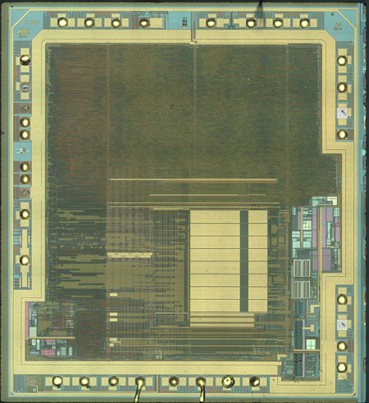
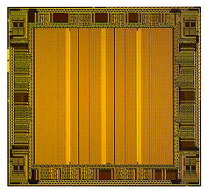
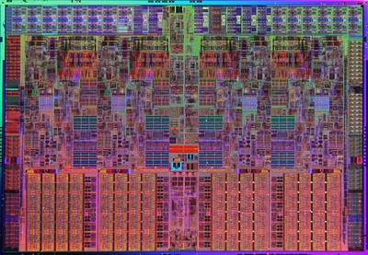
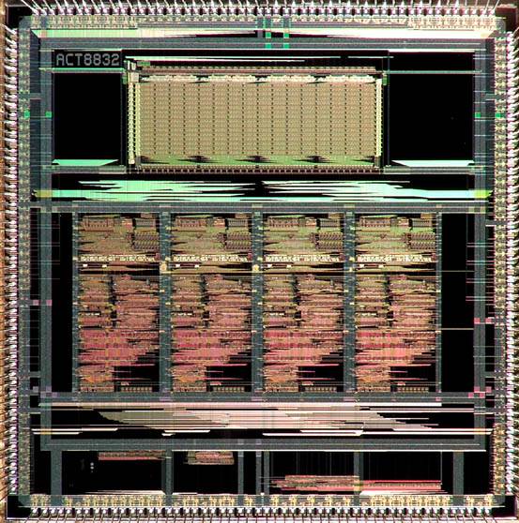
Real Time Logic
Copyright Flylogic.net
Implementation Options
Copyright sharkyextreme.com
FPGA
DSP
uP
Copyright Altera Corp
uC
Copyright William Blair
Granularity

Slide 27
Microprocessors
In order to get the best possible performance, microprocessors may make extensive use of features like
Branch Prediction
Caching
Frequency Scaling
Pipelining
All of these, and more, will effect the real time response of the processor.
If there’s only one ‘thread’ of execution then many of the following effects are greatly reduced. We will define a thread of execution simply as a piece of code executed asynchronously with respect to another. In this way, threads include interrupt and exception handlers so single-threaded execution is actually very rare, even on the smallest of processors.

Slide 28
Microprocessors
In order to get the best possible performance, microprocessors may make extensive use of features like
Branch Prediction
Caching
Frequency Scaling
Pipelining
All of these, and more, will effect the real time response of the processor.
If there’s only one ‘thread’ of execution then many of the following effects are greatly reduced. We will define a thread of execution simply as a piece of code executed asynchronously with respect to another. In this way, threads include interrupt and exception handlers so single-threaded execution is actually very rare, even on the smallest of processors.
Note that a processor is a collection of logic gates only, and is inherently deterministic to known influences. The source of non-determinism in the real time response of microprocessors is the way that features couple response to unknown influences

Slide 29
Microprocessors
Pipelining
Pipelining introduces dependencies between successive instructions (which may be from different threads of execution). This is not a problem if every instruction takes the same amount of time to execute, but if one instruction stalls, then those behind it stall as well.
A stall could be due to a floating point computation (execution time dependent on the actual data value), branch misprediction, cache miss or a number of other inter-instruction dependencies.

Slide 30
Microprocessors
Branch Prediction
When ever the processor encounters an ‘if’ construct (including things like ‘stop looping if’), it attempts to guess the answer and starts executing one branch before the outcome is actually known. This speeds up the case where the processor guesses correctly, but if the processor guesses incorrectly there’s a some amount of time (and energy) spent doing the wrong thing.
Branch prediction is generally deterministic if you look hard enough, but can couple different subsystems in unexpected ways.
For example, the run time of Thread 1 can be affected by the way Thread 2 has conditioned the branch predictor.

Slide 31
Microprocessors
Caching
The processor keeps a ‘cache’ of commonly used (in practice, usually recently used) data somewhere it can get quick access.
Like the previous items, this introduces timing dependencies between seemingly unrelated pieces of code. For example, being interrupted for a short time by a thread that uses lots of data may be more harmful than being interrupted for a long time by a thread that doesn’t touch much data (and therefore many cache lines).
It’s often stated that interrupts must be fast in order to have minimal impact on other processes. More generally, they should be deterministic in their execution time. Rarely would you find an interrupt specified in terms of its data access patterns but you should!

Slide 32
Microprocessors
Frequency Scaling
The previous items could, theoretically, be perfectly modeled. If all the running tasks are deterministic then there’s no problem; the problem they present is that it becomes hard to analyze the interaction between tasks, and to decouple real time and non-RT tasks.
Frequency Scaling cannot be modeled based on knowledge of the processor and software package alone. As the name suggests, this feature changes the speed of execution based upon the physical parameters of the processor. If the processor can be clocked faster without physical damage, it is.

Slide 33
Microprocessors
Frequency Scaling
This sounds great, but couples your Real Time system’s performance to:
Fan speed
Dust
Power supply stability
Ambient Temperature
Meteorology
Time of Year
Celestial Progression
…

Slide 34
Microprocessors
Back to Determinism
So where do we stand on microprocessors versus determinism? High performance processors get that way by sacrificing plenty of things – determinism among them
In fact, modern processors are so non-deterministic, they are actually a useful source of cryptographic entropy. See for example the HAVEGE Project [1]. Note that worst-case execution time is usually still bounded, just not deterministic.
[1] http://www.irisa.fr/caps/projects/hipsor/

Slide 35
FPGAs
How do FPGAs compare to microcontrollers in terms of determinism and real time performance?
FPGAs do have an intrinsic advantage over microprocessors in terms of determinism as unrelated tasks are performed in physically separate places so there is not necessarily any conflict for resources nor coupling between unrelated pieces of code.
If your FPGA design includes some shared resource and an associated arbitration algorithm (memory, radio modem etc.) then you start introducing couplings and associated non-determinism.
These interconnections are very explicit though, and relatively easy to audit.

Slide 36
Interacting with Time
Delaying execution for a fixed amount of time is a commonly-used alternative to busy-waiting or interrupts
Intended Delay
Thread i
Time

Slide 37
Interacting with Time
But the semantics of primitive delays aren’t as one might expect. They’re precise only in their lower bound. In English, rather than “Stop the task then run again after n”, “Stop the task, then after the CPU’s idea of n, make it eligible to be run again”.
Actual Delay
Granularity Difference
Scheduled to run again
Intended Delay
Interrupts Disabled
Given the CPU
Thread i
Time

Slide 38
Interacting with Time
This difference is termed Local Drift
Actual Delay
Intended Delay
Given the CPU
Local Drift
Thread i
Time

Slide 39
Interacting with Time
What is the effect of a ‘zero’ delay?
“Stop the task, then after the CPU’s idea of 0, make it eligible to be run again”.
Actual Delay
Granularity Difference
Scheduled to run again
Intended Delay
Interrupts Disabled
Given the CPU
Thread i
?
Time

Slide 40
Interacting with Time
Returning to our description of delays, what is the effect of a ‘zero’ delay?
“Stop the task, then after the CPU’s idea of 0, make it eligible to be run again”.
Scheduled to run again
A ‘Task Yield’. A voluntary surrender of the CPU to another task (if another task wants it)
Given the CPU
Thread i
Time

Slide 41
Interacting with Time
If the thread is enabled for interrupts then it might be made runnable again sooner: “Stop the task running, then after the CPU’s idea of n, make it eligible to be run again unless someone(thing) wants its attention sooner, in which case run it at that time instead”
Intended Delay
Actual Delay
Scheduled to
run again
Thread i
Interrupt Occurs
Time

Slide 42
Interacting with Time
Naïve delay attempt in C (assumes library support).
This suffers from local drift but also cumulative delay due to the finite time taken to execute the action and to loop around.
while(1) {
do_action();
_delay_ms(Interval);
}

Slide 43
Interacting with Time
Naïve PWM attempt in C
Despite being naïve, it’s actually a very common construct in very simple single-threaded microprocessors where the possible values of local drift are very small or zero. In the general case, this may actually be physically dangerous.
while(1) {
pin_high();
_delay_ms(Interval * Duty);
pin_low();
_delay_ms(Interval * (1 – Duty));
}
Intended
Actual
Duty too high
Duty too low

Slide 44
Interacting with Time
while(1) {
start = get_time();
do_action();
_delay_ms(Interval – (get_time() – start));
}
Attempt to remove cumulative delay by timing the action in the middle and subtracting this number from the overall delay time.
Delay time calculation is not atomic. If an interrupt arrives at the wrong time (including the timer interrupt that’s probably driving the clock behind the get_time() function) then the delay can still be significantly wrong. Don’t do this unless you’ve taken separate measures to ensure the atomicity of that statement!

Slide 45
Interacting with Time
next_time = Clock + Interval;
begin loop
Do_Action;
delay until next_time;
next_time = next_time + Interval;
end loop
The only correct way to do these kinds of delays is to use absolute delay constructs, rather than the relative delays we’ve seen up until now. These will delay on average for the right time, even if the action is sporadically longer than that. Neither C nor the standard C libraries support absolute delays so the example above has been written in Ada. If you are required to do proper absolute delays in C then it is possible to write your own absolute delay in that language.

Slide 46
Interacting with Time
Constructs for specifying timing constraints are strictly part of a programming language and/or its support libraries.
Relative delays only
C, generally simple languages never designed for RT tasks. In C (POSIX), absolute delays may be constructed out of timers and signals.
Both Relative and Absolute delays
Ada, Real Time Java, most process-oriented languages
Absolute delays only
Ada Ravenscar Profile, Occam2, most languages built explicitly for real time use

Slide 47
Safety and Liveness
If a program has been written to interface with real time, the following questions can be asked:
Is the right thing going to happen (liveness)
Is the wrong thing not going to happen (safety)
The property of liveness is that of progress; if a program has to wait for an event (resource), will that event (resource) eventually come? This is a key concept when scheduling resources that have to be used by several threads (including the CPU itself) and will be revisited during discussions of operating systems.
Safety is less subtle. Simply, do all failure modes lead to something safe happening over something bad (controlled shutdown, self destruct…).

