Slide 1
Physical Interfacing
I once thought I had
for an entire year.
It turned out I was just really bored.
ENGN{4,6}521
Embedded Systems

Slide 2
Overview
Interfacing Requirements
Sampling and Domain Conversion
Temperature Sensors
Position Sensors

Slide 3
Interfacing Requirements
We have argued that Embedded Systems are physical instantiations of embodied phenomena. In short: Embedded Systems can’t be defined outside of their interactions with their environment.
Given that, the Embedded System certainly must be able to sense environmental state around them.

Slide 4
Interfacing Requirements
Remember, the environment includes the user and other connected systems – one particular set of hardware may not have any explicit sensors*, but it still will sense and interact with its environment.
We assert that effectively interfacing with the user is very important, however we won’t look at this in any depth. This lecture will focus on the physical aspects of interfacing.
* but it might have implicit sensors. More on this later

Slide 5
Interfacing Requirements
Fundamentally, processing is performed in a digital domain however the inputs are typically analogue.
Temperature
Distance
Depth
etc.

Slide 6
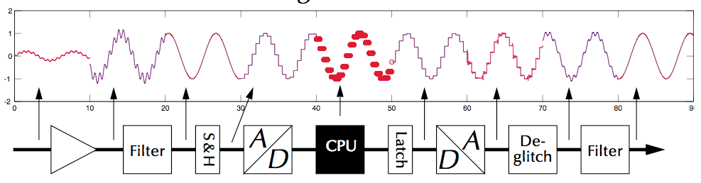
Sampling
The analogue signal chain can be summarized as
Thanks again to Dr Uwe Zimmer!

Slide 7
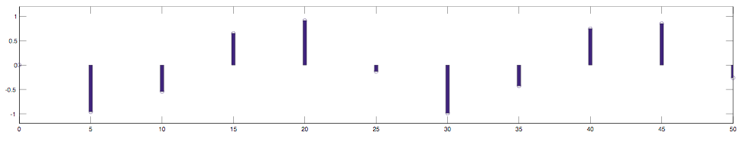
Sampling
Sampling an analog signal at 5-second intervals
Thanks again to Dr Uwe Zimmer!

Slide 8
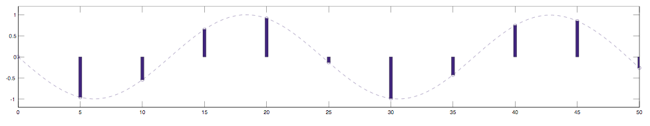
Sampling
Interpolation would suggest something like a sine wave
Thanks again to Dr Uwe Zimmer!

Slide 9
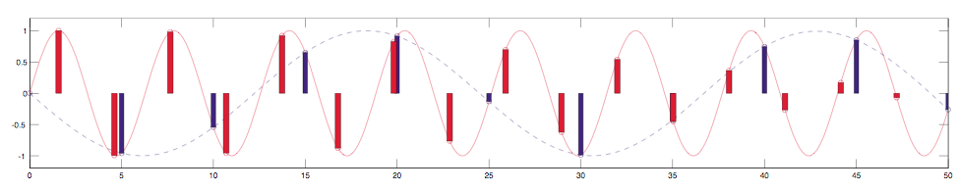
Sampling
Interpolation would suggest something like a sine wave.
But if we sample at a higher frequency, we might gain a different idea of the original signal
Thanks again to Dr Uwe Zimmer!

Slide 10
Sampling
This phenomenon is called ‘aliasing’. Sampling at a lower frequency has given us the wrong picture of the original signal
With sampling frequency F_{s} and signal Bandwidth B, Nyquist’s criterion states
f_{s} > 2B
Also sometimes called the Nyquist Limit. The sampling frequency must be at least twice the analog signal bandwidth in order that no information be lost

Slide 11
Sampling
An extreme example of the Nyquist criterion would be f_{s} = B.
That is, for example, 1 Hz Sine wave sampled once per second. In this case, the sample would occur on exactly the same point in each cycle, giving the impression of a flat line.
The 1Hz sine wave would have aliased to DC.

Slide 12
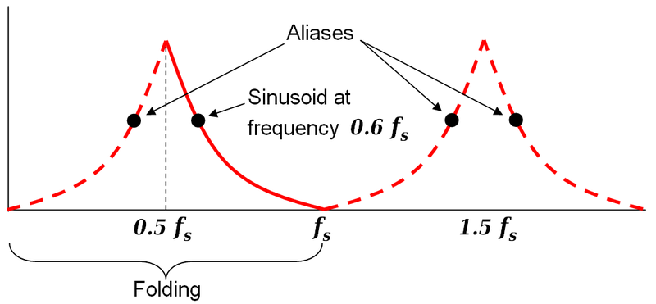
Sampling
In general, the aliased signals are folded around the sample frequency.

Slide 13
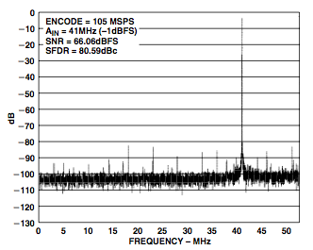
Sampling
An example from the Analog Devices AD10200 characterization:
105MSPS
f_{s} / 2 = 52.5MHz
41MHz isn’t aliased

Slide 14
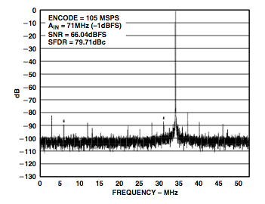
Sampling
An example from the Analog Devices AD10200 characterization:
105MSPS
f_{s} / 2 = 52.5MHz
71MHz is aliased. The alias is folded around 52.5MHz
71 – 52.5 = 18.5
52.5 – 18.5 = 34MHz

Slide 15
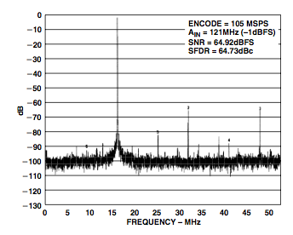
Sampling
An example from the Analog Devices AD10200 characterization:
121MHz aliases to around 16MHz. Note though that in this case, higher order harmonics of the 16MHz aliased signal are within bandwidth. Note the extra peaks at 32MHz, 48MHz.

Slide 16
Sampling
A sampled signal is quantized.
Quantization is a noise source! It’s a non-linear and signal dependent noise source. For a sine wave input, the signal to noise ratio due to quantization is given by:
N is the number of bits
I won’t bother to derive this, check Wikipedia

Slide 17
Sampling
If you put in the actual SNR and rearrange for N, we get the effective number of bits (ENOB).

Slide 18
Sampling
This represents the fact that a high resolution converter is only more useful than a low resolution one if the noise is sufficiently low that the extra bits contain actual information.
This may seem intuitive, however it’s quite common for manufacturers to claim an ADC has performance figures like “4MSPS 12 bit” but if you read closely, not at the same time. For example, at 4MSPS the ENOB might be lower, the ENOB might only be 12 bits at lower frequencies.

Slide 19
Sampling
Ideally the digital output would vary linearly with the input voltage, however actual parts aren’t ideal!
There are two typical types of non-linearity for converters:
Differential Non-Linearity (DNL)
Integral Non-Linearity (INL)

Slide 20
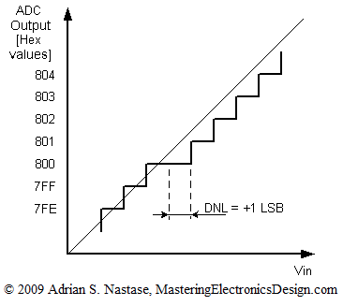
Sampling
DNL describes an error between successive codes. A DNL less than 1 means there are no missed or repeated codes.

Slide 21
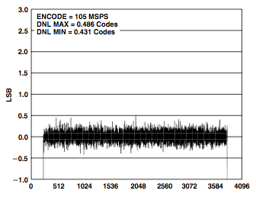
Sampling
A typical high-end ADC has a DNL less than about 0.5

Slide 22
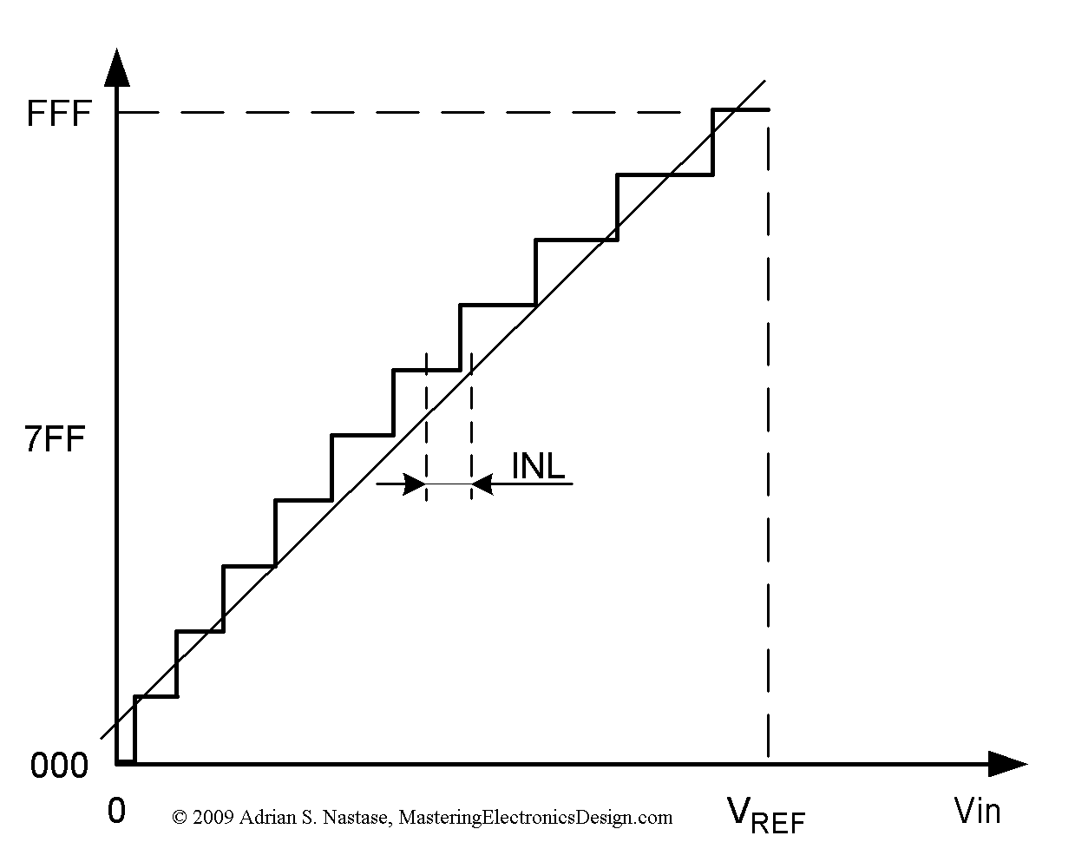
Sampling
INL describes the deviation between the middle of a code and the voltage that code represents

Slide 23
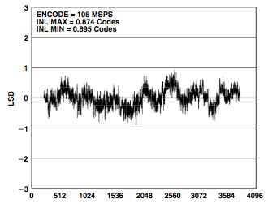
Sampling
An INL always less than 1 means that no input voltage in the middle of a code can trigger an adjacent code.

Slide 24
Converters
There are different types of ADC, each of which make a trade off between
Complexity/Cost
Accuracy
Throughput
Latency

Slide 25
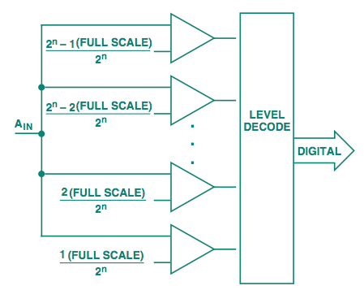
Converters
Flash Converter
Has 2^{N}-1 individual comparators connected directly to decode logic.
Can convert in 1 clock cycle > fast
a 16-bit converter would require 65535 individual comparators > expensive

Slide 26
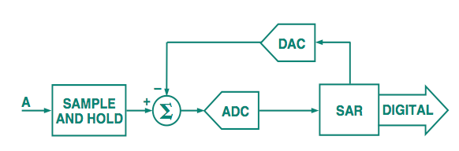
Converters
Successive Approximation
Has one comparator connected to an approximation of the input signal, derived from the previous stages
Can convert in 1 clock cycle per bit > slow
Same circuitry regardless of the number of bits > cheap

Slide 27
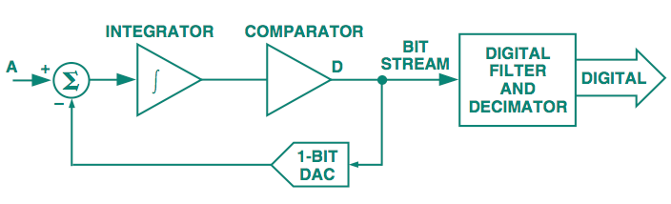
Converters
Sigma-Delta
Has a 1-bit DAC whose output is based on whether the output of an integrator is greater or less than the input signal.
The density of the 1’s in the bit stream represents the analogue signal

Slide 28
Physical Interfacing
Sigma-Delta ADCs have the apparent advantage that they don’t require a formal communications bus to interface to a microcontroller, the micro can dedicate a single input pin to the signal, sample it regularly and deduce the applied voltage by the ratio of high samples to low samples:
loop_for_1_sample {
if (input_pin)
hcount++;
else
lcount++;
}
v = hcount / (hcount + lcount)

Slide 29
Physical Interfacing
This method doesn’t work because of branch delays.
The following two snippets of code should produce the same result, but they don’t: The ‘if’ and ‘else’ branches don’t take the same amount of time to run!
loop_for_1_sample {
if (input_pin)
hcount++;
else
lcount++;
}
v = hcount / (hcount + lcount)
loop_for_1_sample {
if (!input_pin)
lcount++;
else
hcount++;
}
v = hcount / (hcount + lcount)

Slide 30
Temperature Sensors
Every sensor is a temperature sensor, some are just better than others.
Almost all electronic elements are affected by temperature, sometimes this is a good thing, sometimes an effect that needs to be overcome.

Slide 31
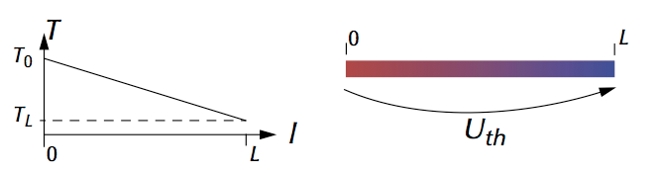
Temperature Sensors
Thermocouples
Thermocouples are a type of temperature sensor based on the Seebeck Effect. Metals in a temperature gradient build up an electric field.

Slide 32
Temperature Sensors
Thermocouples
By using two metals with different Seebeck coefficients, a voltage difference can be measured. This voltage is proportional to the difference in temperatures and difference in Seebeck coefficients
V
T₂
T₁

Slide 33
Temperature Sensors
Thermocouples
If T₁ and the Seebeck coefficients are all known, you can solve for the remote temperature.
V
T₂
T₁

Slide 34
Temperature Sensors
Thermocouples
There are many different types of thermocouples with different properties.
Good for high temperatures, but very small generated voltages
Short Name | Metals | T_{max} | Max V
T | Cu-Constantan | 400ºC | 21.000 mV
J | Fe-Constantan | 700ºC | 39.729 mV
K | NiCr-Ni | 1000ºC | 41.310 mV
S | PtRh-Pt | 1300ºC | 13.138 mV

Slide 35
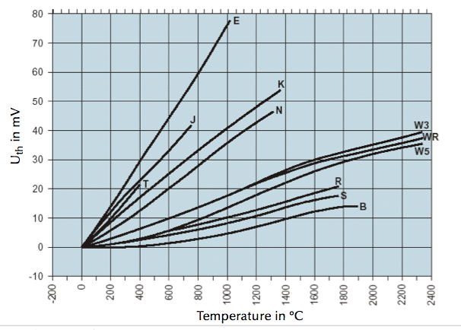
Temperature Sensors
Thermocouples
Also, not too linear

Slide 36
Temperature Sensors
Thermocouples
Cheap
High Temperature
Require precision sensing circuitry
Need to know the temperature of one end already

Slide 37
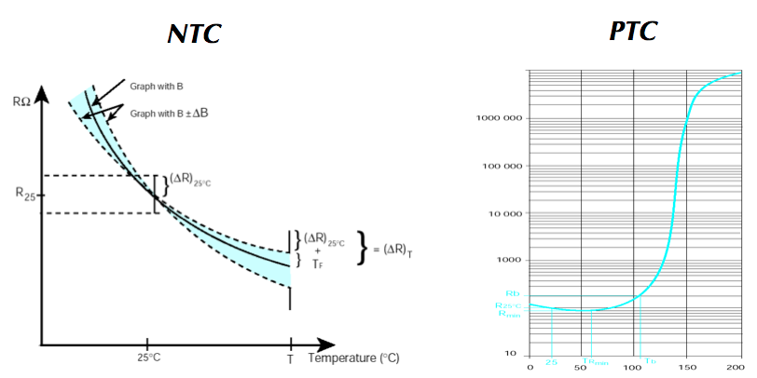
Temperature Sensors
Thermistors
Source: AVX

Slide 38
Temperature Sensors
Thermistors
Negative Temperature Coefficient parts reduce resistance with temperature.
Work fairly well around room temperature but have increasing error outside that band

Slide 39
Temperature Sensors
Thermistors
Positive Temperature Coefficient parts increase resistance with temperature.
Very non-linear and don’t work well around common temperatures

Slide 40
Temperature Sensors
Thermistors
Thermistors fundamentally provide some resistance as a function of temperature.
In order to measure the resistance, current has to be passed through. Current passing through a resistor dissipates power, which generates heat, which changes your reading.
This phenomenon is called ‘self heating’ and isn’t restricted to thermistors

Slide 41
Temperature Sensors
Semiconductor Sensors
Different semiconductor structures exhibit either negative or positive temperature coefficient behaviour over a number of parameters. For example, the IRF9620S MOSFET from Vishay has at least five different parameters that change with temperature!

Slide 42
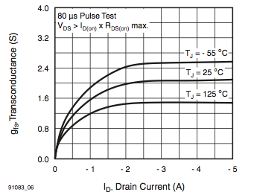
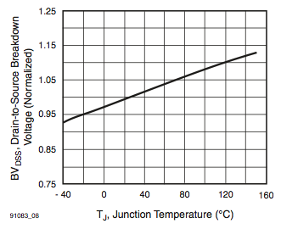
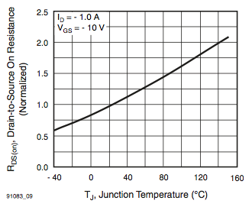
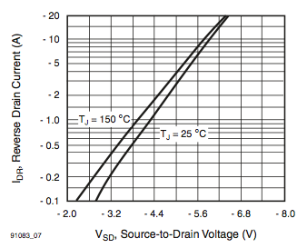
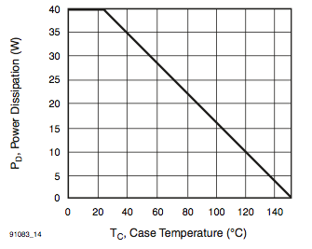
Temperature Sensors
Semiconductor Sensors

Slide 43
Temperature Sensors
Semiconductor Sensors
Semiconductor sensors use these effects to provide a temperature reading. Other semiconductors actively try to minimise the effect of temperature on their operation.
Remember: Everything’s a temperature sensor, some are just better than others!

Slide 44
Position Sensors
GPS is a very important sensing technology in modern technology.
GPS is the specific term for the American Global Navigation Satellite System (GNSS). Other countries are building their own GNSS so they don’t have to rely on America.

Slide 45
Position Sensors
Global GNSS Systems:
GPS (America)
Galileo (Europe)
GLONASS (Russia)
COMPAS (China)

Slide 46
Position Sensors
GNSS systems are composed of three parts:
Satellites (Space Vehicles)
Receiver
Ground Station

Slide 47
Position Sensors
The satellites and base station contain high accuracy atomic clocks. Each time the satellites come in to range of the base station, their clocks are synchronized, keeping all satellites’ idea of time within 1ns of each other.
Receivers pick up the signals from each GPS which contains a time stamp. By comparing the time stamps in each GPS packet, the receiver can calculate how long each signal took to arrive and therefore how far away each satellite is.
This is called trilateration

Slide 48
Position Sensors
R2
R1
Possible locations

Slide 49
Position Sensors
R2
Possible locations
R1

Slide 50
Position Sensors
GNSS systems require readings from four satellites to locate in four dimensions: X Y Z T (or Lat/Long/Alt/Time)
This number of readings will not solve the system to a single point (in general), but it will reduce to a small number of solutions. The correct one can be chosen based upon one extra piece of information: The receiver is generally pretty close to the Earth.

Slide 51
Position Sensors
The satellites transmit three different things in the same signal: Code, Carrier, Data.
The carrier wave is the underlying RF signal. There are actually two carrier frequencies, L1 and L2. The L2 signal is encrypted for US military use only; civilians can only access L1.

Slide 52
Position Sensors
The satellites transmit three different things in the same signal: Code, Carrier, Data.
The code is a pseudo-random sequence modulated on to the carrier wave. The code signal won’t repeat for millions of kilometers so determining the code phase gives the primary measure of distance to the satellite.

Slide 53
Position Sensors
The satellites transmit three different things in the same signal: Code, Carrier, Data.
The data is modulated on to the code signal by flipping the code phase by 180 degrees. This is a low-rate data channel that allows the satellites to broadcast information to the receivers (apart from the normal ranging signal). This data typically contains information such as the satellite ephemeris data - where the satellites are expected to be in the future.

Slide 54
Position Sensors
Sources of Error in GNSS
Clock Errors.
The 1 ns synchronization of the satellites equates to around 30cm of error in each reading.
General Relativity also makes a big difference. The satellites move in lower gravity than the receivers and they also move very fast. The combination of these two effects adds up to around 38 microseconds per day

Slide 55
Position Sensors
Sources of Error in GNSS
Clock Errors.
We have asserted that the time at the receiver is solved for along with position – why wouldn’t the receiver just track time itself? Typical quartz clocks drift around 100ns every second. At any given time, assume the receivers are 1ms wrong, the position will be 300km off!

Slide 56
Position Sensors
Sources of Error in GNSS
Satellite Orbit Errors
The solution of the satellite equations gives the distance to each satellite. In order to solve for actual position, the satellite locations must be known to great accuracy. In practice, the satellites are moving at around 14,000km/h but their position is still known within a few meters.

Slide 57
Position Sensors
Sources of Error in GNSS
Ionospheric Errors
These are the major sources of error in receivers. The signals from the satellites are distorted by their passage through the atmosphere. Ionospheric effects typically cause errors of 10 or more meters.
Actual Signal
Ideal Signal

Slide 58
Position Sensors
Sources of Error in GNSS
Multipath Effects
The signal from the satellite may not reach the receiver by the shortest path. The extra length of the reflected signal will cause an error in the result.
Actual Signal
Ideal Signal

Slide 59
Position Sensors
Solutions to GNSS Problems
The major sources of error in the GNSS system are common to all receivers in a small area. Multiple co-located receivers will all have the same errors due to ionospheric effects, satellite orbital errors, satellite clock errors and the like.

Slide 60
Position Sensors
Solutions to GNSS Problems
If one of those receivers has a precisely surveyed position, it can calculate the error due to these effects and communicate it to those receivers around it. The mobile receivers can subtract the known error and improve their position. This is known as Differential GPS (DGPS) and generally gives sub-meter accuracy depending on the distance between the surveyed and mobile receivers.

Slide 61
Position Sensors
Solutions to GNSS Problems
A simpler incarnation of DGPS is one where the correction signal is not relayed to the mobile receiver, but stored at the base. The paths generated from the mobile receiver can then be ‘fixed’ after the fact.

Slide 62
Position Sensors
Solutions to GNSS Problems
Going the other direction, these corrections can be transmitted back up to an augmentation satellite which in turns transmits them back to regular receivers through normal GPS signals.

Slide 63
Position Sensors
Solutions to GNSS Problems
The satellite augmentation system (SAS) is not available all over the world - Australia isn’t covered. Even in the areas that are covered, the SAS may degrade signal quality as there aren’t any guarantees as to how far away from the receiver the error signals were calculated.

Slide 64
Position Sensors
Solutions to GNSS Problems
Once a DGPS system has isolated the location to within a meter, the system location may be well enough known that the carrier phase information can be used to refine position further.
This is known as Real-Time Kinematic correction (RTK).

Slide 65
Position Sensors
Solutions to GNSS Problems
Once a DGPS system has isolated the location to within a meter, the system location may be well enough known that the carrier phase information can be used to refine position further.
This is known as Real-Time Kinematic correction (RTK).

Slide 66
Position Sensors
Solutions to GNSS Problems
The GPS system has two carrier frequencies, L1 and L2, with L2 for US Military use only. Receivers that happen to have access to L2 can get much more accurate readings without DGPS or RTK.
The single largest cause of errors are the ionospheric distortions. These distortions influence different frequencies in different ways, so by receiving the same information on two bands, the military receivers can largely remove the distortions themselves.

Slide 67
Position Sensors
Other uses of GNSS
The main reason that a GPS unit takes a while to get a ‘fix’ is that the receiver must download all the ephemeris data through the satellite data channel. This may take several minutes.
AGPS, assisted GPS, uses an external data channel (though, for example, 3G) to download this ephemeris data and skip straight to the calculation of distances.

Slide 68
Position Sensors
Other uses of GNSS
The last several slides worth of discussion have centered around using GNSS to calculate position.
In fact, GNSS is much better at giving velocities than positions. Positions require distances, ephemeris and so on. Velocities can be determined directly by monitoring the Doppler shift of the carrier signal from the satellites.

Slide 69
Position Sensors
Other uses of GNSS
Multipath signals can actually be very useful. At the same time each day, a particular satellite will come across exactly the same patch of sky. By monitoring the time of arrival of the multipath reflection each day, the position of the wall causing the reflection can be monitored.

Slide 70
Position Sensors
Other uses of GNSS
This method can be used to monitor the deformation of dam walls to to millimeter accuracy

