Slide 1
Communications and Memories
Here's a tip - aluminum foil makes a lovely hat,
and it blocks out the government's
Keep you guys outta trouble.
ENGN{4,6}521
Embedded Systems

Slide 2
Overview
Communication Stack
SPI, I2C
USB
RAM, ROM, Flash

Slide 3
Communication Stack
OSI Model
Application Software Layer
Application Layer
Presentation Layer
Session Layer
System Software Layer
Transport Layer
Network Layer
Data-Link Layer
Hardware Layer
Physical Layer

Slide 4
Communication Stack
Application Layer
The application layer is the uppermost in the stack. Conceptually this means that it shouldn’t carry data on behalf of another protocol.
Application layer protocols are things like HTTP, NTP etc. They are ‘final products’.
Of course, some application protocols have been subverted to carry other protocols; for example, web applications use HTTP to carry data associated with other protocols e.g. JSON which is in fact a presentation layer protocol itself.

Slide 5
Communication Stack
Presentation Layer
This ensures that both ends of the protocol agree on data formats, that is, the data is ‘presented’ in the same way.
This layer is rarely implemented separately from the application layer, as the presentation of data is dependent on the data itself which in turn is heavily dependent on what the application’s actually trying to say.

Slide 6
Communication Stack
Session Layer
Responsible for controlling ‘conversations’ between each end. This synchronizes the applications at each end and ensures that the data that’s transferred doesn’t fall on deaf ears.
Most of the functionality of TCP counts as a session layer.

Slide 7
Communication Stack
Transport Layer
Relied on for end-to-end transmission, error correction, reliable transmission.
The rest of TCP fits in here, ensuring that packets that leave one end actually arrive at the other, retransmitting as necessary.

Slide 8
Communication Stack
Network Layer
Logical Addressing. Allows applications to request connections to particular logical locations like IP addresses.
There isn’t much that seems logical about IP addresses, but in fact they’re hierarchical identifiers that originally could location particular machines in particular labs, companies, countries etc. As the number of computers wanting IP addresses outstripped the number actually available, this model was broken and the IP address is now pretty arbitrary.

Slide 9
Communication Stack
Data Link Layer
Physical Addressing. Logical addresses are associated with an entity like “the server for web page X”, physical addresses are associated with particular interfaces on particular machines.
In common computer networks, the physical address is the ‘MAC’ address.

Slide 10
Communication Stack
Physical Layer
Responsible for actually twiddling electrical/light/radio states.
Generally also able to detect connection to a network, collision between data sent from the local device to the interface medium.

Slide 11
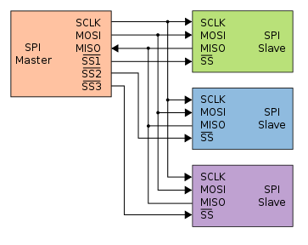
Communication Stack
Serial Peripheral Interface: SPI
One master, many slaves.
One ‘slave select’ line per slave (or ‘chip select’)
Full-duplex, synchronous protocol.

Slide 12
Communication Stack
Serial Peripheral Interface: SPI
Very commonly used for simple peripherals in Embedded Systems such as
Serial memories
Sensors
Interface devices
etc.
Can be run at several MHz if required, so useful for high rate ADCs and memories.

Slide 13
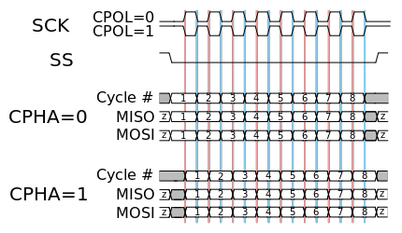
Communication Stack
Serial Peripheral Interface: SPI
SPI defines the Physical Layer only, the data transmitted on the bus is not at all defined by the standard.
The clock edge at which data is sampled is not defined by SPI so care must be taken to ensure compatibility between devices on the bus.

Slide 14
Communication Stack
Inter-IC Communications: I2C
More tightly standardized than SPI, it defines the required clock rate, a multi-master arbitration protocol and even the type of data to be transferred.
I2C was trademarked by Phillips, but rather than jump through licensing hoops, many manufacturers chose instead to implement exactly the same protocol but call it something different. A common alternative name to the same bus is ‘TWI’, the two-wire interface.

Slide 15
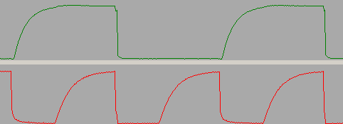
Communication Stack
Inter-IC Communications: I2C
I2C has two wires, a clock and a data line. As such, it is half duplex.
Both lines are ‘Open Drain’, which means that they are driven low but never driven high, instead, pull-up resistors must be fitted to the bus. This means that whenever nothing is explicitly pulling the lines low, the bus idles high.

Slide 16
Communication Stack
Inter-IC Communications: I2C
The open drain design means that when ever a device expects the bus to be high, it must check this fact. If the bus isn’t in the expected state, this means that another device is driving the bus at the same time.
Either this is another bus master fighting for the bus, or an expected slave acknowledgement.

Slide 17
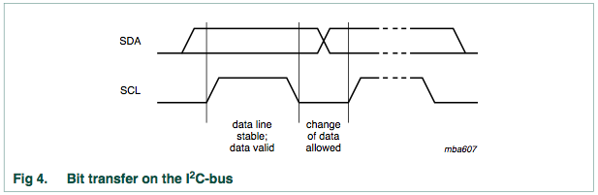
Communication Stack
Inter-IC Communications: I2C
In addition to the actual data, there is a start condition, stop condition and an acknowledge slot. The data must be valid when ever the clock is high
ref I2C specification

Slide 18
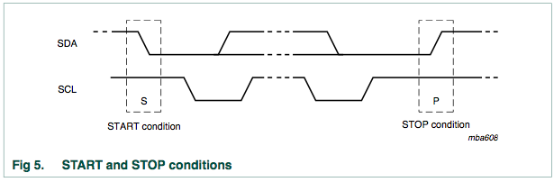
Communication Stack
Inter-IC Communications: I2C
If the data changes while the clock is high, it is interpreted as a control condition. Every transfer starts with SDA falling while SCK is high and ends with SDA rising while SCK is high
ref I2C specification

Slide 19
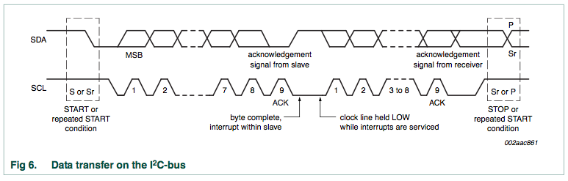
Communication Stack
Inter-IC Communications: I2C
Transfers may run for several bytes, separated by acknowledgements. The slave generates the ACKs, everything else is driven by the master.
ref I2C specification

Slide 20
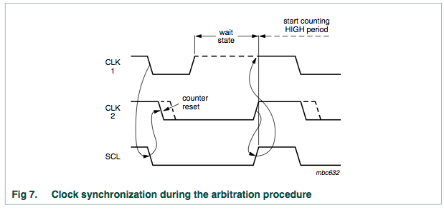
Communication Stack
Inter-IC Communications: I2C
The slave can also indicate to the master that it needs more time to complete a process. The slave can force the clock line to stay low while the master expects it to be high. This is called ‘clock stretching’
ref I2C specification

Slide 21
Communication Stack
Inter-IC Communications: I2C
I2C defines the addressing on the bus as well, though it doesn’t differentiate between physical and logical addresses. The address of a slave is often programmed in to that device at the factory.
The first byte after the start condition contains a slave address and a bit indicating whether the master wishes to read or write data.

Slide 22
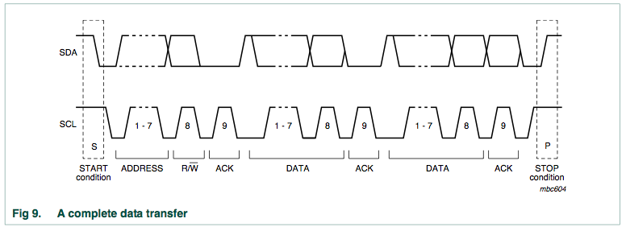
Communication Stack
Inter-IC Communications: I2C
ref I2C specification

Slide 23
Communication Stack
Inter-IC Communications: I2C
Many other protocols are built in top of I2C.
PMBus: Power Management Bus is specified to carry messages regarding voltages, currents, power transfers and the like
SMBus: The System Management bus is commonly found on computer motherboards, communicates simple messages such as ON/OFF
DDC: Display Data Channel lives inside VGA, DVI and HDMI connectors and allows the video card to query display parameters such as resolution, supported colour depth and the like.

Slide 24
Communication Stack
Inter-IC Communications: I2C
I2C is also used in parallel with data channels.
Camera modules commonly use I2C for configuration and a parallel colour bus for the picture information
LCD screens often use I2C (or SPI) for configuration and a parallel colour bus for the picture information
Audio CODECs use I2C for configuration and I2S for data transfer (you should know that from labs!)
Standard computer memory modules use I2C for presence, capacity and error correction information while the parallel memory bus carries the read and write operations.

Slide 25
Communication Stack
Inter-IC Communications: I2C
I2C is also used in parallel with data channels.
Camera modules commonly use I2C for configuration and a parallel colour bus for the picture information
LCD screens often use I2C (or SPI) for configuration and a parallel colour bus for the picture information
Audio CODECs use I2C for configuration and I2S for data transfer (you should know that from labs!)
Standard computer memory modules use I2C for presence, capacity and error correction information while the parallel memory bus carries the read and write operations.

Slide 26
Communication Stack
Universal Serial Bus: USB
USB is by far the most commonly used interface for computer peripherals and devices, although its use in Embedded Systems is somewhat limited.
USB is fairly complex to implement and, though the spec allows for guaranteed bandwidth or latency allocations, few devices take advantage of this.

Slide 27
Communication Stack
Universal Serial Bus: USB
Everyone is familiar with the architecture of USB, with devices connected through hubs in a tree structure. Inside each physical device there are a number of logical ‘endpoints’. Endpoints in each device are logically connected by ‘pipes’.
There’s always a pipe between Endpoint 0 at each end, referred to as the Control Pipe. This carries set up information at start up, including information about how the other endpoints are to be wired up.

Slide 28
Communication Stack
Universal Serial Bus: USB
Pipes between endpoints can either by message pipes, like the control pipe, or stream pipes. Stream pipes are used for most data transfers.
Stream pipes in turn are divided in to three classes: Interrupt, Isochronous and Bulk. Stream pipes are unidirectional.

Slide 29
Communication Stack
Universal Serial Bus: USB
Interrupt transfers can provide bounded latency assuming a complete knowledge of the devices on the bus and that all other devices are well-behaved.
Interrupt transfers are necessarily small amounts of data that must be delivered, such as information from USB mice and keyboards.

Slide 30
Communication Stack
Universal Serial Bus: USB
Isochronous transfers can tolerate data loss more than they can tolerate latency. USB speakers, webcams and the like use Isochronous transfers.
Isochronous transfers have a guaranteed rate (which is generally, but not always, as fast as possible).

Slide 31
Communication Stack
Universal Serial Bus: USB
Bulk transfers take up the ‘rest’. Any bandwidth that isn’t reserved for the other two classes is allocated to bulk transfers.
This is designed to be used by things like USB storage devices, but in practice many devices that should use other types end up using bulk transfers anyway.

Slide 32
Communication Stack
Universal Serial Bus: USB
A common USB peripheral in Embedded Systems are “USB to Serial Converters”. These replace the standard serial ports that were present on most older computers with USB versions. This same concept is extended to “USB to I2C Converters”, “USB to SPI” etc.
These parts all use Bulk transfers and therefore have neither guaranteed latency or bandwidth. This means that an Embedded System using such a converter for communications can’t make any real time guarantees about delivery.
In practice, the simple act of plugging in a mouse can ruin your communications channel.

Slide 33
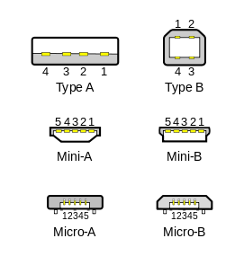
Communication Stack
Universal Serial Bus: USB
Unlike the other busses here, USB also specifies the connectors to be used

Slide 34
Communication Stack
Universal Serial Bus: USB
USB also specifies an amount of power that must be available to a down-stream device through the connector.
A device must draw no more than 500mA from a USB 1.x or 2.0 port or 900mA from a USB 3.0 port, all at 5 volts.
This simple requirement has meant that USB is specified as more than a communications bus, many devices use it just for power!

Slide 35
Memories
There are many different ways to categorize memories:
Volatile or Non-Volatile
Interface type (parallel, serial, differential)
Writable or read-only

Slide 36
Memories
There are many different ways to categorize memories:
Memory | Interface | Volatility | Read Only
SRAM | Parallel | Yes | No
DRAM | Parallel | Super | No
EPROM | Parallel/Serial | No | Yes
EEPROM | Parallel/Serial | No | No
FLASH | Parallel/Serial | No | No
FRAM | Parallel/Serial | No | No

Slide 37
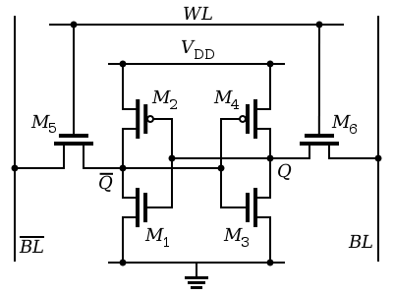
Memories
Static Random Access Memory: SRAM
The simplest type of volatile memory. It takes at least six transistors per bit which is quite a few compared to DRAMs. Consequently SRAMs are typically lower capacity than DRAMs, usually no more than 32- or 64-Mbit (4-8MB).

Slide 38
Memories
Static Random Access Memory: SRAM
The simplest type of volatile memory. It takes at least six transistors per bit which is quite a few compared to DRAMs. Consequently SRAMs are typically lower capacity than DRAMs, usually no more than 32- or 64-Mbit (4-8MB).
Word Line
Access Transistors
Bit Lines
Storage Transistors

Slide 39
Memories
Dynamic Random Access Memory: DRAM
Stores the bit values in capacitors inside the IC rather than in the states of cross-coupled inverters. This takes fewer transistors, but capacitors self-discharge so the data inside has to be regularly refreshed.
This is the ‘dynamic’ in DRAM.
This makes DRAM more power hungry than SRAM in general, as energy is constantly being poured in to capacitors and wasted through their self-discharge.

Slide 40
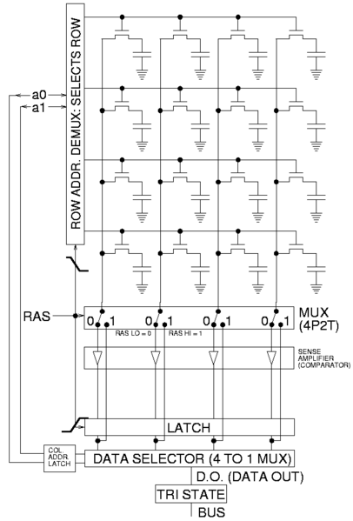
Memories
Dynamic Random Access Memory: DRAM
DRAMs are formed as matrices internally and this is reflected through the external drive scheme.
DRAM requires that both a row and column address be latched in, rather than having a single wide address bus.
This also means that fewer address lines need to be routed between RAM and processor for the same capacity.

Slide 41
Memories
Programmable Read Only Memory (PROM)
Programmable Read Only Memory is made of a number of fuses or antifuses which are blown during programming.
The ‘blank’ state of most PROMs is logical ‘1’, not ‘0’, therefore blank bytes are 0xFF in hexadecimal.
It isn’t possible to ‘unblow’ fuses, so zeros can’t be written back to ones, but it’s generally possible to blow more fuses after the original programming. As such, during multiple program cycles, each bit becomes the logical AND of the old and new bits.

Slide 42
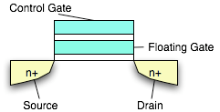
Memories
Erasable Programmable Read Only Memory (EPROM)
EPROM uses floating gates on FETs to store the bit state. In effect, the gate of the FET is turned in to a capacitor which can discharge over time leading to a finite data retention time, though it’s typically of the order of 100 years.
These are erasable by ultraviolet light as the high energy photons ionize the silicon, allowing the charge in the gate to dissipate

Slide 43
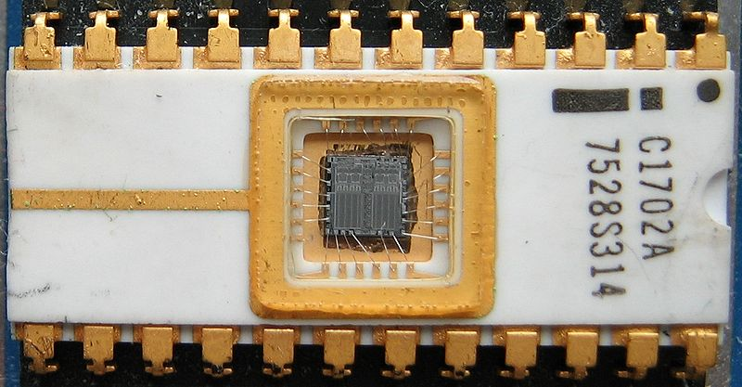
Memories
Quartz windows in the top of the device allow the UV to enter.
The whole chip is exposed at once, therefore the chip cannot be partially erased.
from Wikipedia User ‘Poil’

Slide 44
Memories
Electronically Erasable Programmable Read Only Memory (EEPROM)
Built in the same way to EPROM but with an extra silicon layer in the gate allowing the charge to be dissipated electrically. The dissipation slightly damages the silicon which limits the total number of times a bit can be written, typically to around 10,000 times.
While PROM and EPROM are rarely used, EEPROM is still used extensively for rarely-changed data, such as configuration parameters, serial numbers and the like. Many microcontrollers include some amount of EEPROM for non-volatile data storage.

Slide 45
Memories
Flash Memory
Flash Memory is a specific type of EEPROM. The difference is in the erasure process; the mechanism is outside the scope of this course, however the effect is that Flash memory may be erased as many as 100,000 or 1M times.
Flash comes in two types, NOR and NAND.

Slide 46
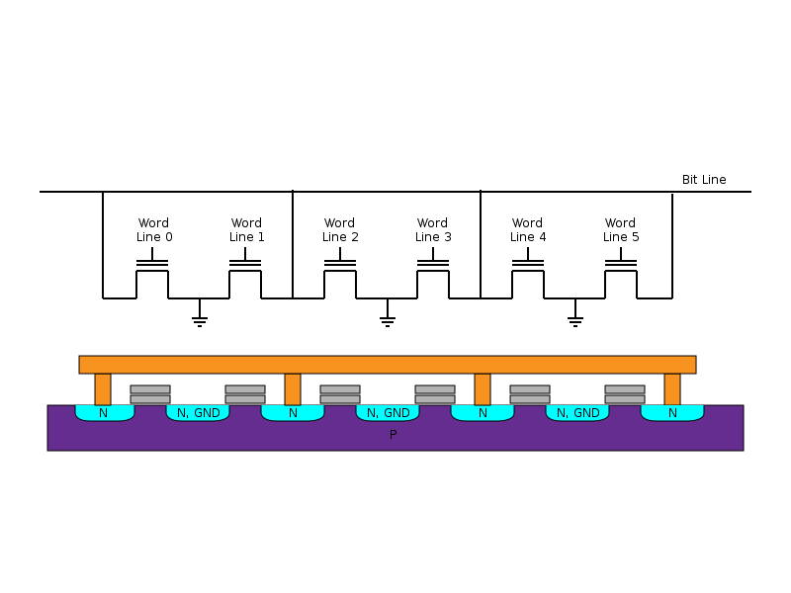
Memories
Flash Memory
NOR flash is low density but relatively high reliability. It’s simple to drive so often used for storage of bootloader or first-execute code which can’t have any drivers loaded first
from Wikipedia User ‘Cyferz’

Slide 47
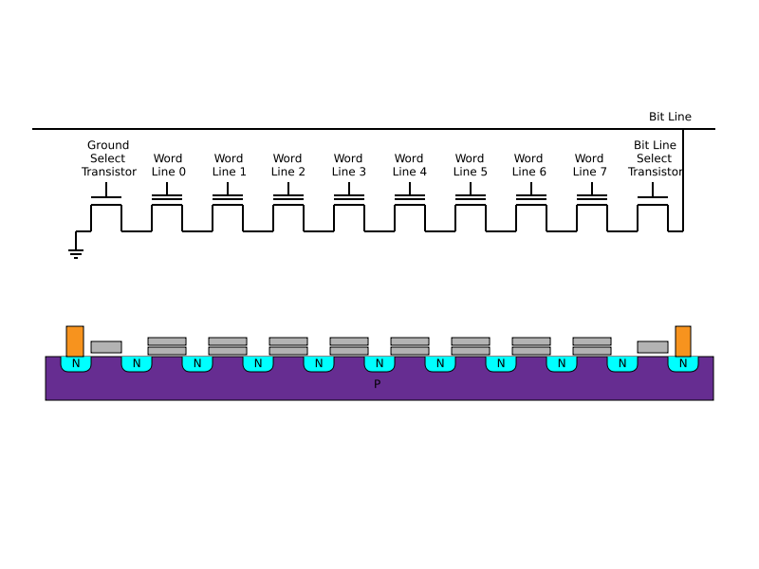
Memories
Flash Memory
NAND flash is higher density and gives a further level of addressing, down to the bit level. Error rates are higher, as a fault in any one transistor in the chain causes a failure of all
from Wikipedia User ‘Cyferz’

Slide 48
Memories
Flash Memory
Like EPROM and EEPROM, flash memory can only be programmed from a logical ‘1’ to a ‘0’. In order to set the bit the other way, the memory must be erased.
Flash memory is typically arranged in ‘erase blocks’ around 64KBit; if any bit in any byte in the block is to be erased, all must be erased.

Slide 49
Memories
Flash Memory
NOR flash can typically be accessed byte at a time.
NAND flash can theoretically be accessed bit at a time, however due to the larger capacity of NAND in general, addressing individual bits is not practical.
In fact, NAND flash may only be able to be accessed page at a time, where a page may be between 512 bytes and 8 kilobytes.

Slide 50
Memories
Flash Memory
EEPROM and Flash memories must be ‘wear leveled’. Each erasure causes damage which in turn limits the number of times each bit can be erased.
If a particular piece of data changes often, it can wear out its piece of memory very quickly. A memory driver should differentiate then between the ‘logical’ address and the ‘physical’ address. The same logical bit of data should be written to different physical locations each time so as not to stress one part of the flash unduly.

Slide 51
Memories
Flash Memory
Flash memory is used inside things like SD cards and USB memory sticks which implement wear leveling internally.
Many such devices cheat at this by assuming the device is only ever going to be formatted with the FAT filesystem. In FAT, one part of the disk is written often (the file allocation table after which the fs is named) and the rest is written occasionally.
As such, many SD cards only wear level the blocks in which the FAT is expected to live. The upshot: Formatting an SD card with anything other than FAT can reduce its lifespan by hundreds of times!

