Slide 1
Physical Integration and Power Considerations
You can't conquer
with a shoddy olive.
Hitler found that out.
ENGN{4,6}521
Embedded Systems

Slide 2
Overview
Power in Embedded Systems
Level translation
Decoupling
Manufacturability

Slide 3
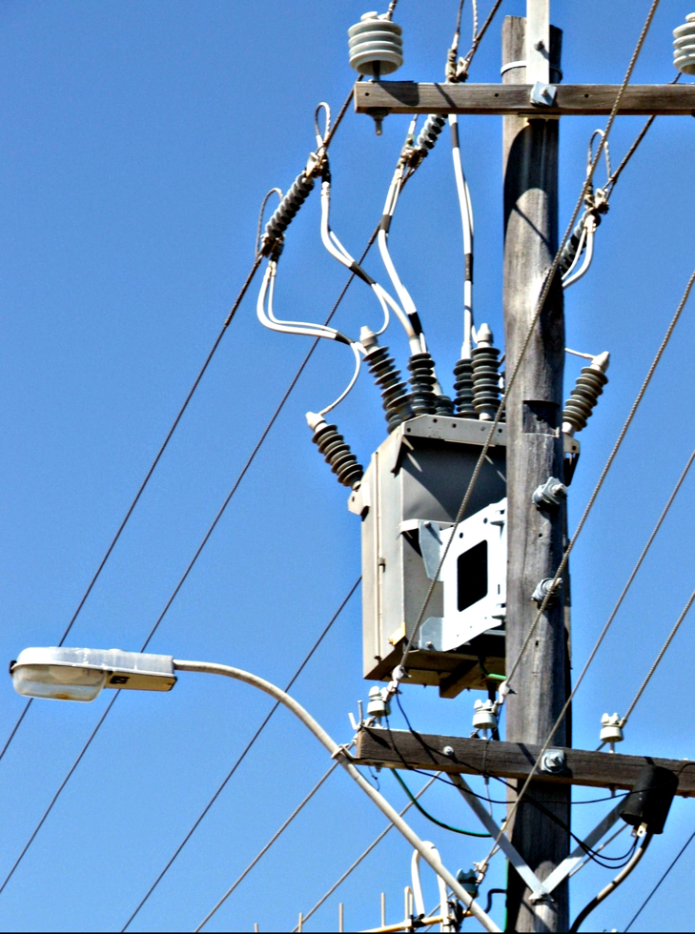
Power
There are different voltage standards used in Embedded Systems.
Power = Voltage x Current
Increasing the voltage means you need less current and therefore smaller wires, connectors and so on.
This is the reason mains power is transmitted at 100s of kV on the main lines then reduced at substations and on-pole transformers

Slide 4
Power
12 Volts
A large Embedded System will draw on the order of 12W so a 12V input will draw around 1A.
12V is rarely used itself, it’s most often regulated down to a more manageable voltage like 5V or 3.3V.
12V is significant because it’s the programming voltage of EPROM devices

Slide 5
Power
5 Volts
TTL: Transistor Transistor Level
Common voltage for older logic devices and automotive parts that have to be relatively noise-immune.

Slide 6
Power
3.3 Volts
LVTTL: Low Voltage Transistor Transistor Level
Most modern logic devices. Roughly the minimum voltage at which flash memory can be programmed.

Slide 7
Power
~1 Volt
The core voltage of most modern CPUs is kept very low in order to minimise power usage.

Slide 8
Power
Many voltages in a system brings many potential issues:
Level translation
Power rail ordering
Conversion losses

Slide 9
Power
Level Translation
5V
High
3.6V
3.2V
High
-
2.4V
-
0.8V
0.8V
Low
Low
0V
0V

Slide 10
Power
Level Translation
Unidirectional, low to high
Check your data sheet, but often a high voltage output from LVTTL will just trigger a 5V high signal
5V
High
3.6V
3.2V
High
-
2.4V
-
0.8V
0.8V
Low
Low
0V
0V

Slide 11
Power
Level Translation
Unidirectional, high to low
Very simple, use a resistive divider.
Works for slowly changing signals only, the resistors form an RC network with the stray capacitance around the board.
5V
High
3.6V
3.2V
High
-
2.4V
-
0.8V
0.8V
Low
Low
0V
0V

Slide 12
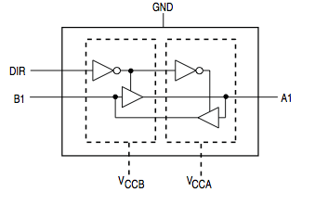
Power
Level Translation
5V
High
3.6V
3.2V
High
-
2.4V
-
0.8V
0.8V
Low
Low
0V
0V
ST1G3236

Slide 13
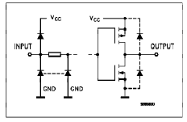
Power
Power Supply Sequencing
Digital inputs almost always have protection diodes

Slide 14
Power
Power Supply Sequencing
If an input is driven higher than the supply voltage or lower than ground, the diodes clamp the input to those voltages
> VCC

Slide 15
Power
Power Supply Sequencing
If an input is driven higher than the supply voltage or lower than ground, the diodes clamp the input to those voltages
< GND

Slide 16
Power
Power Supply Sequencing
This is a major source of ‘smoke’ in multi-voltage systems; incorrect level translation blowing up protection diodes
< GND

Slide 17
Power
Power Supply Sequencing
Even correct level translation can cause problems in multi-voltage systems. Imagine 3.3V driving a 5V input with the data sheet stating that the 5V part will work correctly in this scenario. As such, no level translation is used (or necessary).
Regulators are set up in parallel with each other so as not to overload the 5V one.
The regulators have different start-up times.

Slide 18

Power
Power Supply Sequencing
Reg 1
3.3V
Reg 2
5V
5V
5V
3.3V
0V

Slide 19
Power
Power Supply Sequencing
Reg 1
3.3V
Reg 2
5V
0V
5V
3.3V
0V

Slide 20
Power
Power Supply Sequencing
Reg 1
3.3V
Reg 2
5V
0V
5V
3.3V
0V

Slide 21
Power
Power Supply Sequencing
Reg 1
3.3V
Reg 2
5V
0V
Enable Line
5V
3.3V
0V

Slide 22
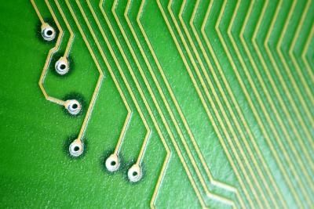
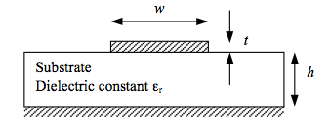

Power
Power traces run over the circuit board
Traces have a complex impedance; that is, both a resistance which dissipates power, but also an inductance and capacitance that stores power in local electric and magnetic fields.
Ref Burkhardt et. al.

Slide 23

Power
The impedance typically acts like an inductor
In words: An instant change in current would require an infinite voltage. In practice, a fast change in current causes a significant change in voltage.

Slide 24
Power
Why is this a problem?
A common source of high frequency changes of current is something like a microcontroller. At each clock edge and each change of internal operation, more or less current is drawn from the voltage bus.
The changes of current coupled to trace impedance causes the voltage rails to fluctuate. If they fluctuate enough, the microcontroller can brown out; i.e. fail.

Slide 25
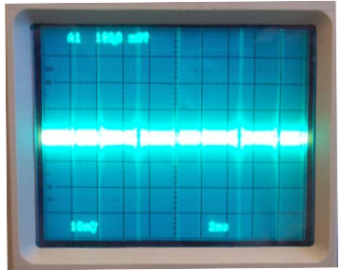
Power
Trace inductance can be cancelled out by placing a capacitor close to the device drawing the power.
The current peaks are satisfied from the capacitor reserve and don’t have to travel down the trace from the power supply.
This is called decoupling
Ref Intersil Application Note 1325

Slide 26
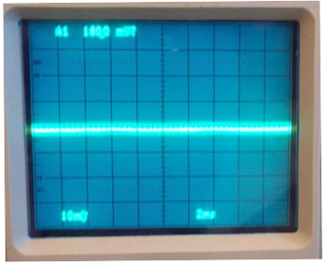
Power
Ref Intersil Application Note 1325

Slide 27
Power
The point of a decoupling capacitor is to cancel out inductance, so the cap itself shouldn’t be a source of inductance!
The physical connections to a capacitor are themselves traces and therefore have inductance. The bigger the capacitor, the bigger the inductance and the less effective the decoupling.
Effective decoupling the relies on several capacitors, effectively scaled
Ref Intersil Application Note 1325

Slide 28
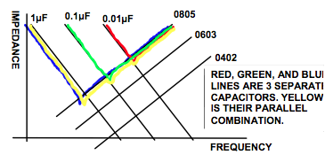
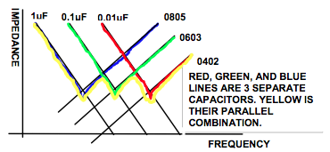
Power
Smaller capacitors also have smaller inductance in general, so have better high frequency response. Big capacitors have better low frequency response.
Multiple capacitors have the best overall response.
The decoupling must then match the frequency response of the current source.
Ref Intersil Application Note 1325

Slide 29
Power
Story time: Microcontrollers, bad decoupling and hard to debug field failures.

Slide 30
Power
Processors are a big source of current draw and especially high frequency changes in current draw. There are a number of reasons for this, but the biggest effect is quite simple: Clocked gate capacitance.
Simplified logic gate

Slide 31
Power
Processors are a big source of current draw and especially high frequency changes in current draw. There are a number of reasons for this, but the biggest effect is quite simple: Clocked gate capacitance.
Simplified logic gate
Charge

Slide 32
Power
Processors are a big source of current draw and especially high frequency changes in current draw. There are a number of reasons for this, but the biggest effect is quite simple: Clocked gate capacitance.
Simplified logic gate
Discharge

Slide 33
Power
Each clock cycle charges the gate capacitance of each gate, then discharges it again.
This makes power proportional to clock frequency, drive voltage, number of gates and gate capacitance.
Double the clock frequency, double the power!

Slide 34
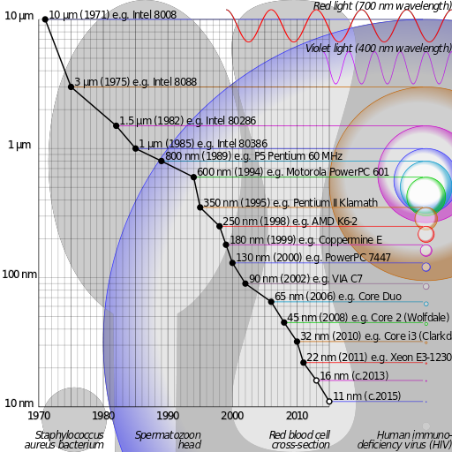
Power
Lots of things contribute to gate capacitance, but simplistically, smaller gates make smaller capacitors. This is the motivation behind the ever-shrinking CPU dies.

Slide 35
Power
The relationship between clock rate and power is often cited as a motivation to use a slower clock rate. However, while the stated relationship is true for CPUs and other clocked entities, some peripherals don’t obey such laws
Regulators
DRAM
Peripherals with a clock fixed by the interface (USB, Ethernet)
etc.

Slide 36
Power
If your system contains power loads that are fixed while the CPU is on, the best power management might actually be race-to-idle. In this scenario, everything is run as fast as possible to complete the fixed amount of work, then turned off completely.
In this case, total power consumption is dependent on the running power, the idle power and the duty cycle.

Slide 37
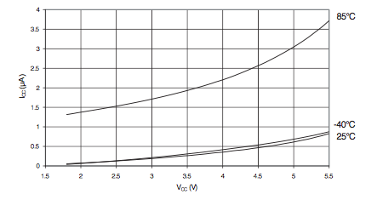
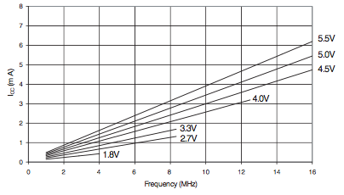
Power
Example: Atmel ATMEGA256
3.3V, 1% on time, room temperature, 8MHz, CPU only:
0.99 * 0.25uA + 0.01 * 1.5mA
~0.0152mA average current.

Slide 38
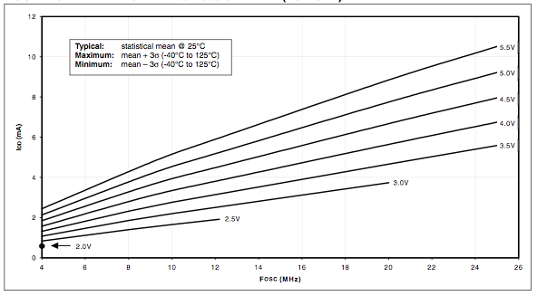
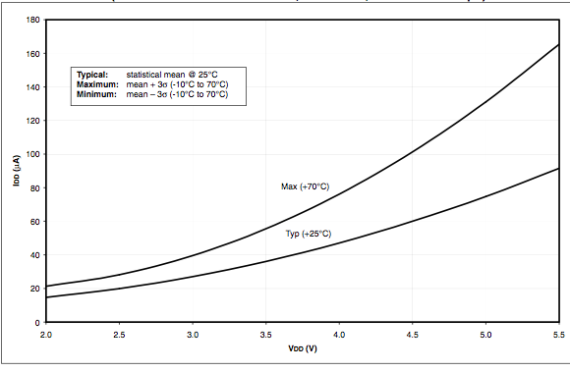
Power
Example: Microchip PIC 18FXX2
3.3V, 1% on time, room temperature, 8MHz, CPU only:
0.99 * 50uA + 0.01 * 2.5mA
~0.0745mA average current.

Slide 39
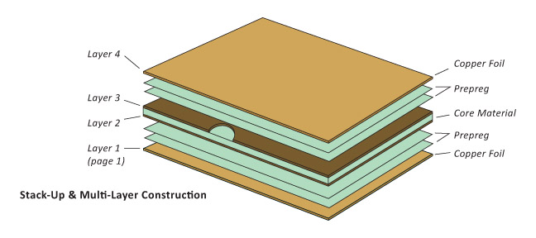
Manufacturability
An Embedded System can’t just be designed, it has to be manufactured.
This all starts with the Printed Circuit Board, PCB.
Ref www.bareboard.com

Slide 40
Manufacturability
A Core material gives the board stiffness and strength while a prepreg material holds the copper that will be etched to become the circuit traces.
Ref www.bareboard.com

Slide 41
Manufacturability
Prepreg is short for pre-impregnated material, and refers to the fact that it is usually a glass fiber matting pre-impregnated with an epoxy resin.
Ref www.bareboard.com

Slide 42
Manufacturability
The most common prepreg is FR4; “type 4 fire retardant”. This is cheap, tough and doesn’t burn (easily) but has poor RF performance and a poor coefficient of expansion. Other materials include aluminium substrates for good thermal dissipation, Teflon for good RF performance etc.
Ref www.bareboard.com

Slide 43
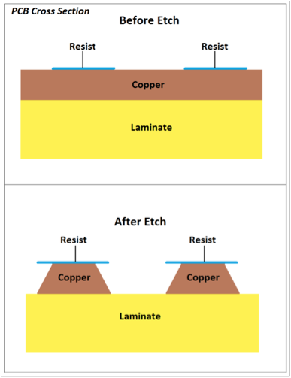
Manufacturability
Each pair of layers comes precoated with copper foil on each side. A resist material is coated on each side in the correct pattern for the traces and the board exposed to an etching chemical.
The chemical gets under the resist so the traces end up trapezoidal rather than the ideal rectangle.
Ref www.pcbunivserse.com

Slide 44
Manufacturability
This process introduces minimum track and space widths. A track that’s too thin might etch completely through and form an open circuit; a space too thin might not provide enough surface area for the etchant to work and cause a short circuit between adjacent traces.
Ref www.pcbunivserse.com

Slide 45
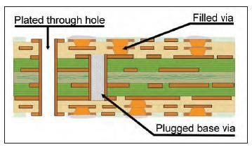
Manufacturability
Any connections between layers are made by connections called vias. Holes for the vias are drilled and the layers are glued together under pressure.
Once glued, the holes are electroplated to make the connections through.

Slide 46
Manufacturability
Vias come in different types:
Through
Blind
Buried
Microvia

Slide 47
Manufacturability
Through vias are drilled and plated through all layers. Blind vias are open on one side only, buried vias aren’t exposed on either side of the sandwich.
Microvias are done differently, with the inner layer left solid copper. A laser is used to burn the outer layers away and is stopped by the terminating copper. The resulting hole is filled with copper to form the connection

Slide 48
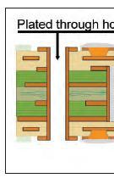
Manufacturability
The plating of a via relies on solution making it down the hole and adhering to the sides.
This places a limit on the aspect ratio of the via. The deeper or thinner the via, the harder it is for the plating material to get through and make a good connection.
h
d

Slide 49
Manufacturability
A via with an aspect ratio that’s too big will end up with less copper in the middle than desired.
This means that the via might seem to be in tact during initial testing but might ‘fuse out’ out during normal operation

Slide 50
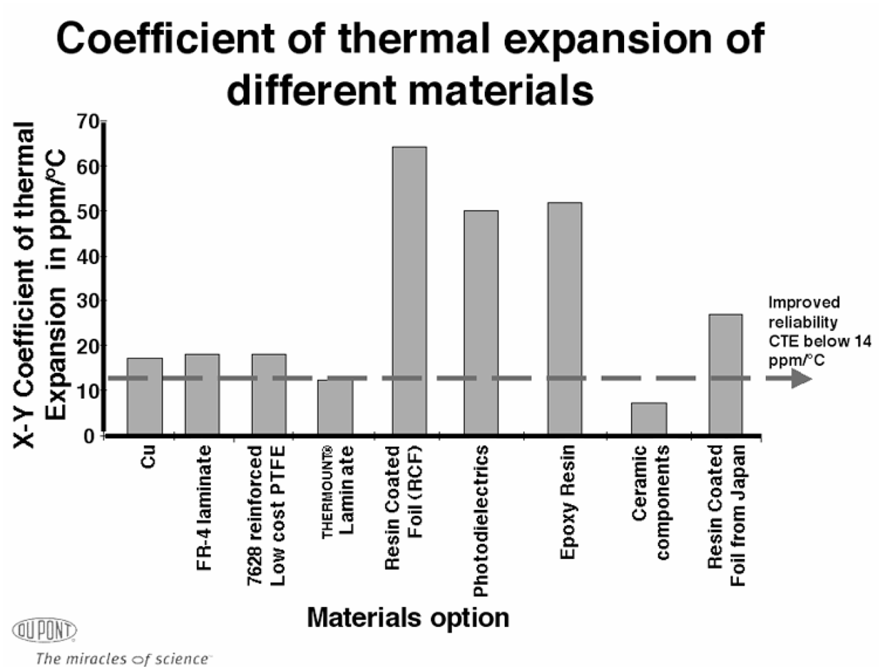
Manufacturability
All components of the system must have matched coefficient of thermal expansion. Mismatches will cause stress under different temperature conditions
ref emerald insights

Slide 51
Manufacturability
There is a slight mismatch in the CTE of Copper and FR4, but they’re pretty close. Copper is fairly ductile so doesn’t usually fracture due to thermal stress, however if it’s already brittle (e.g. in the middle of a badly-filled via), thermal cycling can break it.
A more common source of thermal failures is between ceramic IC packages and the circuit board itself.

Slide 52
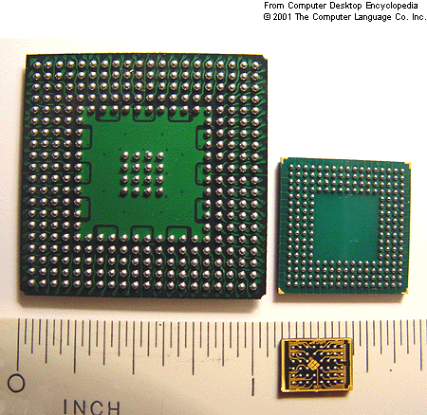
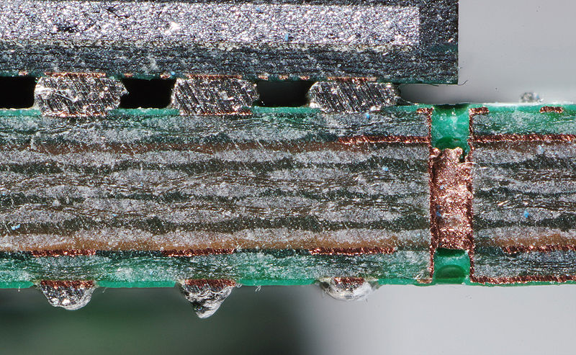
Manufacturability
A common example is large Ball Grid Array (BGA) parts. The board underneath the package can expand twice as much as the package itself, cracking the solder balls
Image credits: Rainer Knäpper,

Slide 53

Manufacturability
As Systems Engineers, all designs should consider factors such as the system lifecycle cost and environmental impact.
In the electronics industry, you’re forced to consider the environment in at least one way: The European Union Reduction of Hazardous Substances directive (RoHS).

Slide 54
Manufacturability
RoHS states that certain chemicals cannot be used in consumer electronics:
Lead (Pb)
Mercury (Hg)
Cadmium (Cd)
Hexavalent chromium (Cr⁶⁺)
Polybrominated biphenyls (PBB)
Polybrominated diphenyl ether (PBDE)

Slide 55
Manufacturability
Historically, solder has been made from Lead and Tin (SnPb).
This is not RoHS-compliant; modern solder is made from other alloys of Tin, Copper, Silver and more exotic materials.
Many electronics professionals speak of RoHS derisively as the quality of Lead-free solder is only recently approaching that of old-school SnPb. It’s generally harder to rework, doesn’t flow as smoothly, is more brittle and doesn’t look as nice.

Slide 56
Summary
Power considerations are critical to Embedded Systems.
Obvious factors such as voltage and current can have unexpected side-effects
level translation
decoupling.
Designing circuit boards requires attention to
trace impedance
actual track thicknesses including etching effects
via sizes and aspect ratios
coefficients of thermal expansion
Modern consumer electronics may not use leaded solder due to the RoHS directive.

