Slide 1
Introduction
ENGN{4,6}521
Embedded Systems

Slide 2
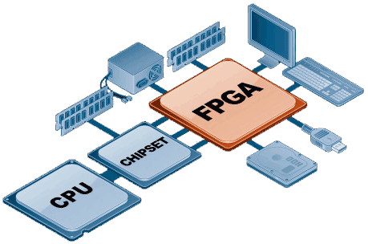
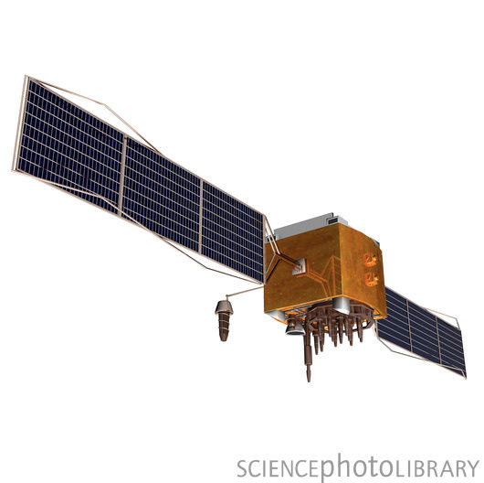
Overview
Review Microcontrollers, FPGAs and why we care
What is “Real Time”? How to recognise it and design for it
Sensors and Interfaces: Your system in the real world
Reliability, Redundancy and making sure your system doesn’t fall over (or lead to others doing the same)
Image credits: 2008 RuggedPCReview.com

Slide 3
Overview
Review Microcontrollers, FPGAs and why we care
Arm you with the tools to go and design real, useful, correct and intelligent Embedded Systems!
What is “Real Time”? How to recognise it and design for it
Sensors and Interfaces: Your system in the real world
Reliability, Redundancy and making sure your system doesn’t fall over (or lead to others doing the same)
Image credits: 2008 RuggedPCReview.com

Slide 4
Who would be interested?
Anyone who…
Is interested in electronic design and Engineering
Wants to be able to design real world electronic systems
Would like insight in to nearly every piece of technology around us

Slide 5
Who’s giving the course?
Ben Nizette
<TODO Pics>
Brad Yu

Slide 6
Course Organisation
Two hours of lectures a week
Theory, concepts and neat examples
Eight labs
Where you’ll learn the most! You’ll see that the world isn’t as neat as the lecture examples
Major Project
The point of the course is to be able to construct an Embedded System you’ll get to do just that!
Final Exam
Oral exam focusing not on numbers and memory, but on problem solving skills and insights

Slide 7
Resources
No formal text book
Each topic will be accompanied by a set of recommended readings and reference material
Lots of reading data sheets, application notes and extraction of technical nuggets from marketing goo

Slide 8
Acknowledgements
Some content inspired by, and built with reference to, Uwe Zimmer’s COMP4330 Real Time and Embedded Systems
Lab material developed with help from the Altera University Program.

Slide 9
Feedback
This is the first time the course is being run. We value your feedback!
If you have any comments on the material, pace, style or anything else, please don’t hold off until the end of the course. Immediate feedback may be given by
Talking to the student rep
Anonymous forum post
Direct email to the lecturers

Slide 10
Topics
Microcontrollers and FPGAs
Recap what you learned in Digital Systems and Microprocessors with a focus on critical analysis of the merits of each architecture
Real Time
Possibly the most important term in the course. You’ll learn what it means, why it’s important, how to identify systems that require it and how to design systems to guarantee it
Physical Interfacing
No Embedded System lives in isolation, by definition. You’ll learn how to connect your system with the world
Redundancy and Reliability
If your PC goes flaky, you reboot it. If your Boeing goes flaky, the situation is a bit more dire

Slide 11
What is an Embedded System
An electronic system within a larger device
A computational system that supports the primary functions of a device
A computational system with tight constraints on size, power consumption and functional correctness
… A tricky thing to define!

Slide 12
What Characteristics Do They Have
Small?
Fast?
Multi-threaded?
Quick Response?
Efficient?
“Low Level”?

Slide 13
What Characteristics Do They Have
Small? Would you call the 787 control systems small?
Fast? Should be fast anyway!
Multi-threaded? Applies to most modern computing systems
Quick Response? Not quick, but predictable
Efficient? Should be efficient anyway!
“Low Level”? Applies, at some level, to most computing systems

Slide 14
What Characteristics Do They Have
Heavily concurrent and/or distributed
Close to the end sensors/actuators
Part of larger systems
Failure often catastrophic and may lead to loss of life, environmental damage, large-scale damage to the system etc.
Predictability and correctness are the most important criteria

Slide 15
What Characteristics Do They Have
Predictability and correctness are the most important criteria.
What is “Correct” and “Predictable”?
The right result at the right time, every time.
Real Time

Slide 16
Table of Contents
Introduction
Review of Verilog and Microprocessors from ENGN3213
Embedded Systems Architecture
Embedded Processors
Real-time and Determinism, Part 1
Real-time and Determinism, Part 2. Embedded Operating Systems Part 1
Embedded Operating Systems Part 2
Sensors and Physical Interfacing
Communications and Memories
Physical Integration and Power
Reliability and Redundancy
Effective Embedded Systems
Exam Prep

Slide 17
Lab Structure
Verilog Review and Primer, Introduction to the Quartus environment
Introduction to the DE2 development board
The Nios microprocessor
Nios processor in depth
6-9. Project Sessions
Project preliminary demo
Final project session
Project demonstration

Slide 18
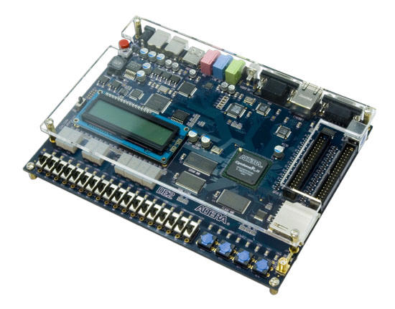
Software Used
10 brand new Altera DE2-115 Development Boards
Altera Quartus v11.1sp2
Altera Nios2 Builder
Nios2 Monitor Program
Nothing particularly different from the
Xilinx tools used previously, but a
much more capable development
board.

Slide 19
Why Altera DE2-115
The DE2-115 is more capable than the Xilinx boards used in ENGN3213, with better peripherals, support
and performance.
Lots of examples, demos and tutorials
Not least of all, Altera gave them
to us for free under the generous
Altera University Program

Slide 20
Why Altera DE2-115
Labs will introduce you to all the features of this board, including driving the VGA, audio, LCD, Nios processor etc.
The project will be supported by a number
of guided, tutorial-like lab sessions.
The focus is on learning by doing,
experimentation and creativity are
emphasized over all.

Slide 21
Major Project
The board will be supplied with full code to drive almost all peripherals, both from hardware and Nios-II procedural code
It will also be supplied with demo projects that make use of this functionality, including
Synthesizing and recording sound
Decoding PAL and NTSC video streams
Many examples of VGA display usage
Ethernet and Web Server functions
IR Remote control
You won’t necessarily get better marks if you write your own drivers! If you do, make sure you have a good reason why the supplied ones don’t suit your needs
Marks are based on the quality of design and justification of design decisions above fine implementation details

Slide 22
Project Examples
http://www.youtube.com/watch?v=gpek7RI7Si8
A demonstration project exists that displays video from the input line on the VGA monitor and another that generates tones on the audio output. The students combine these two projects, add a video overlay and detect colour patches by a simple threshold. A P - CR implementation would use only the supplied tones and structures. An HD implementation would justify design decisions such as any split between procedural code and HDL, would implement their own tone tables, use the object centroid (rather than single pixel or single line detection) and may be extended to include tones switchable by on-screen interaction or other interface (such as the IR remote control).

Slide 23
Project Examples
http://www.youtube.com/watch?v=4hEevgfvqw0
The students implement a simple encryption core and feed it every possible key in turn, looking for the decoded string to equal a known constant. A P grade would use a very simple encryption algorithm, use hard-coded hashes and key sequences, have no formal test cases for the implementation correctness and no analysis of timing or optimisation options. A D grade (or higher) could be achieved using a complex and testably-correct algorithm with the algorithm implemented in a way that is demonstrably optimised for speed within the resource limitations of the DE2 board. The hash could be entered by PS2 keyboard or IR remote control or, for lower grade, push-buttons and switches as shown in the video. An HD could be earned by implementing the algorithm in both procedural code and HDL and doing a critical analysis of the performance and complexity trade-offs.

Slide 24
Project Examples
http://people.ece.cornell.edu/land/courses/ece5760/FinalProjects/f2007/tjs49aw259/AphexTwinFace.mp4
A 64-point FFT with combinatorial logic. The particular demo shown is of the introduction to the Aphex Twin song "Windowlicker” where you can see that the artists drew a face in the frequency domain, converted it to sound as used it as the introduction to their song (only the lower portion of the face is visible with the dynamic range of the implemented FFT).
Like the other projects, actual grade would depend heavily on the actual implementation. Comparison of performance and complexity of an FFT done in logic and C would get good marks, as would an FFT done in combinatorial versus sequential logic. The reverse process could gain high marks as well – a project which is given an input audio stream and a set of data and hides one within the other.

Slide 25
Major Project
Focus on learning, not (necessarily) implementation.
Be creative!
We’re excited to see what you create, and what you learn in the process.

