Slide 2




Presentation on Google Drive Functionalities

Slide 3

Agenda
Key Functionalities
Google Drive UI Analysis and database design as follow
Resolve Permission in Google Drive
Full-text Search with BM25
Q&A

Slide 4

Key Functionalities

Slide 5
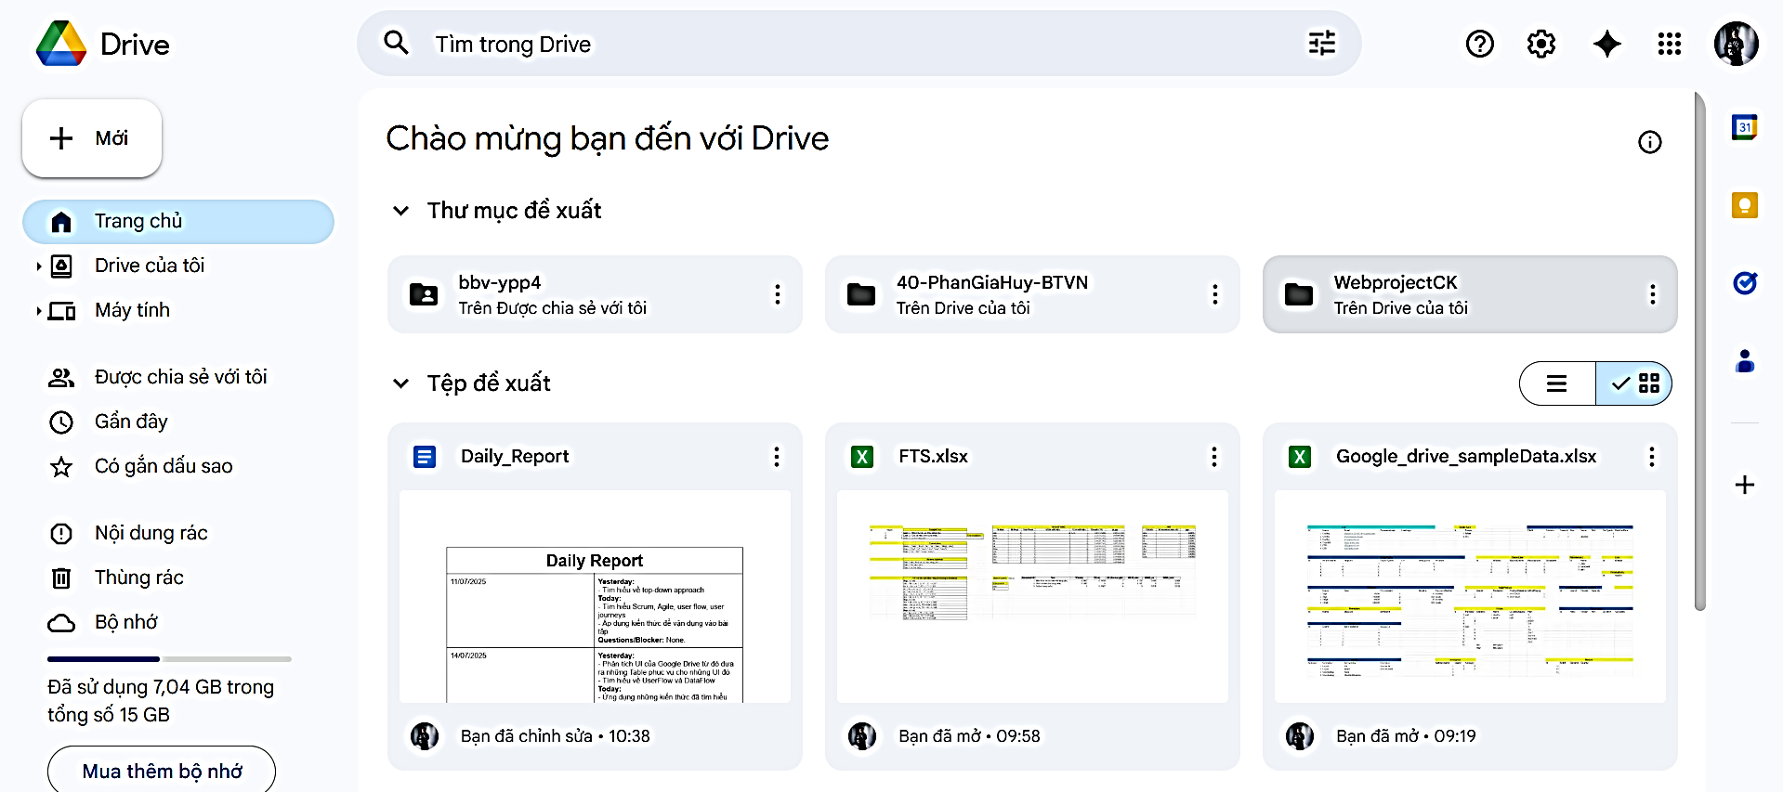
Key Functionalities of Google Drive
File storage and management
Share and collaborate
Search and access
Mobile and offline applications

Slide 6
Google Drive UI Analysis

Slide 7
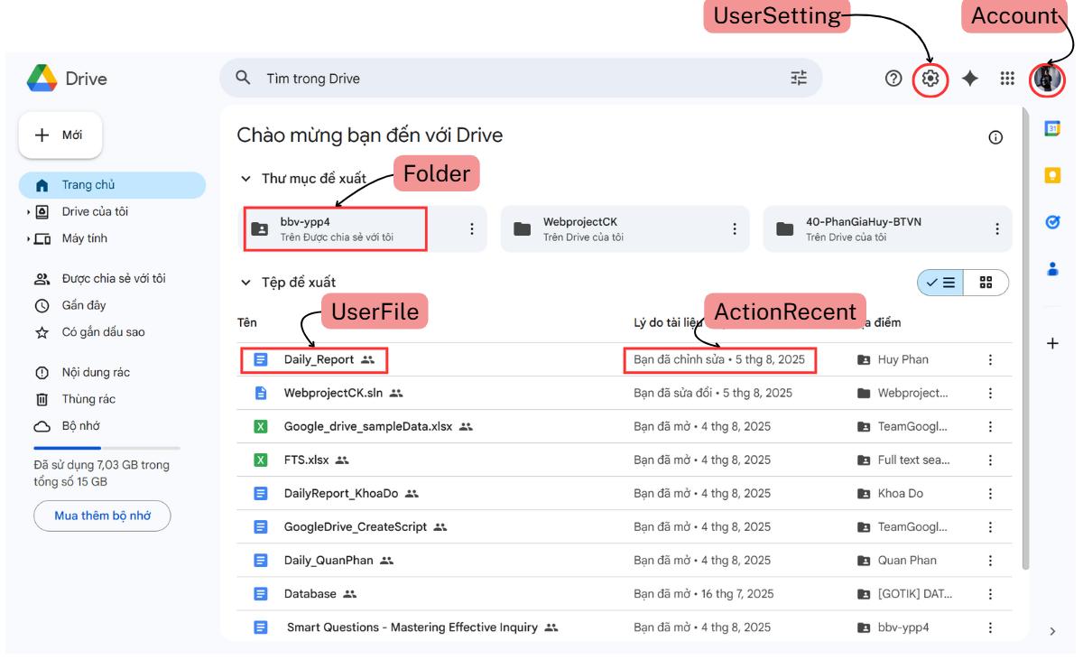
First Screen
Notes:
-- 3.Recomment file
Declare @userId int = 2
select top 10
f.FileId,
a.UserName,
f.UserFileName,
ar.ActionLog,
ar.ActionDateTime
from ActionRecent ar
join Account a on ar.UserId = a.UserId
join UserFile f on ar.ObjectTypeId = 2 and ar.ObjectId = f.FileId
where ar.UserId = @userId
order by ar.ActionDateTime DESC
-- 4.Recomment folder
Declare @userId int = 3
select top 10
fo.FolderId,
a.UserName,
fo.FolderName,
ar.ActionLog,
ar.ActionDateTime
from ActionRecent ar
join Account a on ar.UserId = a.UserId
join Folder fo on ar.ObjectTypeId = 1 and ar.ObjectId = fo.FolderId
where ar.UserId = @userId
order by ar.ActionDateTime DESC

Slide 8
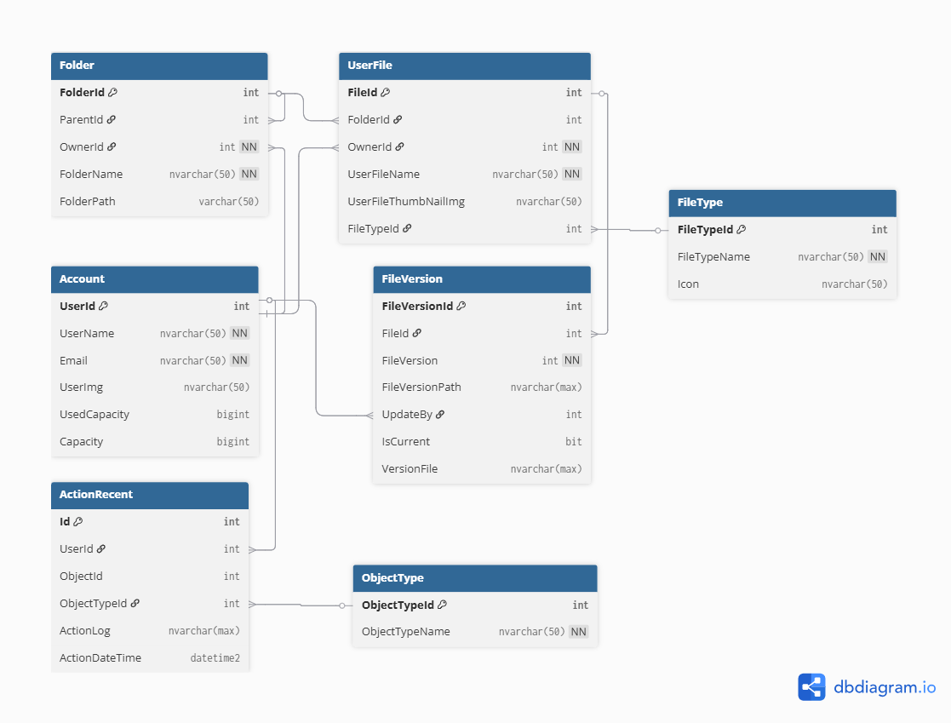
Database Structure of First Screen

Slide 9
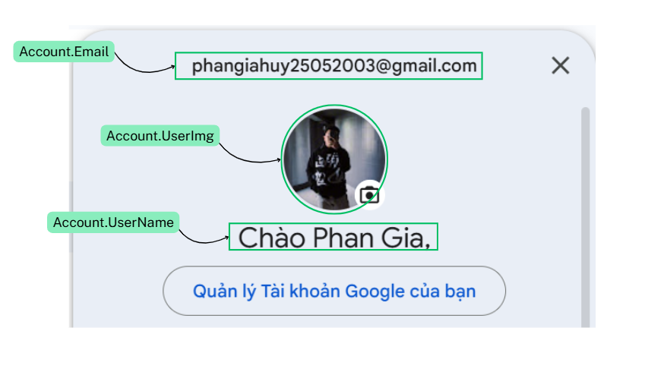
Account Screen
Notes:
-- 1.select User information
Declare @userId int = 1
select
a.UserName as UserName,
a.Email as Email,
a.UserImg
from Account a
where a.UserId =@userId

Slide 10
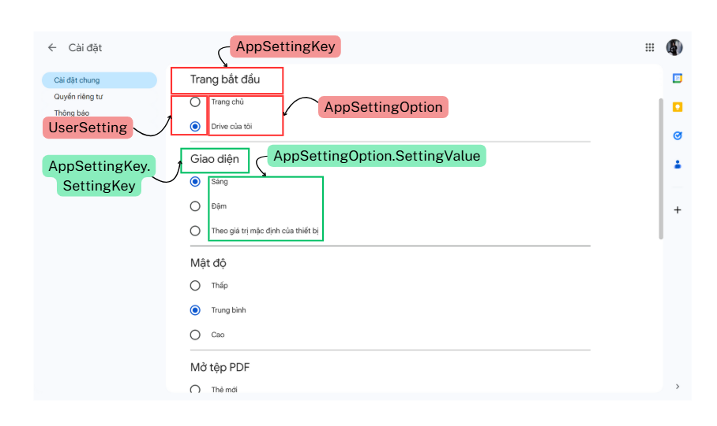
Setting Screen

Slide 11
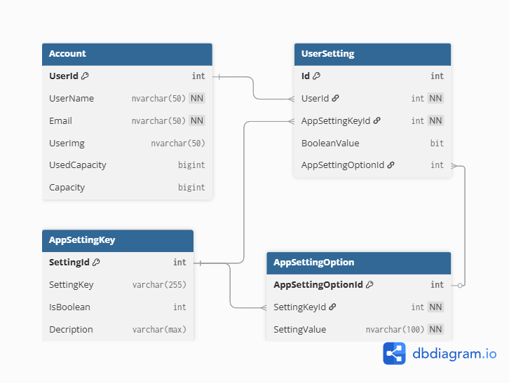
Database Structure For Setting Screen

Slide 12
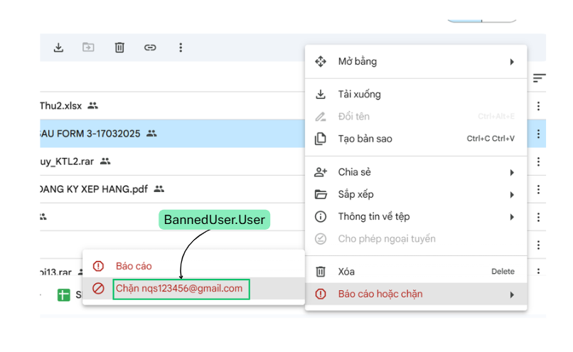
Block User Feature
Notes:
--select banned user of login-user
DECLARE @userId int = 533
SELECT
BU.Id AS BanId,
Banned.UserName AS BannedUserName,
Banner.UserName AS BannedByUserName,
BU.BannedAt
FROM BannedUser BU
JOIN Account Banned ON BU.UserId = Banned.UserId
JOIN Account Banner ON BU.BannedUserId = Banner.UserId
where BU.UserId = @userId
ORDER BY BU.BannedAt DESC;

Slide 13
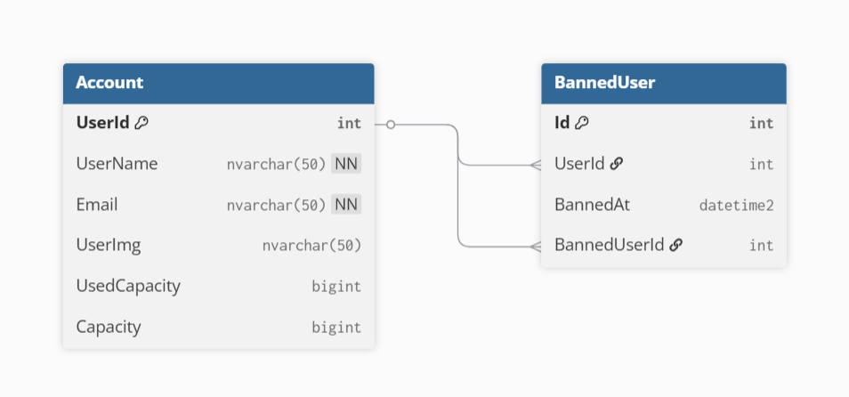
Database Structure of Block User Feature

Slide 14
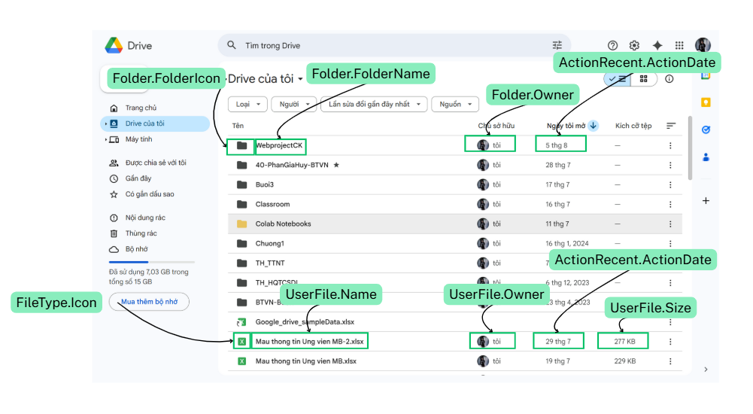
My Drive Screen
Notes:
Declare @LoginUser int = 1
select
uf.FileId,
a.UserName,
uf.UserFileName,
uf.Size as size,
uf.UserFileThumbNailImg,
ft.Icon
from UserFile uf
join Account a on uf.OwnerId = a.UserId
join FileType ft on uf.FileTypeId = ft.FileTypeId
where a.UserId =@LoginUser
-- 2.select login user folder
Declare @userId int = 1
select
fo.FolderId,
a.UserName,
fo.FolderName
from Folder fo
join Account a on fo.OwnerId = a.UserId
where a.UserId =@userId

Slide 15
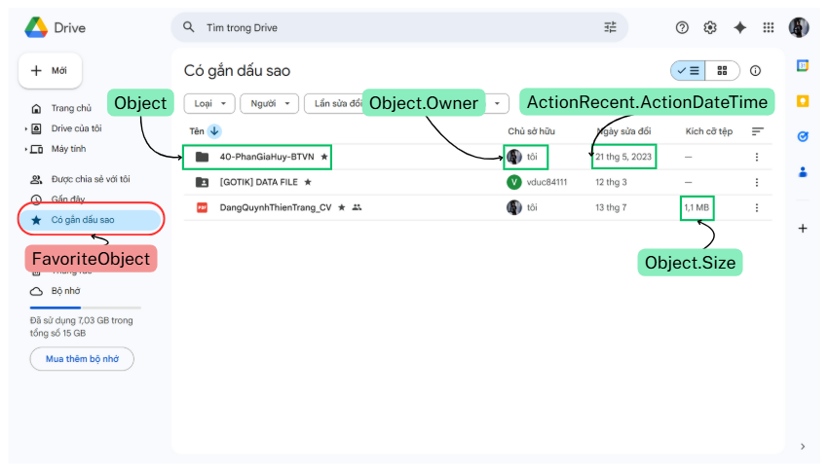
Stared Screen
Notes:
-- 2.select shared folder with login user
Declare @userId int = 101
select
fo.FolderId,
a.UserName,
fo.FolderName
from SharedUser su
join Account a on su.UserId = a.UserId
join Share s on su.ShareId = s.ShareId
join [Folder] fo on s.ObjectTypeId =1 and s.ObjectId = fo.FolderId
where su.UserId = @userId

Slide 16
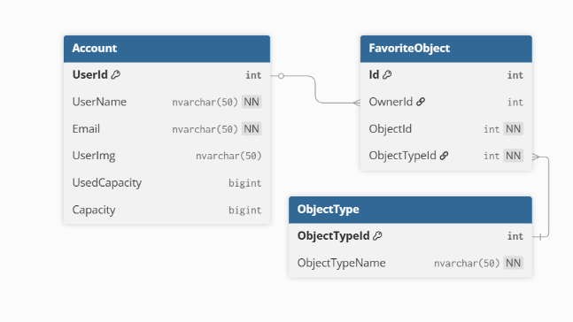
Database Structure of Stared Screen

Slide 17
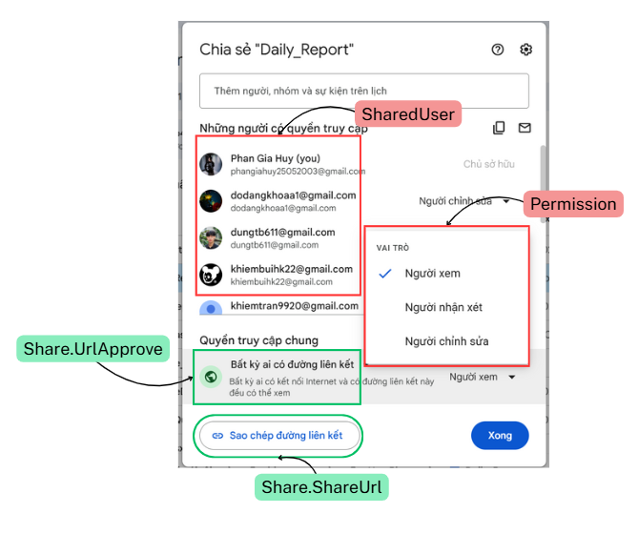
Share Screen

Slide 18
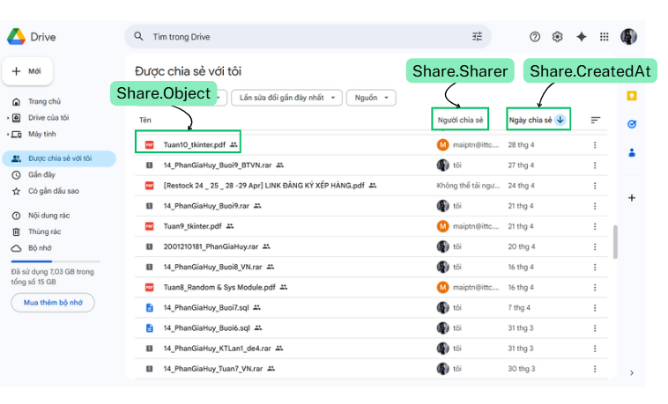
Share With Me Screen
Notes:
DECLARE @userId INT = 102;
SELECT
f.FileId,
a.UserName,
f.UserFileName,
CASE
WHEN EXISTS (
SELECT 1
FROM Share s2
JOIN SharedUser su2 ON s2.ShareId = su2.ShareId
WHERE s2.ObjectTypeId = 1
AND s2.ObjectId = f.FolderId
AND su2.UserId = @userId
) THEN fldr.FolderName
ELSE 'share for me'
END AS Location
FROM SharedUser su
JOIN Account a ON su.UserId = a.UserId
JOIN Share s ON su.ShareId = s.ShareId
JOIN UserFile f ON s.ObjectTypeId = 2 AND s.ObjectId = f.FileId
LEFT JOIN Folder fldr ON f.FolderId = fldr.FolderId
WHERE su.UserId = @userId;
---Sort UserFile By ShareUser where UserId = 2---
declare @Sharer int = 2
declare @shared int = 102
select
uf.FileId,
ft.Icon,
uf.UserFileName as NameOfFile,
a1.UserName as SharerName,
s.CreatedAt as ShareDateTime,
a.UserName as sharedName
from SharedUser su
join Share s on su.ShareId = s.ShareId
left join UserFile uf on s.ObjectTypeId = 2 and s.ObjectId = uf.FileId
join FileType ft on uf.FileTypeId = ft.FileTypeId
join Account a on su.UserId = a.UserId
join Account a1 on s.Sharer = a1.UserId
where su.UserId = @shared and s.Sharer = @Sharer
select * from SharedUser
---sort UserFile by FileType---
declare @OwnerId int = 1
declare @FileType int = 3
Select
uf.FileId,
ft.Icon,
uf.UserFileName,
a.UserName as OwnerName,
uf.CreatedAt
from UserFile uf
join FileType ft on uf.FileTypeId = ft.FileTypeId
join Account a on uf.OwnerId = a.UserId
where uf.FileTypeId = @FileType and uf.OwnerId = @OwnerId
---Sort by Action recent---
WITH RecentObjects AS (
SELECT
ar.ObjectId,
ar.ObjectTypeId,
ar.ActionDateTime,
ar.ActionLog,
CASE
WHEN ar.ObjectTypeId = 1 THEN 'Folder'
WHEN ar.ObjectTypeId = 2 THEN 'File'
ELSE 'Unknown'
END AS ObjectType,
uf.OwnerId AS FileOwnerId,
f.OwnerId AS FolderOwnerId
FROM ActionRecent ar
LEFT JOIN UserFile uf ON ar.ObjectId = uf.FileId AND ar.ObjectTypeId = 2
LEFT JOIN Folder f ON ar.ObjectId = f.FolderId AND ar.ObjectTypeId = 1
WHERE (uf.OwnerId = 11 OR f.OwnerId = 11)
)
SELECT
ro.ObjectId,
ro.ObjectTypeId,
ro.ObjectType,
CASE
WHEN ro.ObjectType = N'File' THEN uf.UserFileName
WHEN ro.ObjectType = N'Folder' THEN f.FolderName
ELSE NULL
END AS ObjectName,
ro.ActionLog,
ro.ActionDateTime
FROM RecentObjects ro
LEFT JOIN UserFile uf ON ro.ObjectId = uf.FileId AND ro.ObjectTypeId = 2
LEFT JOIN Folder f ON ro.ObjectId = f.FolderId AND ro.ObjectTypeId = 1
WHERE ro.FileOwnerId =11 OR ro.FolderOwnerId = 11
ORDER BY ro.ActionDateTime DESC;

Slide 19
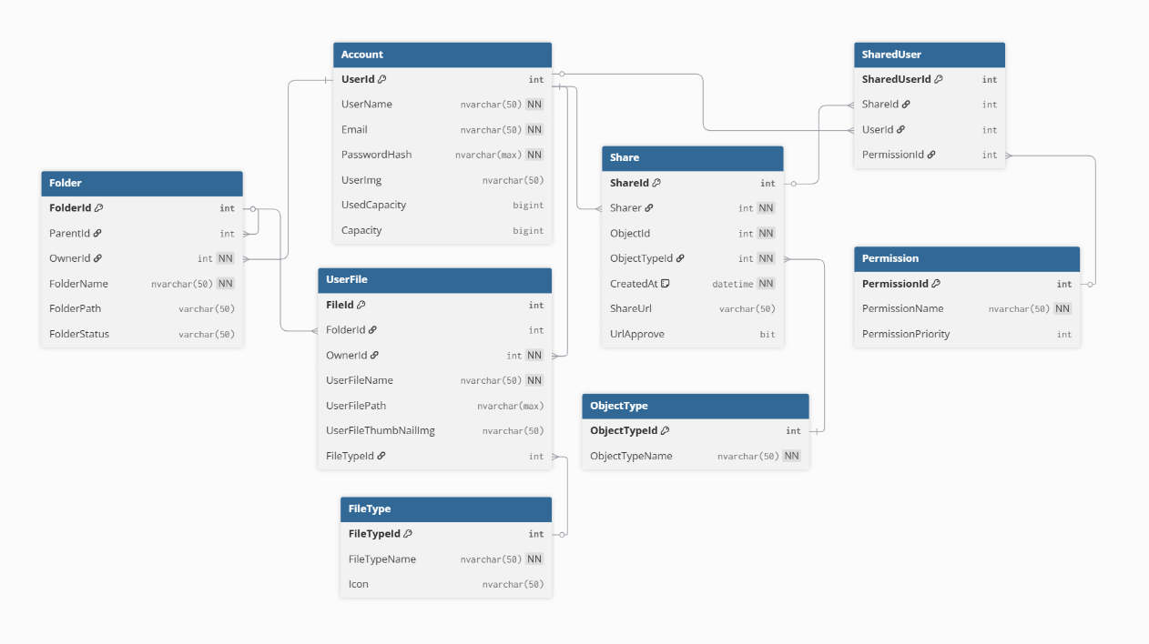
Database Structure of Share feature

Slide 20
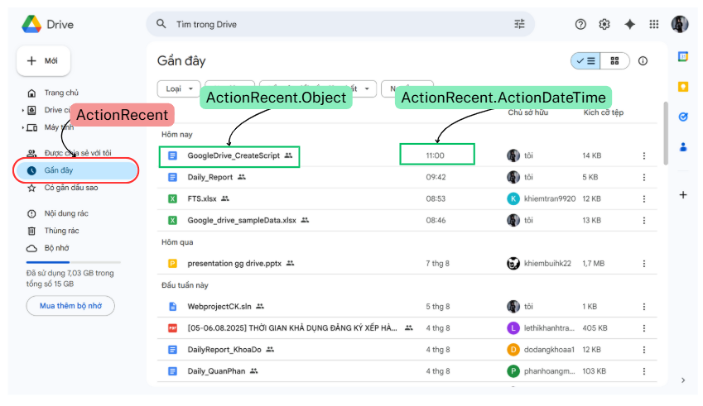
ActionRecent Screen

Slide 21
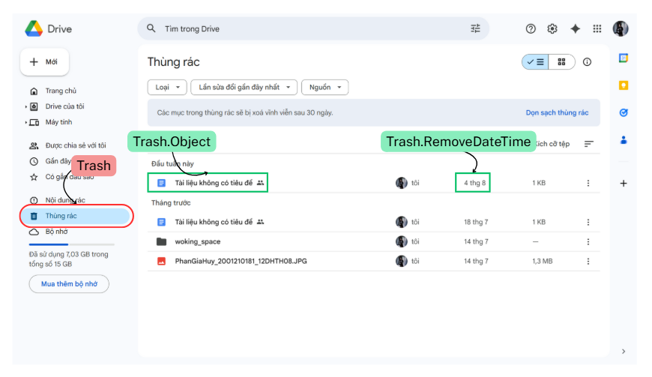
Trash Screen
Notes:
Declare @userId int = 794
select
f.FileId,
f.UserFileName,
a.USerName as FileOwnerName,
a.UserId as UserId,
ft.FileTypeName
from FavoriteObject fa
left join UserFile f on fa.ObjectTypeId = 2 and fa.ObjectId = f.FileId
left join Account a on f.OwnerId = a.UserId
join FileType ft on f.FileTypeId = ft.FileTypeId
where fa.OwnerId = @userId

Slide 22
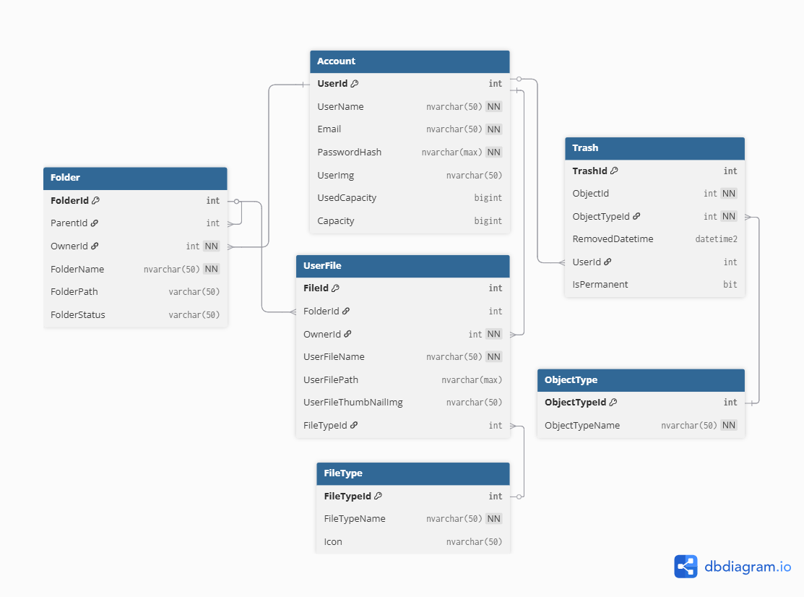
Database Structure of Trash Screen

Slide 23
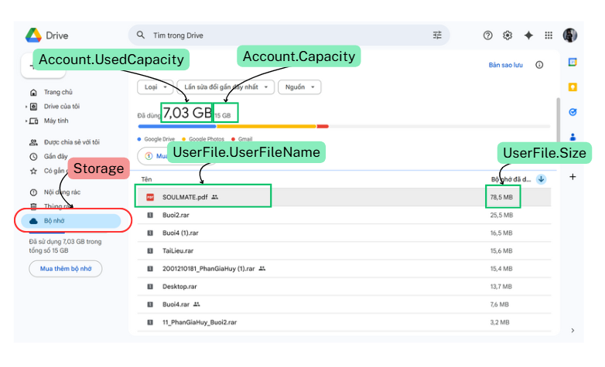
Storage Screen

Slide 24
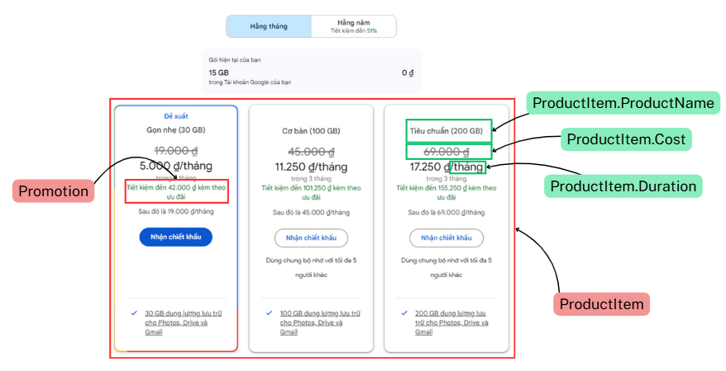
Product Item Screen
Notes:
-- select all of product
select
ProductId,
ProductName,
Cost,
Duration
from ProductItem
-- select Product bought by user
Declare @userId int = 100
select
pro.ProductId,
pro.ProductName,
a.UserId,
a.UserName,
case
when po.IsPercent = 1 then pro.Cost - (pro.Cost * (po.Discount/100))
else pro.Cost - po.Discount
end as TotalCost
from UserProduct up
join Account a on up.UserId = a.UserId
join Promotion po on up.PromotionId = po.PromotionId
join ProductItem pro on up.ProductId = pro.ProductId
where up.UserId = @userId

Slide 25
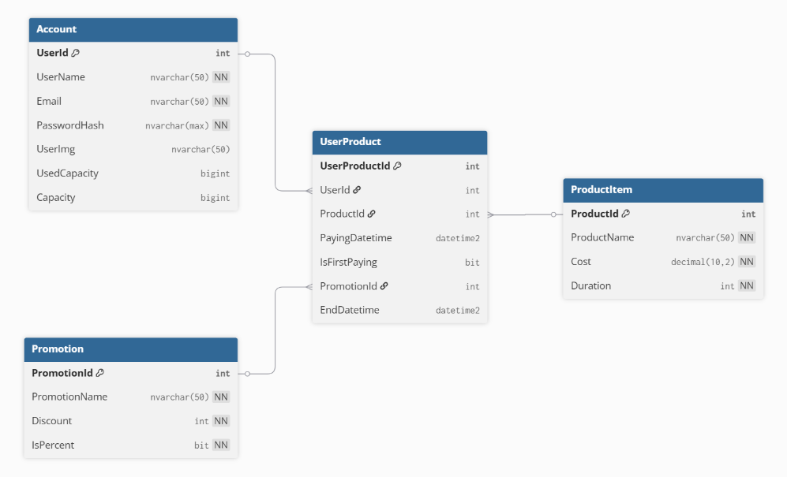
Database Structure of Product Feature

Slide 26
Resolve permission problem in Google Drive

Slide 27
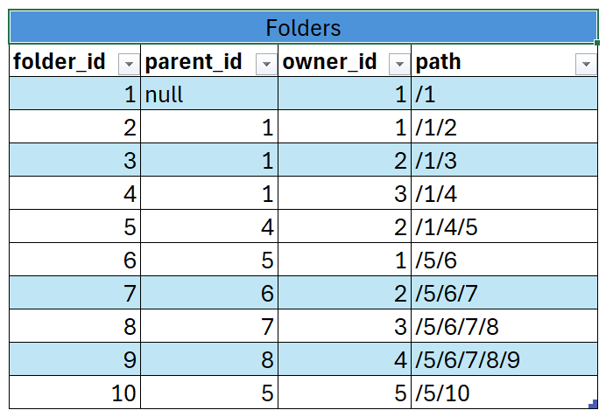
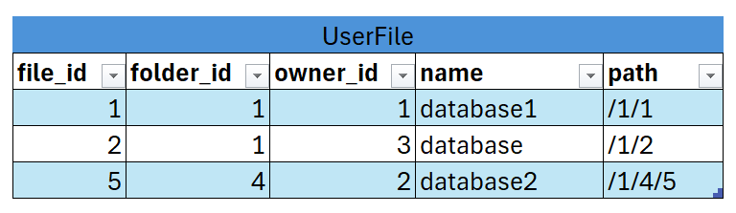
Add column path to table Folder and UserFile
Folders and user files use a hierarchical path:
Folders: ParentFolderPath + "/" + ChildFolderId
Files: FolderPath + "/" + UserFileId
This keeps each item uniquely located and clearly linked to its parent

Slide 28
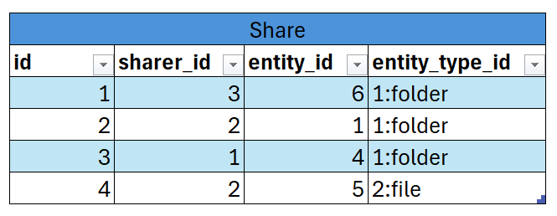
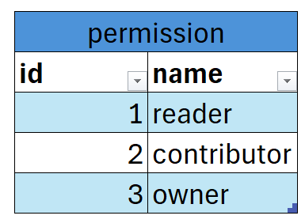
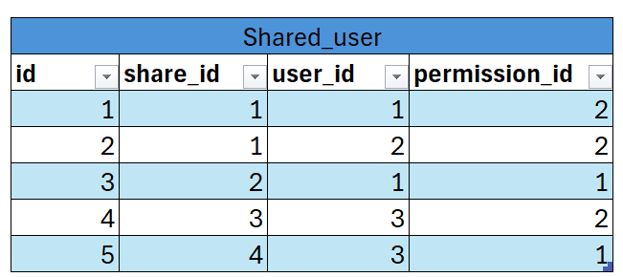
Example Data For Share Feature

Slide 29
WHAT IS BM25 ?
How to score in BM25 ?

Slide 30
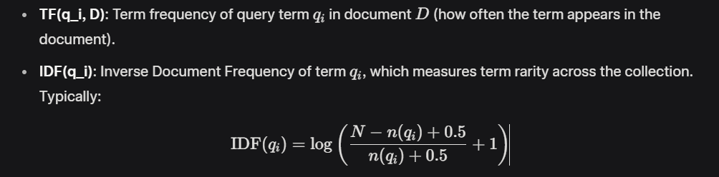
How to score in BM25?
N is total number of document
n(qi) is the number of documents containing qi a.k.a df
|D| : Length of document
avgdl : Average document length in the collection

Slide 31
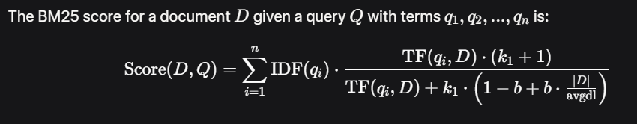
How to score in BM25?
k_1: A parameter (typically 1.2 to 2.0) controlling the impact of term frequency. Higher values allow more influence from frequent terms.
b: A parameter (typically 0.75) controlling the effect of document length normalization. b=0 disables length normalization, while fully normalizes by document length.

Slide 32
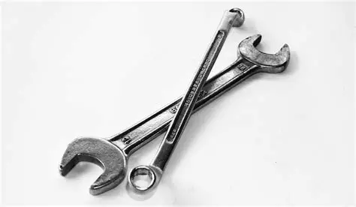
HOW IS FULL TEXT SEARCH WORKS ?

Slide 33
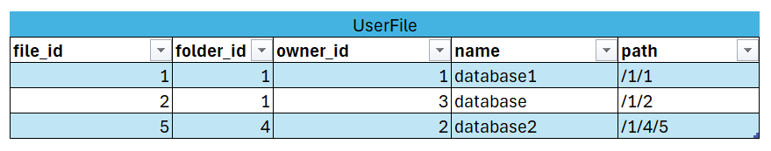
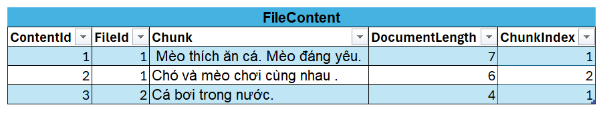
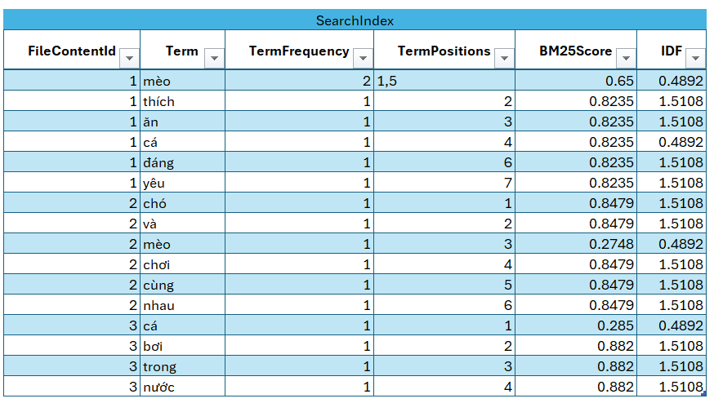
FULL TEXT SEARCH SAMPLE DATA
TOKENIZATION and CACULATE BM25 SCORE

Slide 34
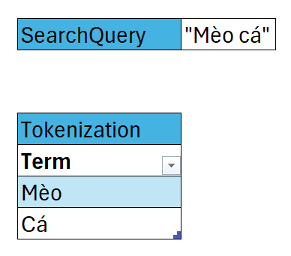
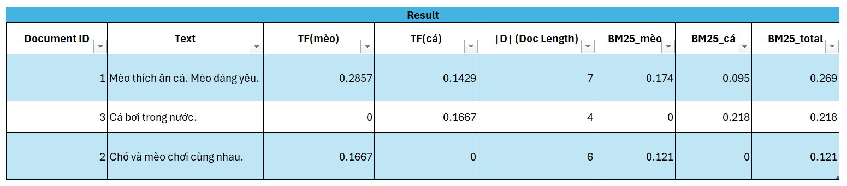
FULL TEXT SEARCH SAMPLE DATA
Use BM25 in full text search

Slide 35
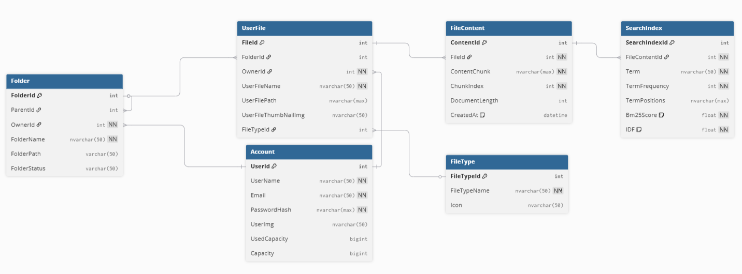
SQL Implement Full Text Search BM25

