Slide 2

Agenda
Google Drive functions and database design as follow
Resolve Permission in Google Drive
Fulltext Search with BM25
Q&A

Slide 3
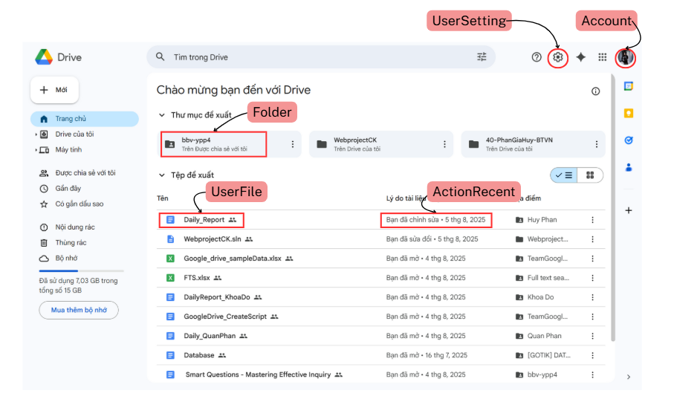
First Screen

Slide 4
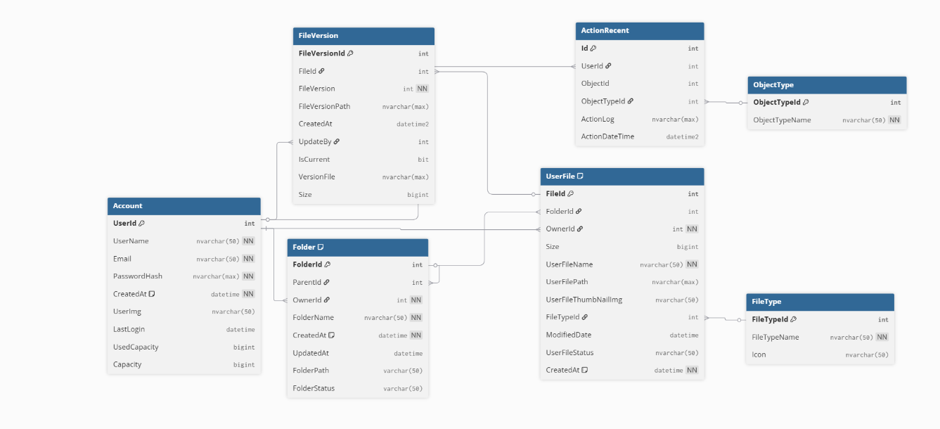
Database Structure of First Screen

Slide 5
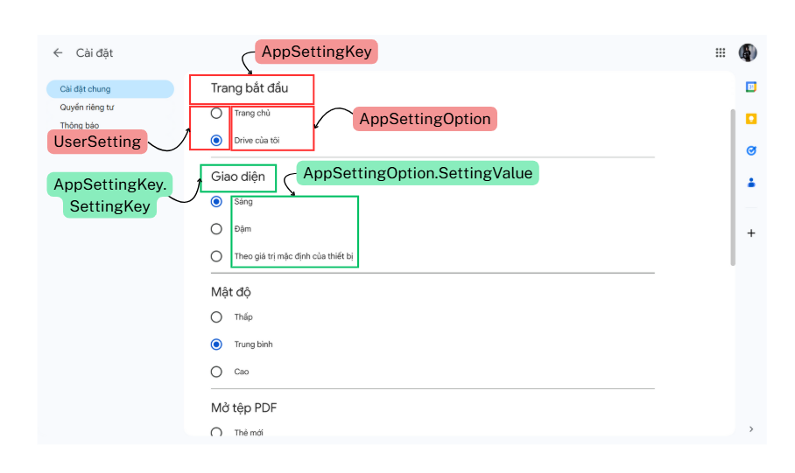
Setting Screen

Slide 6
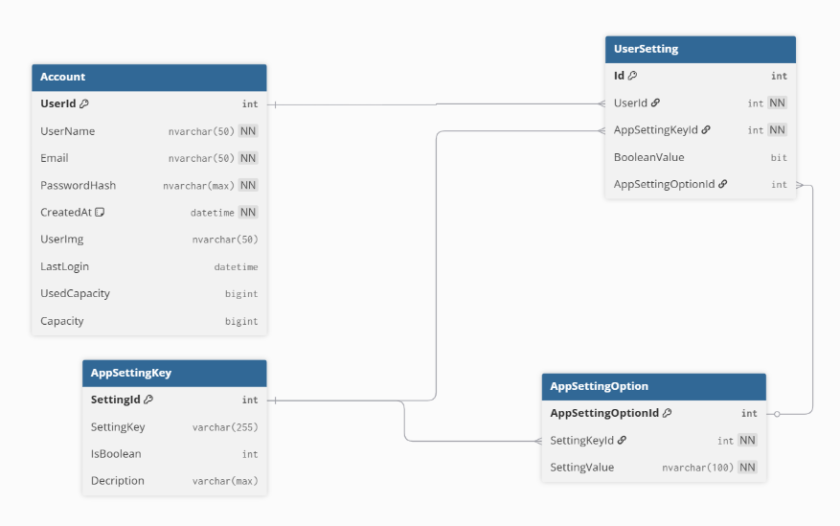
Database Structure For Setting Screen

Slide 7
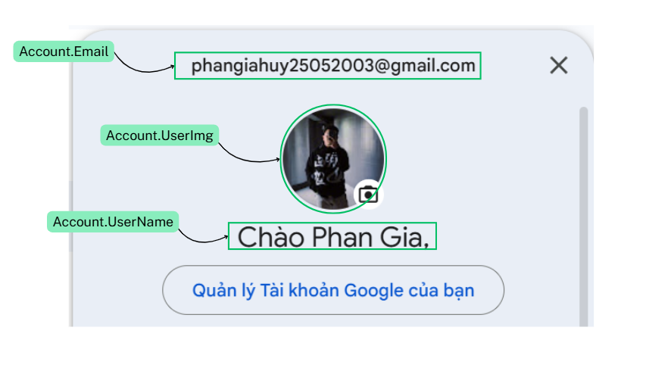
Account Screen

Slide 8

Query For Account Screen
Declare @userId int = 1
select
a.UserName as UserName,
a.Email as Email,
a.UserImg
from Account a
where a.UserId =@userId
Notes:
Declare @userId int = 1
select
a.UserName as UserName,
a.Email as Email,
a.UserImg
from Account a
where a.UserId =@userId

Slide 9
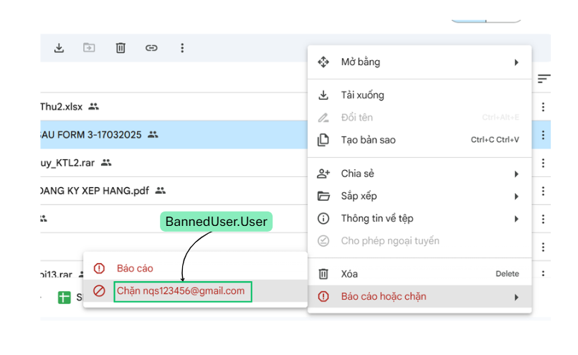
Block User Feature

Slide 10
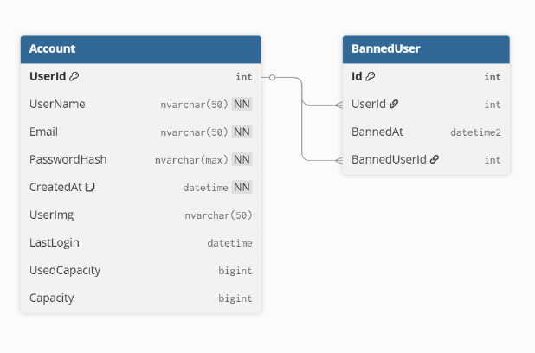
Database Structure of Block User Feature

Slide 11
Block User Feature Query
DECLARE @userId int = 533
SELECT
BU.Id AS BanId,
Banned.UserName AS BannedUserName,
Banner.UserName AS BannedByUserName,
BU.BannedAt
FROM BannedUser BU
JOIN Account Banned ON BU.UserId = Banned.UserId
JOIN Account Banner ON BU.BannedUserId = Banner.UserId
WHERE BU.UserId = @userId
ORDER BY BU.BannedAt DESC;
Notes:
DECLARE @userId int = 533
SELECT
BU.Id AS BanId,
Banned.UserName AS BannedUserName,
Banner.UserName AS BannedByUserName,
BU.BannedAt
FROM BannedUser BU
JOIN Account Banned ON BU.UserId = Banned.UserId
JOIN Account Banner ON BU.BannedUserId = Banner.UserId
where BU.UserId = @userId
ORDER BY BU.BannedAt DESC;

Slide 12
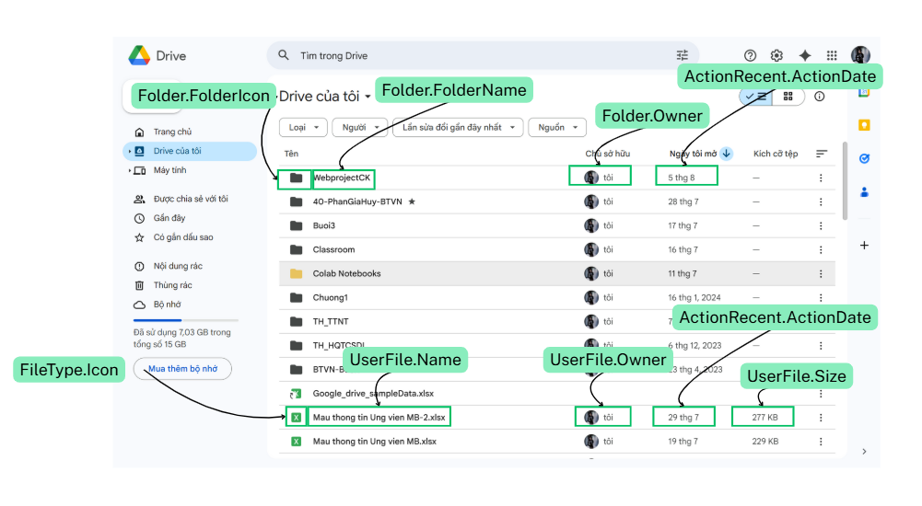
My Drive Screen

Slide 13
My Drive Screen Query
Get file
Get folder
select
f.id,
f. UserFilesName as [FileName],
f. UserFilesPath as FilePath,
f.ModifiedDate as FileUpdateTime,
ft. FileTypeName as FileType,
ft.Icon,
f.Size
from UserFile f
join Account a on f.OwnerId = a.Id
join FileType ft on f.FileTypeId = ft.Id
where a.id = 1
and f.Status = 'active'
order by f.ModifiedDate;
select
f.id,
f. FolderName,
f. FolderPath,
f.UpdatedAt as ModifiedDate,
f.Size
from Folder f
join Account a on f.OwnerId = a.Id
where a.id = 1
and f.Status = 'active'
order by f.UpdatedAt DESC;
Notes:
--get folders of an user
select
f.id,
f. FolderName,
f. FolderPath,
f.UpdatedAt as ModifiedDate,
f.Size
from Folder f
join Account a on f.OwnerId = a.Id
where a.id = 1
and f.Status = 'active'
order by f.UpdatedAt DESC;
--get files of an user
select
f.id,
f. UserFilesName as [FileName],
f. UserFilesPath as FilePath,
f.ModifiedDate as FileUpdateTime,
ft. FileTypeName as FileType,
ft.Icon,
f.Size
from UserFiles f
join Account a on f.OwnerId = a.Id
join FileType ft on f.FileTypeId = ft.Id
where a.id = 1
and f.Status = 'active'
order by f.ModifiedDate;

Slide 14
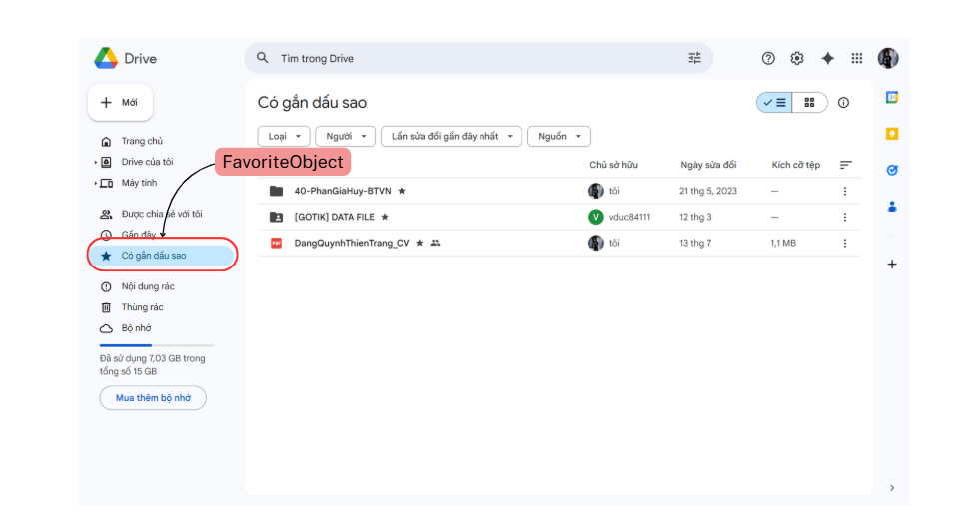
Stared Screen

Slide 15
Stared Screen Query
Declare @userId int = 794
select
uf.FileId,
uf.UserFileName,
f.FolderId,
f.FolderName,
a.USerName as FileOwnerName,
a.UserId as UserId,
ft.FileTypeName
from FavoriteObject fa
left join UserFile uf on fa.ObjectTypeId = 2 and fa.ObjectId = uf.FileId
left join Folder f on fa.ObjectTypeId = 1 and fa.ObjectId = f.FolderId
left join Account a on f.OwnerId = a.UserId
join FileType ft on f.FileTypeId = ft.FileTypeId
where fa.OwnerId = @userId
Notes:
Declare @userId int = 794
select
uf.FileId,
uf.UserFileName,
f.FolderId,
f.FolderName,
a.USerName as FileOwnerName,
a.UserId as UserId,
ft.FileTypeName
from FavoriteObject fa
left join UserFile uf on fa.ObjectTypeId = 2 and fa.ObjectId = uf.FileId
left join Folder f on fa.ObjectTypeId = 1 and fa.ObjectId = f.FolderId
left join Account a on f.OwnerId = a.UserId
join FileType ft on f.FileTypeId = ft.FileTypeId
where fa.OwnerId = @userId

Slide 16
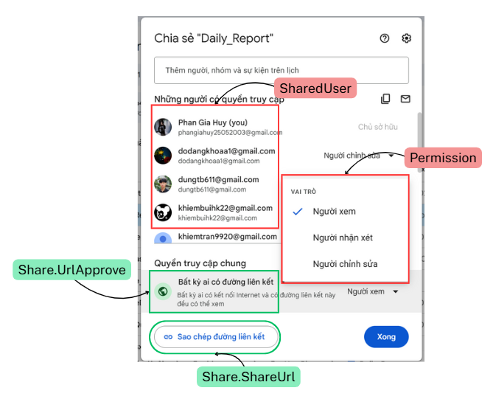
Share Screen

Slide 17
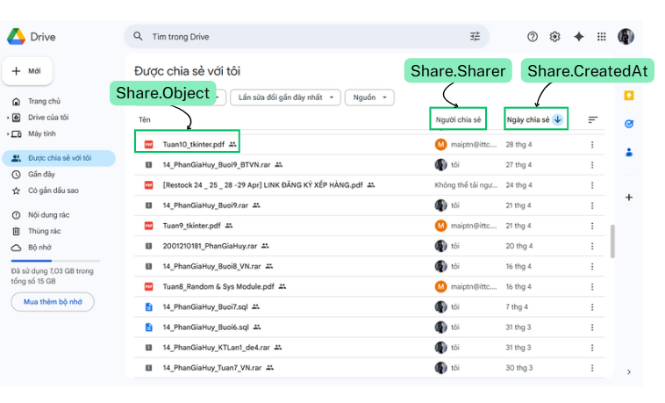
Share With Me Screen

Slide 18
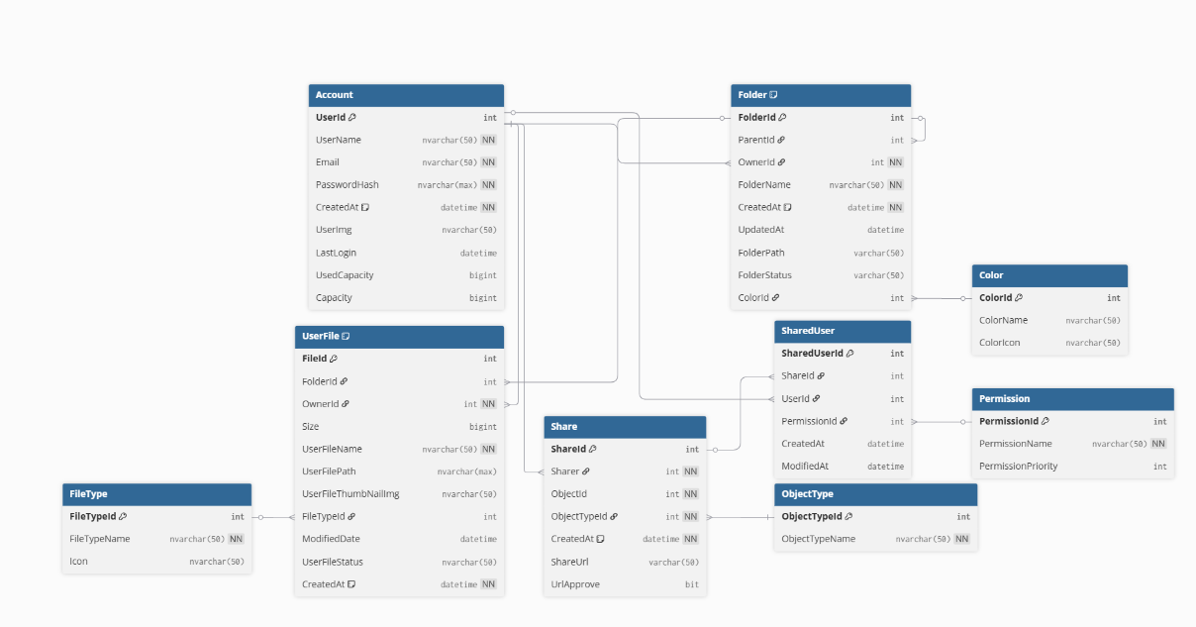
Database Structure of Share feature

Slide 19
Query for Share feature
select
s.ObjectId,
s.ObjectTypeId,
ot.Name as ObjectType,
case
when s.ObjectTypeId = 1 then f.Name
else fi.UserFileName
end as [Name],
p. PermissionName as Permission,
u2.UserName as SharerName,
s.CreatedAt as ShareCreated,
s.ExpiresAt as ShareExpires
from SharedUser su
join Share s on su.ShareId = s.Id
join Account u on su.Id = u.Id
join Account u2 on s.Sharer = u2.Id
join ObjectType ot on s.ObjectTypeId = ot.Id
join Permission p on su.PermissionId = p.Id
left join Folder f on s.ObjectId = f.Id and s.ObjectTypeId = 1
left join UserFile fi on s.ObjectId = fi.Id and s.ObjectTypeId = 2
where su.UserId = 1
and s.ExpiresAt > GETDATE()
order by s.CreatedAt DESC;
Notes:
--get shared objects with an user
select
s.ObjectId,
s.ObjectTypeId,
ot.Name as ObjectType,
case
when s.ObjectTypeId = 1 then f.Name
else fi.UserFileName
end as [Name],
p. PermissionName as Permission,
u2.UserName as SharerName,
s.CreatedAt as ShareCreated,
s.ExpiresAt as ShareExpires
from SharedUser su
join Share s on su.ShareId = s.Id
join Account u on su.Id = u.Id
join Account u2 on s.Sharer = u2.Id
join ObjectType ot on s.ObjectTypeId = ot.Id
join Permission p on su.PermissionId = p.Id
left join Folder f on s.ObjectId = f.Id and s.ObjectTypeId = 1
left join UserFile fi on s.ObjectId = fi.Id and s.ObjectTypeId = 2
where su.UserId = 1
and s.ExpiresAt > GETDATE()
order by s.CreatedAt DESC;

Slide 20
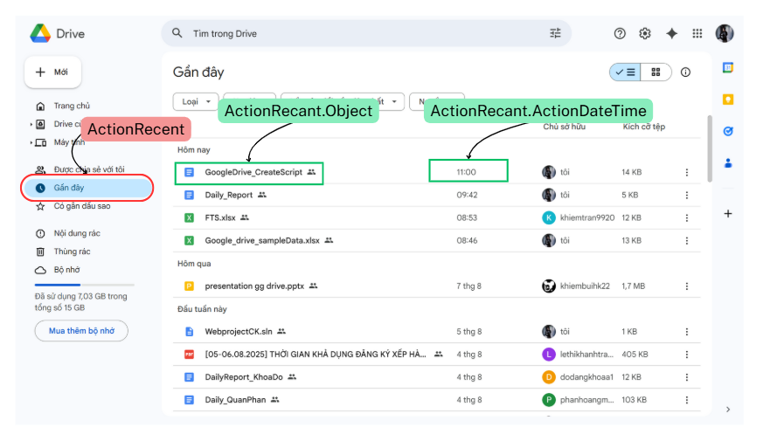
ActionRecent Screen

Slide 21
Query For ActionRecent Screen
select
r.Id,
case
when r.ObjectTypeId = 1 then f.Name
else fi.Name
end as [Name],
case
when r.ObjectTypeId = 1 then f.Path
else fi.Path
end as [Name],
ft.Name as FileType,
r.DateTime as LastAccessed
from Recent r
join Account u on r.Id = u.Id
left join Folder f on f.Id = r.ObjectId and r.ObjectTypeId = 1
left join UserFile fi on fi.Id = r.ObjectId and r.ObjectTypeId =2
join FileType ft on fi.FileTypeId = ft.Id
where r.UserId = 1
order by r.DateTime DESC;
Notes:
select
r.Id,
case
when r.ObjectTypeId = 1 then f.Name
else fi.Name
end as [Name],
case
when r.ObjectTypeId = 1 then f.Path
else fi.Path
end as [Name],
ft.Name as FileType,
r.DateTime as LastAccessed
from Recent r
join Account u on r.Id = u.Id
left join Folder f on f.Id = r.ObjectId and r.ObjectTypeId = 1
left join UserFile fi on fi.Id = r.ObjectId and r.ObjectTypeId =2
join FileType ft on fi.FileTypeId = ft.Id
where r.UserId = 1
order by r.DateTime DESC;

Slide 22
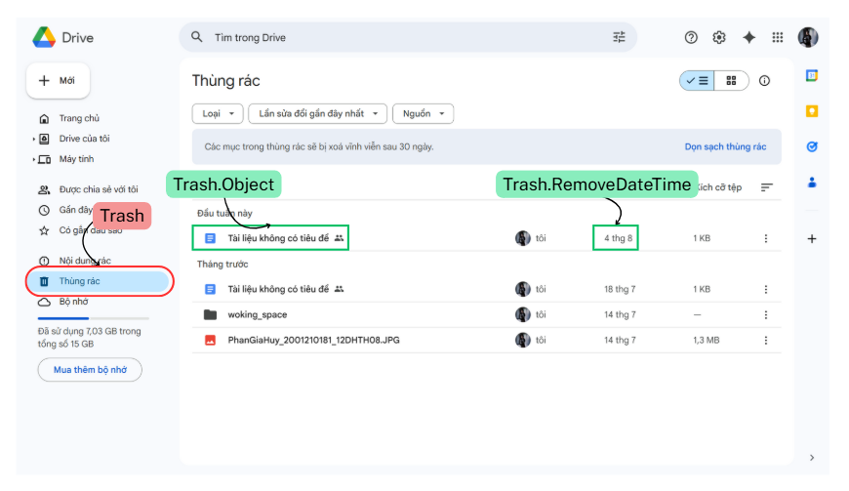
Trash Screen

Slide 23
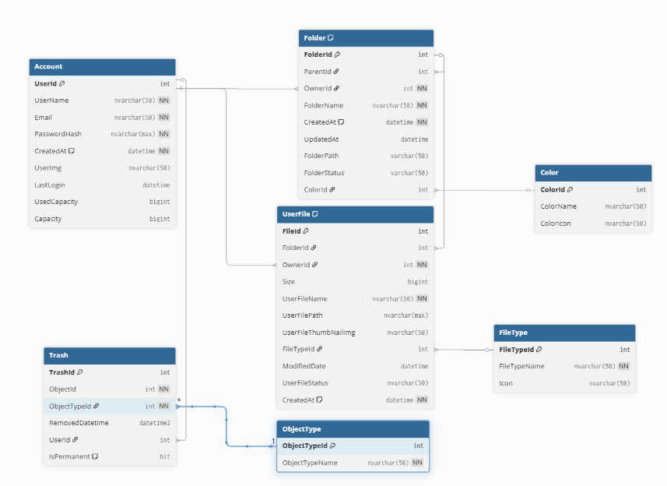
Database Structure of Trash Screen

Slide 24
Trash Screen Query
-- 1.select file have been deleted
Declare @userId int = 704
SELECT
f.FileId,
t.TrashId,
ot.ObjectTypeName,
f.UserFileName,
t.RemovedDatetime,
t.IsPermanent
FROM Trash t
JOIN ObjectType ot ON t.ObjectTypeId = ot.ObjectTypeId
JOIN UserFile f ON t.ObjectTypeId = 2 AND t.ObjectId = f.FileId
WHERE t.UserId = @userId;
-- 2.select folder have been deleted
Declare @userId int = 1
SELECT
fo.FolderId,
t.TrashId,
ot.ObjectTypeName,
fo.FolderName,
t.RemovedDatetime,
t.IsPermanent
FROM Trash t
JOIN ObjectType ot ON t.ObjectTypeId = ot.ObjectTypeId
JOIN Folder fo ON t.ObjectTypeId = 1 AND t.ObjectId = fo.FolderId
WHERE t.UserId = @userId;
Notes:
select
t.id,
t.ObjectId,
t.ObjectTypeId,
t.RemovedDatetime,
case
when t.ObjectTypeId = 1 then f.Name
else fi.Name
end as [Name]
from Trash t
join Users u on t.UserId = u.Id
join ObjectType ot on t.ObjectTypeId = ot.id
left join Folder f on t.ObjectId = f.Id and t.ObjectTypeId = 1
left join Files fi on t.ObjectId = fi.Id and t.ObjectTypeId =2
where t.UserId = 1
order by t.RemovedDateTime DESC;

Slide 25
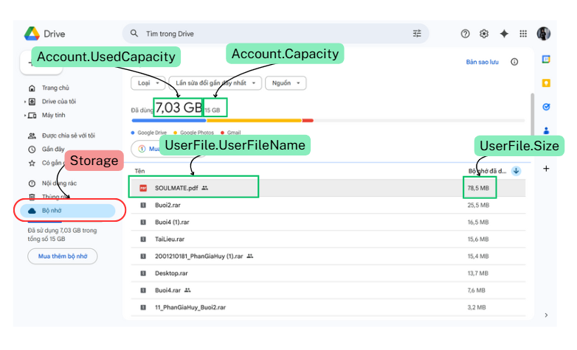
Storage Screen

Slide 26
Storage Screen Query
Get storage
Get list file by size
select
u.Capacity,
u.UsedCapacity,
u.Capacity - u.UsedCapacity as RemainingCapacity
from ACcount u
where u.Id = 1
order by RemainingCapacity DESC;
select
f. UserFileName,
f.Size
from UserFile f
join Account u on f.OwnerId = u.Id
where u.id = 1
order by f.Size DESC;
Notes:
--get storage information of an user
select
u.Capacity,
u.UsedCapacity,
u.Capacity - u.UsedCapacity as RemainingCapacity
from Users u
where u.Id = 1
order by RemainingCapacity DESC;
select
f.Name as FileName,
f.Size
from Files f
join Users u on f.OwnerId = u.Id
where u.id = 1
order by f.Size DESC;

Slide 27
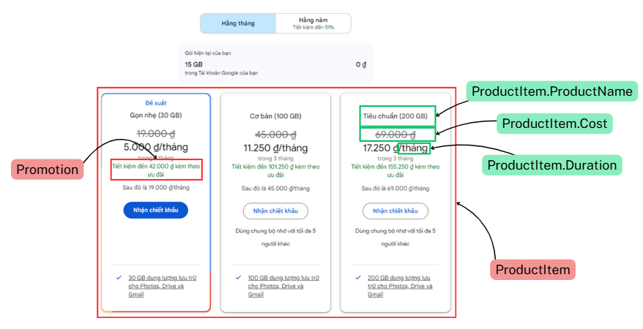
Product Item Screen

Slide 28
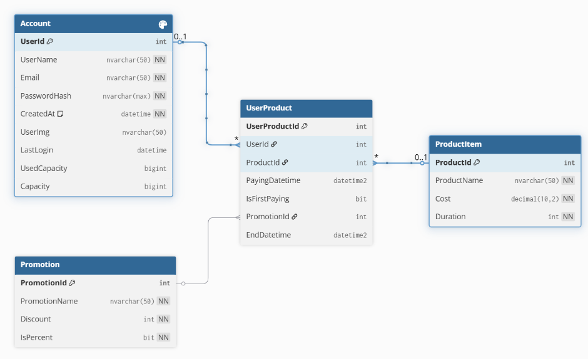
Database Structure of Product Feature

Slide 29
Product Feature Query
select
p.Id,
p.Name as ProductName,
u.Name as UserName,
up.PayingDatetime,
up.EndDatetime,
pr.Name as PromotionName
from UserProduct up
join Products p on up.ProductId = p.Id
join Users u on up.UserId = u.Id
join Promotion pr on up.PromotionId = pr.Id
where u.Id = 199
Notes:
select
p.Id,
p.Name as ProductName,
u.Name as UserName,
up.PayingDatetime,
up.EndDatetime,
pr.Name as PromotionName
from UserProduct up
join Products p on up.ProductId = p.Id
join Users u on up.UserId = u.Id
join Promotion pr on up.PromotionId = pr.Id
where u.Id = 199

Slide 30
Resolve permission problem
in
Google Drive

Slide 31
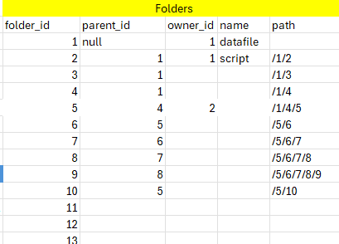
Add column path to table folder
To know what is childrent folder

Slide 32
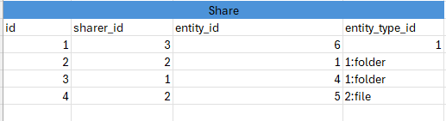
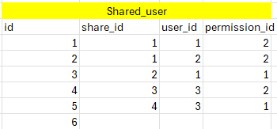
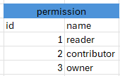

Slide 33
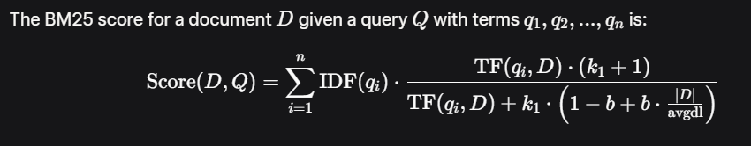
WHAT IS BM25 ?
How to score in BM25 ?

Slide 34
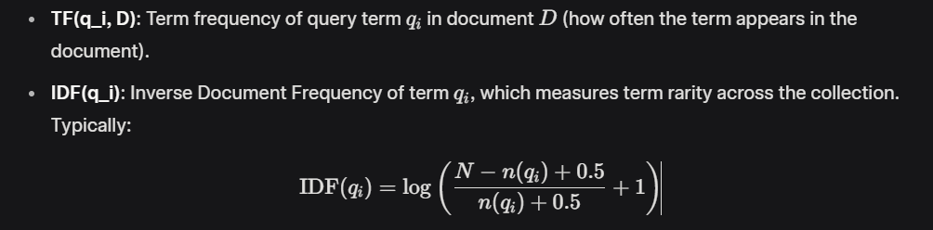
N is total number of document
n(qi) is the number of documents containing qi a.k.a df
|D| : Length of document
avgdl : Average document length in the collection

Slide 35
k_1: A parameter (typically 1.2 to 2.0) controlling the impact of term frequency. Higher values allow more influence from frequent terms.
b: A parameter (typically 0.75) controlling the effect of document length normalization. b=0 disables length normalization, while fully normalizes by document length.

Slide 36

HOW IT WORKS ?

Slide 37
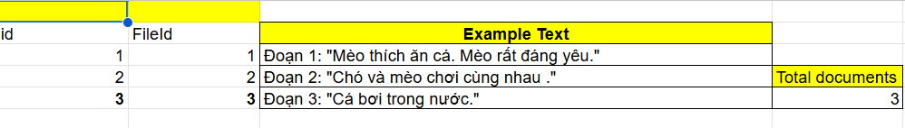
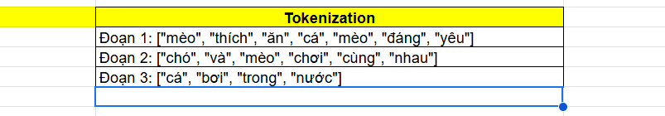

Slide 38
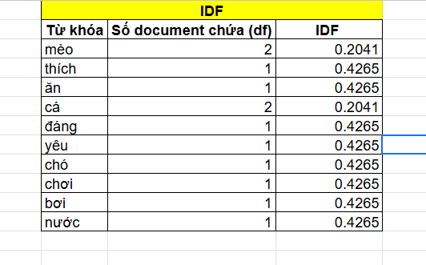

Caculate IDF ( InverseIndexFrequency)
N=3
n(qi)=df(documentfrequency)

Slide 39
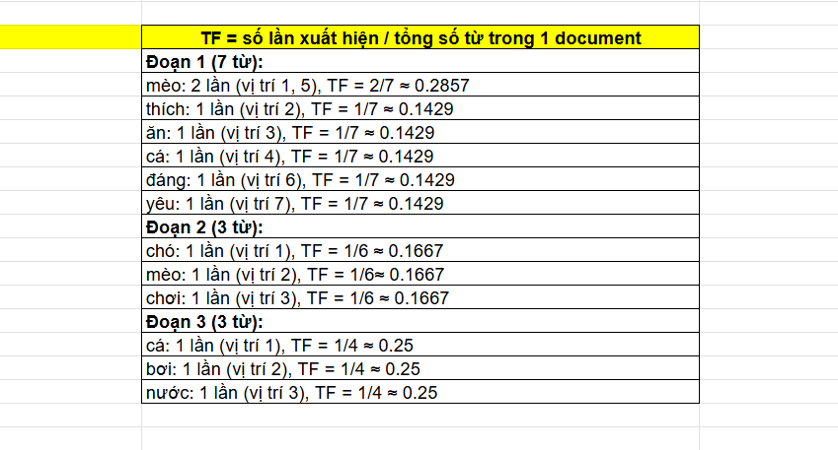
TF (TermFrequency)
Tf = ApperanceCount / |D|

Slide 40
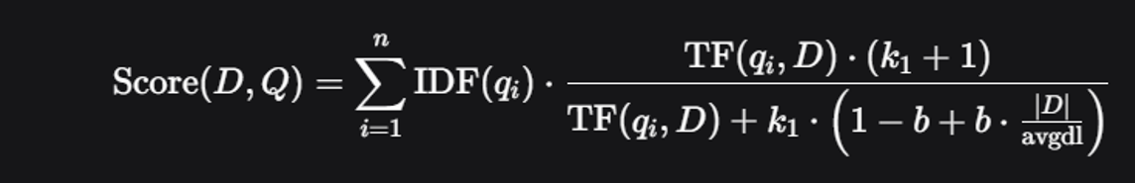
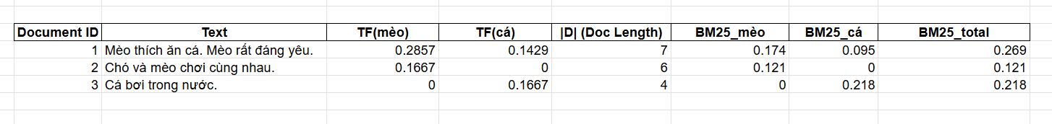
Total Score
k1=1.2
b=0.75
avgdl=5.67

Slide 41
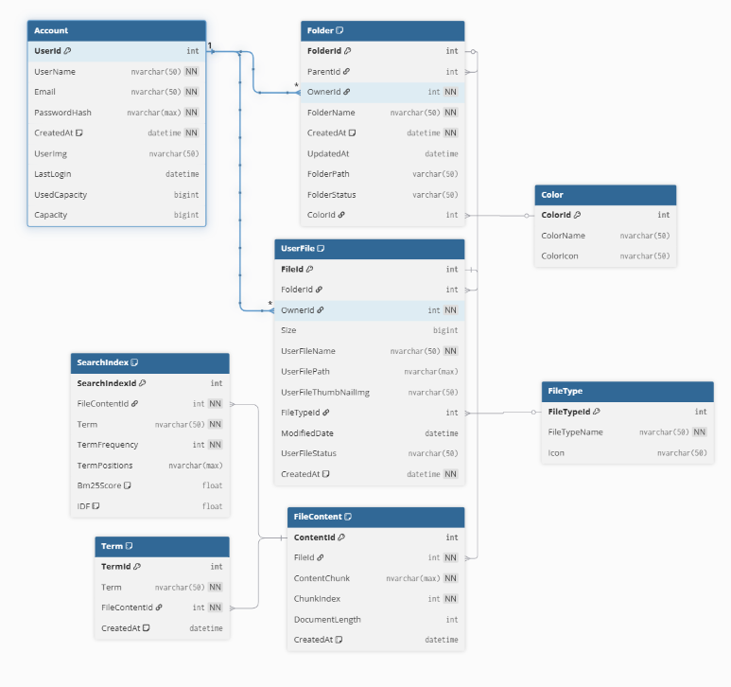
SQL Implement Full Text Search BM25

Slide 42
SQL Implement Full Text Search BM25
SELECT
s.ObjectTypeId,
s.ObjectId,
s.Term,
t.BM25DECLARE @TextQuery nvarchar(50) = 'software';
WITH TokenizedQuery AS (
SELECT Term
FROM dbo.fn_TokenizeText(@TextQuery)
),
AllMatches AS (
SELECT s.FileContentId, COUNT(*) as MatchingTerms
FROM SearchIndex s
JOIN TokenizedQuery tq ON s.Term = tq.Term
GROUP BY s.FileContentId
HAVING COUNT(*) > 0
)
SELECT
fc.FileId,
uf.UserFileName,
fc.ContentChunk,
SUM(s.Bm25Score) AS TotalBm25Score,
COUNT(s.Term) AS MatchedTerms,
(SELECT COUNT(*) FROM TokenizedQuery) AS TotalQueryTerms
FROM AllMatches am
JOIN FileContent fc ON am.FileContentId = fc.ContentId
JOIN SearchIndex s ON s.FileContentId = fc.ContentId
join UserFile uf on fc.FileId = uf.FileId
WHERE s.Term IN (SELECT Term FROM TokenizedQuery)
GROUP BY fc.FileId, fc.ContentChunk, uf.UserFileName
ORDER BY TotalBm25Score DESC;
FROM SearchIndex s
join TermBM25 t on s.Term = t.Term
left join Folder f on f.Id = s.ObjectId and s.ObjectTypeId = 1
left join Files fi on fi.Id = s.ObjectId and s.ObjectTypeId = 2
WHERE t.Term IN ('report')
ORDER BY t.BM25 DESC;

