Slide 1
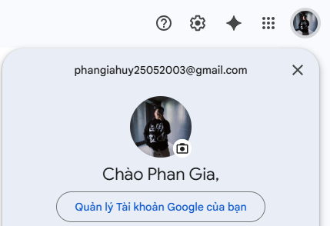
Select User information

Slide 2
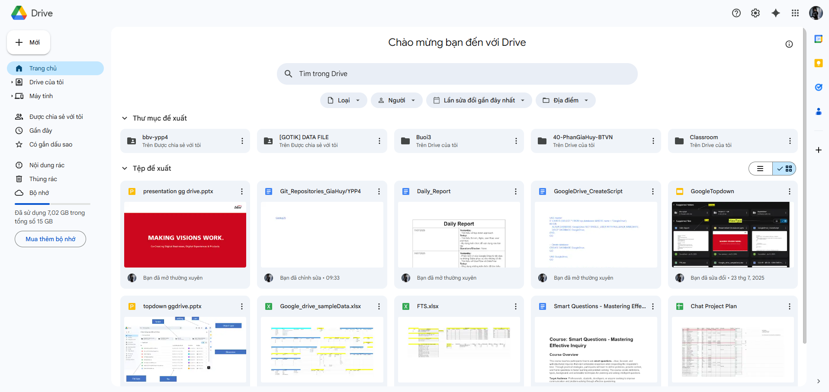
Select login user Setting
Select recomment folder
Select recomment file

Slide 3
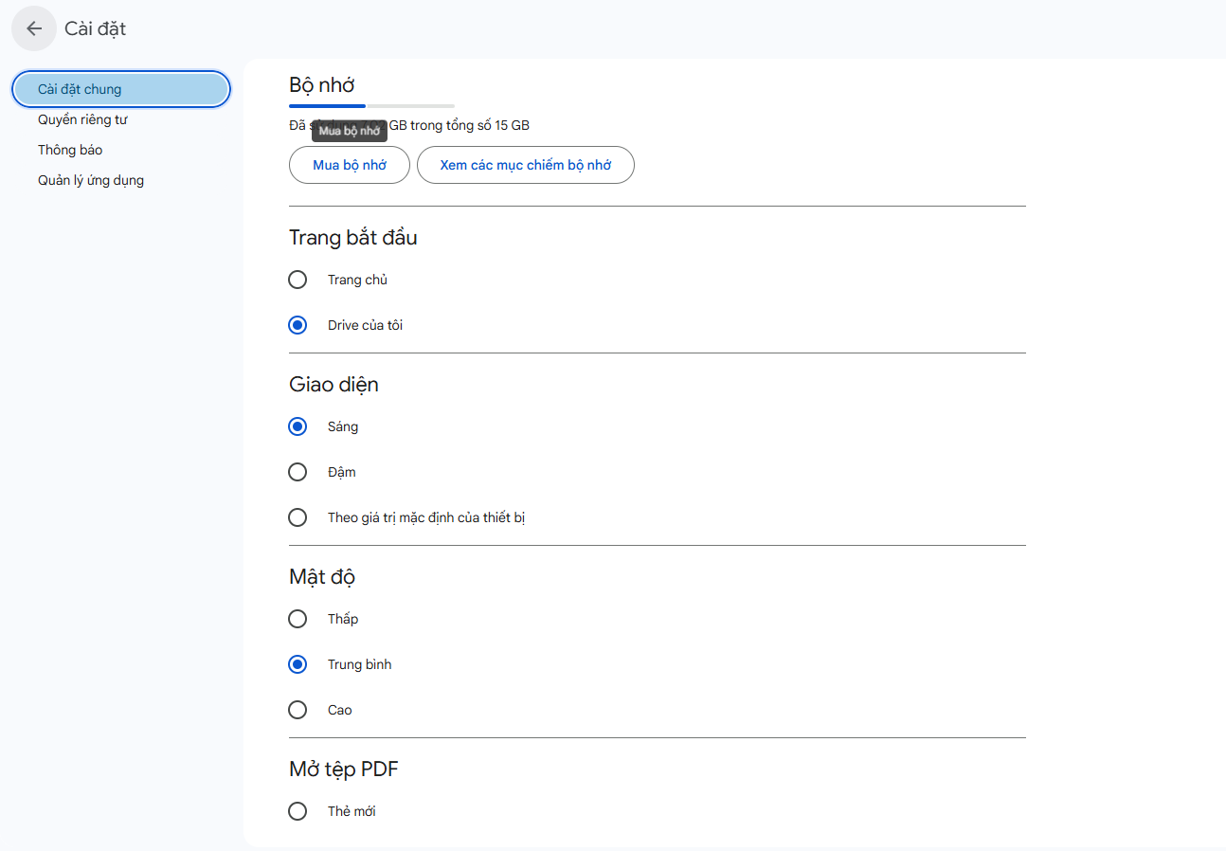
Select Setting of login User

Slide 4
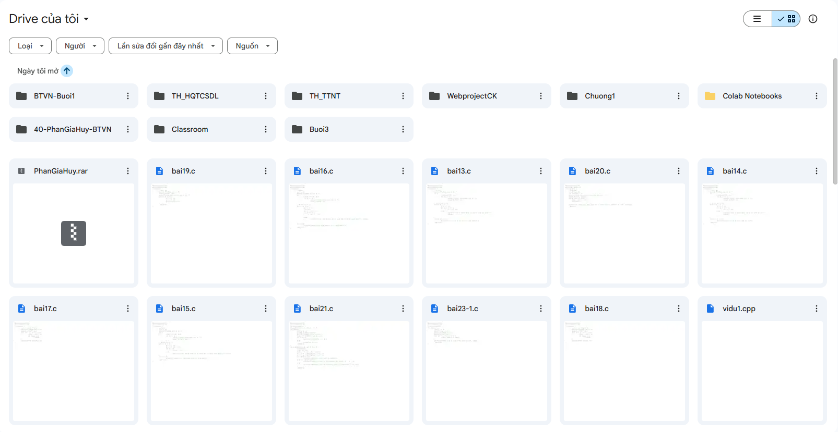
Select File/folder where user login is owner

Slide 5
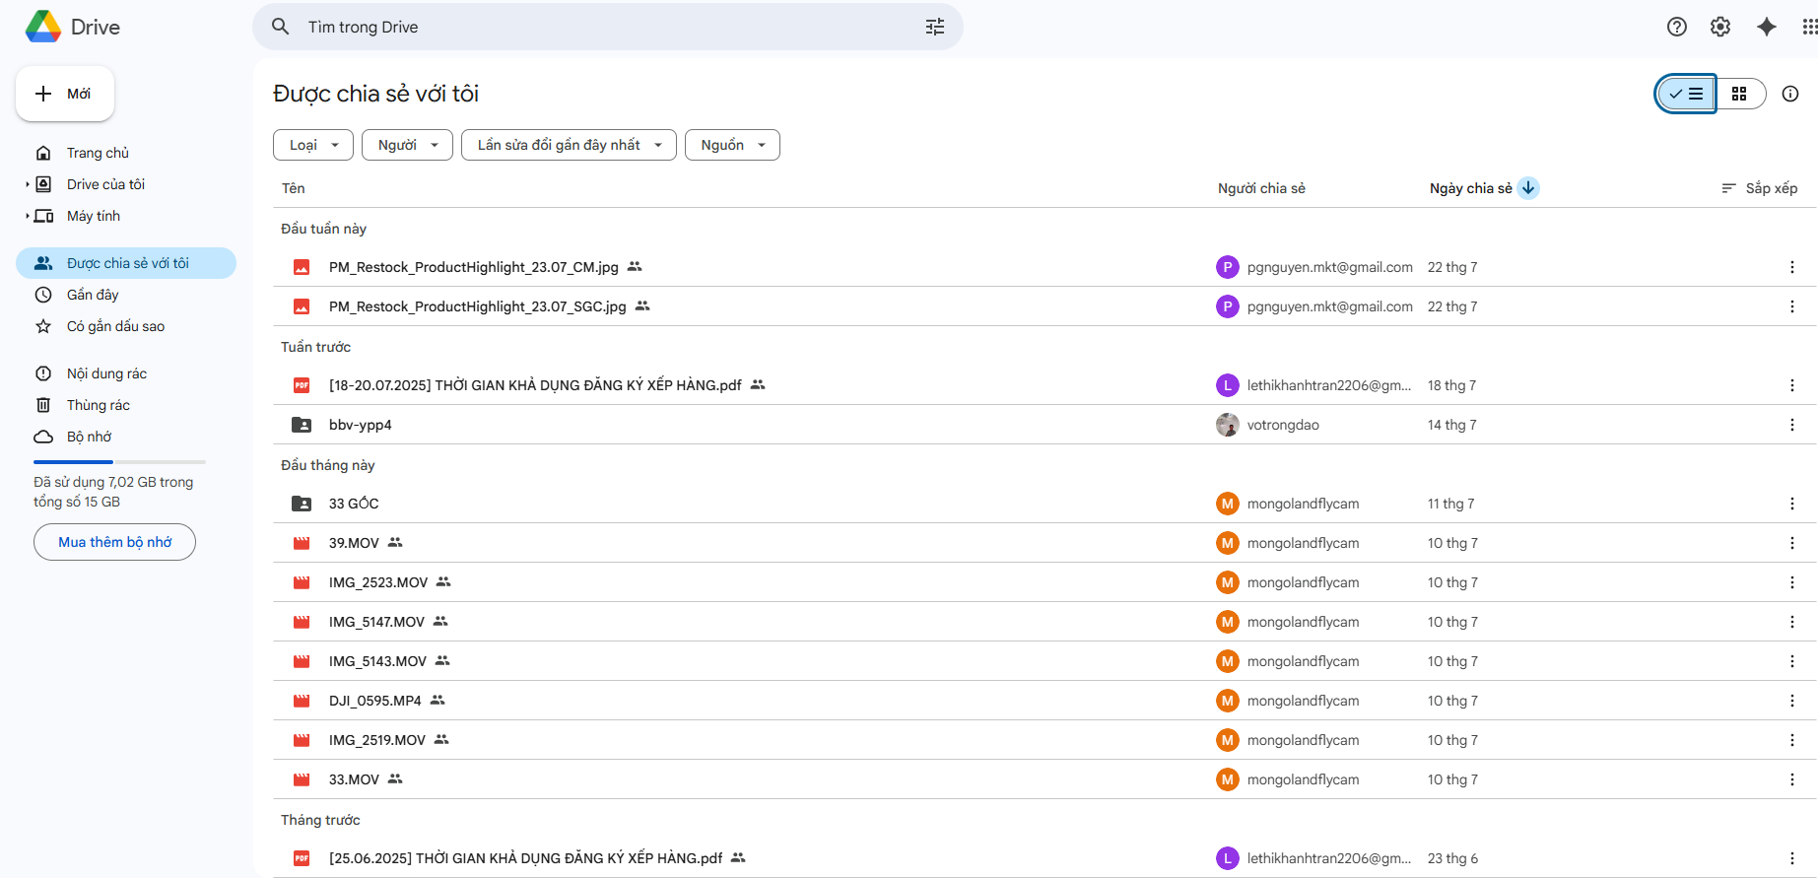
Select file/folder which share for me

Slide 6
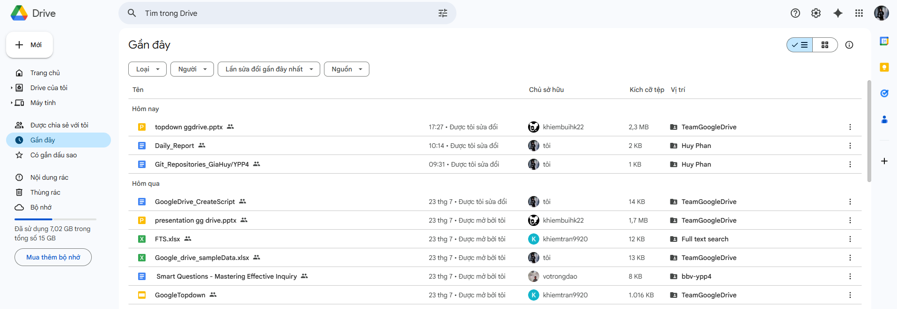
Select File/Folder which action by login user

Slide 7
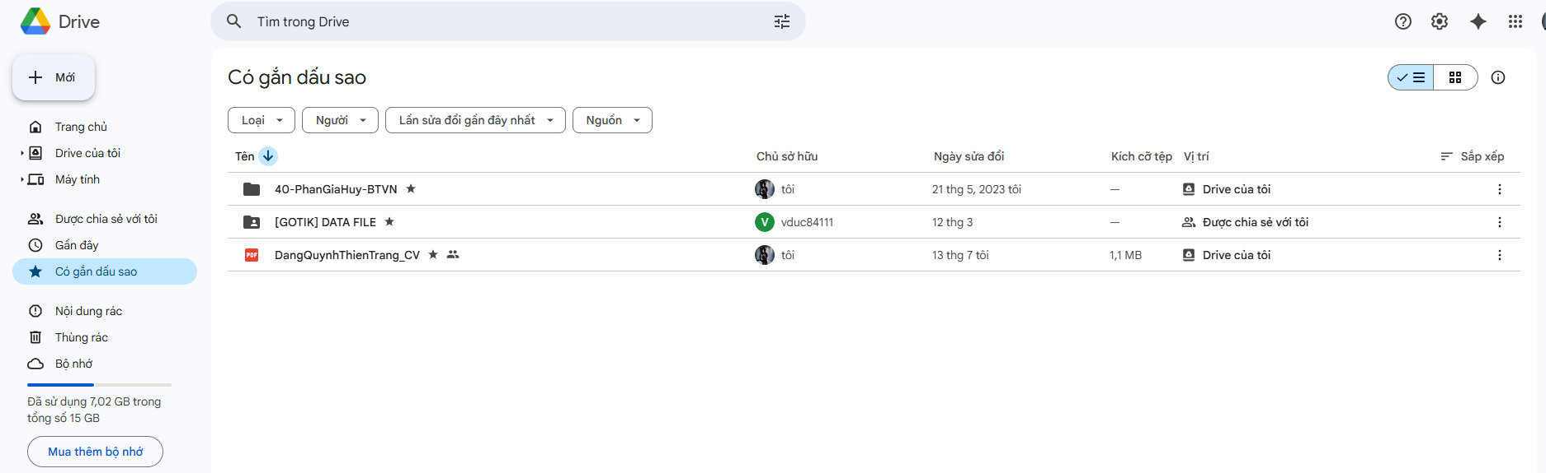
Select stared file/folder of login user

Slide 8
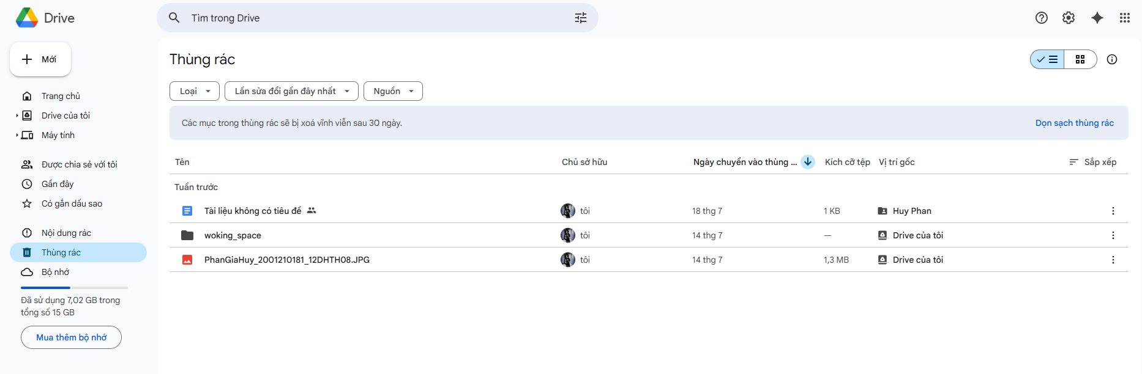
Select file/folder were deleted by login user

Slide 9
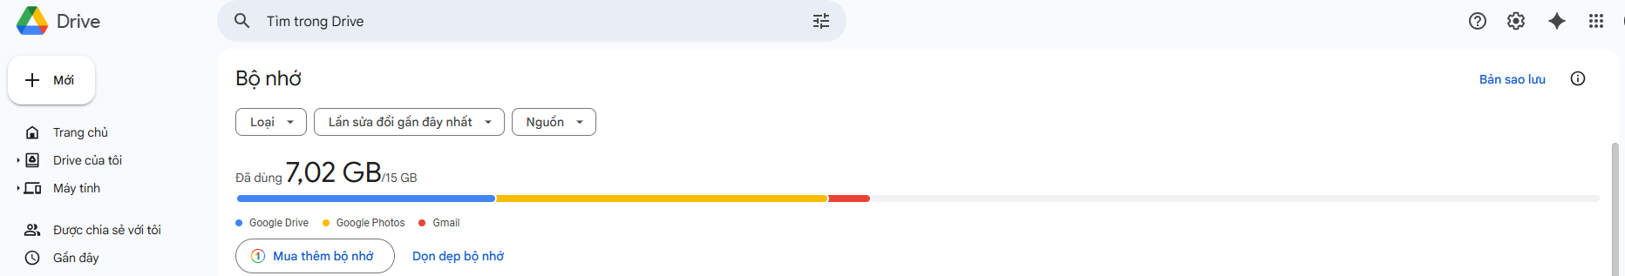
Select login User capacity and UsedCapacity

Slide 10
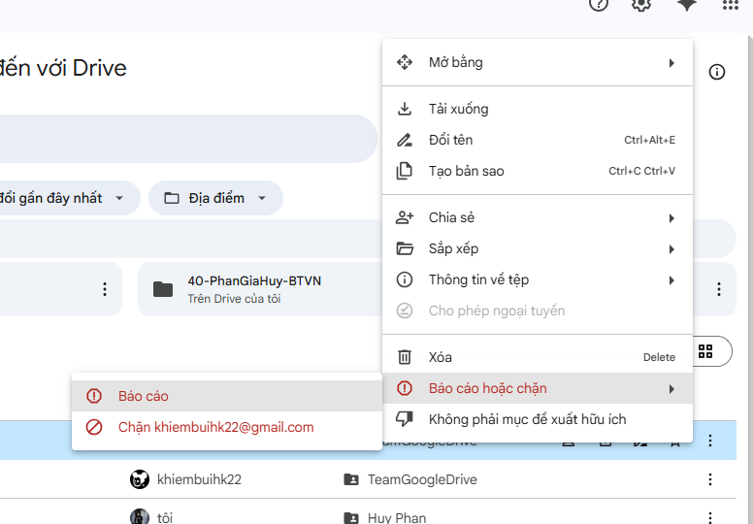
Select User have been Banned by login user

Slide 11
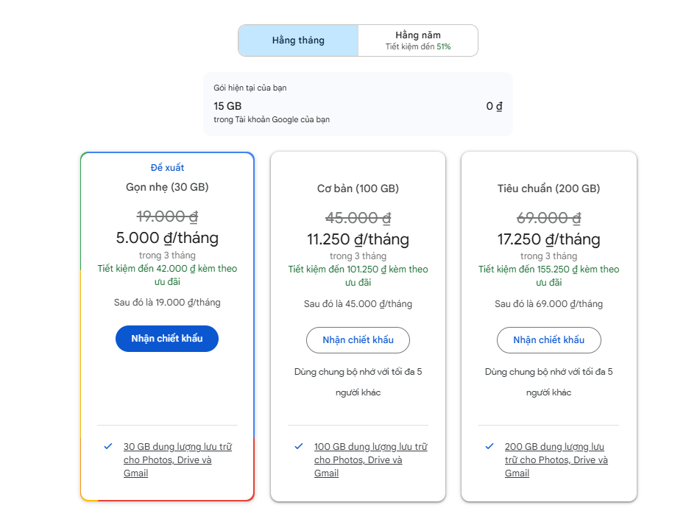
Select Product of login User
Select GoogleDrive’s Products

