Slide 1


Lease Your Future
de la Vega Federico - Gabrieli Gabriele - Galassi Damiano - Giacomelli Gianluca
Grillo Giordano - Iacobelli Leonardo - Roso Delboux Marcus Vinicius

Slide 2



Eni & Basilicata region
Energy transition
Average age 46
Carbon neutrality by 2050
850 M€
Value of agricultural production
Oil & Gas
Extraction
GDP per capita
12,650€
Energy Valley Program.
area of 70 hectares
Unemployment
rate > 13%

Slide 3
ENI in Basilicata SWOT Analysis
STRENGTHS
- Capital availability
- Vertical integration
- Leader in ESG ratings
WEAKNESSES
- Public opinion
- Core product dependency
- Negative externalities related to production
S
W
- Growth of renewable energy production
- Foster local economy
- PNRR
- Availability of labour - Develop and improve the agri-food sector
- Low GDP area
OPPORTUNITIES
- Aging population and demographic reduction
Regulatory changes
- Young migrants
THREATS
O
T

Slide 4






Stakeholders needs and expectations
Citizens | Improving air quality Reducing Noise Increasing income
Landowners | Improve food production Lowering water usage Guarantee product quality
Local authorities | Pollution management Minimize oil leakages
Central governments | Full exploitment of PNRR Guarantee food chain quality Guarantee welfare
Agrifood industries | Increasing export Ecolabelling
Gas distribution companies | Possibility to mix H₂ in gas pipelines

Slide 5
Three Scenarios
EniHub
Hydrogen for the Future
Modernization of agriculture-dedicated technologies
TerrENI
Economical growth
Buildings and technologies for the food of the future
AI and data collection to better agriculture
The meeting place between research and business: a functional structure to generate synergies between business activities, research centers, laboratories, professional services and higher education.
Through electrolysis and dedicated crops we use renewable electricity to "break down" water into hydrogen and oxygen, without producing CO2.
0.46
EniHub
Multi Criteria Analysis:
Social
Logistic and infrastructure
Economic
Environmental
0.78
0.67

Slide 6










Our Solution: TerrENI
EXPORT
QUALITY CHECK
ASSET PORTFOLIO
ENERGY CROPS
COMMUNITY
CENTRAL BODY
LAND
LEASING NETWORK
BLUE
WATER
CROP
YIELD
SUSTAINABILITY
ELECTRICITY
LOCALS
PERCEPTION
BIOGAS-OIL

Slide 7
Time Projections
Short Term​
Medium Term​
Long Term​
Land Concessions
Agriculture modernization​
Fully circular economy​
Exploitation of present
infrastructures
Local economy boost
Land expansion ​
Coupling green energy production​
​
Logistics infrastructures
​
Self-sustained Valley​
Digital twin
AI and data collection
Hydrogen exploitation thanks to new technologies

Slide 8
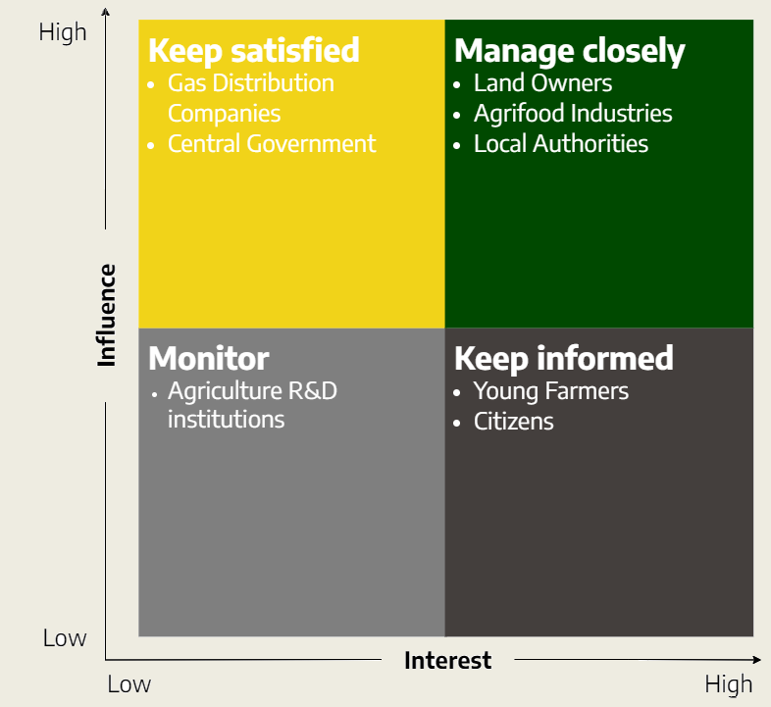








Stakeholders Matrix

Slide 9
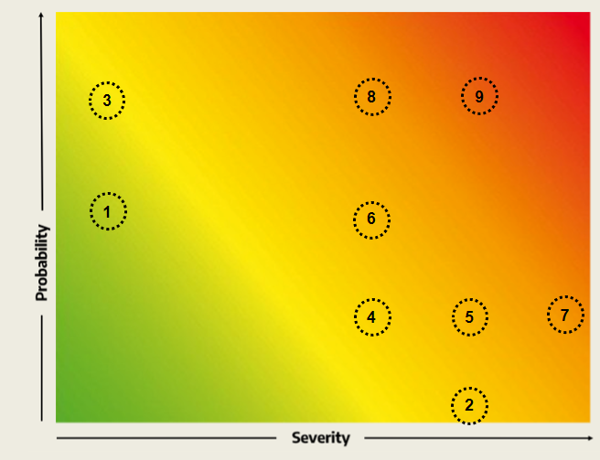
Risk Matrix
BRAIN DRAIN
Special conditions and incentives for young talent
( 8 )
Absence of local trained workers/ experts of agri tech sector
Depreciation of lands
Citizens lack of trust
Local citizens resistence to sell land for future expansions
Potentially low ROI
Future regulatory changes
Current uncertainties about PNRR funds
Presence of better job opportunities elsewhere
Local farmers resistence due to ENI's current reputation
FARMERS RESISTANCE
Transparency and open communication channels
( 9 )
RISK MANAGEMENT
PNRR Rely on capital and partnerships
( 7 )

Slide 10





Coupling energy with lands leasing systems
( 7 )
Foster economic development and self- sustainability
( 8 )
CONCLUSIONS
Boost food production
( 12 )
Investments in logistics and infrastructure
( 8 – 9 – 11 )

Slide 11
Thanks for the attention
TerrENI
de la Vega Federico - Gabrieli Gabriele - Galassi Damiano - Giacomelli Gianluca
Grillo Giordano - Iacobelli Leonardo - Roso Delboux Marcus Vinicius

