Slide 1
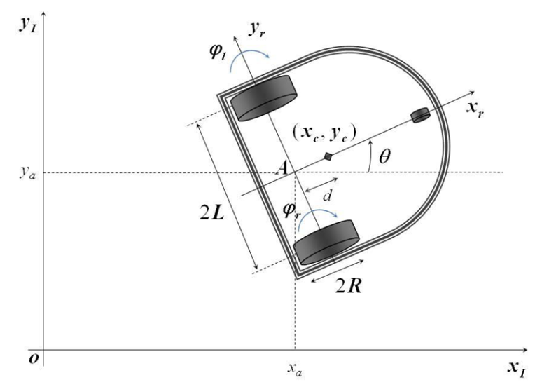

Model variables and parameters
$θ_{c}\left(t\right)$yaw angle
$Y_{c}\left(t\right)$ x-coordinate of the center of mass
$Y_{c}(t)$ y-coordinate of the center of mass
$φ_{l}(t)$ angular rotation of the left wheel
$φ_{r}(t)$ angular rotation of the right wheel
$\dot{φ_{l}}$ angular speed of the left wheel
$\dot{φ_{r}}$ angular speed of the right wheel
2L width of the mobile robot
R radius of the wheel
I_{c.} moment of inertia of the car
I_{w.} moment of inertia of the wheel
d distance center of mass – rear axle
m_{w} mass of the wheel
m_{c} mass of the car
Variables
Parameters

