Slide 1
Integrating TORCS within a DDS environment
Apollonio Marco
Bossi Giacomo

Slide 2
Context and problem addressed
The project required us to create a simulated environment where an ECU running FreeRTOS would be able to communicate through Ethernet and the DDS protocol with the car simulator TORCS
The Proof Of Concept that we implemented allows a monodirectional communication from the ECU to the simulator, allowing to send steer commands through VSS standard and to see the car steer in the simulation according to the input received

Slide 3
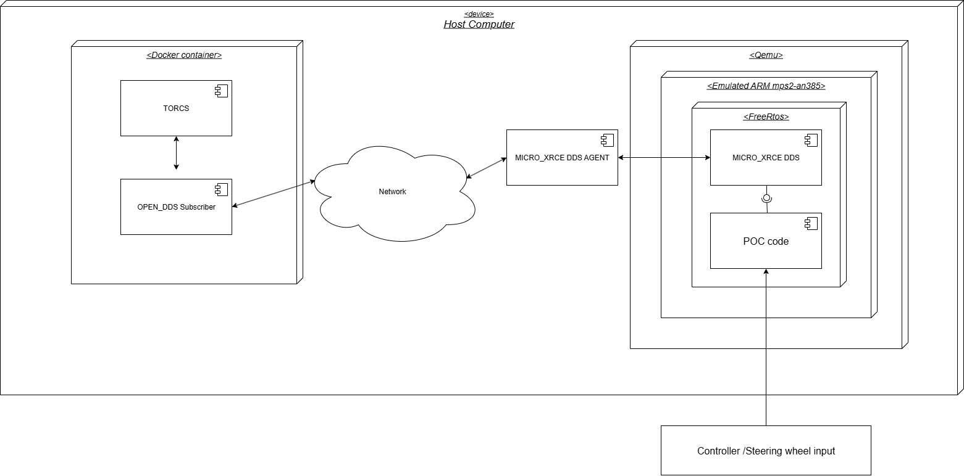
Solution: General Schematization
The implementation is divided mainly in two parts:
The ECU implemented in a Qemu emulator
The TORCS simulator, which was put in a Docker container

Slide 4
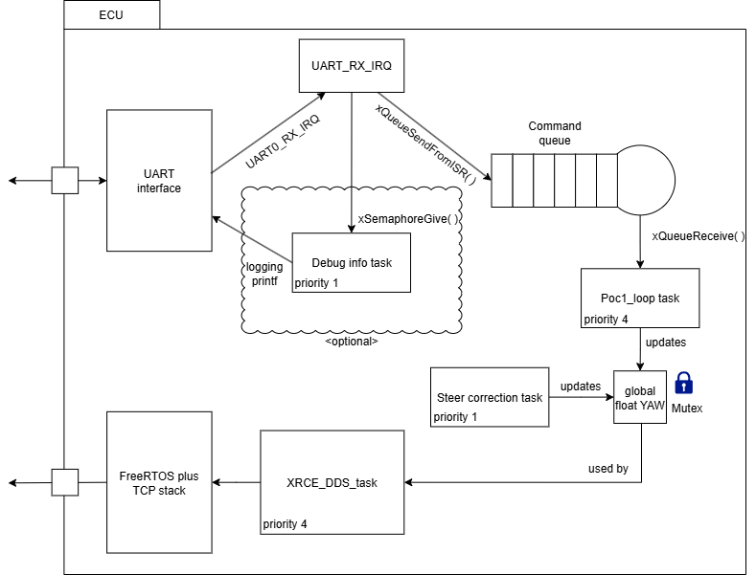
Solution: ECU Implementation
The ECU code is divided in two main tasks:
The UART input reading task, responsible to read the value of the input device
The XRCE DDS task responsible to handle the network setup, create the VSS message to send and send it to the XRCE DDS Agent
The XRCE Agent is a program run on the Host System to allow the interfacing of the ECU to the DDS domain

Slide 5
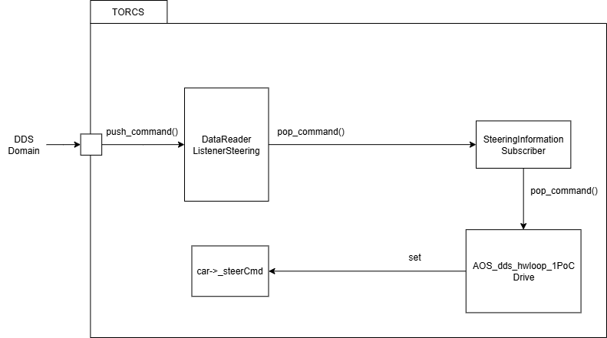
Solution: TORCS Implementation
The TORCS code is a “pilot” created by a make command defined by the developer of the simulator
we added the OPENDDS library to create the subscriber to receive the Steer commands
Once the messages arrive, they are put in a queue and the drive method inside the pilot object will pop them to set the car steer value

Slide 6
Outcomes
Artifacts :
A docker image was created to simplify the process of working with TORCS by installing all the correct dependencies and setting the environment variables needed in an automatic way.
TORCS pilots are the way to interface with TORCS, we implemented a custom one that uses a DDS subscriber to control the car.
The FreeRTOS application is the last artifact and it handles the processing of driving data like yaw in a similar manner of an embedded controller. It receives inputs, processes it and publishes it with XRCE DDS.

Slide 7
Outcomes
Learning outcomes :
How to use properly build systems like Make / MPC
Implementation of interrupt drivers
How the DDS protocol works
Structure of Real Time applications

Slide 8
Outcomes
Problems Encountered
Missing interrupts in the IRQ table
Starvation of FreeRTOS tasks with low priority
Integration of different projects (es. TORCS with DDS)

