Slide 1

UNIVERSITÀ DEGLI STUDI DI PALERMO – DIPARTIMENTO DI INGEGNERIA
VISION TRANSFORMER PRUNING USING HESSIAN-GUIDED NEURAL ARCHITECTURE SEARCH
CANDIDATO
RELATORE
GIACOMO LOMBARDO
PROF.SSA LILIANA LO PRESTI
ANNO ACCADEMICO 2025 / 2026

Slide 2
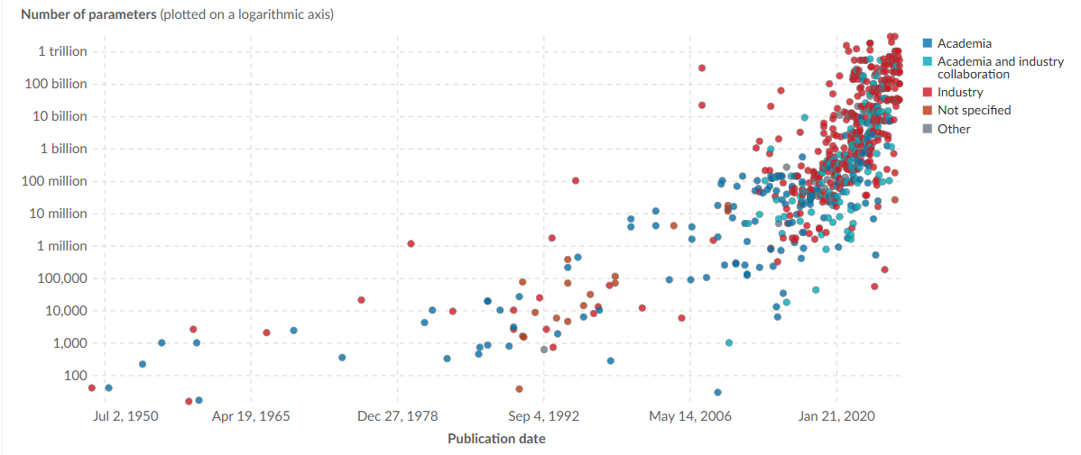
Compression of Transformer-based models
Since the discovery of the Transformer architecture, a lot of models have been trained and deployed for different purposes. The easiest way to improve performance is to increase their scale, but this approach comes with problems, such as the need for expensive hardware and infrastructure to train and use them.
Furthermore, these models cannot be easily deployed on edge devices like smartphones, because of their limited computational capabilities. This causes companies to deploy on the cloud, raising a lot of privacy concerns for users.
Research has focused on improving both the hardware and the models, specifically researchers have developed many compression techniques, making models easier to run on consumer-level hardware.

Slide 3
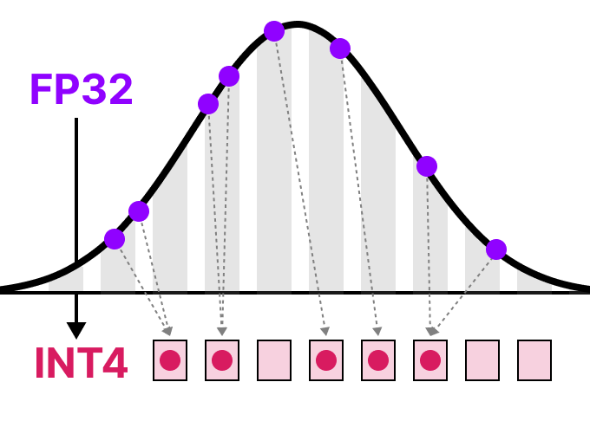
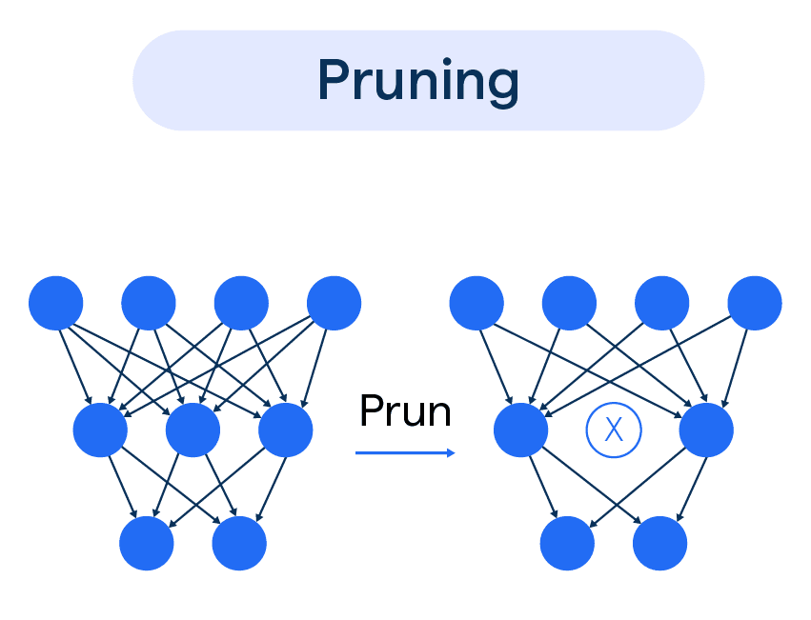
State of the Art Compression Strategies
The main compression techniques are:
Quantization: makes the model smaller in size by encoding parameters with lower precision representations (fp16, int8, int4 instead of fp32). This also allows to decrease inference time by using specialized hardware.
Knowledge Distillation: this technique is used to train a smaller model (student) with the supervision of a bigger model (teacher). This process allows the student to reach better performances while keeping a smaller size.
Pruning: a technique used to reduce the size of a model by removing redundant or less important parameters that contribute little to the model’s performance.
Neural Architecture Search: an automated process for designing artificial neural networks. Instead of relying on manual human design, NAS uses algorithms to discover the most efficient architecture for a specific task.

Slide 4
Main Goal
Given a Vision Transformer model, fine tune it on the desired domain, then compress it iteratively to a certain degree while maintaining high accuracy.

Slide 5
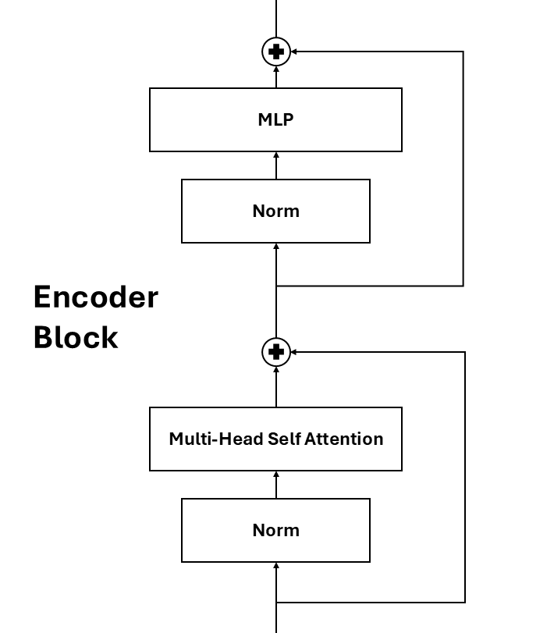
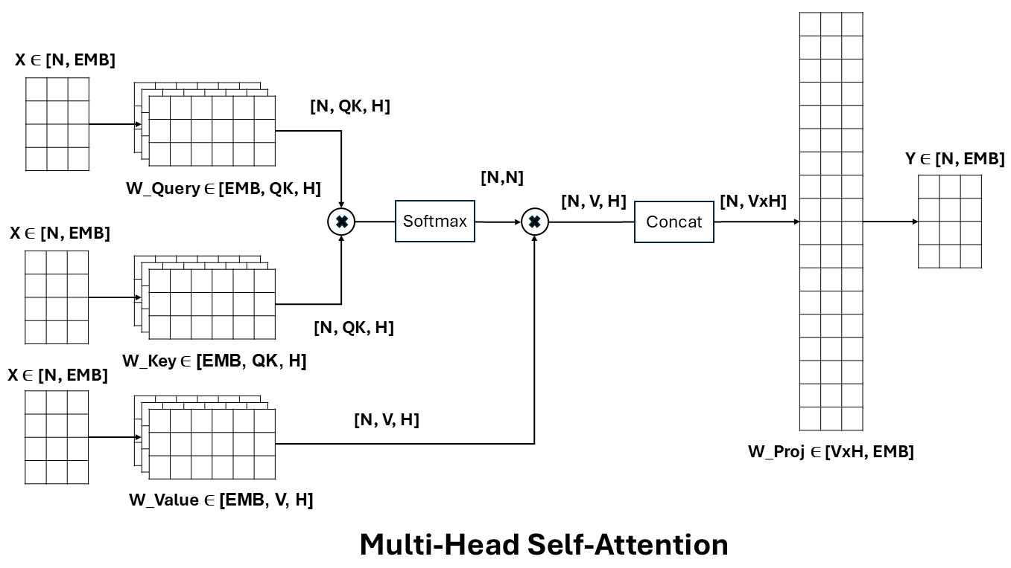
Vision Transformer (ViT)
Encoder-Only Transformer Architecture for handling Images, largely used as a backbone for various architectures and tasks.

Slide 6
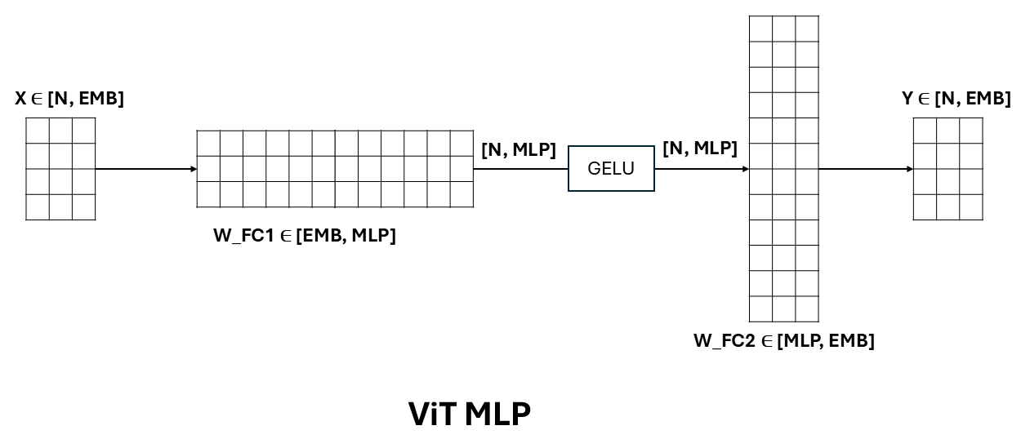
Vision Transformer (ViT)
Encoder-Only Transformer Architecture for handling Images, largely used as a backbone for various architectures and tasks.

Slide 7
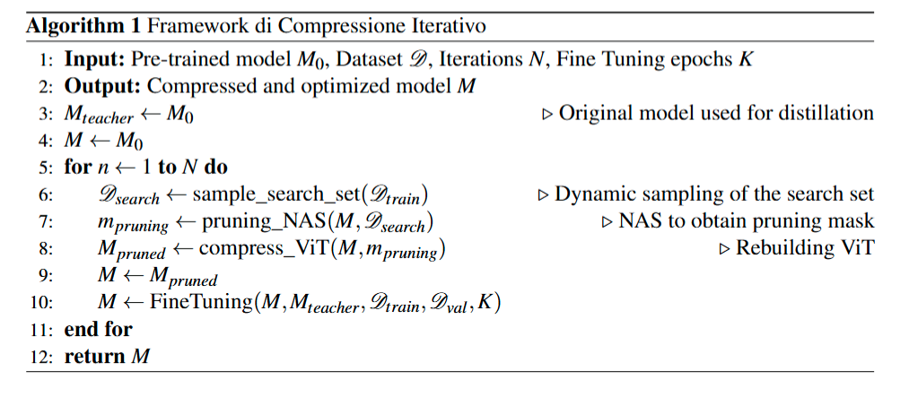
ViT Compression Framework
The compression process is iterative, and every iteration includes two phases:
Pruning (Architecture Training)
Recovery Fine-Tuning (Parameter Training)
In the first phase the search set, used to evaluate every node and to compute parameter importances, is sampled (once every iteration to prevent architecture overfitting). Then we use it for the search process.
The second phase recovers the performance loss caused by the first phase, and it uses KD with the original model.
The actual compression happens during the reconstruction of the entire model, by copying the non-zeroed weights to new and smaller tensors.

Slide 8

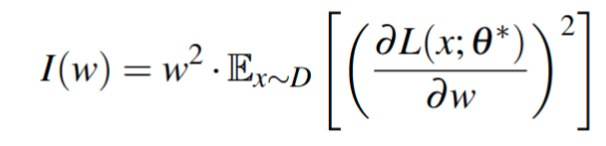
Neural Architecture Search with Branch and Bound
The NAS process explores different subnets, maximizing the objective function, which considers accuracy A and the number of parameters P. Every node in the search tree is a subnet, which is evaluated on the Search Set during exploration, to compute accuracy and, at the same time, the importance of each parameter.
Every action uses the estimation of parameter importance to choose which dimension to prune. We use a metric that considers both magnitude and gradient of the weights:
Notice that the second part is the diagonal approximation of the Fisher Information Matrix, and it approximates the Hessian of the loss function when the model is converging.

Slide 9

Neural Architecture Search with Branch and Bound
The NAS process explores different subnets through a 5-ary tree. For every node (subnet) another 5 nodes are created during the Branch phase. They are explored and evaluated using the objective function.
ViT
The Bound phase is carried out by verifying a simple condition on every node, after the exploration.
MLP
QK
VP
H
EMB
This process is repeated during every compression iteration. To prevent excessive performance degradation the depth of the search tree is limited to 6 actions.
MLP
QK
VP
H
EMB
Pruned by Bound on Best Value

Slide 10
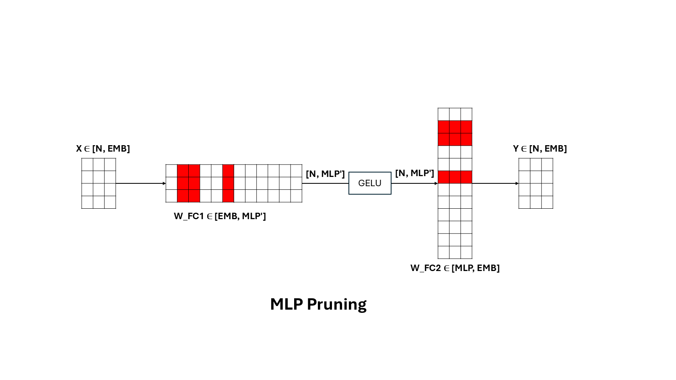
NAS ACTIONS: MLP Pruning
The search process includes 5 possible pruning actions that can be chosen to maximize the objective function:
• Pruning Multi-Layer Perceptron
• Query-Key Pruning
• Value-Projection Pruning
• Head Pruning
• Embedding Pruning
All actions except the last are block-specific.
First, we identify the set of dimensions with
the lowest importance for each block. Finally
we choose the block with the least importance.

Slide 11
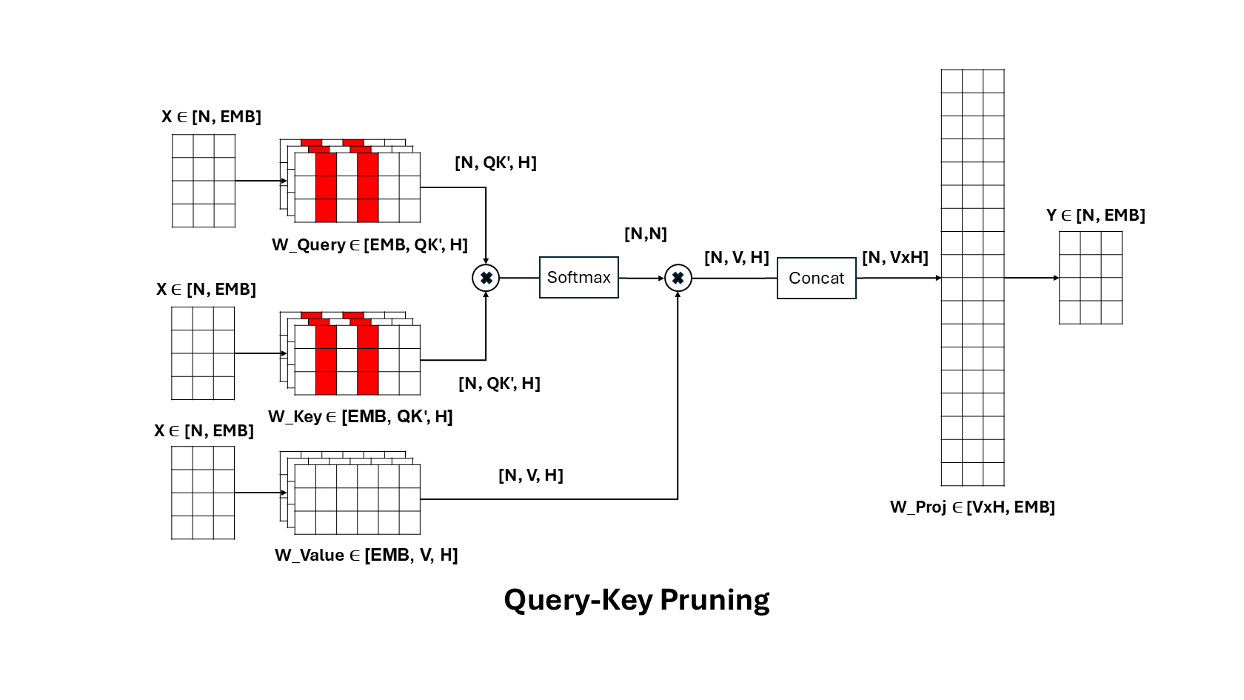
NAS ACTIONS: QK Pruning
The search process includes 5 possible pruning actions that can be chosen to maximize the objective function:
• Pruning Multi-Layer Perceptron
• Query-Key Pruning
• Value-Projection Pruning
• Head Pruning
• Embedding Pruning
All actions except the last are block-specific.
First, we identify the set of dimensions with
the lowest importance for each block. Finally
we choose the block with the least importance.

Slide 12
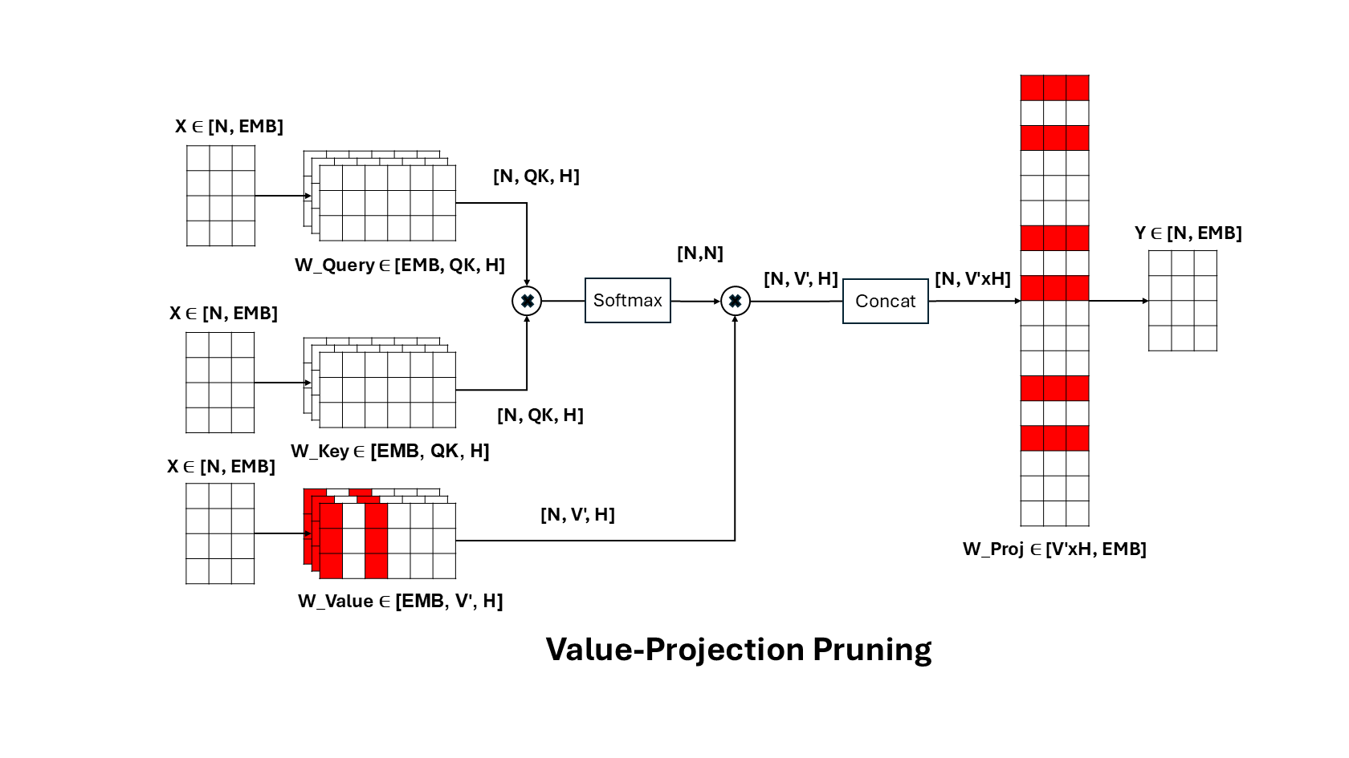
NAS ACTIONS: VProj Pruning
The search process includes 5 possible pruning actions that can be chosen to maximize the objective function:
• Pruning Multi-Layer Perceptron
• Query-Key Pruning
• Value-Projection Pruning
• Head Pruning
• Embedding Pruning
All actions except the last are block-specific.
First, we identify the set of dimensions with
the lowest importance for each block. Finally
we choose the block with the least importance.

Slide 13
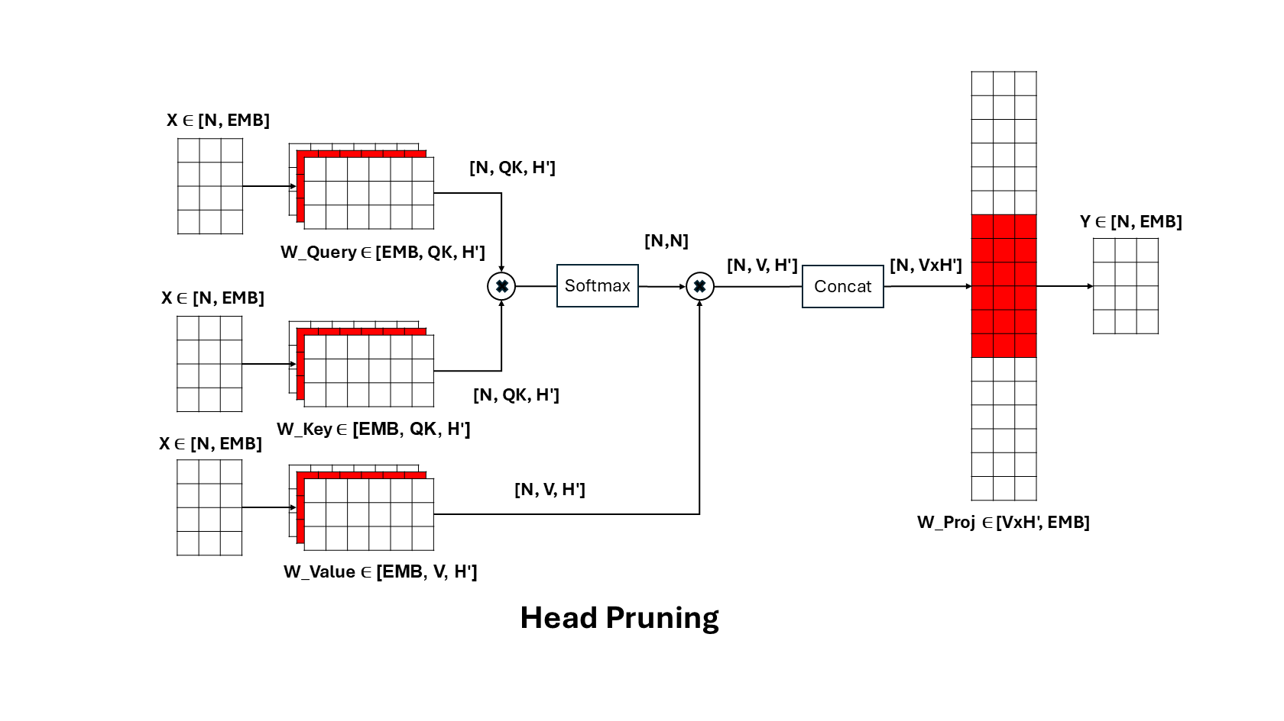
NAS ACTIONS: Head Pruning
The search process includes 5 possible pruning actions that can be chosen to maximize the objective function:
• Pruning Multi-Layer Perceptron
• Query-Key Pruning
• Value-Projection Pruning
• Head Pruning
• Embedding Pruning
All actions except the last are block-specific.
First, we identify the set of dimensions with
the lowest importance for each block. Finally
we choose the block with the least importance.

Slide 14
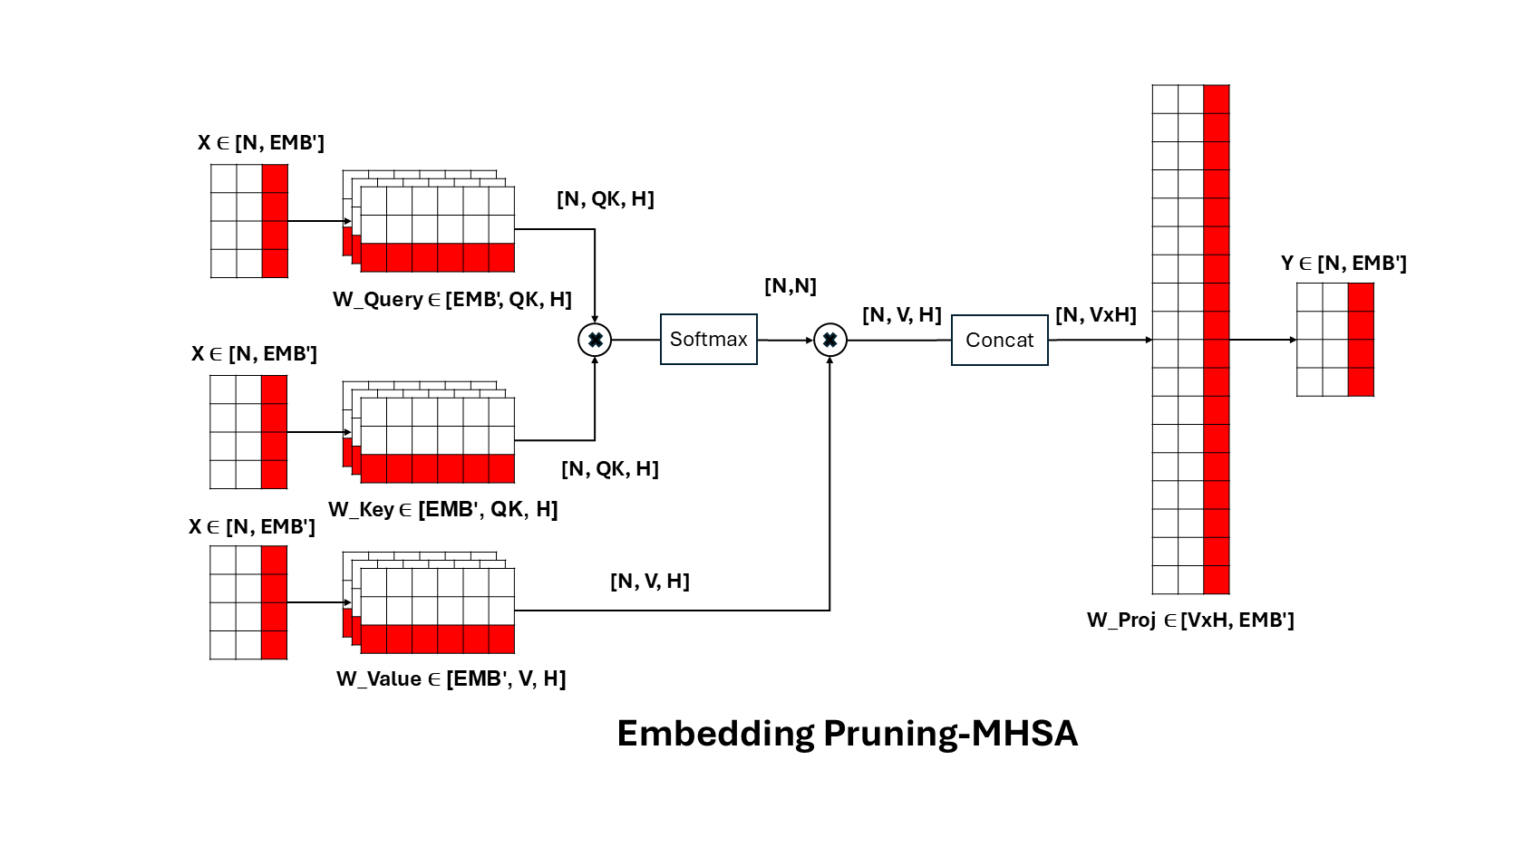
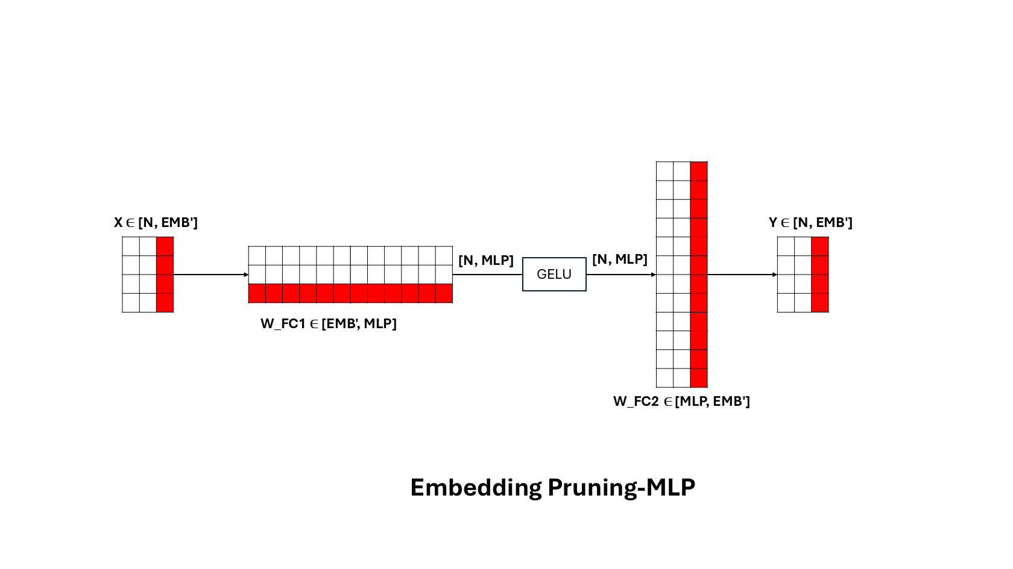
NAS ACTIONS: Embedding Pruning
By pruning the embedding dimension every weight tensor in the model is made smaller. This action is the most important to increase the performance of the ViT model, but it has a great impact on accuracy.

Slide 15
Metrics used
Accuracy (%): the final model Top-1 Accuracy computed on the test set.
Parameter count (MLN): the final number of parameters in the compressed ViT.
GFLOPS: the number of floating-point operations for a single forward pass (1 GFLOPS = 1x10^9 FLOPS).
Throughput (img/s): the number of images the model can process per second.
Latency (ms): the time required to process a single image.

Slide 16
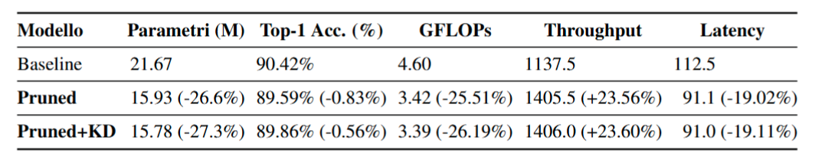
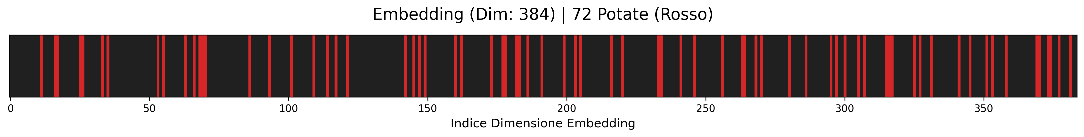
ViT-S Compression on CIFAR100
These tests use the same configuration of 15 iterations and 20 fine tuning epochs.
On CIFAR100 the results show a negligible impact on accuracy (especially using Knowledge Distillation), with an almost 30% compression rate. Thanks to the reconstruction of the model, throughput and latency both show around 20% improvement on a NVIDIA RTX 4080 mobile.

Slide 17
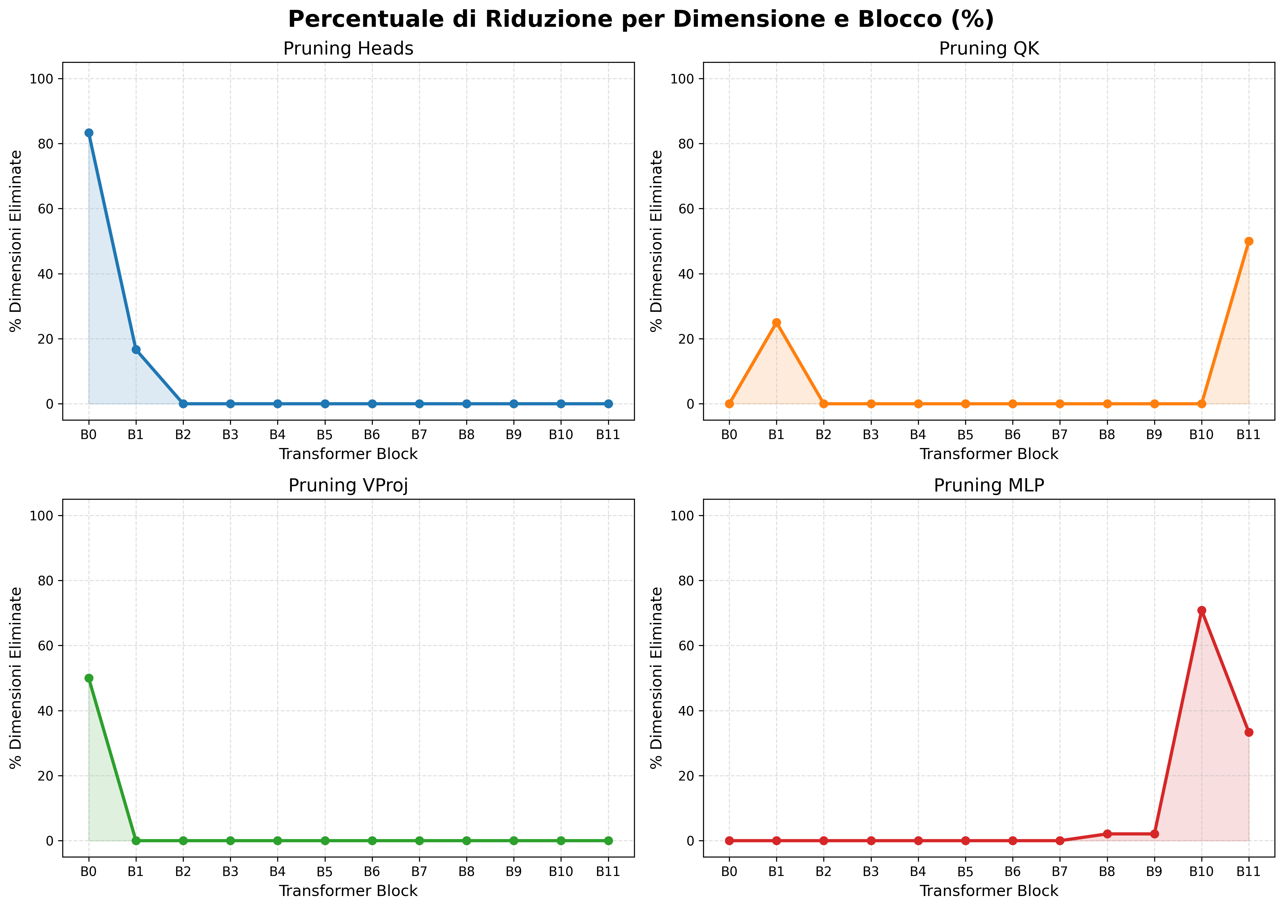
ViT-S Compression on CIFAR100 - analysis
These plots were obtained during the test with KD enabled, but the same patterns can be observed in the test without KD.
On CIFAR100 the compression process cuts 72 out of 384 embedding dimensions, because the images are 32x32, so there is a lot of redundancy in the original model.
The other dimensions show a clear pattern, in the blocks closer to input, attention is less important, while the ones closer to output do not need all the MLP dimensions.

Slide 18
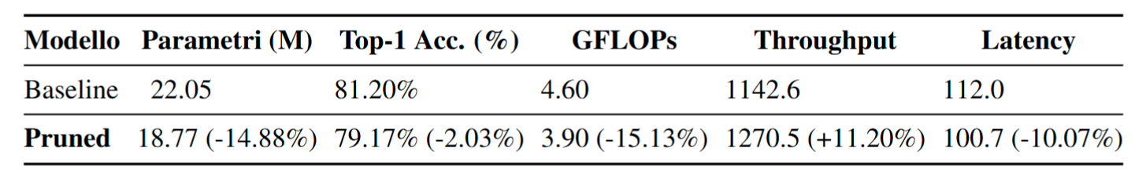
ViT-S Compression on ImageNet-1K
These tests use the same configuration of 15 iterations but 10 fine-tuning epochs. On ImageNet-1K, the results show a more significant impact on accuracy, with a compression rate of nearly 15%. The discrepancy with previous results is due to the much greater difficulty of the dataset.
The patterns of the dimensions in the model are very similar to the ones observed with the CIFAR-100 test.

Slide 19
Conclusions
We’ve developed a novel framework (Branch and Bound is not used at all in this field) to reduce ViT parameters.
We achieve a real compression which translates in better performance during inference, with minimal accuracy loss.
Results show some patterns that could help explain how the Transformer Architecture works on images.
Thank you for your attention!

