Slide 1
Overlay DC grid layout
Giacomo Bastianel, Oscar Damanik, Hakan Ergun
10th August 2023

Slide 2
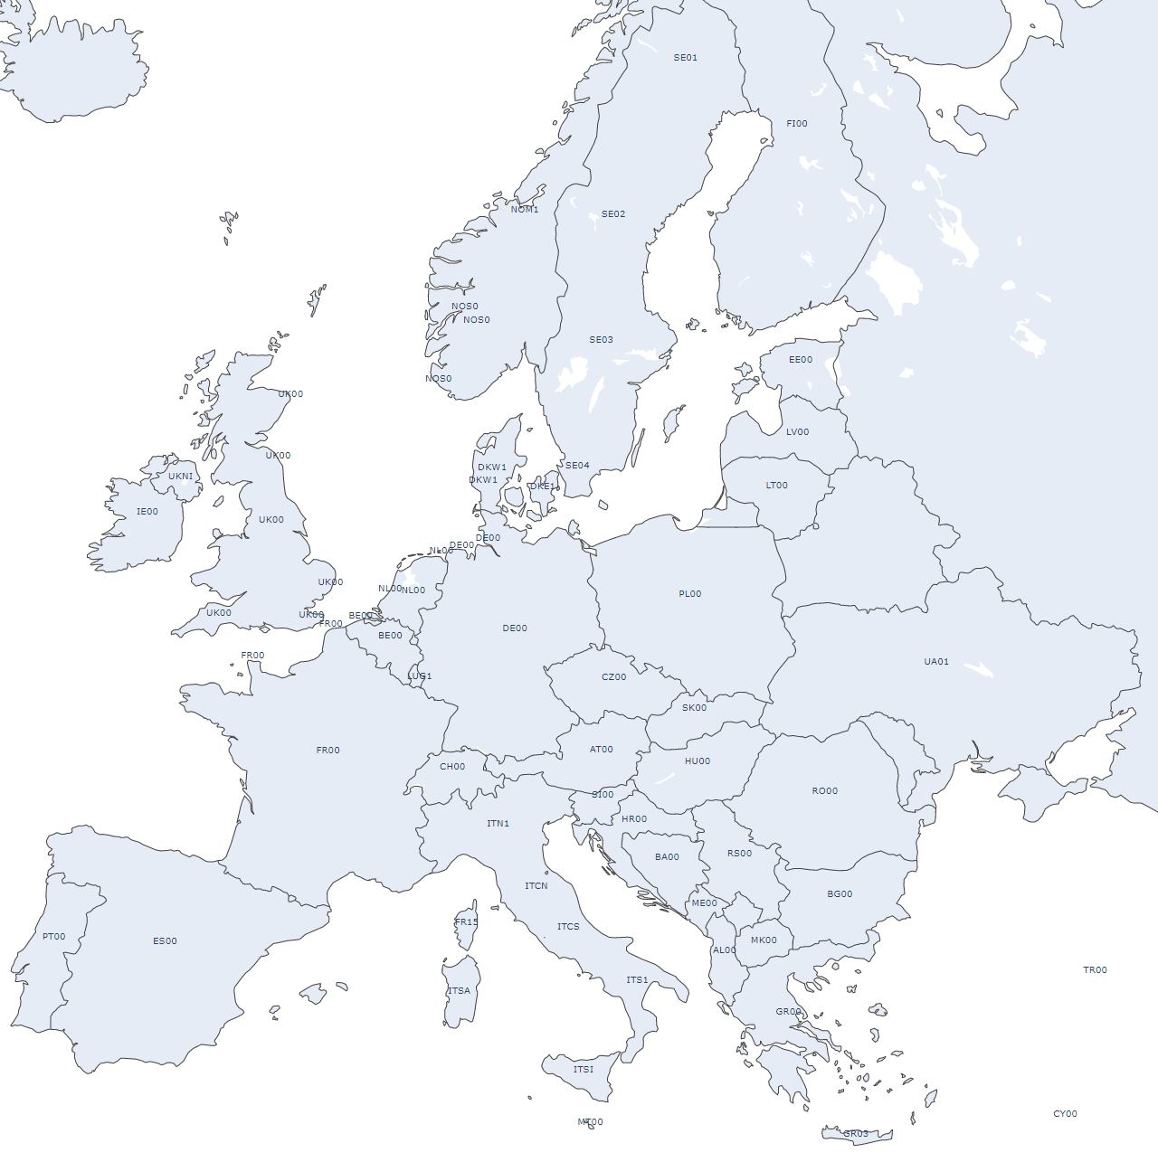
Energy market groupings
group_1 | group_2 | group_3 | group_4 | group_5 | group_6
IE00 | NOS0 | DKW1 | FR00 | CH00 | PL00
UKNI | NOM1 | DKE1 | ES00 | ITN1 | CZ00
UK00 | NON1 | NL00 | PT00 | ITCN | AT00
 | SE04 | BE00 |  | ITCS | SK00
 | SE03 | LUB1 |  | ITS1 | HU00
 | SE02 | DE00 |  | ITSI | UA01
 | SE01 | LUG1 |  | FR15 | RO00
 | FI00 | DEKF |  | ITSA | PLE0
 | EE00 | DKKF |  | MT00 | PLI0
 | LV00 | LUV1 |  | SI00
 | LT00 | LUF1 |  | HR00
 |  |  |  | BA00
 |  |  |  | RS00
 |  |  |  | ME00
 |  |  |  | AL00
 |  |  |  | GR00
 |  |  |  | GR03
 |  |  |  | MK00
 |  |  |  | BG00
 |  |  |  | TR00
 |  |  |  | CY00
 |  |  |  | ITCO
 |  |  |  | IS00
 |  |  |  | TN00

Slide 3
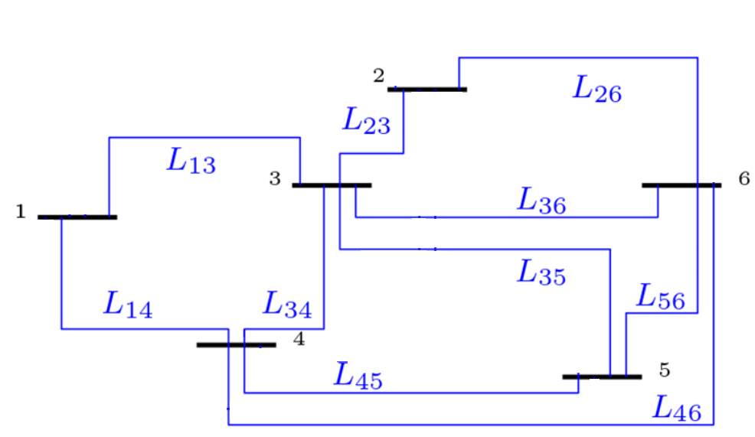
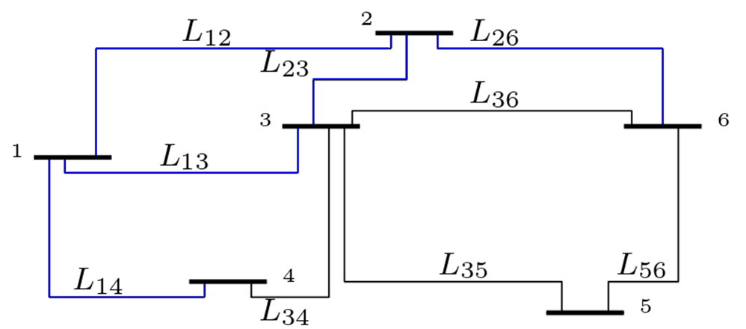
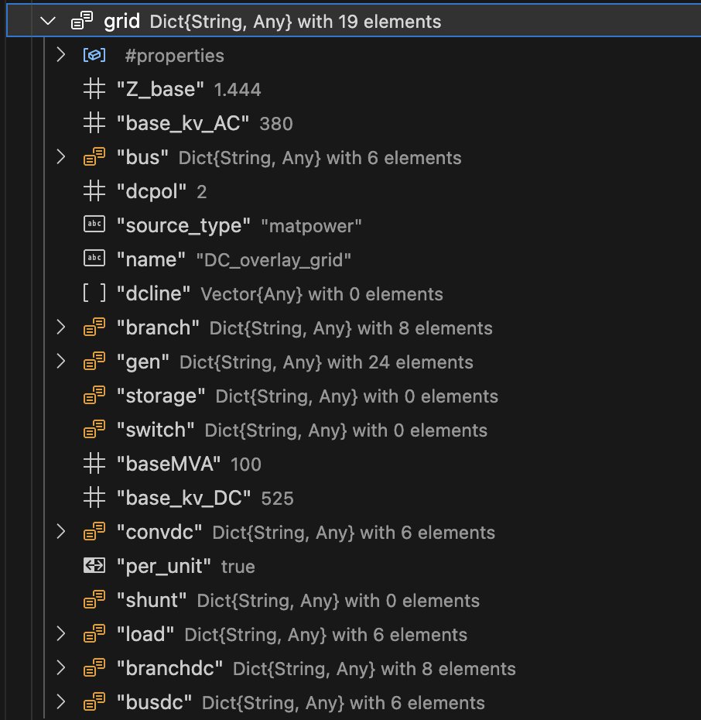
AC grid characteristics
DC grid characteristics

Slide 4
Thanks for your attention!
Questions?

