Slide 1
Building the Belgian grid and load, solar PV and wind time series
Giacomo Bastianel, Hakan Ergun
Giacomo Bastianel, 1^{sr} August 2023
giacomo.bastianel@kuleuven.be
PhD student, EnergyVille - KU Leuven, Genk - Leuven, Belgium

Slide 2
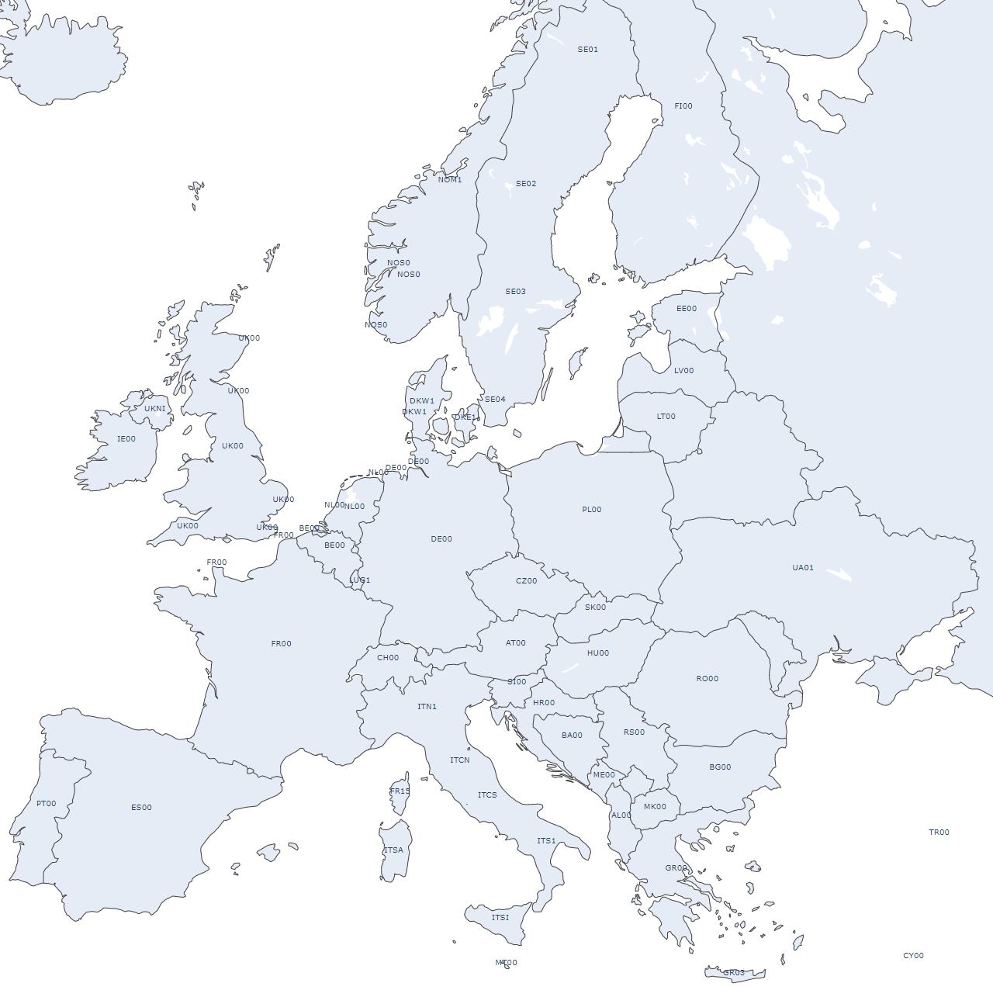
Energy market groupings
group_1 | group_2 | group_3 | group_4 | group_5 | group_6
IE00 | NOS0 | DKW1 | FR00 | CH00 | PL00
UKNI | NOM1 | DKE1 | ES00 | ITN1 | CZ00
UK00 | NON1 | NL00 | PT00 | ITCN | AT00
 | SE04 | BE00 |  | ITCS | SK00
 | SE03 | LUB1 |  | ITS1 | HU00
 | SE02 | DE00 |  | ITSI | UA01
 | SE01 | LUG1 |  | FR15 | RO00
 | FI00 | DEKF |  | ITSA | PLE0
 | EE00 | DKKF |  | MT00 | PLI0
 | LV00 | LUV1 |  | SI00
 | LT00 | LUF1 |  | HR00
 |  |  |  | BA00
 |  |  |  | RS00
 |  |  |  | ME00
 |  |  |  | AL00
 |  |  |  | GR00
 |  |  |  | GR03
 |  |  |  | MK00
 |  |  |  | BG00
 |  |  |  | TR00
 |  |  |  | CY00
 |  |  |  | ITCO
 |  |  |  | IS00
 |  |  |  | TN00

Slide 3
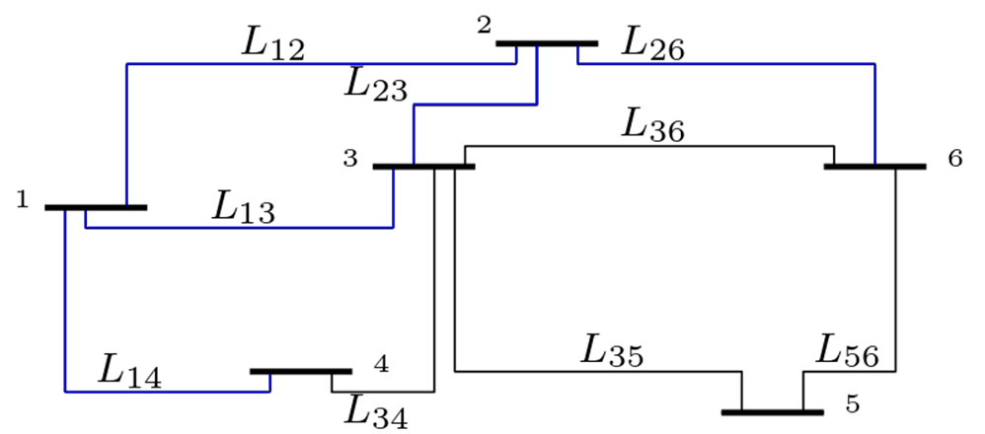
AC grid characteristics
Topology
Transmission lines
name | L_12 | L_13 | L_14 | L_15 | L_16 | L_23 | L_24 | L_25 | L_26 | L_34 | L_35 | L_36 | L_45 | L_46 | L_56
total [MVA] | (+/-) 2000 | (+/-) 3000 | (+/-) 3000 | 0 | 0 | (+/-) 4000 | 0 | 0 | (+/-) 1000 | 7250 | 3375 | 11125 | 0 | 0 | 12225
length [km] | 1500 | 950 | 500 | 1600 | 1550 | 850 | 2000 | 2250 | 1400 | 775 | 900 | 625 | 875 | 1350 | 975
cross section [mm²] | 2x1600 | 3x1600 | 3x1600 | - | - | 4x1600 | - | - | 1x1600 | 9x805.7 | 4x805.7 | 10x1274.4 | - | - | 10x1171.5
Resistance Ω/KM | 0.00705 | 0.0047 | 0.0047 | - | - | 0.00129 | - | - | 0.00515 | 0.0133633 | 0.0133633 | 0.0038856 | - | - | 0.00414625
Inductive reactance Ω/Km | - | - | - | - | - | - | - | - | - | 0.0741667 | 0.0741667 | 0.0237333 | - | - | 0.026575
Capacitive reactance MΩ-Km | - | - | - | - | - | - | - | - | - | 0.0430667 | 0.0430667 | 0.0138556 | - | - | 0.01545
Peak generation and demand
node | 1 | 2 | 3 | 4 | 5 | 6
Solar PV (Peak MVA) | 196000 | 64000 | 560000 | 516000 | 505000 | 309000
Wind onshore (peak MVA) | 54000 | 109000 | 197000 | 218000 | 135000 | 88000
Wind offshore (peak MVA) | 108000 | 9000 | 210000 | 25000 | 4000 | 19000
Flexible generation (peak MVA) | 74758 | 86786 | 166807 | 153261 | 196432 | 93608
Demand (peak MVA) | 64671 | 72615 | 138174 | 138441 | 181092 | 82520

Slide 4
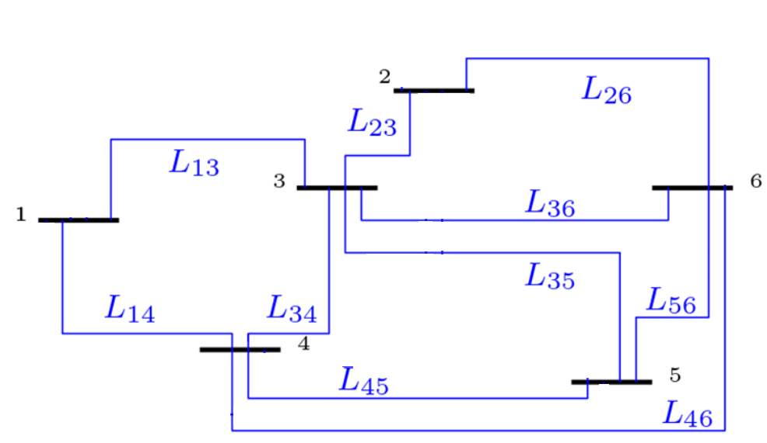
DC overlay grid characteristics
Topology
Converter characteristics
Sub modules | 312
Sub module capacitance | 2000 µF
Arm inductance | 0.1H
DC voltage [kV] | (+/-)500
Capacity [MVA] | (+/-)3000
Transmission lines
Line | L_12 | L_13 | L_14 | L_15 | L_16 | L_23 | L_24 | L_25 | L_26 | L_34 | L_35 | L_36 | L_45 | L_46 | L_56
Total [MVA] | - | (+/-)8000 | (+/-)10000 | - | - | (+/-)6000 | - | - | (+/-)4000 | (+/-)10000 | (+/-)8000 | (+/-)8000 | (+/-)10000 | (+/-)10000 | (+/-)6000
 | - |  |  | - | - |  | - | -
Length [Km] | - | 950 | 500 | - | - | 850 | - | - | 1400 | 775 | 900 | 625 | 875 | 1350 | 975
Cross section [mm²] | - | 8x1600 | 10x1600 | - | - | 6x1600 | - | - | 4x1600 | 10x1600 | 8x1600 | 8x1600 | 10x1600 | 10x1600 | 6x1600
Resistance Ω/Km | - | 0.0017625 | 0.00141 | - | - | 0.00235 | - | - | 0.003525 | 0.00141 | 0.0017625 | 0.0017625 | 0.00141 | 0.00141 | 0.00235
From node | 1 |  |  |  |  | 2 |  |  |  | 3 |  |  | 4 |  | 5
To node | 2 | 3 | 4 | 5 | 6 | 3 | 4 | 5 | 6 | 4 | 5 | 6 | 5 | 6 | 6
Max Generation-Demand [MVA] | 209984 | 530838 | 578882 | 372405 | 332036 | 389384 | 479693 | 270471 | 193741 | 749559 | 540973 | 491143 | 678105 | 595553 | 410767

Slide 5
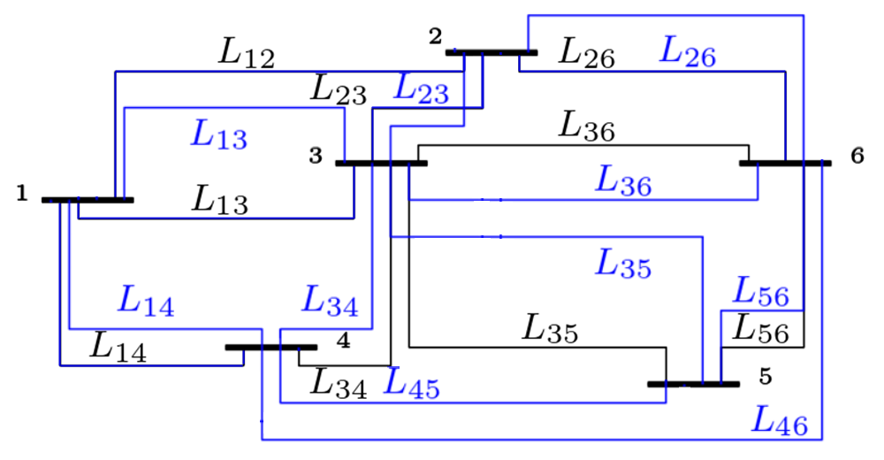
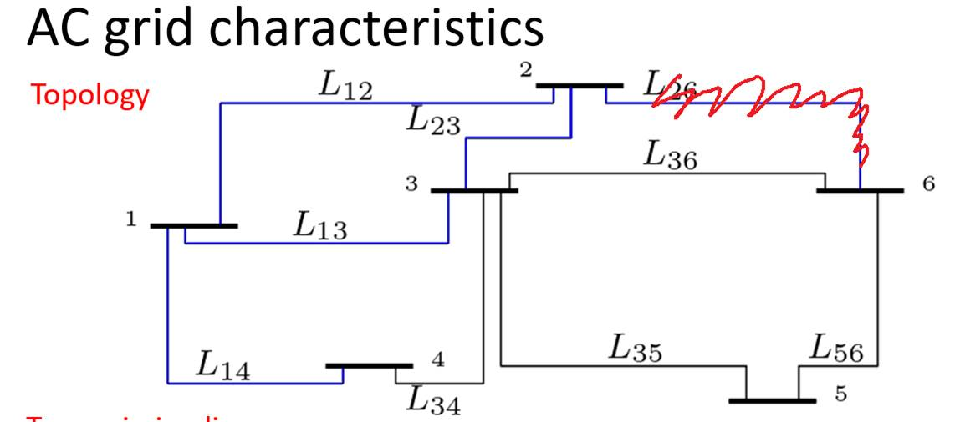
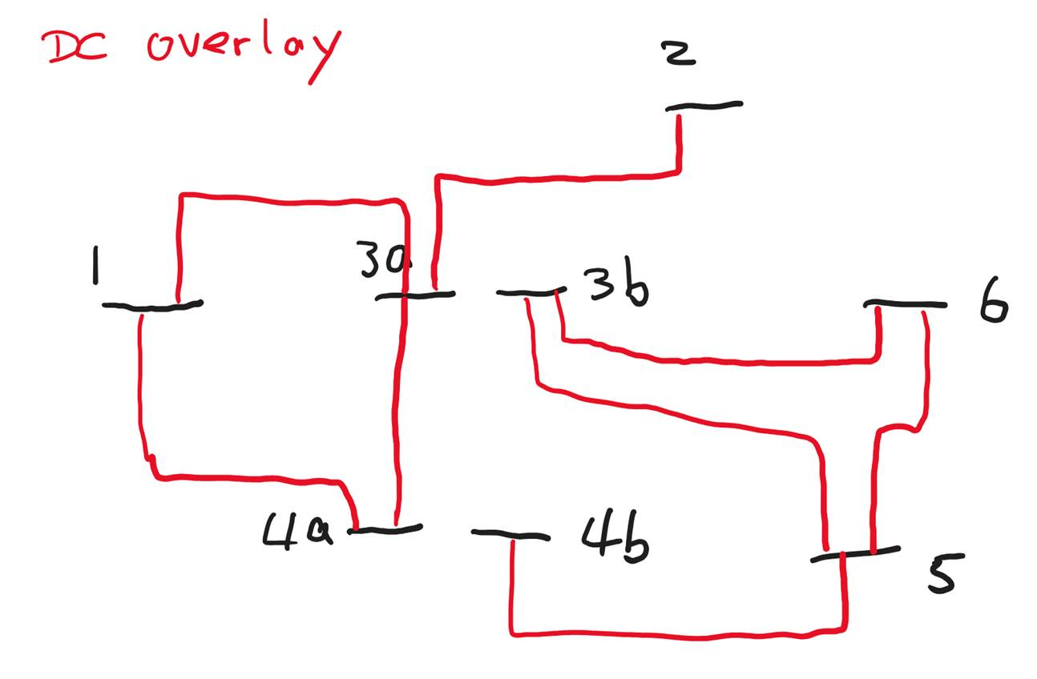

Slide 6
Scenarios
The scenarios are as follows:
MAX Load/RES: the time step with the maximum ratio of the (total load)/(total RES generation)
MIN Load/RES: the time step with the minimum ratio of the (total load)/(total RES generation)
MIN offshore wind: the time step with the minimum total offshore wind generation
MIN onshore wind: the time step with the minimum total onshore wind generation
MIN RES: the time step with the minimum total RES generation
MAX demand: the time step with the highest total demand
Peak available generation per RES type [MVA]
 | Onshore Wind group_1 | Offshore Wind group_1 | Solar PV group_2 | Onshore Wind group_2 | Offshore Wind group_2 | Solar PV group_3 | Onshore Wind group_3 | Offshore Wind group_3 | Solar PV group_4 | Onshore Wind group_4 | Offshore Wind group_4 | Solar PV group_5 | Onshore Wind group_5 | Offshore Wind group_5 | Solar PV group_6 | Onshore Wind group_6 | Offshore Wind group_6 | Solar PV group_6
MAX Load/RES | 0 | 8487.791496 | 4709.065 | 0 | 6016.084 | 224.9021 | 0 | 12429.01 | 6847.477 | 2642.942 | 7646.277 | 869.3453 | 0 | 6176.372 | 60.79033 | 0 | 11537.27 | 787.9716
MIN Load/RES | 28003.99769 | 30269.92961 | 21162.76 | 5092.239 | 30538.54 | 696.5791 | 71774.06 | 12429.01 | 41453.01 | 130987.9 | 39819.6 | 1329.643 | 106685.3 | 10195.58 | 129.8723 | 53375.71 | 9564.869 | 906.7403
MIN offshore wind | 40336.44079 | 1495.4037 | 451.0239 | 9450.104 | 14401.63 | 564.4748 | 89005.83 | 12429.01 | 482.2548 | 142318.9 | 82891.04 | 509.6786 | 102539.4 | 18897.55 | 225.8447 | 45591.02 | 33149.01 | 420.5218
MIN onshore wind | 24141.60045 | 3023.775827 | 4656.358 | 9246.354 | 1490.45 | 86.70698 | 39898.89 | 12429.01 | 5293.251 | 63892.2 | 6017.618 | 98.52518 | 85355.59 | 8153.3 | 134.3193 | 47325.84 | 2709.99 | 380.5611
MIN RES | 0 | 980.8215226 | 870.9934 | 0 | 5459.969 | 96.11722 | 0 | 12429.01 | 2492.901 | 0 | 23945.07 | 2936.936 | 0 | 22885.26 | 333.3209 | 0 | 16506.01 | 1314.817
MAX demand | 0 | 22272.76319 | 12367.6 | 0 | 24480.79 | 578.8142 | 0 | 12429.01 | 1836.097 | 37.09863 | 39226.88 | 1831.735 | 0 | 38293.93 | 418.649 | 0 | 14116.03 | 1080.929
Peak demand [MVA]
 | Demand group_1 | Demand group_2 | Demand group_3 | Demand group_4 | Demand group_5 | Demand group_6
MAX Load/RES | 58273.97 | 77827.5 | 135518 | 125668 | 176470.2 | 80343.97
MIN Load/RES | 43068.63 | 54683.73 | 112433.7 | 91267.3 | 137064.8 | 54103.48
MIN offshore wind | 47110.18 | 54768.01 | 112852.6 | 93431.05 | 134978.8 | 52826.57
MIN onshore wind | 50692.11 | 62246.47 | 134497 | 108018.2 | 174578.7 | 70794.57
MIN RES | 54785.39 | 56597 | 133951.5 | 110811.6 | 164919.7 | 63332.55
MAX demand | 69036.6 | 77640.59 | 155071.1 | 142474.9 | 189193.2 | 93527.58

