Slide 1
Get ready
Open Rstudio
Open the “CPAD2_Cell_Profiles_And_Demographs_V3” script (in V3 version of the script you can chose between the cell by cell normalization and the population based normalization in the first few lines of code: “CellNorm” vs “PopNorm”)
NOTE: Analysis of “Profiles“ and “Membranes“ folders follow the same procedure. Profiles contained within the “Membranes” folder are obtained via the “CPAD1_Extract_Cell_length_from_membrane_stain_GG_Fiji_Macro.R” script.
NOTE2 (R basics):
Run parts of the script by selecting them with the mouse and then pressing “Ctrl + Enter”
Change/Select a working directory by pressing “Ctrl + Shift + H”
Code lines will not run when preceeded by a “#“. Activate/Deactivate part of the code with “#“

Slide 2
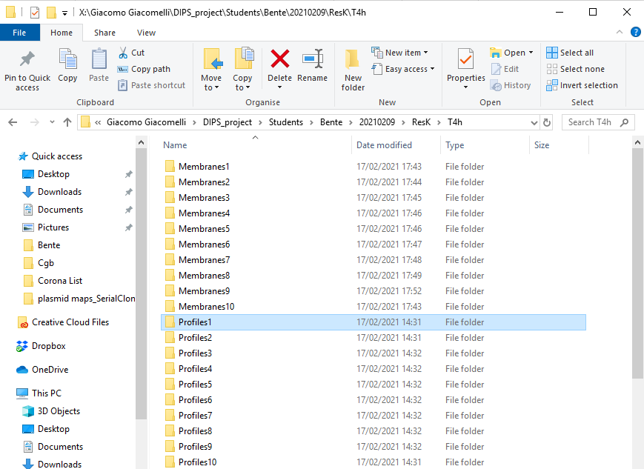
Set the working directory for the current analysis
Set as a working directory the folder that contains all the Profiles/Membranes folders “X:/Giacomo Giacomelli/DIPS_project/Students/Bente/20210209/ResK/T4h“

Slide 3
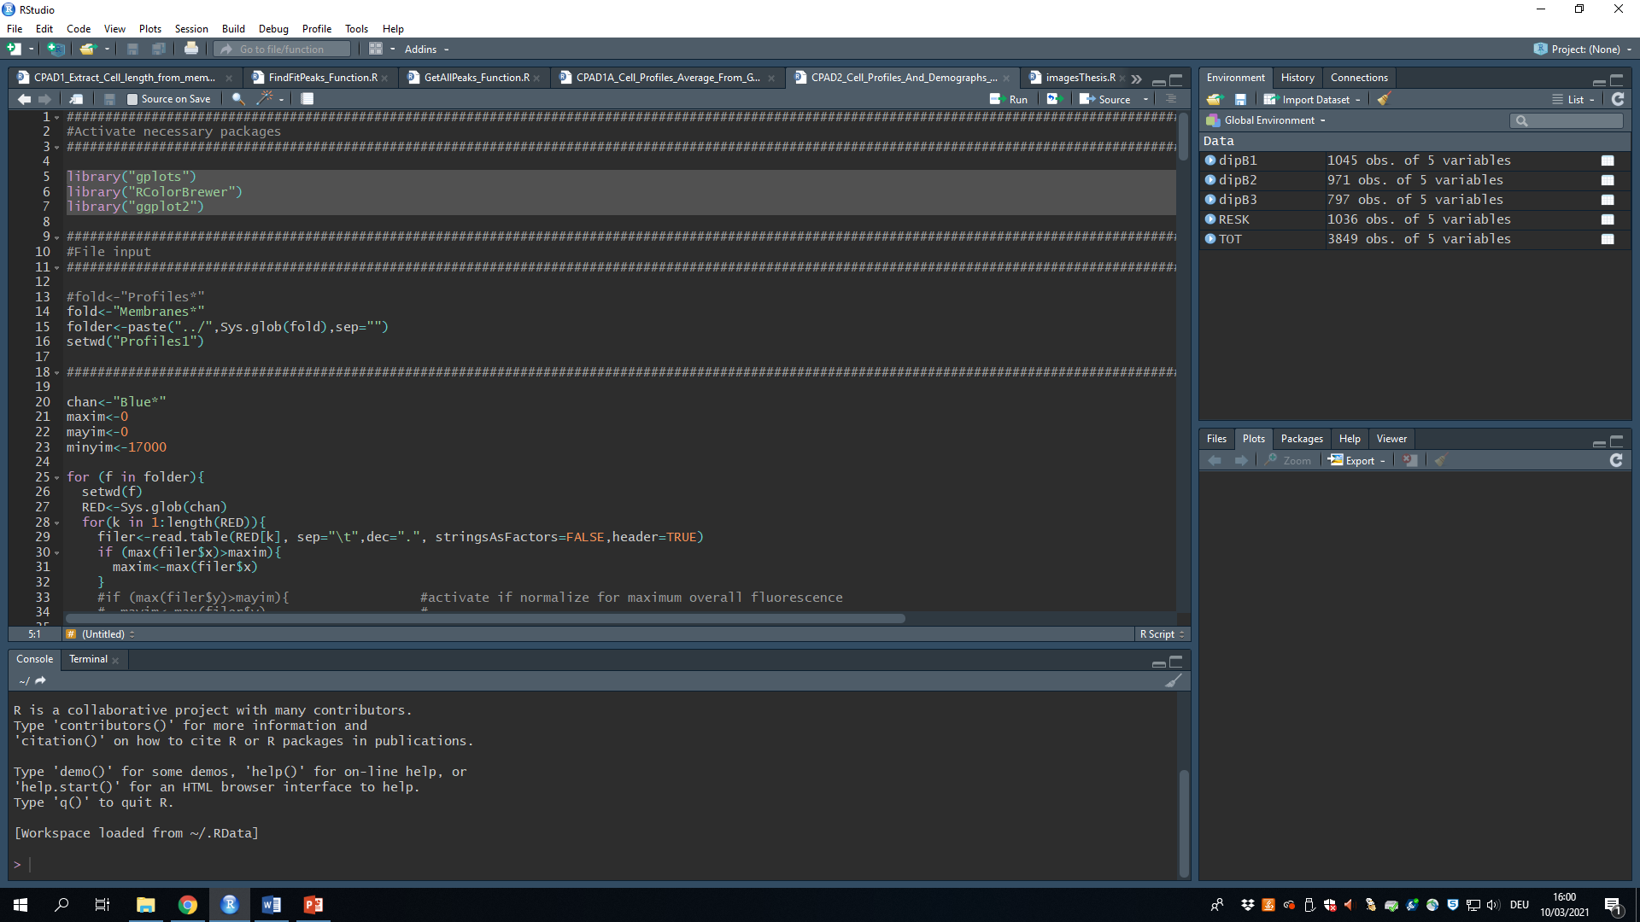
Activate/Install the necessary packages
StartUp the necessary packages (Run the lines of code shown in figure).
NOTE: If you are using R for the first time and you did not previously install the packages shown in figure, you first need to install them. In order to do so, run the following command:
install.packages(“gplots“)
install.packages(“RColorBrewer“)
install.packages(“ggplot2“)

Slide 4
Membranes vs Profiles analysis
Activate the desired analysis type (Profiles/Membranes) and deactivate the remaining one (use “#“).
Run the following command lines:
Set as a working directory any of the Profiles/Membranes folders by running the following command line:
Select the channel of interest (“Red*“,“Blue*“,“Gray*“ or whatever output was decided in the Fiji macro)
NOTE: the name of the file does not necessarily correspond to the actual color of the channel.
Before running the rest of the script, you need to decide the output of choice and the binwidth:
Binwidth needs to be bigger than the smaller interval between x values (in EPI 100/200 nm should be fine)

Slide 5
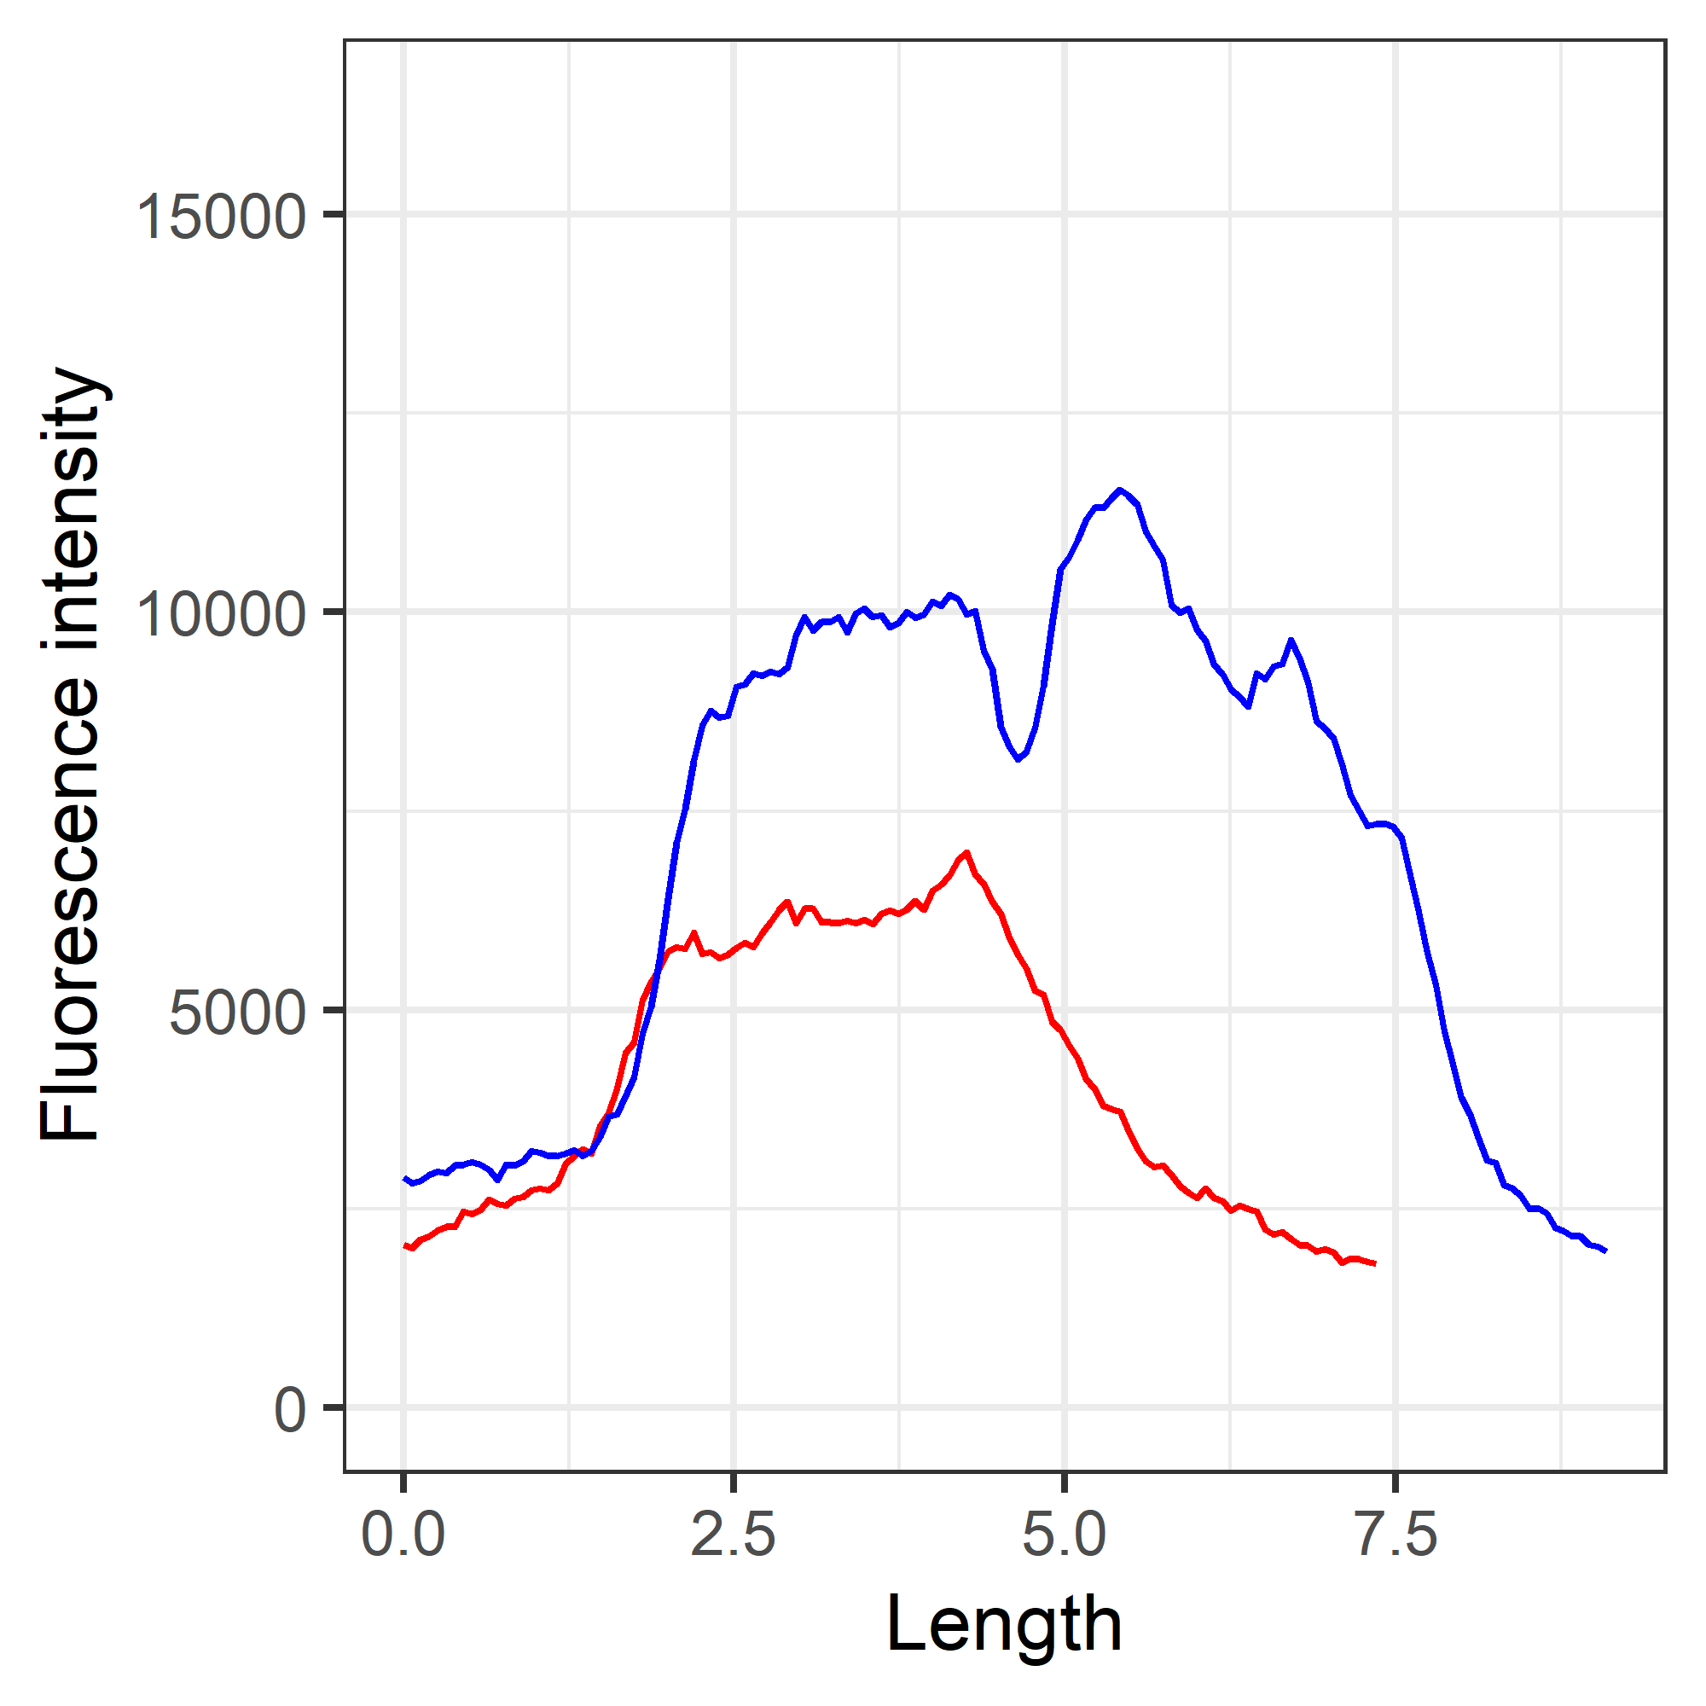
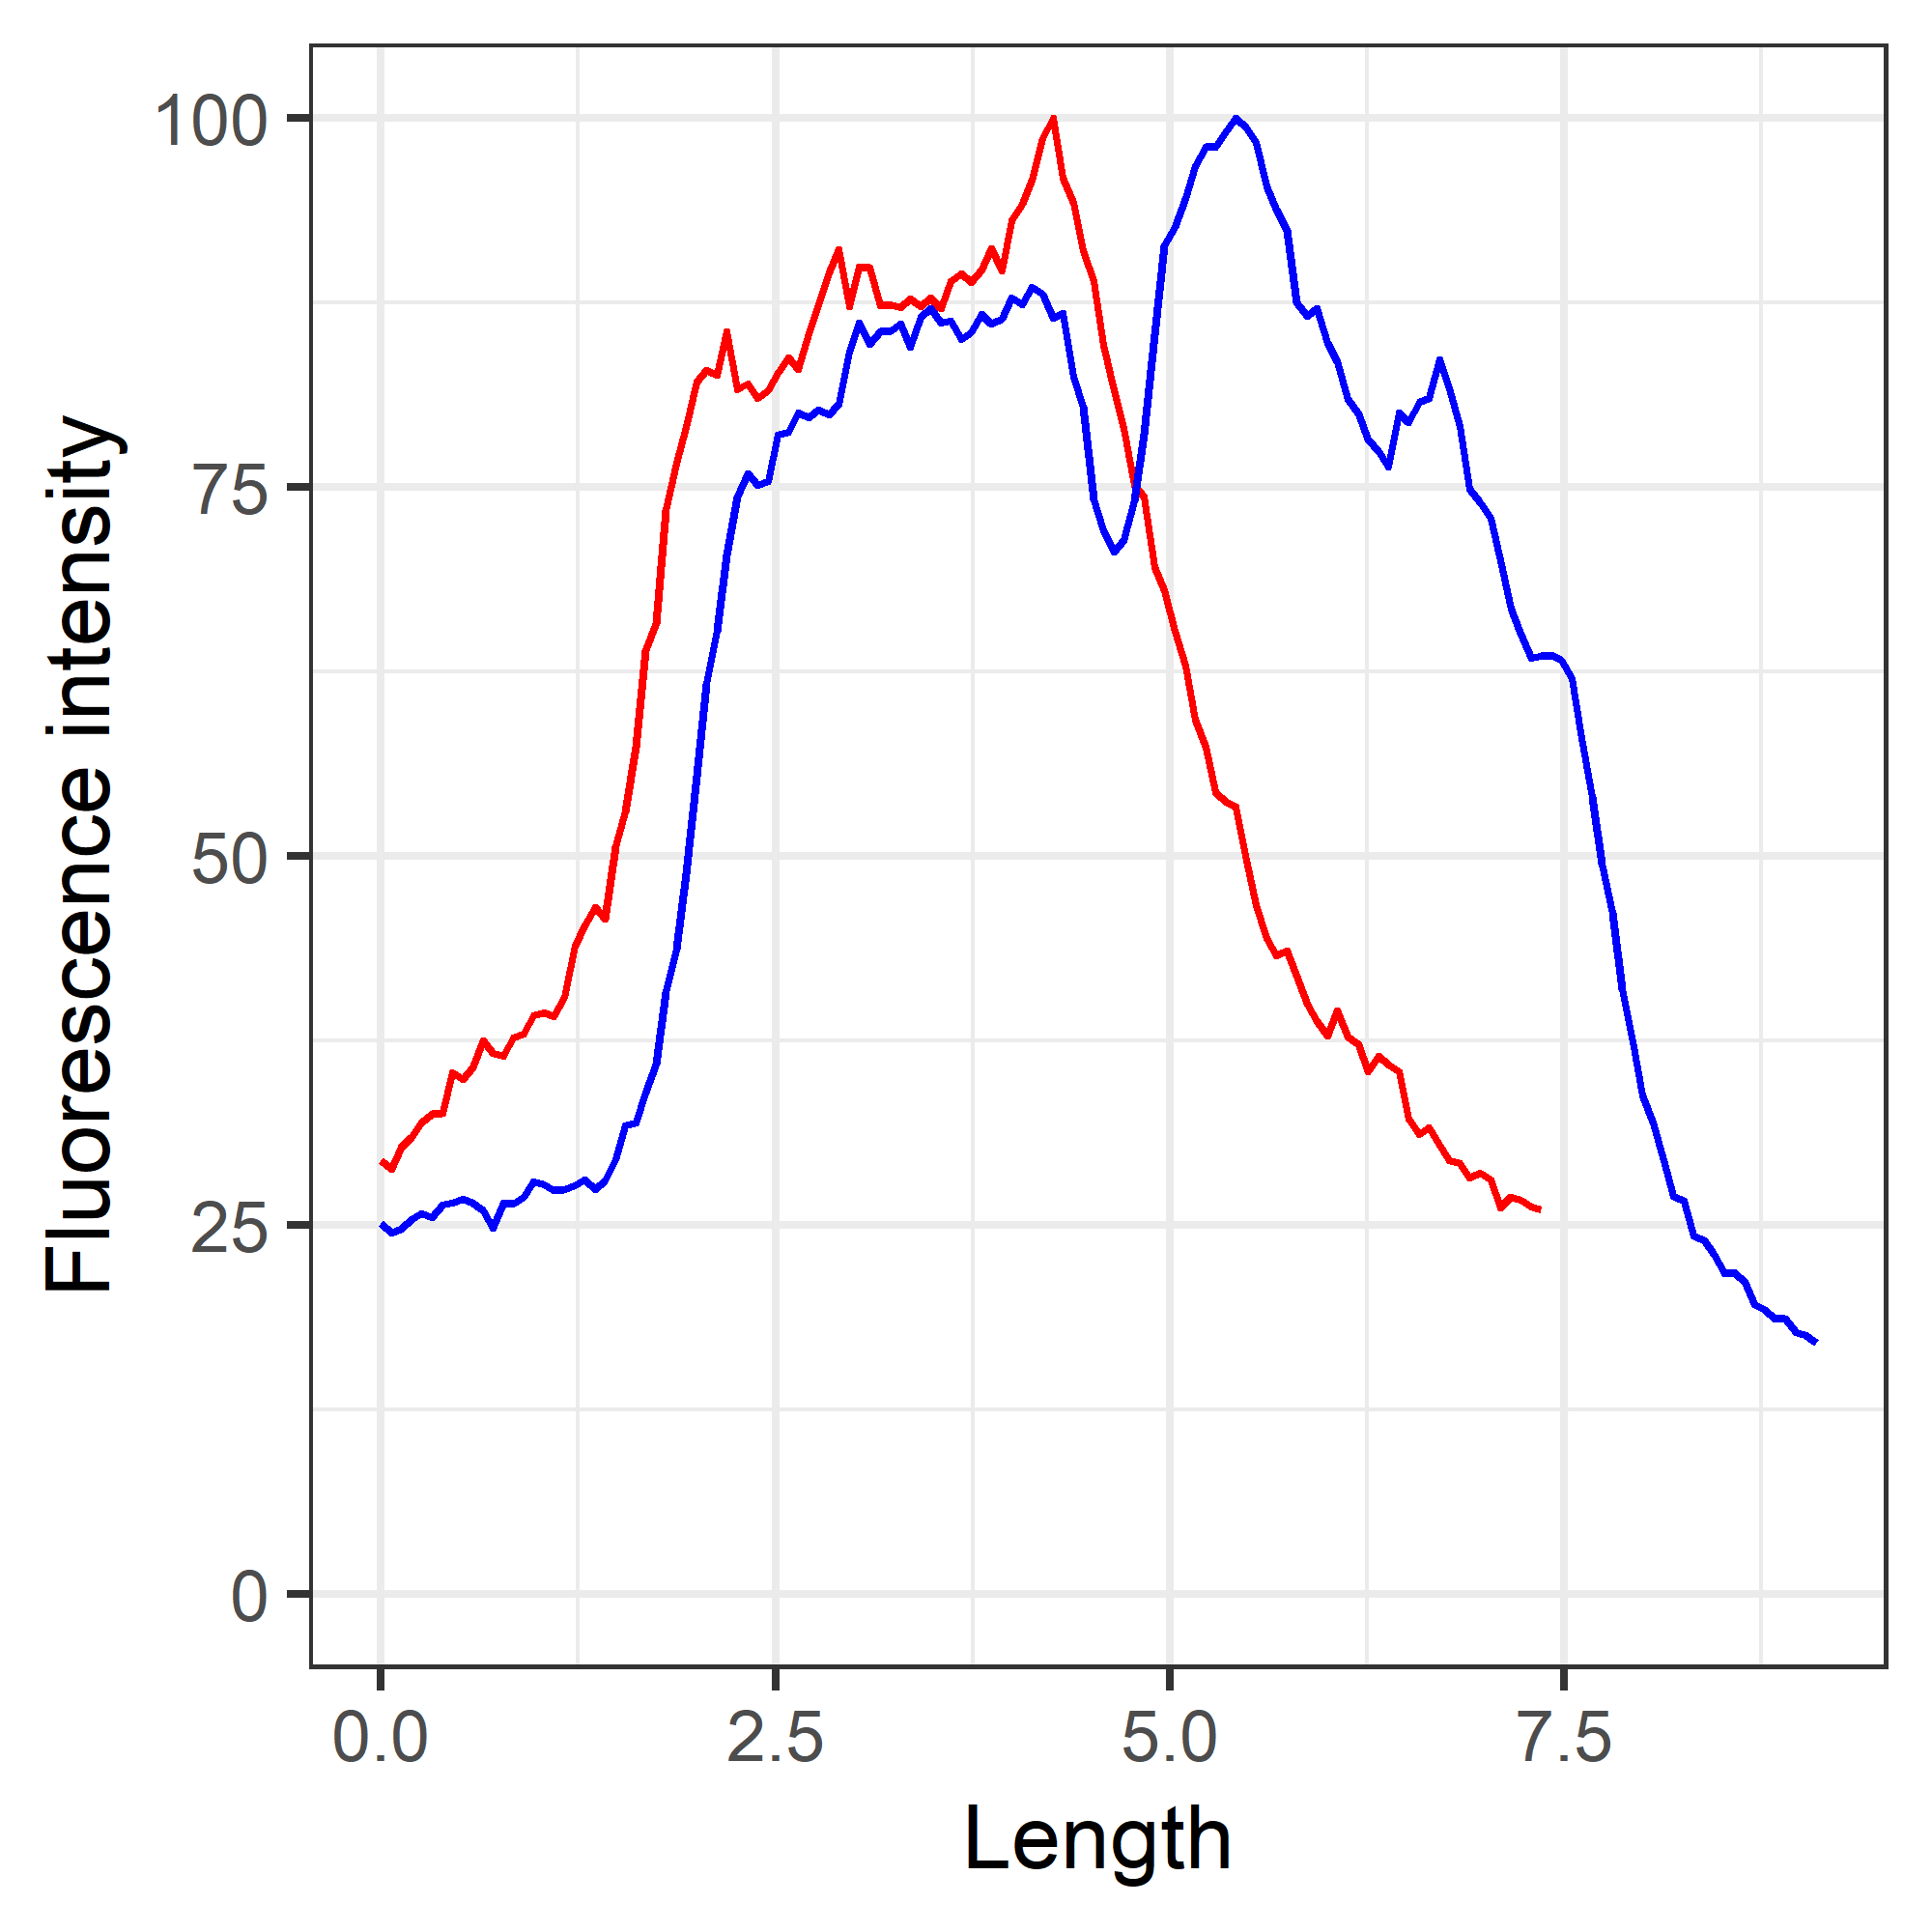
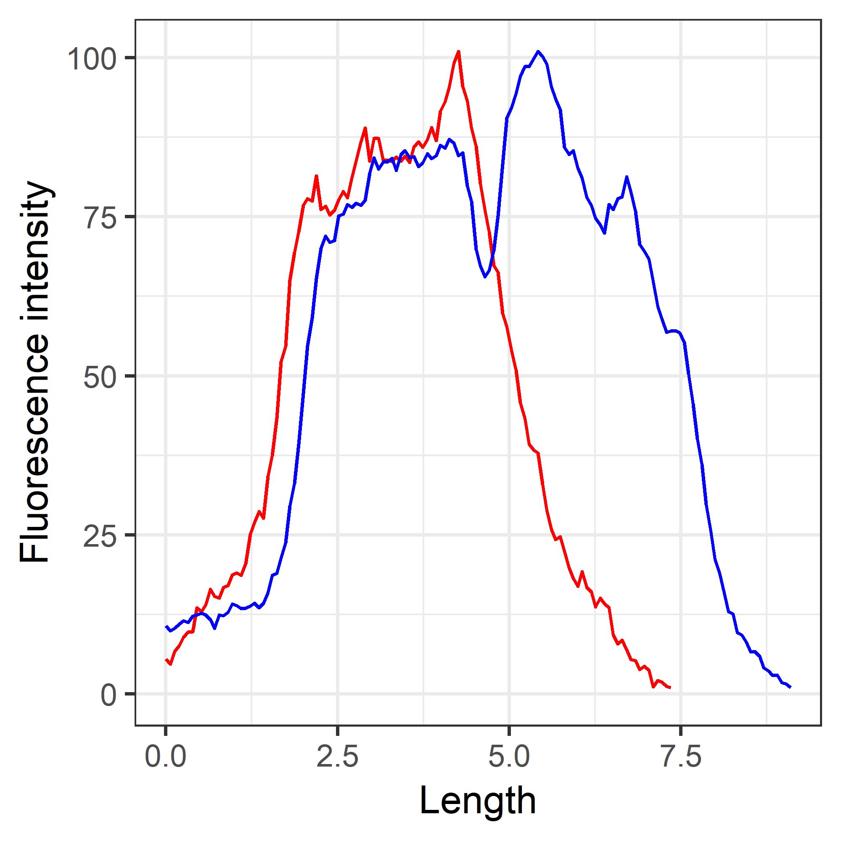
Cell by cell determination of the dynamic range (optimal for localization determination)
Original Profiles:
No correction
Scale: 0-16838
Cell 1: Red
Cell 2: Blue
Max determined for each cell individually
m*100/mayim
Scale: 0-100
Cell 1: Red
Cell 2: Blue
Max and Min determined for each cell individually
1+(m_c*100/mayim_c)
Scale: 0-100
Cell 1: Red
Cell 2: Blue

Slide 6
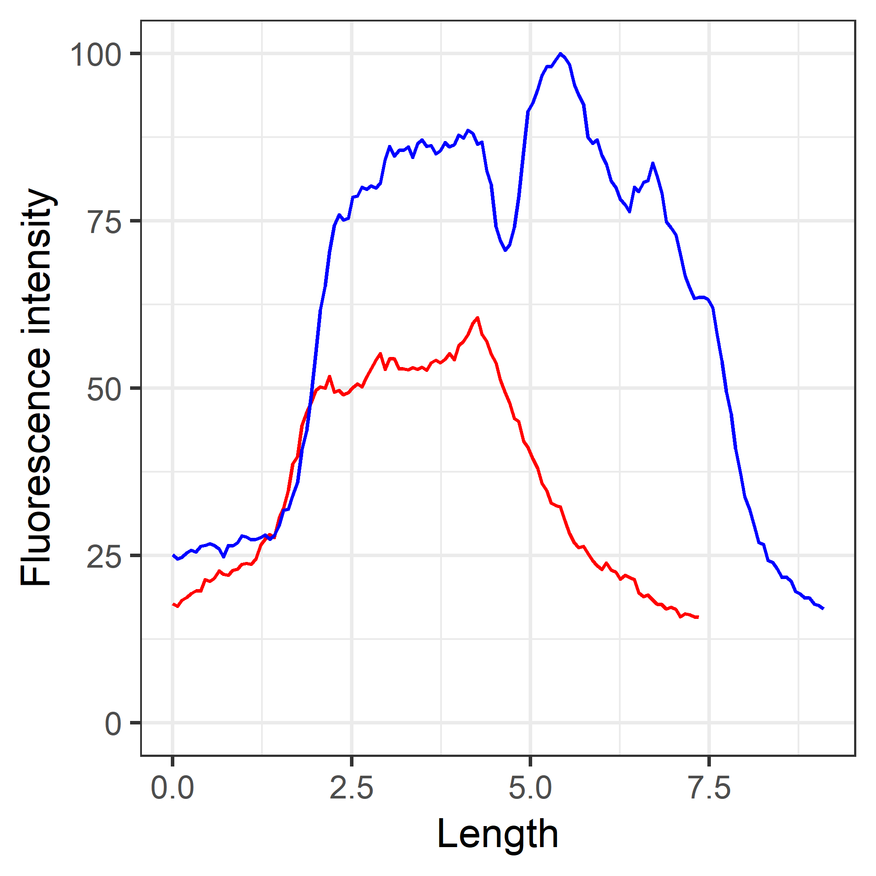
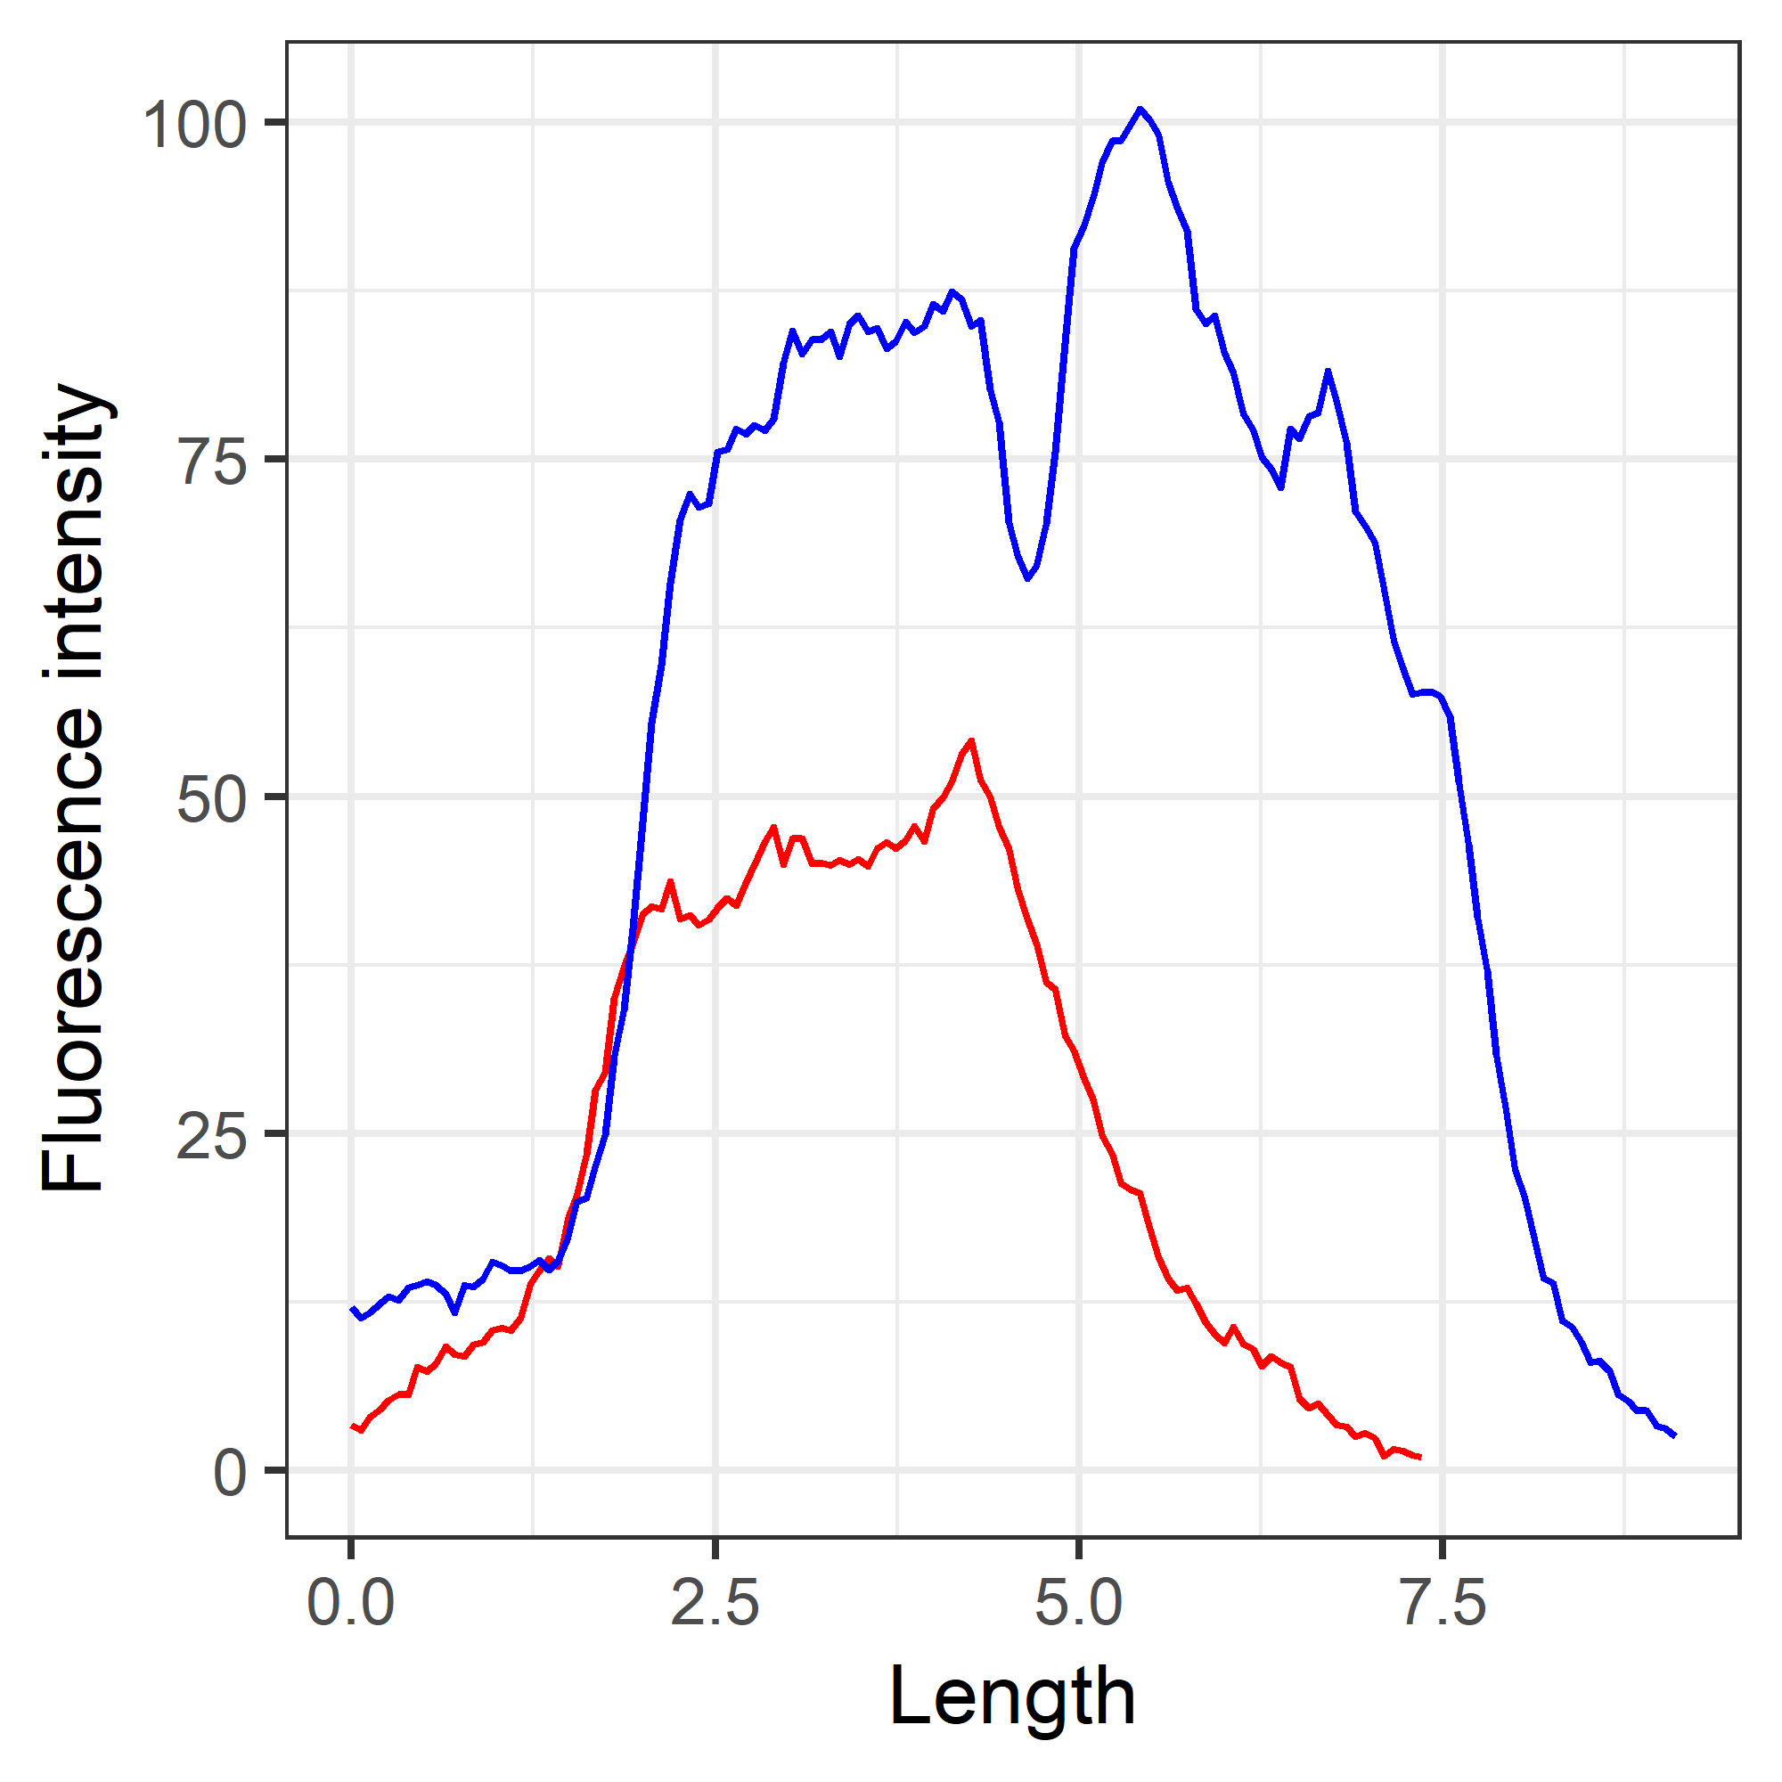
Population based max and min determination of the dynamic range (optimal for cell phase analysis)
Original Profiles:
No correction
Scale: 0-16838
Cell 1: Red
Cell 2: Blue
Max determined across the whole population
m*100/mayim
Scale: 0-100
Cell 1: Red
Cell 2: Blue
Max and Min determined across the whole population
1+(m_c*100/mayim_c)
Scale: 0-100
Cell 1: Red
Cell 2: Blue

Slide 7
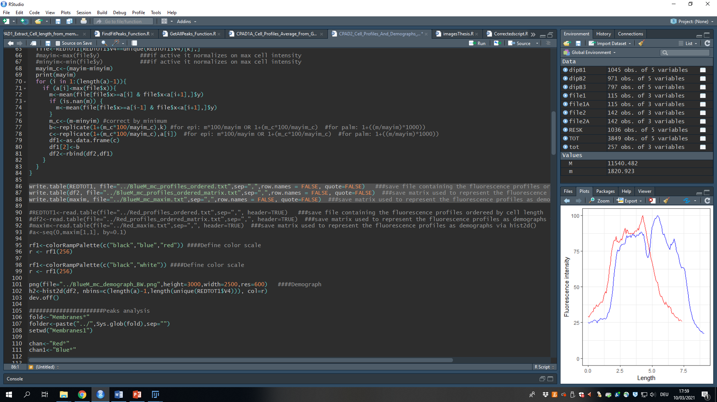
Save the output (and import it back)
Name the three output files as you wish, however I suggest you use the following structure:
REDTOT1-> “../whatever_ordered.txt“
df2->“../whatever_ordered_matrix.txt“
maxim->“../whatever_maxim.txt“
These three files are necessary in order to reimport the data in the future. In order to re-open old files activate and then run the following commands (make sure you are in the correct folder when trying to open files if you did not already specify the entire path):

Slide 8
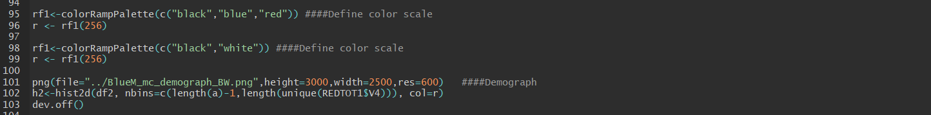
Plot and save the kymograph
Select the scale of choice:
The plotting command will use the last activated scale for the kymograph. You can find more colors here or use hexadecimal codes. By repeating a color name multiple times you can compress the color gradient to different values.
Remember to change the name of the png file to the name of choice prior to saving it (it will overlap files with the same name if present)
NOTE: you can change the height, width and resolution of the image in the png command.
Blue-Red scale
Gray Scale

