Slide 1
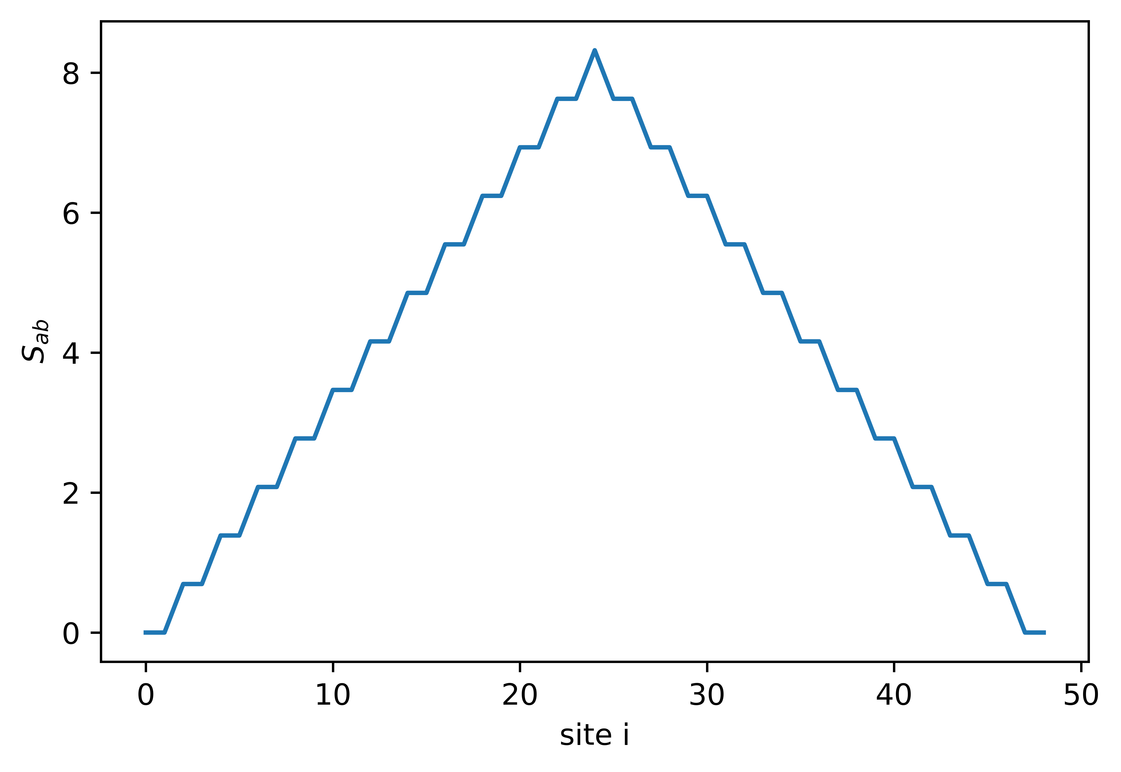











$$4096$$
$$2048$$
$$1024$$
$$512$$
$$256$$
$$128$$
$$64$$
32
$$16$$
$$8$$
$$4$$
$$2$$

