Slide 1

AI Factory Benchmarking
Jan Marxen, Xavier L'Heureux, Vittorio Cozzoli, Giacomo Pauletti
12/01/2025
<number>

Slide 2
Our vision
“Implement a scalable framework for AI Factory Benchmarking, easy to extend with other services, supporting multiple benchmarks at the same time.”
Support reals scenarios: Prompting multiple load-balanced services.
<number>
12/01/2025

Slide 3
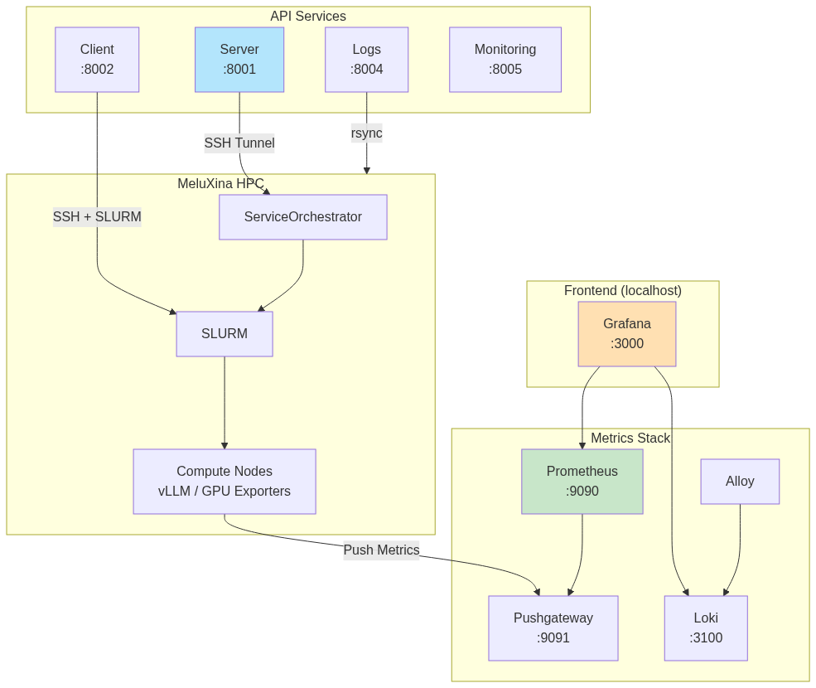
Architecture overview
Microservice architecture
On Meluxina:
  ServiceOrchestrator,
  Services
  Clients
On local machine:
  Logs
  Monitoring
  Grafana UI
12/01/2025
<number>

Slide 4
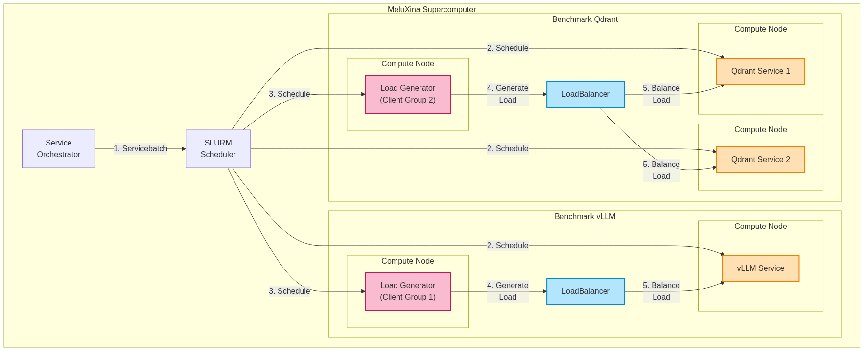
Services and Clients Workflow
Load balancing (e.g. Round-Robin, Current Stress)
ClientGroup: generate the load for service
Created by user/UI with YAML
Example: Requests/min, Prompts, Duration
<number>
12/01/2025

Slide 5
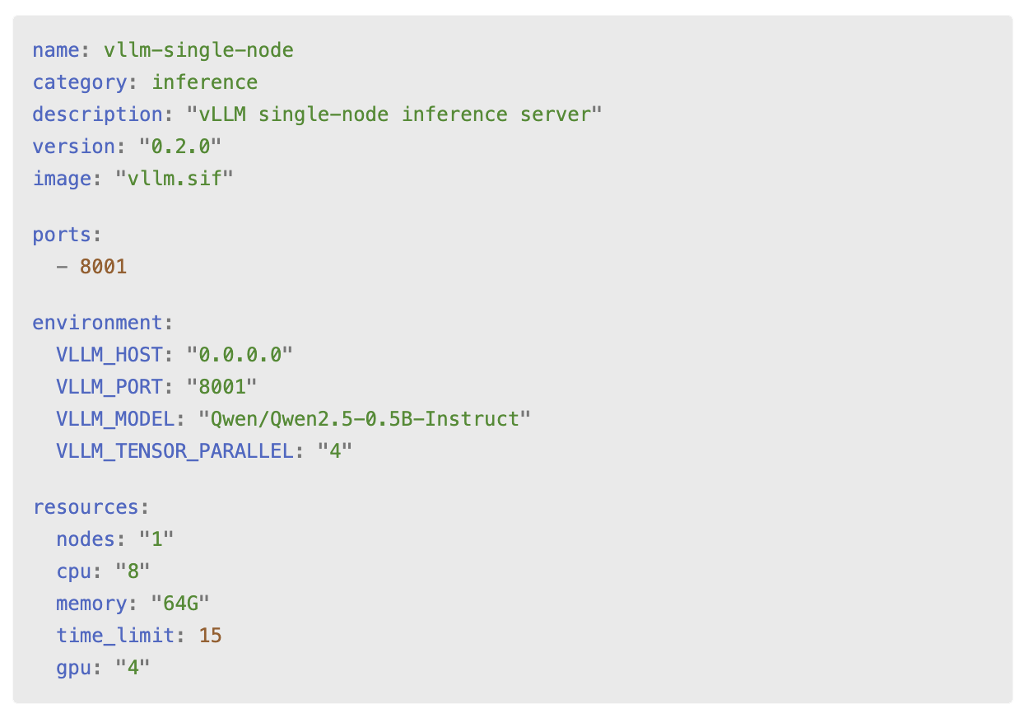
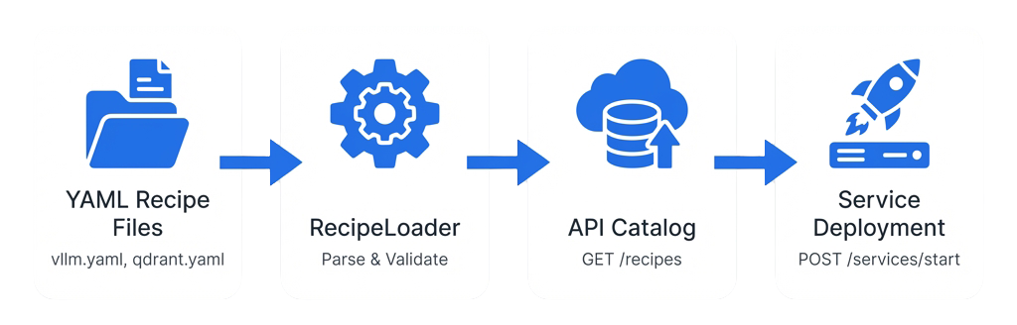
Recipe Ingestion System
Recipe Ingestion
Recipes are YAML files in recipes/{category}/
RecipeLoader parses all .yaml files at startup
Each recipe defines: name, resources, environment, and parameters
Users select recipes via API to deploy services
Example: inference/vllm-single-node deploys a vLLM server with 4 GPUs, 64GB RAM
<number>
12/01/2025

Slide 6
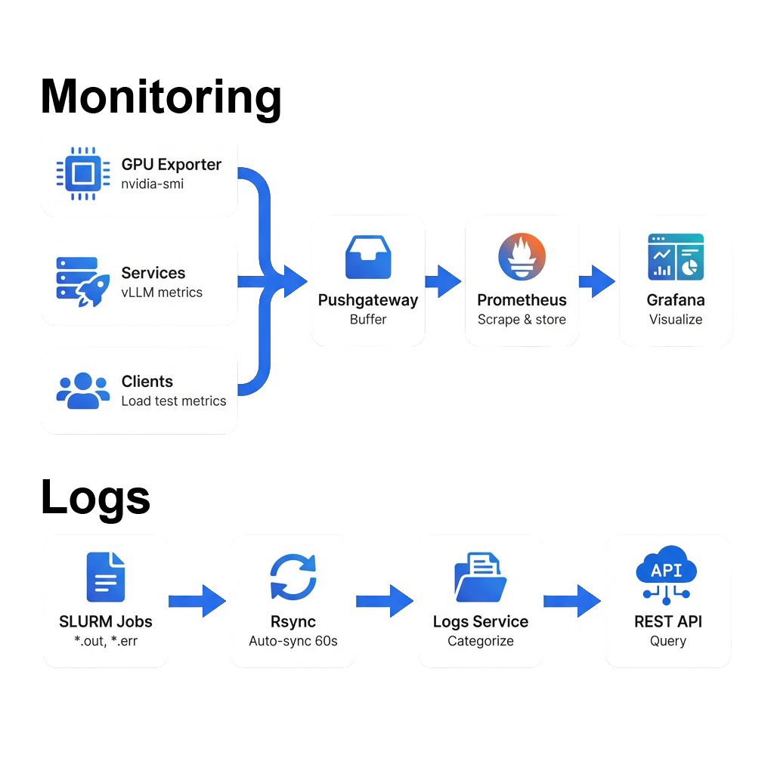
Monitoring & Logs
Overview
Monitoring collects metrics periodically via Prometheus exporters
Logs service categorizes by filename patterns (loadgen-*, vllm-*, etc.)
All accessible through Grafana dashboard or REST APIs (ports 8004, 8005)
Tech Stack
  Prometheus + Grafana: Real-time metrics visualization (utilization, power, temperature, etc)
  Automatic Log Sync: Rsync pulls SLURM logs (*.out, *.err) from MeluXina periodically
<number>
12/01/2025

Slide 7
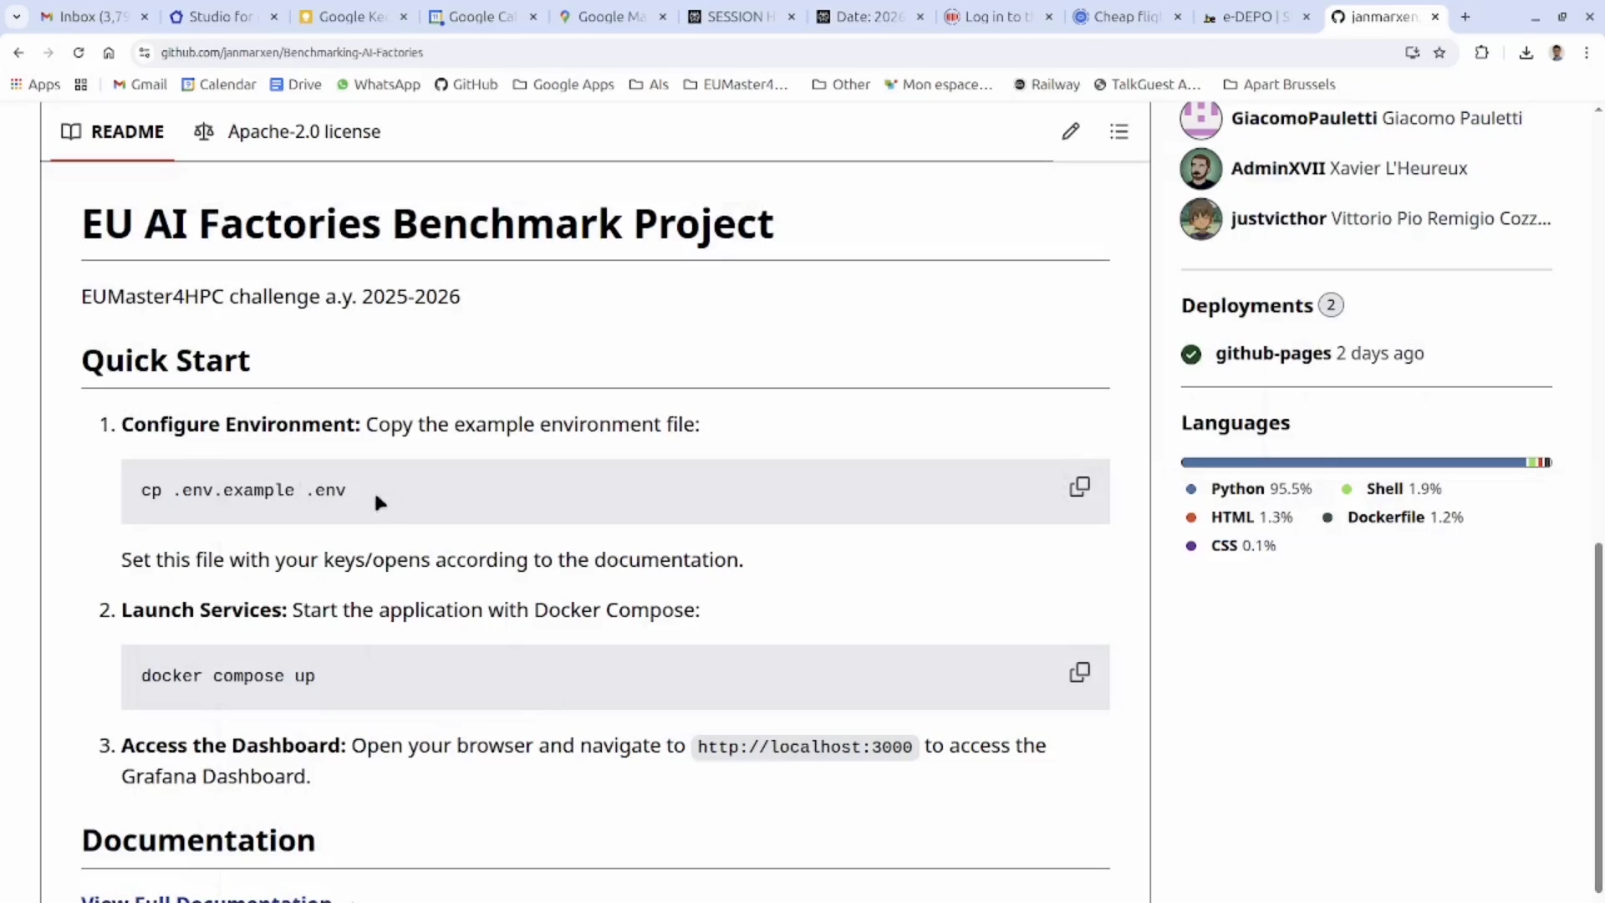
Web UI Demo
<number>
12/01/2025

Slide 8
Resources
Documentation (GitHub pages): link
GitHub repository: link
<number>
12/01/2025

