Slide 1
Logic & Domain Modelling
COMP 41400: Multi-Agent Systems
Lecturer: Rem Collier
Email: rem.collier@ucd.ie

Slide 2
Rules to Logic
Rule based systems are really a special case of Logical Reasoning System.
Facts: propositions (e. g. A, B, …)
Rules: sentences containing implications (A => B)
Inference is a form of logical proof based on a restricted set of inference rules
Logical proofs allow us to ask questions of the form:
Given a set, S, of logical statements, is X true?
This can be used to implement something analogous to forwards-chaining in rule-based systems.
A, B
A & B
A, A => B
B
Conjunction:
Modus Ponens:

Slide 3
Our Weather Example Revisited
Set of Logical Statements:
LOW_PRESSURE (1)
CLOUDY (2)
COLD (3)
HIGH_PRESSURE & ~CLOUDY => RAIN_UNLIKELY (4)
LOW_PRESSURE & CLOUDY => RAIN_LIKELY (5)
Prove RAIN_LIKELY is true
Conjunction (1, 2): LOW_PRESSURE & CLOUDY (6)
Modus Pollens (6, 5): RAIN_LIKELY (7)
Q.E.D.
The problem: how to automate this?
Resolution Rule
(Robinson, 1965)
A v B v ~C, C
A v B
A => B is equivalent to B v ~A

Slide 4
Beyond Propositional Logic
Propositions are limited
Given REM_IS_A_MAN and SOCRATES_IS_A_MAN
What if we want to ask: who is a man?
Predicate logic is a refinement of propositional logic that allows a finer grained representation
Propositions are replaced by predicates.
Predicates are n-ary relations over objects in a domain of discourse.
Objects are represented by constants.
For example:
Consider the constants “Rem”, “Socrates” and “man”
If we assert a binary predicate relationship “is_a”, we can rewrite our propositions as: is_a(rem, man) and is_a(Socrates, man)

Slide 5
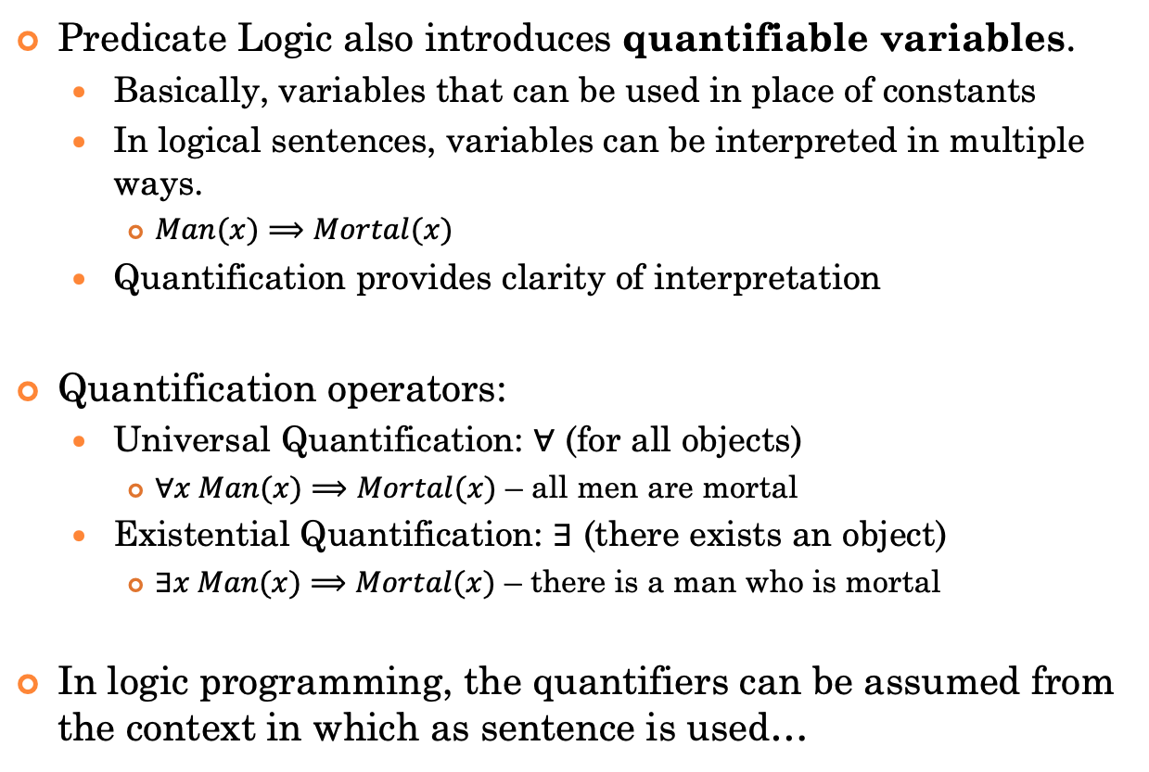
Beyond Propositional Logic
Predicate Logic also introduces quantifiable variables.
Basically, variables that can be used in place of constants
In logical sentences, variables can be interpreted in multiple ways.
$Man(x)⟹Mortal(x)$
Quantification provides clarity of interpretation
Quantification operators:
Universal Quantification: $∀$ (for all objects)
$∀x Man(x)⟹Mortal(x)$ – all men are mortal
Existential Quantification: $∃$ (there exists an object)
$∃x Man(x)⟹Mortal(x)$ – there is a man who is mortal
In logic programming, the quantifiers can be assumed from the context in which as sentence is used…

Slide 6
Domain Modelling with Predicate Logic
(Today’s Goal)

Slide 7
Domain Modelling
This whole lecture has been about exploring different techniques for creating models of the environment.
In this course, we will use predicate logic to do this.
Later, you will learn an Agent-Oriented Programming language called ASTRA that uses predicate logic.
Domain modelling with predicate logic is “simple”
Identify the kinds of objects that exist in the environment and develop naming conventions for them.
Specify the relationships that can exist between these objects as predicates.
In logic, this is referred to a a theory, in MAS it is often considered an ontology.

Slide 8
Example 1: Towerworld
d
a
b
c
table

Slide 9
Example 1: Towerworld
Predicates:
block(X) – X is a block
table(X) – X is a table
on(X, Y) –X is sitting on top of Y
free(X) –block X has nothing on it
holding(X) – X is held by the gripper
Constants:
Blocks: a, b, c, d
The table: table
d
a
b
c
table

Slide 10
Example 1: Towerworld
block(a) block(b) block(c) block(d)
d
a
b
c
table

Slide 11
Example 1: Towerworld
block(a) block(b) block(c) block(d)
table(table)
d
a
b
c
table

Slide 12
Example 1: Towerworld
block(a) block(b) block(c) block(d)
table(table) holding(d)
d
a
b
c
table

Slide 13
Example 1: Towerworld
block(a) block(b) block(c) block(d)
table(table) holding(d)
on(a, table) on(b, table) on(c, table)
d
a
b
c
table

Slide 14
Example 1: Towerworld
block(a) block(b) block(c) block(d)
table(table) holding(d)
on(a, table) on(b, table) on(c, table)
free(a) free(b) free(c)
d
a
b
c
table

Slide 15
Example 2: Cops & Robbers
Remember: 2D grid world with cops and robbers.
Gold on some squares
Cops and Robbers can co-habit squares
How to model this?
1
2
3
4
5
6
7
1
C1
2
C3
C2
R2
3
R1
$25
4
$50

Slide 16
Example 2: Cops & Robbers
Remember: 2D grid world with cops and robbers.
Gold on some squares
Cops and Robbers can co-habit squares
How to model this?
1
2
3
4
5
6
7
1
C1
2
C3
C2
R2
3
R1
$25
4
$50
PARTIAL MODELS FOR EACH AGENT

Slide 17
Example 2: Cops & Robbers
1
2
3
4
5
6
7
What to model?
at(X, Y): location of cop/robber
gold(X): there is X amount of gold on the square
cop(X): Cop X is on the same square
robber(X): Robber X is on the same square
1
C1
2
C3
C2
R2
3
R1
$25
4
$50

Slide 18
Example 2: Cops & Robbers
1
2
3
4
5
6
7
Beliefs of cop 1 @ 1,1
at(1, 1)
Beliefs of cop 2 @ 3,2
at(3, 2)
Beliefs of robber 1 @ 5,3
at(5, 3)
gold(25)
1
C1
2
C3
C2
R2
3
R1
$25
4
$50

Slide 19
Example 2: Cops & Robbers
1
2
3
4
5
6
7
Beliefs of cop 3 @ 6,2
at(6, 2)
robber(R2)
Beliefs of robber 2 @ 6,2
at(6, 2)
cop(C3)
1
C1
2
C3
C2
R2
3
R1
$25
4
$50

