Slide 1
Agent-Oriented Programming
COMP 41400: Multi-Agent Systems
Lecturer: Rem Collier
Email: rem.collier@ucd.ie

Slide 2
Main Topics
What is AOP?
Overview of AgentSpeak(L)
Case Study: Light Switch
Final Remarks

Slide 3
What is AOP?

Slide 4
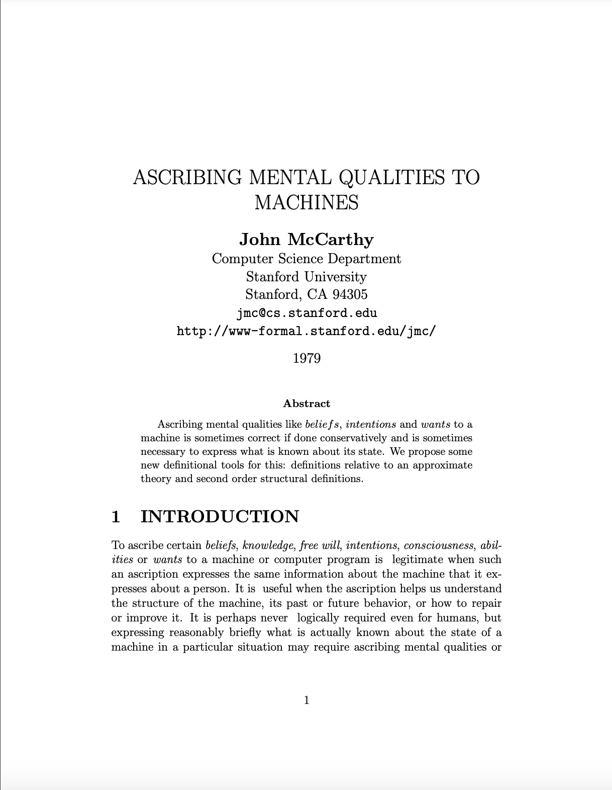
Ascribing Mental Qualities to Machines (McCarthy, 1979)
Why ascribe mental qualities?
The current state of a program may be more readily represented by mental qualities than its actual state.
Simulation of program execution for prediction may be possible, but not practical, while the use of beliefs may make prediction possible without simulation.
Ascribing beliefs may allow deriving general statements about the program’s behavior that could not be obtained from any finite number of simulations.
http://jmc.stanford.edu/articles/ascribing.html

Slide 5
Ascribing Mental Qualities to Machines (McCarthy, 1979)
Why ascribe mental qualities?
The belief and goal structures we ascribe to the program may be easier to understand than the details of program as expressed in its listing.
The belief and goal structure is likely to be close to the structure the designer of the program had in mind, and it may be easier to debug the program in terms of this structure than directly from the listing.
In fact, it is often possible for someone to correct a fault by reasoning in general terms about the information in a program or machine, diagnosing what is wrong as a false belief, and looking at the details of the program or machine only sufficiently to determine how the false belief is represented and what mechanism caused it to arise.
The difference between this program and another actual or hypothetical program may best be expressed as a difference in belief structure.
http://jmc.stanford.edu/articles/ascribing.html

Slide 6
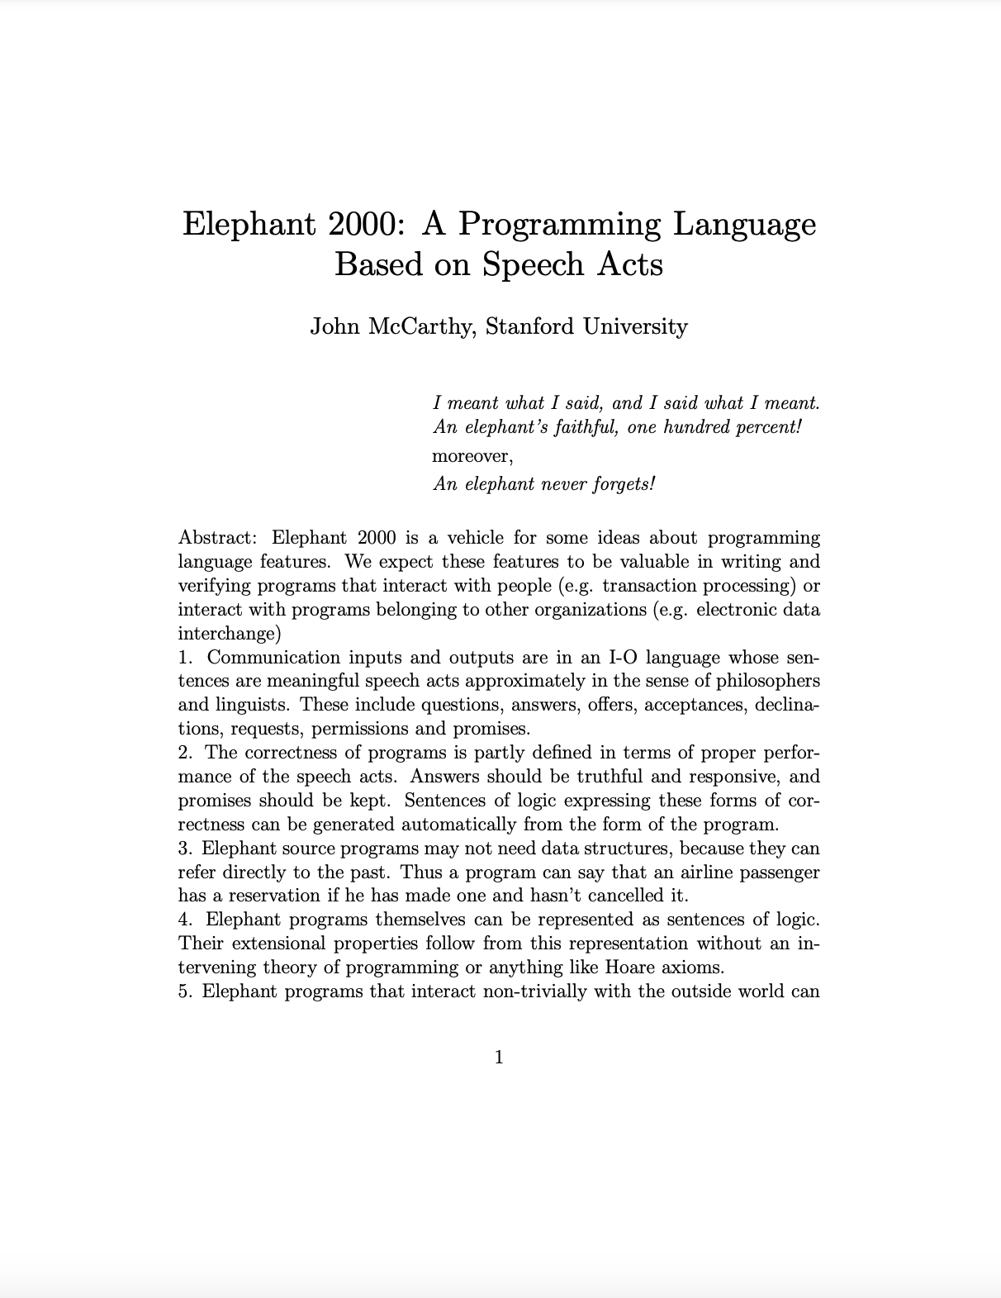
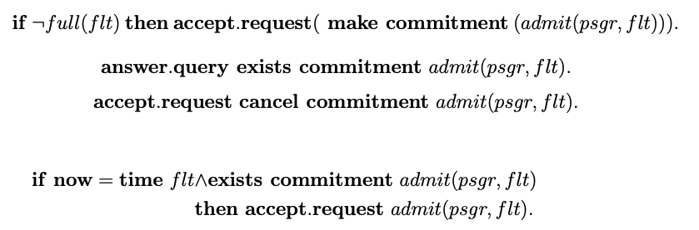
Ascribing Mental Qualities to Machines (McCarthy, 1979)
Why ascribe mental qualities?
The belief and goal structure is likely to be close to the structure the designer of the program had in mind, and it may be easier to debug the program in terms of this structure than directly from the listing.
In fact, it is often possible for someone to correct a fault by reasoning in general terms about the information in a program or machine, diagnosing what is wrong as a false belief, and looking at the details of the program or machine only sufficiently to determine how the false belief is represented and what mechanism caused it to arise.
The difference between this program and another actual or hypothetical program may best be expressed as a difference in belief structure.
Elephant 2000: Example Program
https://www-formal.stanford.edu/jmc/elephant.pdf
http://jmc.stanford.edu/articles/ascribing.html

Slide 7
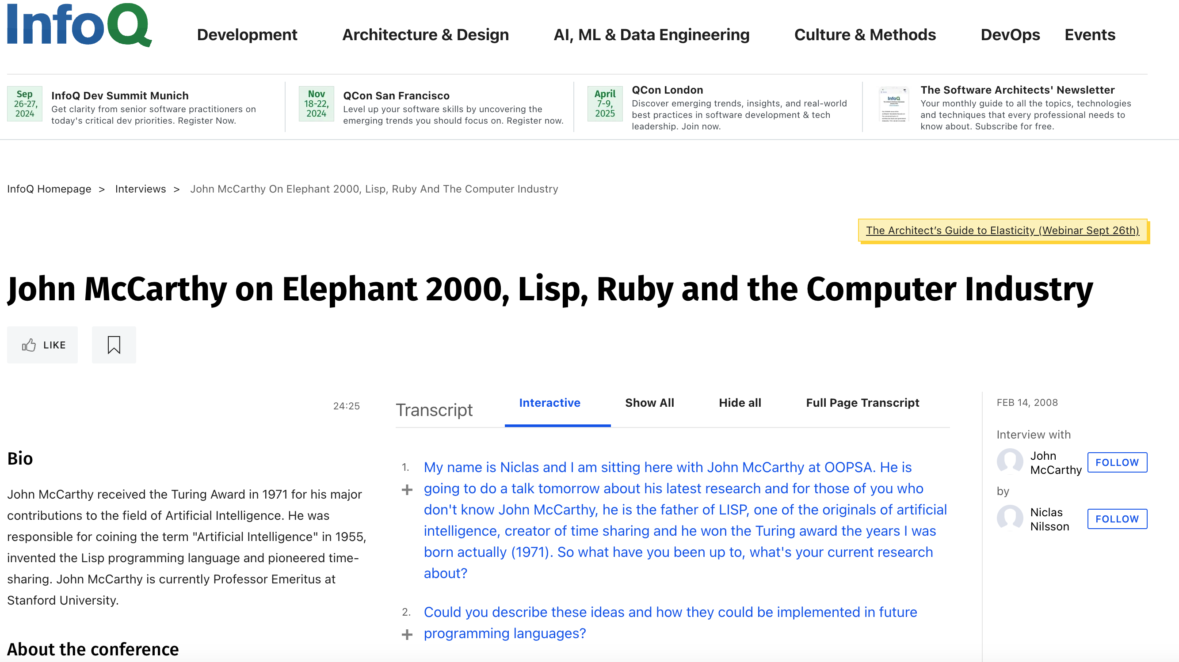
Ascribing Mental Qualities to Machines (McCarthy, 1979)
Why ascribe mental qualities?
The belief and goal structure is likely to be close to the structure the designer of the program had in mind, and it may be easier to debug the program in terms of this structure than directly from the listing.
In fact, it is often possible for someone to correct a fault by reasoning in general terms about the information in a program or machine, diagnosing what is wrong as a false belief, and looking at the details of the program or machine only sufficiently to determine how the false belief is represented and what mechanism caused it to arise.
The difference between this program and another actual or hypothetical program may best be expressed as a difference in belief structure.
Elephant 2000: Example Program
https://www.infoq.com/interviews/mccarthy-elephant-2000/
https://www-formal.stanford.edu/jmc/elephant.pdf
http://jmc.stanford.edu/articles/ascribing.html

Slide 8
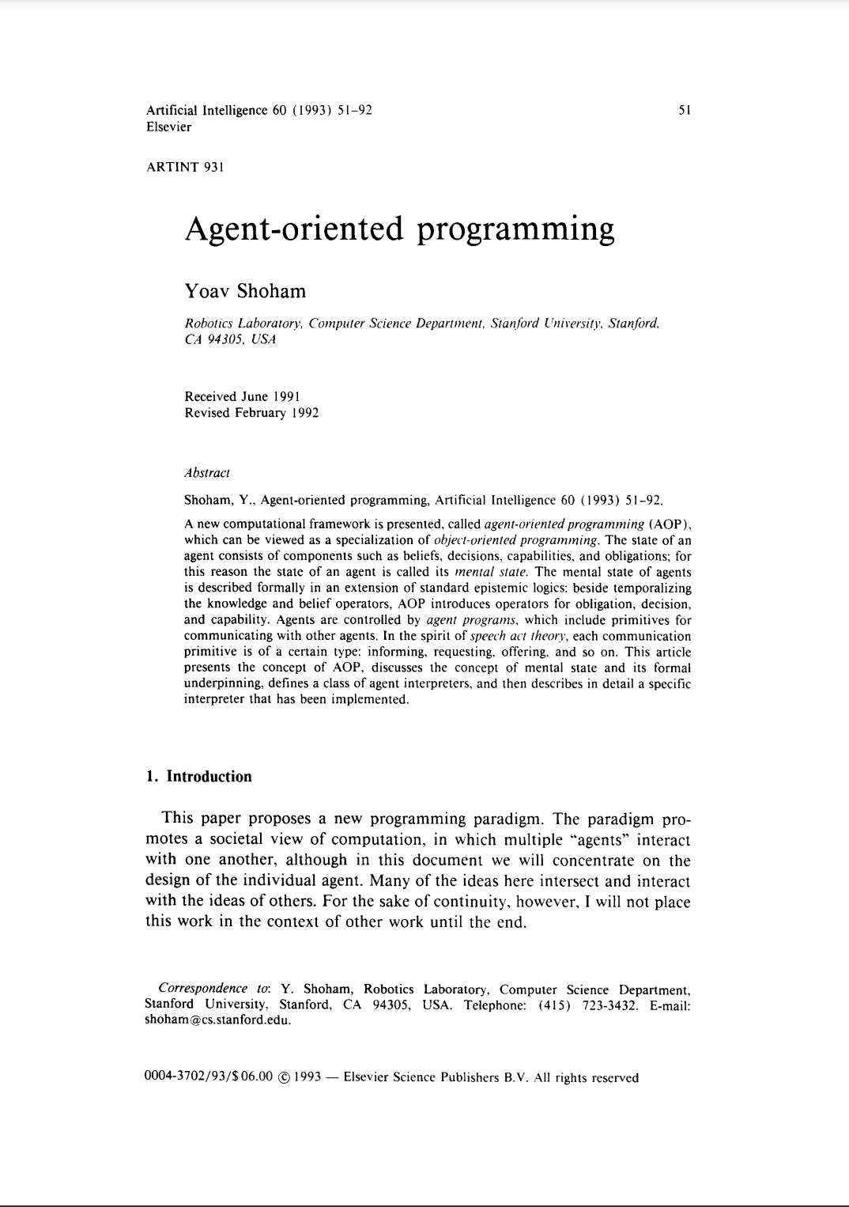
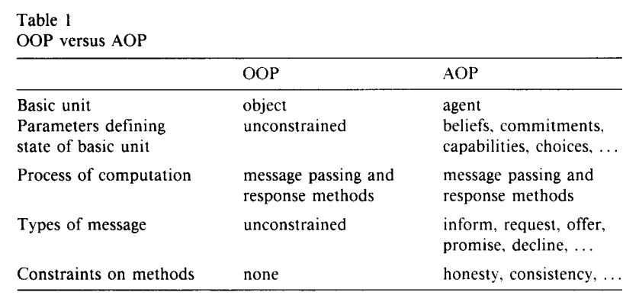
Agent-Oriented Programming (Shoham, 1993)
Based on the idea of programming agents as mental entities.
Relates AOP to OOP
https://www.sciencedirect.com/science/article/pii/0004370293900349

Slide 9
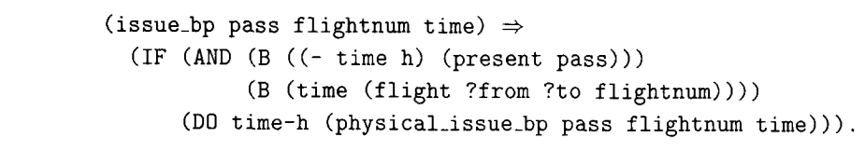

Agent-Oriented Programming (Shoham, 1993)
Defines a complete AOP System as:
a restricted formal language with clear syntax and semantics for describing mental states.
an interpreted programming language in which to define and program agents, with primitive commands (such as request and inform).
an ”agentifier”, converting neutral devices into programmable agents.
Illustrated through a prototype AOP language, Agent-0
https://www.sciencedirect.com/science/article/pii/0004370293900349

Slide 10
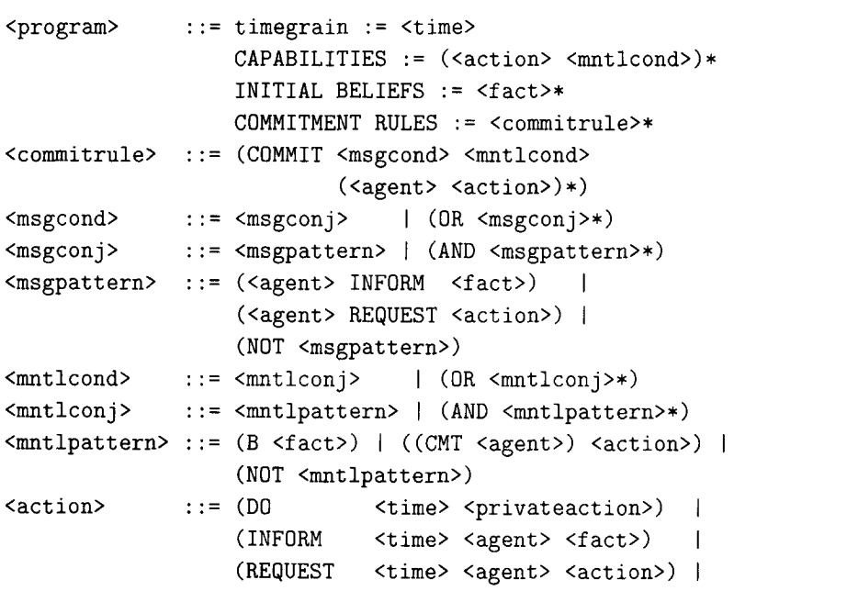
Agent-Oriented Programming (Shoham, 1993)
Defines a complete AOP System as:
a restricted formal language with clear syntax and semantics for describing mental states.
an interpreted programming language in which to define and program agents, with primitive commands (such as request and inform).
an ”agentifier”, converting neutral devices into programmable agents.
Illustrated through a prototype AOP language, Agent-0
Agent-0 EBNF
https://www.sciencedirect.com/science/article/pii/0004370293900349

Slide 11
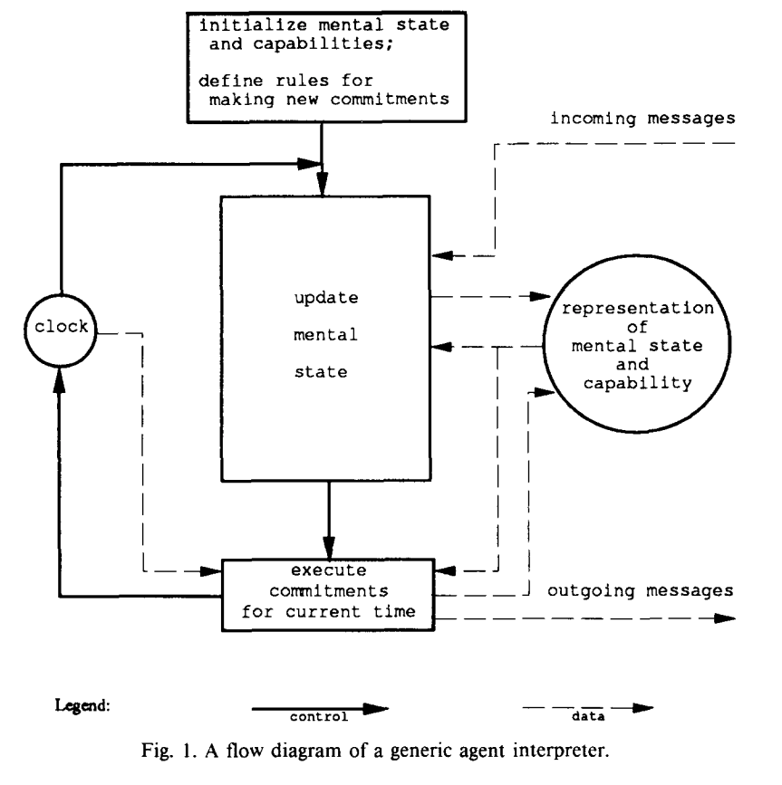
Agent-Oriented Programming (Shoham, 1993)
Defines a complete AOP System as:
a restricted formal language with clear syntax and semantics for describing mental states.
an interpreted programming language in which to define and program agents, with primitive commands (such as request and inform).
an ”agentifier”, converting neutral devices into programmable agents.
Illustrated through a prototype AOP language, Agent-0
Agent-0 EBNF
Agent-0 Interpreter Cycle
https://www.sciencedirect.com/science/article/pii/0004370293900349

Slide 12
Overview of AgentSpeak(L)

Slide 13
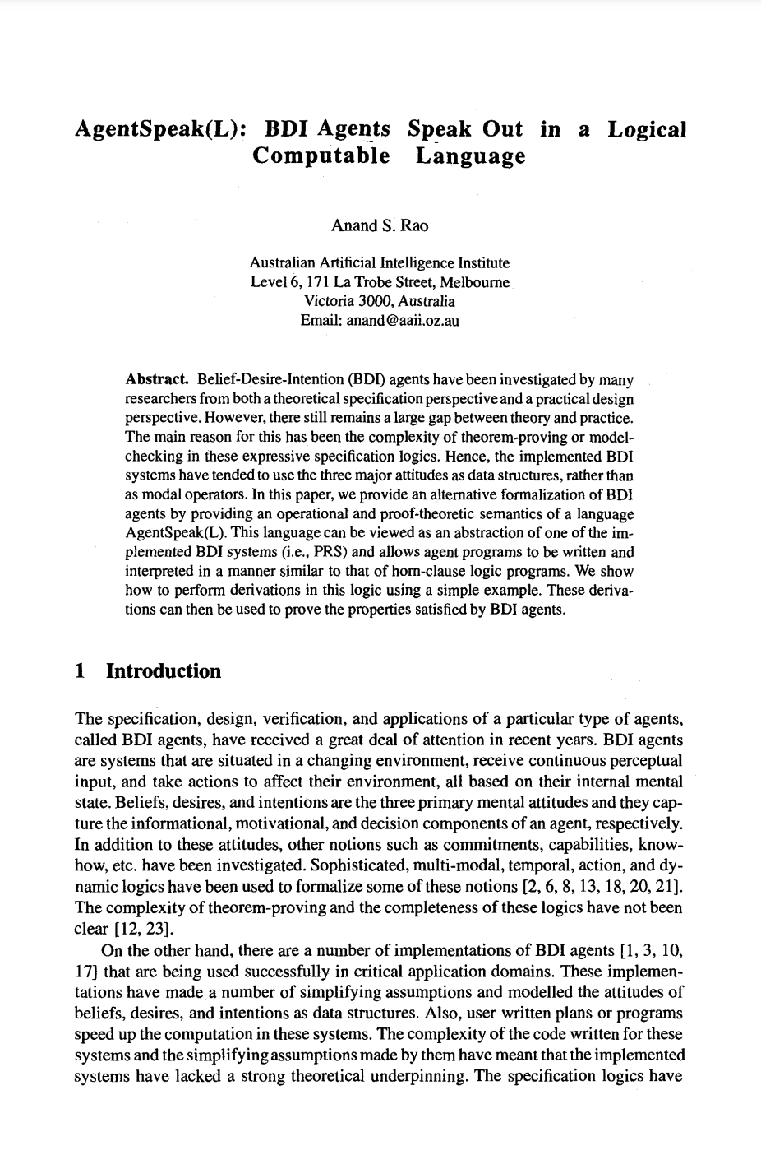
AgentSpeak(L) (RAO, 1995)
An Agent Oriented Programming Language based on the BDI Architecture.
Key Contribution: Strong Correlation between Theory and Practice (but not implemented)
An AgentSpeak(L) agent consists of:
a set of beliefs: predicate logic statements that define the state of the environment.
a set of plans: context-sensitive recipes that map events to a sequence of steps in a context.
an event queue: ordered list of events that model external (environment) or internal (reasoning) events and which are linked to the adoption (+) or retraction (-) of state.
Agents process events sequentially from the event queue, selecting a plan that is adopted an intention.
https://link.springer.com/chapter/10.1007/BFb0031845

Slide 14
AgentSpeak(L) (RAO, 1995)
The agent program is interpreted
The program code is loaded
A perceive-deliberate-act cycle is executed repeatedly
Perceive
Deliberate
Act
https://link.springer.com/chapter/10.1007/BFb0031845

Slide 15


AgentSpeak(L) (RAO, 1995)
Perceive
Deliberate
Act
Domain Modelling
Reasoning Engine
Executing
Actions
Ontologies, Beliefs, Inferences
Plan Selection
Intention 1
Intention 2
…
Event Queue
Intention n
Instantiated
Plans
Plan Library
https://link.springer.com/chapter/10.1007/BFb0031845

Slide 16
AgentSpeak(L) (RAO, 1995)
Perceive
Deliberate
Act
Domain Modelling
Reasoning Engine
Executing
Actions
Ontologies, Beliefs, Inferences
Plan Selection
Intention 1
Updating the Domain Model
(belief change events)
Intention 2
…
Event Queue
Intention n
Instantiated
Plans
Plan Library
https://link.springer.com/chapter/10.1007/BFb0031845

Slide 17
AgentSpeak(L) (RAO, 1995)
Perceive
Deliberate
Act
Domain Modelling
Reasoning Engine
Executing
Actions
Ontologies, Beliefs, Inferences
Plan Selection
Intention 1
Handle the next event
(select a plan)
Update the intentions
Intention 2
…
Event Queue
Intention n
Instantiated
Plans
Plan Library
https://link.springer.com/chapter/10.1007/BFb0031845

Slide 18
AgentSpeak(L) (RAO, 1995)
Perceive
Deliberate
Act
Domain Modelling
Reasoning Engine
Executing
Actions
Ontologies, Beliefs, Inferences
Plan Selection
Intention 1
Intention 2
…
Event Queue
Intention n
Select an intention & execute the next step
Instantiated
Plans
Plan Library
https://link.springer.com/chapter/10.1007/BFb0031845

Slide 19
AgentSpeak(L) (RAO, 1995)
Plans are a sequence of steps to be executed by the agent consisting of:
Private Actions: things that can be directly executed by the agent.
Achievement Goals: decision points that are defined in terms of things the agent would like to happen
Can be future state (intention-to-be) or future activities (intention-to-do)
Denoted with an exclamation mark (!)
Test Goals: decision points that are defined in terms of the current state.
Denoted with a question mark (?)
Test and Achievement goals generate internal events that are added to the event queue.
https://link.springer.com/chapter/10.1007/BFb0031845

Slide 20
AgentSpeak(L) (RAO, 1995)
Intentions: the plans the agent has committed to
Intentions are executed one step at a time.
A step can:
query or change the beliefs
perform an action on the external world
suspend the execution until a certain condition is met
submit new goals.
The operations performed by a step may generate new events, which, in turn, may start new intentions.
An intention succeeds when all its steps have been completed. It fails when the execution of an associated action reports errors.
https://link.springer.com/chapter/10.1007/BFb0031845

Slide 21
Case Study 1: Light Switch

Slide 22


Case Study: A Light Switch
Consider a simple light and switch circuit
Constants:
on, off: indicate state of light/switch
Predicates:
switch(X): the switch is in state X
light(X): the light is in state X
There are 2 desirable (acceptable) states:
State 1:
switch(on), light(on)
State 2:
switch(off), light(off)
Flipping the switch to its alternate position causes the state transition.
State 2 is the initial state of the system.
ON
State 1
OFF
State 2

Slide 23
Case Study: A Light Switch
Objective: The agent’s job is to ensure that the light is in the correct state given the state of the switch.
Initial state:
switch(off)
light(off)
OFF

Slide 24
Case Study: A Light Switch
Objective: The agent’s job is to ensure that the light is in the correct state given the state of the switch.
Initial state:
switch(off)
light(off)
What happens when we flip the switch?
ON

Slide 25
Case Study: A Light Switch
Objective: The agent’s job is to ensure that the light is in the correct state given the state of the switch.
Initial state:
switch(on)
light(off)
What happens when we flip the switch?
The agent senses the change in the switches state and updates its beliefs
ON

Slide 26
Case Study: A Light Switch
Objective: The agent’s job is to ensure that the light is in the correct state given the state of the switch.
Initial state:
switch(on)
light(off)
What happens when we flip the switch?
The agent senses the change in the switches state and updates its beliefs
This also causes two events to be created: -switch(off) and +switch(on)
ON

Slide 27
Case Study: A Light Switch
Objective: The agent’s job is to ensure that the light is in the correct state given the state of the switch.
Initial state:
switch(on)
light(off)
The state of the light is now incorrect
The light should be on, not off.
This change in state should be modelled as a rule:
+switch(on) <- -light(off);+light(on).
ON

Slide 28
Case Study: A Light Switch
Objective: The agent’s job is to ensure that the light is in the correct state given the state of the switch.
Initial state:
switch(on)
light(on)
The state of the light is now incorrect
The light should be on, not off.
This change in state should be modelled as a rule:
+switch(on) <- -light(off);+light(on).
When applied, the state of the light is updated…
ON

Slide 29
Case Study: A Light Switch
Objective: The agent’s job is to ensure that the light is in the correct state given the state of the switch.
Initial state:
switch(off)
light(on)
A similar scenario applies when the switch is set to off.
OFF

Slide 30
Case Study: A Light Switch
Objective: The agent’s job is to ensure that the light is in the correct state given the state of the switch.
Initial state:
switch(off)
light(off)
A similar scenario applies when the switch is set to off.
Another rule can be used to correct the state:
+switch(off) <- -light(on);+light(off).
OFF

Slide 31
Case Study: A Light Switch
Our first AgentSpeak(L) program:
switch(off)
light(off)
+switch(on) <- -light(off);+light(on).
+switch(off) <- -light(on);+light(off).

Slide 32
Case Study: A Light Switch
A better AgentSpeak(L) program:
Initial State
switch(off)
light(off)
Plan
+switch(on): light(off) <-
-light(off);+light(on).
+switch(off) : light(on) <-
-light(on);+light(off).
This is “better” because the agent only updates the light state if it believes that it is not in the correct state…

Slide 33
Some Reflections on AgentSpeak

Slide 34
AgentSpeak(L) Revisited
AgentSpeak(L) can be described as an event-driven language:
Event handlers are ﬁred based on both a triggering event and some context.
Events – either external (environment-based) or internal (goal-based) –are generated and added to an event queue.
Events are removed from the event queue and matched to some event handler which is then fired.
The matching process checks both that the event handler applies to the event and that the handler can be executed based on the context, which deﬁnes valid program states in which the handler may be fired.

Slide 35
AgentSpeak(L) Revisited
In AgentSpeak(L) terminology:
event handlers are known as plan rules;
the program state is modeled as a set of beliefs, that are realized as atomic predicate logic formulae;
the events are also modeled as atomic predicate formulae (with some additional modiﬁers); and
the execution of plan rules is achieved through creation and manipulation of intentions.
Finally, external events are generated through changes to the agent’s state (i.e. the adoption or retraction of a belief), and internal events are generated by declaring goals.

Slide 36
AgentSpeak(L) Revisited
AgentSpeak(L) can also be mapped to OOP
Concrete concepts allow a more fine-grained mapping.
In a nutshell, the novelty of AgentSpeak(L) is contextual method invocation.
Python:
def printHello():
global name
if name is None:
print(“Hello World!”)
else:
print(f”Hello {name}!”)
AOP | OOP | Motivation for mapping
Beliefs | Fields | Global state.
Plan Rules | Methods | Behaviour definition.
Goals | Method Calls | Behaviour calling.
Events | Messages | Behaviour triggering.
Intentions | Threads | Behaviour execution.
AgentSpeak(L):
+!printHello() : name(name) <-
print(”Hello ”,name,”!”)
+!printHello() <-
print(“Hello World!”)

Slide 37
AgentSpeak(L) Revisited
AgentSpeak(L) can also be mapped to OOP
Concrete concepts allow a more fine-grained mapping.
In a nutshell, the novelty of AgentSpeak(L) is contextual method invocation.
Java:
void printHello() {
if (name == null)
…println(“Hello World!”)
else
…println(”Hello “+name+”!”)
}
AOP | OOP | Motivation for mapping
Beliefs | Fields | Global state.
Plan Rules | Methods | Behaviour definition.
Goals | Method Calls | Behaviour calling.
Events | Messages | Behaviour triggering.
Intentions | Threads | Behaviour execution.
AgentSpeak(L):
+!printHello() : name(name) <-
print(”Hello ”,name,”!”)
+!printHello() <-
print(“Hello World!”)

Slide 38
A Note on Beliefs as Fields
Type | Java | AgentSpeak(L)
Primitives | double balance; int age = 42; String name = “Bob”; | balance(0.0) age(42) name(“Bob”)
Arrays | int[] array; int[] ages = {42, 8, 6} | array([]) ages([42, 8, 6])
Data Classes | class person { public String name; public int age; public char sex; } | Modelled as predicates or functional terms: person(“Rem”, 42, m) person(“Tanya”, 6, f) person(“Coral”, 8, f)
Maps | Map<String, String> parents = new HashMap<String, String>(); parents.put(“Tanya”, “Rem”); parents.put(“Coral”, “Rem”); | parents(“Tanya”, “Rem”) parents(“Coral”, “Rem”)
Sets | Set<String> lecturers = new HashSet<String>(); lecturers.add(“Henry”); lecturers.add(“Rem”); | lecturers(“Henry”) lecturers(“Rem”)

Slide 39
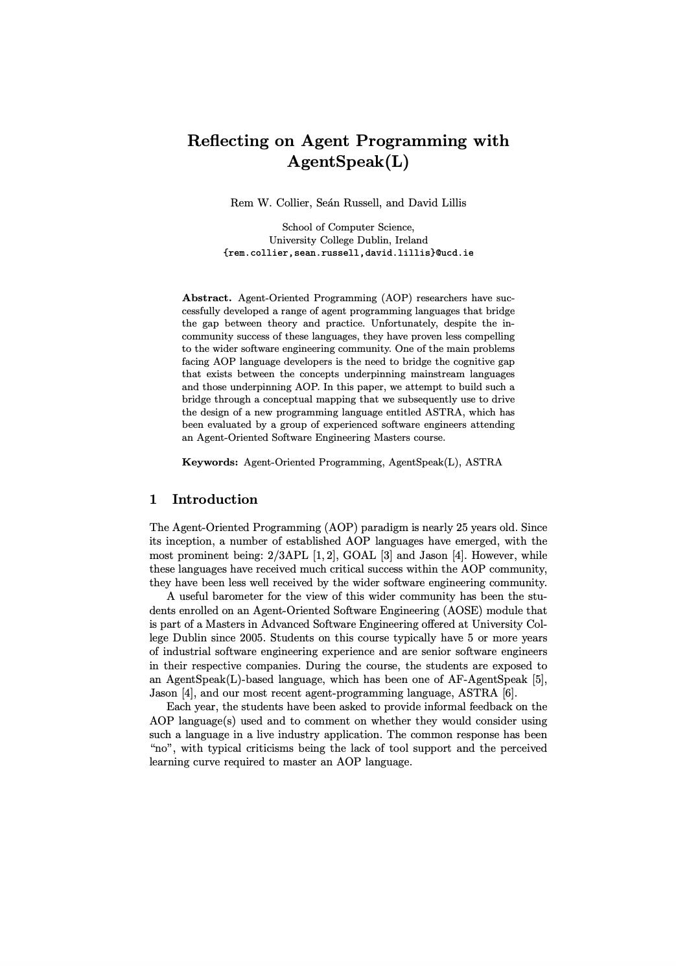
A Note on Beliefs as Fields
Type | Java | AgentSpeak(L)
Primitives | double balance; int age = 42; String name = “Bob”; | balance(0.0) age(42) name(“Bob”)
Arrays | int[] array; int[] ages = {42, 8, 6} | array([]) ages([42, 8, 6])
Data Classes | class person { public String name; public int age; public char sex; } | Modelled as predicates or functional terms: person(“Rem”, 42, m) person(“Tanya”, 6, f) person(“Coral”, 8, f)
Maps | Map<String, String> parents = new HashMap<String, String>(); parents.put(“Tanya”, “Rem”); parents.put(“Coral”, “Rem”); | parents(“Tanya”, “Rem”) parents(“Coral”, “Rem”)
Sets | Set<String> lecturers = new HashSet<String>(); lecturers.add(“Henry”); lecturers.add(“Rem”); | lecturers(“Henry”) lecturers(“Rem”)
https://researchrepository.ucd.ie/entities/publication/84010516-687e-45b1-b867-02768c97152e/details

Slide 40
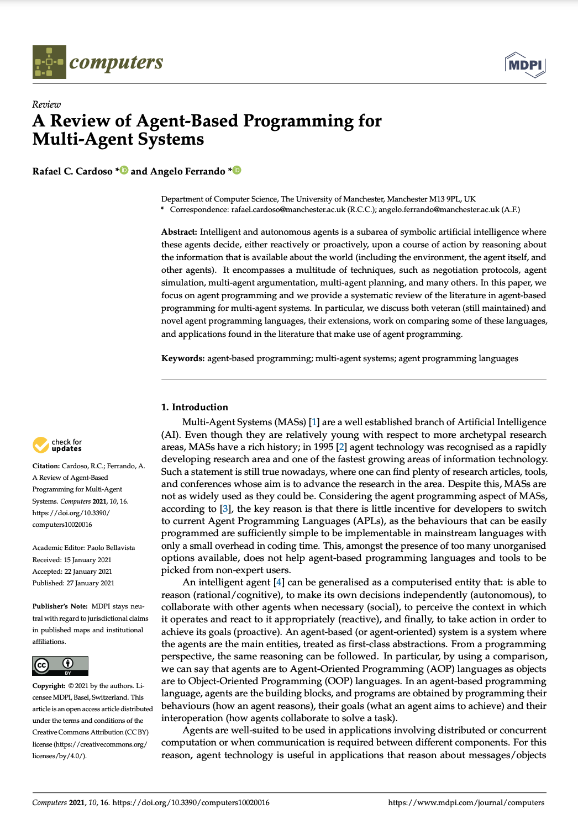
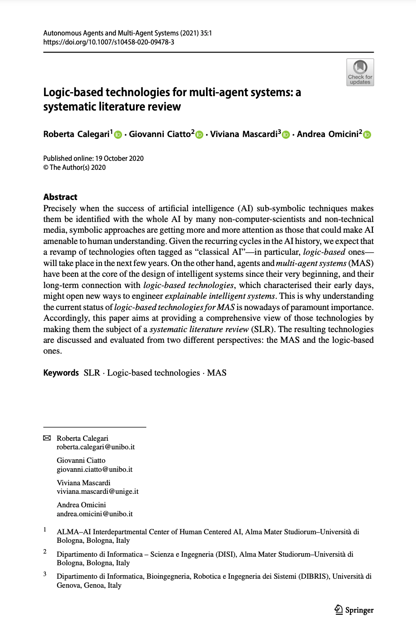
A Note on Beliefs as Fields
Type | Java | AgentSpeak(L)
Primitives | double balance; int age = 42; String name = “Bob”; | balance(0.0) age(42) name(“Bob”)
Arrays | int[] array; int[] ages = {42, 8, 6} | array([]) ages([42, 8, 6])
Data Classes | class person { public String name; public int age; public char sex; } | Modelled as predicates or functional terms: person(“Rem”, 42, m) person(“Tanya”, 6, f) person(“Coral”, 8, f)
Maps | Map<String, String> parents = new HashMap<String, String>(); parents.put(“Tanya”, “Rem”); parents.put(“Coral”, “Rem”); | parents(“Tanya”, “Rem”) parents(“Coral”, “Rem”)
Sets | Set<String> lecturers = new HashSet<String>(); lecturers.add(“Henry”); lecturers.add(“Rem”); | lecturers(“Henry”) lecturers(“Rem”)
https://www.mdpi.com/2073-431X/10/2/16
https://link.springer.com/article/10.1007/s10458-020-09478-3
https://researchrepository.ucd.ie/entities/publication/84010516-687e-45b1-b867-02768c97152e/details

