Slide 1
Introduction to ASTRA
COMP 41400: Multi-Agent Systems
Lecturer: Rem Collier
Email: rem.collier@ucd.ie

Slide 2
Mapping AgentSpeak(L) to ASTRA

Slide 3
ASTRA
An implementation of AgentSpeak(TR)
Basically, the same thing but with a different syntax + concrete ideas about how to define private actions (and other things).
Teleo-Reactive programming concepts are also integrated.
Key Ideas:
Linked to Java (Static Typing + Java Syntax)
Easy to Extend (Modules support adding actions, sensors, …)
Familiar code structure (loops, selections, assignment and local variables)
Multiple Inheritance for Reuse.
Maven-based Build System

Slide 4
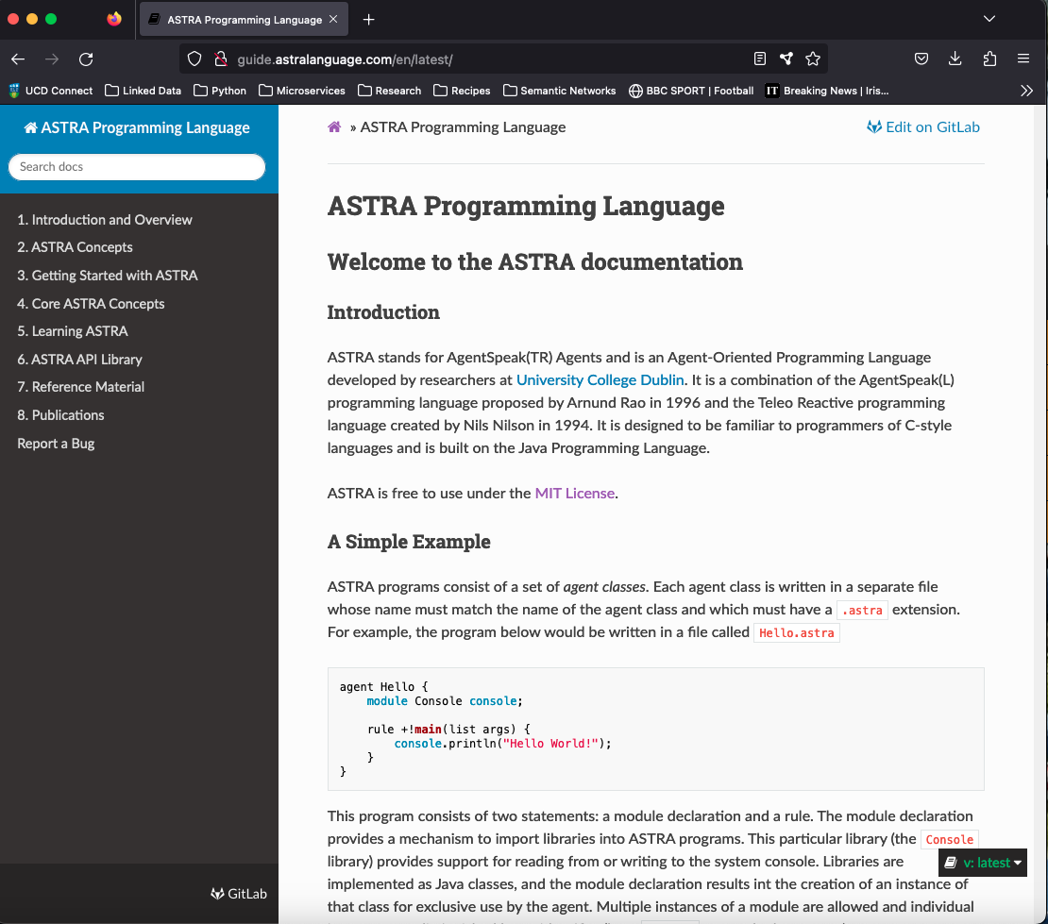
Astra Guide http://guide.astralanguage.com/en/latest/

Slide 5
Modules
Modules are Java classes whose methods can be invoked from ASTRA code.
They are the extension mechanism that ASTRA provides to allow domain specific applications to be built.
Mappings between ASTRA concepts and Java methods is done through the use of annotations.
Modules can be used to implement:
Actions: methods that can be invoked to perform basic activities of the agent.
Sensors: methods that can be called during the belief revision phase of the reasoning cycle.
Terms: methods that, when evaluated, are replaced with constant values.
Formulae: methods that can be evaluated as part of a logical expression.
Events: a custom event model that can be used to create additional event types.
https://guide.astralanguage.com/en/latest/learning/#52-creating-your-own-astra-modules

Slide 6
ASTRA and Types
ASTRA is designed to be close to Java, so it adopts (most of) the Java type system:
4 and 8 byte integers (mapped to Java’s int and long types),
4 and 8 byte ﬂoating point numbers (mapped to float and double types)
representations for character and boolean values (mapped to char and boolean types).
Character strings (string) that maps to the java.lang.String class
A list type that maps to a custom implementation of the java.util.List interface.
A function type (funct) that maps to functional terms.
Any Java Class can be used as a type.
https://guide.astralanguage.com/en/latest/reference/

Slide 7
ASTRA and Extended Plan Syntax
Core programming constructs in ASTRA include:
if statement the most basic form of ﬂow control
while loop usual method of repetition in programming
foreach loop repeats the same actions for every matching binding of a formula
forall loop repeats the same actions for all the values in a specified list.
try ... recover allows for the recovery from failed actions
Local variable declarations for use within a plan rule
assignment allows the value of a local variable to be changed
query binds the values of beliefs to variables
wait pauses execution until condition if true
send sends message to another agent
synchronized enables mutual exclusion in critical sections
constant can be used at the top of a class to define constants.
https://guide.astralanguage.com/en/latest/reference/

Slide 8
ASTRA and Extended Plan Syntax
rule +!sort(list L) {
int j = 0;
while (j < P.size(L)) {
int min = j;
int k = j+1;
while (k < P.size(L)) {
if (P.valueAsInt(L, min) > P.valueAsInt(L, k))
min = k;
k++;
}
if (min ~= j) {
P.swap(L, min, j);
}
j++;
}
}

Slide 9
ASTRA and Multiple Inheritance
ASTRA uses a C++ style multiple inheritance model:
agent A { module Console C; rule +!do(string X) { C.println(X); } }
agent B extends A { rule +!main(list args) { !do(“Hello World”); } }
agent C extends B { rule +!do(string X) { A::!do(“Modified: “ + X); } }
agent D { module Console C; rule +!do(string X) { C.println(“D: “ + X); } }
agent E extends A,D { rule +!main(list args) { D::!do(“Hello World”); } }
https://guide.astralanguage.com/en/latest/multiple-inheritence/

Slide 10
ASTRA and Multiple Inheritance
ASTRA uses a C++ style multiple inheritance model:
agent A { module Console C; rule +!do(string X) { C.println(X); } }
agent B extends A { rule +!main(list args) { !do(“Hello World”); } }
agent C extends B { rule +!do(string X) { A::!do(“Modified: “ + X); } }
agent D { module Console C; rule +!do(string X) { C.println(“D: “ + X); } }
agent E extends A,D { rule +!main(list args) { D::!do(“Hello World”); } }
Agent
A
D
Resultant Class Hierarchy
B
E
C
https://guide.astralanguage.com/en/latest/multiple-inheritence/

Slide 11
ASTRA and Multiple Inheritance
ASTRA uses a C++ style multiple inheritance model:
agent A { module Console C; rule +!do(string X) { C.println(X); } }
agent B extends A { rule +!main(list args) { !do(“Hello World”); } }
agent C extends B { rule +!do(string X) { A::!do(“Modified: “ + X); } }
agent D { module Console C; rule +!do(string X) { C.println(“D: “ + X); } }
agent E extends A,D { rule +!main(list args) { D::!do(“Hello World”); } }
Implicit Base Class (like java.lang.Object)
Agent
A
D
Resultant Class Hierarchy
B
E
C
https://guide.astralanguage.com/en/latest/multiple-inheritence/

Slide 12
Hello World in ASTRA
agent HelloWorld {
module Console console;
rule +!main(list args) {
console.println(“Hello World”);
}
}

Slide 13
Hello World in ASTRA
The name of the agent program (class)
agent HelloWorld {
module Console console;
rule +!main(list args) {
console.println(“Hello World”);
}
}

Slide 14
Hello World in ASTRA
agent HelloWorld {
module Console console;
rule +!main(list args) {
console.println(“Hello World”);
}
}
A library of sensors, actions, terms, events & formulae

Slide 15
Hello World in ASTRA
agent HelloWorld {
module Console console;
rule +!main(list args) {
console.println(“Hello World”);
}
}
A library of sensors, actions, terms, events & formulae
Using the library in an ASTRA plan rule.

Slide 16
Hello World in ASTRA
agent HelloWorld {
module Console console;
rule +!main(list args) {
console.println(“Hello World”);
}
}
A goal adoption event

Slide 17
Hello World in ASTRA
agent HelloWorld {
module Console console;
rule +!main(list args) {
console.println(“Hello World”);
}
}
A goal adoption event
This event is created when an ASTRA program is run.
Similarly to Java, when you run a program, you specify a “start class”.

Slide 18
Hello World in ASTRA
agent HelloWorld {
module Console console;
rule +!main(list args) {
console.println(“Hello World”);
}
}
The !main(…) ASTRA Plan Rule

Slide 19
Hello World in ASTRA
agent HelloWorld {
module Console console;
rule +!main(list args) {
console.println(“Hello World”);
}
}
The !main(…) ASTRA Plan Rule
Java Equivalent:
public class HelloWorld {
public static void main(String[] args) {
…
}
}

Slide 20
3 Important Modules
ASTRA comes with multiple existing modules.
In these slides, we will run through the three most important ones:
astra.lang.Console
astra.lang.Debug
astra.lang.System
Even for these, I will only introduce some of the basic options.
A full list can be found at: https://gitlab.com/astra-language/astra-core/-/tree/master/astra-apis

Slide 21
astra.lang.Console
Contains a set of methods to print to the Console.
agent MyAgent {
module Console c;
rule +!main(list args) {
c.println(”Hello World!”);
}
}

Slide 22
astra.lang.Debug
Display the state of the agent:
dumpBeliefs(): prints out the agents’ beliefs to the console
printEventQueue(): prints the current event queue to the console
printStackTrace(): prints the stack of the current intention.
agent MyAgent {
module Debug d;
rule +!main(list args) {
d.printStackTrace();
}
}

Slide 23
astra.lang.System
Collection of System level actions:
exit(): terminates the program
fail(): action that fails
sleep(int): action that makes the agent go to sleep for a fixed time (ms)
agent MyAgent {
module System s;
module Console c;
rule +!main(list args) {
c.println(”Hello, ”);
s.sleep(1000);
c.println(”World!”);
s.exit();
}
}

Slide 24
Domain Modelling & ASTRA
Domain Modelling involves 3 activities:
Object Naming Conventions: Mapping types of objects in the environment to the domain model.
E.g. blocks = uppercase letters (A, B, C, …)
Identifying Predicates: Deciding which predicates (relations) you will need and which types of objects they will apply to.
E.g. on(X, Y), block(X), holding(X), table(T), free(X)
Specifying Knowledge Source: what knowledge is foundational (sensed) and what knowledge can be derived (through inference).
E.g. free(table) :- true (the table is aways free),
E.g. free(X) :- block(X) & ~on(Y, X) (blocks with nothing on them are free)

Slide 25
Domain Modelling & ASTRA
Object Naming Conventions must be enforced by the programmer when writing ASTRA code or implementing sensors/modules.
Predicates are specified explicitly in ASTRA using the types keyword:
types example {
formula block(string);
formula on(string, string);
formula holding(string);
}
Inferences are specified explicitly in ASTRA using the inference keyword:
inference free(“table”) :- true;
inference free(string B) :- block(B) & on(string Y, X);
inference free(string B) :- block(B) & ~on(Y B);, specifies that a block (B) is free if it is a block and there is nothing (Y) placed on top of it. This rule infers that a block is free if no other block or object is stacked on it.

Slide 26
Example: ASTRA Light Switch

Slide 27
The Light Switch in ASTRA
agent LightSwitch {
types ls {
formula switch(string);
formula light(string);
formula transition(string, string);
}
initial switch(“off”);
initial light(“off”);
rule +switch(string S) { !light(S); }
rule +!light(string S) : transition(string R, S) & light(R) {
-light(R);+light(S);
}
rule +!light(string S) { }
}

Slide 28
ASTRA and Maven
ASTRA adopts standard maven conventions.
ASTRA source code is placed in /src/main/astra
Supporting Java code is placed in /src/main/java
A pom.xml file is used to build code:
Basic ASTRA projects extend astra:astra-base:1.4.2
Building requires the astra:astra-maven-plugin plugin
All maven modules are in Maven Central.
Compiling ASTRA: mvn compile
Deploying ASTRA: mvn astra:deploy

Slide 29
ASTRA POM.XML
<project>
<modelVersion>4.0.0</modelVersion>
<groupId>example</groupId>
<artifactId>hello</artifactId>
<version>1.0.0</version>
<parent>
<groupId>com.astralanguage</groupId>
<artifactId>astra-base</artifactId>
<version>1.4.2</version>
<relativePath></relativePath>
</parent>
<properties>
<astra.main>LightSwitch</astra.main>
</properties>
</project>

