Slide 1
CArtAgO
COMP41400: Multi-Agent Systems
Lecturer: Rem Collier
Email: rem.collier@ucd.ie

Slide 2
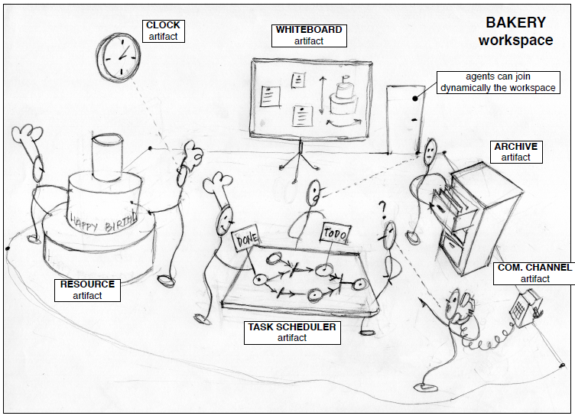
Agents & Artifacts Model
Environments are workspaces containing artifacts that agents create, share, use, adapt for their work.

Slide 3
A&A Basic Concepts
Agents
Autonomous, goal/task-oriented entities
Proactive, reactive, social, …
Create and co-use artifacts for supporting their activities
In addition to direct communication
Artifacts
Non-autonomous, function-oriented entities
Controllable and observable
Modelling the resources and tools used by agents
Designed by MAS programmers
First-class entities for agents
Workspaces
Grouping of agents and artifacts
The shared space in which agents interact

Slide 4
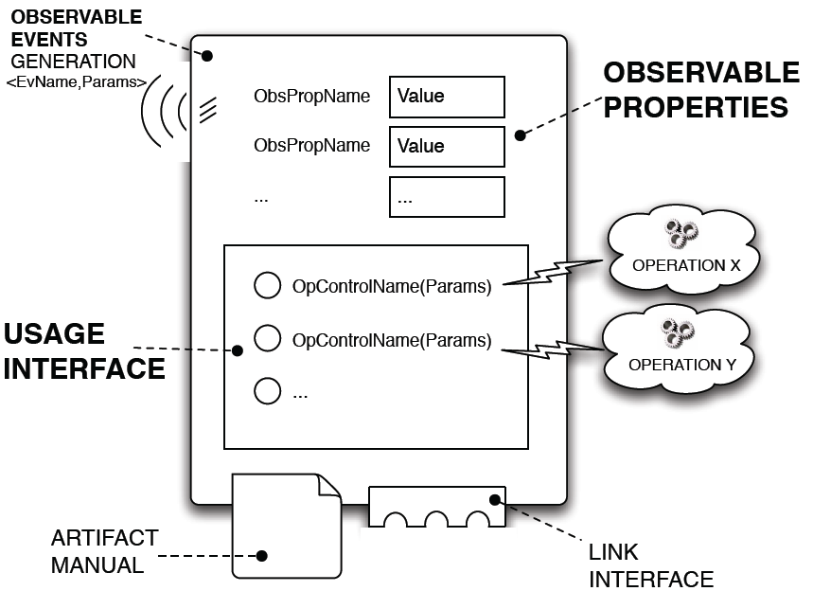
Artifact Model

Slide 5
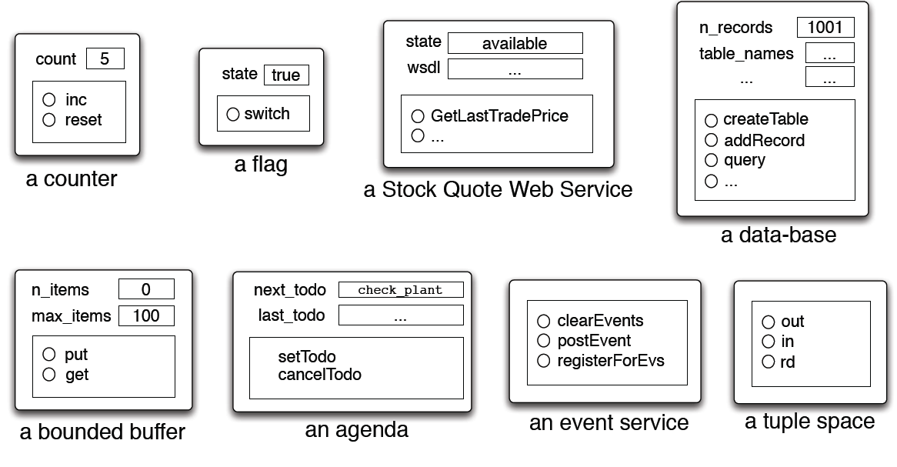
Examples

Slide 6
Agent-Artifact Interaction
Based on the concepts of use and observation.
Triggering and controlling the execution of operations by “acting” on an artifact usage interface
Perceiving events generated by operation execution
Beliefs representing events happening in the artifact or as first-class events
Perceiving artifact observable properties
Beliefs representing the state of the artifact

Slide 7
Artifact Model Features
Artifacts are controllable and observable things
Operation execution as a (possibly long term) controllable process.
Two observable levels: properties and events
Transparent management of concurrency issues:
Synchronisation, mutual exclusion, etc.
Composability through Linking
Also across workspaces

Slide 8
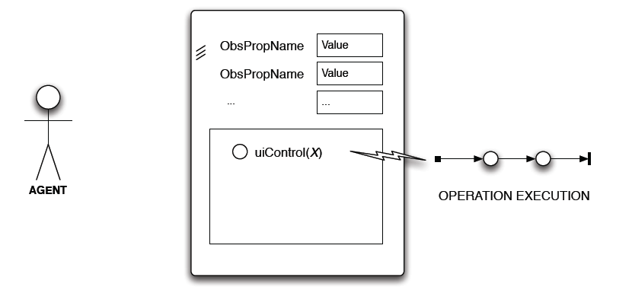
Interaction Model: Use
artifact operation execution
Asynchronous w.r.t. agent
Possibly a process structured in multiple atomic steps

Slide 9
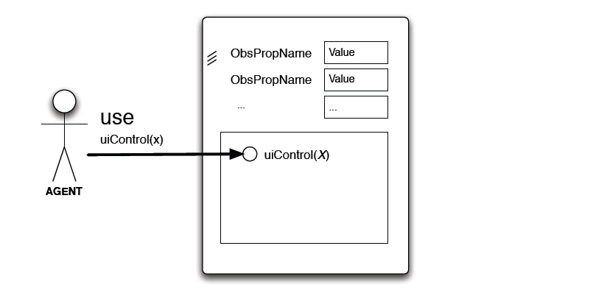
Interaction Model: Use
use action
Acting on op. controls to trigger op execution
Synchronization point with artifact time/state

Slide 10
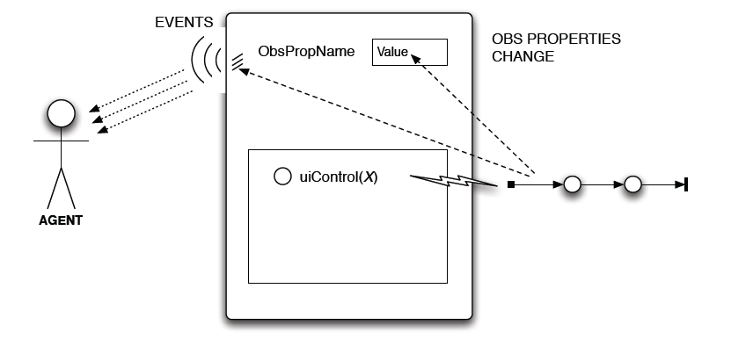
Interaction Model: Use
observable events
Observable events & changes in observable property
Perceived by agents either as (external) events or beliefs

Slide 11
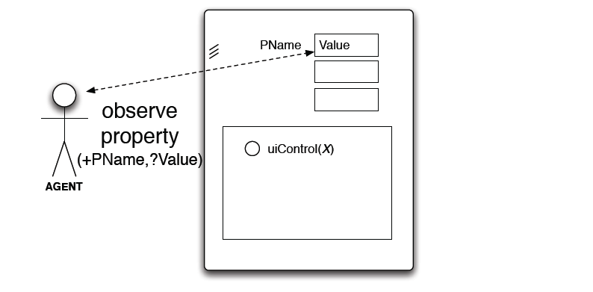
Interaction Model: Observation
observeProperty action
Value of an obs. Property as action feedback
No interaction

Slide 12
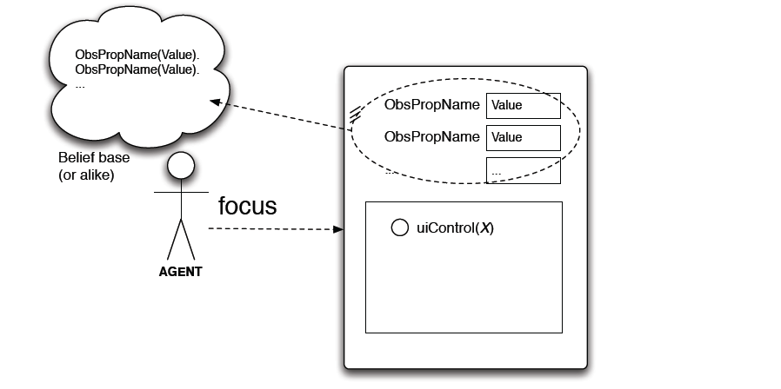
Interaction Model: Observation
focus / stopFocus action
Start / stop a continuous observation of an artifact
Possibly specifying filters
Observable properties represented as beliefs

Slide 13
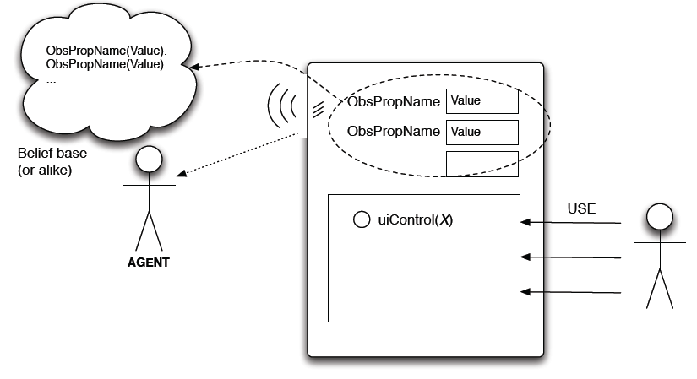
Interaction Model: Observation
continuous observation
Observable events (> agent events / beliefs)
Observable properties (> belief base update)

Slide 14
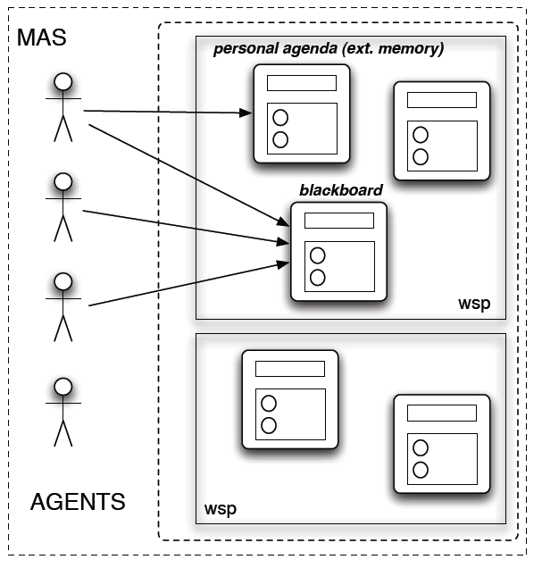
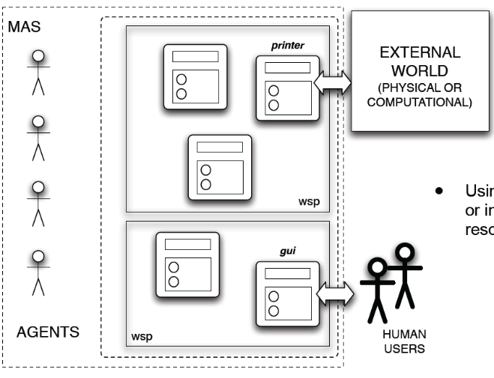
Categories of Artifacts
Personal Artifacts
Designed to provide functionalities for a single agent use
E.g. agenda
Social Artifacts
Designed to provide some kind of global functionalities
Communication, coordination, organisation, …
E.g. blackboards, tuple spaces, bounded buffers, …
Boundary Artifacts
Interfaces to represent external systems
E.g. database, GUI, web services, …

Slide 15
CArtAgO (Uni Bologna)
Platform / infrastructure implementing the A&A model
Runtime environment for executing (possibly distributed) artifact-based environments.
Java–based programming model for defining artifacts
Set of basic APIs for agent platforms to work with artifact-based environments
Distributed and open MAS
Workspaces distributed on Internet nodes
Agents can join and work in multiple workspaces at a time
Role-Based Access Control (RBAC) security model
Open Source Technology:
Available at http://cartago.sourceforge.net

Slide 16
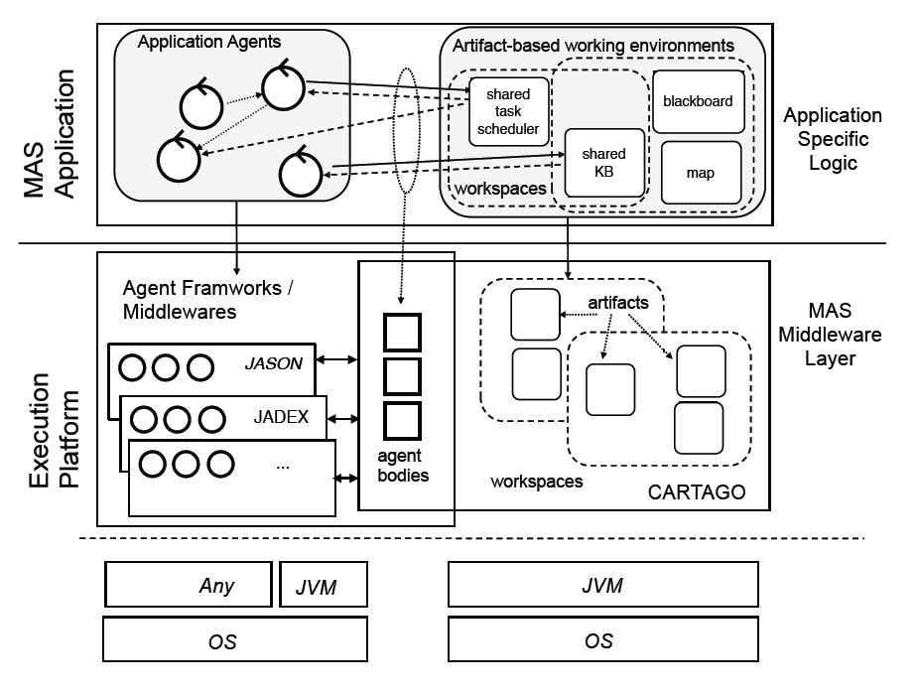
CArtAgO Architecture

Slide 17
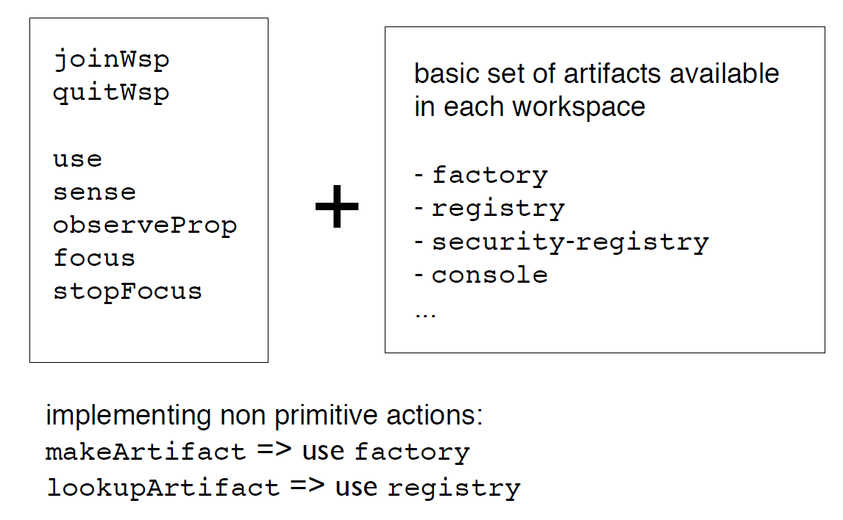
Raw Agent API

Slide 18
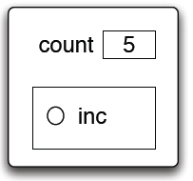
Example: Shared Counter https://gitlab.com/astra-language/examples/cartago/astra-cartago-counter
package cartago;
public class Counter extends Artifact {
@OPERATION void init() {
defineObsProperty("count", 0);
}
@OPERATION void inc() {
int count = getObsProperty("count").intValue();
updateObsProperty("count", count + 1);
}
}
OBSERVABLE PROPERTIES:
count: int
USAGE INTERFACE:
inc: { op_exec_started(inc),
count(X),
op_exec_completed(inc) }
agent Main {
module Cartago cartago; module System S;
rule +!main(list args) {
cartago.startService();
S.createAgent("user", "User");
S.createAgent("obs", "Observer");
}
}
agent Observer {
module Cartago cartago; module System S;
initial !observe();
rule +!observe() {
cartago.link();
!myTool(cartago.ArtifactId id);
cartago.focus(id);
}
rule +!myTool(cartago.ArtifactId id) {
try { cartago.lookupArtifact("c0", id);
} recover { S.sleep(10); !myTool(id); }
}
rule +$cartago.property(string id, count(int val)) {
cartago.println("val: " + val);
}
rule $cartago.signal(string sid, funct S) {
cartago.println("S: " + S);
}
}
agent User {
module Cartago ctgo; module System S;
initial !create_and_use();
rule +!create_and_use() {
ctgo.link();
!setup_tool(cartago.ArtifactId id);
S.sleep(100);
ctgo.inc();
ctgo.operation(id, inc());
}
rule +!setup_tool(cartago.ArtifactId id) {
ctgo.makeArtifact("c0", "artifact.Counter",
ctgo.params([]), id);
}
}

Slide 19
Summary
CArtAgO is good for building open environments.
Developer has control over the environment
Can decide what artifacts are to be created and when
Less mature as artifact libraries tend not to be shared
Key abstraction is the artifact.
Focus is on things agents can use rather than the agents themselves.
CArtAgO can be used with multiple languages.
ASTRA, Jason, Jadex, …

