Slide 1
Agent Communication Languages
COMP 41400: Multi-Agent Systems
Lecturer: Rem Collier
Email: rem.collier@ucd.ie

Slide 2

Agent Interaction
Interaction is:
…sharing of information / tasks between nodes within some distributed system to achieve some common goal…
Platform 1
Platform 2
Agent A
Agent B

Slide 3
Agent Interaction
Message-based Interaction
Explicit form of interaction where the agents interact using Message Transport Services
Platform 1
Platform 2
Agent A
Agent B
Message Transport Service

Slide 4
Agent Interaction
Message-based Interaction
Explicit form of interaction where the agents interact using Message Transport Services
Agent A constructs a message identifying Agent B as the receiver
Platform 1
Platform 2
Agent A
Agent B
Message Transport Service

Slide 5
Agent Interaction
Message-based Interaction
Explicit form of interaction where the agents interact using Message Transport Services
Agent A passages the message to the MTS
Platform 1
Platform 2
Agent A
Agent B
Message Transport Service

Slide 6
Agent Interaction
Message-based Interaction
Explicit form of interaction where the agents interact using Message Transport Services
The MTS delivers the message to the platform of Agent B
Platform 1
Platform 2
Agent A
Agent B
Message Transport Service

Slide 7
Agent Interaction
Message-based Interaction
Explicit form of interaction where the agents interact using Message Transport Services
The MTS delivers the message to Agent B
Platform 1
Platform 2
Agent A
Agent B
Message Transport Service

Slide 8
Agent Interaction
Message-based Interaction
Explicit form of interaction where the agents interact using Message Transport Services
Agent B reads the message and acts…
Platform 1
Platform 2
Agent A
Agent B
Message Transport Service

Slide 9
Speech Act Theory
John Austin: some utterances are like physical actions…
“I now pronounce you man and wife”
What you “say” can be separated from its “intent” and “effect”:
Locutionary Act: the physical speaking of the word
Illocutionary Act: the action you are performing (the intent)
Perlocutionary Act: the effect of the act
John Searle: studied and classified Illocutionary Acts
Decompose illocutionary act to a performative (type) + content
Identified 5 categories of performative: representatives, directives, commissives, expressives and declaratives.
Notes:
Representatives or Assertives Speaker tells you information e.g. ”It is raining”.
Directives Speaker tries to make the hearer do something e.g. ”Please close the window”
Commisives Commits the speaker to future action e.g. ”I will close the window”
Expressives Speaker expresses a mental state e.g. ”Excuse me”, ”congratulations”
Declaratives Effect some changes e.g. ”I name this city Trondheim”

Slide 10
Speech Act Theory
Speech Act Type | Description and Example
Representatives / Assertives | Informing e.g. “it is raining”
Directives | Speaker tries to make the hearer do something e.g. “please close the window”
Commisives | Commits the speaker to a future action e.g. “I will close the window”
Expressives | Speaker expresses a mental state e.g. “excuse me”, “congratulations”
Declaratives | Effect some change e.g. “I name this room the ‘Rem Collier Room’”

Slide 11
Searle’s Theory
He then determined that speech acts can be decomposed in to 2 core components:
A performative verb
e.g. Request, inform
Propositional content
e.g. ”the window is closed”
Speech Act | Please close the door | The door is closed | Is the door closed?
Performative | request | inform | inquire
Content | the door is closed | the door is closed | the door is closed

Slide 12
Applying Speech Act Theory
In software, Speech Act Theory can be modelled as follows:
Locutionary Act: The act of sending a message
Illocutionary Act: The contents of the message
Perlocutionary Act: The effect of the message
Agent Communication Languages (ACLs):
A format for representing the contents of a message.
In theory, it consists of: performative + content
In practice, much more is required as agents lack the contextual information inherent in human communication.
ACLs define a set of valid performatives and an associated meaning (semantics) for them.
Semantics typically define how messages affect mental state

Slide 13
Applying Speech Act Theory
Two main ACLs to date:
1994 - Knowledge Query and Manipulation Language (KQML)
2000 - Foundation for Intelligent Physical Agents (FIPA) ACL
KQML developed for expert system interaction
Many flavours, generally compatible in theory but not in practice (both semantically and transport).
FIPA ACL is part of the wider FIPA standards
Everything was (over) specified.
Compatible at the syntactic and transport layers, but still semantic issues.
Both specify standard interaction patterns (protocols)
Broker, Recruiter, Subscriber, …

Slide 14
Knowledge Query and Manipulation Language (KQML)

Slide 15
KQML
Knowledge Sharing Effort (KSE), funded by ARPA
Central concept: knowledge sharing requires communication, which in turn requires a common language.
KSE focused on defining that common language.
KQML: Knowledge Query and Manipulation Language
Language for both message formatting and message handling protocols.
KIF: Knowledge Interchange Format
Language for expressing message content.
Notes:
The central concept of KSE was that knowledge sharing requires communication, which in turn requires a common language. The effort focused on defining that common language.

Slide 16
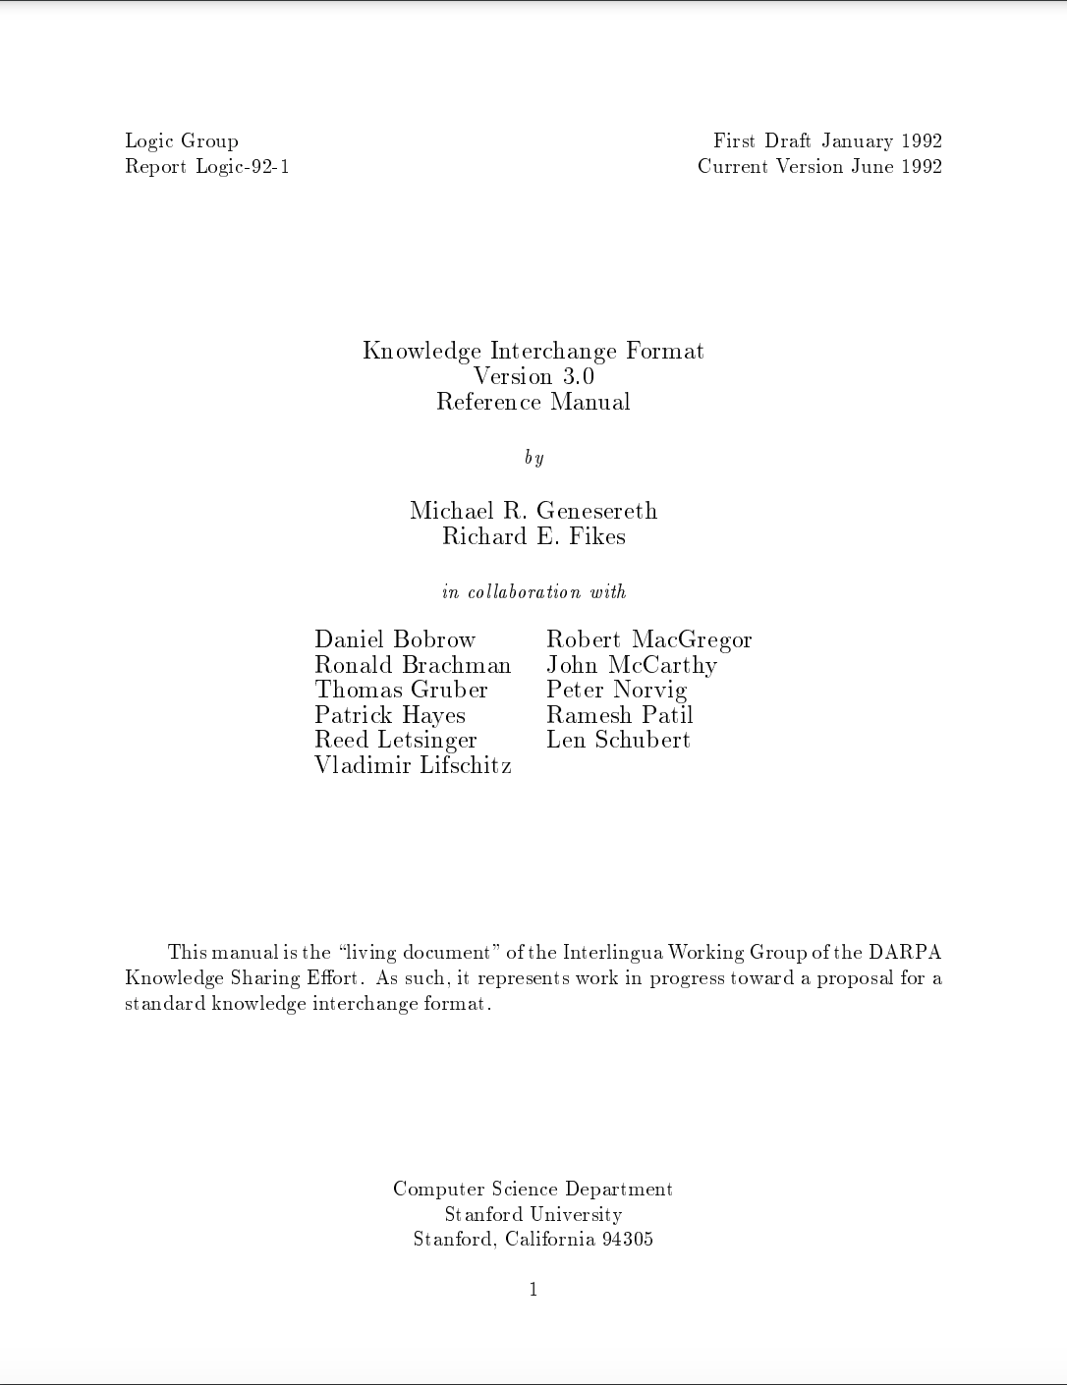
KQML
Knowledge Sharing Effort (KSE), funded by ARPA
Central concept: knowledge sharing requires communication, which in turn requires a common language.
KSE focused on defining that common language.
KQML: Knowledge Query and Manipulation Language
Language for both message formatting and message handling protocols.
KIF: Knowledge Interchange Format
Language for expressing message content.
https://citeseerx.ist.psu.edu/document?repid=rep1&type=pdf&doi=b9176f78f6264451396480e12ac34844a5f6b04b
Notes:
The central concept of KSE was that knowledge sharing requires communication, which in turn requires a common language. The effort focused on defining that common language.

Slide 17
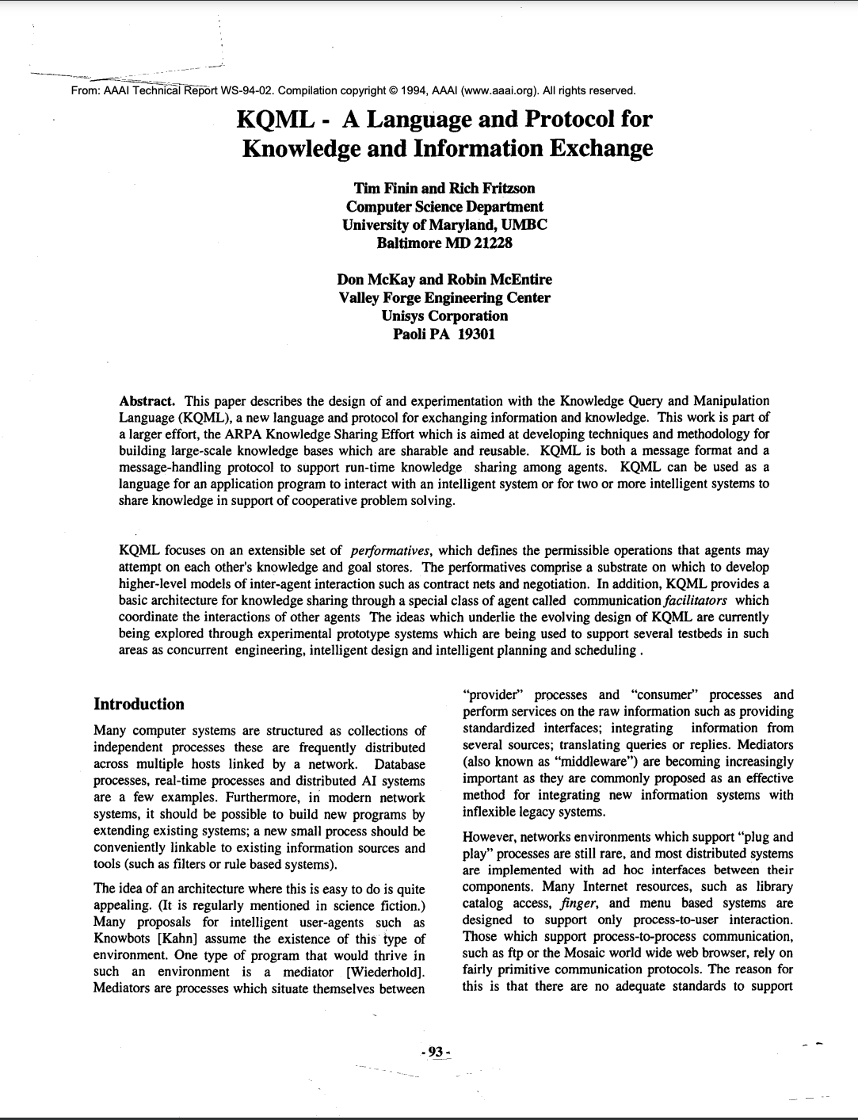
KQML
Knowledge Sharing Effort (KSE), funded by ARPA
Central concept: knowledge sharing requires communication, which in turn requires a common language.
KSE focused on defining that common language.
KQML: Knowledge Query and Manipulation Language
Language for both message formatting and message handling protocols.
KIF: Knowledge Interchange Format
Language for expressing message content.
https://citeseerx.ist.psu.edu/document?repid=rep1&type=pdf&doi=b9176f78f6264451396480e12ac34844a5f6b04b
https://cdn.aaai.org/Workshops/1994/WS-94-02/WS94-02-007.pdf
Notes:
The central concept of KSE was that knowledge sharing requires communication, which in turn requires a common language. The effort focused on defining that common language.

Slide 18
KQML and KIF
KQML is an ‘outer’ language, that defines various acceptable ‘communicative verbs’, or performatives
Example performatives:
ask-if (‘is it true that. . . ’)
perform (‘please perform the following action. . . ’)
tell (‘it is true that. . . ’)
reply (‘the answer is . . . ’)
KIF is a language for expressing message content

Slide 19
KQML Message Structure
KQML is an ‘outer’ language, that:
Defines the set of acceptable ‘communicative verbs’
Is syntactically independent of the inner content.
Provides the additional contextual information necessary for the receiver to understand the message.
e.g.
(ask-if
:sender agenti
:receiver agentj
:language Prolog
:ontology genealogy
:content
“spouse(adam, eve)”)
Communication
Mechanics of communication, e.g. Sender, receiver.
Performatives (message layer)
Logic of communication, e.g. ask, tell.
Content
Content of communication,
e.g. a KIF expression

Slide 20
KQML Performative Categories
Category | Performatives
Basic Query | evaluate, ask-if, ask-one, ask-all, ask-about
Multi-response Query | stream-about, stream-all
Response | reply, sorry
Generic informational | tell, achieve, cancel, untell
Generator | standby, ready, next, rest, discard, generator
Capability-definition | advertise, subscribe, monitor, import, export
Networking | register, unregister, forward, broadcast, route
Notes:
Examples of Performatives:
ask_-all: S wants all of R’s answers to a question.
Stream-all: multiple response version of ask-all
Reply: communicates an expected reply
Sorry: S cannot provide a more informative reply
Tell: S claims to R that C is in S’s virtual knowledge base
Ready: S is ready to respond to R’s previously mentioned performative
Subscribe: S wants updates to R’s response to a performative
Register: S can deliver performatives to some named agent

Slide 21
KIF: Knowledge Interchange Format
“Rem is a lecturer” (isa Rem Lecturer)
“Rem likes Beer” (like Rem Beer)
“The temperature of m1 is 83 Celsius”: (= (temperature m1) (scalar 83 Celsius))
“An object is a bachelor if the object is a man and is not married”: (defrelation bachelor (?x) := (and (man ?x) (not (married ?x))))
“Any individual with the property of being a person also has the property of being a mammal”: (defrelation person (?x) :=> (mammal ?x))

Slide 22
KIF: Knowledge Interchange Format
“Rem is a lecturer” (isa Rem Lecturer)
“Rem likes Beer” (like Rem Beer)
“The temperature of m1 is 83 Celsius”: (= (temperature m1) (scalar 83 Celsius))
“An object is a bachelor if the object is a man and is not married”: (defrelation bachelor (?x) := (and (man ?x) (not (married ?x))))
“Any individual with the property of being a person also has the property of being a mammal”: (defrelation person (?x) :=> (mammal ?x))
KIF is central to KQML as it provides the common language for expressing information (knowledge).

Slide 23
KIF: Knowledge Interchange Format
“Rem is a lecturer” (isa Rem Lecturer)
“Rem likes Beer” (like Rem Beer)
“The temperature of m1 is 83 Celsius”: (= (temperature m1) (scalar 83 Celsius))
“An object is a bachelor if the object is a man and is not married”: (defrelation bachelor (?x) := (and (man ?x) (not (married ?x))))
“Any individual with the property of being a person also has the property of being a mammal”: (defrelation person (?x) :=> (mammal ?x))
KIF is central to KQML as it provides the common language for expressing information (knowledge).
To communicate effectively, agents must agree in advance what things mean – they must have a shared ontology.

Slide 24
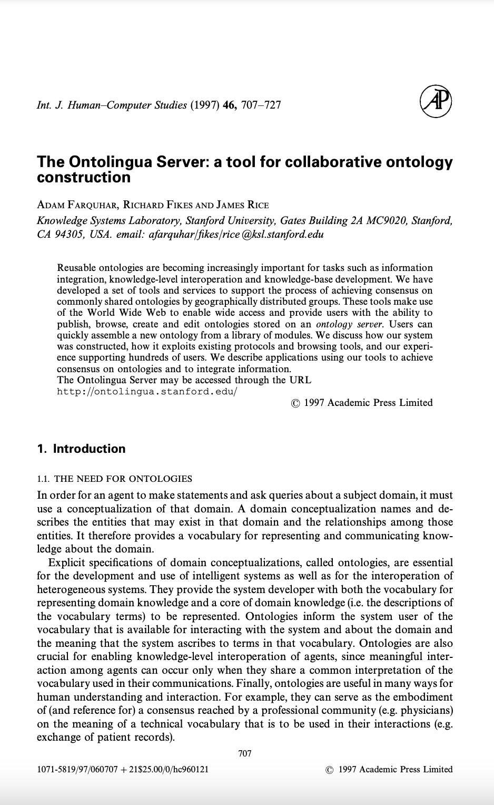
KIF: Knowledge Interchange Format
“Rem is a lecturer” (isa Rem Lecturer)
“Rem likes Beer” (like Rem Beer)
“The temperature of m1 is 83 Celsius”: (= (temperature m1) (scalar 83 Celsius))
“An object is a bachelor if the object is a man and is not married”: (defrelation bachelor (?x) := (and (man ?x) (not (married ?x))))
“Any individual with the property of being a person also has the property of being a mammal”: (defrelation person (?x) :=> (mammal ?x))
KIF is central to KQML as it provides the common language for expressing information (knowledge).
To communicate effectively, agents must agree in advance what things mean – they must have a shared ontology.
https://www.sciencedirect.com/science/article/pii/S1071581996901214

Slide 25
KQML Examples
(stream-about
:sender A :receiver B
:language Prolog :ontology motors
:reply-with q1 :content “item(m1)”)
(tell
:sender B :receiver A
:in-reply-to q1
:content “torque(m1, 12, kgf)”)
(tell
:sender B : receiver A
:in-reply-to q1
:content “status(m1, normal)”)
(eos
:sender B : receiver A
:in-reply-to q1)
performative
(evaluate
:sender A : receiver B
:language Prolog :ontology motors
:reply-with q2
:content “value(torque, m1)”)
(reply
:sender B :receiver A
:language Prolog
:ontology motors
:in-reply-to q2
:content “torque(m1, 12, kgf)”)
content (written in KIF)

Slide 26
KQML Facilitators
KQML environments (may) contain facilitators that help make the communication protocol transparent.
Facilitators: a special class of agents that perform useful communication services such as:
Maintain registry of service names
Forward messages to named services
Routing messages based on content
Provide matchmaking between information providers and seekers
Provide mediation and translation services
Notes:
Reference for Facilitators:
T. Finin, Y. Labrou, J. Mayfield. ”KQML as an Agent Communication Language”. In: J. Bradshaw (ed). Software Agents, AAAI Press/MIT Press, 1997, pp. 291-316.

Slide 27
KQML Facilitators
Point-to-point protocol
A is aware that it is appropriate
to send a query about X to B
There are several ways to achieve this via a Facilitator.
F
tell(X)
ask(X)
A
B
Notes:
F is the Facilitator and is not involved in the communication.

Slide 28
KQML Facilitators
Using the subscribe performative
A Request that Facilitator F monitor for the truth of X. If B subsequently informs F that it believes X to be true, then F can in turn inform A.
1.subscribe(ask(X))
2.tell(X)
F
3.tell(X)
A
B
Notes:
F just forwards

Slide 29
KQML Facilitators
3advertise(ask(X))
1broker(ask(X))
Using the broker performative
A Asks Facilitator to find another agent which can process a given performative.
4tell(X)
F
5tell(X)
2ask(X)
A
B
Notes:
A asks F to find an agent that can process an ask(x) performative. B independently informs F that it is willing to accept performatives matching ask(x). Once F receives both these messages, it send B the query, gets a response and forwards it to A.

Slide 30
KQML Facilitators
2advertise(ask(X))
1recruit(tell(X))
Using the recruit performative
Asks Facilitator to find an appropriate agent to which an embedded performative can be forwarded. A reply is returned directly to the original agent.
F
3ask(X)
4tell(X)
A
B
Notes:
Consider the situation where the performative from A is subscribe(x) rather than tell(x).

Slide 31
KQML Facilitators
1recommend(ask(X))
2advertise(ask(X))
Using the recommend performative
Asks Facilitator to respond with the ”name” of another agent which is appropriate for sending a particular performative.
F
3reply(B)
4ask(X)
A
B
5tell(X)
Notes:
Service discovery.

Slide 32
KQML Criticism
Transportation mechanisms were not defined.
Set of performatives is large and ad hoc.
Lacked the class of performatives: commissives
Not possible to communicate commitment to an action
Difficult to implement multi-agent scenarios without commissives.
Weak semantics of performatives
Different implementations of KQML could not interoperate.

Slide 33
Foundation for Intelligent Physical Agents (FIPA) ACL

Slide 34
FIPA ACL: Introduction
FIPA is the official standards body for multi-agent systems
Its goal was (is) to standardise the concept of an agent and its underlying machinery.
Its goal was (is) to promote interoperability between technologies and systems.
FIPA membership includes many large multinationals (Alcatel-Lucent, Boeing, HP, IBM, Intel,…) and academic/government organisations and research institutes
The initial standards released by FIPA in 2000 included:
Agent Communication
Application Infrastructures
Agent UML
FIPA Standards: http://www.fipa.org/repository/standardspecs.html

Slide 35
FIPA ACL Structure
Performative (communicative act)
20 performatives in FIPA ACL
Housekeeping
e.g. Sender, Reply to, Reply-with, In-Reply-With
Content
the actual content of the message
Language
The language in which the content is written
Ontology
The ontology in which the message needs to be interpreted.

Slide 36
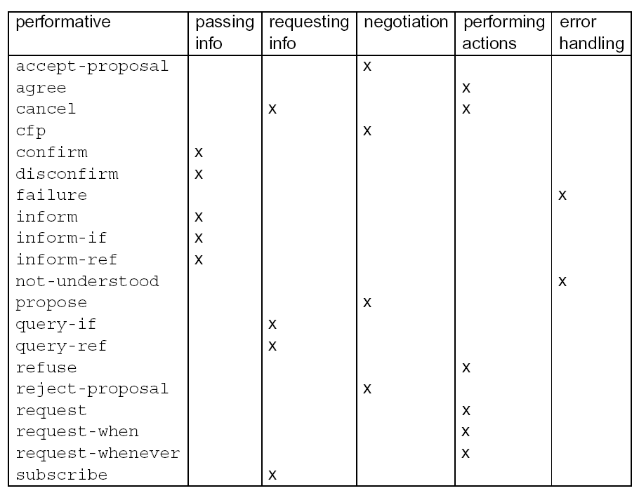
FIPA-ACL: Performatives

Slide 37
FIPA ACL: Message Structure
Transport-message: HTTP
Sender:
Transport-type: FIPA-HTTP
Transport-address: http://www.agentfactory.com:4444/
Transport-properties: none
Receiver:
Transport-type: FIPA-HTTP
Transport-address: http://www.ibeca.org:4444/
Transport-properties: none
Additional-attributes:
none
Envelope:
Comprises of a collection of parameters
Contains at least the mandatory to and sender parameters
Message Body
The fully specified message in the chosen ACL syntax
Can be encoded (e.g. The FIPA Bit Efficient Encoding Mechanism).
Envelope
Payload
(ACL message)

Slide 38
FIPA ACL: Performative Semantics
 | Inform | Request
Content | statement | action
Precondition | Holds that the content is true. Intends that the recipient believe the content Does not already believe that the recipient is aware whether content is true or not | Intends action content to be performed Believes recipient is capable of performing this action Does not believe that sender already intends to perform action

Slide 39
FIPA ACL: Interaction Protocols
Ongoing conversations between agents fall into typical patterns.
In such cases, certain message sequences are expected, and at any point in the conversation, other messages are expected to follow.
In FIPA ACL, these patterns of message exchange are called protocols.
Each message can be annotated with a protocol identifier.
This provides valuable context for the receiver and helps it to
Understand how to respond to the message
(query-if :sender A
:receiver B
:content some-act
:protocol fipa-query-protocol
)

Slide 40
FIPA ACL: Interaction Protocols
Basic FIPA Interaction Protocols:
Propose Protocol
Query Protocol
Request Protocol
Cancel Meta-Protocol
Subscribe Protocol
More complex Protocols:
Recruiting Protocol
Brokering Protocol
Request When Protocol
English and Dutch Auctions, (Iterated) Contract Net (later)

Slide 41
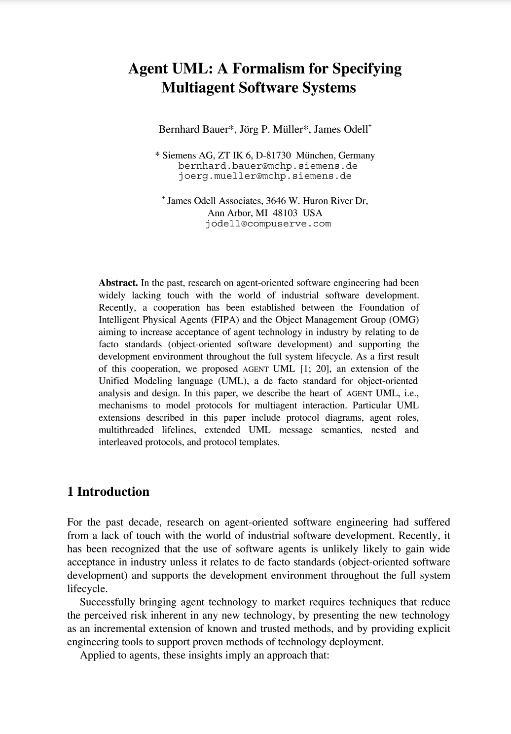
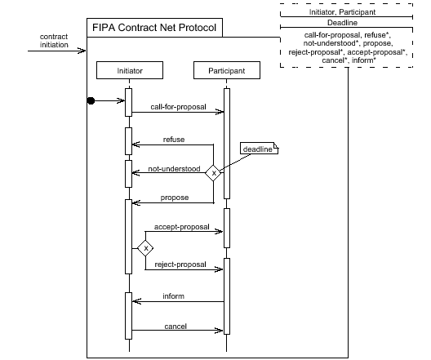
Insert: AUML Protocol Diagrams
https://opus.bibliothek.uni-augsburg.de/opus4/frontdoor/deliver/index/docId/44574/file/44574.pdf

Slide 42
Insert: AUML Protocol Diagrams
Parameterised Templates
https://opus.bibliothek.uni-augsburg.de/opus4/frontdoor/deliver/index/docId/44574/file/44574.pdf

Slide 43
Insert: AUML Protocol Diagrams
Parameterised Templates
Constrained Message Types
https://opus.bibliothek.uni-augsburg.de/opus4/frontdoor/deliver/index/docId/44574/file/44574.pdf

Slide 44
Insert: AUML Protocol Diagrams
Parameterised Templates
Constrained Message Types
Multiple Threads of Interaction
https://opus.bibliothek.uni-augsburg.de/opus4/frontdoor/deliver/index/docId/44574/file/44574.pdf

Slide 45
Insert: AUML Protocol Diagrams
Parameterised Templates
Constrained Message Types
Optional AND, OR, XOR lifeline connectors
Multiple Threads of Interaction
https://opus.bibliothek.uni-augsburg.de/opus4/frontdoor/deliver/index/docId/44574/file/44574.pdf

Slide 46
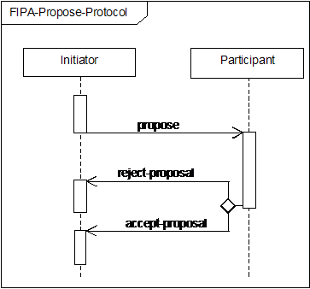
FIPA Propose Protocol
Initiator proposes that the participant perform some action.
The participant can:
Say no (reject-proposal)
Say yes (accept-proposal)
An accept-proposal message is typically followed by:
the execution of the agreed action
(if necessary) informing the initiator of the result of the action.

Slide 47
FIPA Propose Protocol
Robot BC45 asks robot XY29 to pick up box 432987.
(propose
:sender BC45
:receivers (set XY29)
:protocol fipa-propose
:language Prolog
:conversation-id 45
:content “pickup(432987)”)
(reject-proposal
:sender XY29
:receivers (set BC49)
:protocol fipa-propose
:language Prolog
:conversation-id 45
:content “pickup(432987)”)

Slide 48
FIPA Query Protocol
A robot checks whether there is beer in the fridge
(query-if
:sender robot
:receivers (set fridge)
:protocol fipa-query
:language Prolog
:content “have(beer)”)
(inform
:sender fridge
:receivers (set robot)
:protocol fipa-query
:language Prolog
:content “~have(beer)”)

Slide 49
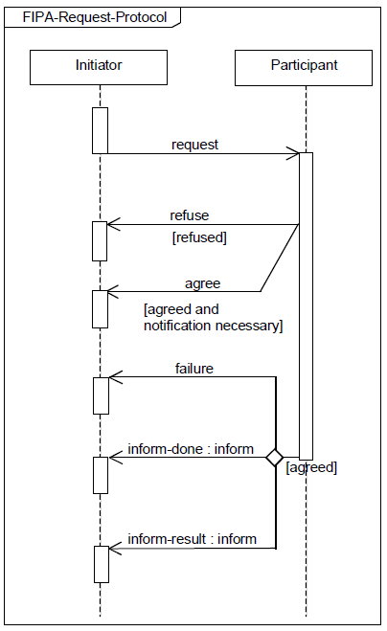
FIPA Request Protocol
Initiator requests that some task be performed
Participant either agrees to or refuses the request
Participant performs the task and tells the initiator:
Of the failure of the task
That the task is done
The result of the task

Slide 50
FIPA ACL: Example Messages
Rem asks the robot for a beer:
(request
:sender rem
:receivers (set robot)
:language ASTRA
:content “get(beer)”
)
(refuse
:sender robot
:receivers (set rem)
:language ASTRA
:content “get(beer)”
)
(request
:sender rem
:receivers (set robot)
:language ASTRA
:content “get(beer)”
)
(agree
:sender robot
:receivers (set rem)
:language ASTRA
:content “get(beer)”
)
(inform
:sender robot
:receivers (set rem)
:language ASTRA
:content “have(beer)”
)

Slide 51
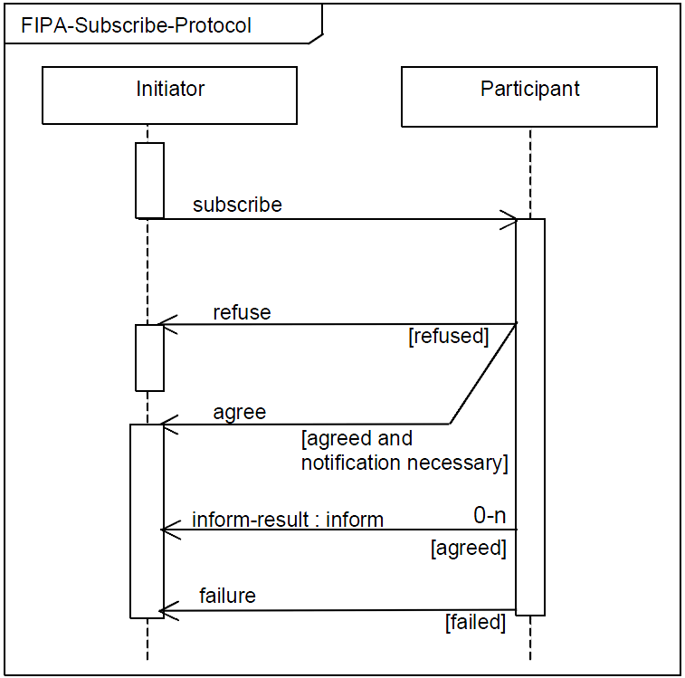
Example: FIPA Subscribe Protocol
Initiator subscribes to the participant.
Participant either agrees or refuses subscription
Participant informs initiator of any information relating to the subscription or sends a failure message if necessary.

Slide 52
FIPA Subscribe Protocol
An advertiser agent offers a subscription service for information about new books:
(subscribe
:sender bob :receivers (set book_launcher)
:protocol fipa-subscribe
:language ASTRA
:content “new_books([\”fantasy\”,\”cooking\”])”)
(agree
:sender book_launcher :receivers (set bob)
:protocol fipa-subscribe
:language ASTRA
:content “new_books([\”fantasy\”,\”cooking\”])”)
(inform
:sender book_launcher :receivers (set bob)
:protocol fipa-subscribe
:language ASTRA
:content “book(\”fantasy\”,
\”Harry Potter and the Philosophers Stone\”,
\”J.K.Rowling\”)”)

Slide 53
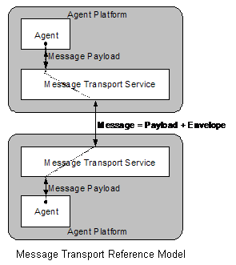
FIPA Transport management
FIPA also defines how messages are sent and received.
This is done using a Message Transport Service:
SC00075 – FIPA Agent Message Transport Protocol over IIOP Specification.
SC00084 – FIPA Agent Message Transport Protocol over HTTP Specification.
These are deployed on an agent platform:
SC00001 – FIPA Abstract Architecture Specification
SC00023 – FIPA Agent Management Specfication

Slide 54
Message-Oriented Interaction
Communication Channels used to route messages.
Asynchronous and private 1:1 communication
Transport Independent
Build on standards
Benefits:
Well suited to internet scale applications
Communication can be direct and (less) public
Drawbacks:
Requires Agent Discovery mechanism(s)
Often viewed as knowledge level interaction - not good for large scale data transfer
Decentralised nature makes monitoring more difficult

