Slide 1
Agent Interaction
COMP 41400: Multi-Agent Systems
Lecturer: Rem Collier
Email: rem.collier@ucd.ie

Slide 2
What is Interaction?
Interaction is:
…sharing of information / tasks between nodes within some distributed system to achieve some common goal…
There are two basic forms of interaction in Multi-Agents Systems:
Shared Resources: interaction is achieved through shared resources that allow both implicit and explicit sharing of data.
Message-oriented: interaction is achieved by transmission of discrete messages between nodes.
Of course, there are also models that consider no interaction (game theoretic) or primitive communication (artificial life).

Slide 3

Agent Interaction
Interaction is:
…sharing of information / tasks between nodes within some distributed system to achieve some common goal…
Platform 1
Platform 2
Agent A
Agent B

Slide 4
Agent Interaction
Shared Resource Communication
Implicit and/or explicit communication via a shared resource/service
Platform 1
Shared Service
Platform 2
Agent A
Agent B

Slide 5
Agent Interaction
Shared Resource Communication
Implicit and/or explicit communication via a shared resource/service
Agent A shares some information on the shared resource
Platform 1
Shared Resource
Platform 2
Agent A
Agent B

Slide 6
Agent Interaction
Shared Resource Communication
Implicit and/or explicit communication via a shared resource/service
Agent B reads the shared information
(possibly not knowing it is from Agent A)
Platform 1
Shared Resource
Platform 2
Agent A
Agent B

Slide 7
Agent Interaction
Shared Resource Communication
Implicit and/or explicit communication via a shared resource/service
Agent B shares some information in response
Platform 1
Shared Resource
Platform 2
Agent A
Agent B

Slide 8
Agent Interaction
Shared Resource Communication
Implicit and/or explicit communication via a shared resource/service
Agent A reads B’s response
Platform 1
Shared Resource
Platform 2
Agent A
Agent B

Slide 9
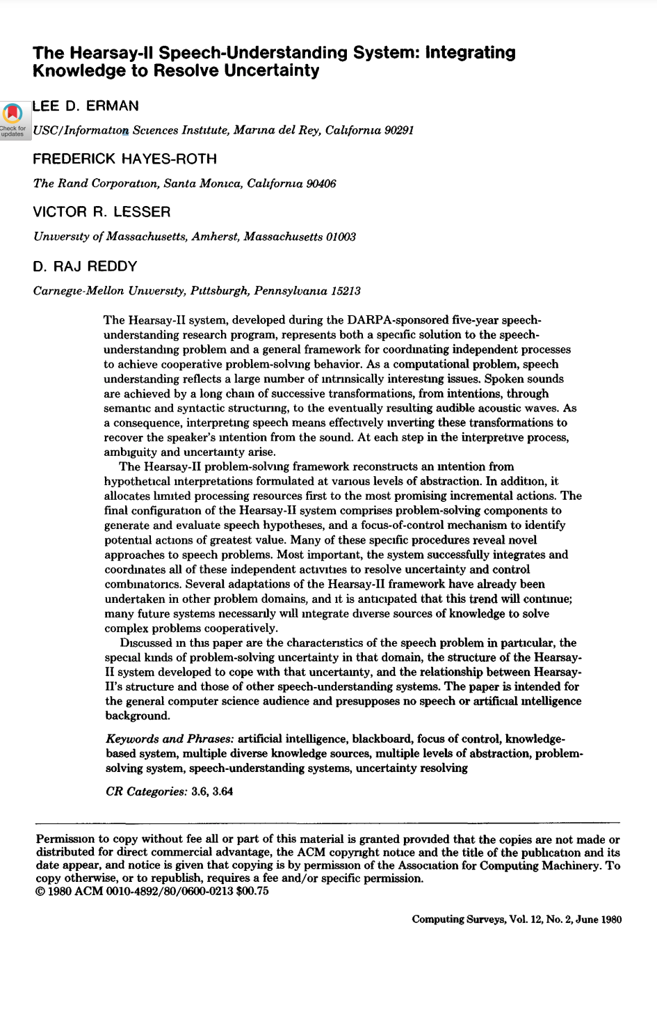
Agent Interaction
Shared Resource Communication
Implicit and/or explicit communication via a shared resource/service
Agent A reads B’s response
Platform 1
Shared Resource
Platform 2
Agent A
Agent B
https://dl.acm.org/doi/pdf/10.1145/356810.356816

Slide 10
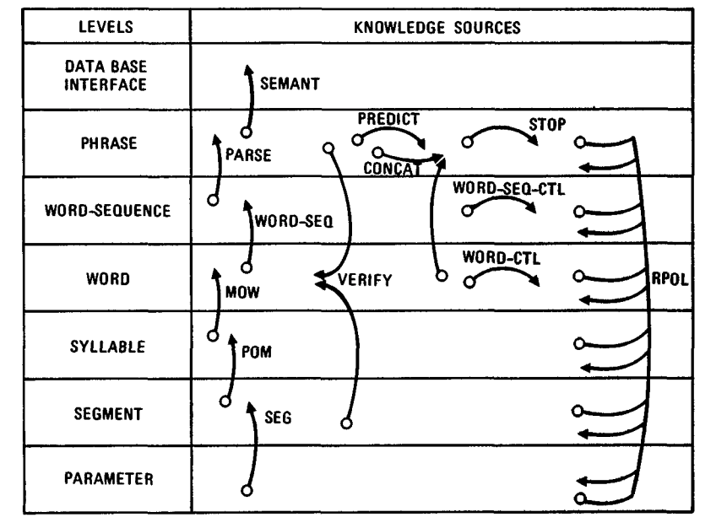
Agent Interaction
Shared Resource Communication
Implicit and/or explicit communication via a shared resource/service
Agent A reads B’s response
Platform 1
Shared Resource
Platform 2
Agent A
Agent B
https://dl.acm.org/doi/pdf/10.1145/356810.356816

Slide 11
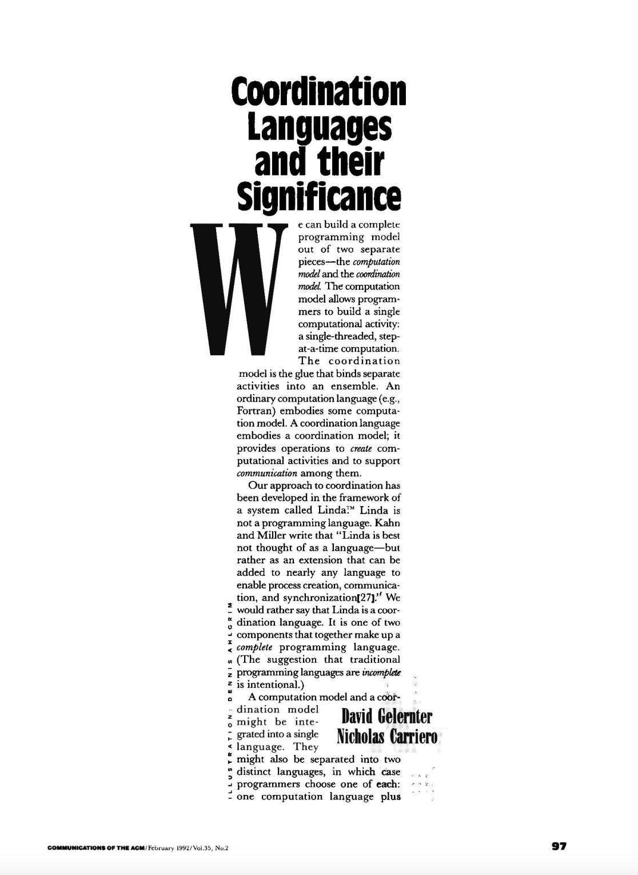
Agent Interaction
Shared Resource Communication
Implicit and/or explicit communication via a shared resource/service
Agent A reads B’s response
Platform 1
Shared Resource
Platform 2
Agent A
Agent B
https://dl.acm.org/doi/pdf/10.1145/129630.376083
https://dl.acm.org/doi/pdf/10.1145/356810.356816

Slide 12
Agent Interaction
Shared Resource Communication
Implicit and/or explicit communication via a shared resource/service
Agent A reads B’s response
And don’t forget about environment frameworks like CArtAgO…
Platform 1
Shared Resource
Platform 2
Agent A
Agent B
https://dl.acm.org/doi/pdf/10.1145/129630.376083
https://dl.acm.org/doi/pdf/10.1145/356810.356816

Slide 13
Coordination Languages (aka Tuple Spaces)

Slide 14
Tuple Spaces
A tuple is an immutable ordered list of 1 or more values.
<5>
<“Lecturer”, “Rem”>
<“Rem”, “age”, 48>
A tuple space is a shared memory consisting of multiple tuples that may be interacted with by one or more processes (agents).
They may be stand alone or distributed.
They are designed for concurrent programming
They expose a simple, Read, Write, Delete API
Example: The Linda Coordination Language:
https://jamesmccaffrey.wordpress.com/2020/07/28/the-linda-programming-language/

Slide 15
Tuple Space: Operations
Creating (Out Operation): Out(“Rem”, 48)
Adds a tuple to the tuple space
Tuples must be unique, but not individual parameters
Reading (Rd Operation): Rd(string:name, int:age)
Uses a template (parameters are variables)
Matches the template to tuples and returns one matching tuple (non-deterministically)
Deleting (In Operation): In(string:name, int:age)
Same as reading, but removes the matched tuple

Slide 16
Example
Tuple Space
Agent B
Agent A

Slide 17
Example
Tuple Space
<“Rem”, 48>
Agent B
Out(<“Rem”, 48>)
Agent A

Slide 18
Example
Tuple Space
<“Rem”, 48>
Rd(<string:x, int:y>)
Agent A
Agent B

Slide 19
Example
Tuple Space
<“Rem”, 48>
{x/”Rem”, y/48}
Agent A
Agent B

Slide 20
Example
Tuple Space
<“Rem”, 48>
Agent B
<“Joe”, 60>
Out(<“Joe”, 60>)
Agent A

Slide 21
Example
Tuple Space
<“Rem”, 48>
<“Joe”, 60>
?
Rd(<string:x, int:y>)
Agent A
Agent B

Slide 22
Example
Tuple Space
<“Rem”, 48>
<“Joe”, 60>
{x/”Rem”, y/48}
Agent A
Agent B

Slide 23
Example
Tuple Space
<“Rem”, 48>
<“Joe”, 60>
?
In(<string:x, int:y>)
Agent A
Agent B

Slide 24
Example
Tuple Space
<“Joe”, 60>
{x/”Rem”, y/48}
Agent A
Agent B

Slide 25
Example
Tuple Space
<“Joe”, 60>
In(<string:x, int:y>)
Agent A
Agent B

Slide 26
Example
Tuple Space
{x/”Joe”, y/60}
Agent A
Agent B

Slide 27
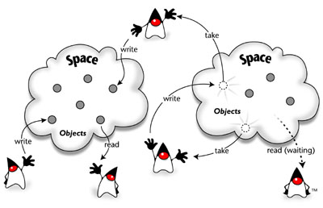
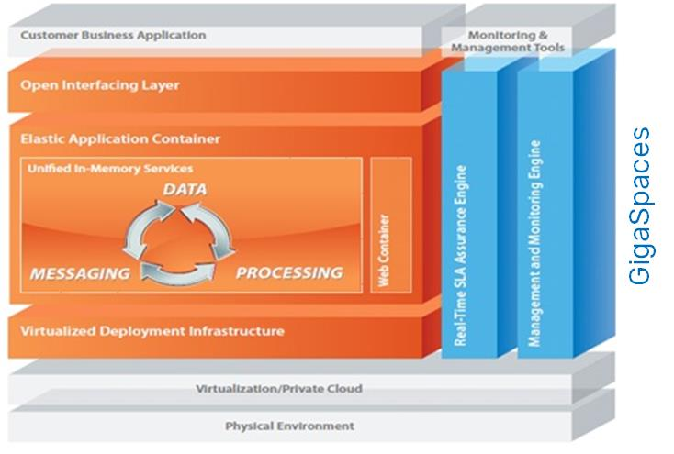
JavaSpaces https://river.apache.org/
Originally implemented as part of Jini (now Apache River)
A failed distributed systems technology from the 1990s.
Includes a tuple-space implementation known as JavaSpaces.
Tuples = objects
Templates = classes
https://www.gigaspaces.com/

Slide 28
Shared Resource Interaction
Some form of shared service used to manage interaction.
Can be simple and generic (e.g. tuple spaces)
Can be complex and domain-oriented (e.g. artifacts) or task oriented (e.g. blackboards)
Distribution and replication can be used to improve reliability
Benefits
Extensibility: all agents communicate via shared space
Better for sharing larger quantities of data.
Supports 1:m (broadcast) type communication
Easy to monitor and manage system activities
Drawbacks
Loss of Privacy: information is (potentially) public
Information Overload: bad design can lead to large quantities of data
literally robocup

