Slide 1
AOSE Methodologies
Lecturer: Rem Collier
Email: rem.collier@ucd.ie

Slide 2
Introduction
Many AOSE Methodologies have been proposed.
Knowledge Engineering Based Approaches:
MAS-CommonKADS
Agent Specific Approaches:
GAIA + Extensions
ROADMAP
SODA
Prometheus
Object-Oriented Based Approaches:
MESSAGE
MaSE
PASSI
Agent UML (Notation)
In this course we will look at PROMETHEUS & GAIA

Slide 3
GAIA

Slide 4
Why Look at GAIA?
It’s different from other approaches:
It is founded upon a set of concepts that are well-suited for multi-agent systems.
It does not deal directly with specific modelling techniques
It is not tied to a single implementation.
However, GAIA does not:
Include support for the capturing and modelling of system requirements.
Offer any insights as to how the design may be implemented.

Slide 5
GAIA – Domain Characteristics
Agents are coarse-grained computational systems, each making use of significant computational resources.
GAIA-designed systems maximise some global quality measure, but may be sub-optimal from the point of view of the system components.
Gaia is not intended for systems that admit the possibility of true conflict.
GAIA makes no assumptions about the delivery platform.
Agents are heterogeneous, in that different agents may be implemented using different programming languages, architectures, and techniques.

Slide 6
GAIA – Domain Characteristics
GAIA supports the development of closed systems.
The organisation structure of the system is static, in that inter-agent relationships do not change at run-time.
The abilities of agents and the services they provide are static, in that they do not change at run-time.
The overall system contains a comparatively small number of different agent types (less than 100).

Slide 7
GAIA & Organisational Structures
To adequately model the target system, the analysis phase of GAIA adopts the view of the system as an organisation.
Their rationale for this is that the concept of an organisation fits with the concept of a multi-agent system:
A multi-agent system is comprised of a set of computational entities (agents) that play roles, and whose global system behaviour is realised through the interactions that occur between those entities.
Key Point: roles are a good level of abstraction for modelling the structure of an organisation.

Slide 8
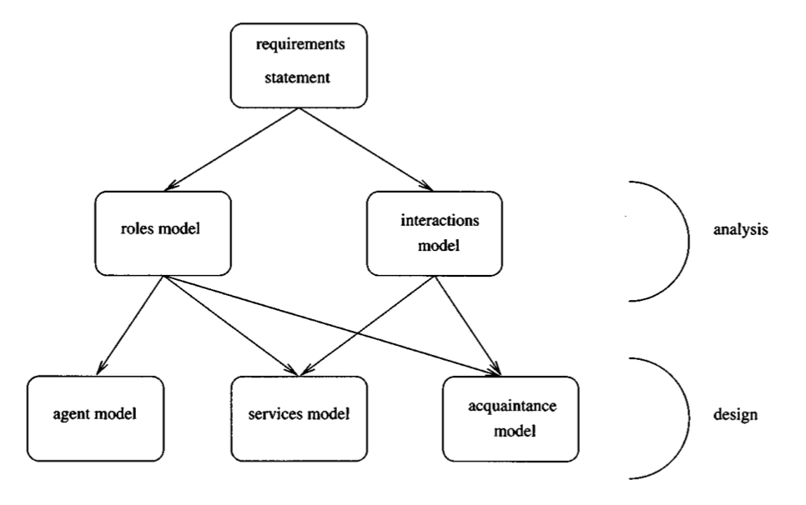
The GAIA Process
Gaia encourages a developer to think of building agent-based systems as a process of organisational design.

Slide 9
ANALYSIS PHASE

Slide 10
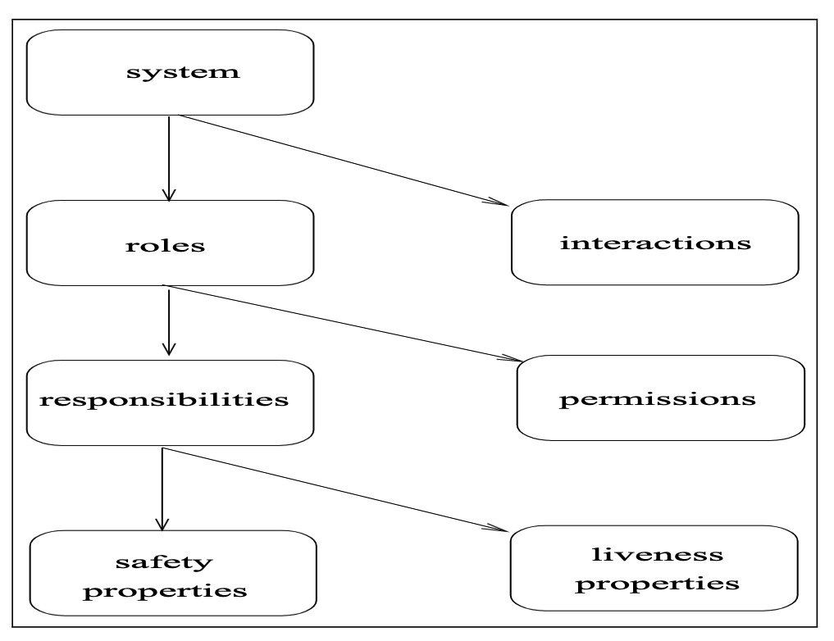
Analysis Concepts

Slide 11
The Roles Model
Identifies the roles that agents will play in the final system.
E.g. President of the United States, Minister of Education, …
Roles are characterised by two types of attribute:
The permissions associated with the role.
What types of resource does it need to fulfil the role, and in what ways does it need to exploit them.
The responsibilities of the role.
What activities is the agent required to undertake when playing this role, and how should it use those activities to achieve the goals associated with the role.
Support for the construction of this model takes the form of a Role Schema template.

Slide 12
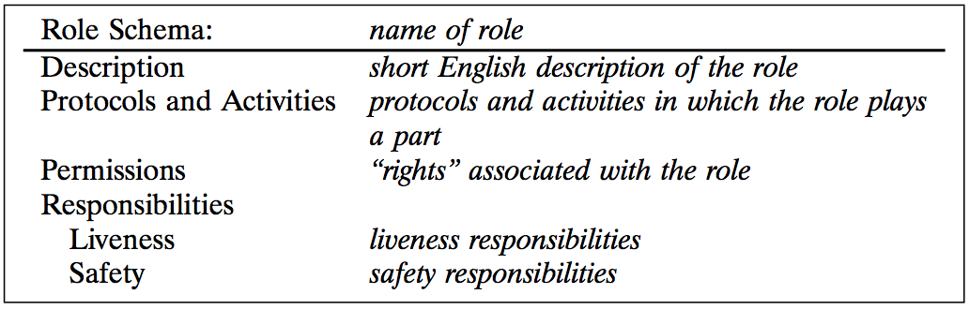
The Role Schema Template

Slide 13
Permissions
Permissions specify resource requirements for roles, represented as “the information or knowledge that an agent has”.
Some roles might generate information
Other may need to access / modify information
Some information may be supplied on creation of an agent playing a role
An access rights model is applied:
Read Access (read): the role must be able to access the specified information but does not need to modify that information.
Write Access (change): the role must be able to modify the value of the specified information.
Create Access (generate): the role creates/generates the specified information.

Slide 14
Example: Lecture Attendance Monitoring Agent
Behaviour:
The agent is required to record attendance at the start of every lecture.
It does this by receiving a message from attending student agents, passing the students id number.
The LAM agent then reads the current time and adds an <id, time> tuple to the attendance records in the student registry.
Permissions:
The agent is able to read the current time
The agent is able to read the id of the student being checked
The agent is able to generate an attendance record

Slide 15
Responsibilities
Responsibilities define the functionality required by the role. They are divided into two categories:
Liveness Responsibilities. Those that, intuitively, state that “something good happens”.
Safety Responsibilities. Those that, intuitively, state that “nothing bad happens”.
That is, they specify invariants that must be maintained during the execution of the role.
For example, the invariant that the coffee stock is never empty can be represented by the following safety expression:
coffeeStock > 0
It is implicitly assumed that these responsibilities will apply across all states of the system execution.
If the role is infinitely long, then the invariant will always remain true.

Slide 16
Liveness Responsibilities
Liveness responsibilities are things that the agent must do while playing the role.
They are represented as a liveness expression – a regular expression that takes the form:
ROLENAME = expression
The atomic components of a liveness expression are:
Activities are fundamental actions that must be directly executable by the agent.
Protocols define interactions with other roles and are defined in the Interaction Model.
Liveness expressions follow common patterns:
Guaranteed Response type achievement goals take the form “a request is always followed by a response”.
Infinite Repetition type achievement goals take the form “x will happen infinitely often”.

Slide 17
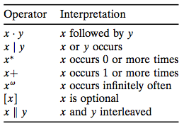
Liveness Expressions
LAM Agent:
LAM = ( Notify . ReadTime . Record )^{w}
Alternate LAM Agent solution:
LAM = ( Notify . Check . ReadTime .
CreateRecord . SubmitRecord )^{w}
Coffee Machine Example:
COFFEEFILLER = (Fill . InformWorkers . CheckStock . AwaitEmpty)^{w}
Reuse and readability is also supported:
COFFEEFILLER = (All)^{w}
All = Fill . InformWorkers . CheckStock . AwaitEmpty

Slide 18
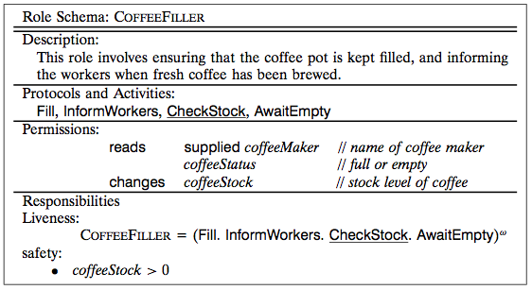
Example Schema

Slide 19
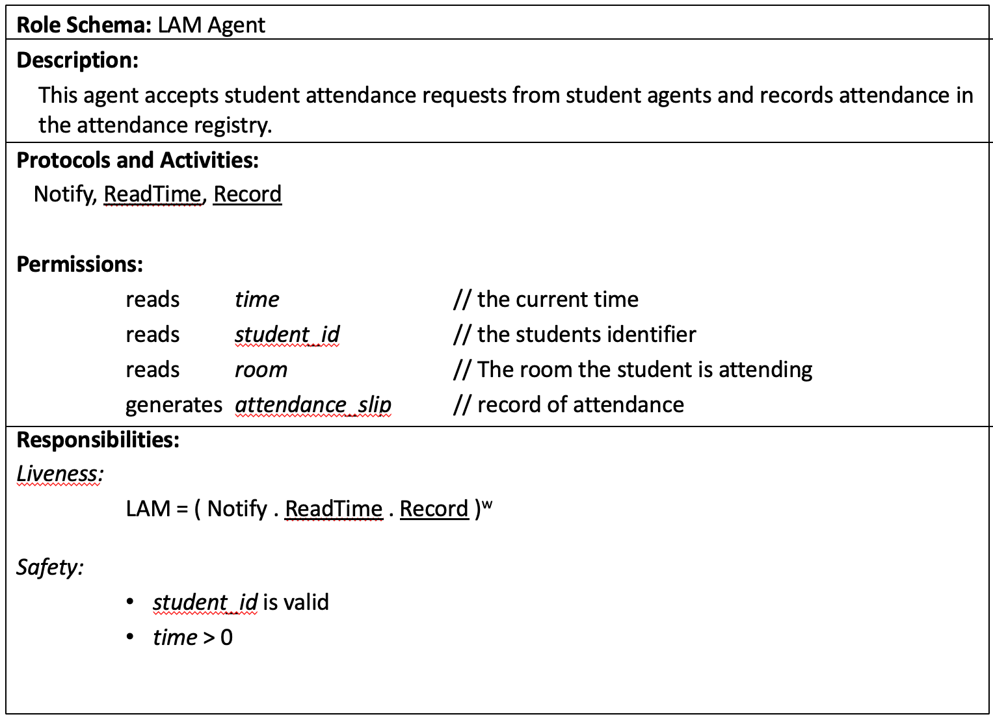
Example Schema

Slide 20
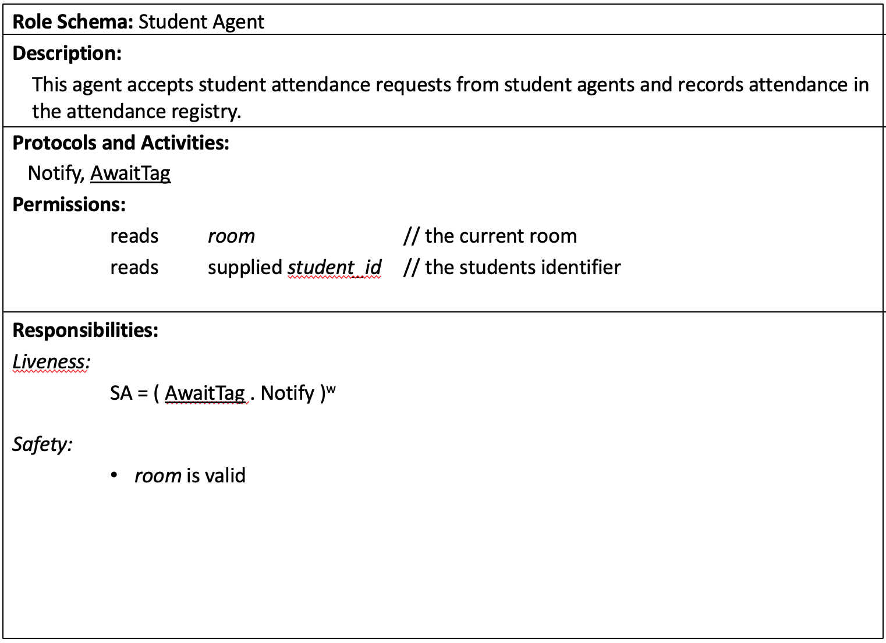
Example Schema

Slide 21
The Interactions Model
High level view of interaction within the system.
Interaction occurs between agents playing roles.
Interactions are mapped to the Protocols in a liveness condition.
Interaction descriptions should focus on the nature and purpose of the interactions rather than the specific steps.
Each interaction can be as complex or as simple as necessary (e.g. a move update interaction vs a contract net protocol interaction).
Can involve multiple initiators or multiple responders.

Slide 22
The Interactions Model
Consists of a set of protocol definitions that combine:
purpose: brief textual description of the nature of the protocol
initiator: the role(s) responsible for starting the interaction;
responder: the role(s) with which the initiator interacts;
inputs: information used by the role initiator while enacting the protocol;
outputs: information supplied by/to the protocol responder during the interaction;
processing: brief description of any processing the protocol initiator performs during the interaction.

Slide 23
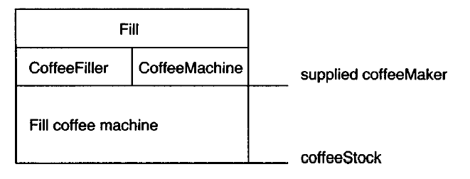
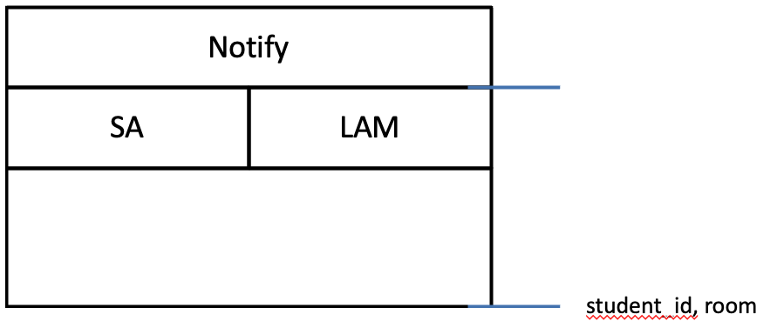
The Interactions Model
The Fill Protocol:
The Notify Protocol:

Slide 24
The Analysis Process
Identify the roles in the system.
Deliverable: Unelaborated role model
For each role, identify and document the associated protocols.
Deliverable: Protocol Model
Using the protocol model as a basis, elaborate the roles model.
Deliverable: Elaborated role model
Iterate stages (1) - (3).
Refine the models

Slide 25
DESIGN PHASE

Slide 26
The Design Process
The goal of the design process is to transform the analysis models into a sufficiently low level of abstraction that traditional design techniques may be used to implement agents.
It involves the generation of three models that identify:
The agent types and agent instances that will make up the system (Agent Model).
The main services that are required to realise the model (Service Model).
The lines of communication between the different agents (Acquaintance Model).
Remember: GAIA has been designed for closed systems that have a static organisational structure!

Slide 27
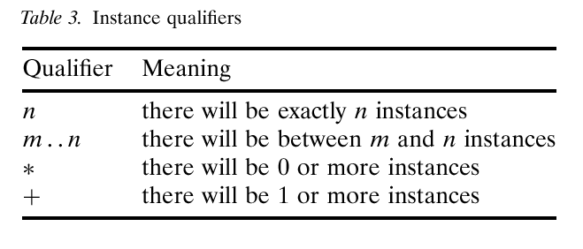
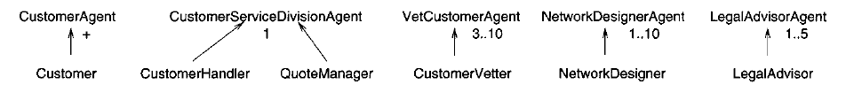
The Agent Model
The goal of this model is to identify what types of agent must exist.
Informally, an agent type is modelled as a set of roles that an instance of that type must play.
Types are represented using agent type trees.
These trees associate one or more agent roles with one or more agent types.
Instance qualifiers are used to specify how many instances of each type must exist.

Slide 28
The Services Model
In GAIA, a service is basically a function of an agent.
That is, the service model is used to refine the protocols, activities and responsibilities of the agent.
There should be at least one service per activity.
Services may also be associated with protocols.
The service model specifies inputs, outputs, pre-conditions, and post-conditions for each service (activity).
For example:
The CheckStock activity will take as input the stock level and some threshold value and will simply compare the two.
The pre- and post-conditions will both state that the stock level is greater than zero.

Slide 29
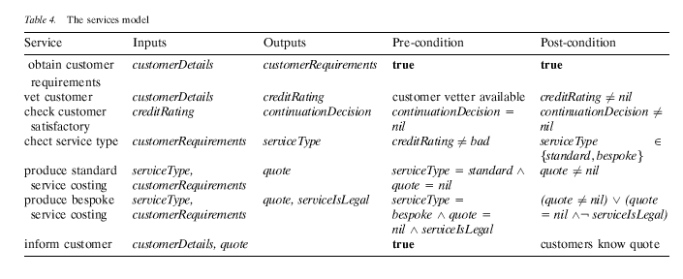
The Services Model

Slide 30
SA/LAM Services
Service | Inputs | Outputs | Pre-Conditions | Post-Conditions
Agent: SA
AwaitTag | n/a | room student_id | true | room != nil student_id != nil
Agent: LAM
ReadTime | n/a | time | true | time != nil
Record | room, student_id, time | attendance_slip | room != nil student_id != nil time != nil | attendance_slip != nil

Slide 31
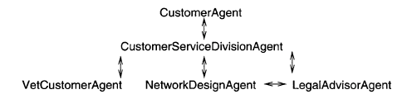
The Acquaintance Model
This third model specifies the lines of communication between the agent types.

Slide 32
The Design Process
Create an Agent Model:
Aggregate the roles into agent types and refine to form an agent type hierarchy
Document the instances of each agent type using instance annotations.
Develop a Service Model by examining the activities, protocols, and safety and liveness properties of each role.
Develop an Acquaintance Model from the Interaction Model and the Agent Model.

Slide 33
Summary
GAIA v.1 is designed for closed systems (<100 agent types):
Static community: all agents are identified at design time
Tight coupling: all agent relationships are identified at design time
Static functionality: all available services are identified at design time
However, some of the typical benefits of agent-based systems come from using them to build open systems:
Dynamic community: agents can be created / destroyed at runtime
Loose coupling: agent relationships
Dynamic functionality: new services can be added as required at run time.

Slide 34
Recommended Reading
Michael Wooldridge, Nicholas R. Jennings, and David Kinny, “The Gaia methodology for agent-oriented analysis and design”, in Journal of Autonomous Agents Multi-Agent Systems Vol. 3, No. 3, pp 285–312, 2000
Franco Zambonelli, Nicholas R. Jennings, Michael Wooldridge, “Developing Multiagent Systems: The Gaia Methodology”, in ACM Transactions of Software Engineering and Methodology, Vol. 12, No. 3, pp 317-370, July 2003
Cernuzzi, L, Juan, T, Sterling, L, Zambonelli, F, “The Gaia Methodology: Basic Concepts and Extensions”, in Methodologies and Software Engineering for Agent Systems, Springer-Verlag, 2004.

Slide 35
Prometheus

Slide 36
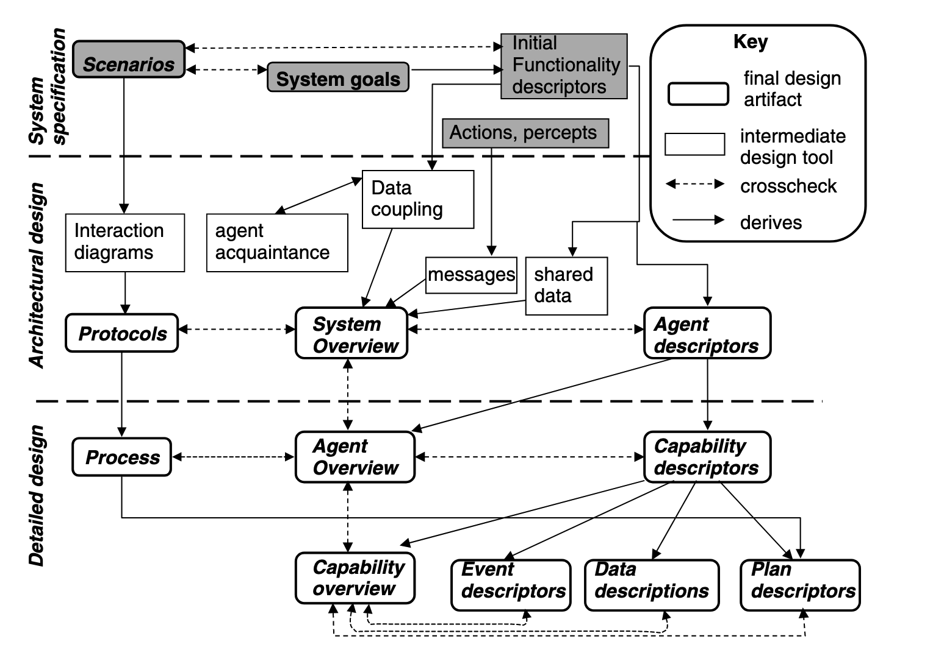
Prometheus
Padgham, L., & Winikoff, M. (2002, July). Prometheus: A methodology for developing intelligent agents. In International Workshop on Agent-Oriented Software Engineering (pp. 174-185). Springer, Berlin, Heidelberg.

Slide 37
Prometheus: System Specification
Objective: To identify the basic functionalities of the system.
Models:
System Goals: identify and design the behaviours of the system in terms of goals that should be achieved.
E.g. enrol student, authenticate user, …
Scenarios: define use cases of the system (sequences of actions, percepts, sub-scenarios,…).
Consist of: an identification number, a natural language overview, an optional field context, the scenario, a summary of all the information used, and a list of small variants.
Functional Descriptors: groupings of goals and associated actions / percepts / data.
Consist of: a name, description, actions, percepts, data used, and produced and a description of interactions are defined
Percepts and Actions: lists of actions and percepts associated with the environment

Slide 38
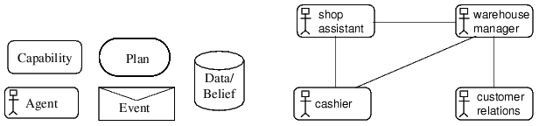
Prometheus: Architectural Design
During this stage the following activities are performed:
Identification of which agents should belong to the MAS
Grouping of agents which share the same functionalities
Identification of the agent acquaintance diagram which defines the links among interacting agents
Definition of the agent descriptors, characterized by name, description, cardinality, functionalities, reads data, writes data, interacts with
Definition of the events, messages and shared data objects
Definition of the interaction diagrams and interaction protocols

Slide 39
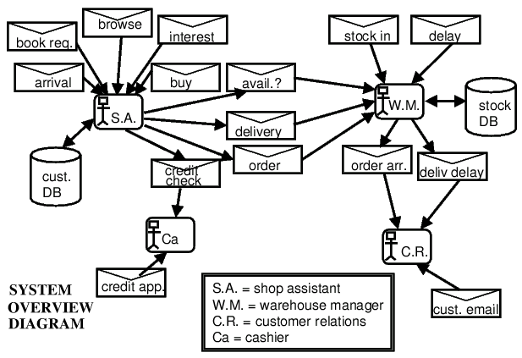
Prometheus: Architectural Design
Identification of the system overview diagram which ties together agents, events and shared data objects using AUML

Slide 40
Prometheus: Detailed Design
Focuses on developing the internal structure of each agent and how it will achieve its task within the system
The developer must define capabilities, internal events, plans and detailed data structures
Capability descriptor: contains inputs and produced events, a description of functionality, a name, interactions with other capabilities, inclusions and a reference to read and write data
Agent overview diagram: shows capabilities within an agent
Capability overview diagram: takes a single capability and describes its features
The final design artifacts are the individual plan, event and data descriptors
The Plan descriptor provides an identifier, the triggering event type, the plan steps, a context and a list of data read and written

