Slide 1
Auctions
Lecturer: Rem Collier
Email: rem.collier@ucd.ie

Slide 2
What is an Auction?
An Auction takes place between an auctioneer and a collection of bidders.
Goal is for the auctioneer to allocate the goods to one of the bidders.
In most settings, the auctioneer desires to maximise the price; bidders desire to minimise the price.
Price
bidder
auctioneer
bidders
auctioneer

Slide 3
Auction Parameters
Value of goods | Private, public/common, Correlated
Winner determination | First price, second price
Bids may be | Open cry, Sealed
Bidding may be | One shot, ascending, descending

Slide 4
English Auctions
Auctioneer starts a round specifying the current minimum prices (initially the reserve price)
Bidders propose a bid (> the current minimum).
Bidders who don’t want to bid, do not submit a proposal
The Auctioneer compares all proposals received by a given deadline and selects the best.
It accepts this bid; rejects all other bids and starts a new round
If no better bid has been found the item is awarded to the agent from the previous round that made the highest bid (> the reserve price).
If two or more agents made the same bid, some form of resolution strategy is required (e.g. first bid received).

Slide 5
English Auctions
English auctions are:
First price
Open cry
Ascending
Dominant strategy: successively bid a small amount more than the highest current bid until it reaches the valuation, then withdraw.
Susceptible to Winners curse
Winner is the one who overvalues the goods on offer and may end up paying more than its worth.
Susceptible to shills
Artificial raising of the bidding price by the auctioneer through bogus bidders...
Price
Bidder x
Bidder 1
auctioneer
Notes:
Susceptible to shills: lying by the auctioneer to put bogus bids to artificially raise the current bidding price.

Slide 6
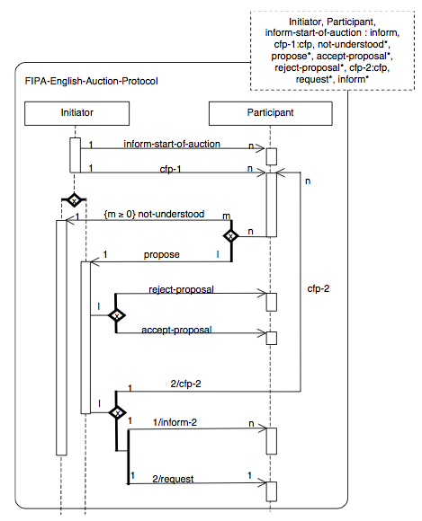
English Auctions

Slide 7
Dutch Auctions
Auctioneer starts a round specifying an artificially high bid (> expected sale price)
Bidders decide whether to agree to the valuation.
The no bidders agree with the valuation, then the auctioneer sends out a new lower price.
The winner is the first bidder to accept the current price for the item.
If the prices reaches a reserve level with no bids, then the item is withdrawn (no bidder).

Slide 8
Dutch Auctions
Dutch auctions are:
Open cry
Descending
Auctioneer starts at an artificially high price.
Then continually lowers the offer price until an agent makes a bid which is equal to the current offer price.
Dominant strategy: None
Susceptible to Winners curse
Price
auctioneer
auctioneer
Bidder

Slide 9
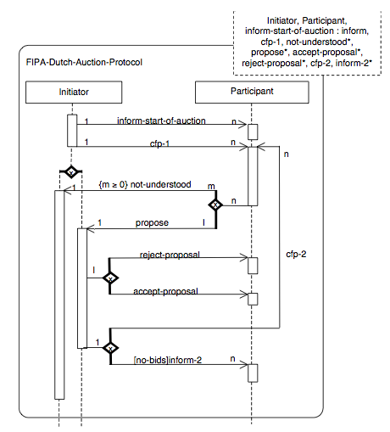
Dutch Auctions

Slide 10
First-price Sealed-bid Auctions
One shot auction
Single round, where bidders submit a sealed-bid for the good.
Goods are awarded to agent that made the highest bid.
Winner pays price of highest bid.
Best strategy: bid less than true value.
Bidders
auctioneer

Slide 11
Vickrey Auctions
Vickrey auctions are:
second-price
sealed-bids
Goods are awarded to agent that made the highest bid.
Winner pays price of second highest bid.
Best strategy: bid the true value.
Susceptible to anti-social behaviour & shilling
Notes:
.

