Slide 1
Introduction to Negotiation
Lecturer: Rem Collier
Email: rem.collier@ucd.ie

Slide 2
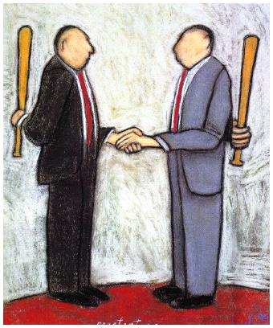
Negotiation
”The process of several agents searching for an agreement” e.g. about price.
Reaching consensus
”Rules of Encouter” by
Rosenchein and Zlotskin, 1994

Slide 3
Phone Call Competition Example
Customer wishes to place long-distance call
Carriers simultaneously bid, sending proposed prices
Phone automatically chooses the carrier (dynamically)
EIR
Three
Vodafone
€0.20
€0.18
€0.23

Slide 4
Best Bid Wins
Phone chooses carrier with lowest bid
Carrier gets amount that it bid
EIR
Three
Vodafone
€0.20
€0.18
€0.23

Slide 5
Attributes of the Mechanism
Carriers have an incentive to invest effort in strategic behavior…
Three
EIR
Vodafone
€0.20
“Maybe I can bid as high as $0.21...”
€0.18
€0.23

Slide 6
Best Bid Wins, Gets Second Price (Vickrey Auction)
Phone chooses carrier with lowest bid
Carrier gets amount of second-best price
EIR
Three
Vodafone
€0.20
€0.18
€0.23

Slide 7
Attributes of the Vickrey Mechanism
Carriers have no incentive to invest effort in strategic behavior
Three
EIR
Vodafone
€0.20
“I have no reason to overbid...”
€0.18
€0.23

