Slide 1
Negotiation

Slide 2
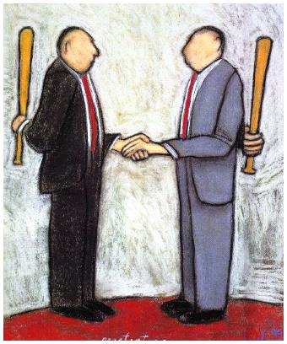
Negotiation
”The process of several agents searching for an agreement” e.g. about price.
Reaching consensus
”Rules of Encouter” by
Rosenchein and Zlotskin, 1994

Slide 3
One-to-One Negotiation

Slide 4
Monotonic Concession Protocol
A negotiation framework in which two agents reach agreement.
Negotiation takes a series of rounds:
In the first round, each agent makes an initial proposal
In subsequent rounds, each agent can either make a concession or stick with their current proposal
Keep going until either agreement is reached or conflict arises.

Slide 5
Monotonic Concession Protocol
A negotiation framework in which two agents reach agreement.
Negotiation takes a series of rounds:
In the first round, each agent makes an initial proposal
In subsequent rounds, each agent can either make a concession or stick with their current proposal
Keep going until either agreement is reached or conflict arises.
Agent A
Agent B
A’s proposal
B’s proposal
INITIAL PROPOSALS

Slide 6
Monotonic Concession Protocol
A negotiation framework in which two agents reach agreement.
Negotiation takes a series of rounds:
In the first round, each agent makes an initial proposal
In subsequent rounds, each agent can either make a concession or stick with their current proposal
Keep going until either agreement is reached or conflict arises.
Agent A
Agent B
A’s proposal
B’s proposal
A & B CONCEDE

Slide 7
Monotonic Concession Protocol
A negotiation framework in which two agents reach agreement.
Negotiation takes a series of rounds:
In the first round, each agent makes an initial proposal
In subsequent rounds, each agent can either make a concession or stick with their current proposal
Keep going until either agreement is reached or conflict arises.
Agent A
Agent B
A’s proposal
B’s proposal
A STICKS & B CONCEDES

Slide 8
Monotonic Concession Protocol
A negotiation framework in which two agents reach agreement.
Negotiation takes a series of rounds:
In the first round, each agent makes an initial proposal
In subsequent rounds, each agent can either make a concession or stick with their current proposal
Keep going until either agreement is reached or conflict arises.
Agent A
Agent B
A’s proposal
B’s proposal
A CONCEDES & B STICKS

Slide 9
Monotonic Concession Protocol
A negotiation framework in which two agents reach agreement.
Negotiation takes a series of rounds:
In the first round, each agent makes an initial proposal
In subsequent rounds, each agent can either make a concession or stick with their current proposal
Keep going until either agreement is reached or conflict arises.
Agent A
Agent B
A’s proposal
B’s proposal
A STICKS & B CONCEDES

Slide 10
Monotonic Concession Protocol
A negotiation framework in which two agents reach agreement.
Negotiation takes a series of rounds:
In the first round, each agent makes an initial proposal
In subsequent rounds, each agent can either make a concession or stick with their current proposal
Keep going until either agreement is reached or conflict arises.
Agent A
Agent B
A’s & B’s proposal
A CONCEDES & B STICKS

Slide 11
Monotonic Concession Protocol
A negotiation framework in which two agents reach agreement.
Negotiation takes a series of rounds:
In the first round, each agent makes an initial proposal
In subsequent rounds, each agent can either make a concession or stick with their current proposal
Keep going until either agreement is reached or conflict arises.
Agreement
Agent A
Agent B
A’s & B’s proposal
A CONCEDES & B STICKS

Slide 12
Monotonic Concession Protocol
A negotiation framework in which two agents reach agreement.
Negotiation takes a series of rounds:
In the first round, each agent makes an initial proposal
In subsequent rounds, each agent can either make a concession or stick with their current proposal
Keep going until either agreement is reached or conflict arises.
Agent A
Agent B
A’s proposal
B’s proposal
What if
A STICKS & B STICKS?

Slide 13
Monotonic Concession Protocol
A negotiation framework in which two agents reach agreement.
Negotiation takes a series of rounds:
In the first round, each agent makes an initial proposal
In subsequent rounds, each agent can either make a concession or stick with their current proposal
Keep going until either agreement is reached or conflict arises.
Conflict
Agent A
Agent B
A’s proposal
B’s proposal
A STICKS & B STICKS

Slide 14
Monotonic Concession Protocol
A negotiation framework in which two agents reach agreement.
Negotiation takes a series of rounds:
In the first round, each agent makes an initial proposal
In subsequent rounds, each agent can either make a concession or stick with their current proposal
Keep going until either agreement is reached or conflict arises.
Concession: a proposal that is better for your opponent than your previous proposal
Conflict
Agent A
Agent B
A’s proposal
B’s proposal
A STICKS & B STICKS

Slide 15
Monotonic Concession Protocol
A negotiation framework in which two agents reach agreement.
Negotiation takes a series of rounds:
In the first round, each agent makes an initial proposal
In subsequent rounds, each agent can either make a concession or stick with their current proposal
Keep going until either agreement is reached or conflict arises.
Concession: a proposal that is better for your opponent than your previous proposal
Agreement: one agent makes a proposal that is better for their opponent than the opponent’s own proposal
(or as good as).
Conflict
Agent A
Agent B
A’s proposal
B’s proposal
A STICKS & B STICKS

Slide 16
Monotonic Concession Protocol
A negotiation framework in which two agents reach agreement.
Negotiation takes a series of rounds:
In the first round, each agent makes an initial proposal
In subsequent rounds, each agent can either make a concession or stick with their current proposal
Keep going until either agreement is reached or conflict arises.
Concession: a proposal that is better for your opponent than your previous proposal
Agreement: one agent makes a proposal that is better for their opponent than the opponent’s own proposal
(or as good as).
Conflict: arises when there is a round where no agent concedes; this is considered the worst possible outcome
Conflict
Agent A
Agent B
A’s proposal
B’s proposal
A STICKS & B STICKS

Slide 17
Monotonic Concession Protocol
A negotiation framework in which two agents reach agreement.
Negotiation takes a series of rounds:
In the first round, each agent makes an initial proposal
In subsequent rounds, each agent can either make a concession or stick with their current proposal
Keep going until either agreement is reached or conflict arises.
Concession: a proposal that is better for your opponent than your previous proposal
Agreement: one agent makes a proposal that is better for their opponent than the opponent’s own proposal
(or as good as).
Conflict: arises when there is a round where no agent concedes; this is considered the worst possible outcome
Conflict
Agent A
Agent B
A’s proposal
B’s proposal
Negotiation Strategy (Zeuthen): the agent with the lower willingness to risk conflict should concede.
Defined as the ratio of the loss incurred by accepting your opponent’s proposal and the loss incurred by causing conflict
A STICKS & B STICKS

Slide 18
Multilateral Concession Protocol
Many-to-many Negotiation:
Protocol: Still broadly the same, but each agent must message the N other participants (or a centralised resource is used).
Conflict: still means that nobody concedes during one round.
Agreement: one agent makes a proposal that everyone likes at least as much as their own proposal.
Concession: unclear, possibly many strategies...
Agent 1
Agent N
Agent 2
P₁
P_{N}
Proposal
Space
P₂
…
P_{M+1}
…
P_{M}
Agent (M+1)
Agent M

Slide 19
Multilateral Concession Protocol
Many-to-many Negotiation:
Protocol: Still broadly the same, but each agent must message the N other participants (or a centralised resource is used).
Conflict: still means that nobody concedes during one round.
Agreement: one agent makes a proposal that everyone likes at least as much as their own proposal.
Concession: unclear, possibly many strategies...
Possible Concession Strategies:
Strong concession: Make a proposal that is strictly better for each of the other agents.
Weak concession: Make a proposal that is strictly better for at least one of the other agents.
Pareto concession: Make a proposal that is no worse for the other agents and strictly better for one of them.
Utilitarian concession: Make a proposal such that the sum of utilities of the other agents increases.
Egalitarian concession: Make a proposal such that the minimum utility amongst the other agents increases.
Nash concession: Make a proposal such that the product of utilities of the other agents increases.
Egocentric concession: Make a proposal that is worse for yourself.

Slide 20
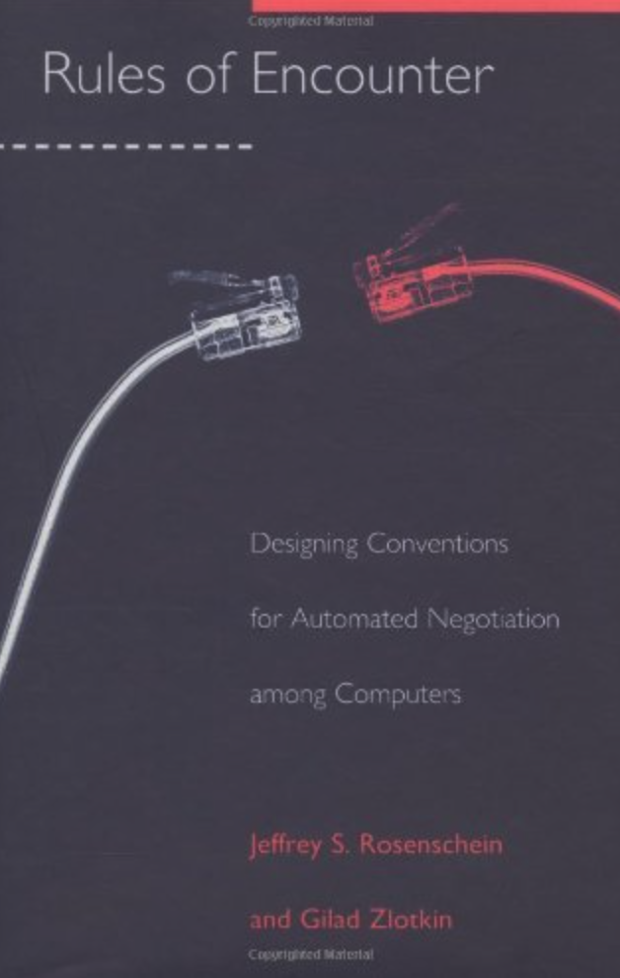
Multilateral Concession Protocol
Many-to-many Negotiation:
Protocol: Still broadly the same, but each agent must message the N other participants (or a centralised resource is used).
Conflict: still means that nobody concedes during one round.
Agreement: one agent makes a proposal that everyone likes at least as much as their own proposal.
Concession: unclear, possibly many strategies...
Possible Concession Strategies:
Strong concession: Make a proposal that is strictly better for each of the other agents.
Weak concession: Make a proposal that is strictly better for at least one of the other agents.
Pareto concession: Make a proposal that is no worse for the other agents and strictly better for one of them.
Utilitarian concession: Make a proposal such that the sum of utilities of the other agents increases.
Egalitarian concession: Make a proposal such that the minimum utility amongst the other agents increases.
Nash concession: Make a proposal such that the product of utilities of the other agents increases.
Egocentric concession: Make a proposal that is worse for yourself.
https://amzn.eu/d/79m5SDI

Slide 21
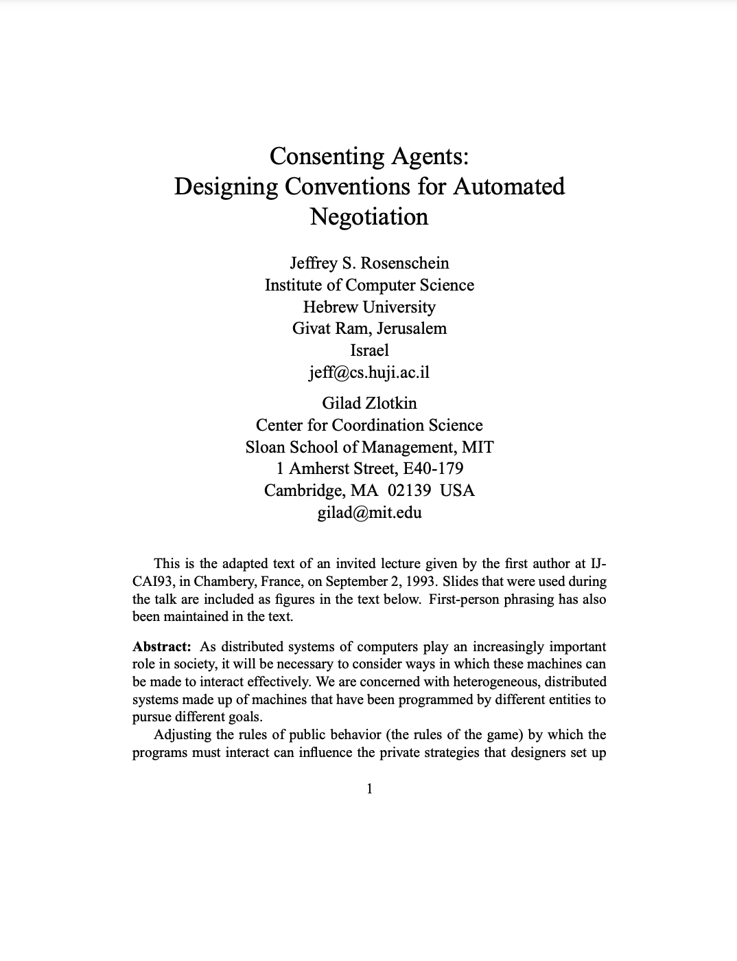
Multilateral Concession Protocol
Many-to-many Negotiation:
Protocol: Still broadly the same, but each agent must message the N other participants (or a centralised resource is used).
Conflict: still means that nobody concedes during one round.
Agreement: one agent makes a proposal that everyone likes at least as much as their own proposal.
Concession: unclear, possibly many strategies...
Possible Concession Strategies:
Strong concession: Make a proposal that is strictly better for each of the other agents.
Weak concession: Make a proposal that is strictly better for at least one of the other agents.
Pareto concession: Make a proposal that is no worse for the other agents and strictly better for one of them.
Utilitarian concession: Make a proposal such that the sum of utilities of the other agents increases.
Egalitarian concession: Make a proposal such that the minimum utility amongst the other agents increases.
Nash concession: Make a proposal such that the product of utilities of the other agents increases.
Egocentric concession: Make a proposal that is worse for yourself.
https://www.eecis.udel.edu/~decker/courses/886f04/pubs/RosenscheinAIMag94.pdf
https://amzn.eu/d/79m5SDI

Slide 22
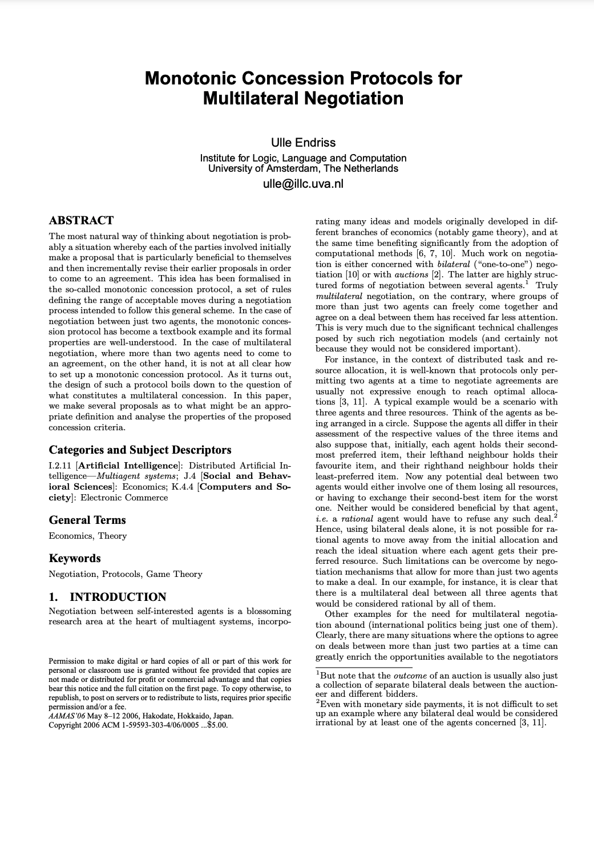
Multilateral Concession Protocol
Many-to-many Negotiation:
Protocol: Still broadly the same, but each agent must message the N other participants (or a centralised resource is used).
Conflict: still means that nobody concedes during one round.
Agreement: one agent makes a proposal that everyone likes at least as much as their own proposal.
Concession: unclear, possibly many strategies...
Possible Concession Strategies:
Strong concession: Make a proposal that is strictly better for each of the other agents.
Weak concession: Make a proposal that is strictly better for at least one of the other agents.
Pareto concession: Make a proposal that is no worse for the other agents and strictly better for one of them.
Utilitarian concession: Make a proposal such that the sum of utilities of the other agents increases.
Egalitarian concession: Make a proposal such that the minimum utility amongst the other agents increases.
Nash concession: Make a proposal such that the product of utilities of the other agents increases.
Egocentric concession: Make a proposal that is worse for yourself.
https://www.eecis.udel.edu/~decker/courses/886f04/pubs/RosenscheinAIMag94.pdf
https://amzn.eu/d/79m5SDI
https://eprints.illc.uva.nl/id/eprint/176/1/PP-2006-01.text.pdf

Slide 23
One-to-Many Negotiation
(AUCTIONS)

Slide 24
Auctions
An Auction takes place between an auctioneer and a collection of bidders.
Goal is for the auctioneer to allocate the goods to one of the bidders.
In most settings, the auctioneer desires to maximise the price; bidders desire to minimise the price.
auctioneer
bidders
Value of goods | Private, public/common, Correlated
Winner determination | First price, second price
Bids may be | Open cry, Sealed
Bidding may be | One shot, ascending, descending
Price
bidder
auctioneer

Slide 25
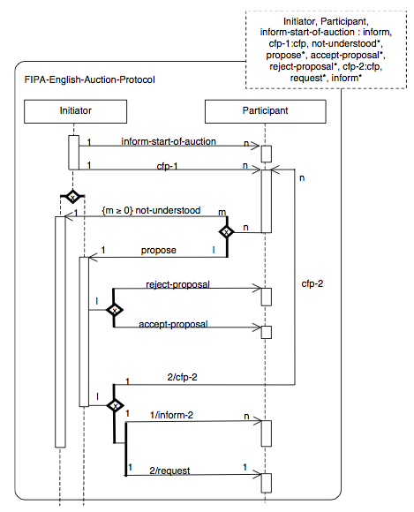
English Auctions
Auctioneer starts a round specifying the current minimum prices (initially the reserve price)
Bidders propose a bid (> the current minimum).
Bidders who don’t want to bid, do not submit a proposal
The Auctioneer compares all proposals received by a given deadline and selects the best.
It accepts this bid; rejects all other bids and starts a new round
If no better bid has been found the item is awarded to the agent from the previous round that made the highest bid (> the reserve price).
If two or more agents made the same bid, either some form of resolution strategy is required (e.g. first bid received) or one of the agents must make another bid.

Slide 26
English Auctions
English auctions are:
First price
Open cry
Ascending
Dominant strategy: successively bid a small amount more than the highest current bid until it reaches the valuation, then withdraw.
Susceptible to:
Winners curse: The Winner is the one who overvalues the goods on offer and may end up paying more than its worth.
Shills: Artificial raising of the bidding price by the auctioneer through bogus bidders...
Price
Bidder x
Bidder 1
auctioneer
Notes:
Susceptible to shills: lying by the auctioneer to put bogus bids to artificially raise the current bidding price.

Slide 27
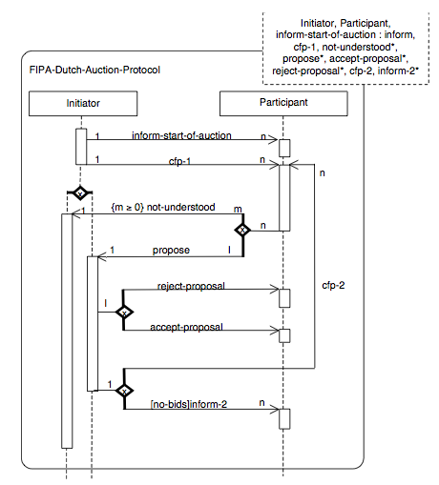
Dutch Auctions
Auctioneer starts a round specifying an artificially high bid (> expected sale price)
Bidders decide whether to agree to the valuation.
The no bidders agree with the valuation, then the auctioneer sends out a new lower price.
The winner is the first bidder to accept the current price for the item.
If the prices reaches a reserve level with no bids, then the item is withdrawn (no bidder).

Slide 28
Dutch Auctions
Dutch auctions are:
Open cry
Descending
Auctioneer starts at an artificially high price.
Then continually lowers the offer price until an agent makes a bid which is equal to the current offer price.
Dominant strategy: None
Susceptible to: Winners curse
Price
auctioneer
auctioneer
Bidder

Slide 29
First-price Sealed-bid Auctions
One shot auction
Single round, where bidders submit a sealed-bid for the good.
Goods are awarded to agent that made the highest bid.
Winner pays price of highest bid.
Best strategy: bid less than true value.
Bidders
auctioneer

Slide 30
Vickrey Auctions
Vickrey auctions are:
second-price
sealed-bids
Goods are awarded to agent that made the highest bid.
Winner pays price of second highest bid.
Best strategy: bid the true value.
Susceptible to anti-social behaviour & shilling
Notes:
.

Slide 31
Example

Slide 32
Phone Call Competition Example
Customer wishes to place long-distance call
Carriers simultaneously bid, sending proposed prices
Phone automatically chooses the carrier (dynamically)
EIR
Three
Vodafone
€0.20
€0.18
€0.23

Slide 33
Best Bid Wins
Phone chooses carrier with lowest bid
Carrier gets amount that it bid
EIR
Three
Vodafone
€0.20
€0.18
€0.23

Slide 34
Attributes of the Mechanism
Carriers have an incentive to invest effort in strategic behavior…
Three
EIR
Vodafone
€0.20
“Maybe I can bid as high as €0.21...”
€0.18
€0.23

Slide 35
Best Bid Wins, Gets Second Price (Vickrey Auction)
Phone chooses carrier with lowest bid
Carrier gets amount of second-best price
EIR
Three
Vodafone
€0.20
€0.18
€0.23

Slide 36
Attributes of the Vickrey Mechanism
Carriers have no incentive to invest effort in strategic behavior
Three
EIR
Vodafone
€0.20
“I have no reason to overbid...”
€0.18
€0.23

