Slide 1
Tech it easy
Politecnico di Milano, Milan
July 16, 2016
Paola Bahiti paola.bahiti@mail.polimi.it
Davide Berretta davide.berretta@mail.polimi.it
Giada Colella giada.colella@mail.polimi.it
Chiara Coletti chiara.coletti@mail.polimi.it
Politecnico di Milano

Slide 2


Slide 3

Our idea

Slide 4
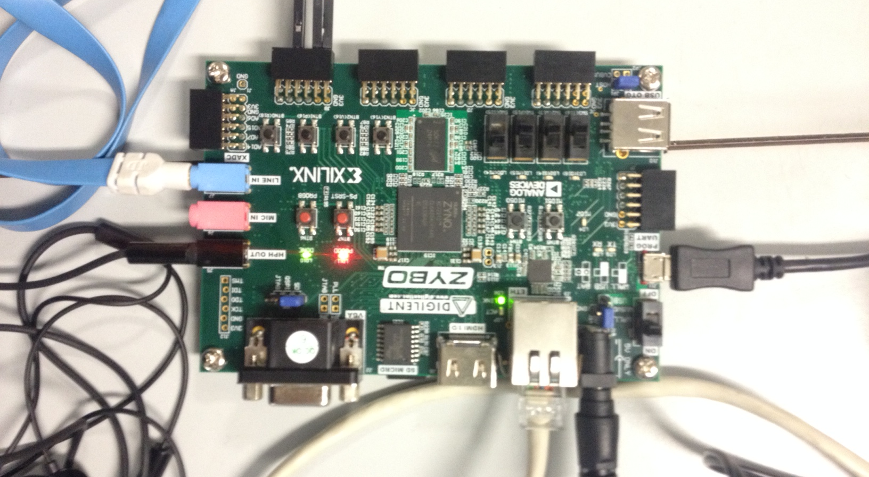

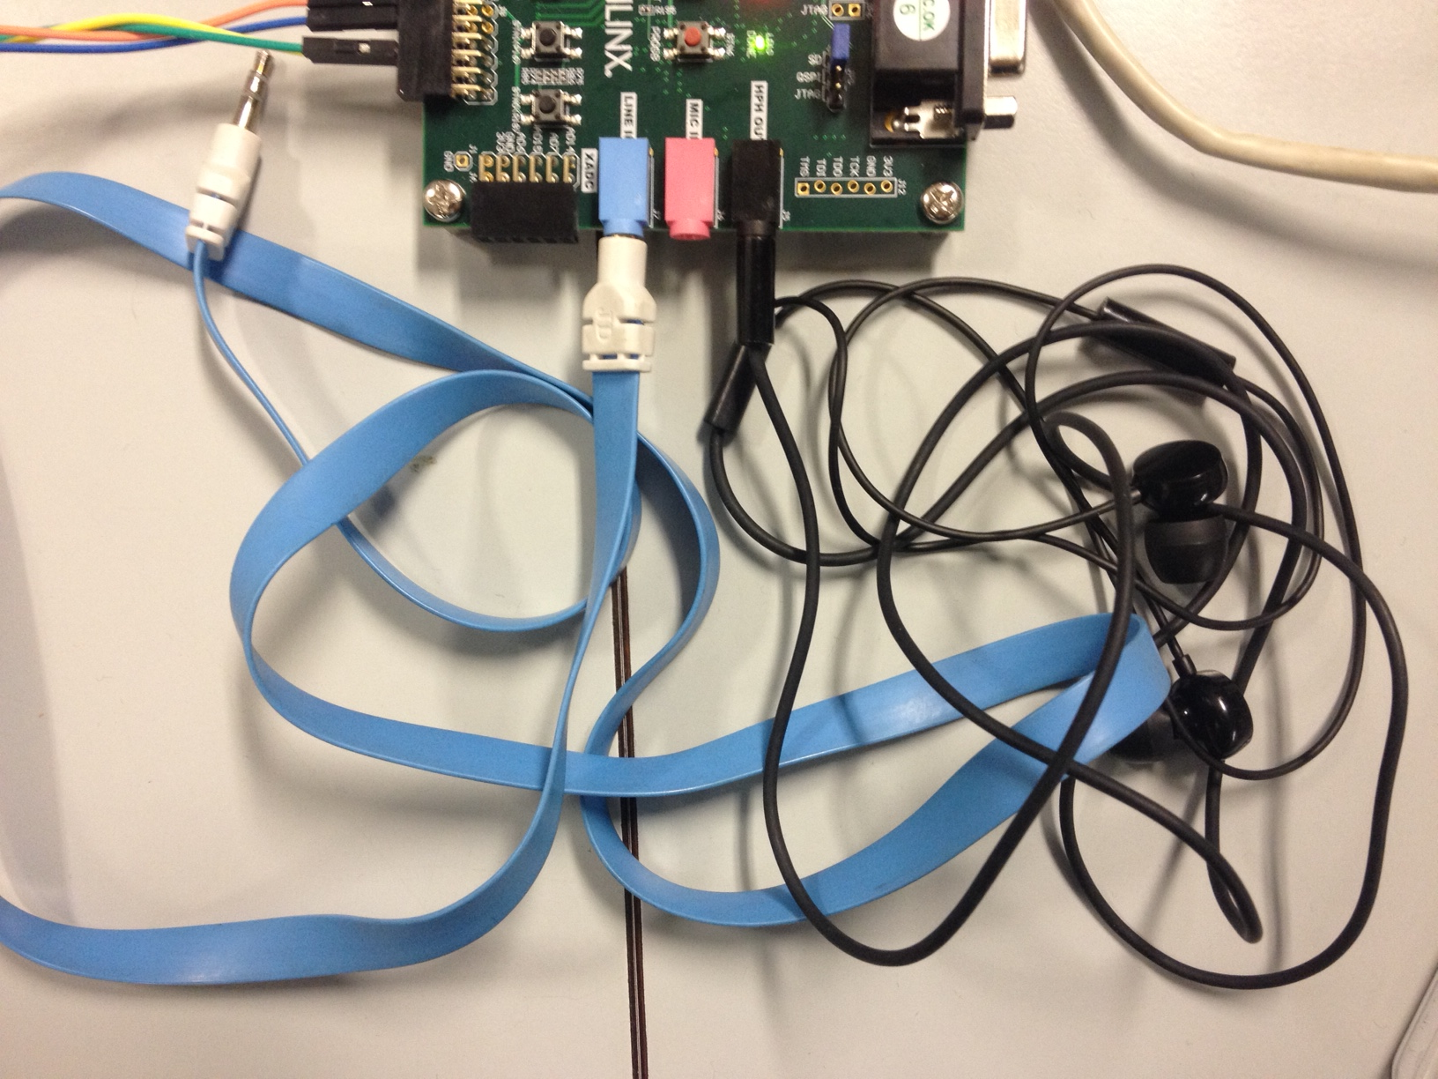
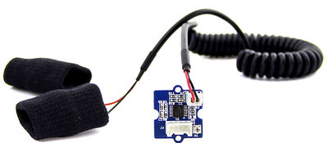
Implementation
Headphones
GSR grove sensor
Zybo board

Slide 5
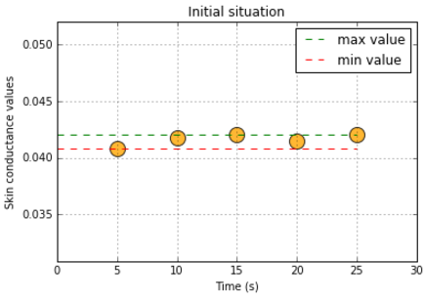
Results
Plotting five initial samples obtained in a small time range (30 seconds) and showing the two threshold values.

Slide 6
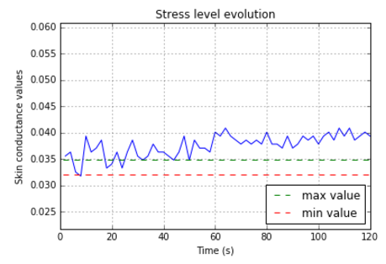
Results
Plotting values obtained while listening to the calming music, with the previous threshold values.
We can observe an initial transient zone and some peaks .

Slide 7

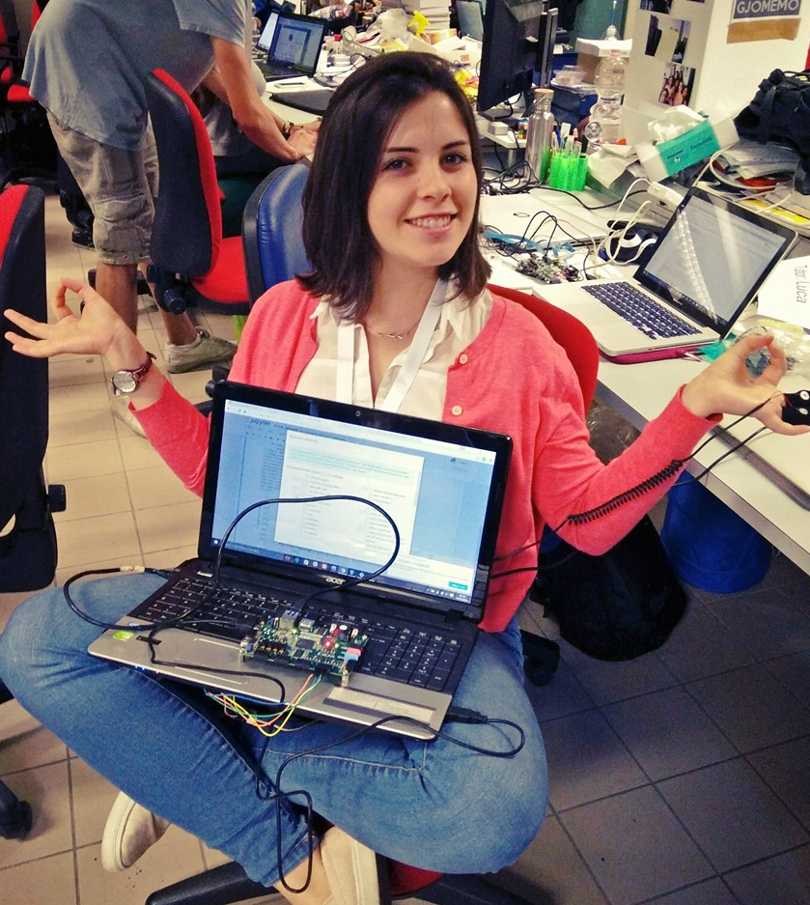
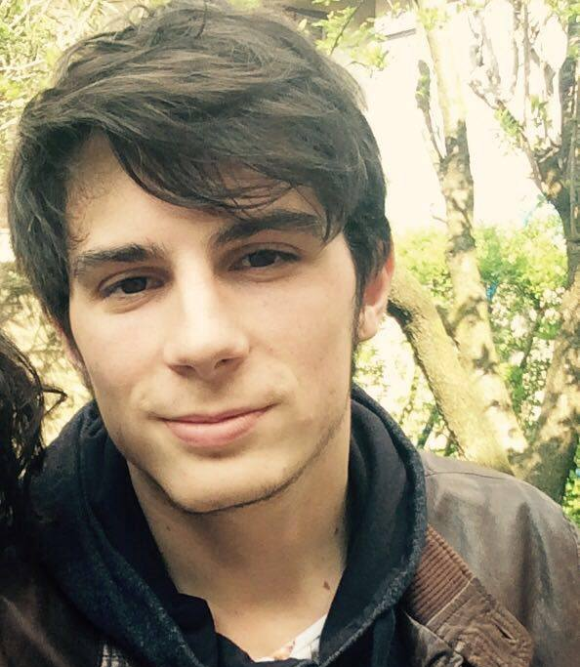
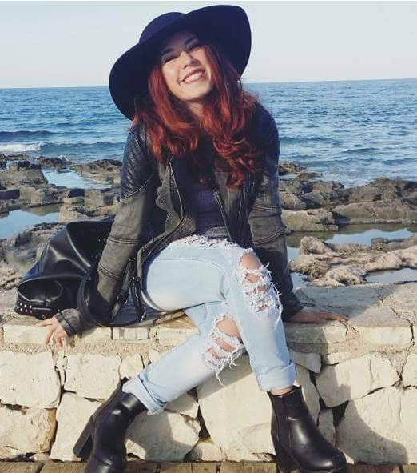
Our team
We are four Biomedical Engineering students @Politecnico di Milano
Paola Bahiti
Chiara Coletti
Davide Berretta
Giada Colella

Slide 8

Thanks for your attention!
Paola Bahiti
Davide Beretta
Giada Colella
Chiara Coletti
Follow us un GitHub: https://github.com/GiadaColella/XPH16

