Slide 1

ezAccount
Improving network security in a tax accountant office
RISK MANAGEMENT & NETWORK SECURITY ANALYSIS
PREPARED FOR
Family-run accountancy firm
Yair Levy • Federico Niccolini
Emanuele Urselli • Gianmarco Pastore • Alessandro Zanatta • Sergio Parigi • Andrea Vergori

Slide 2

ezAccount - Improving network security in a tax accountant office
Introduction
TEAM 1
Objectives
Mitigate cybersecurity risks and improve the overall security of a tax accountant firm, ezAccount
ezAccount current situation
Tax accountant with 5 employees
2 offices in Tampa and S. Petersburg
Offers financial, accounting and taxation services
Problems
Lack of business continuity, incident response, and recovery plan
It has some security issues related to the network and staff training
Notes:
This project is prompted in an effort to mitigate cybersecurity risks and improve the overall security of a tax accountant office.
The company is composed of 2 offices, one in Tampa, the other in S.Petersburg with a total of 5 employees. It handles financial, accounting and taxation needs so that customers can focus on growing their business and supports business operations through the preparation and filing of company tax declarations, maintaining the company accounts.
EzAccount does not have an IRP nor a BCP, and has a naïve network architecture, which can be the source of many network vulnerabilities.
With our intervention we intend to bring the safety level of this company above the average level of the other SME.

Slide 3
ezAccount - Improving network security in a tax accountant office
Recognize and define the problem
TEAM 1
Cybersecurity in tax accounting SMEs
Management of sensitive data
Shift towards digital and cloud services
Dangers deriving from: collaboration with insecure third parties, network vulnerabilities, phishing, social engineering, compromise of company emails.
Lack of in-house skills (Parkin et al., 2016, 1-2)
Impact of an attack both on owner and clients
Increase in the number of cyber attacks during Covid-19 (Lallie et al., 2021, 3-11)
Notes:
For accountants and tax firms, it is part of daily business to work with their customers’ highly sensitive data.
These data are currently stored and processed through cloud services, unlike in the past, in which their own IT systems were used.
It is impossible to guarantee the privacy of customer data, as every Internet connection and every email can pose a potential danger.
Accounting firms are often the victims of cyber attacks when working with third parties that are not secure, when they have network vulnerabilities, from phishing scams, through social engineering, or having their business email compromised.
Cyber attacks can force the company to shut down for many weeks due to data and system execution recovery, or cause it to fail due to huge economic losses.
In the event of data loss, the owners violate their professional duty of confidentiality.
This makes them fully accountable, and also puts their company's reputation and economic future at risk.
Of course, the loss of tax returns and financial data not only impacts the firm itself, but clients as well.
They will not only have to deal with the cost of the breach by paying a cyber security company to recover and restore information, they will also miss on new business opportunities, they will not be able to work on existing business, and they will have to deal with the bad press caused by the data breach.
Consider that, during the pandemic, phishing attacks grew by 600% in March 2020 and have been part of 86% of the total global attackS.

Slide 4
ezAccount - Improving network security in a tax accountant office
Gather facts
TEAM 1
Current technical situation of ezAccount firm
2 offices with a NAS on each
Cloud-based applications for tax accountancy
Shared Wi-Fi and unrestricted usage of personal devices
Pinned passwords
Remote connection via standard OS VPN
Many devices connected to the network (printers, security cameras)
Tier 1 of NIST cybersecurity framework
Notes:
The company represents a small accountancy firm, made up of 5 employees.
The organization consists of two offices that share a common network connection through the use of two suitably configured home routers.
A Network Attached Storage (NAS) on each office allows to perform tasks such as storage and backup.
The main application software used for tax accounting, tax returns and other daily activities is cloud-based.
The owner allows her two children and her customers to use the wifi connection of the offices and the password is pinned on the board of the meeting room, accessible to anyone.
In addition, the owner often works from home, using the office laptop and accesses the network using the standard VPN of the operating system.
The company does not use a firewall to protect its internal, unsegmented network, and the mobile devices used currently do not use a secure VPN.
The company does not have a business continuity, incident response and business recovery plan.
The overall cybersecurity position for the company is considered a level 1 within the implementation levels of the NIST cybersecurity framework.

Slide 5
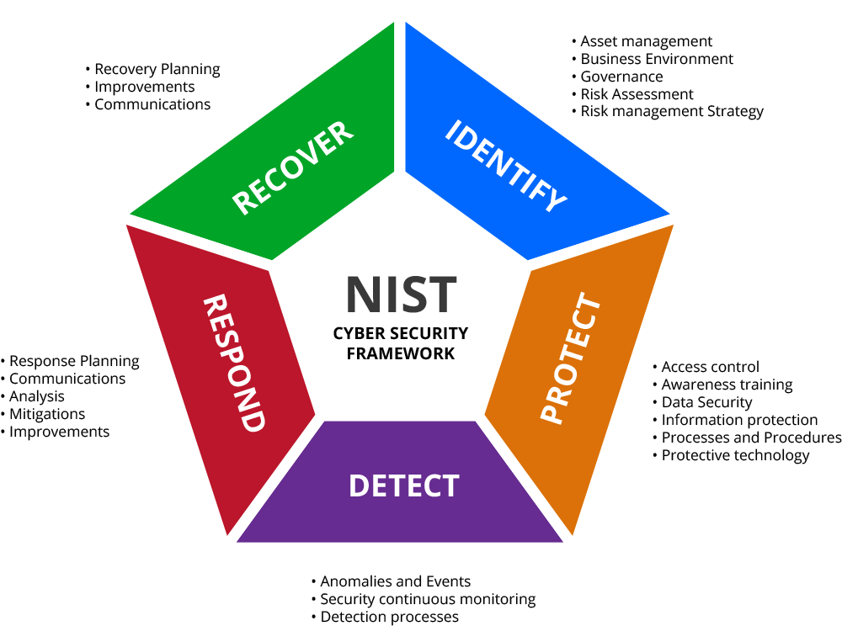
ezAccount - Improving network security in a tax accountant office
Project scope, goals, and objectives
TEAM 1
Project scope
Managerial problems (cyber-hygiene, cyber-awareness)
Technical aspects (network defense)
Objectives
Efficient and safe network architecture (firewalls, VPN, centralized antivirus, IDs)
Mitigate lack of encryption or unsafe access control policies
Train employees and managers, establishing an IRP and a BCP.
Notes:
Tax accountants, such as ezAccount, are smart working due to the pandemic and risk cyber attacks.
The overall goal is to improve security through: identity management, access control, anomaly detection, continuous network monitoring and employee training, resulting in the development of BCP, IRP and RP.
These improvements will take the company to a higher level than the NIST framework.
So the three main objectives of the project are:
Implement efficient and secure network architecture.
Mitigate common threats related to technical problems.
Train employees and managers, establishing an IRP and a BCP.

Slide 6
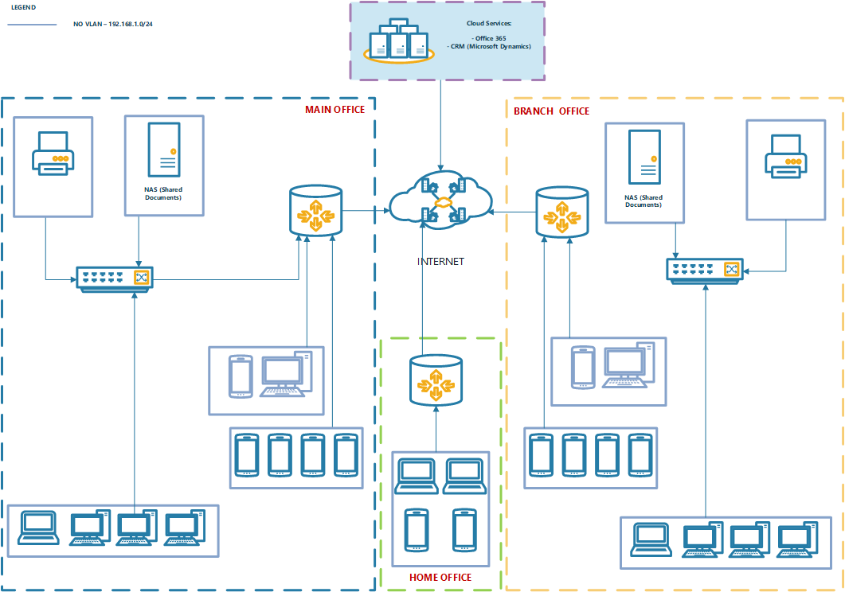
ezAccount - Improving network security in a tax accountant office
Proposed Solution - Before network improvement
TEAM 1
Notes:
Actual Situation
There are three location geographically distributed. The first is the CEO home, the second the Main Office and the last one, the branch office.
Main and branch office are organized on the same mode. All the cabled devices (nas, printers, fixed PC) are connected to a simple HPE 24P switch, all with 192.168.1.0/24 address class and no VLAN (Everyone can speak to everyone). The Switch and all wireless devices (guests devices included) are directly connected to router using Wi-Fi. The Wi-Fi password is a simple 8 characters password write on a post-it pinned on blackboard. The two NAS present on each office are not synchronized and maybe have different data.
Offices are a fixed public IP address and the router is configured with simple VPN connection (to call, not site-to-site). The two offices cannot communicate as a single office.
At own home, the CEO have a laptop that transport from home to office, the sons laptop and some family’ smartphones. All devices are connected using Wi-Fi to Router. To work on Main/Branch offices resources the CEO have a VPN software client installed on own Laptop. To be sure to have a “backup laptop” in case of own laptop fault, the VPN software is also installed on Son’s Laptop. The Wi-Fi connection in the offices and CEO home is configured as WPA and the VPN policy use ad AES-128 protocol.
On the cloud we have the CRM and the Office 365 services

Slide 7
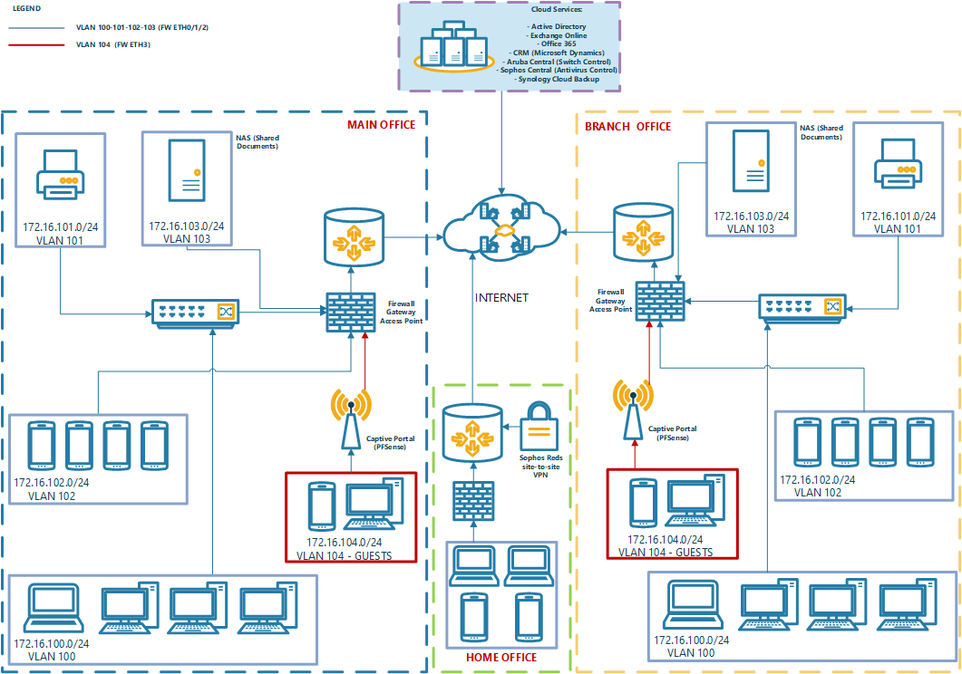
ezAccount - Improving network security in a tax accountant office
Proposed Solution - After network improvement
TEAM 1
Notes:
Future Situation
On this schema we can see an improvement in every aspect of the network.
In the Main and Branch office all the cabled devices (PC, Printer, NAS) are connected to an advanced HPE Switch configured using VLAN. The firewall/Gateway appliance (Sophos) have the following rules:
Manage all the permissions from different VLAN
Intrusion Detection System
Web Proxy
VPN site-to-site management (AES-256)
All users’ wireless devices (Laptop, Managed Smartphones) can connect directly to Firewall Wi-Fi but all guest’s devices are separatly managed using a PFSense Captive Portal appliance connected to a different firewall port. This VLAN is completely disconnected from the others and provides to guest the internet connection only.
All the VLAN passes from the first two firewall ports except the NAS and the Captive Portal that have a reserved port to improve security.
At CEO home we have a Bitdefender Box Firewall connected to a router and the Sophos RED always connected to office with a site-to-site VPN. The only device authorised on this vpn must be the CEO laptop. All sons devices are re-routed on Internet directly.
The site-to-site VPN permit to have a “Big Office” that include all the offices (Main, Branch, Home)
Speaking about NAS, We’ll use a good enterprise Synology RS NAS on Raid-5 configuration. The two NAS will be syncronized using Synology C2 Storage cloud service (encrypted end-to-end) and backed up using Synology C2 Backup cloud service.
Some cloud services will be added to improve security and configurability of the environment like:
Aruba Central (switch manager)
Sophos Central (Antivirus centralized manager)
Third Part advanced antispam like LibraEsva

Slide 8
ezAccount - Improving network security in a tax accountant office
Action plan (Part 1)
TEAM 1
ACT_# | Item | Description | Type | NIST Category
ACT-1 | Firewall Installation for both offices, proxy configuration for web site access segmentation, Adoption of VPN with strong encryption. Intrusion detection system (IDS) activation | Buy two (Sophos Firewall). Implement the follow features: Configure Firewall Policies Configure Web Proxy used by company users Configure site-to-site VPN and install VPN software client on the CEO Laptop Buy one (Sophos RED) for home security connected to Office Firewalls using a fixed VPN connection Buy one Bitdefender Box Firewall (@ CEO Home) Buy two HPE Managed Switch (24 ports) Configure different VLAN for every type of device (wireless, printers, PC and NAS, captive portal) Install Servers/Network Secure Cabinet Buy two enterprise level NAS (Synology RS Series) synchronized by a Synology service. Home can reach the main nas using VPN connection All NAS data will be saved on cloud using Synology C2 Backup service Buy a BYOD cloud system (Cisco Meraki) Install PFSense Captive Portal Appliance | Technical | PR-AC
 |  | Configure the IDS (Intrusion Detection System) | Technical | DE.AE
 |  | Buy a (Sophos) Central Antivirus for every device of the organization | Technical | DE.CM
ACT-2 | Employee training about cyber-hygiene and cyber-awareness | Manager training Employee training | Managerial | PR.AT
Notes:
Regarding the action plan, we have decided to apply the NIST Cybersecurity Framework guidance on how to mitigate cyber threats in order to adopt a comprehensive cybersecurity strategy. We have linked every action to one or more NIST categories and we have also defined the type of the action, that is, if it is technical or managerial.
The first measures to implement are the installation of firewalls, the network segmentation, the adoption of VPN with strong encryption, the use of an IDS and of a centralized antivirus. To achieve this objectives, we have devised the need for a number of devices, such as Sophos firewalls, a VPN using Sophos RED, a Bitdefender home firewall, NAS for in-site storage and NAS cloud synchronization for off-site backup, as well as a captive portal appliance for customers and Jane’s children.
The second action to implement is the training of manager and employees on topics regarding the cyber-hygiene and cyber-awareness.

Slide 9
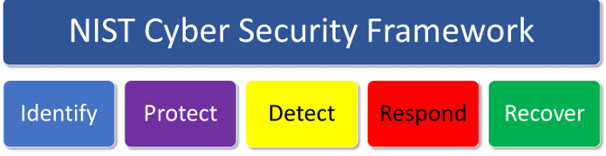
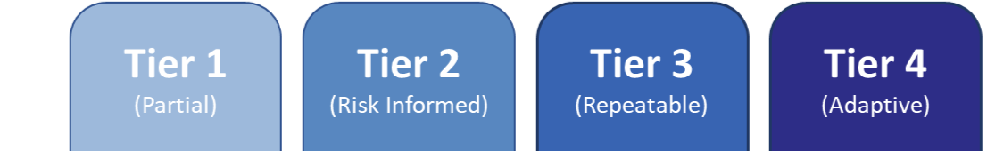
ezAccount - Improving network security in a tax accountant office
Action plan (Part 2)
TEAM 1
ACT_# | Item | Description | Type | NIST Category
ACT-3 | Create Business Continuity (BC) and Incident Response (IR) Plan | Define disaster recovery procedure Setup Emergency Contact list Employee Training Configure automatic security updates | Managerial Technical | RC.RP
 |  | Implements a Maintenance Program (update/security fix) | Technical | PR.MA
 |  | Define Response procedure | Managerial | RS.CO
 |  | Detailed assets of hardware & software and business data flow | Managerial | ID.AM
ACT-4 | Use of data encryption on every asset, data synchronization on the cloud. Enroll all mobile devices to BYOD manager. Least privilege configuration, implementation of role-based access control (RBAC), zero-trust authentication and/or 2FA | Configure data encryption on each device Implement backup strategies on BYOD Configure Two-Factor authentication Configure Role Based Access Control on NAS | Technical | PR-DS
Notes:
Thirdly, as the firm lacks a Business Continuity Plan and an Incident Response Plan, there is a need to define and implement both of these plans. We will answer this need, and we will also implement a Maintenance program to address security updates and fixes.
Finally, every asset will use data encryption and their data will be synchronized on the cloud, all mobile phones will be enrolled in a Bring your own device service. Systems will also be configured to comply to the least privilege principle, to implement RBAC and to use zero-trust or 2 Factor Authentication.

Slide 10
ezAccount - Improving network security in a tax accountant office
Risk Management Analysis (RMA) outline
TEAM 1
Risk rank | Threat type | Risk description | Likelihood of occurrence | Impact on organization | Mitigation strategy | ACT_#
1 | Data breach | Unauthorized disclosure of sensitive customer data, due to data breach | HIGH | HIGH | Firewall Installation for both offices, proxy configuration for web site access segmentation, Adoption of VPN with strong encryption. Intrusion detection system (IDS) activation | ACT-1
2 | Ransomware | Network modification, loss of productivity, files and financial loss as a result of revenue generating operations being shut down or/and paying ransom | HIGH | HIGH | Employee training about cyber-hygiene and cyber-awareness, use of RAID 5, antivirus, disable macro scripts, use of server proxy for internet access | ACT-2
3 | Data leakage | Loss of data confidentiality, communication confidentiality due to data leakage | MEDIUM | HIGH | Adoption of VPN with strong encryption | ACT-1
4 | Unauthorized Remote Access | Loss of confidentiality, integrity and availability. due to unauthorized remote access | MEDIUM | HIGH | Least privilege configuration, implementation of role-based access control (RBAC), zero-trust authentication and/or 2FA | ACT-4
5 | Network breach | Loss of confidentiality due to network breach | MEDIUM | HIGH | VLAN adoption, installation of a captive portal on a dedicated VLAN | ACT-1
6 | Business Operation continuity/recovery risk | Business operation disruption and potentially bankruptcy due to the lack of business continuity plan / Incident Response Plan | LOW | HIGH | Create Business Continuity (BC) and Incident Response (IR) Plan | ACT-3
7 | Physical access | Loss of backup data files due to theft of hardware or sabotage | LOW | HIGH | Use of data encryption on every asset, data synchronization on the cloud. Enroll all mobile devices to BYOD manager | ACT-4
Notes:
During the RMA we decided to assign high impact to all threats. In fact, for a tax accountant, any loss or disclosure of sensitive data can have disastrous consequences. Despite this, the danger of the threats is not the same, which is why they have been ordered with a rank. Futhermore each threat of the table is associated to a specific item of the action plan.
The first and worst threat is data breach, unauthorized disclosure of sensitive customer data. In order to avoid it we will install firewalls in both offices, implement network segmentation,IDS and adopt VPN with strong encryption. The second threat is ransomware, one of the most common threats nowadays. The proposed mitigation startegy is based on employees training about cyeber-hygene and cyber-awareness and on technical countermeasures like antivirus and proxy server to access internet.
The next three threats in the table, with medium likelihood, are related to the network vulnerabilities and to the lack of data encryption that emerged in our analysis. They will be mitigated by the network upgrade and the adoption of secure access control mechanisms.
Last but not least there are Business Operation contnuity/recovery risk and physical theft. The first one is quite dangerous, despite the low likelihood, because the lack of incident response and recovery procedures can complicate even more a situation which is already bad.

Slide 11
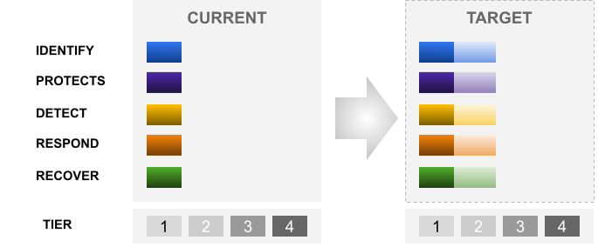
ezAccount - Improving network security in a tax accountant office
Anticipated project results
TEAM 1
Notes:
The expected result of this project allows to considerably increase the level of cybersecurity of the company. Using NIST's cybersecurity framework, it will offer the company an effective and efficient way to comply with it and achieve its intended results. Furthermore, to simplify the improvement process, training hours are provided for all company personnel. As shown in the figure we intend to bring EzAccount, according to the NIST framework, from tier 1 to tier 2. This is a noticeable improvement that allows the company to resist the most common threats like data breaches, ransomware and malware, data leakage, unauthorized remote accesses and consequent losses of confidentiality, integrity and availability of the data and the service offered, aligning all with a new business continuity, incident response and recovery plan.

Slide 12
ezAccount - Improving network security in a tax accountant office
Proposed Costs - Non Recurring Cost
TEAM 1
Activity list
Start-up material list
Action | ACT-REF | Hours | Cost/Hour | Price
Configure Firewall Policies | ACT-1 | 4 | € 100 | € 400
Configure Navigation Proxy used by company users | ACT-1 | 4 | € 100 | € 400
Configure the Intrusion Detection System (IDS) | ACT-1 | 4 | € 100 | € 400
Install and configure VPN client to all devices | ACT-1 | 6 | € 100 | € 600
Configure different VLAN for every device | ACT-1 | 2 | € 100 | € 200
Configure NAS on cluster mode | ACT-1 | 4 | € 100 | € 400
Manager and employee training | ACT-2 | 4 | € 100 | € 400
Define recovery procedure | ATC-3 | 4 | € 100 | € 400
Setup Emergency Contact list | ATC-3 | 2 | € 100 | € 200
Configure automatic security updates | ATC-3 | 2 | € 100 | € 200
Implements a Maintenance Program | ATC-3 | 4 | € 100 | € 400
Configure data encryption on each device | ATC-4 | 8 | € 100 | € 800
Implement backup strategies on BYOD | ATC-4 | 4 | € 100 | € 400
Configure 2 factor authentication | ATC-4 | 4 | € 100 | € 800
Configure Role Based Access Control on NAS | ATC-4 | 6 | € 100 | € 600
TOTAL ACTIVITIES |  | € 6.600
Item | ACT-REF | Qty | Unit Price | Price
Sophos XGS Firewall | ACT-1 | 2 | € 300 | € 600
Bitdefender box firewall | ACT-1 | 1 | € 250 | € 250
Sophos RED | ACT-1 | 1 | € 350 | € 350
HPE Aruba 2930F | ACT-1 | 2 | € 2.250 | € 4.500
Servers/Network Secure Cabinet | ACT-1 | 2 | € 200 | € 400
(Sophos) Central Antivirus | ACT-1 | 1 | € 100 | € 100
Synology RS 819 + DISKS | ACT-1 | 2 | € 1.650 | € 3.300
TOTAL MATERIAL |  | € 9.500
TOTAL COST |  | € 16.100
Notes:
Here add description off all day activities and initial component to be bought
All activitieswill be performed internally
<describe and comment each item>
hihlight byod, vlan and secure cabinet among the others

Slide 13
ezAccount - Improving network security in a tax accountant office
Proposed Costs - Recurring Yearly
TEAM 1
Activity Maintenance List
Recurring Cost (yearly) Material List
Action | ACT-REF | Hours | Cost/Hour | Price
Configure Firewall Policies | ACT-1 | 1 | € 100 | € 100
Configure Navigation Proxy used by company users | ACT-1 | 1 | € 100 | € 100
Configure the IDS (Intrusion Detection System) | ACT-1 | 1 | € 100 | € 100
Maintenance of the recovery procedure | ATC-3 | 4 | € 100 | € 400
Setup Emergency Contact list | ATC-3 | 1 | € 100 | € 100
RECURRING ACTIVITIES (YEARLY) |  | € 800
Item | ACT-REF | Qty | Unit Price | Price
Sophos FW annual maintenance | ACT-1 | 1 | € 1.000 | € 1.000
Aruba Central (3 years subscr) | ACT-1 | 1 | € 200 | € 200
(Sophos) Central Antivirus | ACT-1 | 1 | € 500 | € 500
Synology Cloud C2 Backup | ACT-1 | 1 | € 99 | € 99
Synology Cloud C2 Storage | ACT-1 | 1 | € 139 | € 139
RECURRING MATERIAL (YEAR) |  | € 1938
TOTAL COST |  | € 2738
Notes:
like all the safety and security system we need to Perform a continues maintenance
we are planning to spend 8 hours per year in order to maintenace software, policies and recovery procedures.
<describe & comment each item>
<highlight emergency contact list

Slide 14
ezAccount - Improving network security in a tax accountant office
Conclusion
TEAM 1
The proposed project
Ensures greater confidentiality and integrity of the resources
Improves the company ability to respond and recover from an incident
Involves an investment of 16.100$ and 62h to make the company risk-informed
Achieves NIST tier 2
Notes:
Accountants' offices are locations that contain private information that could harm customers if it became public or lost. Changes to the cybersecurity location may allow for greater confidentiality and availability of these critical resources to authorized employees of the accounting firm. In this project, various areas are highlighted where the organization's cybersecurity can be improved. Improving cybersecurity in these areas will reduce the likelihood of the accounting firm experiencing cyberattacks and improve the firm's ability to respond to and recover from an incident. It is estimated that approximately 70 hours of consultancy by a cybersecurity specialist and an initial investment of
€ 18,838 will be required.

Slide 15
ezAccount - Improving network security in a tax accountant office
References
TEAM 1
Barrett, M. P. (2018). Framework for Improving Critical Infrastructure Cybersecurity (1.1). NIST Cybersecurity Framework. https://doi.org/10.6028/NIST.CSWP.04162018
Fernandez De Arroyabe, I., & Fernandez De Arroyabe, J. C. (2021). The severity and effects of Cyber-breaches in SMEs: a machine learning approach. Enterprise Information Systems. 10.1080/17517575.2021.1942997 To link to this article: https://doi.org/10.1080/17517575.2021.
IRS warns about COVID-19 economic impact payment fraud. (2021, June 4). Internal Revenue Service. Retrieved November 24, 2021, from https://www.irs.gov/compliance/criminal-investigation/irs-warns-about-covid-19-economic-impact-payment-fraud
Lallie, H. S., Shepherd, L. A., Nurse, J. R.C., Erola, A., Epiphaniou, G., Maple, C., & Bellekens, X. (2021, June). Cyber security in the age of COVID-19: A timeline and analysis of cyber-crime and cyber-attacks during the pandemic. Computers & Security, 105(1), 102248. 10.1016/j.cose.2021.102248
Parkin, S., Fielder, A., & Ashby, A. (2016). Pragmatic Security: Modelling IT Security Management Responsibilities for SME Archetypes. 10.1145/2995959.2995967

Slide 16
THANK YOU
_for your precious time and attention_

