Slide 1
Attribute Clusters
Project
Descriptor
 | Project Title | Researcher Name | Description | Sample Processing | Sample Delivery | Protocol | Data Processing | Repositories | Link
Group ID
Size
Age
Gender
oxygen
drugs
survival rate
Group Descriptor

Slide 2
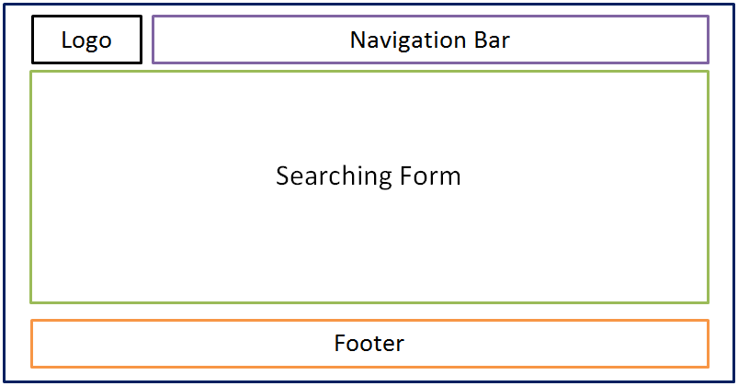
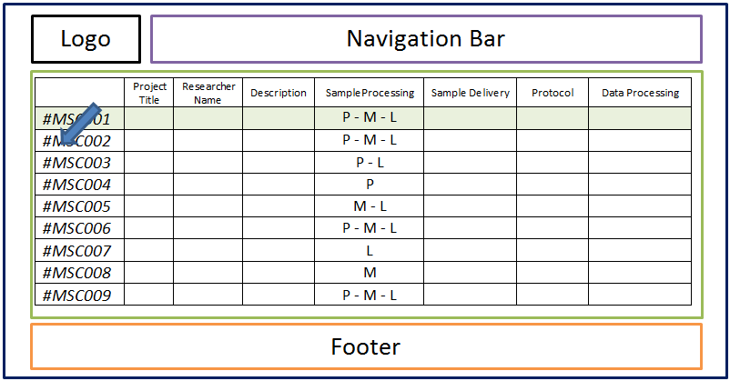
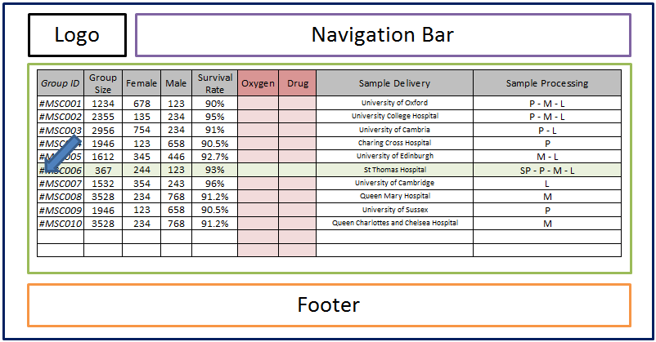
Searching Level
Project
Descriptor
Group Descriptor

Slide 3
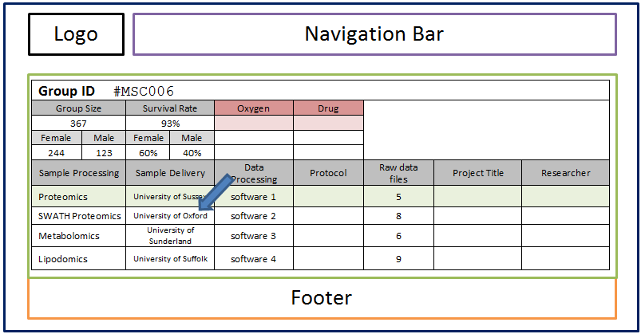
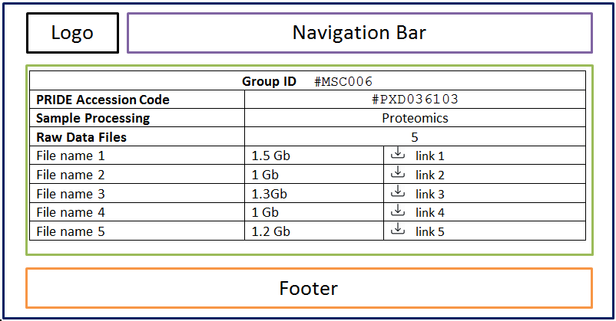
Full Record Level

Slide 4
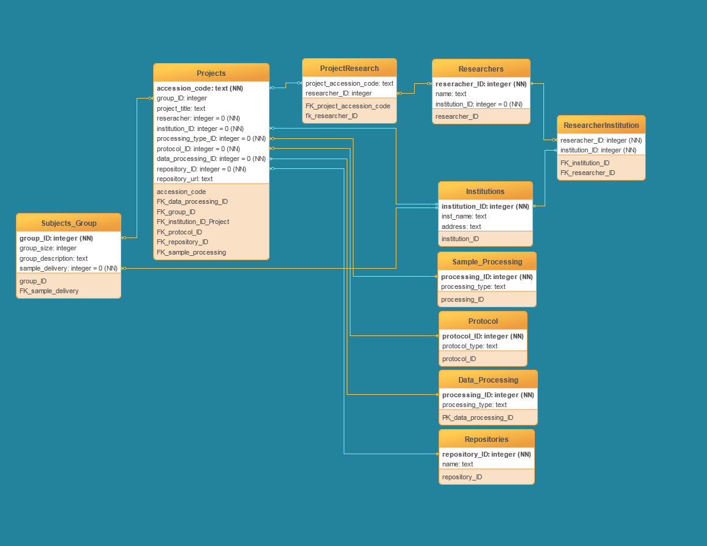
Project Descriptor Database Physical Schema

Slide 5
Attributes Definition
Group_ID
Disentangle subject ID-Project ID
Preprocessing before the submission on the Cov19-MSC
Cov19-MSC Accession Code
Institution
One for each group, one for each project
Researcher
More than one for each project

