Slide 1

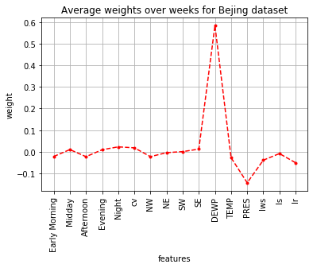
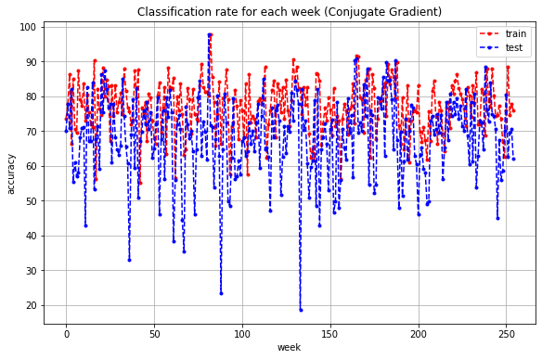
Pollution Level Forecasting
Gianmarco Centonze, Antonio Scrimieri
Particular Matter
Methodology
Results
PM2.5 is microscopic solid or liquid matter suspended in the air that have a diameter of less than 2.5 μm that penetrating into the lungs may have serious consequences on the health, especially of sensitive people (children, older adults, heart or lung ill people).
The weather conditions change the level of PM2.5 readings and affect different cities in a different way.
Can we predict the PM2.5 level?
Which weather parameters are the one with biggest impact?
Given the datasets that collected weather conditions for 4 different years in different chinese cities (e.g., Beijing, Shanghai) and the PM2.5 values detected in one week, we try to predict the one of the week after.
We performed a Linear Regression (with Conjugate Gradient method) and mapped the results into 3 categories, associated with different risks. Subsequently, the obtained results were compared with the results of a Logistic Regression model performed on the same data.
Finally, we computed the mean of the classification rate over the weeks and we reported the results over the test set in Table I. Logistic Regression perform better on the training set (87.35), but the Linear Regression gives better result on test set.
The feature that affect the PM2.5 value the most (regardless the city) is the Dew Point, i.d. the temperature to which air must be cooled to become saturated with water vapor (see Figure II).
Table I. Results over sets
City | Train Accuracy | Test Accuracy
Beijing | 76.97% | 68.18%
Shanghai | 79.79 % | 63.68%
Shenyang | 77.49% | 63.93%
Chengdu | 83.72% | 73.52%
Fig I. Accuracy over weeks
Fig II. Features weights for Beijing dataset

