Slide 1
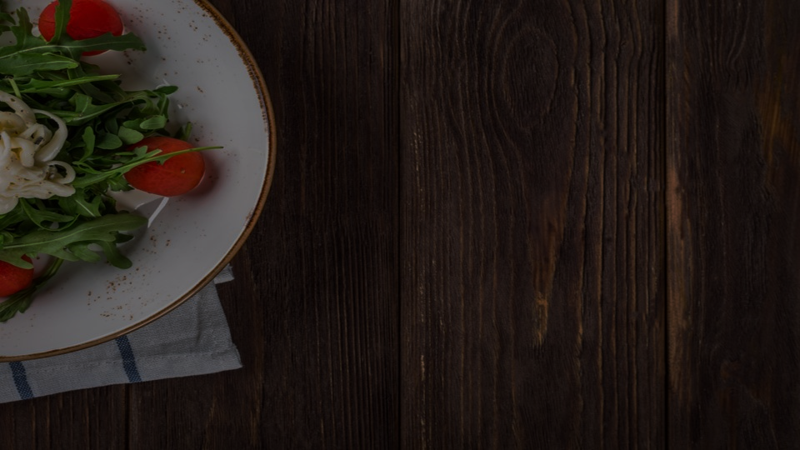
Survey on Food Image Classification Using Convolutional Neural Networks
University of the Philippines Tacloban College
Researcher: Lester E. Lascano
Adviser: Prof. John Paul T. Yusiong
May 2024
Notes:
Hello Everyone, I am Lester and I will be presenting my Survey on Food Image Classification using Convolutional Neural Networks

Slide 2
Presentation Outline
Datasets
Transfer Learning of CNN
Parallel CNN
Ensemble Learning
Conclusion
Notes:
The topics that will be covered in this presentation will be as follows.

Slide 3
Datasets
Authors | Dataset | # of images | # of classes
Matsuda et al. | UEC-Food100 | 9,060 | 100
Kawano and Yanai | UEC-Food256 | 31,651 | 256
Bossard et al. | Food-101 | 101,000 | 101
Lee et al. | Food-101N | 310,109 | 101
Singla et al. | Food-5k | 5,000 | 2
 | Food-11 | 16,643 | 11
Ciocca et al. | Food-254DB | 247,636 | 254
Notes:
First lets look at the datasets. Many food datasets have been built in food image classification problem to cover a wide range of food dishes with specific and broad categories. Here are some of the publicly available datasets out there based on my survey the Japanese Food dataset UEC-FOOD100 and 256, the large comprehensive dataset Food101 and Food101N, Food5k Food 11, and Food254DB.

Slide 4
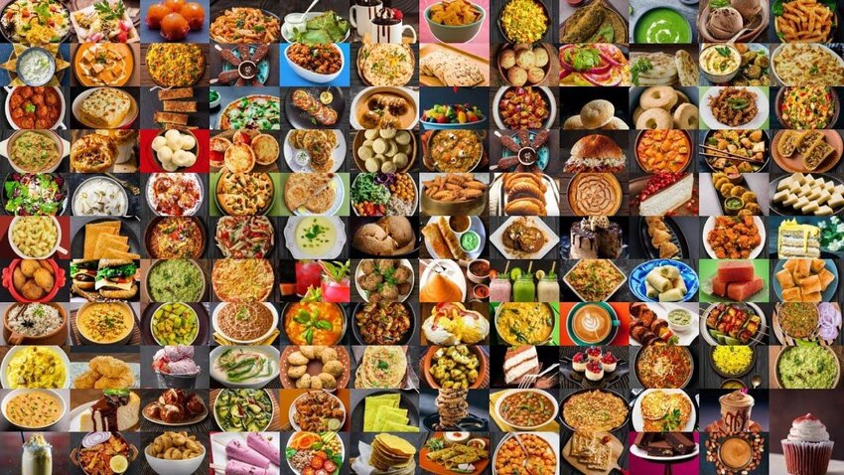

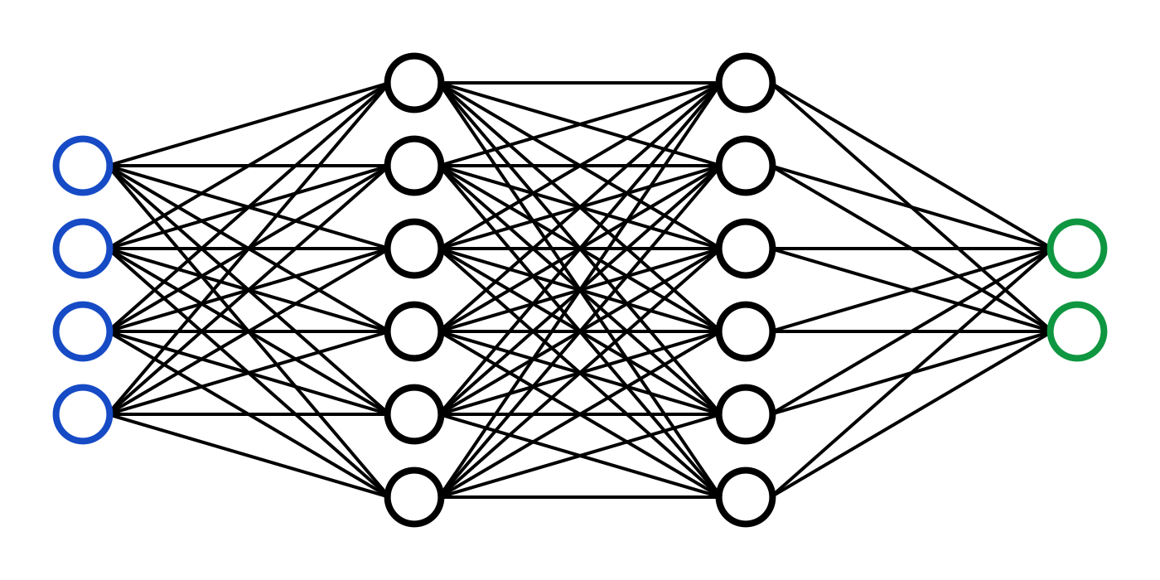
Transfer Learning of CNN
Pizza
Notes:
Different CNN models have been used in food image classification problems; however, these models require large amounts of data to learn meaningful features from the input and take time to train.

Slide 5
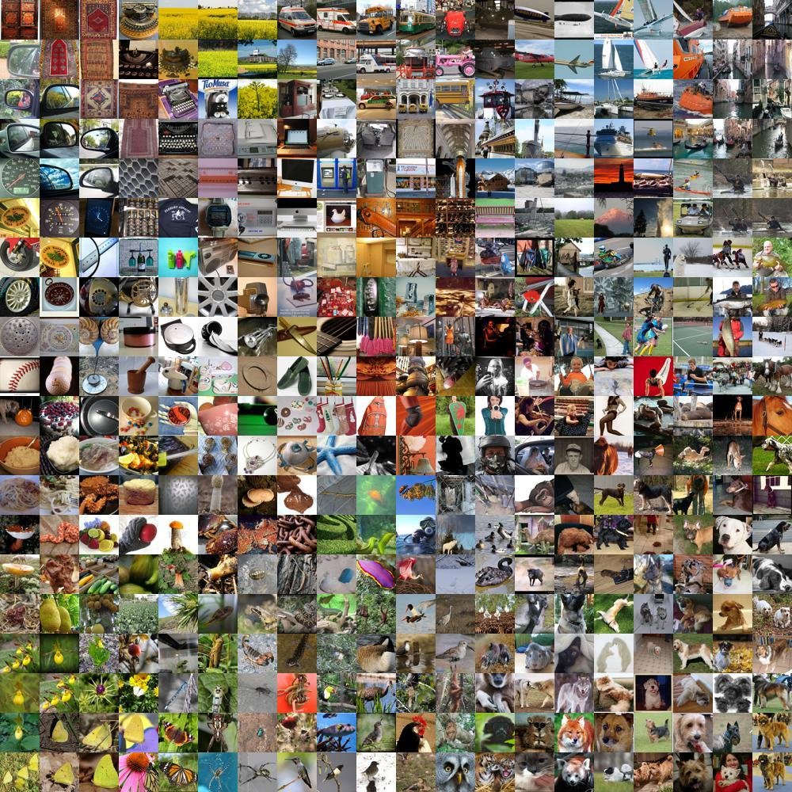
Transfer Learning of CNN
ImageNet
Knowledge Transfer
Pizza
Fine-tuning
Notes:
Based on my survey transfer learning techniques are now more commonly used to solve the problem of insufficient data. This allows CNN models to transfer knowledge from one area to another. In this case, a model that has been trained on ImageNet is repurposed, and the knowledge from the pre-trained model is being transferred to solve a new task by fine-tuning the model to solve the food classification problem, saving time and resources instead of training a model from the ground up.

Slide 6
Transfer Learning of CNN
Author | Year | Dataset | Method | Accuracy
Singla et al. | 2016 | Food-11 | Fine-tuned GoogleNet | 83.60
De Bonis et al. | 2019 | Food-101 | Fine-tuned GoogleNet | 73.00
Rajayogi et al. | 2019 | Indian Food Dataset | Fine-tuned InceptionV3 | 87.90
Phiphiphatphaisit and Surinta | 2020 | Food-101 | Fine-tuned MobileNet + data augmentation | 72.59
VijayaKumari et al. | 2022 | Food-101 | Fine-tuned EfficientNetB0 | 80.00
Notes:
Here are some studies that used this transfer learning technique. We have Singla et al and Debones et al who used fine-tuned googleNets
Rajayogi et al used fined tuned inception v3 for their Indian Food dataset
And VijayaKumari who used a finetuned EfficientNetb0.

Slide 7
Parallel CNN
Pizza
Notes:
The different CNN models previously mentioned have single-input architectures. To further increase the classification accuracy of models, studies employ parallel CNNs.

Slide 8
Parallel CNN
Concatenation
Pizza
Fully Connected
Softmax
Notes:
In this approach, the features extracted by the parallel CNNs are concatenated and then fed into the fully connected layers to make the final prediction. Parallel CNN architecture can consist of one input fed into different kinds of CNNs, or multiple variations of one input fed into multiple CNNs of the same kind, or both.

Slide 9
Parallel CNN
Author | Year | Dataset | Method | Accuracy
Pandey et al | 2017 | Food-101 | Parallel CNN (AlexNet, GoogleNet, and ResNet) | 73.50
Martinel et al. | 2018 | Food-101 | Parallel CNN WISeR | 90.27
 |  | UEC-256 |  | 83.15
 |  | UEC-100 |  | 89.58
Şengür et al. | 2019 | Food-11 | Parallel CNN (AlexNet + VGG16) with SVM classifier | 88.08
 |  | Food-101 |  | 79.86
Notes:
Here are some studies that did a Parallel architecture, Pandey et al who did a Parallel CNN of AlexNet, GoogleNet, and ResNet.
Martinel which created a Wiser model with 2 subnetworks, a residual network and slice network.
And sengur et al. who did a parallel architecture of AlexNet and VGG 16 with SVM as the classifer

Slide 10
Ensemble Learning
Tasci, 2020
VGG16
72.88%
71.16
VGG19
GoogleNet
70.96
Voting mechanism
Prediction
79.49
ResNet101
84.28% accuracy
↑ 4.79%
79.08
InceptionV3
Notes:
Another approach is an ensemble which can be achieved through voting mechanisms on the final prediction of each model in the ensemble to achieve higher accuracy. This is what tasci did by using 5 different CNN models VGG16, VGG19, GoogleNet, ResNet101, and Inceptionv3. With this approach he achieved an accuracy of 84.28% which is 4.79 higher than the best model in the ensemble.

Slide 11
Conclusion
This mini-survey showed that Different datasets have been created to cater to certain purposes, such as classifying Indian and Japanese dishes. Transfer learning techniques have been widely used across all the studies, and they all showed promising results. However, conventional approaches typically rely on single-color space images as inputs, which may not fully capture the diverse visual characteristics of food items. There is still room for improvement.
Notes:
This mini-survey showed that Different datasets have been created to cater to certain purposes, such as classifying Indian and Japanese dishes. Transfer learning techniques have been widely used across all the studies, and they all showed promising results. However, conventional approaches typically rely on single-color space images as inputs, which may not fully capture the diverse visual characteristics of food items. There is still room for improvement.

Slide 12
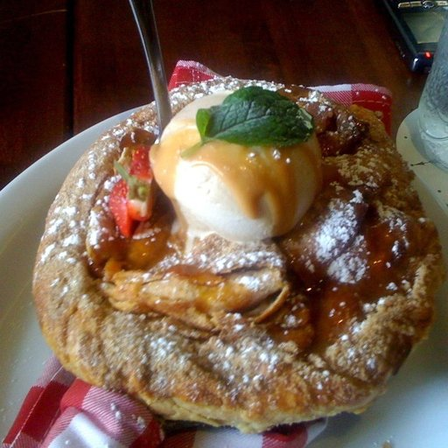
Conclusion
Prediction
Concatenation
Fully Connected
Softmax
Notes:
such utilizing Two-Input Parallel networks, which are capable of handling multi-color space images,

Slide 13
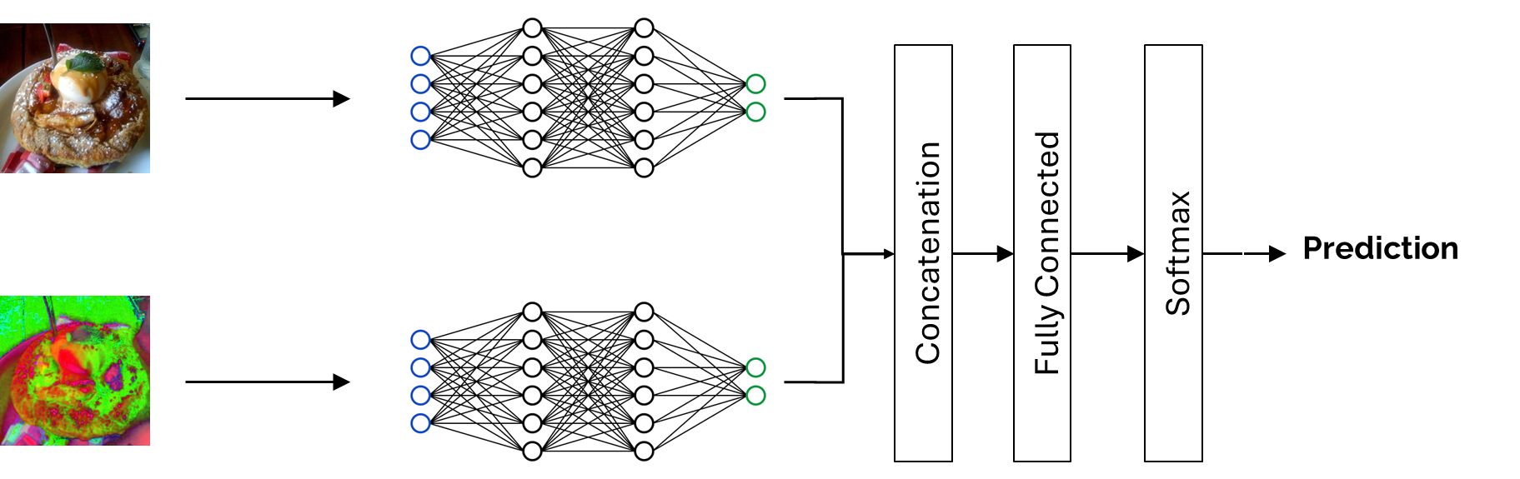
Conclusion

Slide 14
Conclusion
Voting mechanism
Prediction
Notes:
And doing an ensemble approach to this multi-color space Two-Input Parallel networks to further increase performance.

