Slide 1

AQI Evaluation APP
Group: The Marpions
SUEZ Matteo, ANDRIANO Giancarlo

Slide 2


WHY OUR SOFTARE
Unique Funtcionalities Provided
Real-Time Evaluations
Lifetime Software Support
Up to 10 different Locations
Expert Software Engineers

Slide 3


WHAT WE PROVIDE
01
AQI CALCULATION
04
PollutanTS EVALUATION
*Up to 4 pollutants:
-SO2
-NO2
-PM10
-O3
02
LOCATION COMPARISON
05
OFFICIAL EU RECOMM.
03
SENSOR SIMILARITY

Slide 4
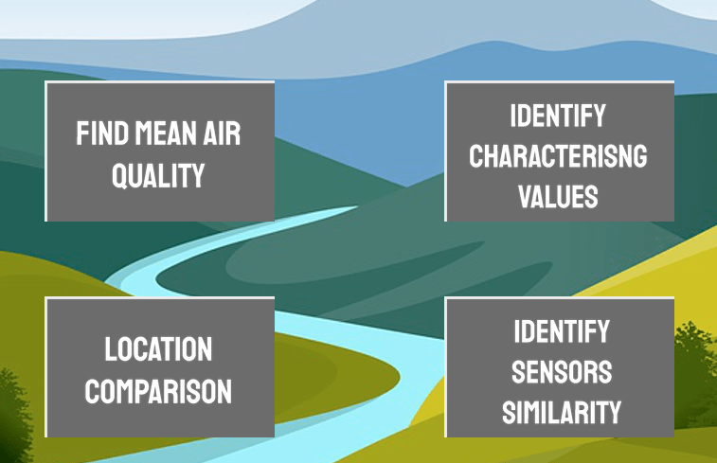
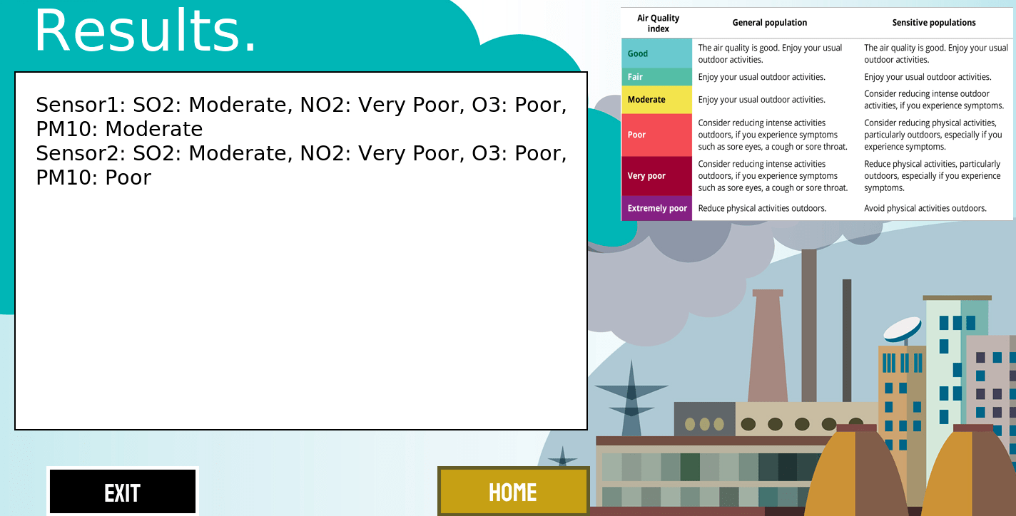
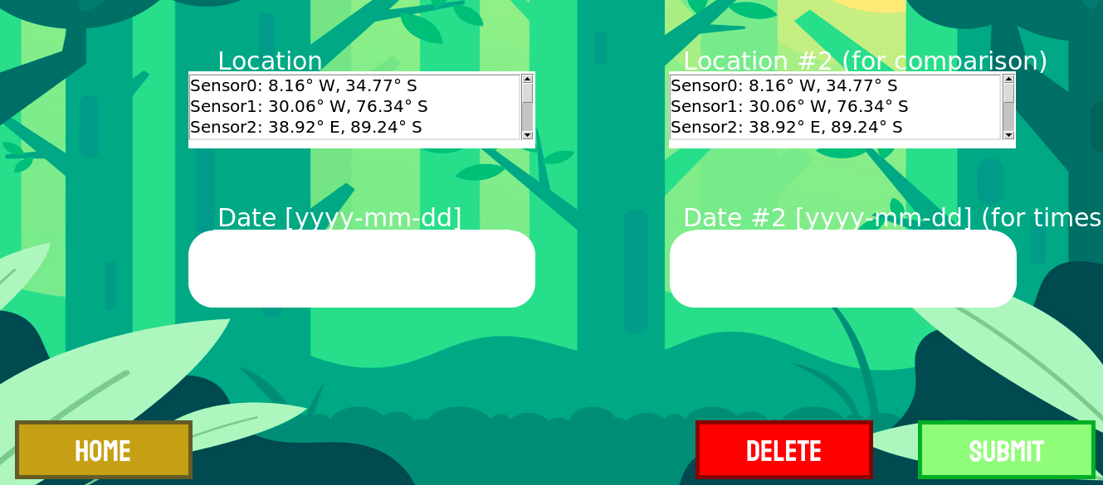
USER - FRIENDLY GUI

Slide 5
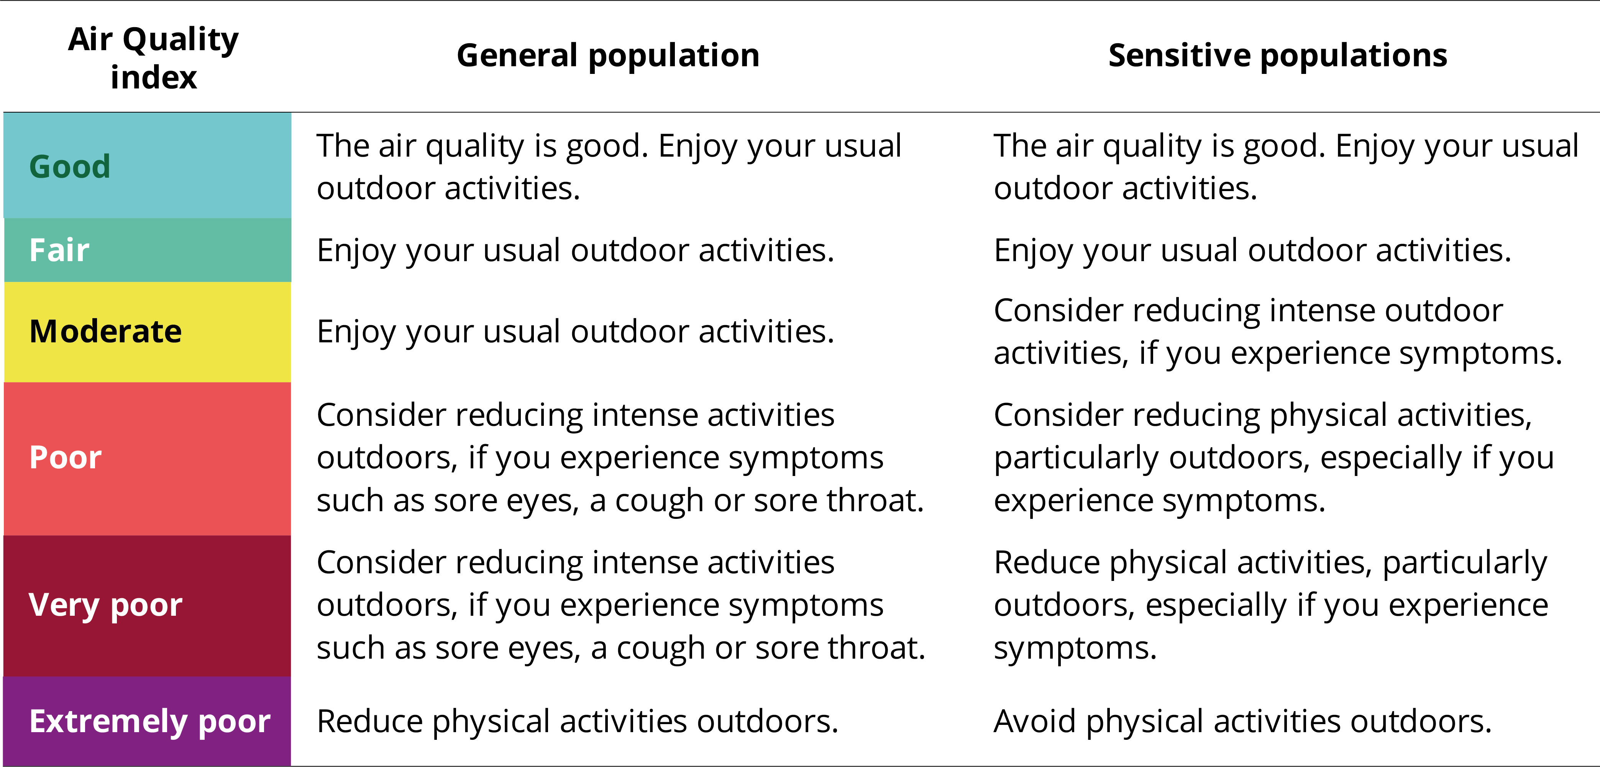
OUR AIR QUALITY DEFINITION
https://www.eea.europa.eu/themes/air/air-quality-index

Slide 6
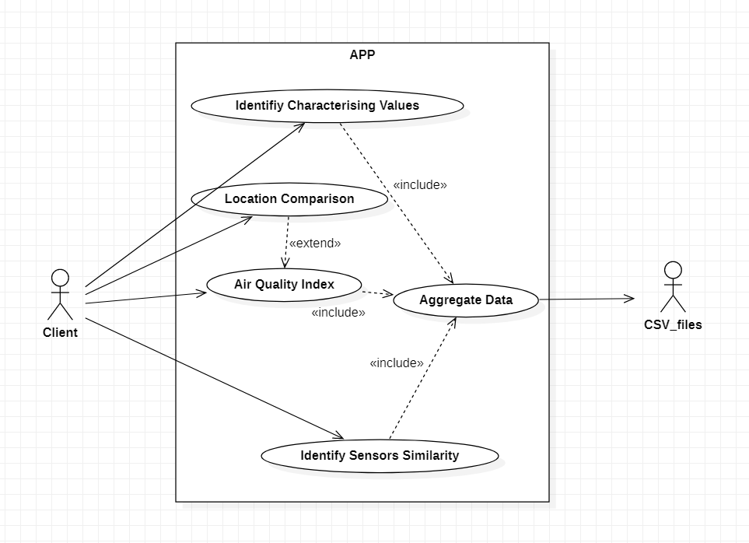
USE – CASE DIAGRAM: A SKETCH

Slide 7
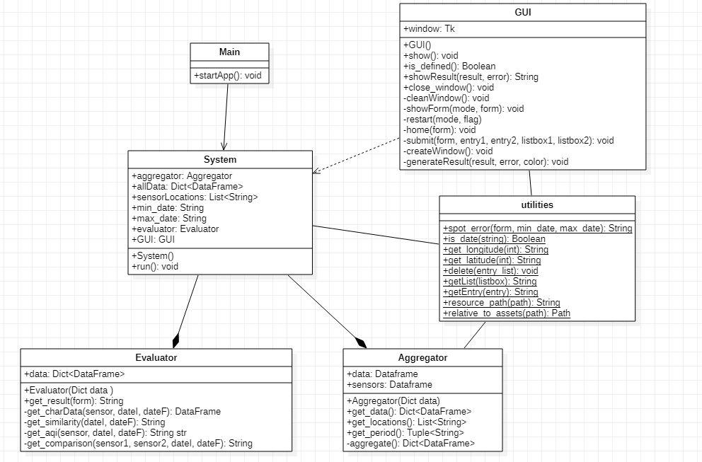
CLASS - DIAGRAM: OVERVIEW

Slide 8
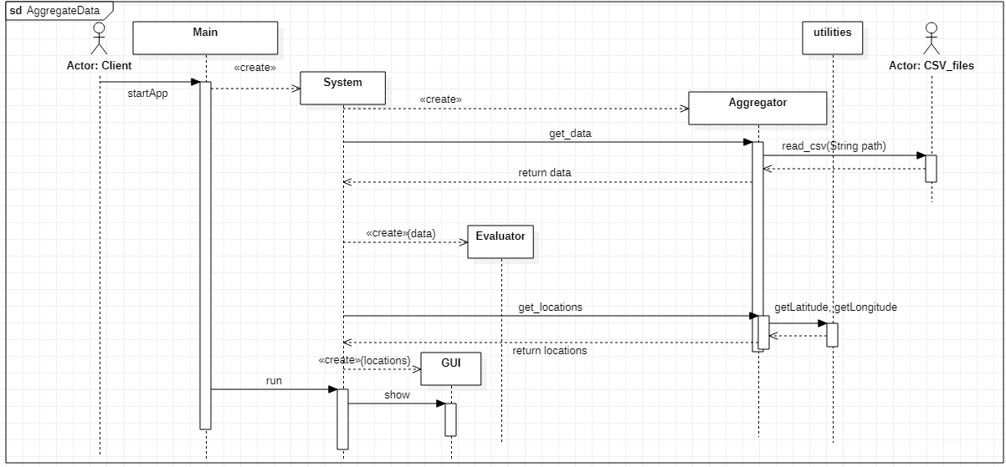
SEQUENCE DIAGRAMS: DEEP IN DETAILS.... Data Aggregation

Slide 9
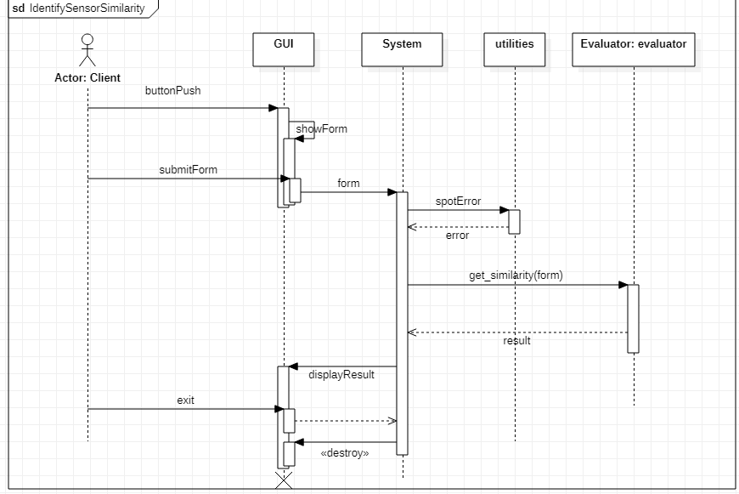
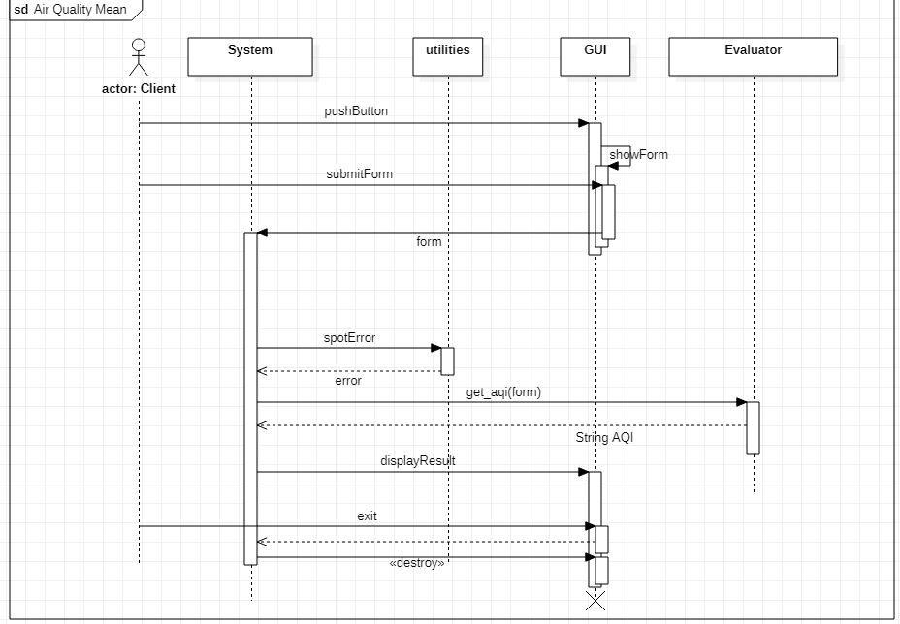
SEQUENCE DIAGRAMS: DEEP IN DETAILS.... Sensors Similarity AQI index

Slide 10
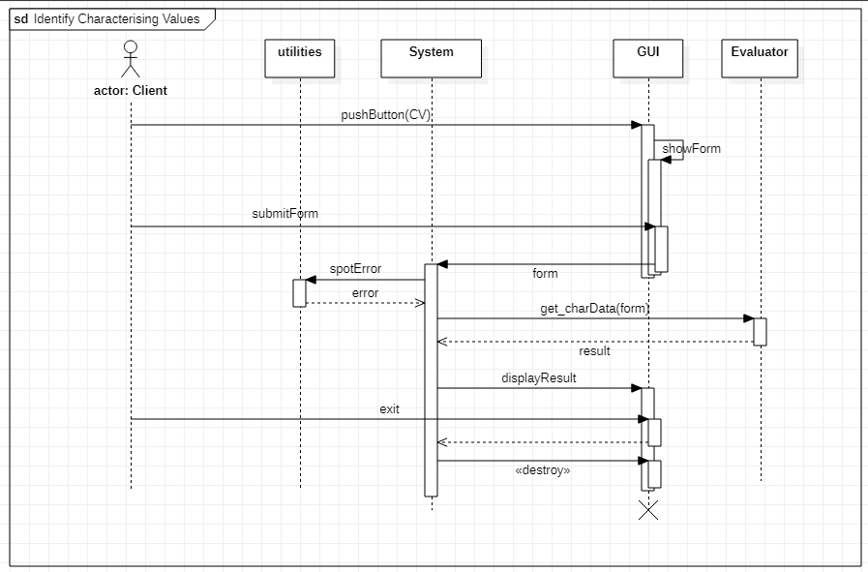
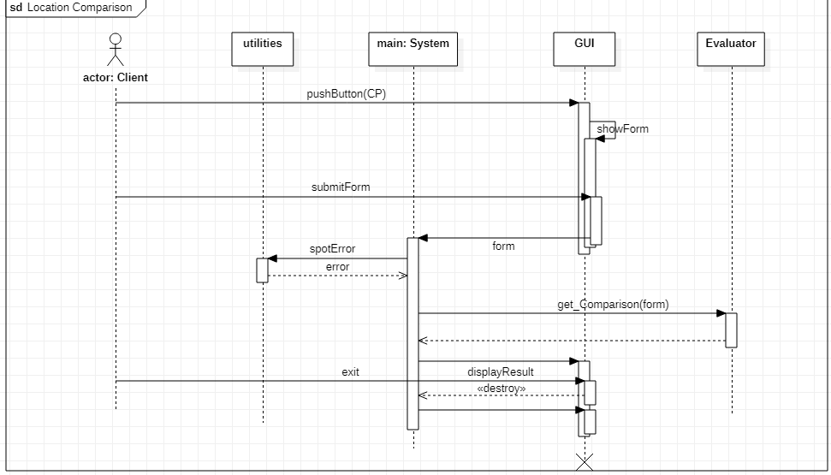
SEQUENCE DIAGRAMS: DEEP IN DETAILS.... Pollutants Eval. Location Comparison

Slide 11

THANKS FOR LISTENING

