Slide 1
AQI Evaluation APP
Group: The Marpions
SUEZ Matteo, ANDRIANO Giancarlo

Slide 2


WHY OUR SOFTARE
Unique Functionalities Provided
Real-Time Evaluations
Lifetime Software Support
Up to 10 different Locations
Expert Software Engineers

Slide 3


WHAT WE PROVIDE
01
AQI CALCULATION
04
Specific pollutant values
*Up to 4 pollutants:
-SO2
-NO2
-PM10
-O3
02
LOCATION COMPARISON
05
OFFICIAL EU RECOMM.
03
SENSOR SIMILARITY

Slide 4
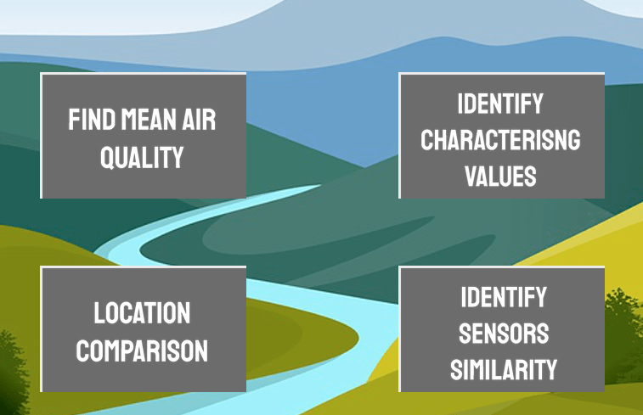
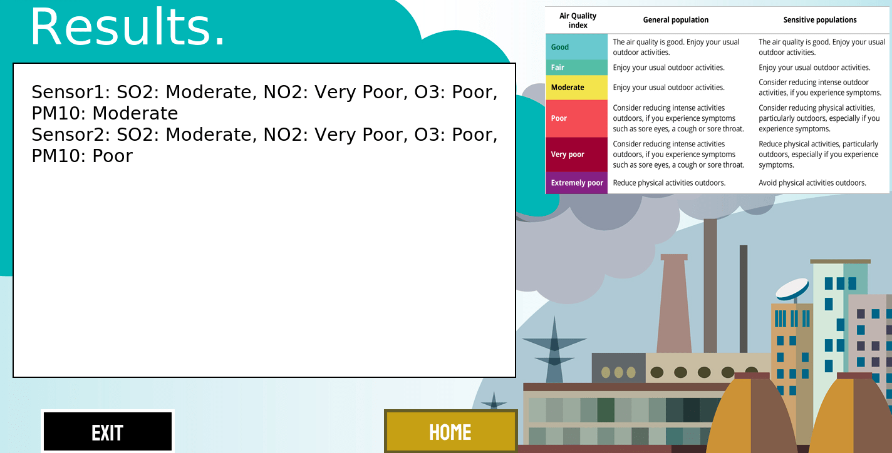
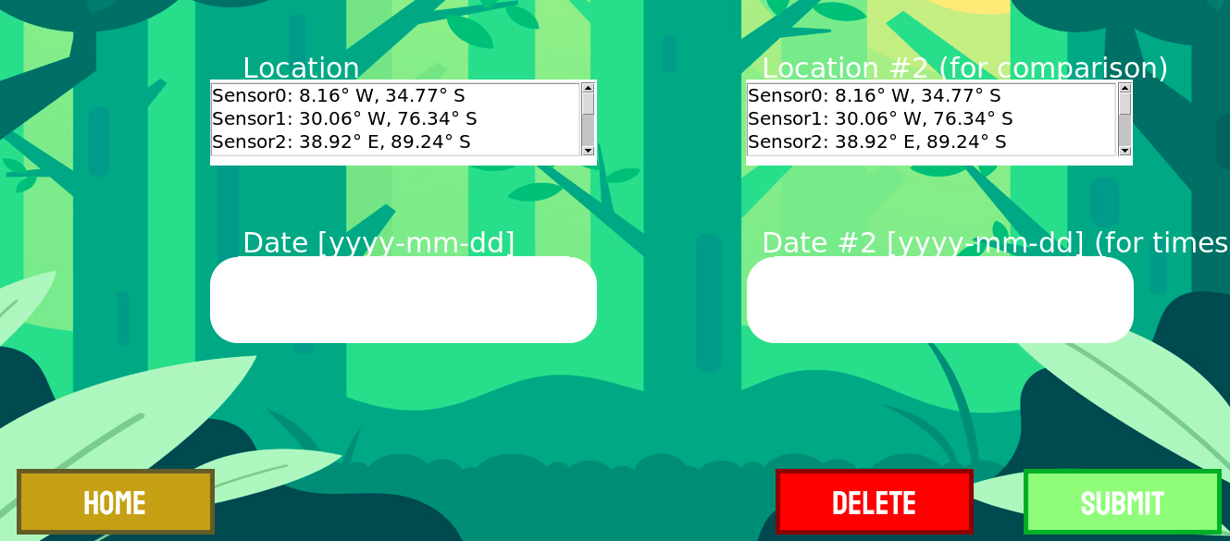
USER - FRIENDLY GUI

Slide 5

THANKS FOR LISTENING

