Slide 1
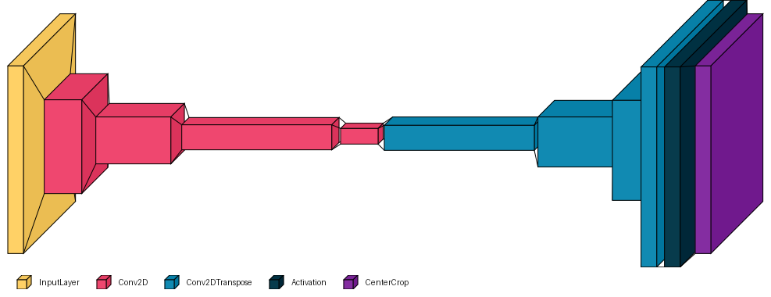
Activation
Layer
(64x64x1)
Transposed
Convolutional
Layer
(64x64x1)
Input Layer
(50x60x1)
Output
Layer
(50x60x1)
Convolutional
Layer
(13x15x64)
Transposed
Convolutional
Layer
(16x16x64)
Convolutional
Layer
(7x8x128)
Transposed
Convolutional
Layer
(8x8x128)
Latent
Map
(4x4x32)
Convolutional
Layer
(25x30x32)
Transposed
Convolutional
Layer
(32x32x32)
Encoder
Latent
Representation
Decoder

