Slide 1


Development of a simulative environment for a teleoperation task using an Haptic Device
Faculty of Information Engineering, Computer Science and Statistics
M.Sc. in Artificial Intelligence and Robotics
AA 2015-2016
Professor:
Marilena Vendittelli
Alessandro De Luca
Presenter:
Aloise Irvin, Colosi Mirco, Gigli Andrea

Slide 2
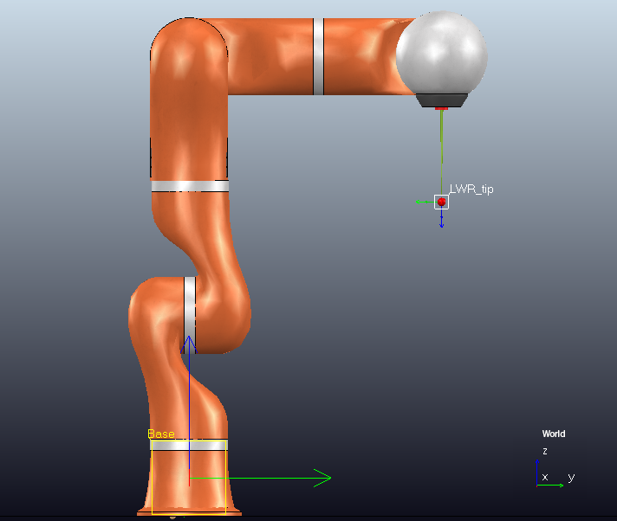
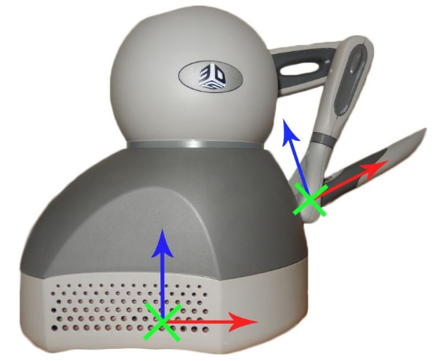
Master-slave frame mismatch
The frames of Geomagic Touch’s end effector and KUKA’s tool-tip do not coincide, so to guarantee coherent movements of the slave it is necessary to align them.
Fixed Offset between the frames
The $x$- axis of Geomagic’s pencil has to coincide to the $z$- axis of the KUKA’s tool-tip. This fixed rotational offset must always be added to have a intuitive teleoperation.

Slide 3
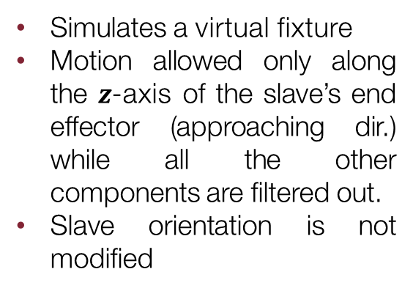
Workspace extension (1)
The first thing to underline is that master and slave do not have the same workspaces. A clutching mechanism is required to extend Geomagic limited workspace. This is done using the 3 buttons on the device.
Button 1
Button 2
Button 3
Fully releases the clutch between master and slave
Slave position is modified
Slave orientation is modified
Partially releases the clutch between master and slave
Slave position is not modified
Slave orientation is modified
Simulates a virtual fixture
Motion allowed only along the $z$-axis of the slave’s end effector (approaching dir.) while all the other components are filtered out.
Slave orientation is not modified

Slide 4
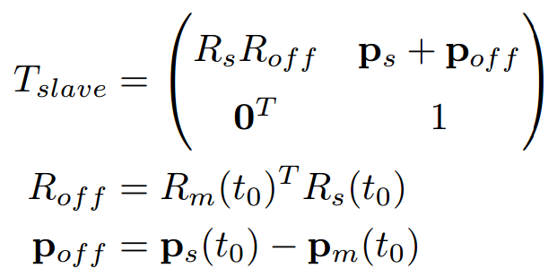
Workspace extension (2)
The software has to evaluate the offset between the current pose of slave’s end effector and the current master pose every time the user switches button.
In this way it is possible to command correctly and in a more intuitive way the slave through the haptic device. Slave position is not modified
If no button is pressed the slave will not move, allowing the user to rearrange the master pose to be more comfortable for the task, or to achieve distant points inside the slave’s workspace.

Slide 5
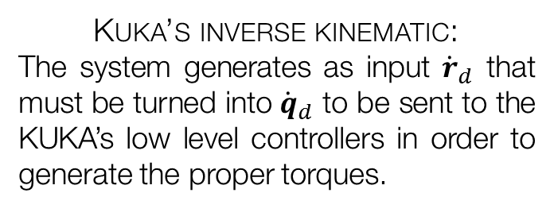
Teleoperation task
The aim of the project is use the Geomagic Touch (master) to simulate the teleoperation of a KUKA LWR 4+ (slave).
At each time-step, given the right desired pose ${(p_{d} φ_{d})}^{T}$, the robot has to converge to it and a force feedback must be returned through the haptic device. Two main problems to be solved:
Kuka’s inverse kinematic:
The system generates as input ${\dot{r}}_{d}$ that must be turned into ${\dot{q}}_{d}$ to be sent to the KUKA’s low level controllers in order to generate the proper torques.
Teleoperation schemes:
Three possible schemes have been developed in order to verify which one is more suited to a needle insertion task.
The system has been used to perform a needle insertion task, perforating a synthetic tissue modelled in the scene.

Slide 6
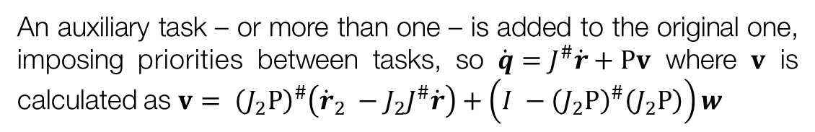
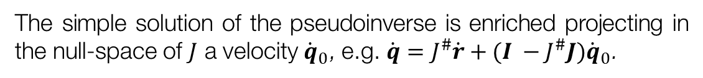
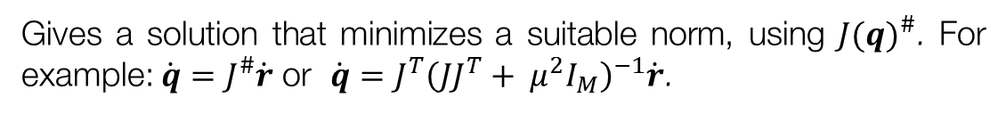
Kuka lwr 4+ inverse kinematics (1)
Inverse kinematics of a redundant manipulator can be solved using different approaches.
Starting from $\dot{r}=J(q)\dot{q}$
Jacobian-based Methods
Gives a solution that minimizes a suitable norm, using ${J(q)}^{\#}$. For example: $\dot{q}=J^{\#}\dot{r}$ or $\dot{q}=J^{T}{\left(JJ^{T}+ μ^{2}I_{M}\right)}^{−1}\dot{r}$.
Null-space Methods
The simple solution of the pseudoinverse is enriched projecting in the null-space of $J$ a velocity ${\dot{q}}_{0}$, e.g. $\dot{q}=J^{\#}\dot{r}+(I −J^{\#}J){\dot{q}}_{0}$.
An auxiliary task – or more than one – is added to the original one, imposing priorities between tasks, so $\dot{q}=J^{\#}\dot{r}+Pv$ where $v$ is calculated as $v= {\left(J_{2}P\right)}^{\#}\left({\dot{r}}_{2} −J_{2}J^{\#}\dot{r}\right)+\left(I −{\left(J_{2}P\right)}^{\#}\left(J_{2}P\right)\right)w$
Task augmentation Methods
In the system in analysis has been used a null-space based method to evaluate the right $\dot{q}$ that we provide as inputs of the KUKA low-level controllers.

Slide 7


Kuka lwr 4+ inverse kinematics (2)
In order to achieve smooth movements of the slave robot, it has been decided to discard the default VREP’s IK group and to implement the following custom null-space-based IK.
$$\dot{q}=J^{\#}{\dot{r}}_{d}+(I −J^{\#}J){\dot{q}}_{0}$$
$${\dot{q}}_{0}= q_{start} −q$$
${\dot{r}}_{d}= \left({v_{d} \atop ω_{d}}\right)+ K_{p}e_{cartesian}=\left({v_{d} \atop ω_{d}}\right)+ K_{p}\left({p_{d}−p \atop T_{xyz}\left(φ\right)[φ_{d}− φ]}\right)$
Where $v_{d}$ and $ω_{d}$ are the references, while the term $e_{cartesian}$ is necessary to force the convergence of KUKA’s end-effector to the desired pose.

Slide 8
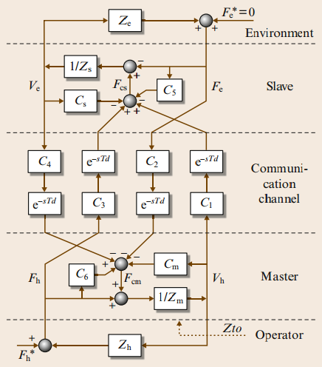




Teleoperation schemes (1)
Once that the system is able to generate desired pose references and that the slave is able to converge to them, a force feedback must be returned to the haptic device.
User
Master Velocities
$$F_{mc}$$
$$v_{m}/p_{m}$$
Teleoperation
Scheme
Inverse Kinematics
Environ.
$$F_{ext}$$
$$v_{s}/p_{s}$$
Slave Motion
Slave Velocity
Slave Torques

Slide 9
Teleoperation schemes (2)
The system developed allow the user to choose between 3 teleoperation schemes:
Position – Force/Position
Position - Position
Position - Force
Very popular among the schemes
The most complete of the three, it needs 3 port
It allows to feel the robot while moving and the external forces.
Fully releases the clutch between master and slave
Slave position is modified
Slave orientation is modified
Fully releases the clutch between master and slave
Slave position is modified
Slave orientation is modified

Slide 10
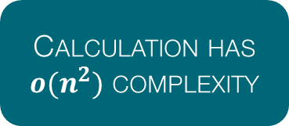
Teleoperation schemes
The system developed allow the user to choose between 3 teleoperation schemes
Calculation has $o(n^{2})$ complexity
Difficult to integrate in a mini-batch SGD
Unbiased estimate of MK-MMD:
In this way, the author are able to reduce the computation complexity to $o\left(n\right)$ improving the scalability to large dataset.

Slide 11
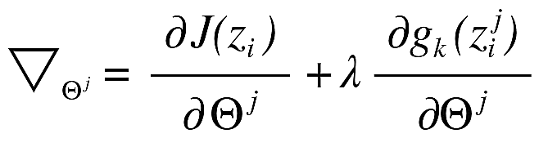
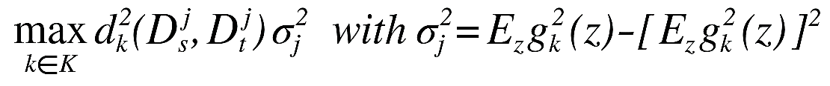
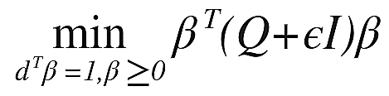
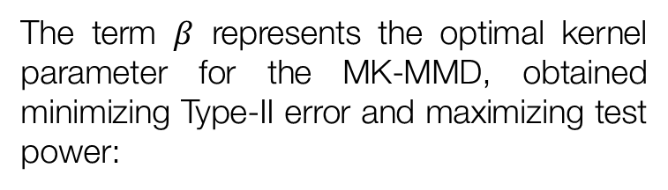
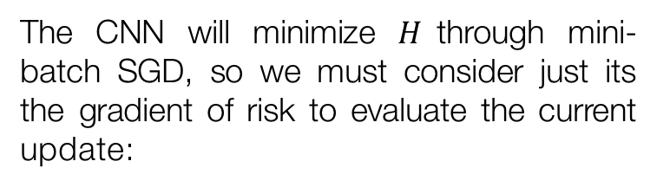
Algorithm analysis (2)
The algorithm performs an alternate optimization of the proper CNN parameters $Θ$ and of the regularizer ones, indicated by $β$.
CNN Parameters
Regularizer parameters
The CNN will minimize $H$through mini-batch SGD, so we must consider just its the gradient of risk to evaluate the current update:
The term $β$ represents the optimal kernel parameter for the MK-MMD, obtained minimizing Type-II error and maximizing test power:
QP Problem

Slide 12




Experiments: setup
Now it will show the results of the proposed architecture compared with current state-of-the-art algorithms for domain adaptation: TCA, GFK, CNN, LapCNN, DDC. The authors performed tests on two different dataset.
The first dataset used is OFFICE-31, which has images belonging to 3 different domains: Amazon (A), Webcam (W) and DSLR (D). The second one is OFFICE-10 + CALTECH-10, which takes some images from the 10 common classes between the Caltech-256 (C) dataset and the previous one.
Four configurations for DAN architecture:
$${DAN}_{7}$$
$${DAN}_{8}$$
$${DAN}_{SK}$$
$$DAN$$
Multi-kernel
Single layer
Single-kernel
Multi-layer
Multi-kernel
Multi-layer

Slide 13
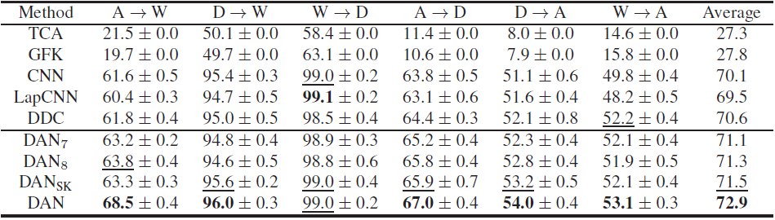
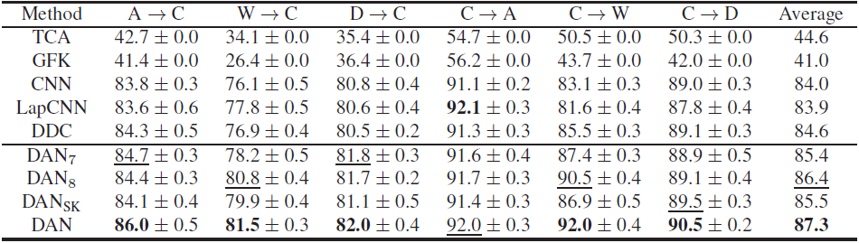
Experiments: results (1)
The following results demonstrate how well the DAN architecture generalizes, transferring pre-trained deep features across the domains:
OFFICE-31 Dataset Outcomes
OFFICE-10 + CALTECH-10 Dataset Outcomes

Slide 14
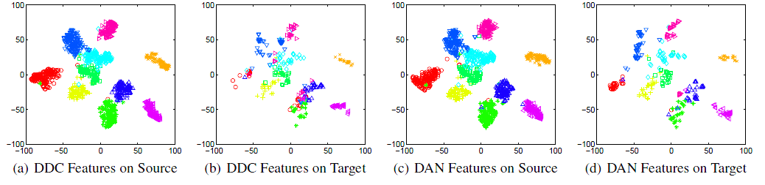
Experiments: results (2)
In order to better demonstrate the improve in transferability of the new deep features, the authors plotted the t-SNE embedding of the images both for the DDC architecture (single layer single kernel MMD regularizer) and for the DAN one:
Two main remarks:
DAN features discriminates better the points w.r.t. DDC ones
Categories are aligned better passing from source to target using DAN features.

Slide 15
Conclusions
The authors of the paper proposed a new architecture that uses deep features to tackle the feature transferability across different domains: the Deep Adaption Network (DAN).
In a CNN, domain discrepancy is higher for deep-layer features and a simple fine-tuning of the higher layer would not improve the domain adaptation. The authors used the mean-embedding matching of the multi-layer representation of each domain into a RKHS to enhance transferability.
Two key aspects characterize DAN architecture:
Multi-kernel MMD
Multi-layer regularizer
Different kernel may embed the source/target probability distributions into RKHS with different statistics.
Critical in order to lessen the domain discrepancy, reducing the source bias from the classifier.

