Slide 1


Development of a simulative environment for a teleoperation task using an Haptic Device
Faculty of Information Engineering, Computer Science and Statistics
M.Sc. in Artificial Intelligence and Robotics
AA 2015-2016
Professor:
Marilena Vendittelli
Alessandro De Luca
Presenter:
Aloise Irvin, Colosi Mirco, Gigli Andrea

Slide 2
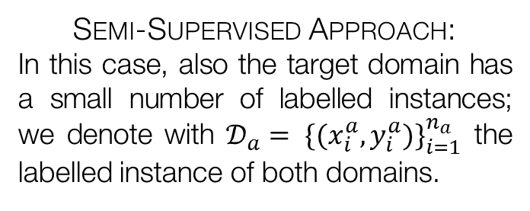
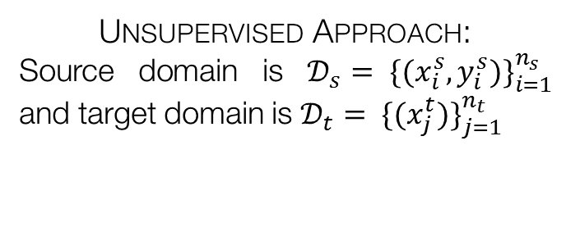
Introduction
The paper proposes a new deep architecture to deal with the task of Domain Adaptation, called Deep Adaption Network (DAN).
Domain Adaption is the task of transferring the knowledge acquired on a source domain to a related target domain which has a different distribution.
Unsupervised Approach:
Source domain is $𝒟_{s}= {\{(x_{i}^{s}, y_{i}^{s})\}}_{i=1}^{n_{s}}$ and target domain is $𝒟_{t}= {\{(x_{j}^{t})\}}_{j=1}^{n_{t}}$
Semi-Supervised Approach:
In this case, also the target domain has a small number of labelled instances; we denote with $𝒟_{a}= {\{(x_{i}^{a},y_{i}^{a})\}}_{i=1}^{n_{a}}$ the labelled instance of both domains.
It is good to notice that simple fine-tuning will not work in this situation, since the labelled data available is not sufficient to improve the network in such task.

Slide 3
Motivations
One of the possible approaches to succeed in domain adaptation is to learn domain invariants models from the data available in order to bridge the two domains.
Why are Convolutional Neural Network suitable for such task?
CNNs are able to acquire richer models from the data w.r.t. shallow features. They better analyse the samples, learning variation’s factor and grouping features hierarchically with respect to invariant aspects (making them robust to noise).
Early layers’ feature are generic, going deeper they become more specific (increased domain-discrepancy).
Grouping hierarchically the features generates always more compact representation, losing generality (and, thus, transferability).
Enlarged dataset can bias the network, deteriorating domain adaptation performances (statistical unbounded risk as outcome).
Multiple issues:

Slide 4
Related Works
Transfer learning is a task that the scientific community is trying to develop since some years, because it fits lots of realistic problem and could help in saving time and efforts.
Several different approaches have been tried:
Those methods try to learn some shallow representation model in which the two domain are closer. They are very task depended and, thus, very limited for actual applications.
Shallow features
Convolutional Neural Networks are able to achieve better result thanks to the richness of the extracted features, but they just reduce the domain-discrepancy.
Deep Features
“Ancestor” of the proposed method in which the CNN is improved adding a single adaption layer and taking in consideration dataset shift in the loss function. Limited by suboptimal kernel matching for the two probability distribution (single kernel approach).
Single Adaption Layer

Slide 5


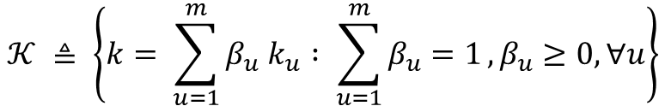
Statistical model of DAN architecture
In order to bound the target error it is necessary to add a discrepancy measure to the source error. The method used by the authors to address this problem is the Multi-Kernel Maximum Mean Discrepancy (shortened as MK-MMD).
Given two distributions $p$ and $q$ and a RKHS $ℋ_{k}$ relative to kernel $k$, the mean embedding of the distribution $p$ in $ℋ_{k}$ is given by:
$$E_{x \sim p} f\left(x\right)= {\left\langle f\left(x\right), μ_{k}(p)\right\rangle }_{ℋ_{k}}$$
Squared MK-MMD
$$d_{k}^{2}\left(p,q\right)= {\left\|E_{p}\left[φ\left(x^{s}\right)\right]−E_{q}[φ(x^{t})]\right\|}_{ℋ_{k}}^{2}$$
The characteristic kernel associated with the mapping $φ$ is a convex combination of $m$ PSD-kernels $\{k_{u}\}$; in formulae:
$$𝒦 ≜ \left\{k= \sum_{u=1}^{m}{β_{u} k_{u}} : \sum_{u=1}^{m}{β_{u}=1}, β_{u}≥0, ∀u\right\}$$
Multi-kernel approach is one of the key components to achieve good performance in domain adaptation task, since they can match both high-order and low-order moments to minimize Type-II error.

Slide 6
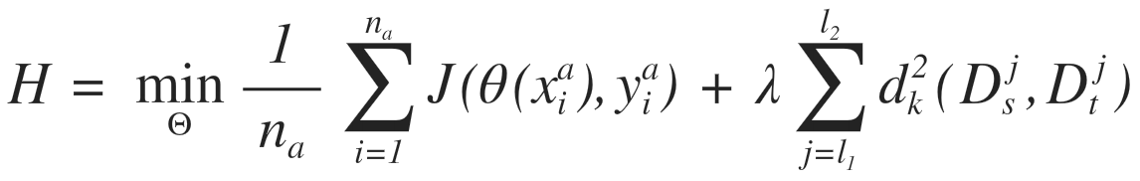
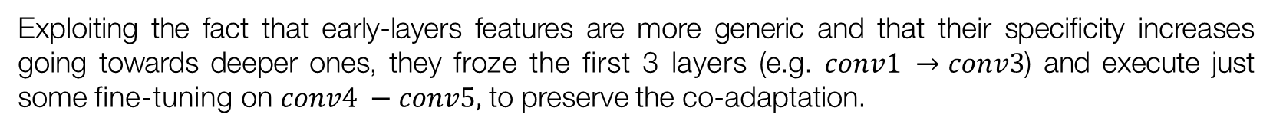
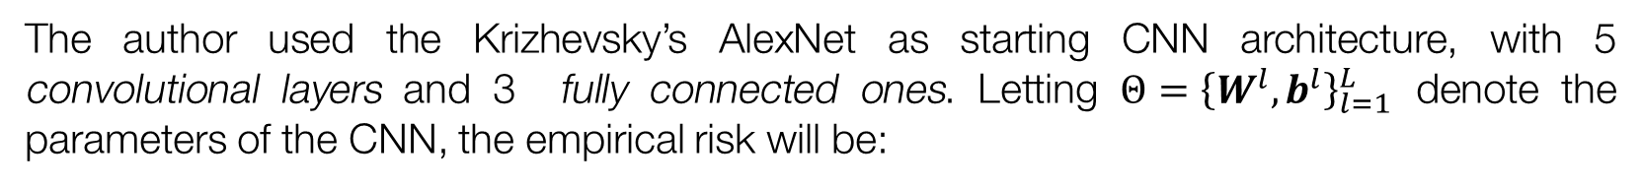
DAN analysis
The author used the Krizhevsky’s AlexNet as starting CNN architecture, with 5 convolutional layers and 3 fully connected ones. Letting $Θ={\left\{W^{l},b^{l}\right\}}_{l=1}^{L}$ denote the parameters of the CNN, the empirical risk will be:
Exploiting the fact that early-layers features are more generic and that their specificity increases going towards deeper ones, they froze the first 3 layers (e.g. $conv1 →conv3$) and execute just some fine-tuning on $conv4 −conv5,$ to preserve the co-adaptation.
Layers $fc6 →fc8$ have a too much enhanced domain discrepancy, so the authors re-trained them with a MK-MMD-based multi-layer adaption regularizer to the previous risk function:

Slide 7
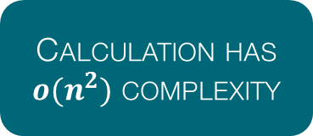
Algorithm analysis (1)
Computing the MK-MMD in the way we have previously seen introduces some issues for the scalability and the integration on the CNN architecture. There are two main problems:
Calculation has $o(n^{2})$ complexity
Difficult to integrate in a mini-batch SGD
Unbiased estimate of MK-MMD:
In this way, the author are able to reduce the computation complexity to $o\left(n\right)$ improving the scalability to large dataset.

Slide 8
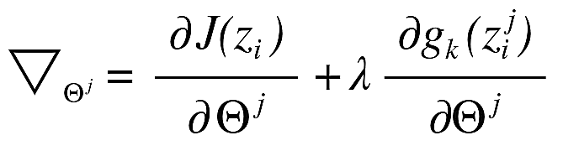
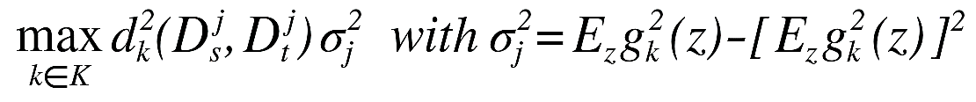
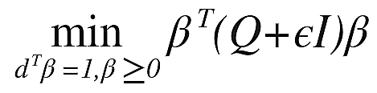
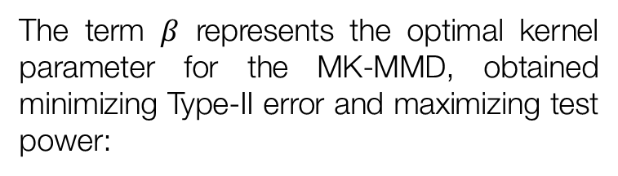
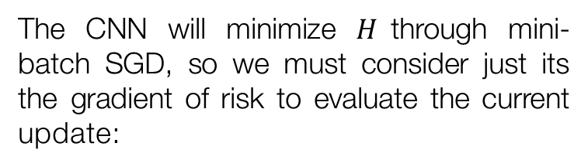
Algorithm analysis (2)
The algorithm performs an alternate optimization of the proper CNN parameters $Θ$ and of the regularizer ones, indicated by $β$.
CNN Parameters
Regularizer parameters
The CNN will minimize $H$through mini-batch SGD, so we must consider just its the gradient of risk to evaluate the current update:
The term $β$ represents the optimal kernel parameter for the MK-MMD, obtained minimizing Type-II error and maximizing test power:
QP Problem

Slide 9




Experiments: setup
Now it will show the results of the proposed architecture compared with current state-of-the-art algorithms for domain adaptation: TCA, GFK, CNN, LapCNN, DDC. The authors performed tests on two different dataset.
The first dataset used is OFFICE-31, which has images belonging to 3 different domains: Amazon (A), Webcam (W) and DSLR (D). The second one is OFFICE-10 + CALTECH-10, which takes some images from the 10 common classes between the Caltech-256 (C) dataset and the previous one.
Four configurations for DAN architecture:
$${DAN}_{7}$$
$${DAN}_{8}$$
$${DAN}_{SK}$$
$$DAN$$
Multi-kernel
Single layer
Single-kernel
Multi-layer
Multi-kernel
Multi-layer
Notes:
TCA: Transfer Component Analysis with MMD-regularized PCA
GFK: Geodesic Flow Kernel, kernel based, interpolates across intermediate subspaces to bridge the two distributions.
CNN: simple AlexNet
LapCNN: variant of AlexNet based on Laplacian Graph regularization
DDC: domain adaption variant of AlexNet using single-layer (7) single-kernel MMD (Deep Domain Confusion by Tzeng et al)

Slide 10
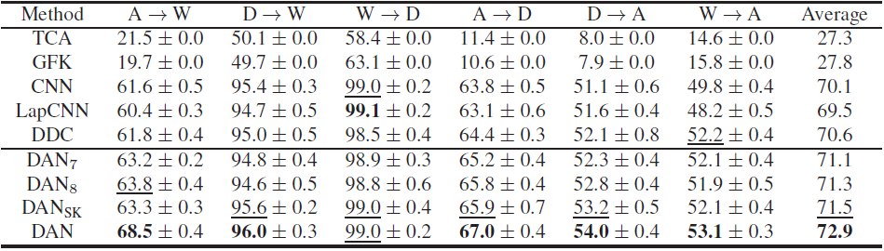
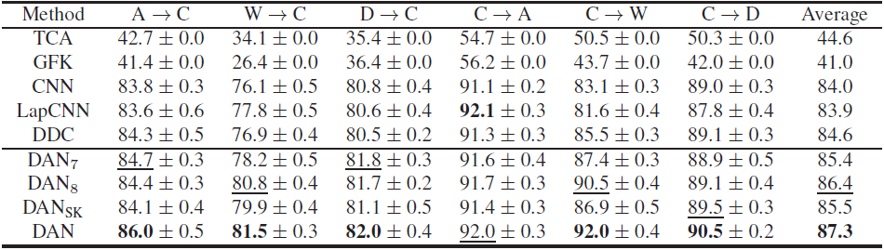
Experiments: results (1)
The following results demonstrate how well the DAN architecture generalizes, transferring pre-trained deep features across the domains:
OFFICE-31 Dataset Outcomes
OFFICE-10 + CALTECH-10 Dataset Outcomes
Notes:
DDC, TCA: Gaussian kernel for MMD with bandwidth $γ$ (median of pairwise distances on the training data)
DAN: m Gaussian kernels for MK-MMD with bandwidth varying in $\left[2^{−8}γ : 2^{1/2}: 2^{8}γ\right]$
Learning rate for last layer retraining 10x higher .

Slide 11
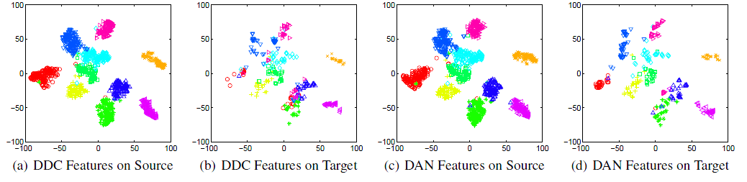
Experiments: results (2)
In order to better demonstrate the improve in transferability of the new deep features, the authors plotted the t-SNE embedding of the images both for the DDC architecture (single layer single kernel MMD regularizer) and for the DAN one:
Two main remarks:
DAN features discriminates better the points w.r.t. DDC ones
Categories are aligned better passing from source to target using DAN features.
Notes:
t-SNE: t-Distributed Stochastic Neighbour Embedding, technique for dimensionality reduction for visualization of high dimensional datasets.

Slide 12
Conclusions
The authors of the paper proposed a new architecture that uses deep features to tackle the feature transferability across different domains: the Deep Adaption Network (DAN).
In a CNN, domain discrepancy is higher for deep-layer features and a simple fine-tuning of the higher layer would not improve the domain adaptation. The authors used the mean-embedding matching of the multi-layer representation of each domain into a RKHS to enhance transferability.
Two key aspects characterize DAN architecture:
Multi-kernel MMD
Multi-layer regularizer
Different kernel may embed the source/target probability distributions into RKHS with different statistics.
Critical in order to lessen the domain discrepancy, reducing the source bias from the classifier.

