Slide 1
ΑρχΕς ΚατανεμημΕνων ΣυστημΑτων ΛογισμικΟΥ
Project presentation
Vagelis Giannelos
Manos Andrianakis

Slide 2
Presentation overview
Tools, frameworks and libraries
What we have implemented so far
What remains to be done

Slide 3

Great start - Failed attempt
PHP-based microweb framework Lumen by Laravel
Experience with Laravel framework and php
Zookeeper library problems

Slide 4

Tools frameworks and libraries
Python 3.6.2
Easy to Use
Open Source
Many libraries
Great community

Slide 5


Tools frameworks and libraries
Flask 1.1.2
Python-based microweb framework
Lightweight, simple, fast
Built-in development server
Used by Pinterest, Linkedin…
Jinja2: Python template engine for dynamic markup

Slide 6
Tools frameworks and libraries
Modules - Libraries
Kazoo
Requests, SocketIO
SQLAlchemy, pymsql
Werkzeug.security, jwt

Slide 7
Tools frameworks and libraries
Tools
JavaScript
Zookeeper
Docker
MySQL
XAMPP - Apache webserver - phpMyAdmin

Slide 8


Apache zookeeper
Simplicity Stability Speed
Service Discovery
Notification System
Reliability - Recovery

Slide 9

Docker
Simplification - Portability
OS-level virtualization
Container System – Isolation
Docker Swarm

Slide 10
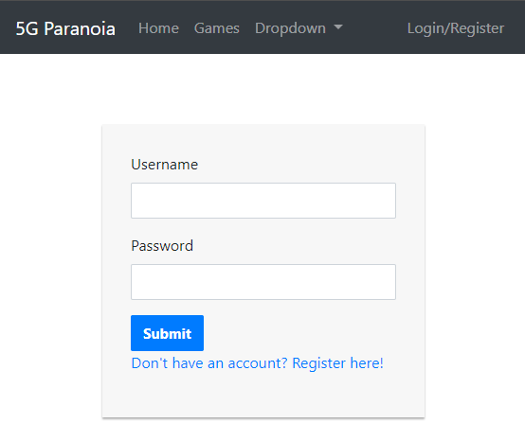
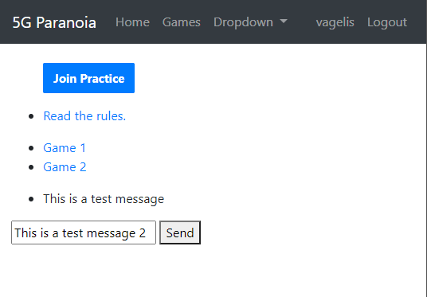
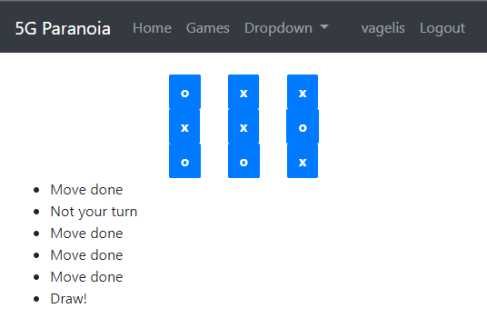
Current state
Simple front-end implemented from scratch using bootstrap
Consistent pages using template inheritance
Pages: Homepage, Login, Register, Games, Game Lobby, Play
TicTacToe game implemented from scratch
Chess game implemented using python-chess

Slide 11
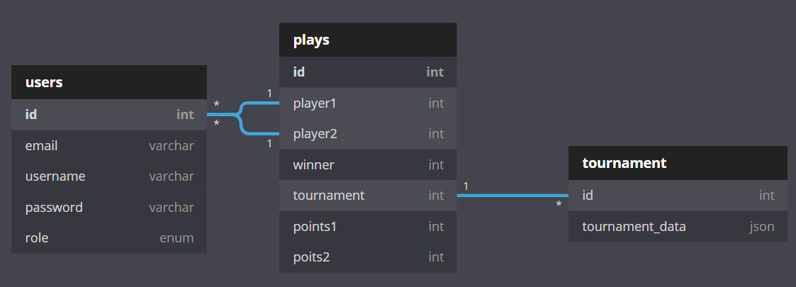
Current state
Minimal database, dynamic data stored in services/zookeeper
Services connect to zookeeper and save/load data on nodes
Only ‘player’ role implemented and practice plays
User authentication using password hash stored on DB

Slide 12
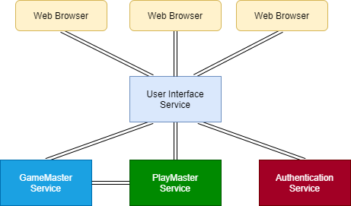
Services
User Interface
Game Master
Play Master
Authentication

Slide 13
Services
Services communication using hard-coded IPs and http requests
JavaScript and SocketIO is used to refresh page content without page reloading
Special events are created and emitted for different actions

Slide 14
Services
User Interface Service:
The only service the user communicates with directly
Produces and serves the pages
On user connection, opens a socket through SocketIO and register its sid (assumed one UserInterfaceService, will be moved to Playmaster)
Handles all requests and actions of the user
Communicates with the other services to perform the actions requested by the user
Stores the session variables

Slide 15
Services
Authentication Service:
Only communicates with the User Interface Service
Generates JSON Web Tokens (JWT) on user connection which is stored in UIS session
Handle user registration, login and stores their data in the database
Will handle access control for different user roles

Slide 16
Services
Game Master Service:
Holds information for the waiting lists of the games
Creates games and assigns them to Playmaster
Match players (first in – first paired matchmaking)
Store game results in database
Fetches player games and statistics

Slide 17
Services
Play Master Service:
Handles requests for game creation by GMS
Holds information of active games
Verify move requests and send game info on change to players
Announces results to GMS

Slide 18
Currently working on
User roles
Tournaments
Inter-service authentication
Service replication
Failure detection and recovery
Docker implementation
More work on Zookeeper

Slide 19

Thank you for your attention

