Slide 1
ReCall 2 | Quarterly Planning Q4 / 2026
15th and 16th September 2026 Barcelona
Confidential

Slide 2
ReCall 2 | Agenda Quarterly Planning
DAY 1 Tuesday 15.09.2026
09:00 – 18:00
DAY 2 Wednesday 16.09.2026
09:00 - 15:00
MORNING
Welcome
Get to know & Ice Breakers
Vision 2027 Update
Product vision · Architectural vision
External milestones · Focus topics
Architecture: GVF · Cognos · ORU/RVT
SDV Background
Review & Live Demo Q3
MORNING
Roadmap Q4
Prioritization & team division
  Features: (Bandicode · Bugbusters)
  Architecture
Feature refinement → breakout sessions
Planned objectives for next 3 months
LUNCH BREAK
LUNCH BREAK
AFTERNOON
Farewell Inma
Intercultural Training
AFTERNOON
Status Update Reboot Plan
Retro (focus on AllHands)
EVENING · Seat Code Terrace

Slide 3

Get to know and icebreaker
Icebreaker - Chocolates
  Each person chooses a chocolate color and joins the group of people who have chosen the same color. Based on the chosen color, they are assigned a prompt.
  A conversation regarding the assigned prompt is taken, encouraging active interaction of everyone. Group members should also come together to discuss and align their expectations regarding the Q4 Planning.
  Then, a representative of each group shares what they discussed (key insights) with everyone, highlighting commonalities, differences, and interesting findings. For example: “We discovered that several of us share paella as our favorite dish,” or “We all enjoy going to the beach on vacation,” etc.
  Finally, your group's expectations regarding this Q4 planning is shared by this representative.

Slide 4
Get to know and icebreaker
Colors and prompts
Favorite pet or animal
Favorite music
Favorite food
Hobbie or favorite sport
Desired destination to travel

Slide 5

Get to know and icebreaker
Icebreaker - Impromptu networking
Participants walk around the space when the music begins.
The music stops: they quickly pair up with the closest person.
They ask each other questions :
  Share how you’re arriving at the session.
  What outcomes do I expect from this session?
  What challenges do I see in this event?
The music plays again; participants thank each other and resume walking. When the music stops again, they form a new pair and repeat the dynamic. This continues for several rounds (2-3).
Then we share voluntarily the main idea or conclusion in this survey.

Slide 6

Get to know and icebreaker
Your ideas

Slide 7
Todo
Vision 2027 Update
• Product vision
o → Updated slide (Thomas)
• Why SDV
o → Jens‘ slides
• Architectural Vision
o → Martins 3 step RVT slides
• External Milestones
o → from steering commitee slides
• Missed Campaigns
o @Thomas

Slide 8
ReCall 2 | Long Term Product Roadmap
@Thomas: Updaten für Q4
Vision 2028
New vehicle architecture
Architecture Roadmap
Enrichment of existing functions
New Markets & Brands
ORU
GVF
Vehicle selection
Details see architectural roadmap
Modul 1,
Modul 2
Feature needed for Support
China
Scout
MOIA
Focus Q3/26
Further details for the roadmap in the JIRA roadmap board

Slide 9
ReCall2 | Product Vision & Roadmap
The product roadmap is defined based on the long‑term vision, while remaining flexible to adapt to key external dependencies and the architecture roadmap, ensuring a constant learning.
Product Vision 2026 & 2027
New vehicle architecture
Architecture Roadmap
Enrichment of existing functions
New Markets & Brands
2026
Q3
Q4
2027
Q1
Q2
Q3
Q4
2028
External Project Milestones
Reporting for markets
(Prio 0)
Cloud Analytics Platform (aftersales)
USA – market
France - market
31.12. | Authentication methods for Business Contract Partner Mgmt. (BCPM) and Group Retail Portal
31.01. | SOP for VW Anhui
12.03. | RVT - Start VIN data creation
26.03. | RVT - Start Homologation
31.03. | Fallback -Test
07.05 | RVT ready (MS) Replacement of Carport by Group Vehicle File Replacement of COGNOS by ? New ORU Interface
Introduction of new brands
  Scout
  Moia
Replacement KVPS by BCPM
End-of-life of CARPORT
End of usage IDAA
Replacement of all
ORU-Interface for all generations
Architecture Roadmap
Clean up the logs
One Database unification
Planning and sequencing for engine jobs
Specification of data base/SQL parameters
CI/CD Pipeline overhaul
Getting rid of queues & triggers
Check & replace Group Service Bus and remaining interfaces
Restructuring the data model
Shift SQL procedures to application layer
Due to key dependencies, the roadmap will be reviewed and refined quarterly,
while safeguarding the long-term product vision.

Slide 10
Recall2 for RVT/SDV
Recall2 for Software Defined Vehicles
INTERNAL

Slide 11
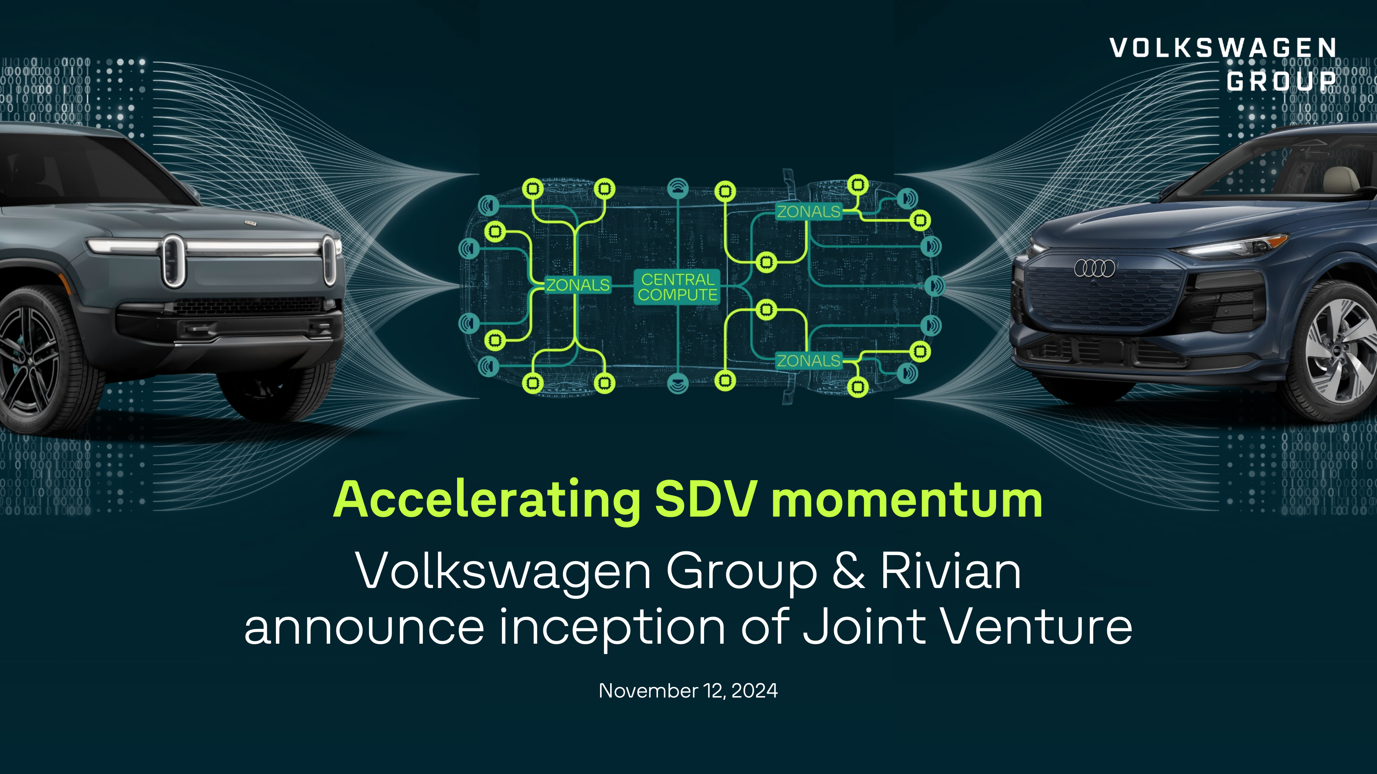
Notes:
This is from the announcement of VW from 2024
Left: Rivian R2 (Competitor, no VW Group Brand)
Right: VW Group Car (Audi Q6 E.Tron)
Middle: Electric/Electronic Hardware and Software
Software Defined Vehicle – what is that?
- new Electric/Electronic Architecture of the Vehcile, meaning few ECUs (Electronic Controll Units) instead of many. In the past: every part delivered by a supplier came with its own ecu
- Next generation Vehicles are software based

Slide 12

Notes:
Volkswagen Group – industry leading vehicle technology, but needs to catch up with software
Rivian – Competitor with best in class technology stack
Joint Venture: Rivian & Volkswagen Group Technologies (RVT)
Disclaimer: Markets NA and EU. Asia, Africa & SA will use new „CEA - China Electrical Architecture“. Developed by XPeng, CARIAD China and VWGroup China Technology Company.

Slide 13
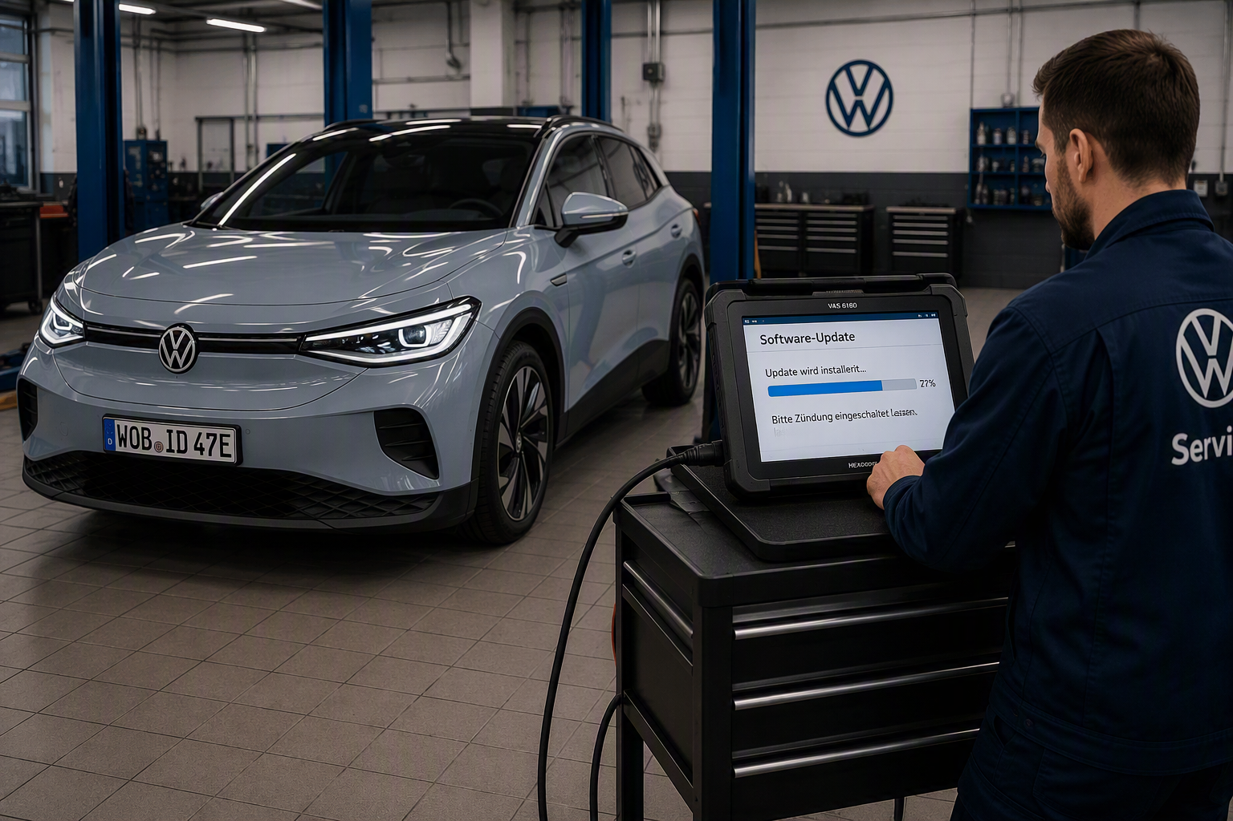
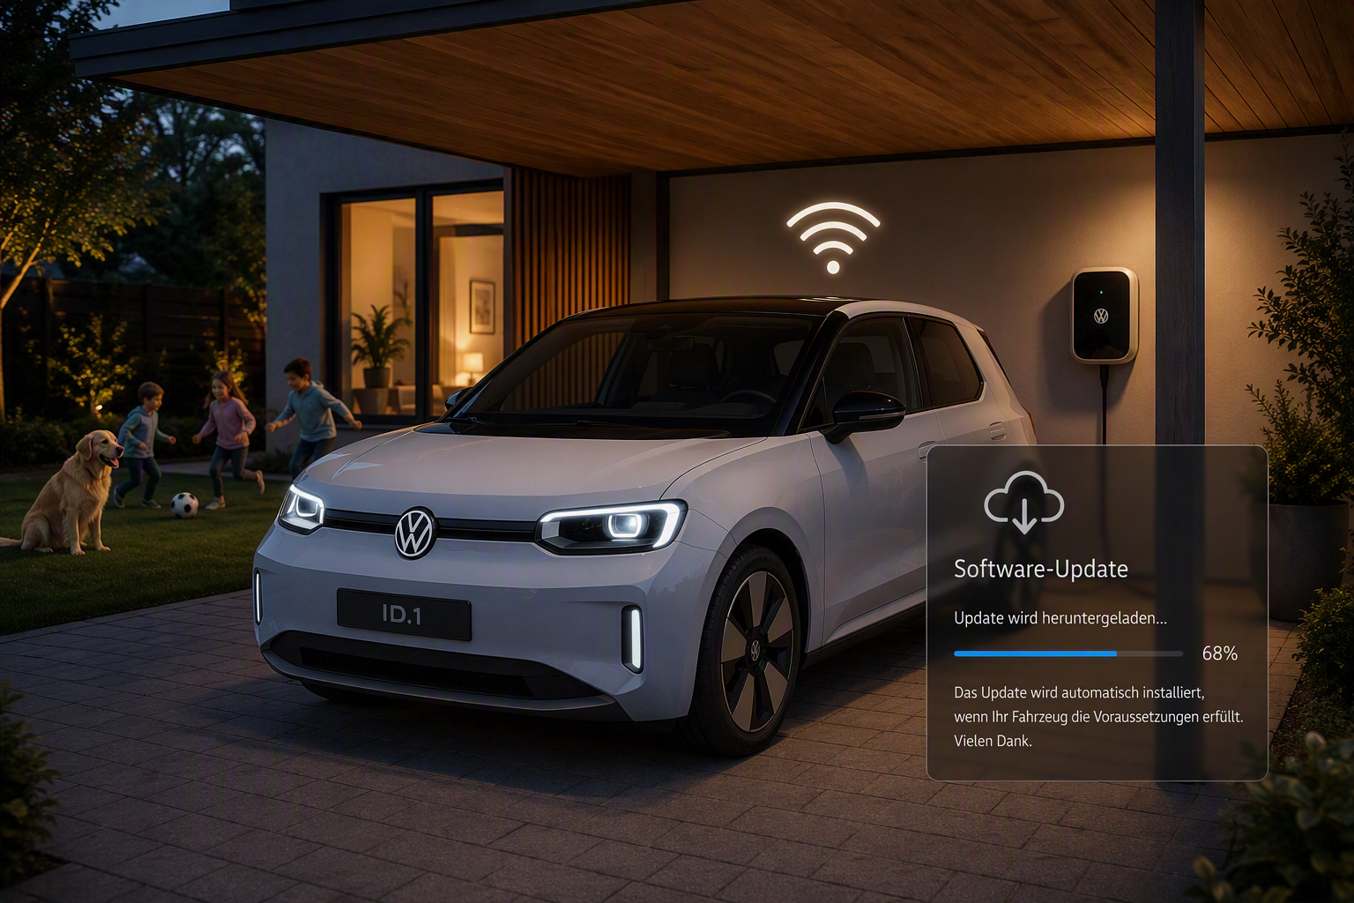
What changes with SDV?
Software Update in the Workshop
Software Update directly at the Customer
Notes:
Less repairs in workshop, more repairs at home
New features rolled out OTA
- no appointments
- no service costs
- faster updates
- more updates
Recall2 is essential to manage all recall campaign relevant software updates
Recall2 is used indirectly via APIs

Slide 14
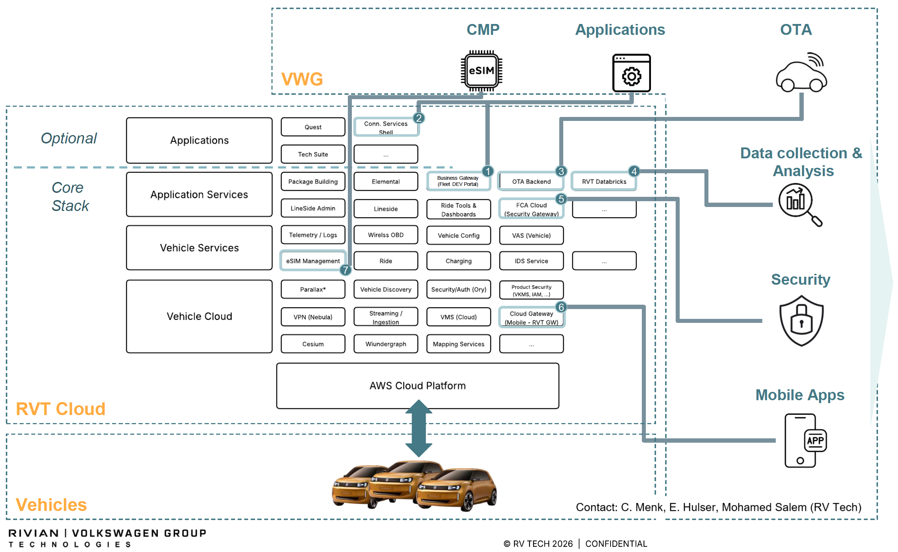
RVT provides cloud services, that need to be connect to the Volkswagen Group System Landscape
Notes:
First Model: ID.1
New electronics and Electrics
but not only that, it all comes with cloud connectivity
Most important: Over the Air Updates
RVT Cloud comes with lot of services
But something is missing
- e.g: how to install the vehicle software in production line
- or: how to handle security relevant updates in the field
Why is that?
- Rivian (not RVT) as a competitor has less complexity (3 models), large scale systems like Recall are not needed
- Chance for simplification, but Business needs to continue (in parallel new and old models)

Slide 15
Recall2 documents all online updates, so that legal authority requests can be fullfilled
Recall2
Notes:
First Model: ID.1
New electronics and Electrics
but not only that, it all comes with cloud connectivity
Most important: Over the Air Updates
RVT Cloud comes with lot of services
But something is missing
- e.g: how to install the vehicle software in production line
- or: how to handle security relevant updates in the field
Why is that?
- Rivian (not RVT) as a competitor has less complexity (3 models), large scale systems like Recall are not needed
- Chance for simplification, but Business needs to continue (in parallel new and old models)

Slide 16
Getting Recall2 Ready for SDV
Where we stand today – and where we are heading
TODAY
2 Remote Updates per year
CarPort & Cognos
Daily Batch Processing, RVS
Updates & Campaigns in Recall2 UI
AFTER
Weekly Remote Updates
GVF & new Vehicle Selection
Realtime via REST
Integrated Updates & Campaigns in Recall2 / ORU

Slide 17
ReCall 2 | Quarterly Planning Q4 2026
Based on the “Product Vision & Roadmap” the following main objectives have prioritized
New vehicle architecture
Architecture Roadmap
Enrichment of existing functions
New Markets & Brands
Vehicle selection with GVF
Development a Mockup for the front end
Develop POC for the GVF-Inferface
Database clustering
Reduction of services
Logging concept
Multi Context Multi Brand
Enable multi country options
Introduction
China VW Anchui, VCIC
1
M2
M1
M2
Replacement of CARPORT by GVF
Build interfaces to GVF for regular exchange processes (Scrapped VIN)
New authentication system
Missed Campaigns
M2
New interface to ORU backend
Technical conception of ORU interfaces
(Development start in Q1/2027)
Request for RVS reports
Finalizing of all 30 open request
RVS-reports for the Importer
M2
Introduction of new consumer type
for the VIN checker
M2
New role
Support administrator
(Read only)
M1
M2
Management controls – Approver on notifications
M1
Operation work (Bugs, Support,…)
M1
M2

Slide 18
ReCall 2 | Quarterly Planning Q4 2026
Based on the “Product Vision & Roadmap” the following main objectives have prioritized
New vehicle architecture
Architecture Roadmap
Enrichment of existing functions
New Markets & Brands
Vehicle selection from GVF
Development a Mockup for the front end
Develop POC for the GVF-Inferface
Database clustering
Reduction of services
Logging concept
Multi Context Multi Brand
Enable multi country options
Introduction
China VW Anchui, VCIC
M2
M1
M2
Replacement of CARPORT by GVF
Build interfaces to GVF for regular exchange processes (Scrapped VIN)
New authentication system
Missed Campaigns
M2
New interface to ORU backend
Technical conception of ORU interfaces
(Development start in Q1/2027)
Request for RVS reports
Finalizing of all 30 open request
RVS-reports for the Importer
M2
Introduction of new consumer type
for the VIN checker
M2
New role
Support administrator
(Read only)
M1
M2
Management controls – Approver on notifications
M1
Operation work (Bugs, Support,…)

Slide 19
ReCall 2 | Architecture Roadmap
today
Car Select
Cognos
CarPort
ReCall 2
VW ORU via
RVS & GSB
ORU 2/3
ORU 4
ORU NEXT

Slide 20
ReCall 2 | Architecture Roadmap
today
Car Select
Cognos
CarPort
ReCall 2
Needed for SDV
1
Car Select
UI
1
GVF
2
VW ORU via
RVS & GSB
ORU 2/3
ORU 4
ORU NEXT

Slide 21
ReCall 2 | Architecture Roadmap
today
Car Select
Cognos
CarPort
ReCall 2
Needed for SDV
1
Car Select
UI
1
GVF
2
VW ORU via
RVS & GSB
ORU 2/3
ORU 4
via REST
ORU NEXT
Smart Campaign
3
SDV OTA

Slide 22
ReCall 2 | Architecture Roadmap
today
Car Select
Cognos
CarPort
ReCall 2
Needed for SDV
1
Car Select
UI
1
GVF
2
VW ORU via
RVS & GSB
ORU 2/3
ORU 4
via REST
ORU NEXT
Smart Campaign
3
SDV OTA

Slide 23
ReCall 2 | Architecture Roadmap
today
Car Select
Cognos
Incremental Phaseout
CarPort
ReCall 2
Needed for SDV
1
Car Select
UI
1
GVF
2
VW ORU via
RVS & GSB
ORU 2/3
Incremental Phaseout
ORU 4
via REST
ORU NEXT
Smart Campaign
3
SDV OTA

Slide 24
ReCall 2 | Architecture Roadmap
today
ReCall 2
Needed for SDV
1
Car Select
UI
1
GVF
2
ORU 2/3
ORU 4
via REST
ORU NEXT
Smart Campaign
3
SDV OTA

Slide 25

ReCall 2 | High level Architectural Concept
Current situation: Design of 2017
Sources
ReCall 2 – Worldwide – in all Group Brands and Regions
AWS hosted FR, Vanguard
Recipients
RVS
CARPORT
assigned Dealer
ORU
GSB
SCS
Notification
SCS‘s - Modul 1: Safety and compliance decision made by the PSC
SCS - Modul 2: Field Campaigns
MBB
OEMIL
Market Data’s
using COGNOS
- Identification of
customer vehicles
affected by a compaign
BCAL
Importers APP‘s
Repare-Data
SAGA/2
FISKUS
Reserve
RVS
Notification
PSC Decision
ORU
MBB
OEMIL
KVPS&BCMP
Database
HST2
Call
Manuell triggert uploads
DPMP
Vehicle-Data
Data-Analytics
Risk
GSB
ORU
CARPORT
Scraped
Development
Tunning Vehicle
CARPORT
Mainframe
Web-Interfaces
(Currently ca. 236 million vehicles)
Vehicle lists (XML, CSV,..., )
MBB
OEMIL
Copy
data
Filter-criteria
> 150 consumer
IDAA
Based on the Mainframe
Cognos
EOB
2025
Authentication
Cloud.IDP
GRP
REST
CSV
Transportation authorities
Query
Results
reports
CONFIDENTIAL
Notes:
Prämisse bei der Entwicklung der Architektur: möglichst die gleichen Schnittstellen Technologien und Inhalte des Altsystems zu übernehmen um eine einfache Integration in der Umstellung der Systeme zu ermöglichen.
2 Probleme bringt die Architektur mit:
Die Selektion der von einem rückruf betroffenen Fahrzeuge wird wieterhin auf der IDAA / CARPORT durchgeführt. Dazu werden Web-Interfaces und Cognos (IBM):
1) Dieser Teil der Applikation ist nicht in RECALL2 integriert. 7 Einzelnen Server. Unterscheidet sich deutlich vom Händlig von RECALL2
2) 2 Freeläncer entwickelt den Umfang
3) keine Abdeckung durch den Support
4) IDAA EOB 2025 (Lizenzkosten übersteigen das Projektbudget)
- Für China wird ein eigener Tenant durch den GC4IS gefordert, Architektur ist auf AWS / Vanguard ausgelegt, nicht Multi-cloudfähig

Slide 26
High level Architectural Concept - Concept to Support RVT
Recipients
parallel operation of both ORU – Interfaces, Replacement CARPORT by GVF, latest Ende 2027
REST
GVF
assigned Dealer
Sources
ReCall 2 – Worldwide – in all Group Brands and Regions
AWS hosted FR, Vanguard
ORU
GSB
ORU
SMART Campaign
MBB
OEMIL
SCS
Notification
SCS‘s - Modul 1: Safety and compliance decision made by the PSC
SCS - Modul 2: Field Campaigns
Repare-Data
SAGA/2
FISKUS
Reserve
RVS
using COGNOS
- Identification of
customer vehicles
affected by a compaign
BCAL
GSB
ORU
MBB
OEMIL
Database
KVPS&BCMP
HST2
> 150 consumer
Vehicle
lists
Manuell triggert uploads
GVF AWS hosted
request
RVS
ORU
GVF-Daten
Copy
data
Spiegel der GVF-Daten
MBB
OEMIL
GVF
Scraped
Development
Tunning Vehicle
REST
(Currently ca. 236 million vehicles)
CALL
Vehicle lists (XML, CSV,..., )
Market Data’s
Vehicle-Data
Data-Analytics
Importers APP‘s
ORU
SMART Campaign
Risk
CARPORT
Mainframe
Web-Interfaces
(Currently ca. 236 million vehicles)
DPMP
Authentication
Cloud.IDP
GRP
Copy
data
Filter-criteria
IDAA
Based on the Mainframe
Query
Cognos
CSV RVS
Manuell triggert reports
Results
CONFIDENTIAL

Slide 27
ReCall 2| High level Architectural
Desired state after changes
Sources
ReCall 2 – Worldwide – in all Group Brands and Regions
AWS hosted FR, Vanguard
Recipients
Repare-Data
SAGA/2
FISKUS
Reserve
RVS
REST
GVF
assigned Dealer
SCS
Notification
SCS‘s - Modul 1: Safety and compliance decision made by the PSC
SCS - Modul 2: Field Campaigns
using COGNOS
- Identification of
customer vehicles
affected by a compaign
ORU
SMART Campaign
BCMP
BCAL
HST2
Manuell triggert uploads
Notification
PSC Decision
GSB
> 150 consumer
GVF
Scraped
Development
Tunning Vehicle
REST
Database
CSV
RSV
Manuell triggert reports
Vehicle
lists
Data product ReCall 2
ORU
SMART Campaign
GVF AWS hosted
CAP
request
GVF-Daten
RSV
DPMP
Spiegel der GVF-Daten
(Currently ca. 236 million vehicles)
Market Data’s
Authentication
Cloud.IDP
GRP
Copy
data
Regular REPORTS for Importers APP‘s
CONFIDENTIAL

Slide 28
ReCall 2 | Quarterly Planning Q4 2026
Based on the “Product Vision & Roadmap” the following main objectives have prioritized
New vehicle architecture
Vehicle selection from GVF
Development a Mockup for the front end
Develop POC for the GVF-Inferface
Replacement of CARPORT by GVF
Build interfaces to GVF for regular exchange processes (Scrapped VIN)
New interface to ORU backend
Technical conception of ORU interfaces
(Development start in Q1/2027)
Operation work (Bugs, Support,…)

Slide 29
ReCall 2 | Quarterly Planning Q4 2026
Based on the “Product Vision & Roadmap” the following main objectives have prioritized
New vehicle architecture
Development a Mockup for the front end
Development a front end
New front end for the VIN-Selection inside ReCall 2 is needed
Vehicle selection from GVF
Development a Mockup for the front end
Develop POC for the GVF-Inferface
Creating a Query from the VIN-Selection and send it to GVF
Interface for Importing the VIN-Selection from GVF
Develop POC for the GVF-Inferface
Daily Import of Scratched-, Tunning- or Development-Vehicle
Replacement of CARPORT by GVF
Build interfaces to GVF for regular exchange processes (Scrapped VIN)
Change of the Dealer Assignment

Slide 30
Lunch Break!
Enjoy your meal – see you back shortly!
We continue at

Slide 31
Let’s call it a day!
Thank you for your input and discussion.
Please join us on the terrace for a relaxed close to the day.
We’ll reconvene tomorrow at 9:00

Slide 32
Welcome to our 2nd day!
We hope you had a fantastic night's sleep!

Slide 33
ReCall 2 | Agenda Quarterly Planning
DAY 1 Tuesday 15.09.2026
09:00 – 18:00
DAY 2 Wednesday 16.09.2026
09:00 - 15:00
MORNING
Welcome
Get to know & Ice Breakers
Vision 2027 Update
Product vision · Architectural vision
External milestones · Focus topics
Architecture: GVF · Cognos · ORU/RVT
SDV Background
Review & Live Demo Q3
MORNING
Roadmap Q4
Prioritization & team division
  Features: (Bandicode · Bugbusters)
  Architecture
Feature refinement → breakout sessions
Planned objectives for next 3 months
LUNCH BREAK
LUNCH BREAK
AFTERNOON
Farewell Inma
Intercultural Training
AFTERNOON
Status Update Reboot Plan
Retro (focus on AllHands)
EVENING · Seat Code Terrace

Slide 34
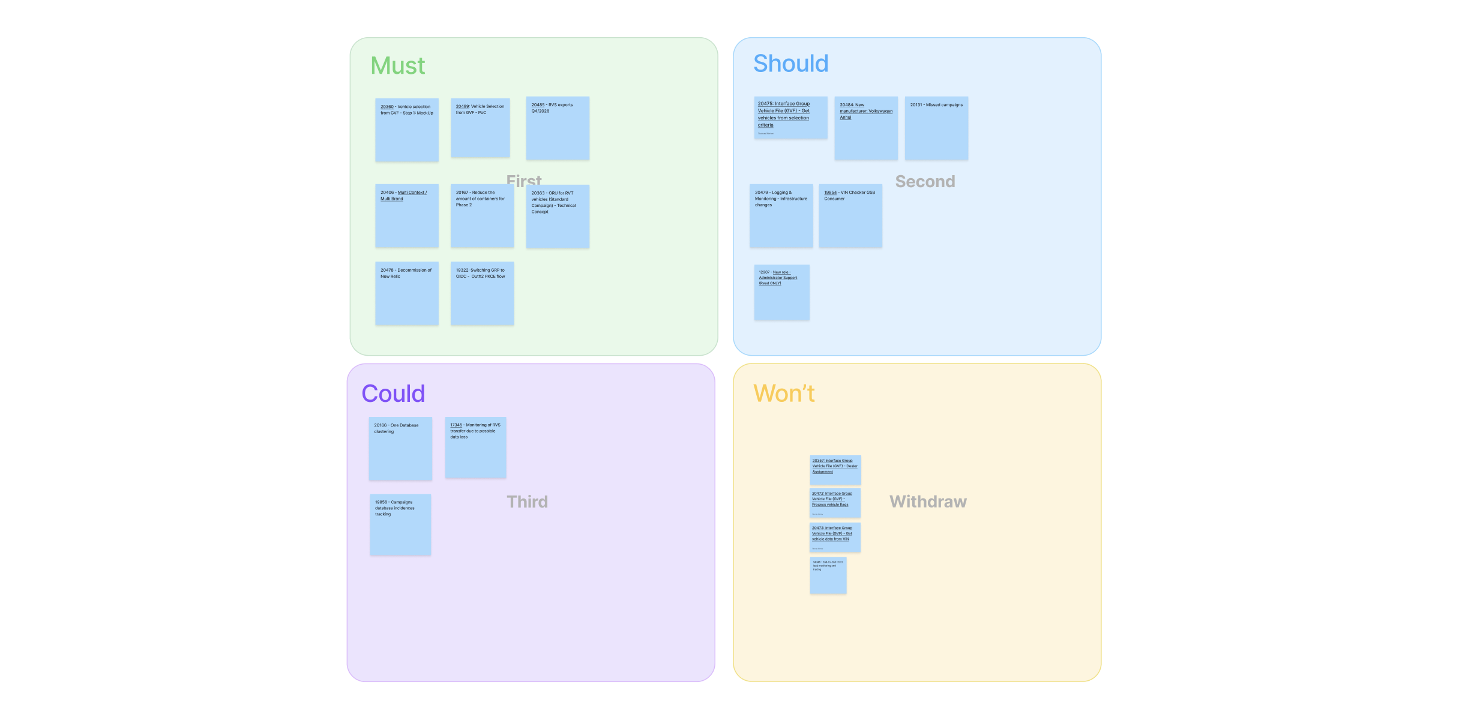
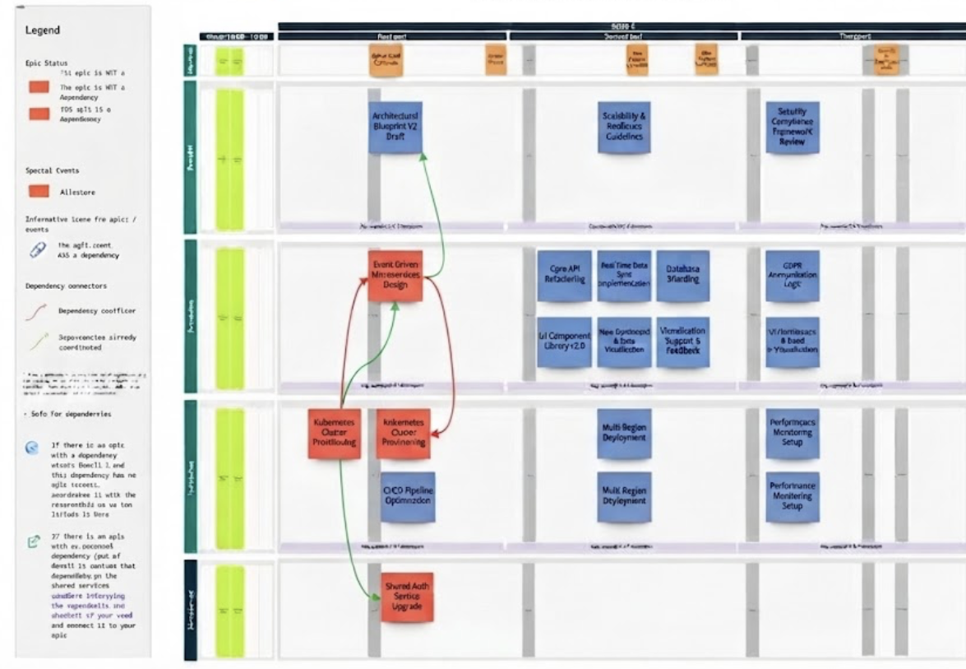
Roadmap Q4
Previous work
Work to be done
SCOPE AND HIGH-LEVEL REFINEMENT
Business Priorities for Q4
Vision and Objectives definition
Breakdown:
  Initiatives
    Epics
Prioritization of epics with MoSCoW (Must-Should-Could-Won't)
High-level dependencies and enablers identification
Reorganization of the priorities
REFINE AND SHAPE THE WORK
Roadmap Q4 (Activity)
Team division: (Bandicode · Bugbusters · Architecture)
Feature refinement → Breakout sessions and dependencies negotiation
Review the risks
Quarterly plan double-check
Confirmation: Objectives for the next 3 months

Slide 35
Lunch Break!
Enjoy your meal – see you back shortly!
We continue at

Slide 36
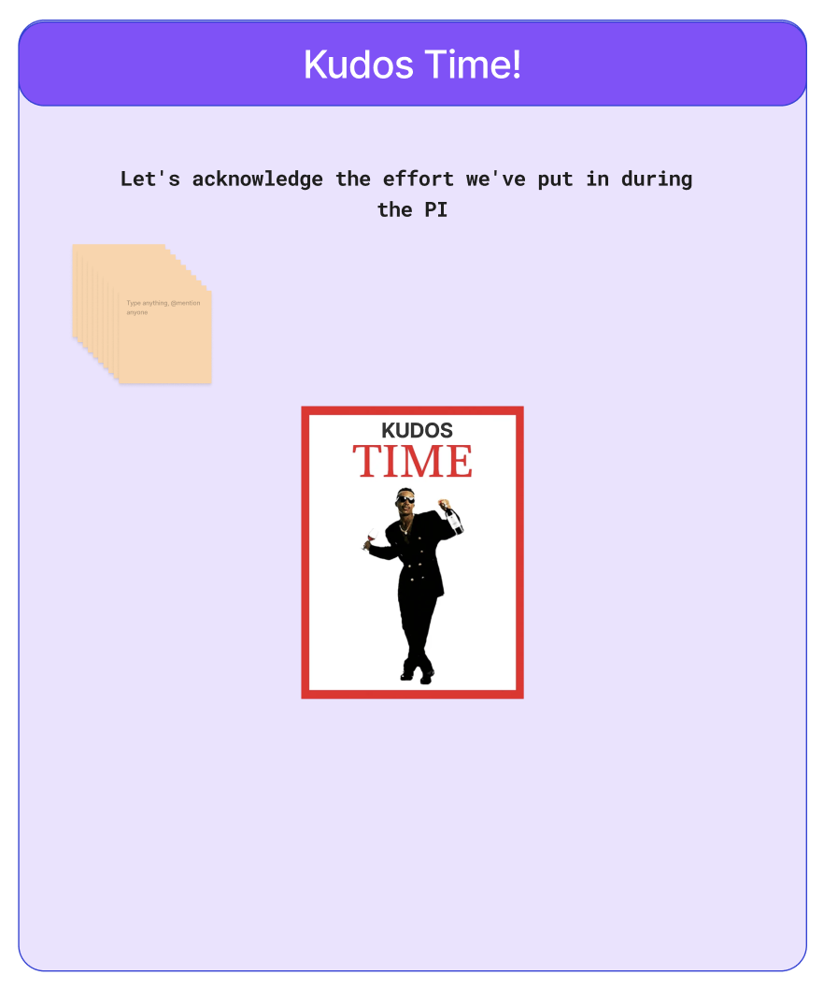
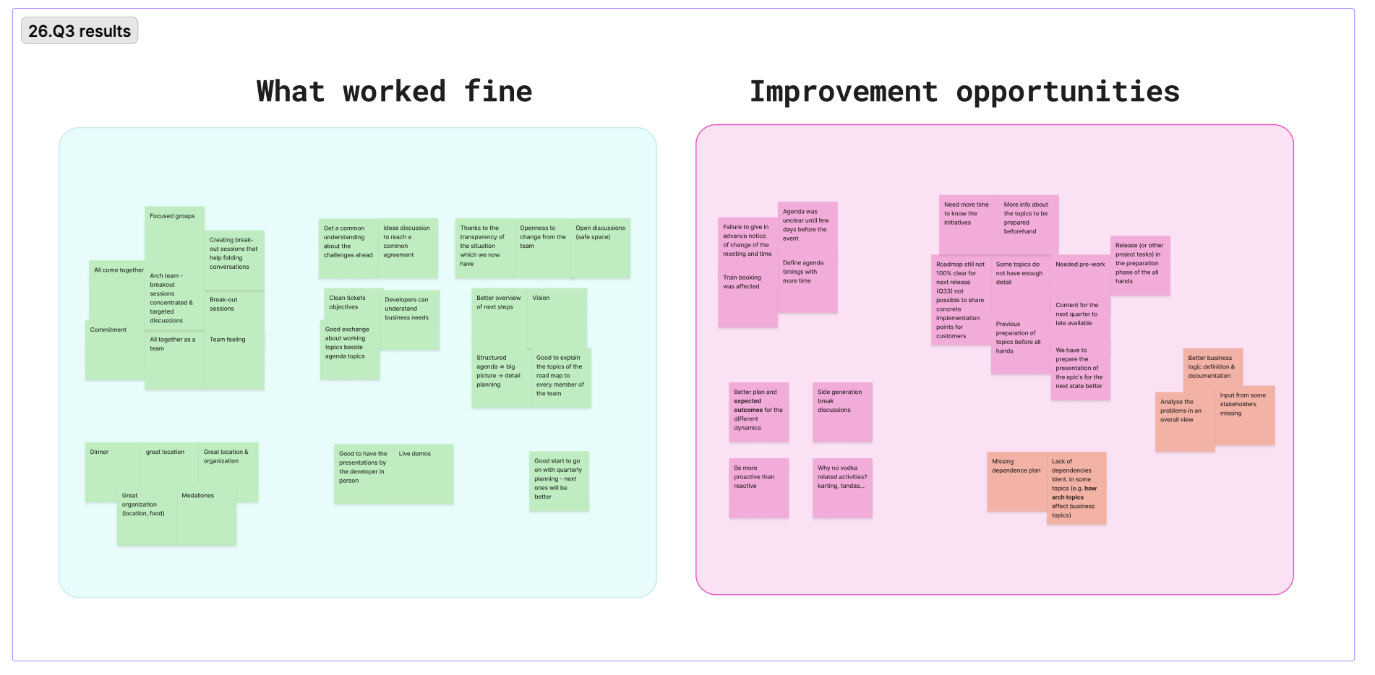
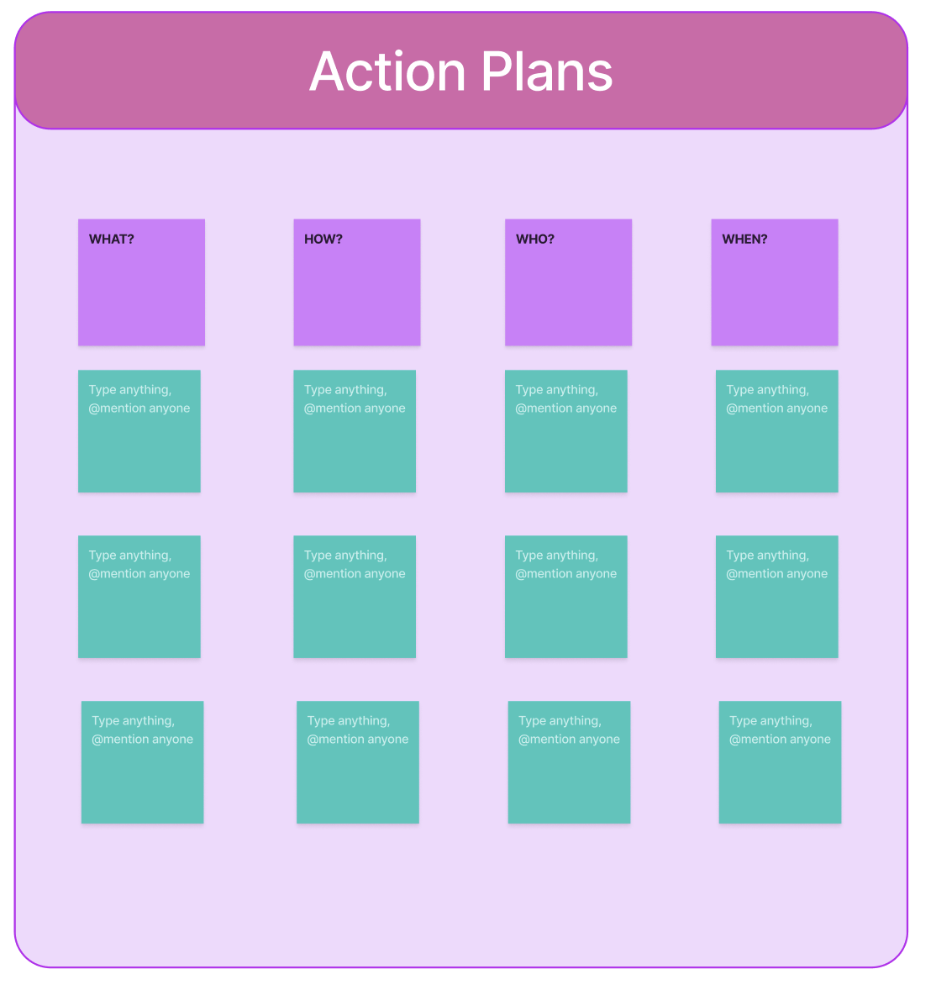
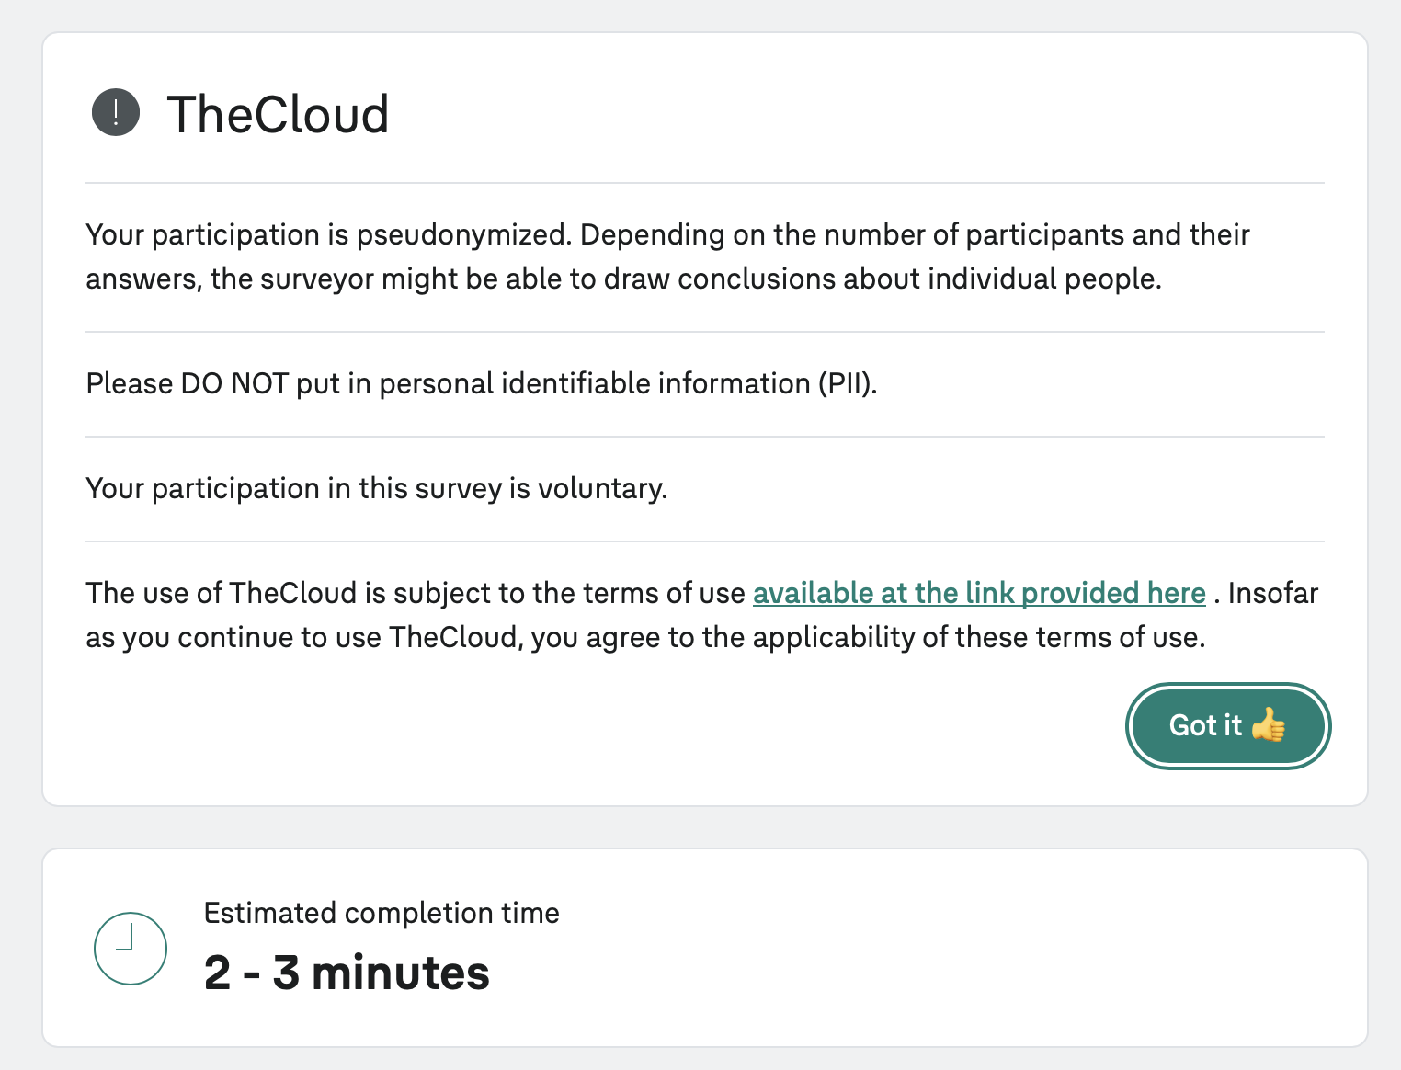
Retrospective
Before leaving the Q4 planning event
SCOPE
Retrospective Activity
Kudos time!
Reviewing last retrospective insights
Survey
Discussing main pain points
Action plans
Closure

Slide 37
Thank you for a great workshop
Thank you for your energy, ideas, and open discussion
Safe travel home to everyone!

