Slide 1

Classroom Workstation Reimage
Giang Augustson
Capitol Technology University
AE-458
Senior Design Project II

Slide 2
Abstract
This project addresses Capitol Technology University’s need to have a process for reimaging classroom workstations every semester. The goal is to keep these workstations as up-to-date as possible to minimize security risks and improve students’ learning experience. There are two components to the project: configuring the tool and performing a test deployment in a classroom. The tool used is Windows Deployment Services. The project was started on January 13, 2020 and completed successfully on March 20, 2020.

Slide 3
Background
At Capitol Technology University, one of the security issues present is the lack of a process for regularly reimaging the classroom workstations. As a result, the software on a lot of these computers doesn’t have the updates necessary to patch known vulnerabilities. This means that many of them are exposed to cyberattacks that take advantage of those vulnerabilities. It is also plausible that some of them have already been infected by malware. The problem is exacerbated by the fact that each workstation is shared by multiple students. Consequently a compromised workstation can cause damage to more than one student.

Slide 4
Intents
The project is intended to primarily benefit any Capitol Technology University student who uses the classroom workstations. Computers with up-to-date software will have a significantly lower chance of being affected by any potential exploits. Therefore, when these computers are better protected, the students’ data are also better protected.
For students, the intended results of the project are not purely security-related. Reimaged computers will operate more smoothly making them less frustrating to use. In addition, the up-to-date programs will provide the latest features that may be necessary for a class. This will make for a better learning experience.
This project will also benefit the University’s administrators. It’s a preventative method that minimizes the chances of any unpatched software being exploited and causing a security breach. Mitigating such an event would cost the institution a lot of time and money. In this case, it’s much better to be proactive.

Slide 5
Methodology
First, the tool used for reimaging the workstations – Windows Deployment Services (WDS) – was configured. This process involved preparing a patched Windows Server 2016 virtual machine to be the WDS server, preparing a patched Windows 10 virtual machine with all the necessary applications installed to be the base image, and adding the boot image and install image to the WDS server.
After all the configurations were completed, two test deployments were performed in a classroom. All 19 workstations in the chosen classroom were reimaged using WDS. Any issues encountered were resolved as they occurred.

Slide 6
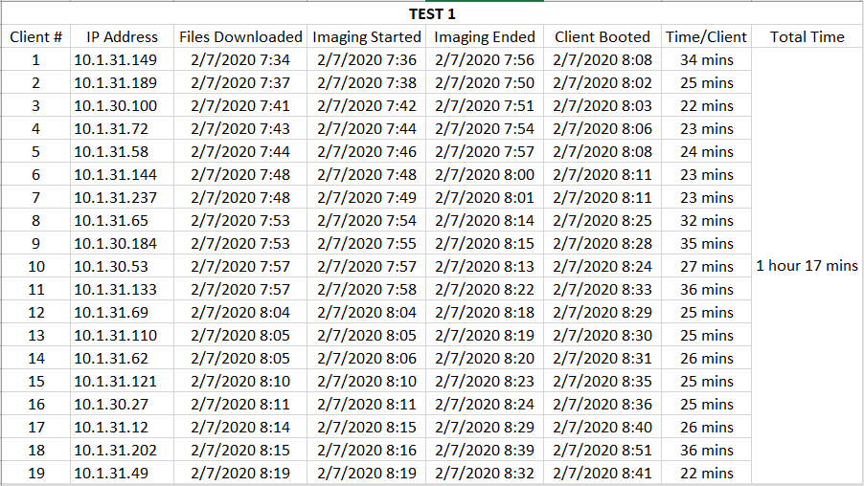
Results
The first test run met the Best success criterion which states that the imaging process needs to complete successfully on 19 computers in under 2 hours in total.

Slide 7
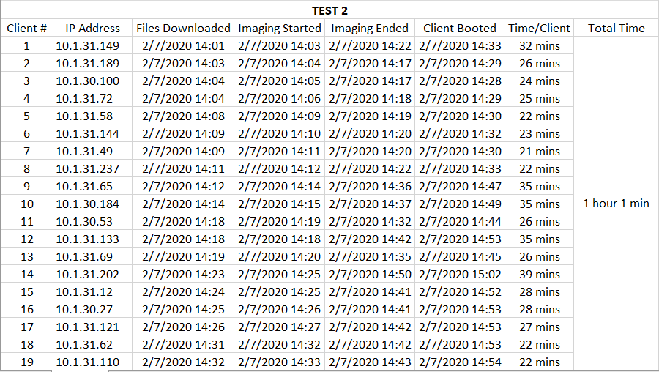
Results (cont.)
The second test run also met the Best success criterion which states that the imaging process needs to complete successfully on 19 computers in under 2 hours in total.

Slide 8
Conclusion
This project is considered a success because all of its deliverables were completed on time, and both of the test runs met the Best success criterion previously defined in the test plans. The scope of the project does not include campus-wide image deployments over a period of time. Therefore, presently, it cannot be confirmed if the WDS solution improves the security of classroom workstations or the University’s network. However, the project’s test results have shown that WDS is stable and reliable enough to be used across campus.

